Slide 1
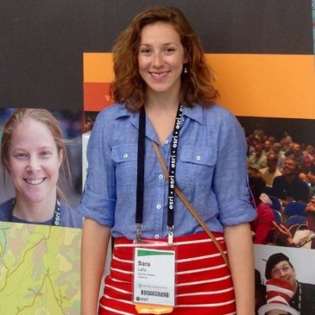
Sara Lafia http://www.orcid.org/0000-0002-5896-7295
Your research in a sentence. A linked data model relating research objects (publications and datasets) and making their implicit spatial references explicit
For your research you need: (mark all that apply) - placenames or coordinates
Do you georeference data? - yes, with the aid of Esri’s world gazetteer and GeoNames API with OpenStreetMap (generating bounding boxes for spatial resource discovery)
Do you give or attempt to give your georeferences back to the data provider? - no
If you are researcher, do you use the polygon / uncertainty data? - not uncertainty
If you are a collection / data manager do you create polygons? - yes; bounding boxes
What is the biggest issue you run into when georeferencing? Reconciling references to unbounded areas with bona fide (v fiat boundaries), such as mountain regions
Share an idea you have for what would make georeferencing better / faster. Inclusion of spatial footprints in gazetteers, rather than centerpoints, for named places

