Slide 1
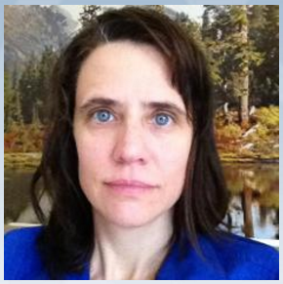
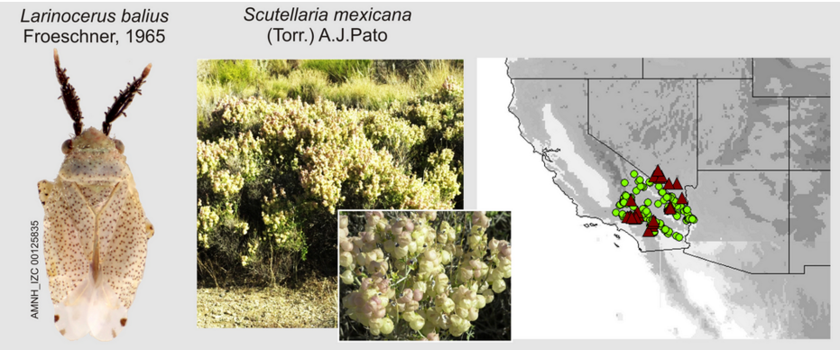
Researcher – Katja Seltmann (I also manage collections)
Your research in a sentence. Defining areas of Endemism and looking at species distributions.
For your research you need:
date (time) data
place data
taxon data
Do you georeference data?
Do you give or attempt to give your georeferences back to the data provider?
If you are researcher, do you use the polygon / uncertainty data? X – I would like to use polygons more!
If you are a collection / data manager do you create polygons? X
What is the biggest issue you run into when georeferencing? The biggest issue is having to re-georeference poorly (centrads to states, etc.) georeferenced coords, or those without error.
Share an idea you have for what would make georeferencing better / faster. Put in errors!

