Slide 1
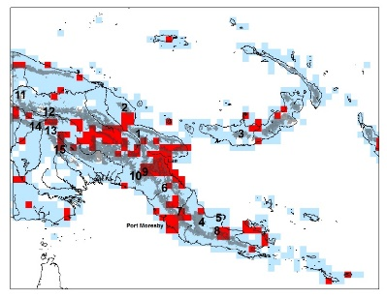








Mike Yost Collection / Data Manager
Your georeferencing work in a sentence. I use GEOLocate (embedded in Symbiota) to georeference specimens (mostly mushrooms) at several herbaria throughout the US using both point-radius and polygon methods.
Do you georeference data? Teach others to georeference?
Do you update your database with researcher-provided georeferences?
As a collection / data manager do you create polygons / uncertainty data?
What is the biggest issue you run into when georeferencing? Vague descriptions (near Denver) or using local verbiage of localities not recognized by Google Maps. Often counties are not included with locations.
Share an idea you have for what would make georeferencing better / faster. Specificity is key. Need counties to narrow down localities (as there may be several in a single state). Keep in mind we use Google Maps to georeference, so using mile markers or descriptions of the local terrain are largely unhelpful when georeferencing locations.

