Slide 1
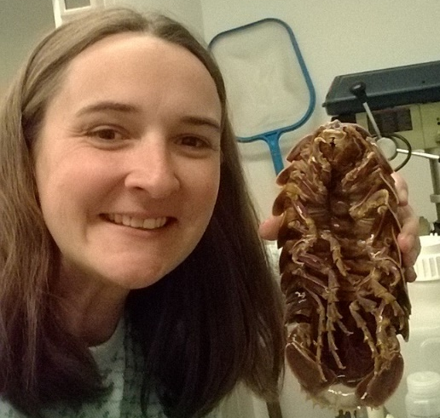








Jessica Utrup, Museum Assistant II Yale Peabody Museum of Natural History
Your georeferencing work in a sentence. I use GEOLocate and Google Earth, and I teach others to use GEOLocate to georeference legacy site data for paleontological specimens.
Do you georeference data? Teach others to georeference?
Do you update your database with researcher-provided georeferences?
As a collection / data manager do you create polygons / uncertainty data?
What is the biggest issue you run into when georeferencing? Finding localities that have long since vanished into the prairies or been absorbed by urban sprawl.
Share an idea you have for what would make georeferencing better / faster. A centralized place to find paleontological sites that have vanished.

