Slide 1
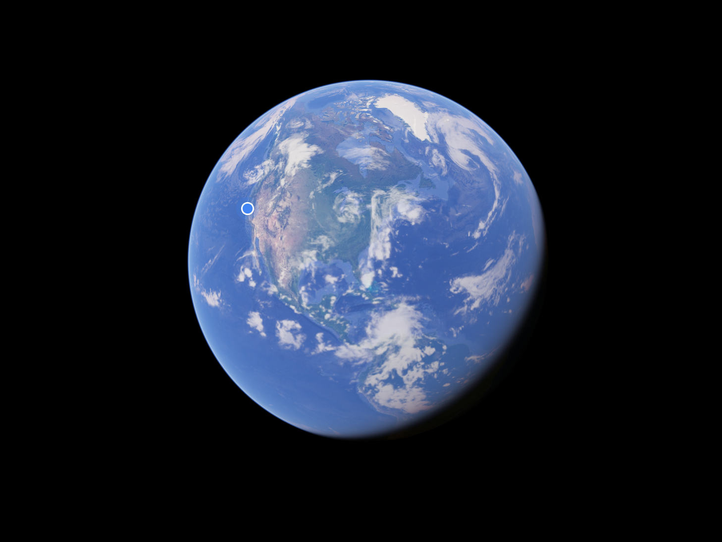
Online Resources for Georeferencing Georeferencing for Research Use iDigBio, Santa Barbara, 4-7th October 2016

Slide 2
Links with links
http://georeferencing.org/
http://herpnet.org/Gazetteer/GeorefResources.htm
http://www.canadensys.net/georeferencing
https://www.idigbio.org/wiki/index.php/Georeferencing
Notes:
What about unknown datum for UTM?
Online exercises: renewed file
Extent for MTM exercise (datum unknown)?

Slide 3
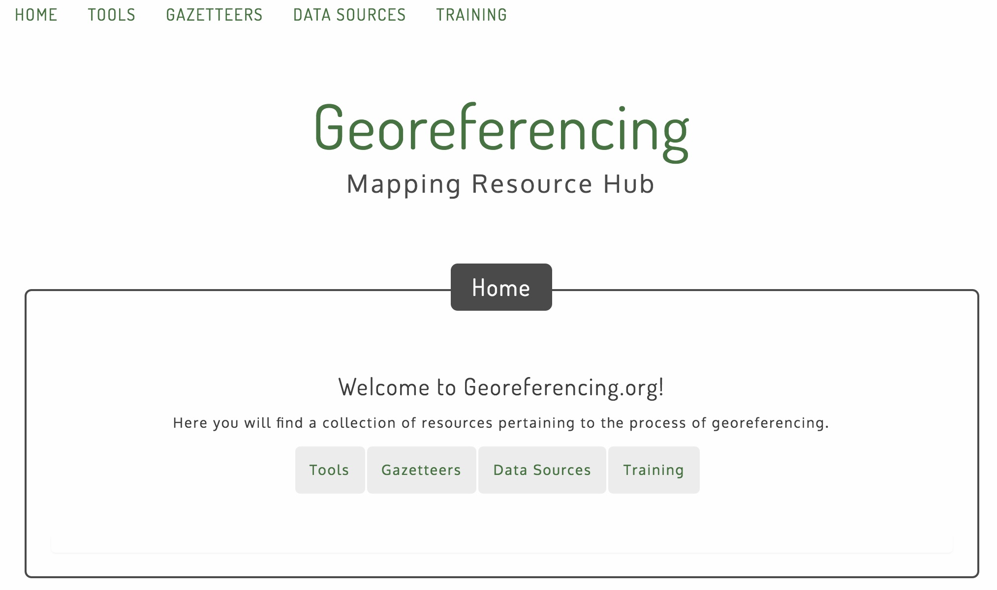

Slide 4
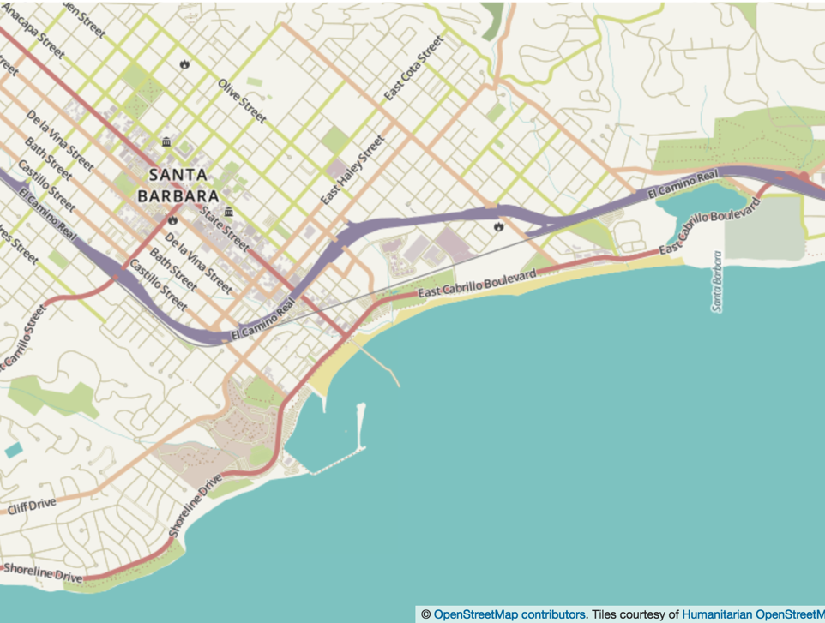
Digital Maps

Slide 5
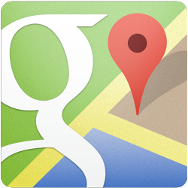
Google Maps
Datum: WGS84
Free text search, depends on zoom level
Directions for travelling by car, bike, public transport and foot
Views: map, earth, terrain, street view, plus various layers of information
Data compiled from different sources (sources at the bottom of the map)
http://maps.google.com

Slide 6
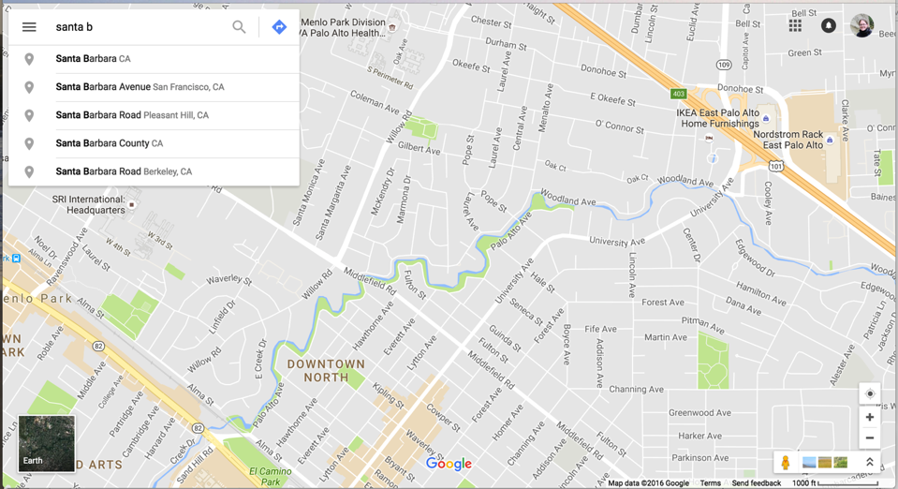
Google Maps – Search
Search with suggestions (depends on zoom level)

Slide 7
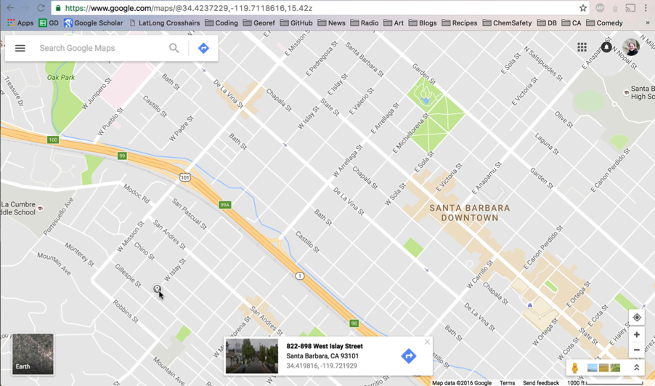
Google Maps – Lat-long
Lat-long of map center
Click for point
Lat-long of point

Slide 8
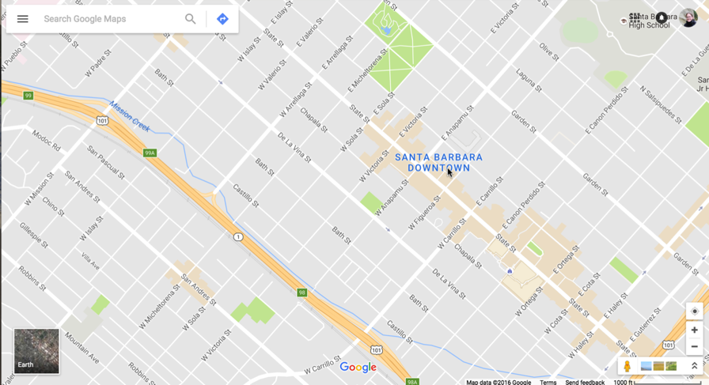
Google maps – Shapes
Click for shape

Slide 9
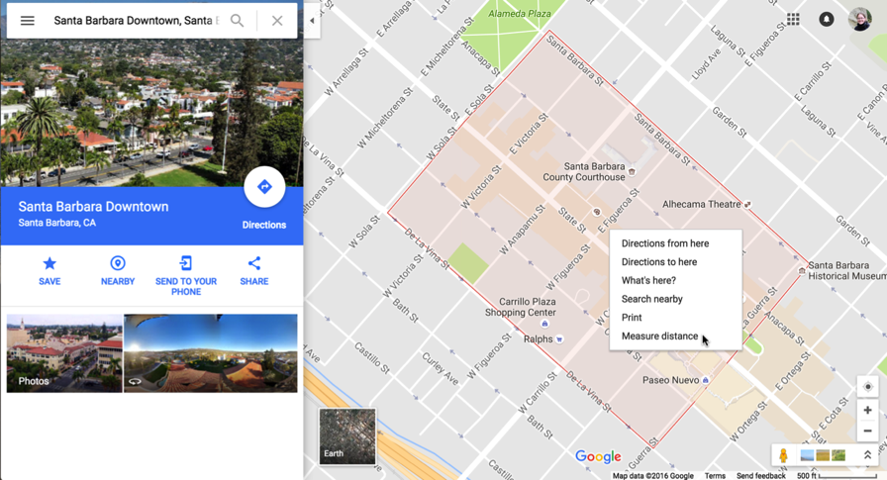
Google maps – Measure
Right-click to measure

Slide 10
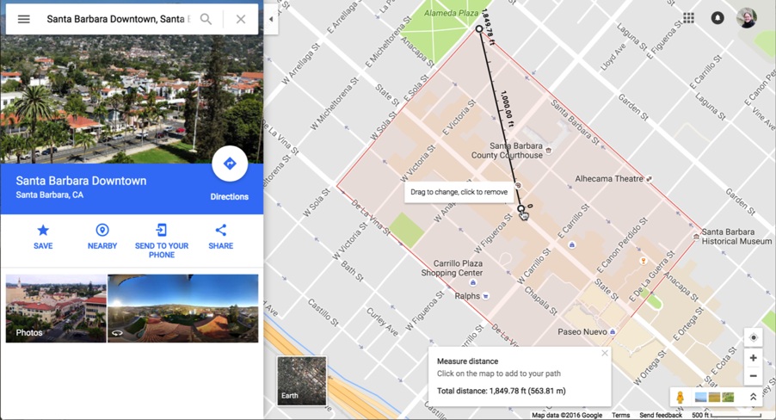
Google maps – Measure
Units on the map depends on domain: search from almost any other country and you will get metric (e.g. www.google.ca/maps/ ). It is also possible to trace a path using measurement tool.

Slide 11
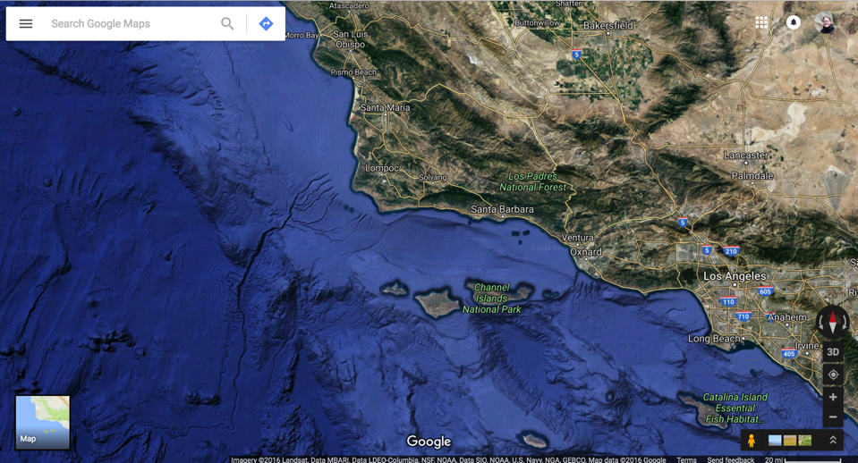
Google maps – Earth (aerial)
Flip between map and earth

Slide 12
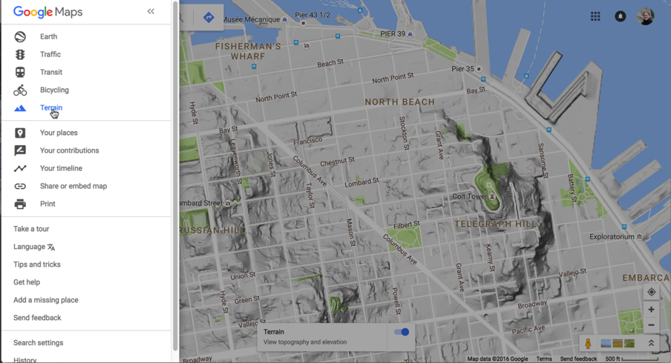
Google maps – Terrain
Other options, including terrain view, are in side menu

Slide 13
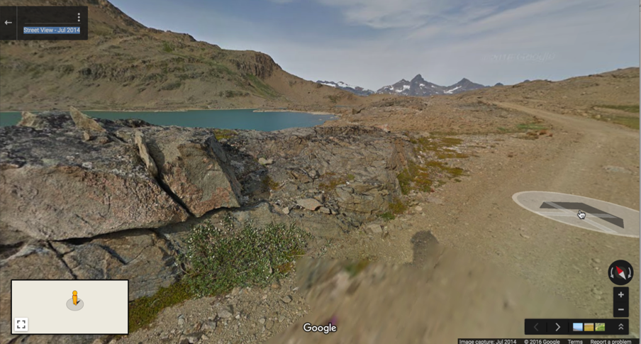
Google Maps – Street View
Flip from map to street view to identify exact point of collection

Slide 14
Google Earth -3D globe desktop app
Same data as Google Maps, similar functionality
Add a placemark to get lat-long
Use ruler to measure extent
Use path to measure along a route
Several coordinate formats (set in preferences)
Numerous information layers such as buildings, roads, borders etc. (format: kml, kmz)
Add your own layers (e.g. township-range-section grid:http://www.metzgerwillard.us/plss/plss.html or geological map:https://mrdata.usgs.gov/geology/state/).
Save your plotted points
Datum: WGS84
http://earth.google.com

Slide 15
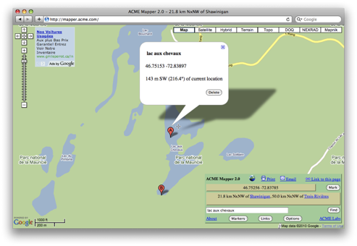
ACME Mapper
Google Maps interface
Map, satellite, hybrid and terrain, Topo, DOQ, NEXRAD and Mapnik
Free text search not dependent on zoom level
Markers cannot be moved, but new markers can be placed at crosshairs (click ‘Mark’)
Several coordinate formats for each marker + heading and distance from crosshairs
Saves all markers automatically
Gives you a descriptive locality
Datum: WGS84 (& NAD27)
http://mapper.acme.com/

Slide 16
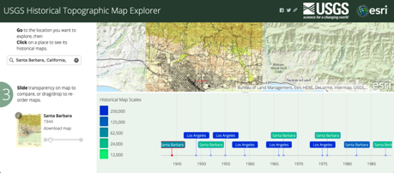
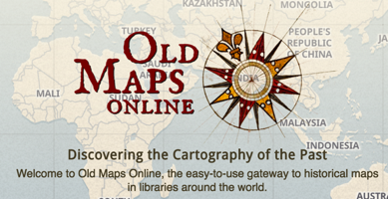
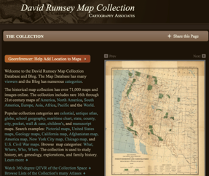
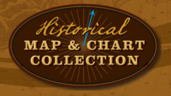
Scanned/Historical Maps
All iterations of USGS topo maps (can navigate through time-line)
http://historicalmaps.arcgis.com/usgs/
Historical maps:
http://www.oldmapsonline.org/ http://www.davidrumsey.com/
https://historicalcharts.noaa.gov/
(historical coastline maps)
Perry-Castañeda Library map collection – large collection of digitized maps and resources at UT Austin:
http://www.lib.utexas.edu/maps/map_sites/cities_sites.html

Slide 17
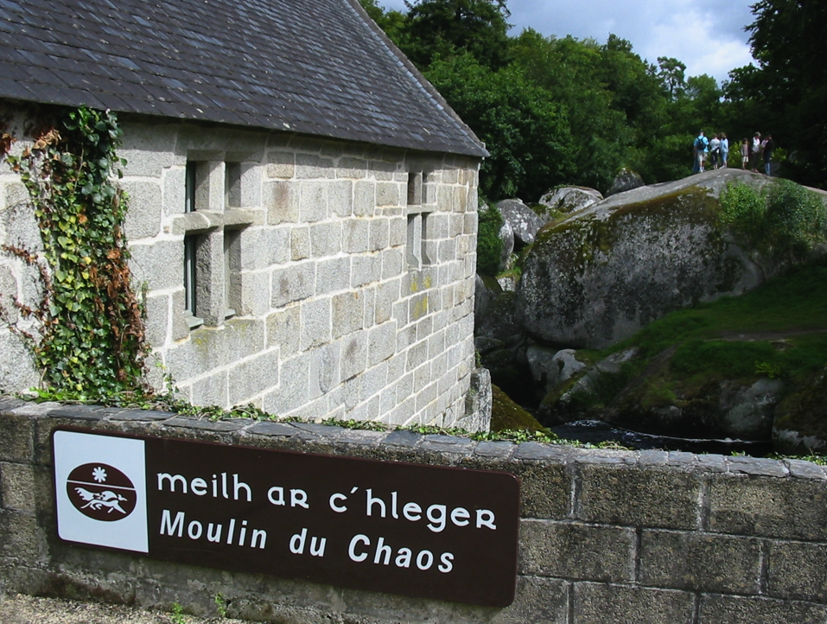
Names and Places

Slide 18
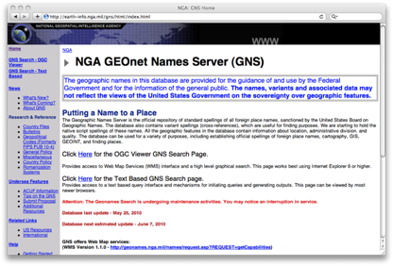
GEOnet Names Server (GNS)
Worldwide data from National Geospatial-Intelligence Agency (NGA) and US Board on Geographic Names (BGN)
NIMA = National Imagery and Mapping Agency
Degrees minutes seconds, precision to nearest minute
Uses feature type (e.g. basin, canal etc.)
Used as a source for many gazetteer
Homepage: http://geonames.nga.mil/gns/html/
For US data, use Geographic Names Information System (GNIS: http://geonames.usgs.gov/pls/gnispublic/
Datum: WGS84
Notes:
GNS: GeoNet Names Server
NGA: National Geospatial-Intelligence Agency
US BGN: US Board on Geographic Names

Slide 19
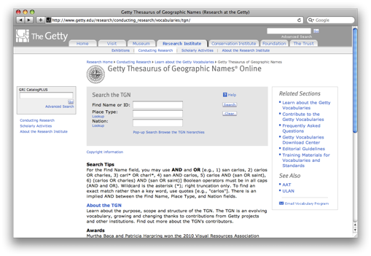
Getty Thesaurus of Geographic Names (TGN)
Worldwide gazetteer by The Getty Research Institute
Useful for finding alternative and old names
Uses feature types
Organized in geographical hierarchy
Degrees minutes or no coordinates - use recent name and search in Google Maps
Example: New Amsterdam, US
http://bit.ly/Getty-TGN

Slide 20
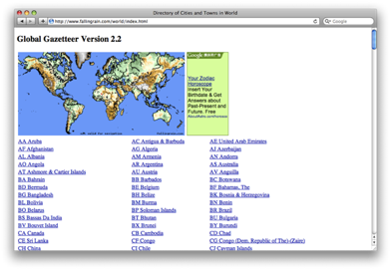
Falling Rain
Worldwide gazetteer for cities and towns
Great for hard to find localities, especially outside US
Degrees minutes (seconds), based on NIMA
Browse to find locality (no search)
Provides hierarchy, alternative names, topo maps, altitude, weather information and location of nearby towns in nautical miles (nm). Use georeferencing calculator to translate nm into kilometers.
Example: Qaryeh-ye Gol`alam, Velayat-e Lowgar, AF
Datum: WGS84
http://www.fallingrain.com

Slide 21
FuzzyG – JRC Fuzzy Gazetteer
Worldwide gazetteer designed for bad spelling.
Useful for finding alternative, doubtful spelling and old names
Uses feature types, by continent
Degrees minutes or no coordinates - use recent name and then search in Google Maps
Example: Narobi instead of Nairobi, Africa
http://dma.jrc.it/services/fuzzyg/

Slide 22
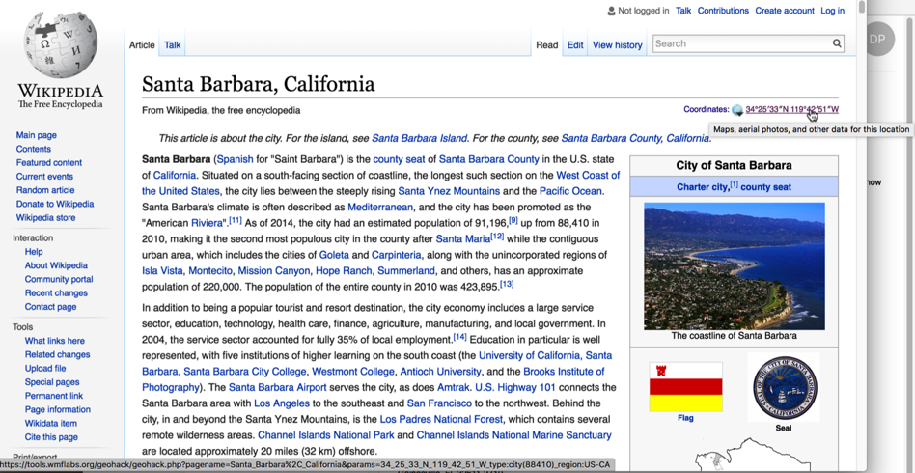
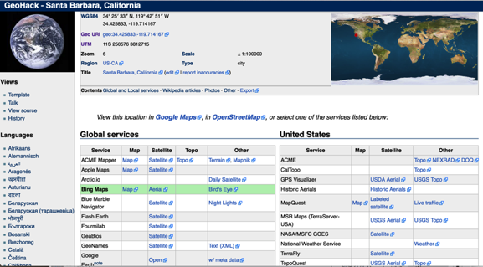
Wikipedia/Geohack

Slide 23
Other
Wikimedia Commons Atlas of the World: (http://commons.wikimedia.org/wiki/Atlas)
An organized and commented collection of geographical, political, and historical maps
Statoids (http://www.statoids.com/)
Information about administrative divisions (provinces, counties) and their history, area, population, codes, etc.
No coordinates!
CIA World Factbook (http://bit.ly/dDtT1i)
Similar to Statoids

Slide 24
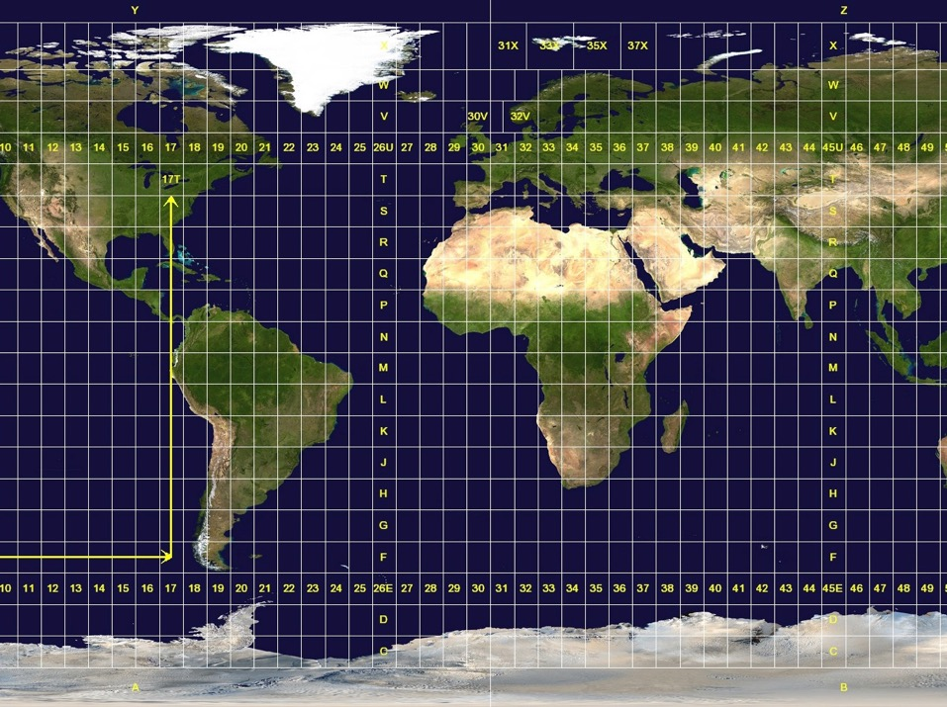
Other Grid/Coordinate Systems

Slide 25
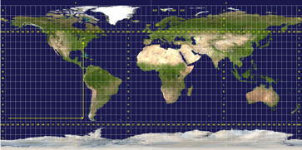
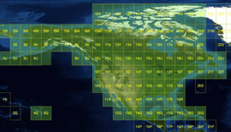
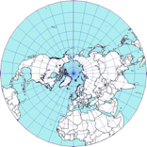
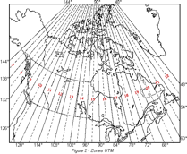
UTM (MGRS, UPS) and MTM
UTM: Universal Transverse Mercator
Divides earth into 60 zones: 6 degree band of longitude per zone
Datum: WGS84 and others
Default extent: 30m (if recorded with GPS receiver)
MGRS: Military Grid Reference System (http://mgrs-data.org/)
based on UTM and UPS (universal polar stereographic coordinate system)
MTM: Modified Transverse Mercator
Used in Canada: 3 degree band of longitude per zone
Conversions:
http://leware.net/geo/utmgoogle.htm
http://www.earthpoint.us/Convert.aspx
http://awsm-tools.com/geo/utm-to-geographic
17N 630084 4833438
zone easting northing

Slide 26
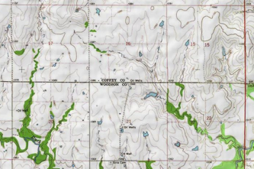
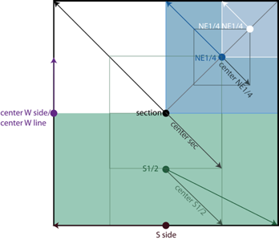
Public Land Survey System (PLSS)
Mainly used in the West, Midwest and some Southern states in the US
Uses Township-Range-Section (TRS): e.g. T13N-R14E-S15, Arizona, Coconino County
For standard extents (but note, not all sections are standard!): http://manisnet.org/ GeorefGuide.html
To get lat-long: http://www.earthpoint.us/ (“search by description”)
Grid for Google Earth: http://www.metzgerwillard.us/plss/plss.html
Standard TRS divisions, and extents

Slide 27
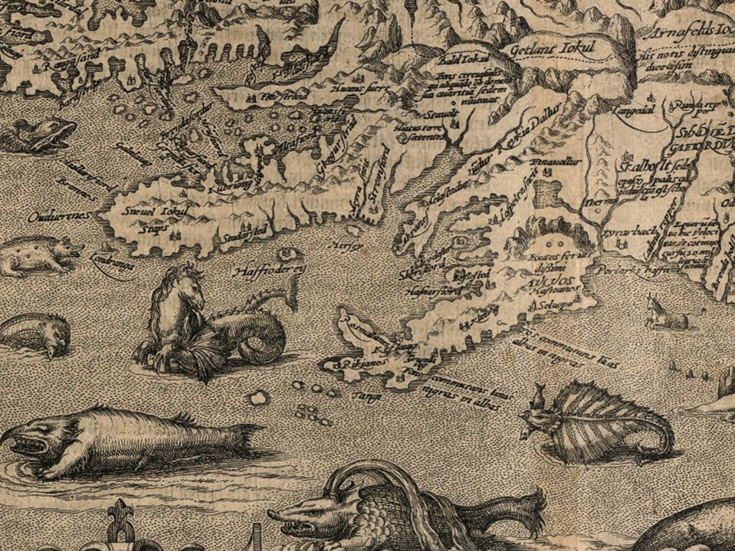
Data Visualization

Slide 28
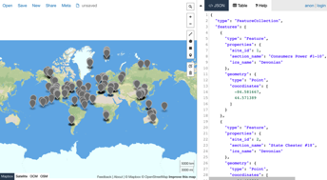
Data Visualization
GPS Visualizer (http://www.gpsvisualizer.com/)
Use to translate a file with coordinates into kml or a picture
Simplemappr (http://www.simplemappr.net/)
Similar - for publication
CARTO (formerly CartoDB) (http://carto.com)
Online geospatial database by Vizzuality
Drag and drop CSV upload
Easy customization of your map
Share and embed your map
owerful development tools
Free account = 5 tables / 5MB of data
Geojson.io (geojson.io)
Plot points and convert from csv to geojson

Slide 29
Some links
Google Maps: maps.google.com
Google Earth: google.com/earth/
Hard to find localities: fallingrain.com
Old and alternative names: bit.ly/Getty-TGN
PLSS/Township-range-section: www.earthpoint.us
UTM map: www.dmap.co.uk/utmworld.htm
UTM calculator: http://www.earthpoint.us/Convert.aspx
GEOnet names server (GNS) for worldwide data: http://earth-info.nga.mil/gns/html/

Slide 30
Some more links
http://www.openstreetmap.org/: free, editable map of the world
http://global.mapit.mysociety.org/: can give you administrative boundaries if you have a lat-long (could be useful for verifying localities outside the US)
http://www.gelib.com/ng-topo.htm: topo map overlay for Google Earth
http://mrdata.usgs.gov/geology/state/: geology layers for Google Earth
http://www.nrcan.gc.ca/earth-sciences/geography-boundary/geographical-name/11680: natural resources of Canada, search by geographic names, lat-long, rectangular area..
http://www.gadm.org/: Global Administrative Boundaries Database
http://www.geody.com/ : Google Earth wiki
http://www.naturalearthdata.com/: for making maps
http://geo.data.gov/geoportal/catalog/main/home.page: various geographical datasetshttp://maps.nls.uk/: historical maps of Scotland/Great Britain/Ireland and Belgium
http://cidades-brasil-ibge-google-earth.softonic.com.br/download: cities in Brazil for google
http://www.bl.uk/maps/ and
http://www.bl.uk/maps/georeferencingmap.html: British Library crowd-source project for historical maps
http://www.uwgb.edu/dutchs/usefuldata/ConvertUTMNoOZ.HTM: UTM conversion, other useful resources
http://www.oceangrafix.com/search/byregion: NOAA maps
https://www.loc.gov/rr/geogmap/sanborn/: Sanborn Fire Insurance Maps (good for identifying building within cities)
….and many many more at georeferencing.org

