Slide 1
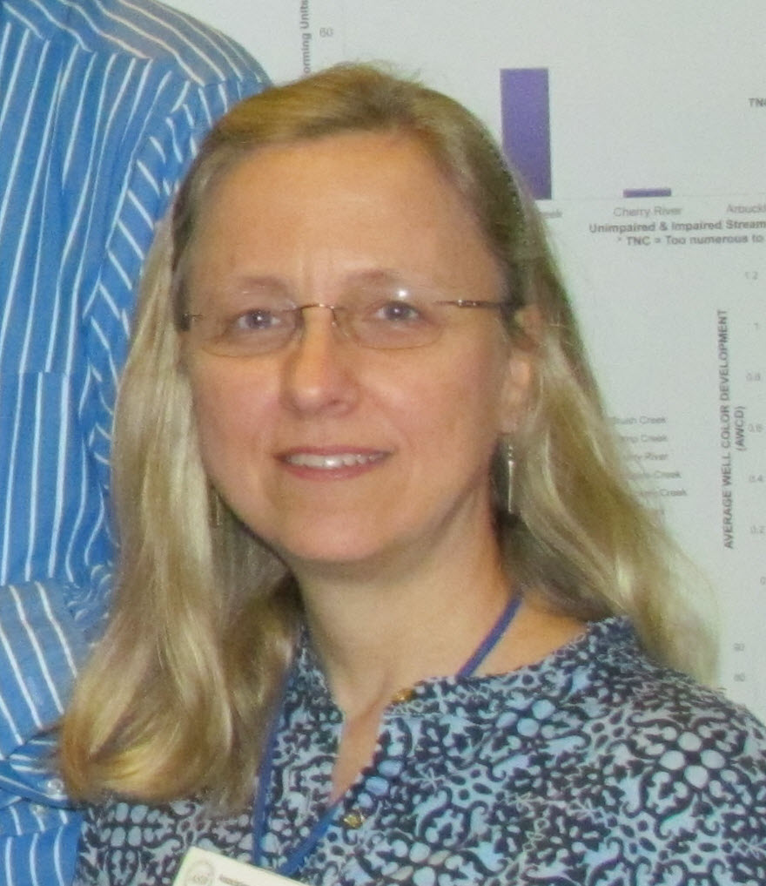
Georeferencing for Research Use spreadsheets and Open Refine
Deborah Paul,
@idbdeb @iDigBio #GRU2016
Georeferencing for Research Use, iDigBio-CCBER Short Course hosted by NCEAS. Oct 4 – 7, 2016
Notes:
Symposium Section: Frontiers in Entomology
Symposium Title: Entomology in the Digital Age
Talk Title: Biodiversity informatics skills for collections and research in the 21st Century
Author: Deborah L. Paul, Pam Soltis, Matt Collins
At iDigBio, beyond mobilizing data, we’re working with our data providers and the informatics community to enhance museum specimen data and ensure the data and media are fit-for-use. We are engaging researchers and data providers to help them take advantage of ever-growing datasets, and the tools, methods, and apps that support robust data creation and research data use. For the last six years, through our collaborations with NSF bio-centers (NESCent, NEON, BEACON, SESYNC, DataONE, …), Data Carpentry, iDigBio workshops, symposia, surveys, and webinars we’re learning a lot about the computational and data literacy skills needs of our stakeholders. People in our collections data pipeline include: scientists and students collecting future specimens-to-be-accessioned, collection managers, data managers, data aggregators, downstream researchers, and the general public.
As museum collections mobilize to digitize their holdings, contributing more-and-richer data to our community portals -- students, museum staff, and researchers are often finding it’s not a small task to be good custodians of the data. While formal science programs are teaching bioinformatics skills for genomic and metagenomics research, few are strategically teaching the pre-requisite skills to current researchers, students and staff that are necessary to manage data effectively over a lifetime. These skills help insure data is discoverable, and in a standardized format that supports research analysis reproducibility.
This talk provides an overview of the current landscape for biodiversity informatics skills from our experiences at iDigBio. You are invited to share your experiences and insights about what it will take to address these needs into the future.

Slide 2
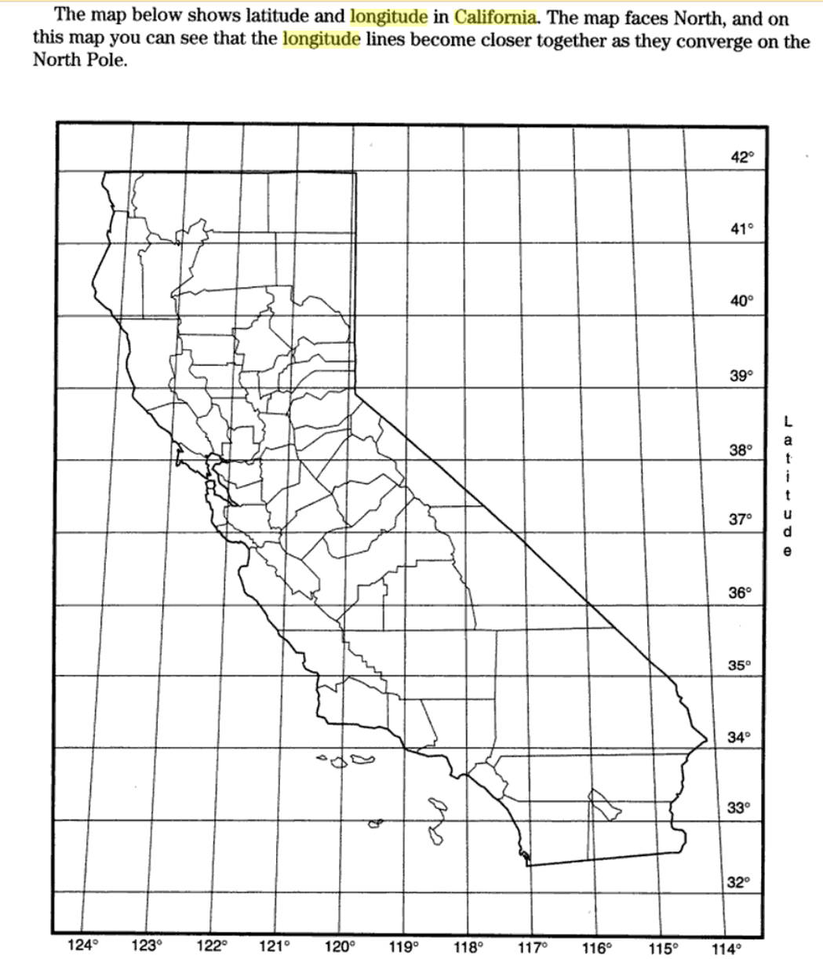
Notes:
https://books.google.com/books?id=o2Lp3tZ02bQC&pg=PA113&lpg=PA113&dq=eastern+most+longitude+of+california&source=bl&ots=6GBU4EyUZd&sig=NUrbtI1l4mBebASAL40_d3BXcXs&hl=en&sa=X&ved=0ahUKEwjij8K8yZ_PAhWBVSYKHYJiCvoQ6AEITDAI#v=onepage&q=eastern%20most%20longitude%20of%20california&f=false

Slide 3
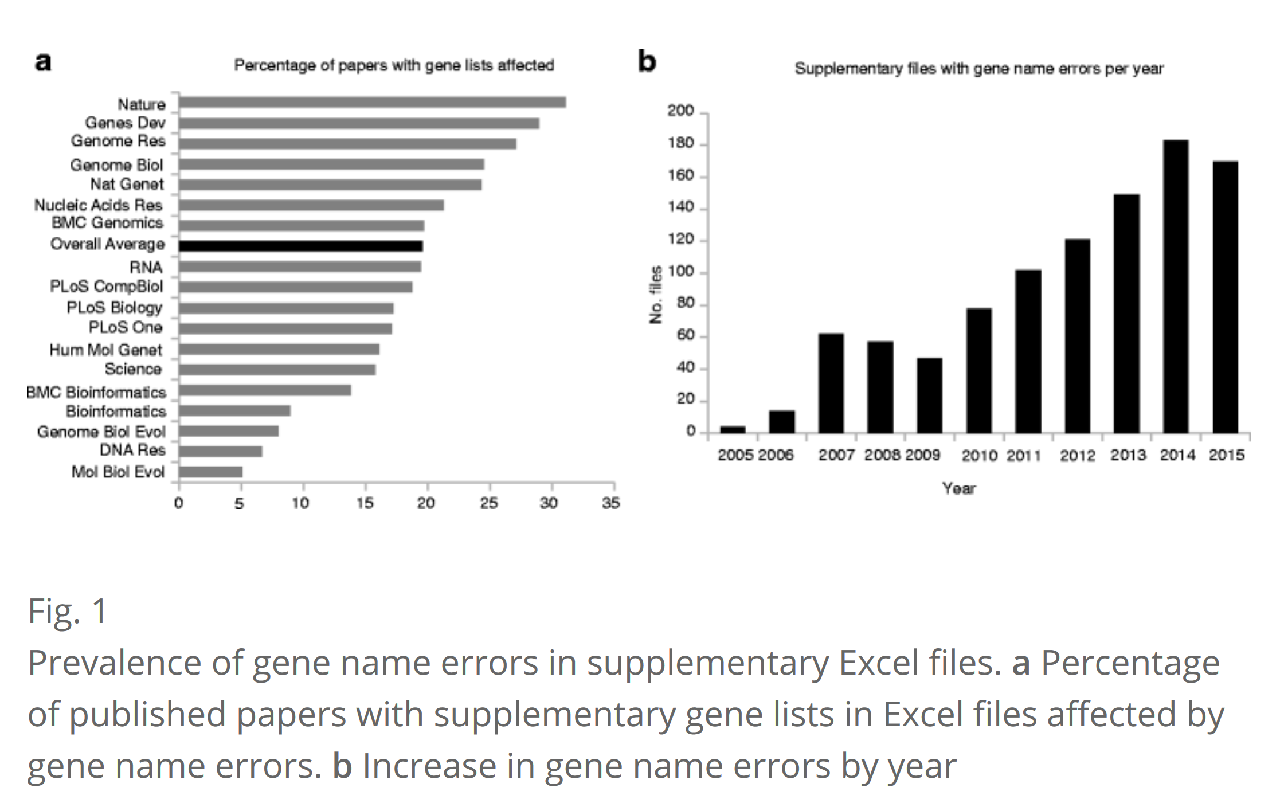
Abstract
The spreadsheet software Microsoft Excel, when used with default settings, is known to convert gene names to dates and floating-point numbers. A programmatic scan of leading genomics journals reveals that approximately one-fifth of papers with supplementary Excel gene lists contain erroneous gene name conversions.

Slide 4
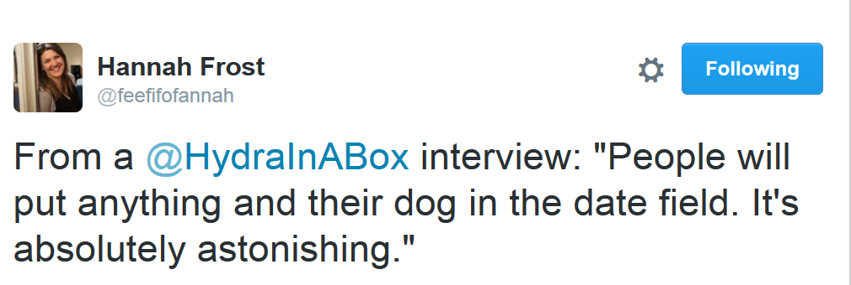
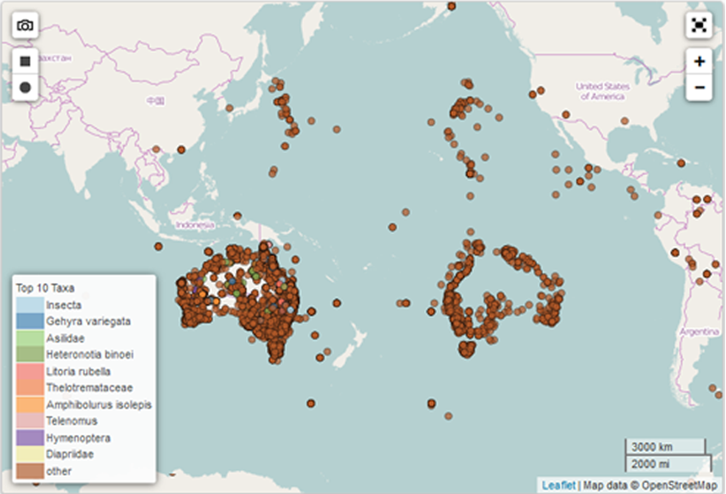
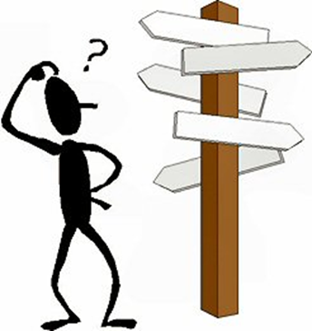
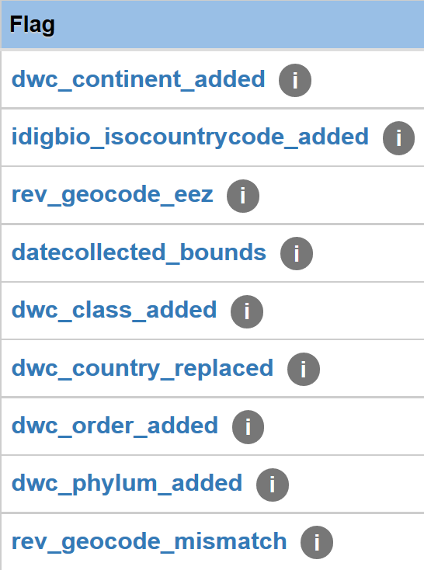
Notes:
What are some of the challenges faced when using this data? How are folks addressing these?
Access - where is this data?
Formatting - do you know how to transform it, use it to enhance your data?
Spotty coverage (gaps)
Possible duplication
Needs georeferencing or validation
Taxonomic challenges - need verification
non-standard Country values
How can you, the entomologist, taxonomist, systematist, ecologist, genomicists, enhance our data?
Voucher
Add your expertise and insights to the research questions and approaches
Add your locality knowledge
Fill in the gaps (taxonomic, geographic, associations, traits, ...)
What about your future research projects? How about incorporating voucher specimens in your research efforts (NEON example) - supporting reproducible research. Use our data to enhance your research

Slide 5
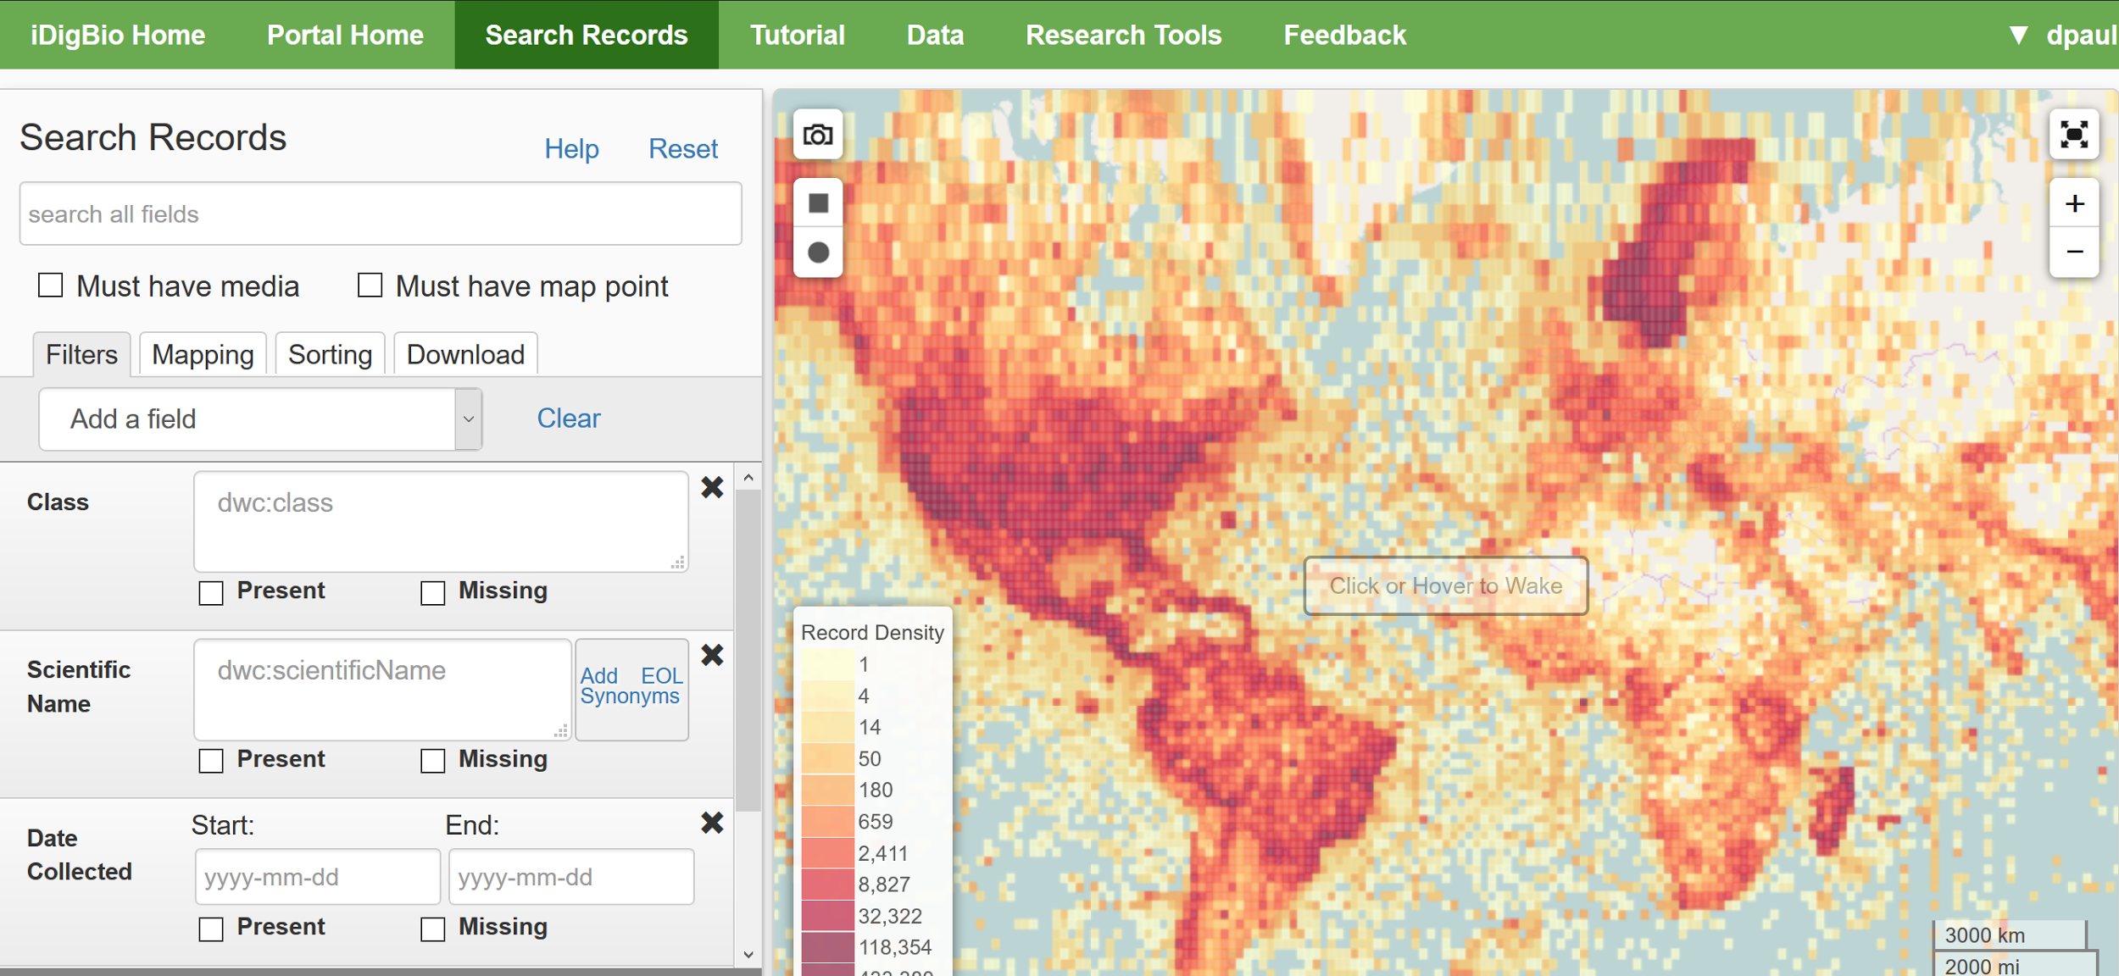
www.idigbio.org
Notes:
iDigBio is a 10 year project, currently in year 6, funded by the National Science Foundation to foster (inculcate?!) a culture of digital transformation in natural history collections. Our database currently contains over 65 Million records and 15 Million images - all about vouchered museum specimens (no observations).
For the first 5 years, we focused our efforts on figuring out how to think about collections’ digitization in a systematic way. With collections staff, curators, collection managers, researchers, and technical staff, we used workshops, webinars, symposia, and publications to foster discovery and dissemination of digitization best practices.
Along with mentoring the digitization of collections, our mandate includes: providing robust access to the data in our online database, working with researchers and collections staff on skills needed to work with our data, and tightening integration between key software products to speed up access to and research use of this rich data resource.

Slide 6
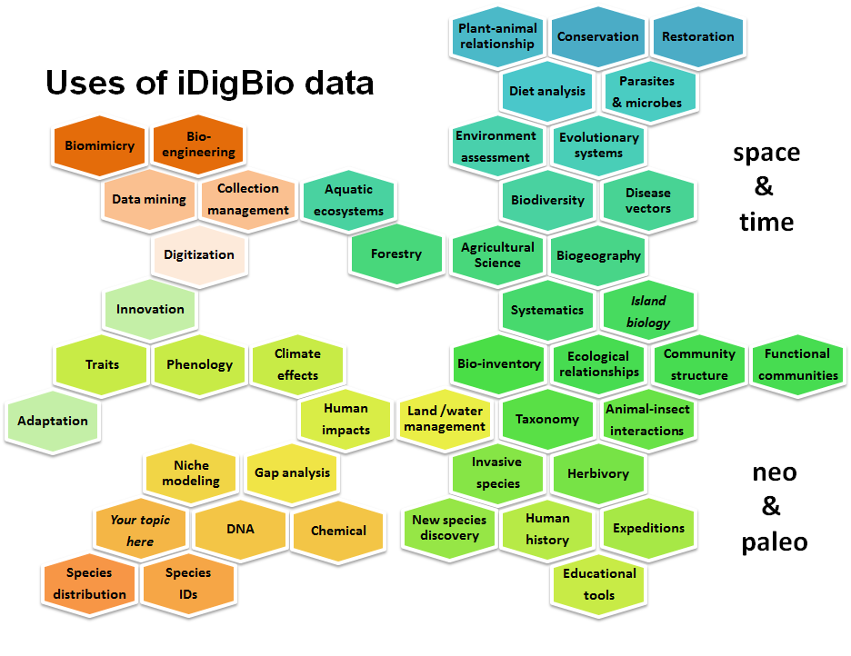
Shelley James, iDigBio 2016
Notes:
How can these data be used (Shelley’s slide on uses so far)? What kind of skills and literacy do you need for these research examples?
Note potential industrial, agricultural, and bio-engineering uses.
What about novel uses? ecotourism? sentiment or attitude shifting? apps that encourage interaction and engagement with nature
Using data to plan expeditions, discover new species, reveal cryptic species, clarify areas of endemism, climate change, phenology, species declines, ecological restoration, back-casting, ENM, conservation status (Seltmann, 2014), …
Advantages (1 slide)
using gaps to inform future work, testing models, engaging / reaching more people, opportunity to learn new skills / concepts, ...

Slide 7
Let’s investigate our California Carabidae (Beetles) Dataset
Why look at data?
Is it worth the time to clean it?
Research Examples from the BITC Lecture on Data Cleaning.
Focus on Date (Time), Place, and Taxon Name Data.

Slide 8
What are we looking for?
Why should we care about these issues?
How efficient can we be?
Will you be certain of finding all errors?
Notes:
REPRODUCIBILITY and Data Life. (Data quality is part of the story).
Typos
Formatting Issues (capitalization, white spaces, weird characters (UTF8!) all values TOLOWER
Standardization (dates, taxonomy and nomenclatural issues, controlled vocabularies)
Missing data (georeferences)
Data errors (spelling, date conundrums, incorrect georeferences,…)
Duplications
Separators are different (; , | ())
How many decimal digits in the georeferences?

Slide 9
Opening a delimited file in this case a csv (that’s comma-separated)
To avoid snafus it’s a good idea to always open these files using “import from text”
Just say No to “double-click” to open.
Spreadsheets try to help you and they will
Mess up your date fields
Change your gene names to dates
They can and do guess the data-type incorrectly, in-other-words

Slide 10
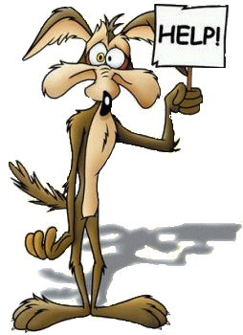
What’s the first thing to do before opening a data file where you will likely make changes? How will you track what changes you make?
Make a back up
Name it meaningfully
No spaces or special characters in filenames
Plan where you will store these files
Make a record of changes

Slide 11
Opening a delimited file in this case a csv (that’s comma-separated)
To avoid snafus it’s a good idea to always open these files using “import from text”
Just say No to “double-click” to open.
Spreadsheets try to help you and they will (as examples)
Mess up your date fields
Change your gene names to dates
Add sig figs to georeferences
They can and do guess the data-type incorrectly, in-other-words

Slide 12
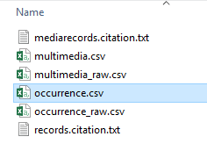
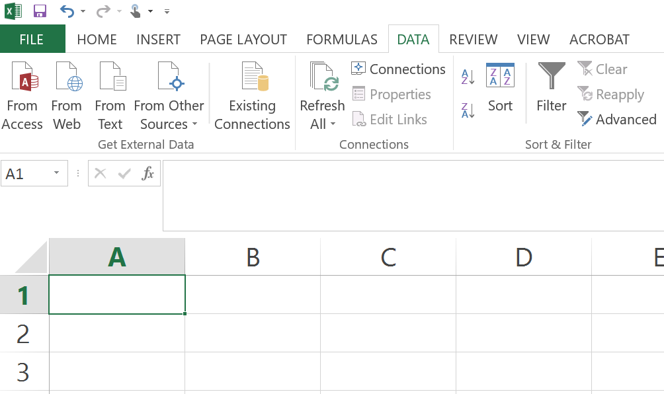
Import “from text”

Slide 13
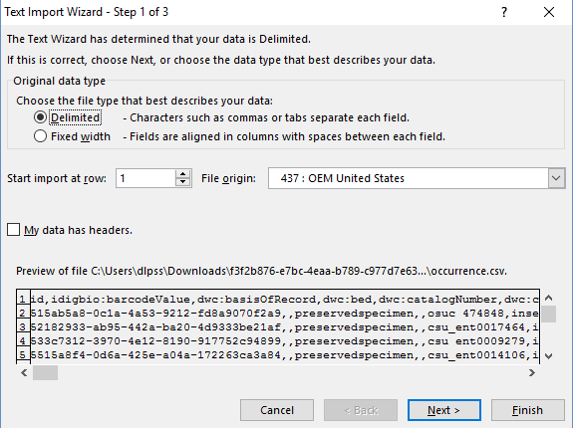
Notes:
UTF-8

Slide 14
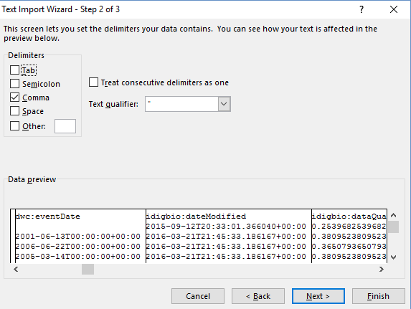

Slide 15
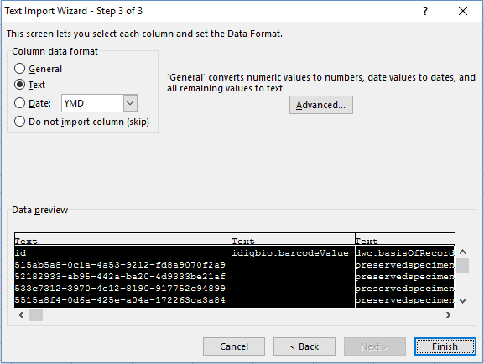
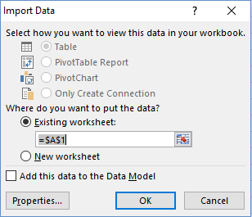

Slide 17
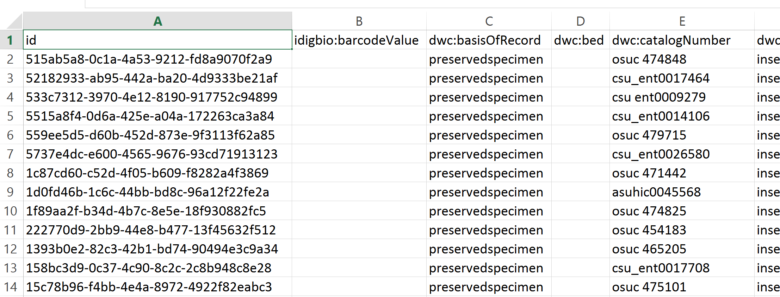
What the data looks like
Is there a UUID or other Globally Unique ID for each specimen record?
[HINT: is any data missing that you need to see?]
Notes:
GeodeticDatum
And other GEO fields

Slide 18
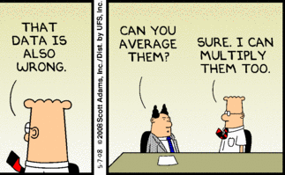
Now, let’s explore the data. For the next 5 minutes, please find all the issues you can, and note how you would fix.
Please be prepared to share what issues you find

Slide 19
Your Observations
Notes:
Typos
Formatting Issues (capitalization, white spaces, weird characters (UTF8!) all values TOLOWER
Standardization (dates, taxonomy and nomenclatural issues, controlled vocabularies)
Missing data (georeferences)
Data errors (spelling, date conundrums, incorrect georeferences,…)
Duplications
Separators are different (; , | ())
How many decimal digits in the georeferences?
2 dwc:eventDate columns but they are not the same
dwc:eventDate (is a date-time stamp, but time has no useful values?)
could strip to date only
insert blank column
change column > format cell type > to general
=LEFT(M3,10)
(cell, character number)
Click on cell, crtl c on that cell, scroll to bottom, shift+click in last cell, crtl v
Copy column, paste contents back in as “paste values” (gets rid of formulas)
From Web: Jump to the bottom of data with Ctrl+Arrow. Provided there are no blank cells in your data, press Ctrl+Down Arrow to move to the last row in the data set. Use Ctrl+Up Arrow to move to the first row in the data set. Add the Shift key to select from the current cell to the bottom. Mar 27, 2014
dwc:recordedBy separators (; , | ())
All text values have been changed TOLOWER, how do you change case?
dwc:county
format, the word county,
multiple counties
some instances have more than one county – what to do for visualization?
does this mean multiple traps?
dwc:verbatimEventDate
date ranges
various date formats
taxon name issues?
order of the fields
some fields needed are in the occurrence_raw.csv
what to do? copy and paste?
merge? [Use Open Refine]?

Slide 20
Date Data
Notice more than one dwc:eventDate field
What’s the difference?
Which is useful in this dataset?
Do you need the time-stamp?

Slide 21
A Pivot Table example: Let’s look at the dwc:eventDate for all the occurrences in the dataset
Using the dwc:eventDate that has no time stamp
For Pivot Tables to work on date data the dwc:eventDate format must be of type date.
Why is this visualization useful? What kinds of issues might we see?

Slide 22
Number of specimens collected on a given date

Slide 23
Zoom in to just a few records in the Pivot Table

Slide 24
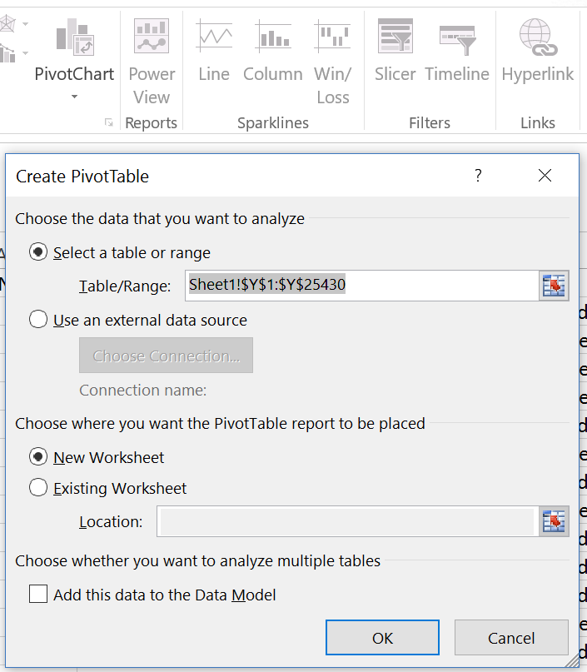
How to create this Pivot Table
highlight the dwc:eventDate field (and the header)
choose (under Charts) > insert Pivot Chart and Pivot Table > new worksheet > click ok

Slide 25
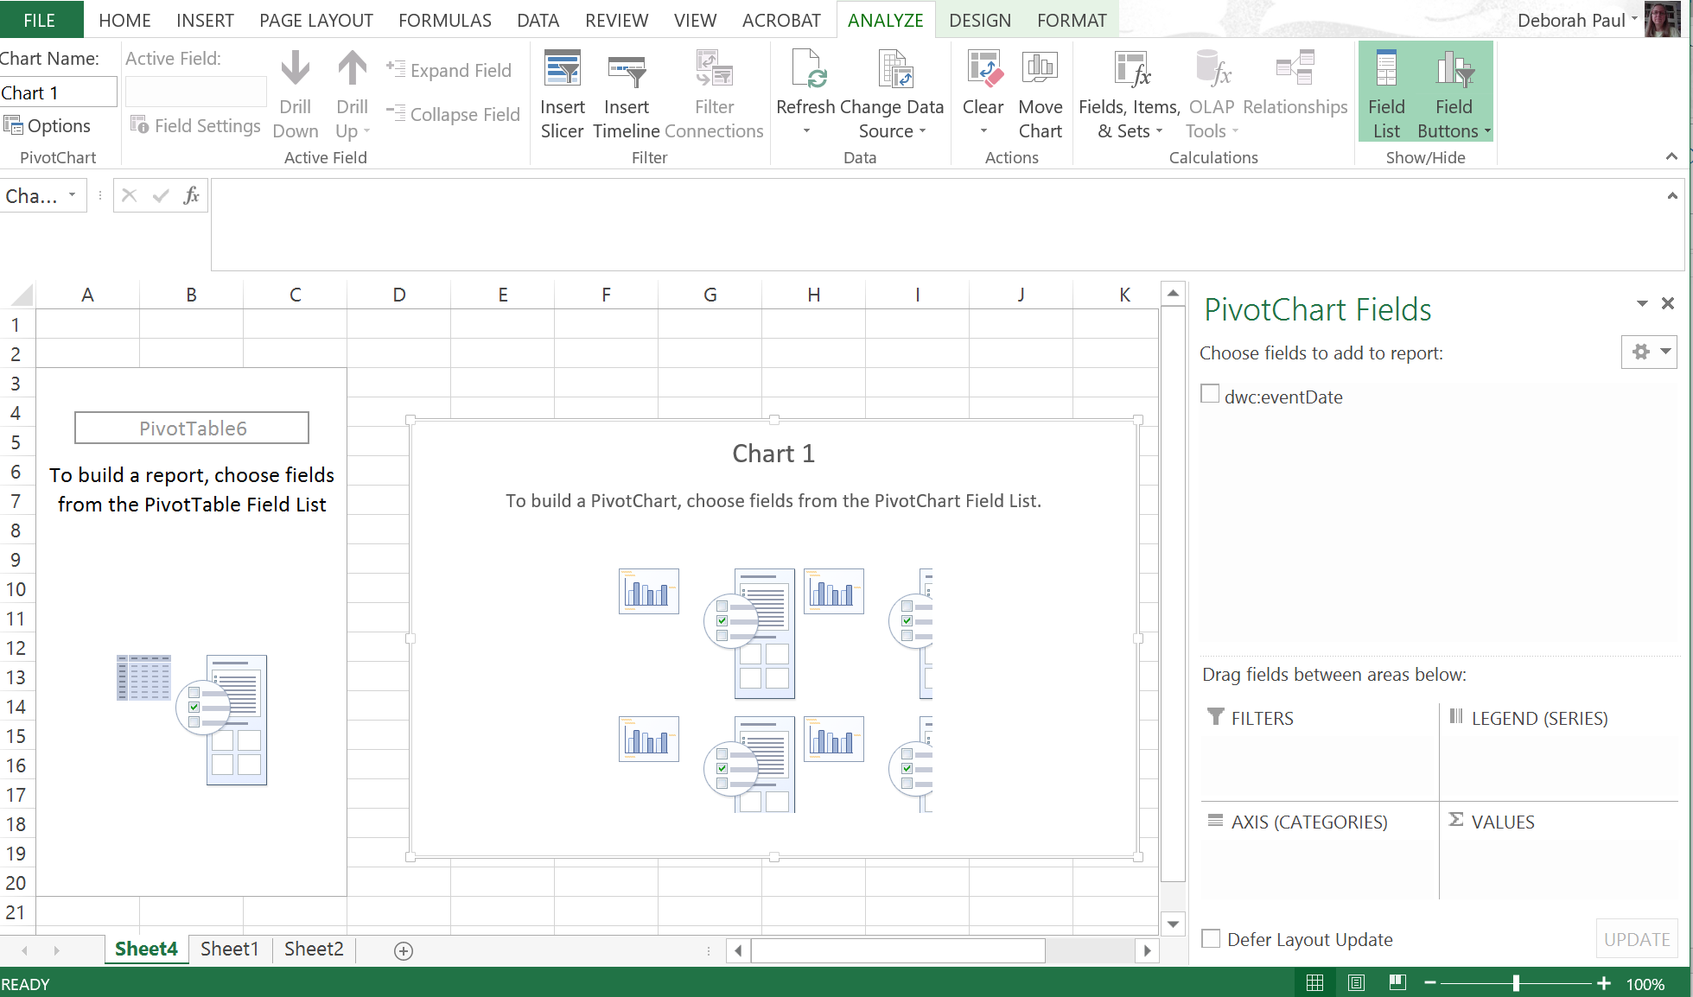
You end up here

Slide 26
See dwc:eventDate?
Drag and drop it into the AXIS and the VALUES boxes.
You’ll now see a Pivot Table for your Dates and Count of dwc:eventDate
And you see a Pivot Chart showing date distribution.

Slide 27
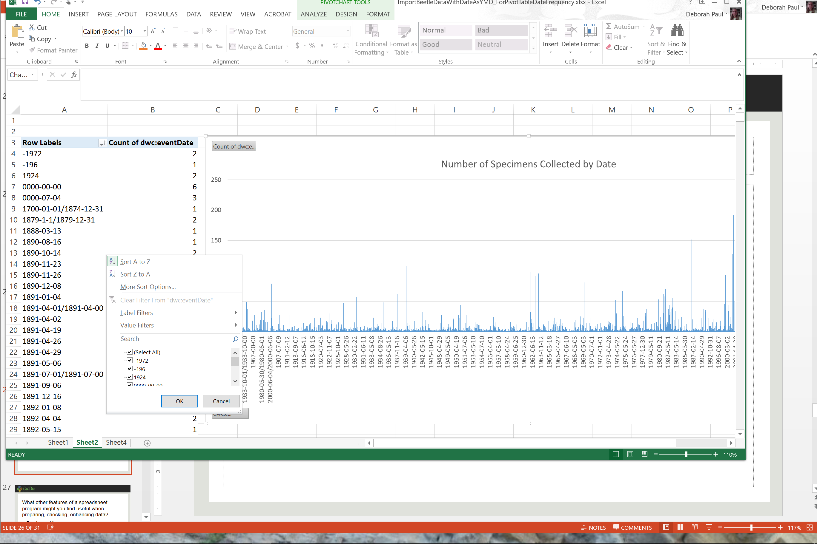
What the resulting table and chart look like.
Notice the sort and limit features
Notes:
Latitude Ranges 1 point is lat 43 degrees, 11 points questionable at -109 and -113
And others have lat < 32 so these are Mexico.

Slide 29
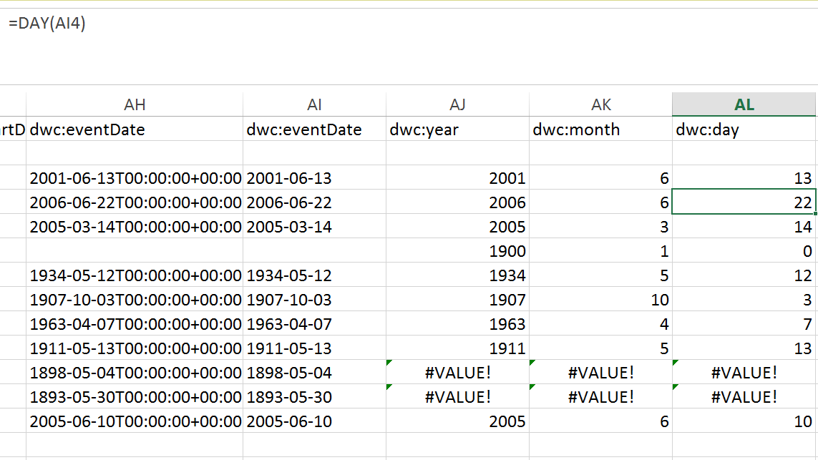
Splitting YYYY-MM-DD
YEAR()
MONTH()
DAY()

Slide 30
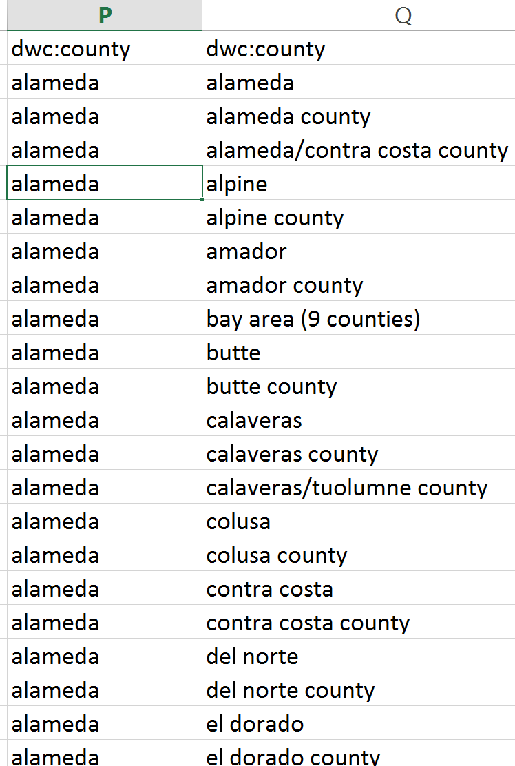
Place issues – dwc:county
More than one county
/ and () as separators
The word “county” is in the field
Do these issues matter?
What to do?
What order to fix?

Slide 31
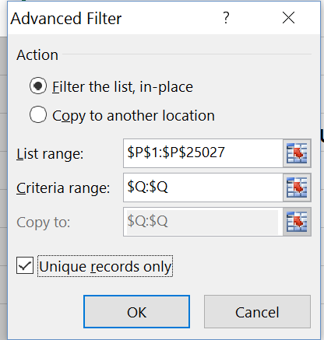
dwc:county – unique values
Sort data set by dwc:county
This moves all blanks to end
Use Data tab > Filter Advanced > Unique Records, to see issues
Plan strategy
Use Find and Replace to remove “county”
Use Text-to-Columns to separate by “/”
And then see (9 counties)…
Notes:
Editing: Find and Replace
Data Tools: Text to Columns
alameda alameda county alameda/contra costa county alpine alpine county amador amador county bay area (9 counties) butte butte county calaveras calaveras county calaveras/tuolumne county colusa colusa county contra costa contra costa county del norte del norte county el dorado el dorado county el dorado/placer county fresno fresno county fresno/san benito county glenn glenn county humboldt humboldt county imperial imperial county inyo inyo county jedediah smith redwood state park kern kern county kings kings county lake lake county lassen lassen county lassen volcanic national park los angelas los angeles los angeles county los angeles/san bernardino county madera madera county marin marin county mariposa mariposa county mariposa/tuolumne/mono/madera county mendocino mendocino county merced merced county modoc modoc county mono mono county mono/alpine/tuolumne county mono/tuolumne county monterey monterey county napa napa county napa/solano/yolo county nevada nevada county nevada/sierra county no locality record orange orange county placer placer county plumas plumas county redwood national park riv. riverside riverside county sacramento sacramento county san benito san benito county san benito/monterey county san bernardino san bernardino county san diego san diego county san francisco san francisco county san joaquin san joaquin county san luis obispo san luis obispo county san luis obispo/santa barbara county san mateo san mateo county san mateo/santa clara county san mateo/santa clara/santa cruz county santa barbara santa barbara county santa clara santa clara county santa cruz santa cruz county sequoia national park shasta shasta county shasta/lassen/plumas/tehama county sierra sierra county sierra/placer/nevada/yuba/plumas/el dorado county siskiyou siskiyou county solano solano county solano/yolo county sonoma sonoma county sonoma/napa/lake county stanislaus stanislaus county sutter sutter county tehama tehama county toulumne trinity trinity county tulare tulare county tuolumne tuolumne county tutare unknown locality ventura ventura county yolo yolo county yuba yuba county

Slide 32
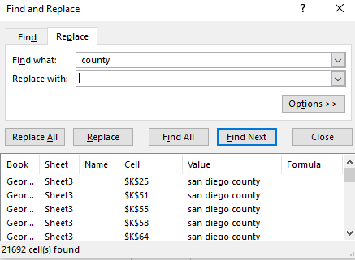
Use Find and Replace to remove the word county and the space in front

Slide 33
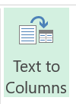
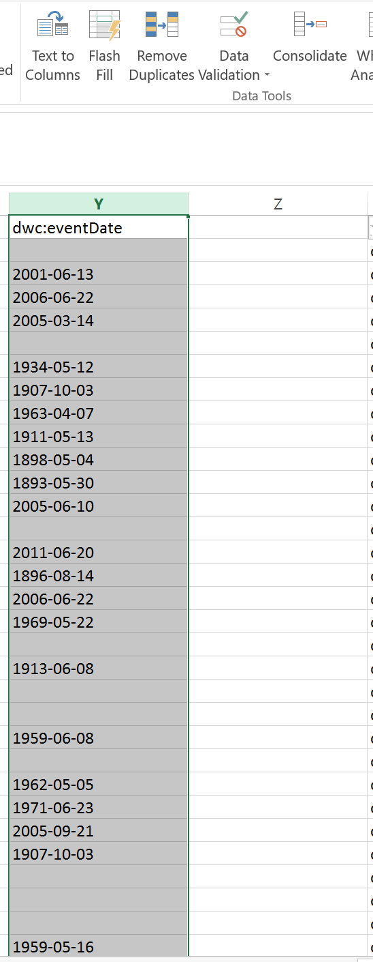
Splitting YYYY-MM-DD into separate fields to look for any issues.
Try using Text-to-Columns
What happens?
What about date ranges with “/”
Open another copy of the data, import this field as text and then try “Text to Columns”
First divide by the date range separator “/”, then use Text-to-Columns again to divide the date field into 3 columns, YYYY, MM, DD.
Then you can look at years, months, days separately to evaluate any issues.
Notes:
HINT you may also want to split by the year range / separator first.

Slide 34
Geopoint data
From iDigBio, we have a decimal latitude and decimal longitude in JSON format.
How to separate this?
Try it
How did you do it?

Slide 35
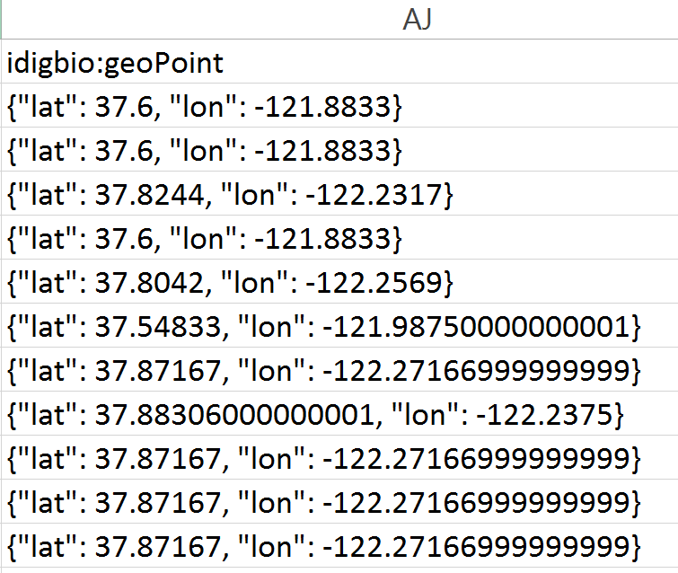
One possible path to separate lat and lon
First copy the column
Using Find and Replace
Remove {“lat”:_
Remove _“lon”:
Remove }
Use Text-to-Columns to separate by comma
What abt sig figs?

Slide 36
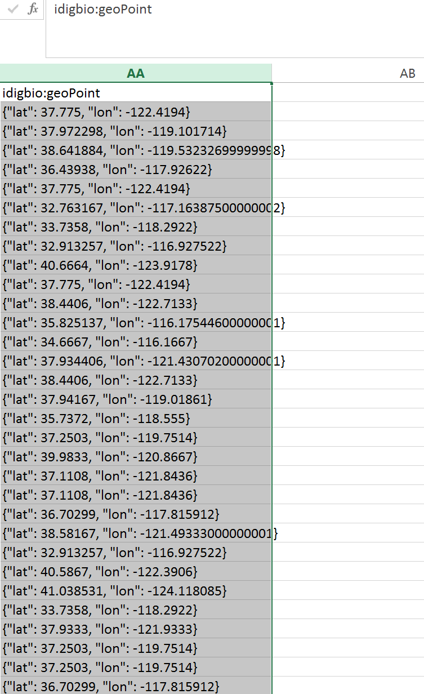
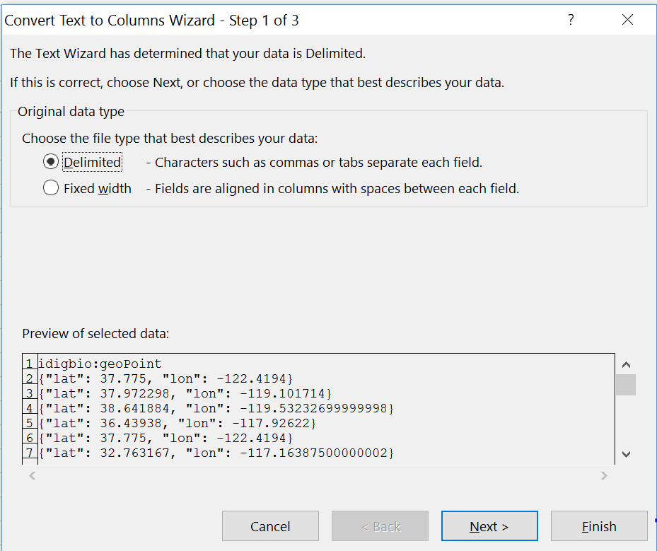
Text to Columns
Highlight geopoint column
Data tab > text to columns

Slide 37
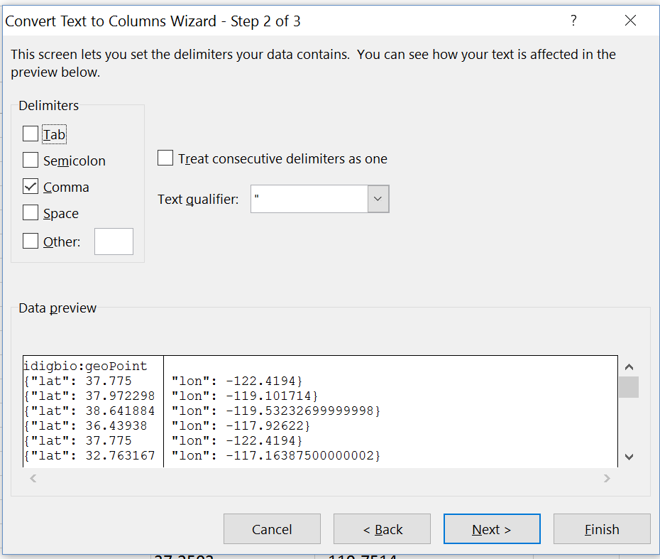

Slide 38
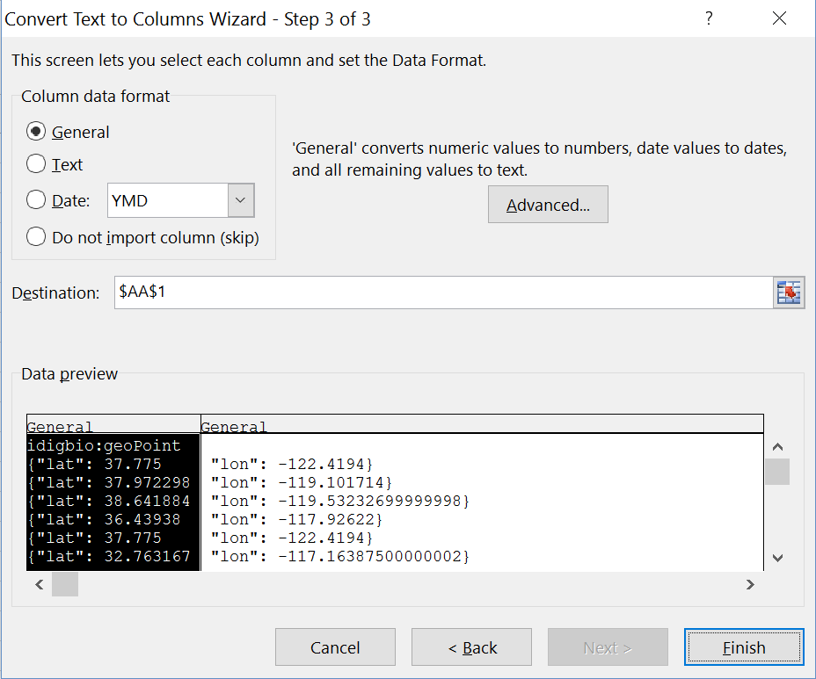

Slide 39
What other features of a spreadsheet program might you find useful when preparing, checking, enhancing data?
Functions and features
TRIM()
SUM()
PROPER()
TOLOWER()
TOUPPER()
ROUND()
VLOOKUP()
HLOOKUP()
Sort & Filter > Advanced > unique values
LEFT()
RIGHT()
Highlight duplicates
Text to columns
Copy-paste
Pivot Tables
open carefully (import from text)
CONCATENATE()

Slide 40
What are your spreadsheet tips and tricks? What else would you look at in this spreadsheet?
Lat / Lon ranges?
Notes:
Taxon and Collector names
Latitude Ranges 1 point is lat 43 degrees, 11 points questionable at -109 and -113
And others have lat < 32 so these are Mexico.

Slide 41
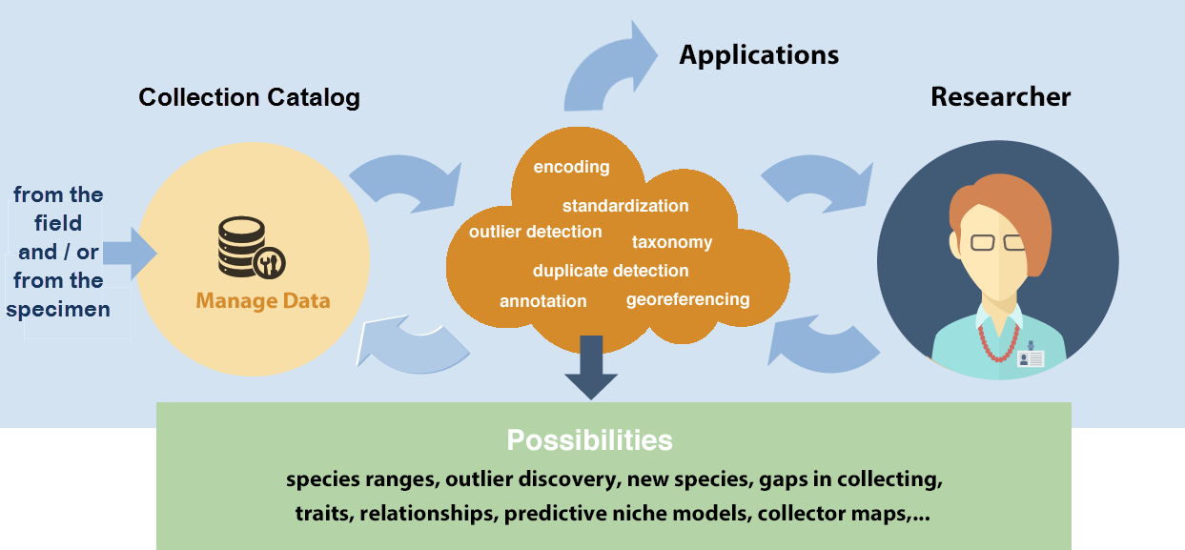
The research data pipeline | your institution & career needs
Data > Knowledge > Application
Notes:
Researcher collects data (in a museum, and / or in the field), Researcher to publication, submit data to museum to a data repository, tell museum about the paper. Collection Mgr, Data Mgr, Curator, Technical Assistant, Student, Volunteer, may provide data, or take researcher’s data for the in-house collection’s database. What skills do these people need? Where’s the overlap? Which skills are critical? Which skills are (probably) more timeless? [with the understanding of today].
Challenges for Data Collectors: using standards, software integration, annotations, data gaps, collector bias, need to learn new skills, grasp new concepts

Slide 42
What skills and knowledge are needed?
What level of skills are needed? an IT point-of-view
Conversational awareness
or mastery?
command-line manual pages
automated file naming / renaming
OpenRefine (http://openrefine.org)
large text files
concatenate files
computer directory structure
write a text file not in Word
the idea that you can parse a file
the shell commands, piping, grepping
which tool do we need to use to do an analysis
csv files (delimited) files
formulate questions for your data and have them answered by your computer
preparing data for analysis (such as formatting, trimming, masking, deduplication, mapping to a standard, etc)
awareness of data and metadata standards, ...
and how to map data to them or make them compliant
(BEACON, SESYNC, NEON, NESCent, iPlant, iDigBio)
Notes:
What biodiversity informatics skills and knowledge are needed - from IT staff across major NSF projects.
better spreadsheet skills data cleaning / standardization skills import and export of (text) data encoding (UTF-8) formatting (dates, for example) using suggested / required field formats

Slide 43
Sentiments about data from researchers and graduate students
manage data in Excel and it's terrible.
organizing GIS data and it's becoming a nightmare.
having a hard time analyzing microarray, SNP or multivariate data with Excel and Access.
I want to use public data.
I work with faculty at undergrad institutions and want to teach data practices, but I need to learn it myself first.
companies are asking for data analysis experience.
trying to reboot my lab's workflow to manage data and analysis in a more sustainable way.
re-entering data over and over again by hand; there must be a better way.
overwhelming amounts of data.
out of my depth on computation and want to increase my confidence.
(BEACON, SESYNC, NEON, NESCent, iPlant, iDigBio)
Notes:
What are some skills that researchers ask for, or tech staff realize researchers need for working with this, and all data - to support reproducible research and long-lived data?
Where / how are you acquiring these data skills?

