Slide 1
Getting Your Data Out There: Data Publishing & Data Standards with iDigBio
Molly Phillips & Joanna McCaffrey
data@idigbio.org
Notes:
Today I am going to talk through the basics of data publishing with iDigBio, and give you things to keep in mind when collecting and organizing your data to make them easily ingestible and searchable in data aggregates

Slide 2
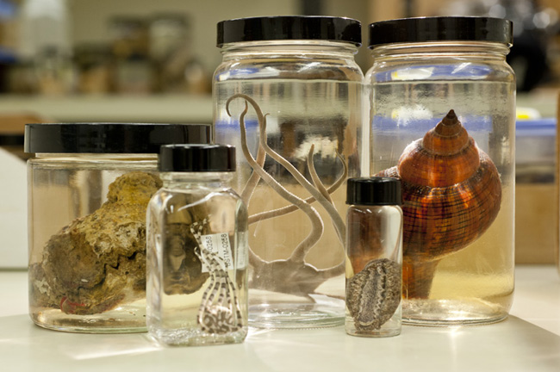
What do we mean by data publishing?
making biodiversity datasets publicly accessible & discoverable, in a standardized form, via an access point, typically a web address (a URL).
Notes:
What iDigBio means by publishing is making biodiversity datasets publicly accessible & discoverable, in a standardized form, via an access point, typically a web address (a URL).
iDigBio is looking to publish data that are already a part of a museum collection, in a museum database.

Slide 3
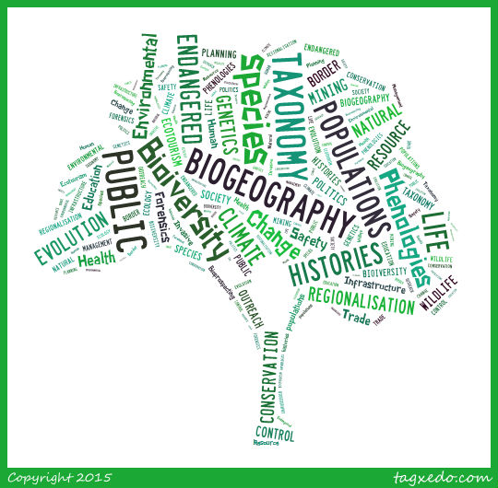
Why publish data?
Data Use
Data Quality
Uses of
Specimen Data:
Attribution
Notes:
So why publish data?
Data publishing increases access to your data.
When your data are accessible
they can be used by others for research & education,
the data’s accuracy can be assessed by the community,
& researchers or institutions can receive credit when their data are used in projects & publications.

Slide 4
Data Quality
Notes:
You have heard quite a bit about data standards and quality already but I am going to talk about them from the perspective of a data aggregate, iDigBio.

Slide 5
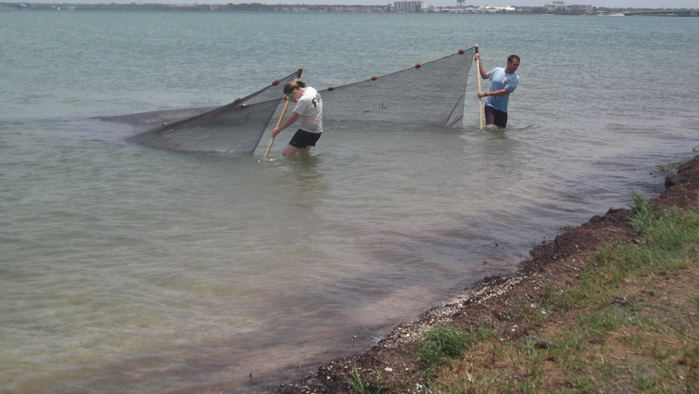
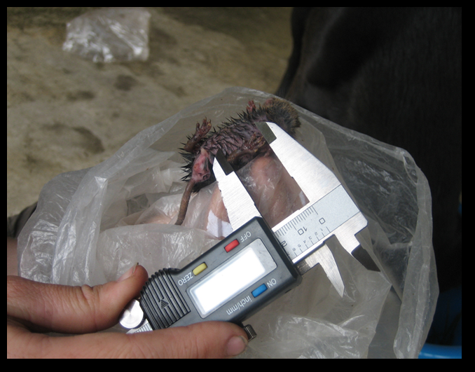
Data collection & standards
Data quality starts with what you collect & ends with what you publish
Notes:
You have been hearing about this all week but the quality of your data starts with what you collect in the field. If you collect using the data standards that are applicable for your community then you will have less work to do when you want to publish.
If we didn’t use standards your data would be unfindable and unreliable in a aggregated database.
We don't want to limit what data you collect, but where there is overlap, it is awesome and efficient if it fits without extra preparation.

Slide 6
Biodiversity data standards
Darwin Core
biodiversity informatics (specimen and observation data)
Audubon Core
multimedia related to specimens
Notes:
The two data standards that are relevant for sharing data with iDigBio are Darwin Core for specimen data and Audubon Core for multimedia associated with specimens.

Slide 7
Darwin Core
What: Darwin Core is a glossary of terms intended to facilitate the sharing of information about biological diversity.
How: The Darwin Core is based on taxa, their occurrence in nature as documented by observations, specimens, samples, and related information.
Where: http://rs.tdwg.org/dwc/terms/ provides reference definitions, examples, and commentaries.
Notes:
If you work with specimen data become familiar with Darwin Core, the biodiversity data standard (recommendation) from TDWG and supported by GBIF and many other data aggregators (like us).
If you are familiar with the terms from Darwin Core then you will collect more valuable and easily publishable data along with your specimens.
TDWG AKA Taxonomic Databases Working Group now Biodiversity Information standards

Slide 8
Data standards & Darwin Core
With data standards like Darwin Core, we have established rules for how we enter certain fields.
examples:
Date
Lat/Lon
Genus
Species
Notes:
Examples would be when collecting the following terms– in Darwin Core these are reserved vocabulary fields and must be recorded in certain manner.

Slide 9
More on data standards for Darwin Core
Dates: – dwc:eventDate is a date and nothing else.
Also for dwc:day, dwc:month, dwc:year:
this is not a month: Spring
this is not a day: 10-18
this is not a year: 1989? Or [1989]
Taxonomy are reserved fields too:
this is not a species: shrimp
Get rid of your Tics:
* [] {} ?...
Use the verbatim & remarks fields for things that do not fit the definitions.
Notes:
In Darwin Core dates belong in the field dwc:eventDate
Other information about the day of collection can be stored in the Darwin Core terms dwc:day, dwc:month, dwc:year.
But keep in mind these are reserved fields so Spring is not a month, 10-18 is not a day, and 1989? Is not a year.
Similarly with taxonomic fields: Shrimp is not a species.
Many people use personal markings in their personal datasets.
These fields are not full text search so when you include tics like ? Your data will not be found in searches
Clean your data and remove any tics from your datasets before sharing them. Or better yet get out of the habit of putting them there in the first place.
You can use the verbatim and remarks fields in DarwinCore to personalize a record with information that does not fit the definitions for any of the other fields.

Slide 10
More data tips…
Your dataset is no longer just for local use, there are other considerations for being digital, and available to the public:
Put dates in ISO 8601 format, i.e., YYYY-MM-DD, e.g., 2014-06-22
fill in dwc:scientificName with genus and species
parse out the dwc:scientificName elements to fill in dwc:genus and dwc:specificEpithet
Provide as much higher taxonomy as you feel comfortable with, fill in tribe, sub+super family, kingdom, division, class, order) get out of ‘family’ land.
Make sure lat and lon coordinates are in decimal, and not degs, mins, secs,
Do not export '0' in fields to represent no value. (This applies to all place holders)
put elevation in METERS units in the elevation field without the units (e.g., the fields dwc:minimumElevationInMeters and dwc:maximumElevationInMeters already assume the numeric values are in meters, so there is no need to include the units with the data)
Watch out for diacritics, save in UTF-8 (encoding)
Notes:
These tips come from our Biodiversity Informatics Manager, Joanna McCaffrey, who has a lot of experience cleaning datasets for ingestion.
UTF-8 is a character encoding capable of encoding all possible characters (called code points) in Unicode. The encoding is variable-length and uses 8-bit code units. It was designed for backward compatibility with ASCII and to avoid the complications of endianness and byte order marks in UTF-16 and UTF-32.

Slide 11
Data Sharing
Notes:
Now on to Four ways to publish with iDigBio

Slide 12
Data publishing: where to begin with iDigBio?
Email data@idigbio.org
There are four basic ways to share:
Least Ideal
Most Ideal
Technical skill vs. time, updatability, data buy-back etc.
Notes:
You can begin the process by reaching out to us via email.
This talk is only intended to explain some of the basic options for data publishing so you can start to envision which method would be best for your dataset.
We are interested in two basic data types:
Specimen data
Media associated with specimens
The ways to publish with iDigBio vary in the level of technical skill and time they require as well as how easy it is to send updates and buy-back any data cleaning that occurred during publishing.
Your media and specimen data can arrive together or separately.
We will start with specimen data.

Slide 13
# 1 – BEST: Send data to GBIF? Great, we’ll take that!
Darwin Core Archive (DwC-A)
on an RSS feed produced by IPT
https://code.google.com/p/gbif-providertoolkit/
Notes:
Best way to get data to iDigBio is to use IPT to help you generate the mapping of your database fields to Darwin Core, and to provide the resulting archive with an RSS feed for easy updates
GBIF will provide this using their IPT so if you already send data to GBIF the work is already done!
An IPT stands for Integrated Publishing Toolkit - a Java tool used to publish and share biodiversity datasets
RSS (Rich Site Summary); originally RDF Site Summary; often called Really Simple Syndication, uses a family of standard web feed formats^{[2]} to publish frequently updated information: blog entries, news headlines, audio, video. The reason you want your data on an RSS feed is because you would not have to tell us there are updates, everything is automatic.

Slide 14
#2- Also great: Use Symbiota
when you mark your data to publish, all the necessary parts of the package are generated.
Custom Darwin Core Archive (DwC-A) on an RSS feed produced by Symbiota
automatic media
http://symbiota.org
Notes:
Symbiota is a web-based collection management software
http://symbiota.org/
Symbiota creates a custom DWC Archive file with automatic media linking.
(You would need to decide if Symbiota will be the primary database manager you use or if it will just be the conduit you use to publish your data.
If it is the former then Symbiota can create GUIDs for your records, if it’s the latter than you need to include your own GUIDs.)

Slide 15
# 3- Adequate: Export your data as CSV/TXT file with DwC fieldnames & let us host it on our IPT
Create a custom CSV or TXT file,
with XML style field names from Darwin Core,
e.g., domain:fieldName
dwc:catalogNumber
ac:provider
Notes:
You could also make your own DWC file and we can host it on our IPT.
This method requires someone to have the time and skill to create a DwC file on their own. Using xml style field names from Darwin Core. See the example for what that would look like.
Another great option is setting up an IPT through VertNet.
They provide great support but there can be a waiting list.

Slide 16
# 4- Will work in a pinch: Throw your data over the wall
This method has its challenges:
data manipulations
UUID, higher taxa, dates, zeros…
Updates
Buy-backs
Backlog
Notes:
The last, and least preferable way: Throw data over the wall (meaning as is) and let us help.
This method has its challenges:
We might need to perform data manipulations (on dates, dec lat/lon, removing ‘0’ values)
& do data development (Add a GUID, higher taxonomy, country code, split out dates) So If you are going to be submitting updates, it is important to have a plan to ‘buy-back’ the improvements/fixes we make.
Also, Your data could end up in a backlog if we get a flood of requests that require a lot of maintenance.
This method is the greatest risk for us and the greatest trouble for the provider.
However, we don’t want to leave anyone out in the cold, we just do not think this method is very sustainable on either end.

Slide 17
Media
3 ways to get media to iDigBio:
use Audubon Core extension to IPT
via Symbiota
Media ingestion appliance
Linked to the specimen
Linked to the specimen
Can be linked to the specimen
Notes:
1. Create a file of Audubon Core metadata using the GBIF or iDigBio IPT
Please include a URL to the media and camera info (EXIF), photographer. PLUS a link to the specimen record via occurrenceID.
2. Media is linked automatically when using Symbiota to publish.
3. This method allows the provider to upload a collection of images for crowd sourcing. With the appliance, you can upload images before the records are available. To link to existing specimen records, you need to associate the uploaded images with iDigBio records in a CSV file that's sent by the appliance as part of the upload batch.

Slide 18
Metadata
Notes:
what associated information should accompany your specimen records and media when publishing with iDigBio?
Metadata is also DarwinCore, it is data about data, field names are metadata, as well as the info about the dataset - owners, etc.

Slide 19
Metadata
A set of data that describes and gives information about other data.
For us, its data that describe a biodiversity dataset.
Metadata facilitates:
Data discovery
Search & retrieval
Reuse (licensing)
Attribution
Expressions of fitness-for-use
Communication
Notes:
You have already heard about Metadata from previous presenters but I am going to give a brief introduction into what fields iDigBio requires
Metadata is important to include with your data because it facilitates:
Communication- Metadata are the standards we as a community have agreed on.

Slide 20
What metadata does iDigBio need?
Information about the provider
responsible parties (name, address, email, role)
institution name, institution code
URL to the data at your institution
descriptive paragraph of the collection
Equivalent to the eml.xml file produced by IPT
Notes:
iDigBio requires
Information about the provider including:
responsible parties (name, address, email, role)
institution name, institution code
URL to the data at your institution
descriptive paragraph of the collection
This would be equivalent to the eml.xml file produced by IPT

Slide 21
Check for existing collections:
In GRBio.org
Repositories:
http://grbio.org/find-biorepositories
Institutional collections: http://grbio.org/find-institutional-collections
In Index Herbariorum
http://sweetgum.nybg.org/ih/
Notes:
We ask that everyone publishing with us check with the Global Registry of Biorepositories (GRBio) & update if you wish. We are working with them to make sure their data on collections & repositories is up to date and we need the community’s help.
You can also check Index Herbariorum (if you are an herbarium).
It is important to keep your information up to date in your eml.xml file, as well as with GRBio and IH so remember to update everywhere if information changes.

Slide 22
Copyrights: please include rights info
Use:
CC0 for data (not copyrightable)
CC BY for media
Notes:
These are iDigBio’s recommendations for copyrights on data and media respectively.
It is really important that the community is all on the same page for copyright policy on data.
It is also easier to make all of your copyrights homogeneous across your dataset.
CC BY lets others distribute, remix, tweak, and build upon your work, even commercially, as long as they credit you for the original creation
All in all though
Also CC BY-SA- This license lets others remix, tweak, and build upon your work even for commercial purposes, as long as they credit you
CC BY-NC-SA
This license lets others remix, tweak, and build upon your work non-commercially, as long as they credit you and license their new creations under the identical terms.
CC BY-NC
This license lets others remix, tweak, and build upon your work non-commercially, and although their new works must also acknowledge you and be non-commercial, they don’t have to license their derivative works on the same terms

Slide 23
Data Ingestion
Notes:
So what happens after you share data with iDigBio?

Slide 24
Data ingestion process
Notes:
This diagram shows the steps for data ingestion from the point of view of iDigBio’s data mobilizing & ingesting team:
We start with negotiating - This is where we reach out to you, or you reach out to us and we talk. This stage hopefully ends with data exported by the provider, ready for inspection and ingestion.
Next is mobilizing - the process of evaluating data for ingestion fitness begins with a cursory inspection and ends with data passing inspection and ready for ingestion.
Then we move to ingesting – which means incorporating the providers data into our databases, indexing the data, and making it available to search for in the Portal.
evaluating - the process of evaluating occurs when we receive a dataset and evaluate it for fitness before ingestion and also occurs if their is a failure in the ingestion process.
Sometimes we address the issues in house and sometimes we send it back to the provider on a case-by-case basis.

Slide 25
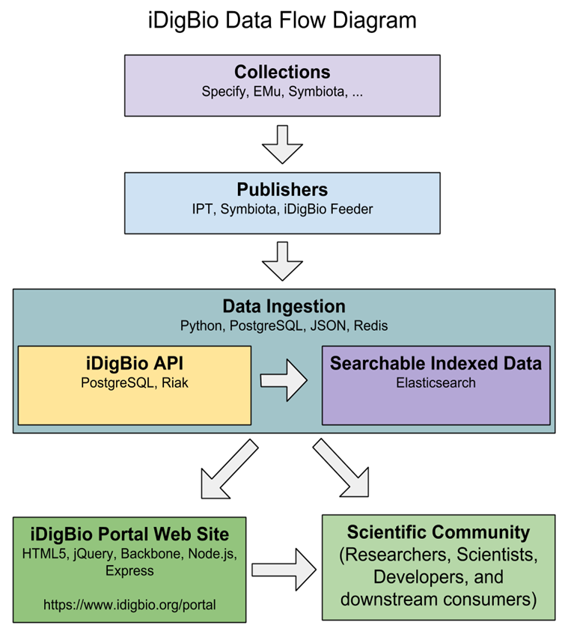
What happens when you send us your data?
Notes:
So we get data from collectors through IPT, Symbiota etc..
we store it in a database (one for specimens and one for media records)
& We index the data so they are searchable
And that is when you can then go to the portal and search for your data or use the iDigBio API to perform searches.
(the idigbio feeder works on the other end of IPT and pushes the data into the portal).

Slide 26
Architecture components
Notes:
This diagram shows the cyberinfrastructure we have to provide our records and media storage.
We call this the layer cake: The top layer is what you will be interacting with.
If you would like further information about the our architecture talk with Matt but we have a non SQL database using RIAK with Ceph Object storage.

Slide 27
Further Resources…
https://www.idigbio.org/wiki/index.php/Data_Ingestion_Guidance more information about the iDigBio data ingestion process.
https://www.idigbio.org/portal/publishers look who is already providing data to iDigBio.
http://rs.tdwg.org/dwc/terms/ for the Darwin Core glossary.
https://www.idigbio.org/wiki/index.php/Example_of_trivial_transformations_on_INHS_fish_dataset example dataset transformations for data ingestion into iDigBio.
https://www.idigbio.org/wiki/images/0/01/ImageIngestionCheatSheet_Sheet1.pdf tips on using iDigBio’s image ingestion appliance.
https://www.idigbio.org/wiki/images/0/03/GUIDgeneration.pdf how to create UUID GUID in an excel spreadsheet.
https://www.idigbio.org/wiki/images/e/e2/ToPrepareAnAudubonCore.pdf how to prepare an Audubon Core file using IPT.
https://www.idigbio.org/wiki/index.php/CYWG_iDigBio_DwC-A_Pull_Ingestion how to set up an RSS Feed.
https://code.google.com/p/gbif-providertoolkit/ more information about the GBIF IPT.
http://grbio.org/find-institutional-collections GRBio.
http://symbiota.org Symbiota.
http://vertnet.org/ VertNet.
Notes:
We will provide this presentation for you to access on the workshop’s wiki page.

Slide 28
Thank you!

