Slide 1
#field2db @idigbio
http://idigbio.adobeconnect.com/field2db
Wiki ~ it’s yours
Google Doc

Slide 2
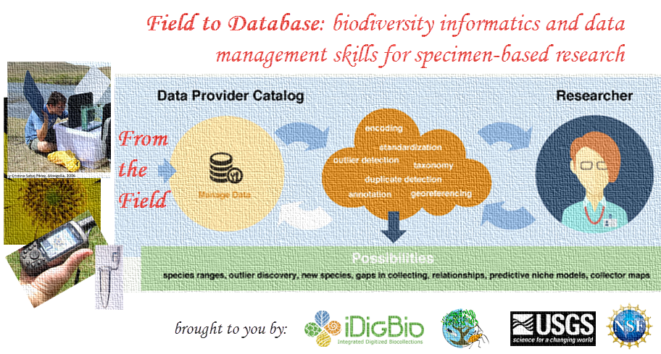
Workshop Welcome, Logistics & Introduction:
Debbie Paul, Pam Soltis, et al
iDigBio - Gainesville, Florida
March 9 – 12, 2015
Organizers: Deb Paul (iDigBio), Katja Seltmann (TTD-TCN, AMNH), François Michonneau (FLMNH - iDigBio), Derek Masaki (USGS - BISON), Pam Soltis (FLMNH - iDigBio PI), Shari Ellis (iDigBio), Kevin Love (iDigBio)

Slide 3
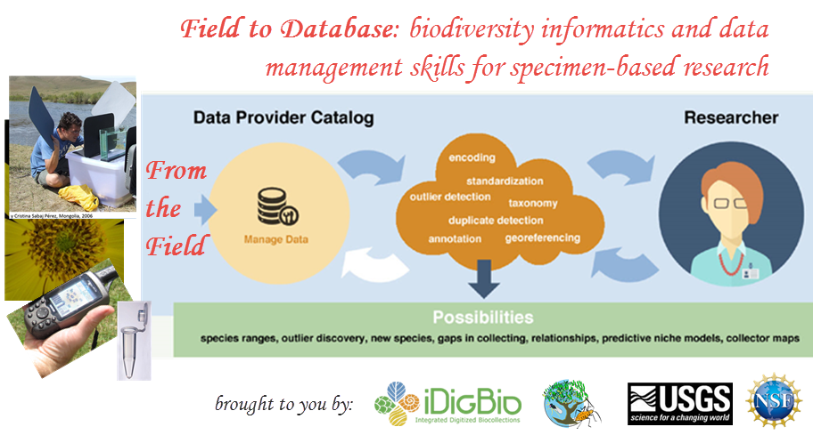
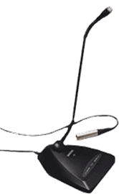
Field to Database #field2db
WELCOME!
participant list
facilities
Pascal’s
field trip transportation
group notes Google doc
our data, your data
our goals, your goals
microphones
wiki (log-in to iDigBio)
twitter #field2db
adobe connect (chat) http://idigbio.adobeconnect.com/field2db
lunch
questions?

Slide 4
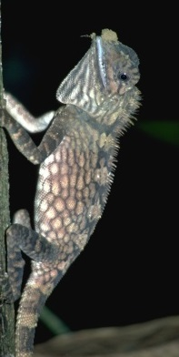
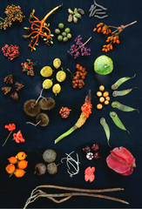
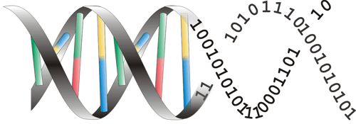
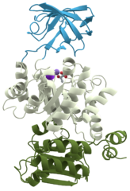
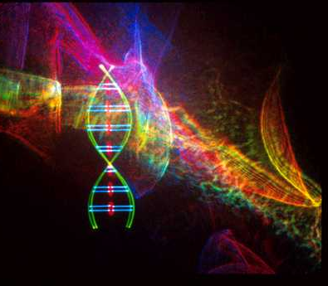
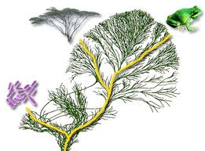
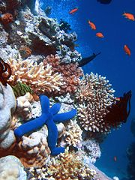
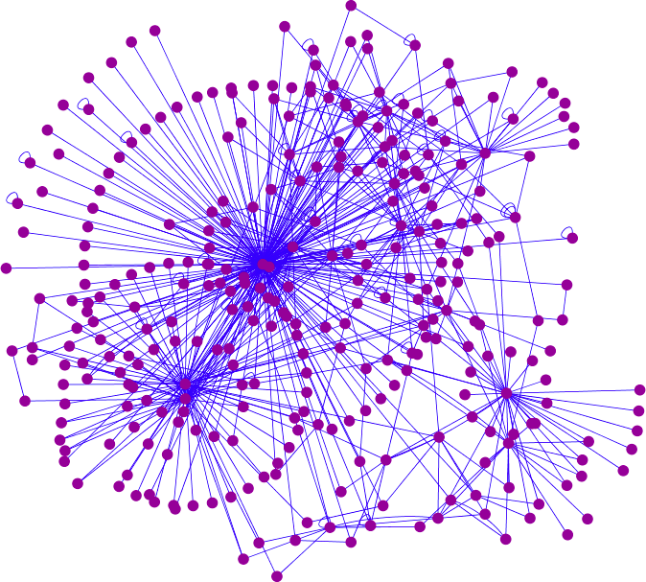
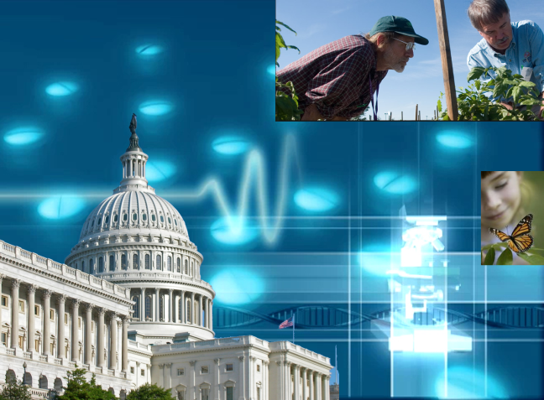
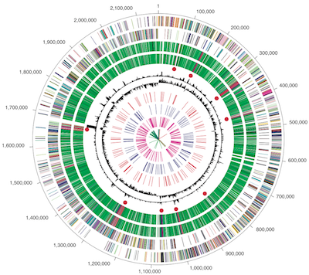
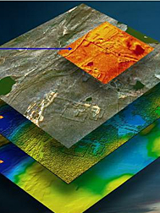
Integrative biodiversity research: It’s about the science questions
Facilitate use of biodiversity data to address environmental and economic challenges
Researchers
Educators
General public, citizen scientists
Policy-makers
Climate Change
Invasive Species
Human health
Food Security

Slide 5
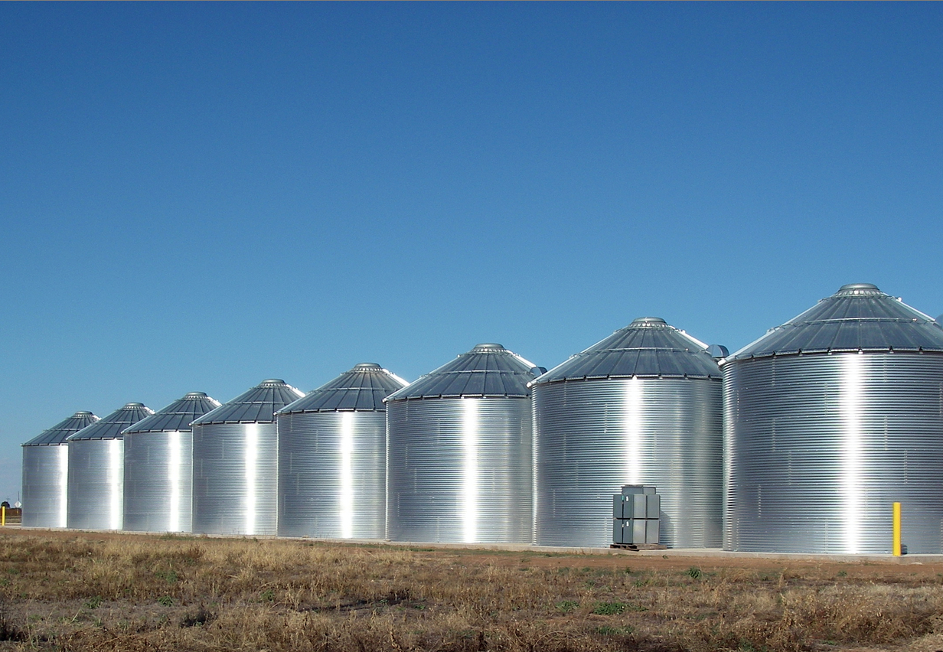

Tree of Life, phylogenomics
Organisms -> species
Taxonomic/ phylogenetic
Trophic interactions
Phenotypic expression
Genetic
Functional
Molecular -> Ecosystem
Bioactive compounds/chemistry
US National Science Foundation Dimensions of Biodiversity Program
Interaction at the intersection of taxonomic, genetic, functional domains

Slide 6

iDigBio – Integrated Digitized Biocollections
10 year effort to digitize and mobilize the scientific information associated with vouchered specimens held in U.S. research collections (Larry Page – PI)
Project Management (PM) and PM skills development (David Jennings)
Effective digitization
standards and workflows
(Greg Riccardi et al.)
Provide for cyberinfrastructure
needs (Jose Fortes et al.)
Develop research use cases and collaborations (Pam Soltis et al.)
Education and outreach (Bruce McFadden et al.)
Plan for long-term sustainability of the national digitization effort

Slide 7
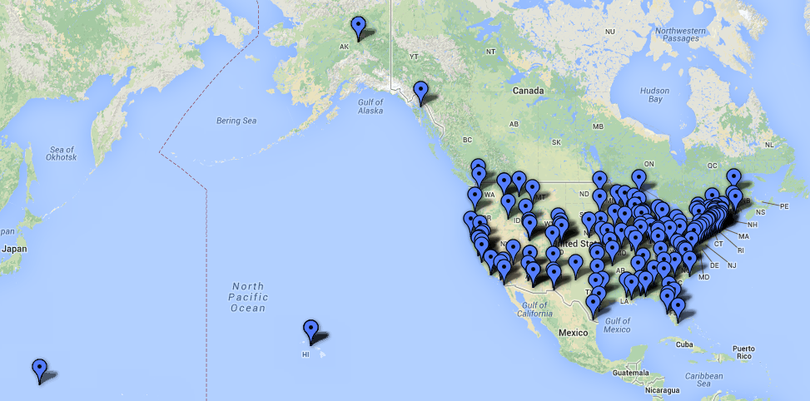
Estimated 1 billion specimens in 1,600 collections in the US
over 205 institutions

Slide 8
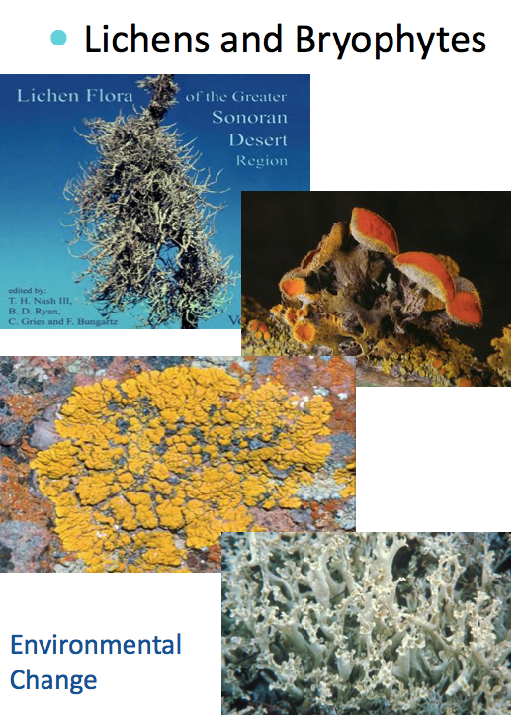
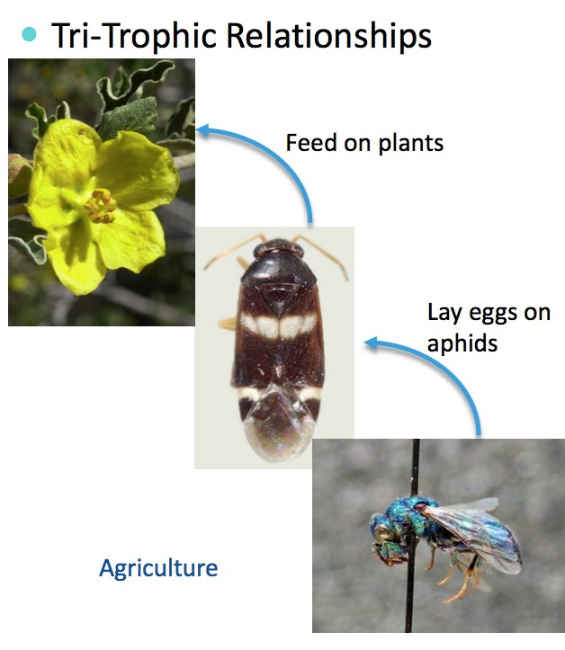
Thematic Collections Networks (2 of 13+)…

Slide 9
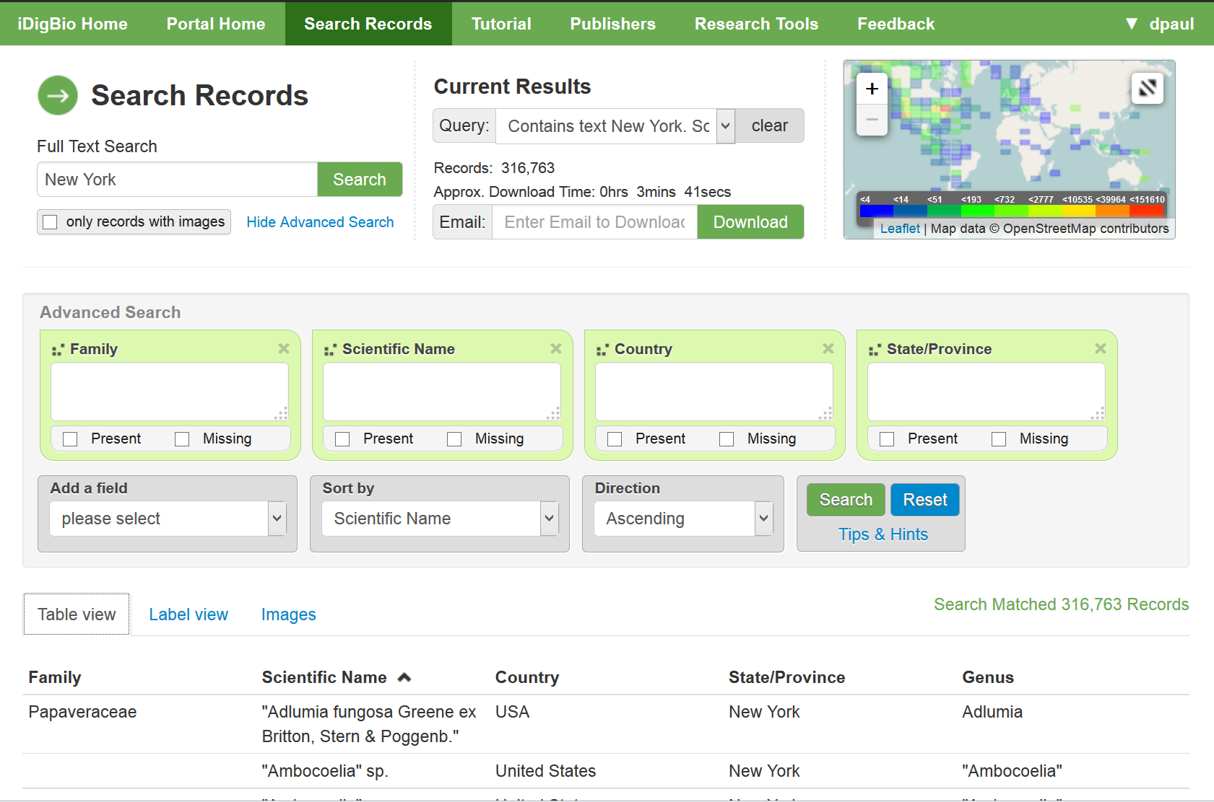

Slide 10
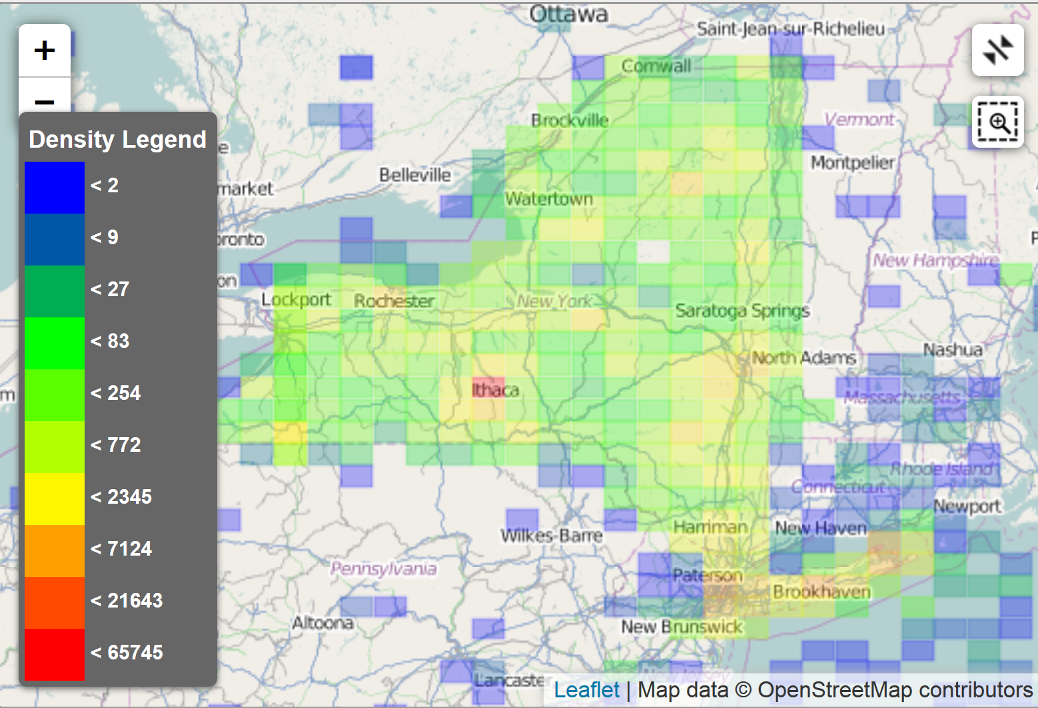

Slide 11
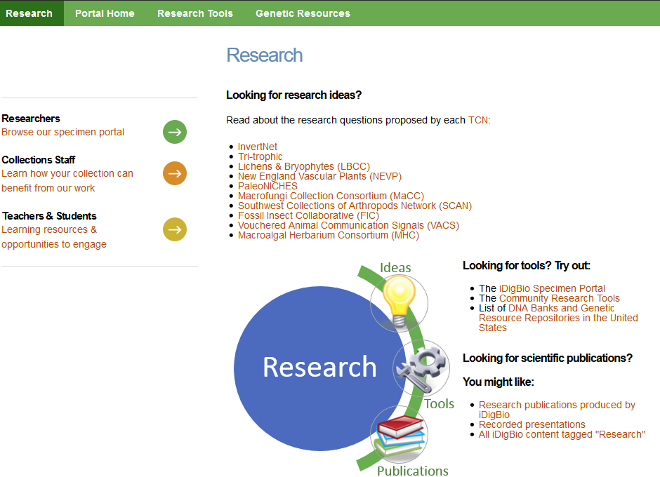

Slide 12
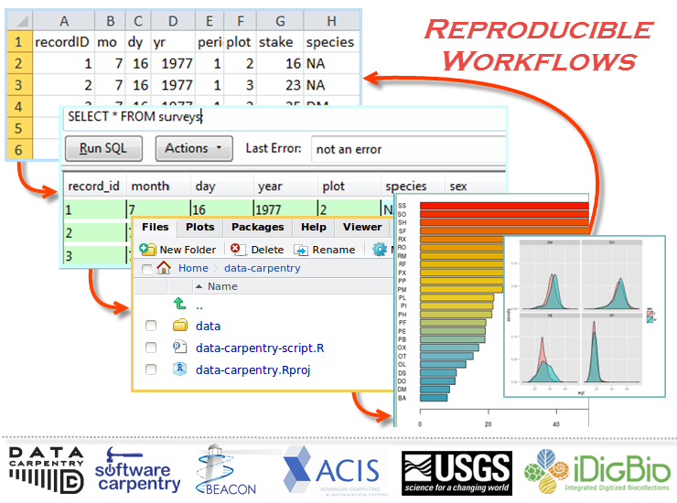

Slide 13
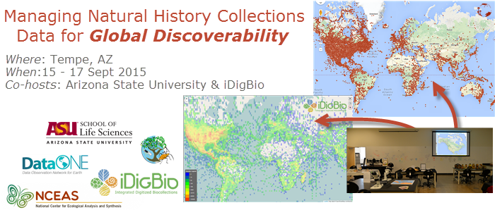
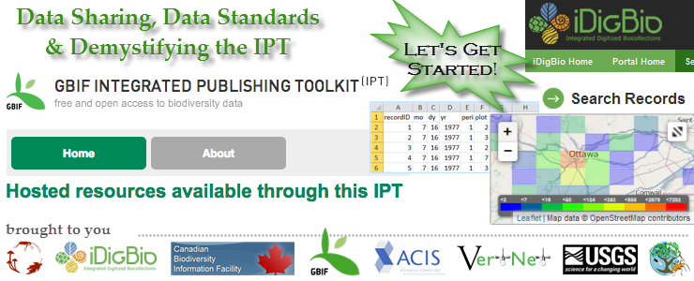
Biodiversity Informatics Workshop Series 1-4
Welcome to F2DB and Logistics
Biodiversity Informatics Workshop Series 1-4
Notes:
This F2DB workshop is the third in a series of four workshops, conceived by iDigBio and the Tri-Trophic TCN, and collaboratively developed by iDigBio, TTD-TCN, USGS-BISON, GBIF, VertNet, Canadensys, NCEAS, ASU, Data Carpentry, Software Carpentry, ACIS, and DataONE. From a data-life-cycle point-of-view, at this workshop we are focused on the origination of specimen data, the collecting event, and the standardization of that collected field data to make sure the data are suitable for upload into any database.
Across domains, there is the realization that we have a biodiversity informatics skills and knowledge gap. These workshops are just four, of many different groups who are addressing these needs. Until these gaps are addressed effectively at the undergraduate level, we’ll continue to need these types of workshops, webinars, and online courses. If you have an interest in the recently funded RCN UBE group called QUBES, Matt Collins was at their first meeting, and Deb was at their community input meeting, prior to QUBES funding.

Slide 14
Our 4-Day Course Scenario – see the wiki
Why are we here?
Our invited collectors
Their scientific workflows
In-the-field, apps
And back again
What did we learn?
Reproducible Research
Using R with your data, clean it, use it, share it
APIs
Extending the long tail of data

Slide 15
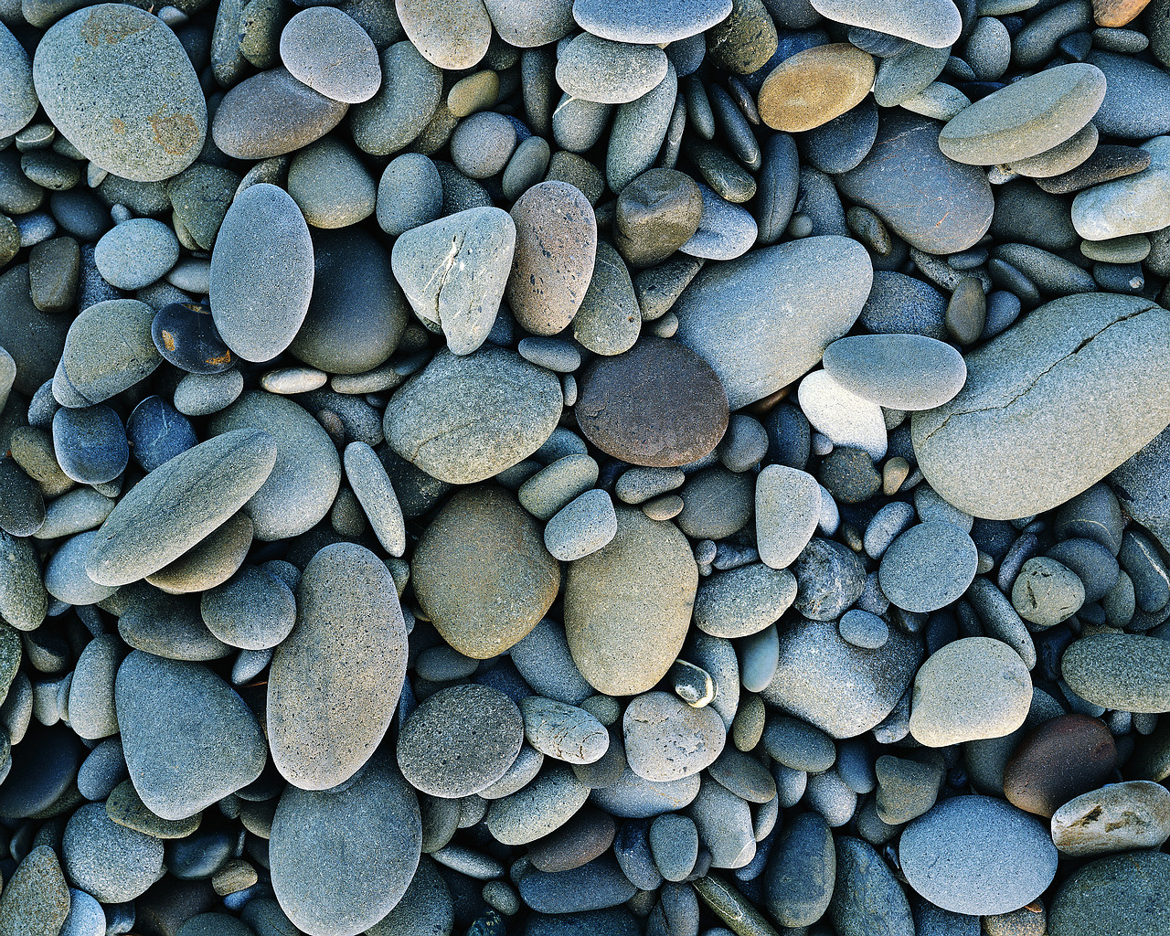
Data and Metadata. It’s about discovery and data re/use. It’s about feedback and accountability. It’s about credit and attribution. It’s about curation not ownership). Make sure your data’s not under a rock.
data
data
data

Slide 16
Our workshop goals
Enhance your skills / knowledge for getting a dataset into a standard format and improving and extending that data
Enhance your Darwin Core and Data Sharing Standards knowledge
You become ambassadors for data standards and data standards development
Enhance your knowledge about where data goes and how it gets there once it leaves your collection
Inform collectors about best practices for data / metadata and publishing datasets
Understand what it means to extend the long tail of data.

