Slide 1
Linking Heterogeneous Data in Biodiversity Studies: from field to database and the need for data carpentry
Pamela S. Soltis
Florida Museum of Natural History
University of Florida

Slide 2
Synthetic Research and Complex Data Analysis
Large data sets
Heterogeneous data
Multiple software packages
Multi-step analytical workflows
Where do we get the training to do this?

Slide 3
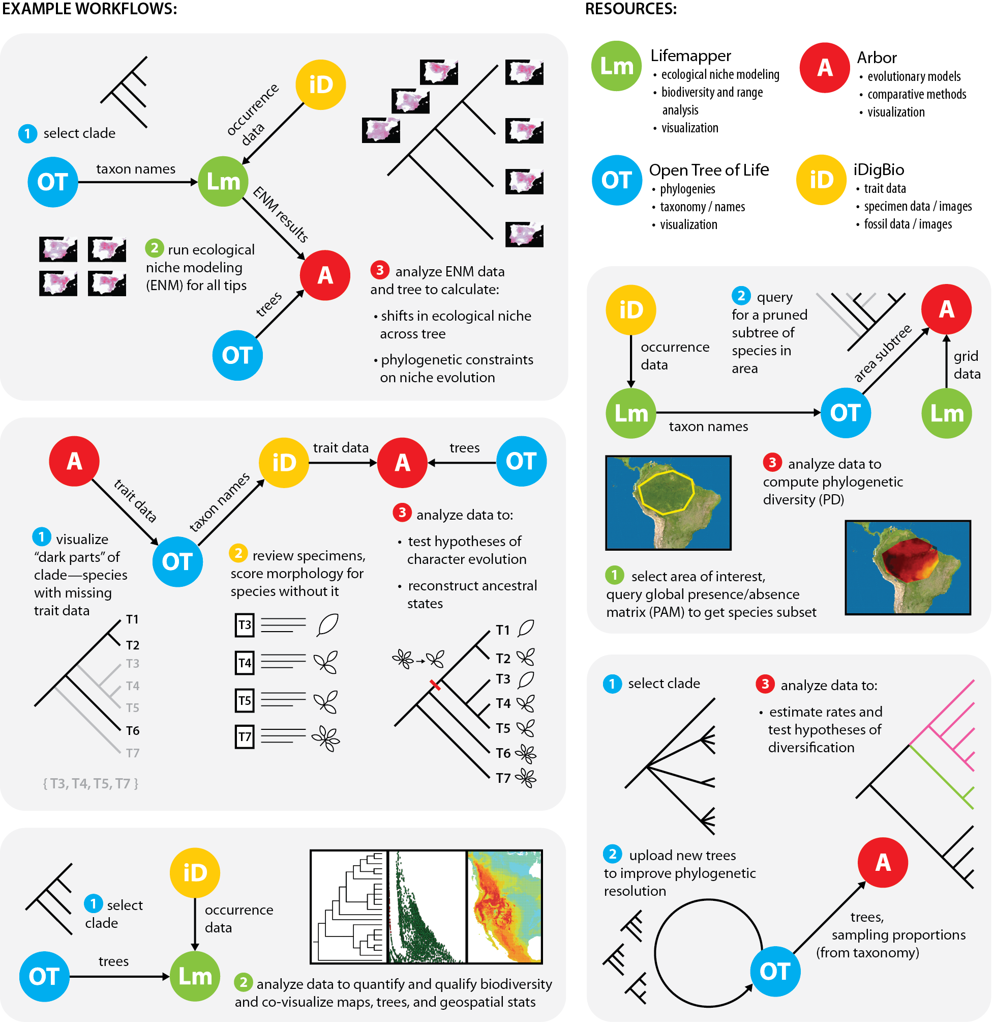
Connecting Trees, Specimens, Tools

Slide 4
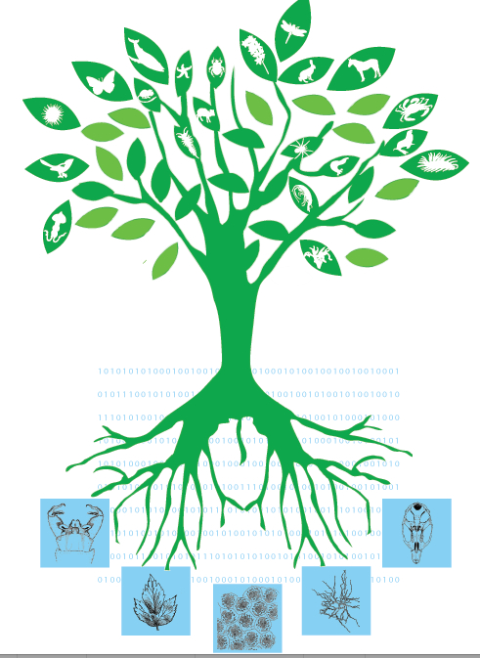
Connecting Trees, Specimens, Tools

Slide 5
Connecting Trees, Specimens, Tools

Slide 6
Connecting Trees, Specimens, Tools

Slide 7
Unpacking… Phylogenetic Trees
((cow:12, gnu:10)bigThings:3, (ant:23, bat:19)smallThings:5))

Slide 8
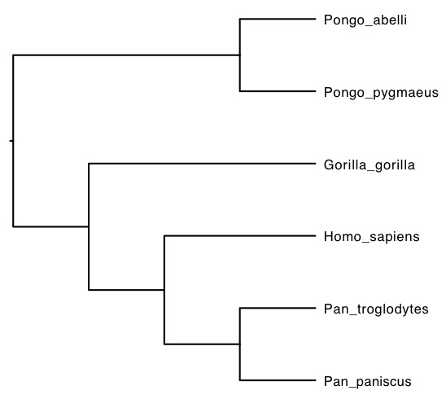
Using DNA Sequences to Build Trees
Unpacking… DNA Sequences
nothinginbiology.org

Slide 9
Connecting Trees, Specimens, Tools

Slide 10
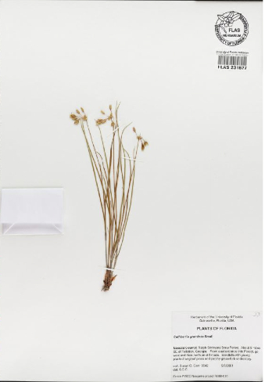
Unpacking…Ecological Niche Modeling: locations
Callisia graminea
grassleaf roseling
29.65, -82.32
number,dwc:preparations,dwc:identificationVerificationStatus,idigbio:subfamily,idigbio:preparationCount,fcc:pickedBy,dwc:eventRemarks,dwc:VerbatimEventDate,dwc:associatedReferences,idigbio:endangeredStatus,dwc:locationAccordingTo,dwc:georeferenceSources,dwc:associatedSequences,dwc:formation,dwc:higherClassification,dwc:catalogNumber,dwc:verbatimSRS,dwc:higherGeography,dwc:individualCount,dwc:decimalLongitude,dwc:datasetName,dwc:month,dwc:georeferencedBy,dwc:eventTime,dwc:identificationQualifier,idigbio:

Slide 11
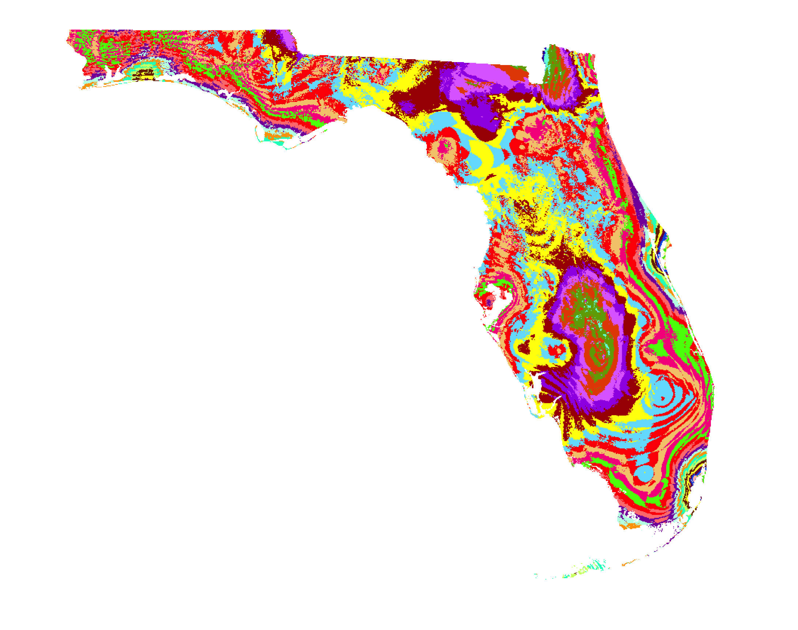
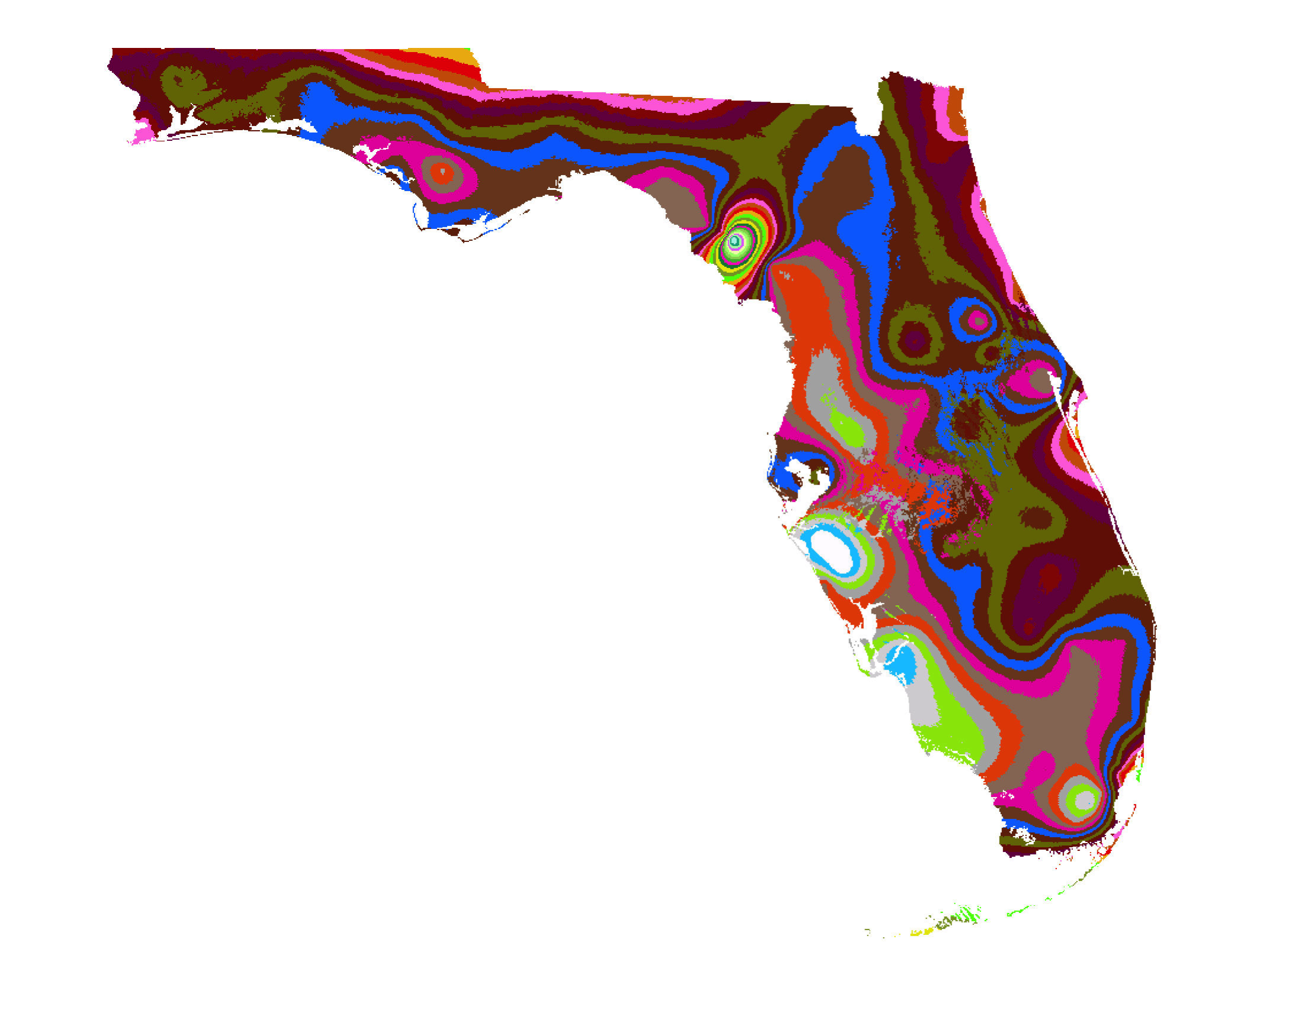
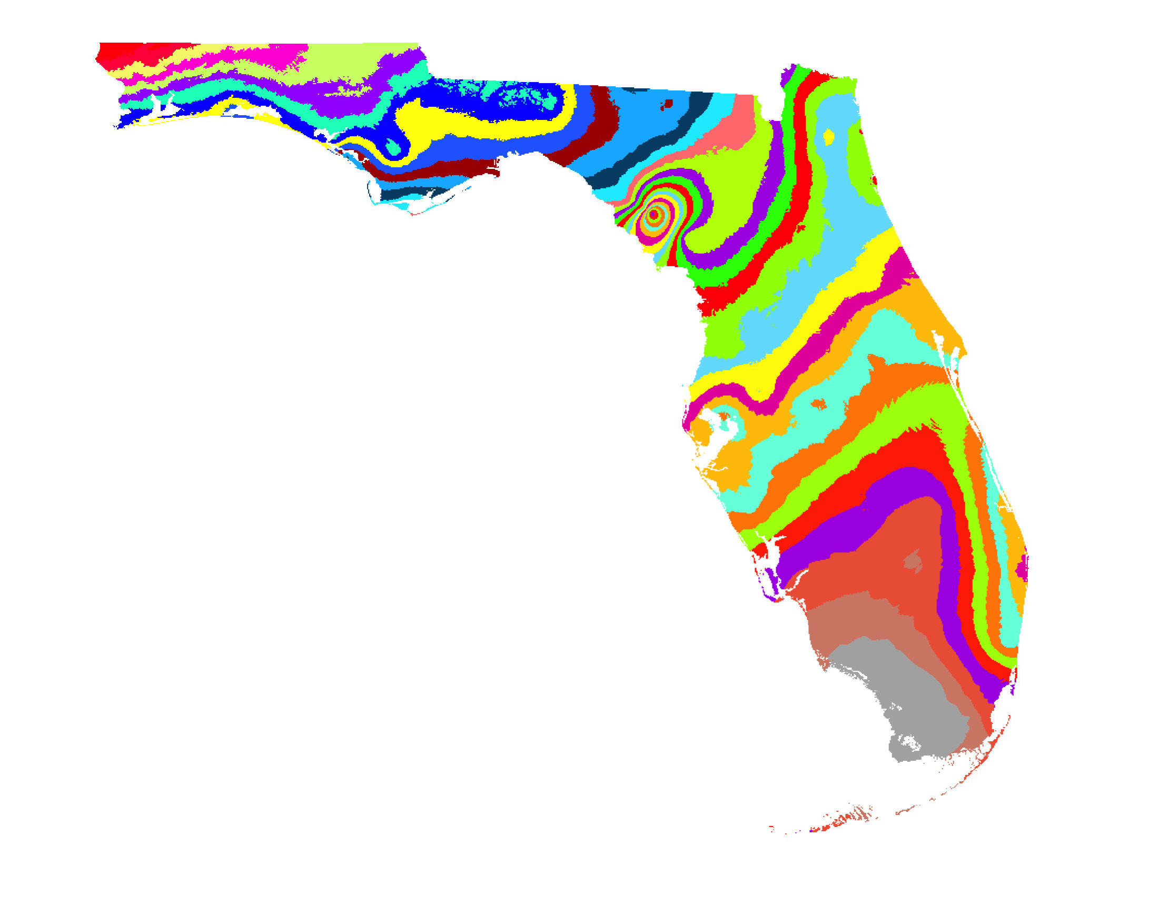
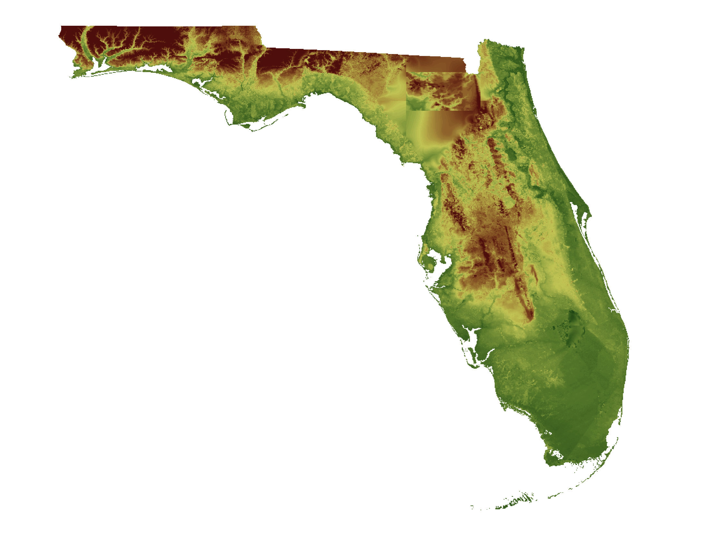
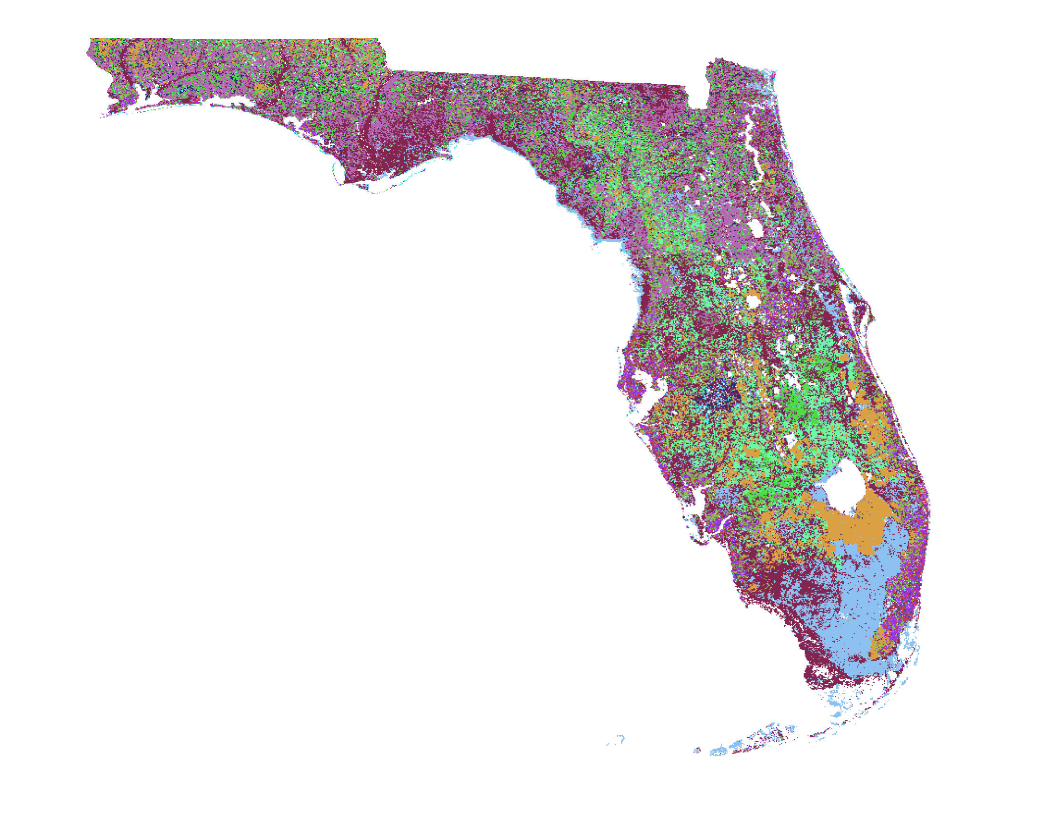
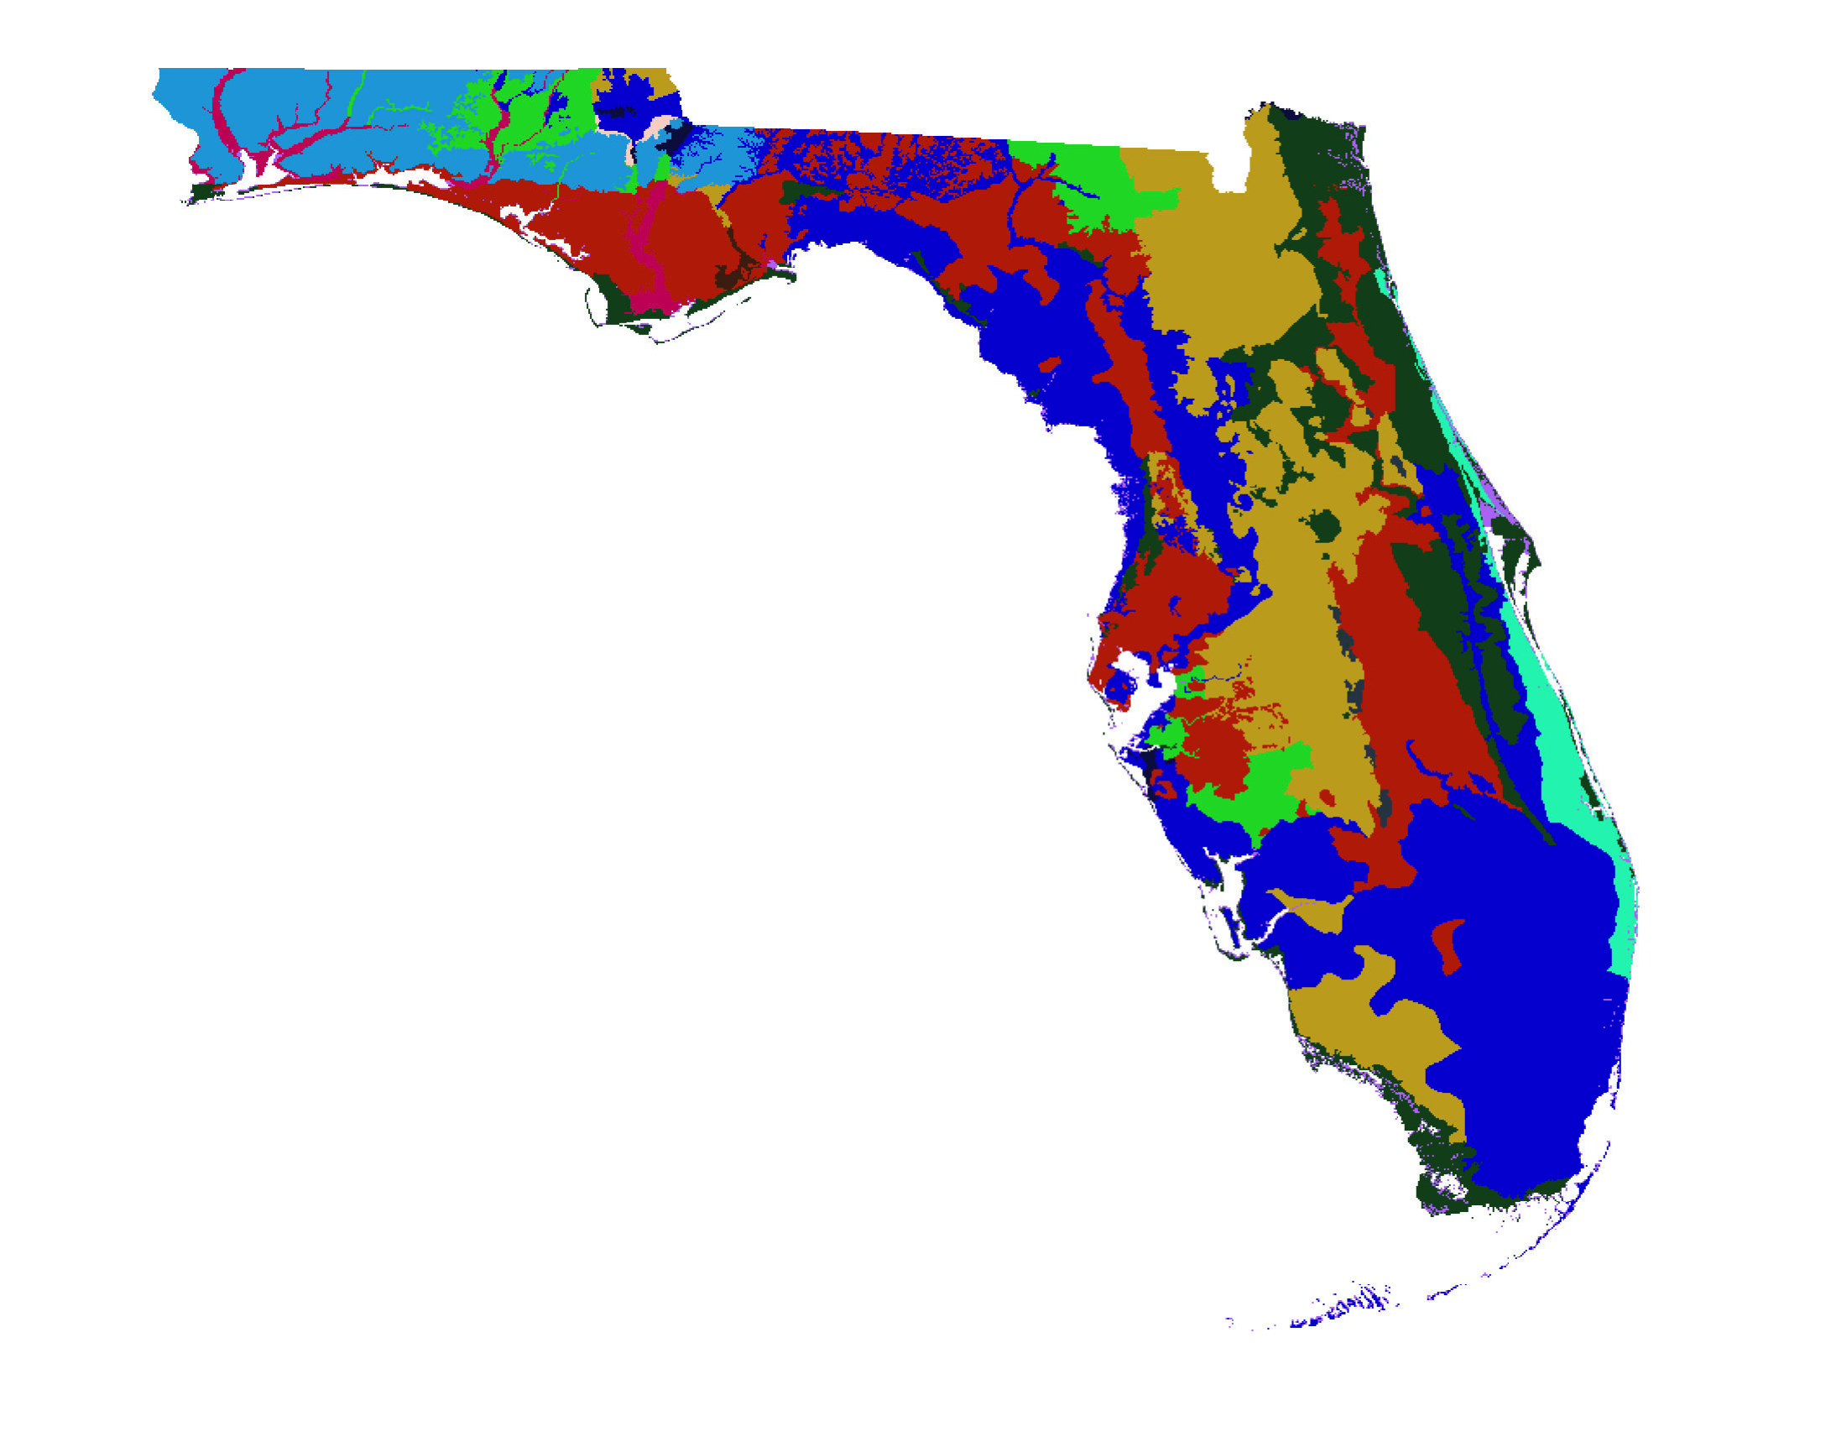
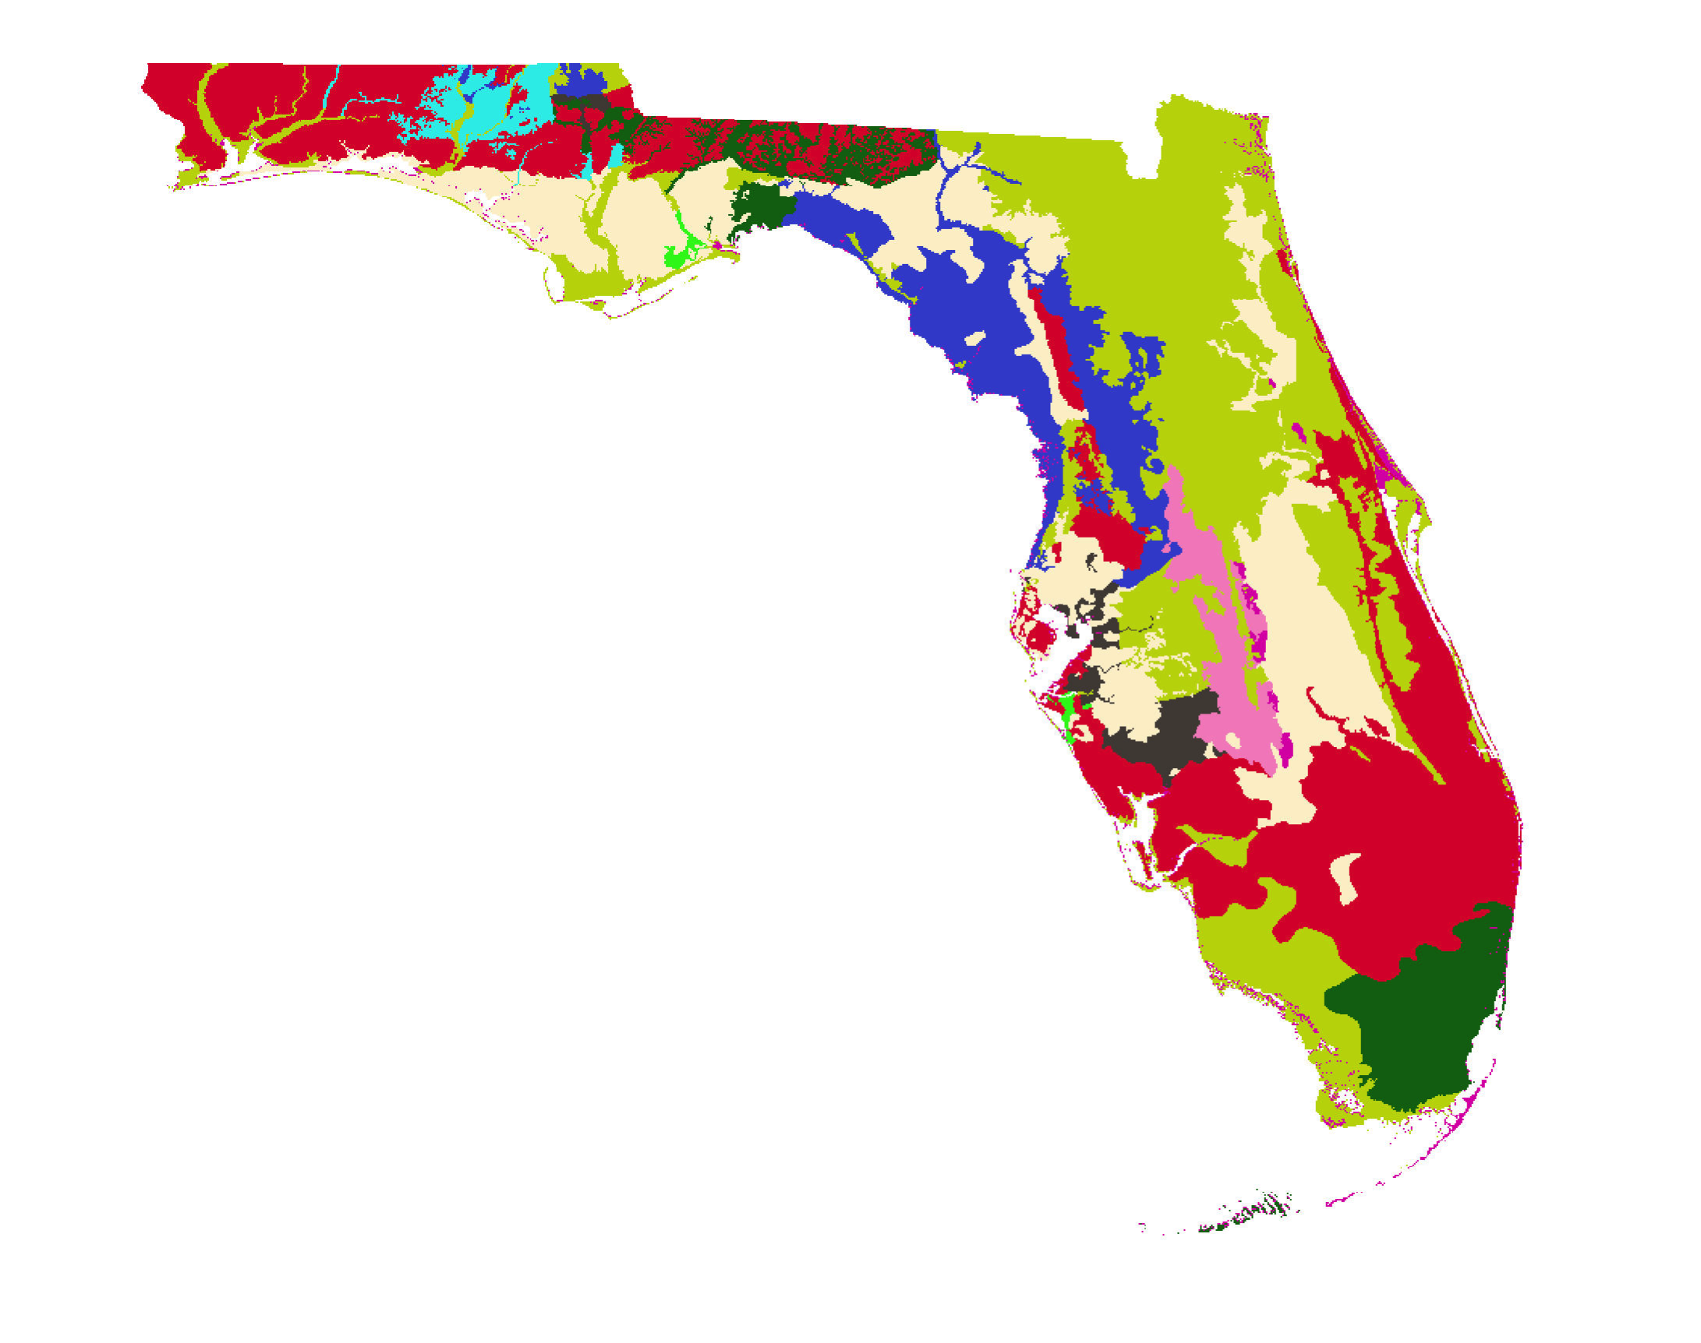
Unpacking…Ecological Niche Modeling:
Environmental Layers
Bioclim 1
Bioclim 2
Bioclim 3
Land Cover
Altitude
Rock Type 1
Rock Type 2
C. Germain-Aubrey et al.

Slide 12
Connecting Trees, Specimens, Tools

Slide 13
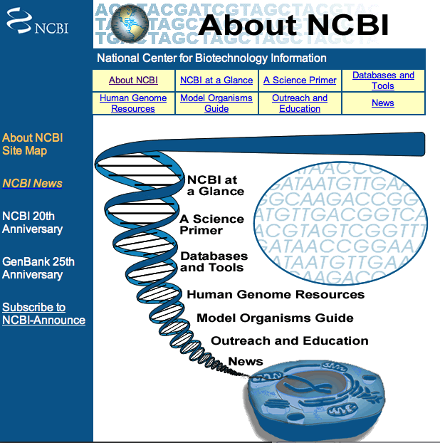
Data Sources
GenBank
TreeBASE
Dryad
iDigBio
Herbarium consortia
Worldclim

Slide 14
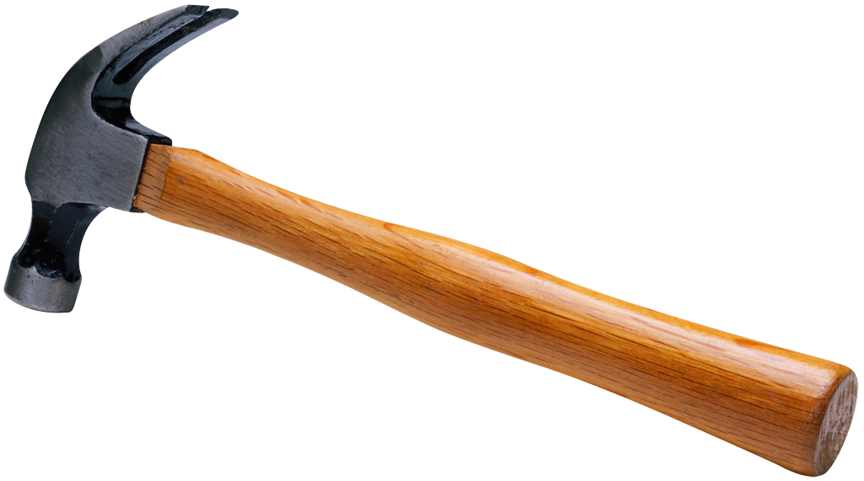
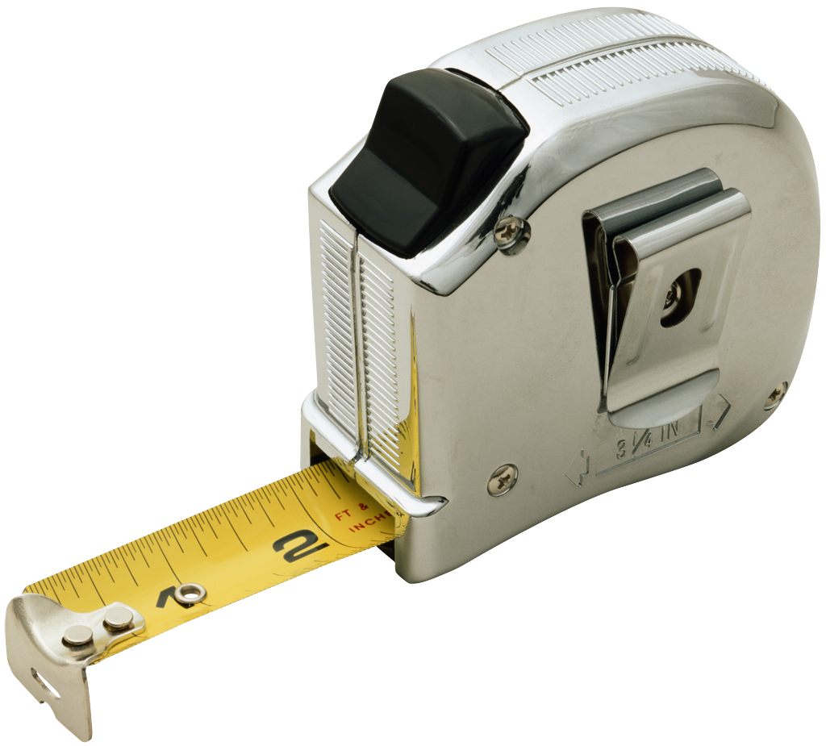
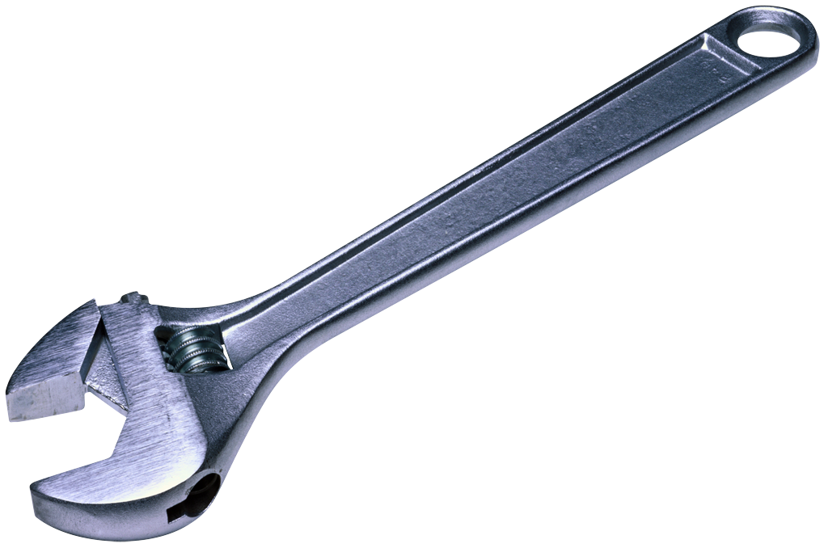
Data Carpentry: skills…
Necessary for synthetic research
Important for employment
Facilitate data sharing, reproducibility
Prevent/reduce errors
Prevent loss of data, wasted effort & funds

Slide 15
Data Carpentry: skills…
Necessary for synthetic research
Important for employment
Facilitate data sharing, reproducibility
Prevent/reduce errors
Prevent loss of data, wasted effort & funds
Starting with Data Collection:
Use/re-use
Standards
Management

Slide 16
Love your data, and help others love your data, too
Share your data online, with a permanent identifier
Conduct science with a particular level of reuse in mind
Publish workflow as context
Link your data to your publications as often as possible
Publish your code (even the small bits)
State how you want to get credit
Foster and use data repositories
Reward colleagues who share their data properly
Be a booster for data science

Slide 17
Thanks and good luck!
psoltis@flmnh.ufl.edu

