Slide 1
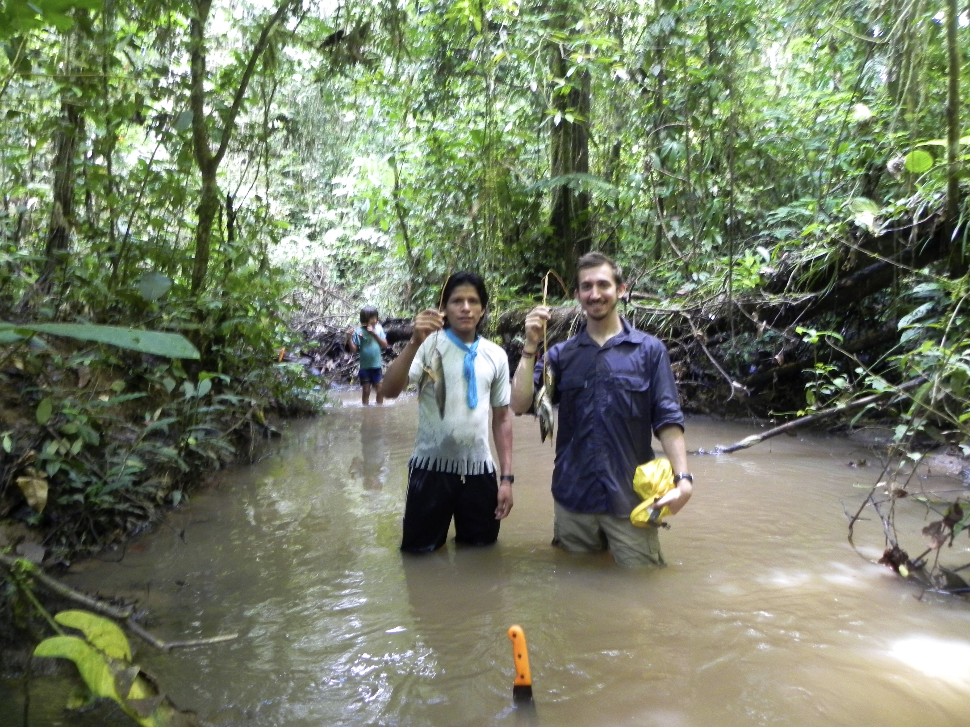


why a field to db workshop?

Slide 2
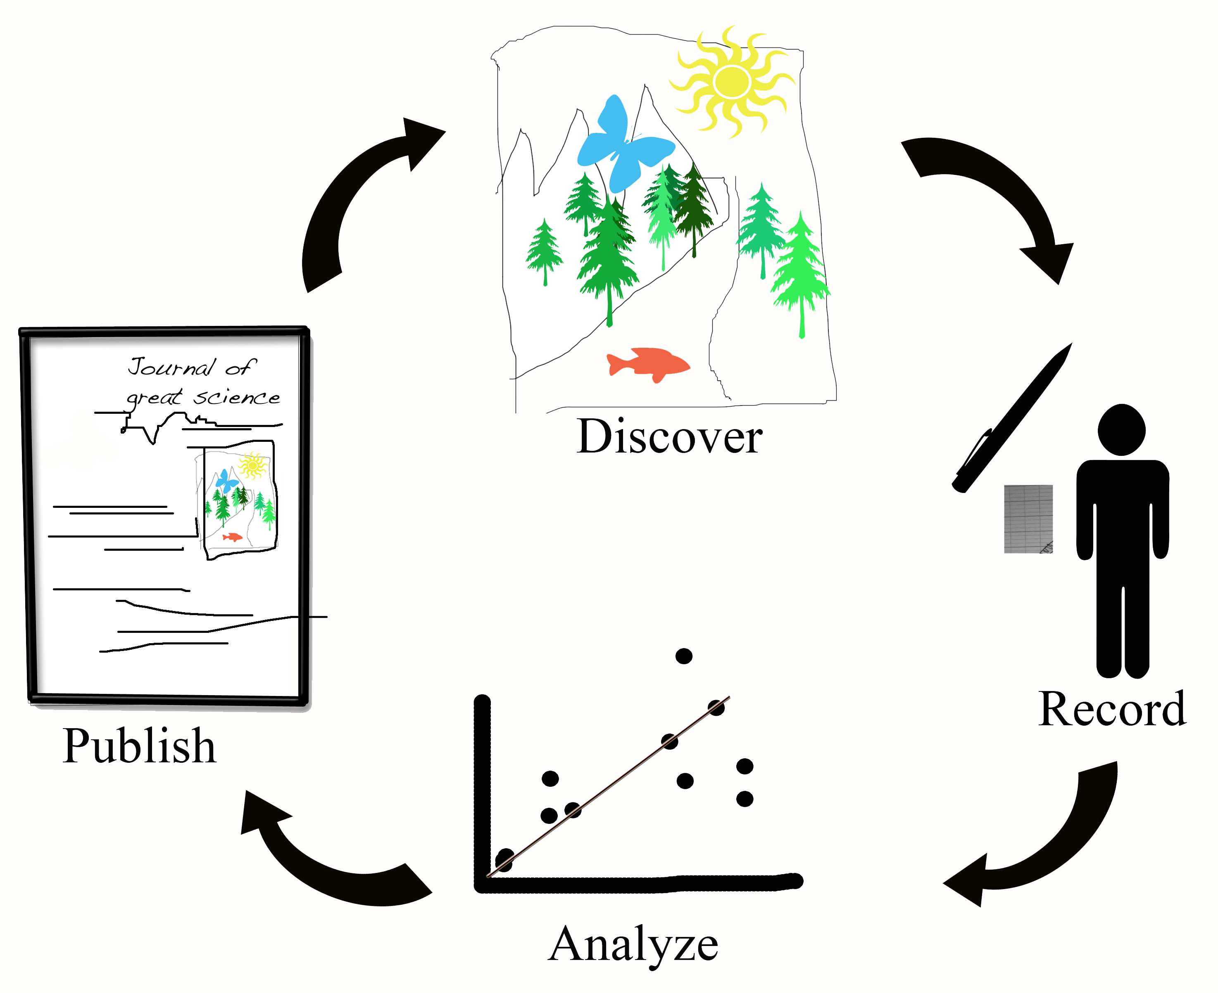
lifecycle of field biology data

Slide 3
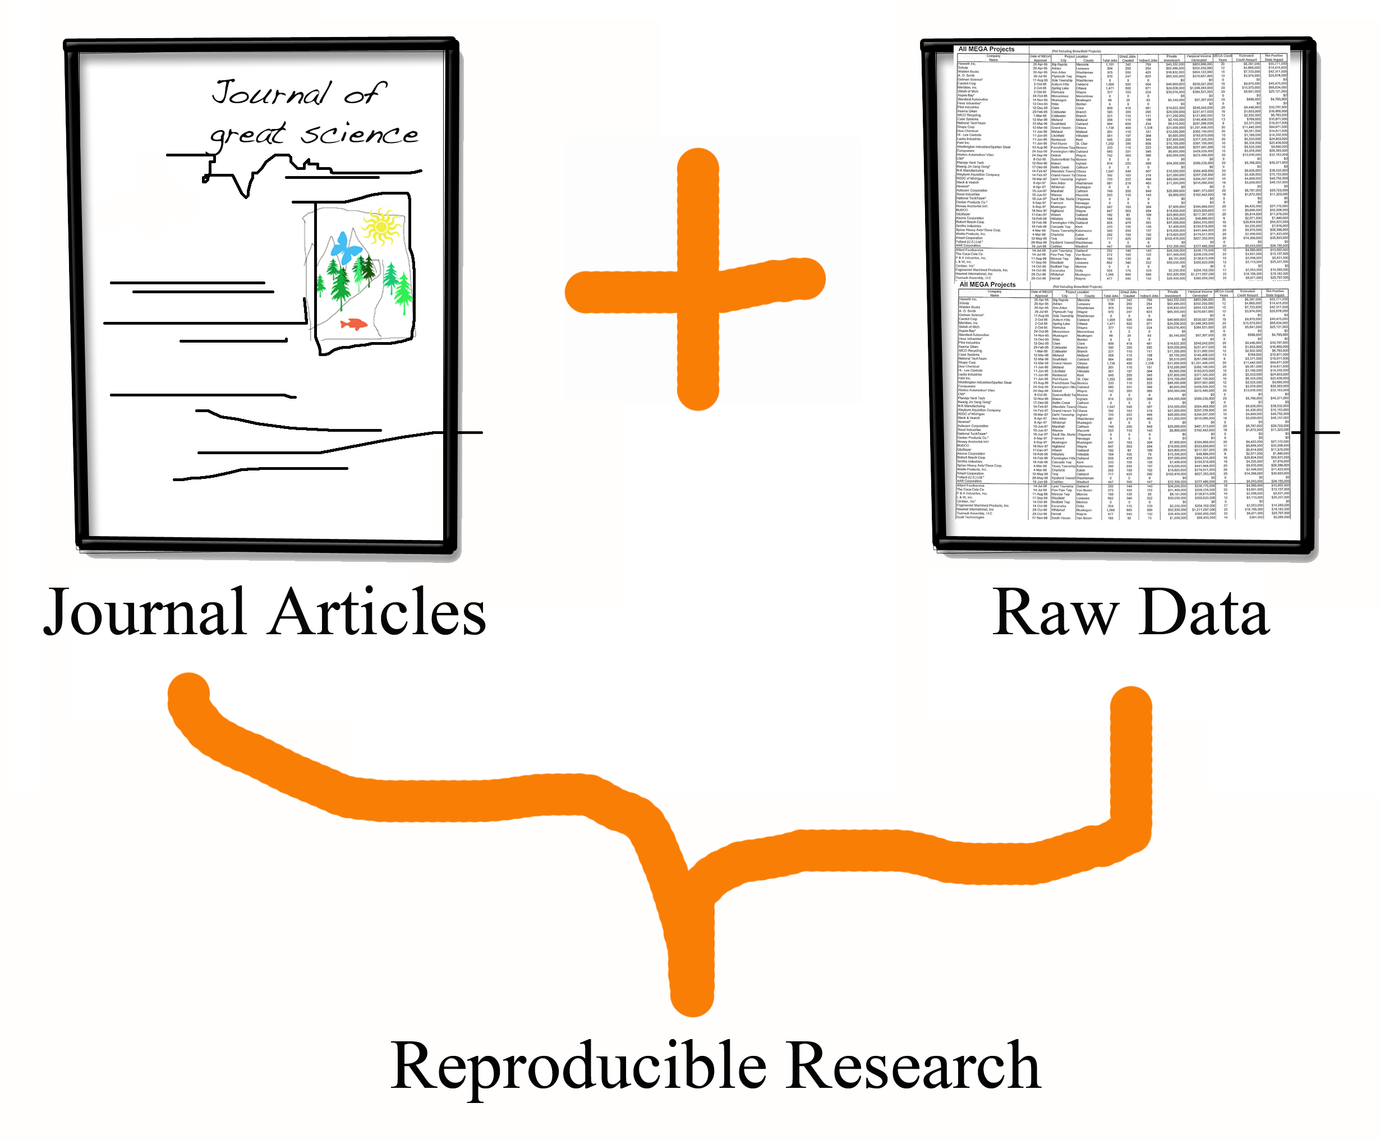
publishing today

Slide 4


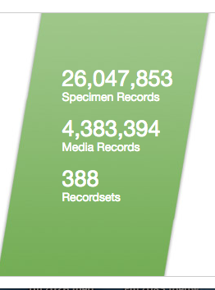


What do we do with all of the data?
Charlotte Germain-Aubrey – cgermain@ufl.edu March 9, 2015

Slide 5
Using big data for big questions
Distribution of biodiversity over landscape?
Distribution of characteristics over landscape?
  (trees, herbs, endemics, xeric-adapted, etc…)
How will climate change impact this distribution?
Will the impact be the same for all species/communities?
Has it started already?
….. etc, etc…..
Combine with other sources of big data

Slide 6
Ecological data (physiology, morphology, etc…)
- Potential adaptation to climate change
- Future changes
- Ecological drivers of change
Evolutionary ecology
Layers
(BioClim, USGS…)
Niche modeling
- Phylogenetic distribution
- Phylogenetic uniqueness
- Evolutionary signal to response to climate change
- Regional phylogeny
- Phylogenetic communities
Georeferenced
collections
Phylogenetics
GenBank
BIOINFORMATICS PIPELINES

Slide 7

Research applications of museum data:
The past, present and future of Florida plants
Julie Allen, Charlotte Germain-Aubrey, Douglas Soltis, Robert Guralnick, Jose Miguel Ponciano, Lucas Majure, Kurt Neubig, Pamela Soltis
Notes:
You might have heard about iDigBio. It is a 10 year project, funded by NSF, to facilitate the digitization of biological data from all collections in the US. There are an estimated 1 billion collections in 1,600 collections. This is a huge enterprise.

Slide 8
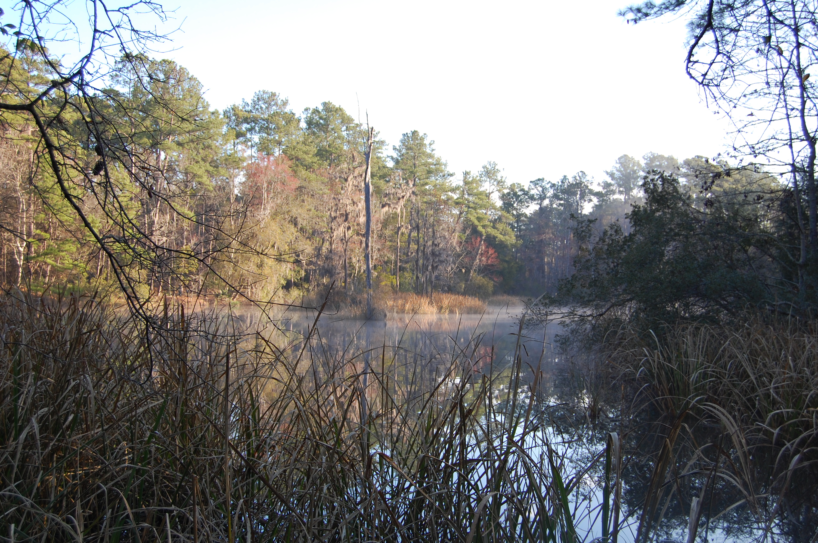
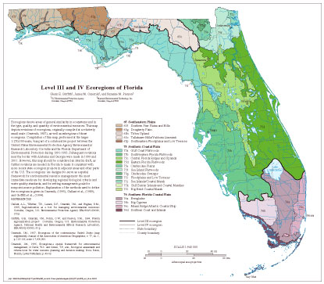
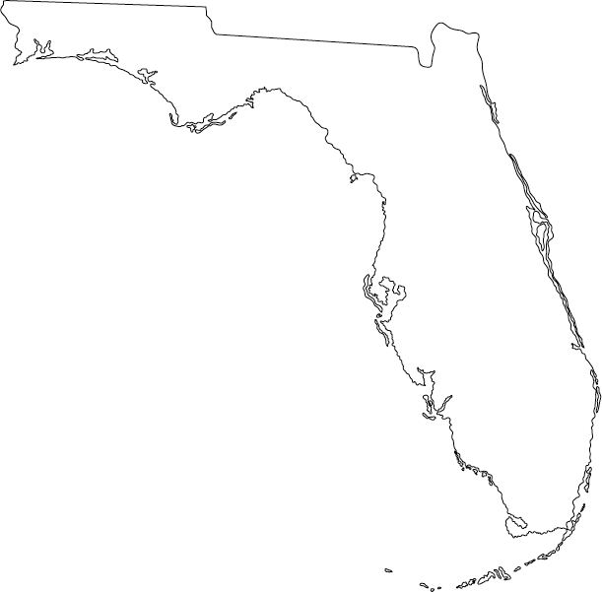
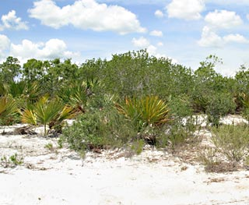
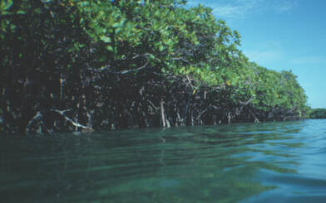
Florida
Notes:
Overlap of temperate and sub-tropical climates
Administrative maps easier to gather data and for conservation applications
Let the data determine what is an ecosystem rather than our preconcieved idea

Slide 9
Road Map
Collect museum data
Ecological niche models for each species
  understand diversity of Florida
    Past, Present, Future
Phylogenetic Tree of these same species
  explore the phylogenetic diversity of Florida

Slide 10
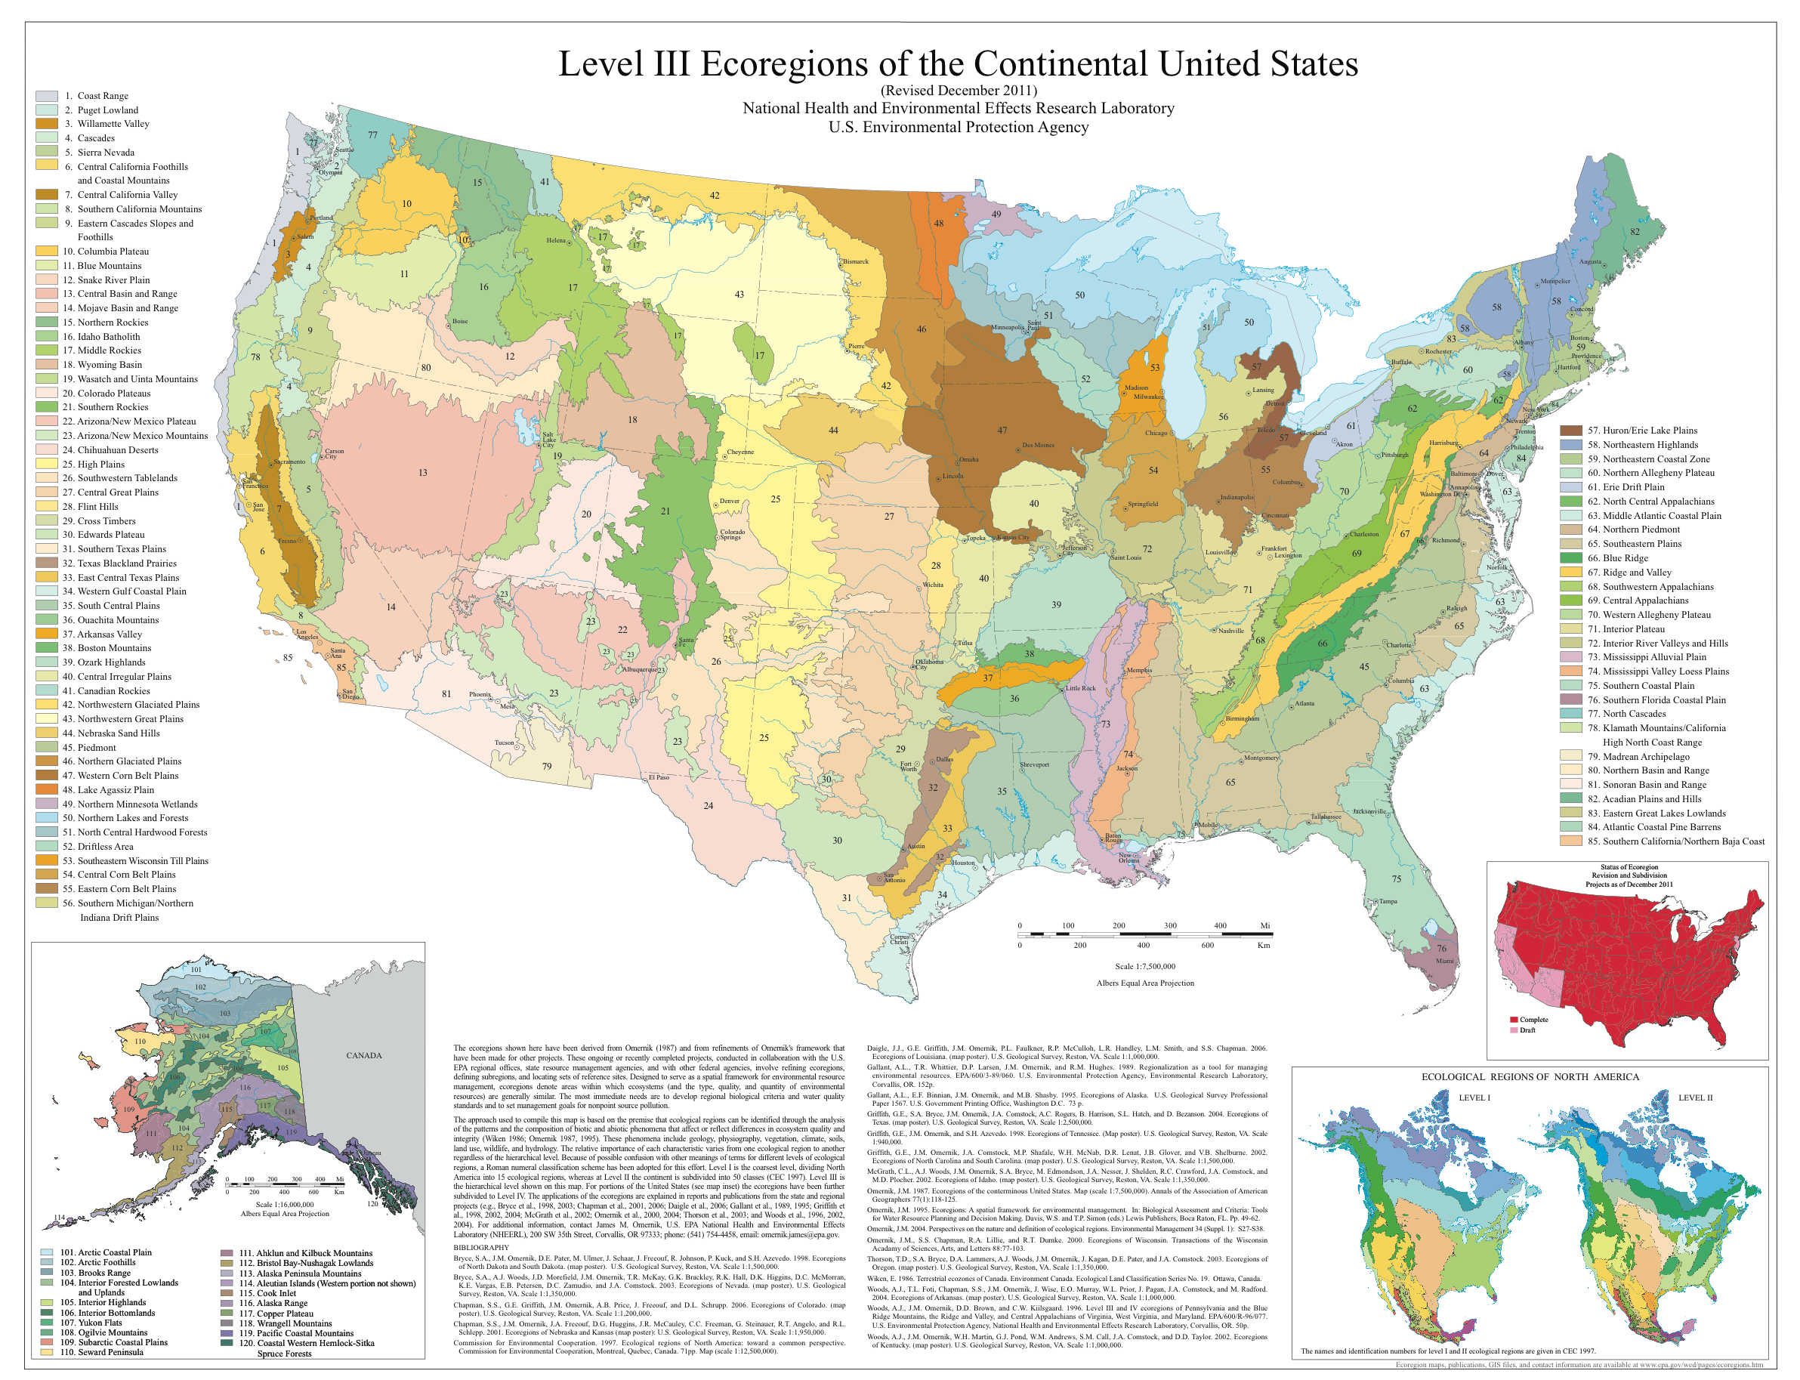
Notes:
Problem plants do not adhere to our state boundaries and tend to be more associated with ecoregions.

Slide 11
Data collecting
Florida Plant Atlas
Florida Native Area Inventory
Global Information Facility
Florida State University Herbarium
Louisana State University Herbarium
University of North Carolina Herbarium
Alabama Plant Atlas
Mississippi State University Herbarium
Florida Museum of Natural History Herbarium
    >500,000 georeferenced points

Slide 12
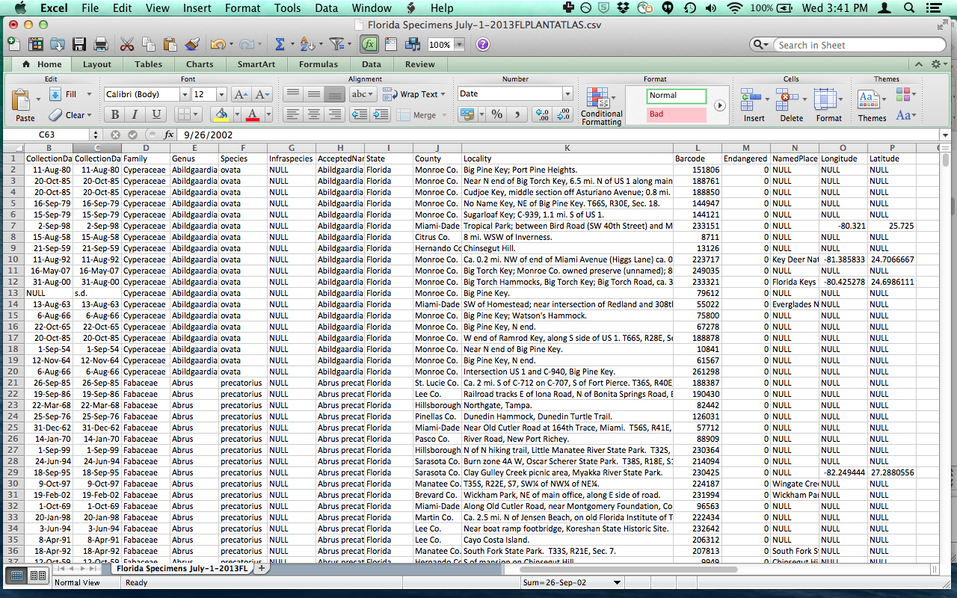

Slide 13
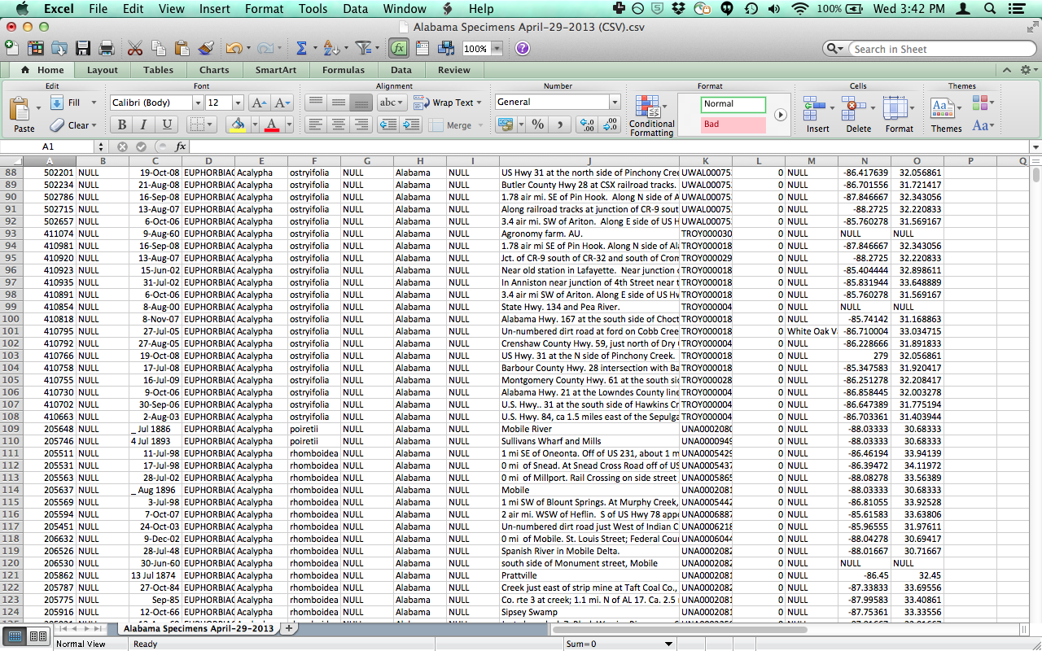

Slide 14
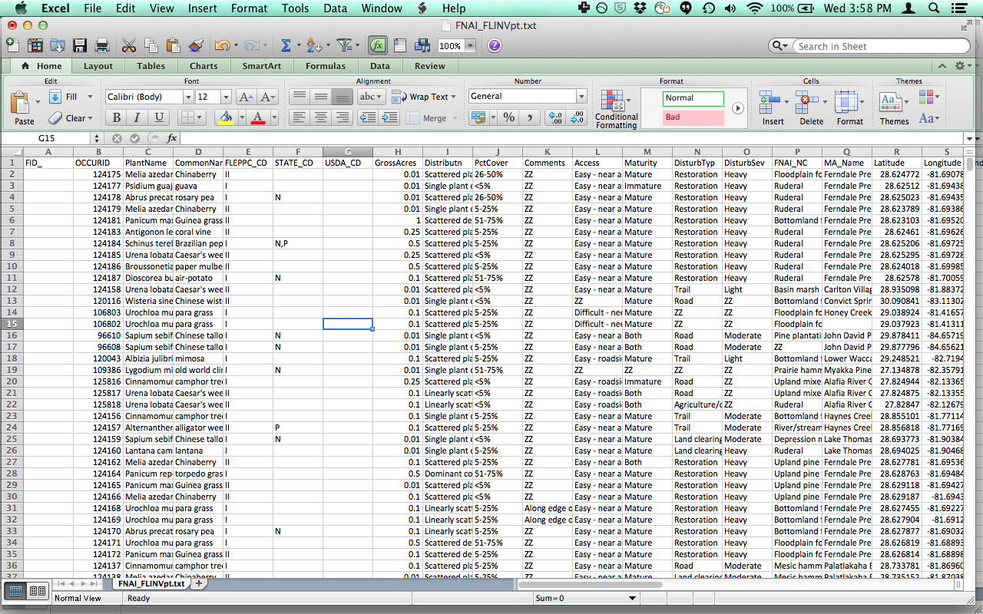

Slide 15
Formatting challenges
Reconciling datasets within each institution
Reconciling datasets between institutions
Georeferencing specimens
Transforming Lat/Long
UNCERTAINTY info missing !!!!
Dates format (had to make assumptions)
Taxonomic Name Reconciliation
Pool datasets together – large files

Slide 16
Data collecting
Florida Plant Atlas
Florida Native Area Inventory
Global Information Facility
Florida State University Herbarium
Louisana State University Herbarium
University of North Carolina Herbarium
Alabama Plant Atlas
Mississippi State University Herbarium
Florida Museum of Natural History Herbarium
    >500,000 georeferenced points
iDigBio to the rescue !!!

Slide 17
Data cleaning
Wunderlin list of 4,094 species of Florida plants
  Check list against Tropicos accepted names
All non-Florida species removed
Duplicates removed
3 EPA ecoregions
  391,937 points
  343,266 dated points
30+ points per species
  372,241 pts and 1,548 species

Slide 18
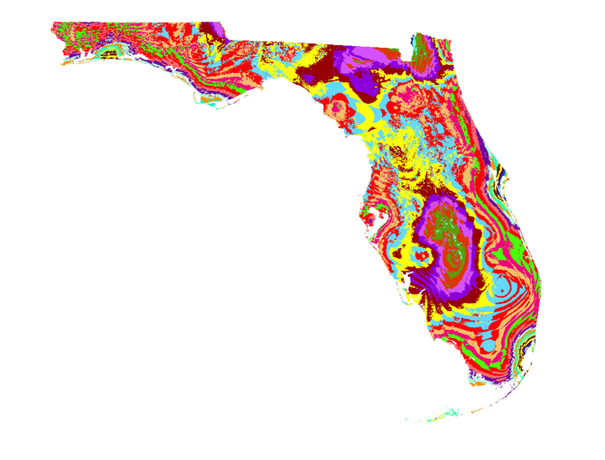
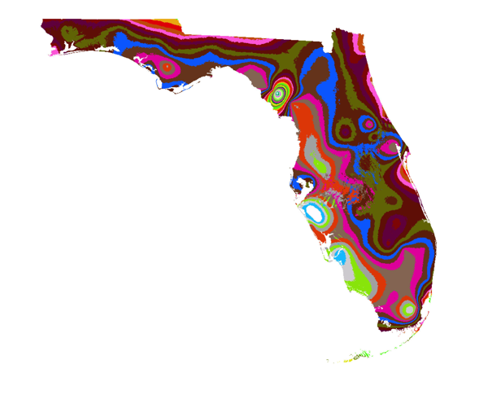
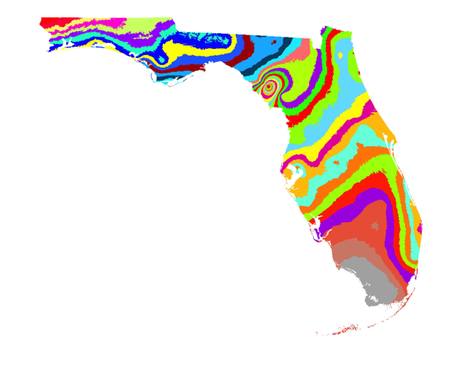
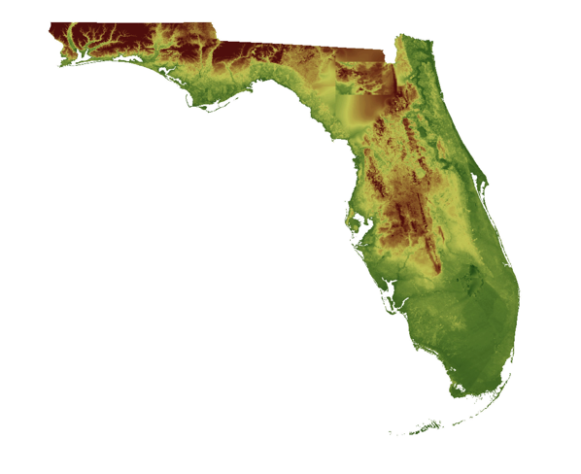
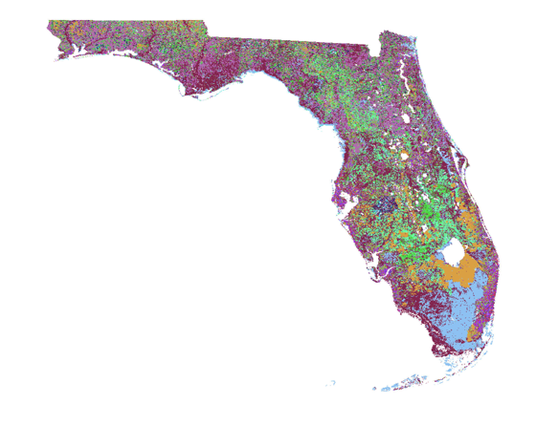
Flatspike Sedge
Ecological Niche Modeling

Slide 19
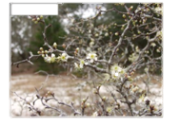
Flatspike Sedge
Scrub Palm

Slide 20
How many species are predicted to reside in this point?

Slide 21
All Plant Diversity
Notes:
WITH BIOINFORMATIC APPROACHES WE CAN DO THINGS LIKE THIS

Slide 22
Museum Specimens and Climate Data
Extraction R – package – dismo to create bioclim layers from monthly PRISM data
Associate each species record with the climate data for the correct year.
Notes:
consensus models from 3 hand-picked future scenarios: CCSM4, MPI and MIROC5. The models were very similar in htier outcomes, so we felt comfortable to work on consensuses

Slide 23
Museum Specimens and Climate Data
Extraction R – package – dismo to create bioclim layers from monthly PRISM data
Associate each species record with the climate data for the correct year.
R package in progress
Notes:
consensus models from 3 hand-picked future scenarios: CCSM4, MPI and MIROC5. The models were very similar in htier outcomes, so we felt comfortable to work on consensuses

Slide 24
Climate Data
Bioclim correlation 8 layers < 0.85
Altitude
Geology
Ran models for all 1,548 species.
Combined maps to create a heat map of all species and then cropped it to Florida.
Notes:
consensus models from 3 hand-picked future scenarios: CCSM4, MPI and MIROC5. The models were very similar in htier outcomes, so we felt comfortable to work on consensuses

Slide 25
2002 - 2012

Slide 26
Endemism hotspots
2002 - 2012
Endemic diversity / Total diversity
Notes:
Alpha endemic map lots of endemics in the central eastern coast. Hotspots eastern coast not quite as strong, this is a very species poor area but most of these species are endemics which we cannot see with the present alpha diversity. Species poor areas are hard to pinpoint that they are endemic hotspots.

Slide 27
Florida’s Past
Take models of each species and project it to the climate layers created from 1902 – 1912.

Slide 28
Florida’s Past
1902 - 1912

Slide 29
Future Models
Consensus models from 3 hand-picked future scenarios:
  CCSM4 –Community Climate System Model
  MPI – Max Plank Institute
  MIROC5 – Model for the Interdisciplinary Research on Climate
Both highest and lowest estimates of CO₂
2050 and 2070
12 models for all 1,548 species
averaged for a consensus of these models

Slide 30
Future Projections
105
299
con 5026, 1548, 110, 0.071
con 5085, 1548, 207, 0.1337
con 7026 , 1548, 105, 0.0678
con 7085 1548, 299, 0.193
Species Extinct from Florida
Notes:
SIGN of homogenization. Minimum number of species has increased quite a bit. Working on biodiversity measures to examine this.
consensus models from 3 hand-picked future scenarios: CCSM4, MPI and MIROC5. The models were very similar in htier outcomes, so we felt comfortable to work on consensuses DID 12 models and here I am showing the consensus or average of these models

Slide 31
Future Endemics
10
22
Endemic Species Extinct

Slide 32
Next Steps
Species clusters
Movement Analysis
Sea level rise change
Notes:
Brent Mishlner - using a whole host of new tools, palaeo endemic to neo endemic – palaeo endemic have been in a habitat for quite some time, neo endemic more recent probably more likely to move around. Florida does not have much elevation and as a penninsula the sea level has risen and fallen and isolated areas from the main land. Some places have been there for a very long time. Florida was thought to be a refuge for species during the recent glaciations and might even have been as recent as 10,000 th evolutionary history is very heterogeneous. Pertinent to look at phylogeentic diversity.

Slide 33
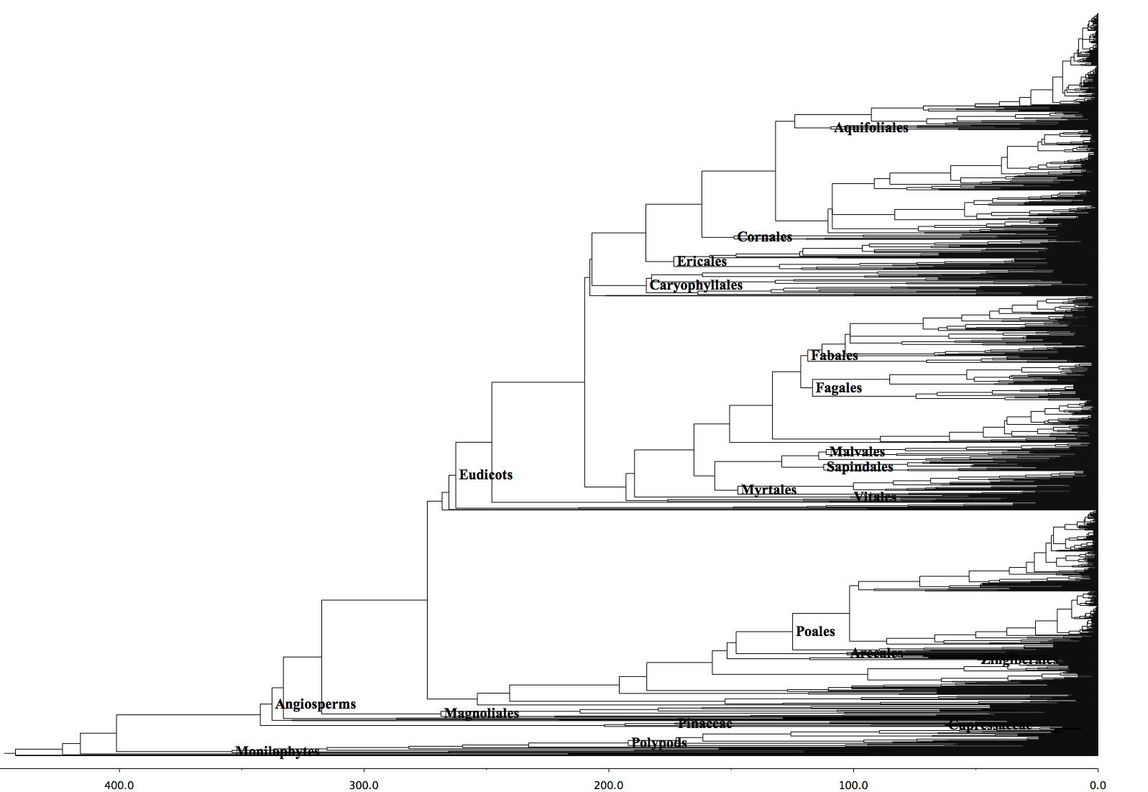
Florida Phylogeny
1,548 species
685 genera
183 Families

Slide 34
‘basic’ niche modeling
R package Biomod2
Use Bioclim climatic layers
Use altitude and geology
9 species
Run 3 algorithms: general linear model, random forest, maximum entropy

