Slide 1




Biodiversity Data Dialogues
Notes:
Hello,
My name is Joe Miller, I am Executive director of the Global Biodiversity Information Facility, GBIF.
What you see in the background is the map of the digitally known biodiversity, 1.3 billion records of fungi, plants, animals and other organism. These data were compiled, cleaned and published in 20 years of existence of GBIF.

Slide 2
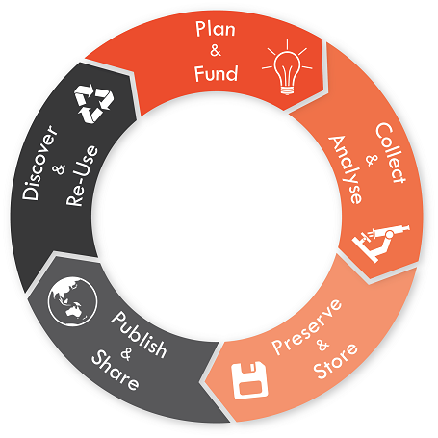
The research data lifecycle
Generate / Access
(re)Organize
Modify
Analyze
Archive
Cite
University of Sydney https://library.sydney.edu.au/research/data-management/research-data-management.html

Slide 3
Science instruments
Existing:
Research planning Collecting data Data analysis Publication Distribution
Often overlooked:
Data management
Data
... collecting
... input
... editing
... analysis
... archival

Slide 4
Open Data
Christine Laney, laney@battelle.org, @cmlaney
Ecological Society of America annual meeting, Louisville KY
Special Session: Biodiversity Data Dialogues #biodiversity data
August 12, 2019
Opportunities for collaborative research
Notes:
Question: How many of you feel that you understand what the term “open data” means?
Volunteer answers?

Slide 5
What is Open Data, and why is it important?
“With data comes responsibility…”
“We are bridge builders… ” “…but we should not build bridges to nowhere!”
– notes from RDA 13th plenary April 2019
https://www.pmel.noaa.gov/arctic-zone/ipy-1/
Notes:
We often use this term casually, with the general understanding that open data is any data that is online, is un-redacted, is not behind any major barriers (like request for personal information that would disregard privacy, or behind a paywall), and can be used for other purposes beyond the original intent that led to collection in the first place. We also have a general understanding that by sharing data openly, others will find a valuable use for the data and thus benefit society through increased impact for the currency that funded the original research, and new information or tools. We have struggled for decades (centuries!) to figure out how to support data sharing and scaling. We have had large programs spanning regional, national, and international scales. Some of the earliest initiatives often cited as precursors to our initial state were of a limited time span and took more years to plan than to initiate and complete. Others have been ongoing with the support of government agencies for over 100 years, and continue to add new knowledge. Newer grassroots initiatives have evolved over the past few decades and have strengthened our understanding of the importance of long-term monitoring, not just to solve immediate practical problems like how to navigate in the Arctic, but to the fundamental science of how our ecosystems are structured and how they respond to changes in biotic and abiotic drivers. As data producers, providers, and users, we need to consider the many facets of responsibility that we share in creating efficient, effective solutions to common issues.

Slide 6
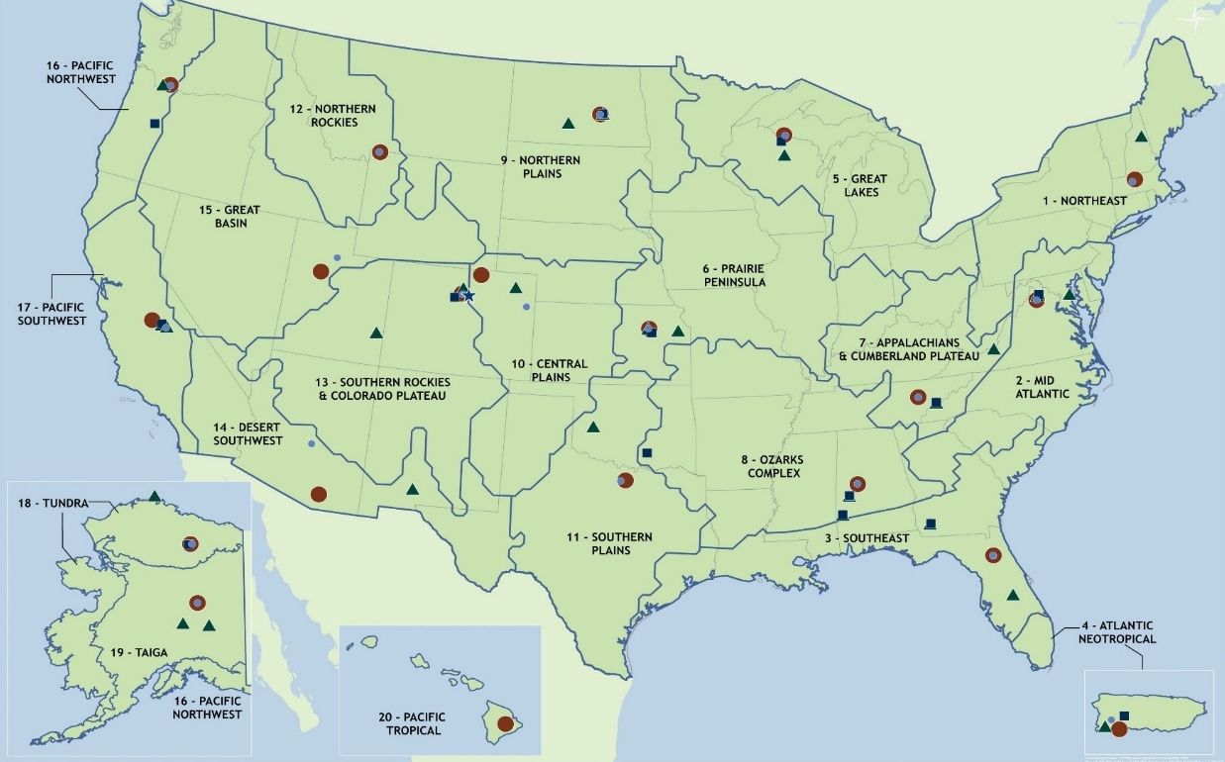
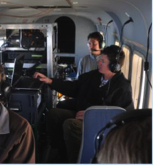
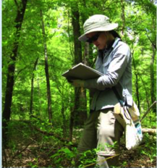
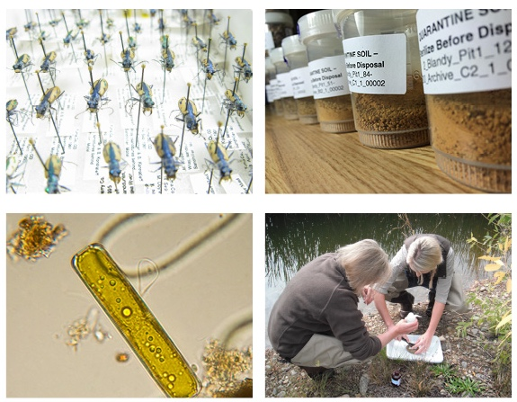
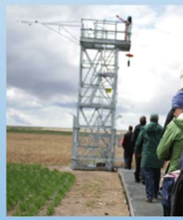
NEON – Open Data for Ecology
Airborne remote sensing
Hyperspectral imagery
Canopy chemistry
Ecosystem structure
DEM/DTM and more
Observational sampling
Vegetation/Phenology
Water quality and more
Small mammals*
Fish*
Ground beetles* & bycatch
Mosquitos*
Ticks*
Zooplankton*
Benthic macroinvertebrates*
Vascular plants, algae, bryophytes and lichens
Soil microbes*
Soil (ambient & frozen)
Dust
*including genomic extracts
Automated
instruments
Air/soil temperature
Wind speed/direction
C/H2O/energy fluxes
Radiation and more
Notes:
NEON provides a highly coordinated national system for monitoring a number of critical ecological and environmental properties at multiple spatial and temporal scales.
Coordinated and co-located measurements of drivers of environmental change and biological responses, collected using standardized methods to systematically sample variability and trends in ecological characteristics, allow inferences at regional to continental scales. Where possible, terrestrial and aquatic sites have been colocated to enable more complete understanding of nutrients, water, and energy through terrestrial and aquatic ecosystems.
NEON collects data and samples using a combination of field sampling, sensors, and airborne remote sensing measurements at varying space and time scales. The Observatory ingests, monitors quality, and processes data into useable products that are broadly accessible to user communities. The automated instruments provide data that are more easily structured as time series, but also are high volume, where the summarized data are being provided at somewhere between 1 and 30 minute resolutions. The remote sensing compounds the difficulty with the complexity of moving a platform across a large open space, dealing with cloud cover that may impact data quality, and sensors that are recording enormous quantities of raster and point cloud data. The observational sampling protocols provide a wide range of small, but highly diverse and complex datasets, challenging to collect, quality check, and integrate into analyses that have a wide spatial or temporal extent, or that span multiple research disciplines.
NEON is an ambitious program designed to address the growing global demands on our nation’s natural resources. NEON has been designed to provide new information that can be used to challenge and advance current ecological theory, and to partner with other organizations to optimize investments in environmental science.
Continental scale: Integrated data collection at 81 field sites distributed across 20 domains – or ecoregions – in the United States (including Puerto Rico, Alaska, and Hawaii).
NEON data is a combination of three different collection systems: automated instruments, observational sampling in the field, and airborne remote sensing. The diversity of data collection methods allows for comprehensive sampling at each site. The data collected through these three systems may be studied in conjunction with each other since they are collected in close proximity at each field site. The data are also comparable across ecosystems and field sites which means researchers can study connections and patterns and develop models to forecast environmental trends locally, regionally and even at the continental scale.
In addition to field data, the observational sampling system collects physical samples, which are archived for later use in research and teaching. Physical samples are not only connected to their contextual field data, but any data produced during analyses performed by a lab after collection. This can include morphological measurements, taxonomic identifications, and genomic sequences.

Slide 7
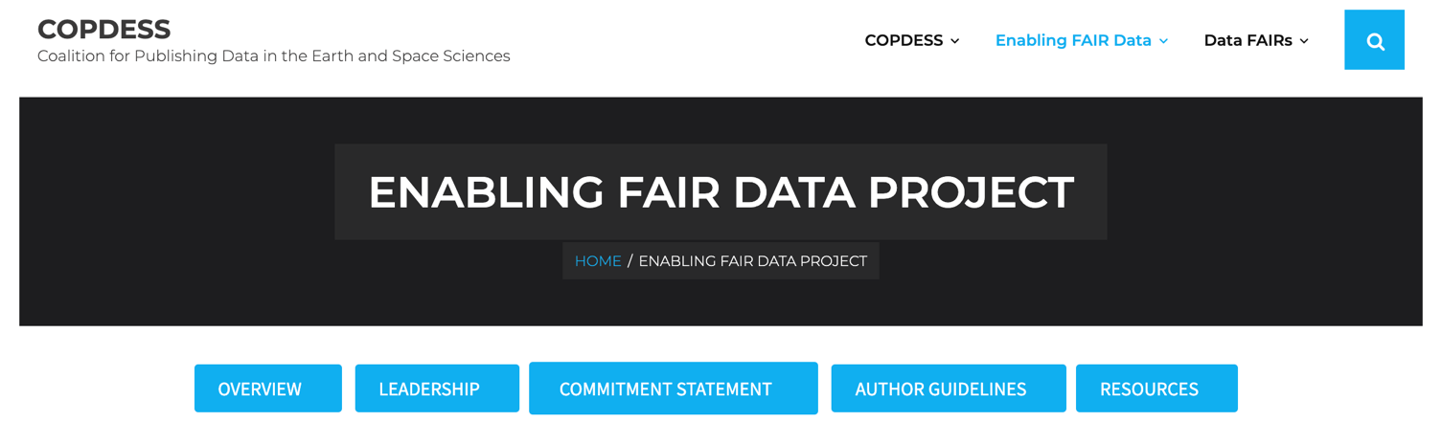
Using FAIR to Define Open Data
Data producers
Repositories
Libraries
Publishers
Funding agencies
Findable
Accessible
Interoperable
Reusable
Wilkinson, M D et al. (2016). Scientific Data 3: 160018.DOI: https://doi.org/10.1038/sdata.2016.18
Notes:
As the research community has been endeavoring to define Open Data and its benefits, the FAIR data principles were framed formally by the Force11 group. FAIR is composed of the general principles Findable, Accessible, Interoperable, and Reusable, with guidance around each facet. Numerous discussions among data providers, funding agencies, publishers, libraries, and data repositories, through numerous community gatherings and fora, have both refined FAIR and elucidated areas that need further definition – such as trust that open data are of high quality, fit for use, and unbiased or at least documented enough to discover which biases exist. NEON, as an open data provider, is a signatory on the Commitment Statement, as are many of the organizations represented here today.
In a nutshell, FAIR is a very high-level umbrella of overarching guidelines to all partners involved in data work to work jointly on making data findable, accessible, interoperable, and reusable. There are ongoing, fervent discussions about the practicalities and details of FAIR, as well as proposed extensions.
Question: which of these terms seems completely clear? Findable? …

Slide 8
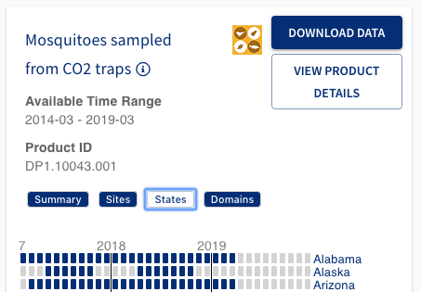
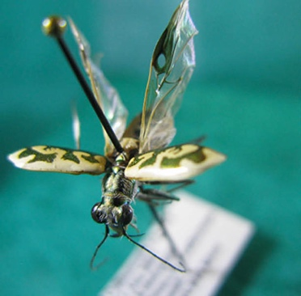
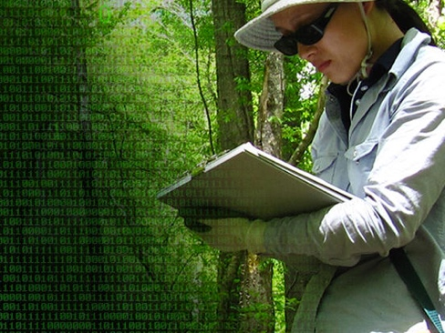
Making data findable and accessible
{
"data": [
{
"productCodeLong": "NEON.DOM.SITE.DP1.00001.001",
"productCode": "DP1.00001.001",
"productCodePresentation": "NEON.DP1.00001",
"productName": "2D wind speed and direction", "productDescription": "Two-dimensional wind speed and direction, available as two- and thirty-minute aggregations of 1 Hz observations. Observations are made by 2-D sonic …
Provide human and machine readable information about each data product
Use community standards for documentation
Use globally unique and peristent identifiers on data, metadata, physical objects, and responsible persons where possible
+
+
Notes:
A few things that help make data findable and accessible are: first- put data online. But having a webpage doesn’t make the data easy to discover. So there are a few techniques that can help. First, provide human and machine readable information about each dataset or data product – there are numerous schemas that help assure the format and content of such information. For NEON, we use the ecological metadata language, or EML, to provide such structure – and then we make it available in XML and JSON formats. Second, use community standards for documentation, including for the names of variables in the dataset, the format of timestamps, and for data quality flags – or if this isn’t possible right away, try to build a structured system that can later be mapped to community standards. Third, use globally unique and persistent identifiers of data, metadata, physical objects, and responsible persons where possible. Short identifiers can be linked to a wealth of information, and linked identifiers can be used to describe relationships between multiple objects.

Slide 9

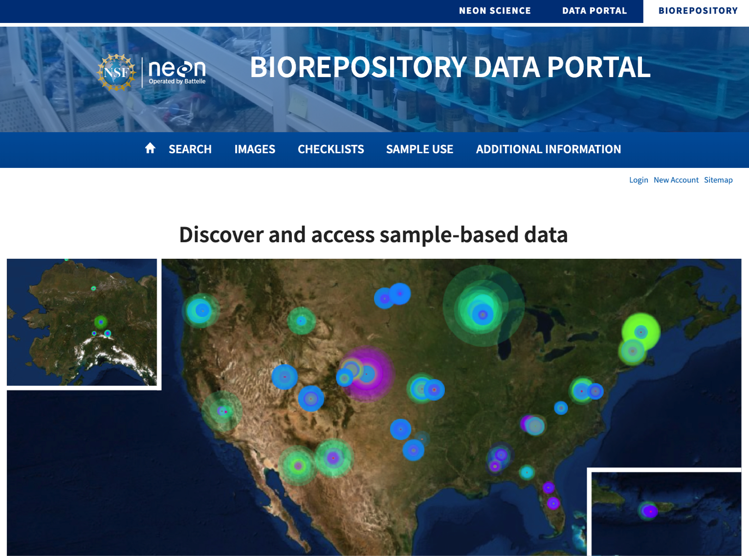
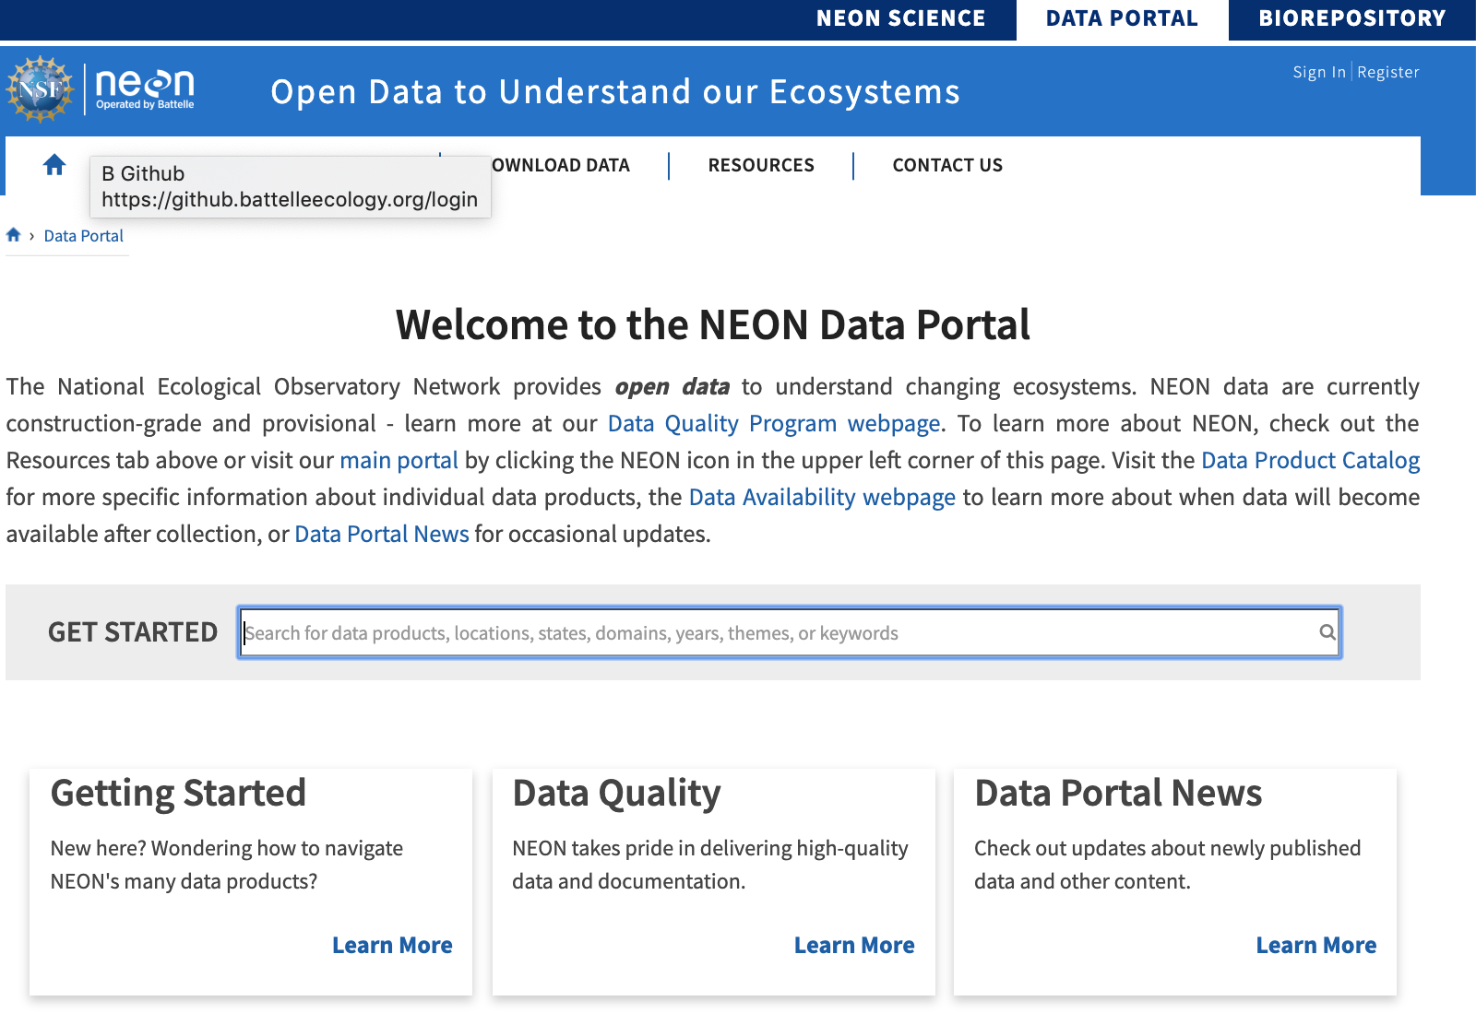
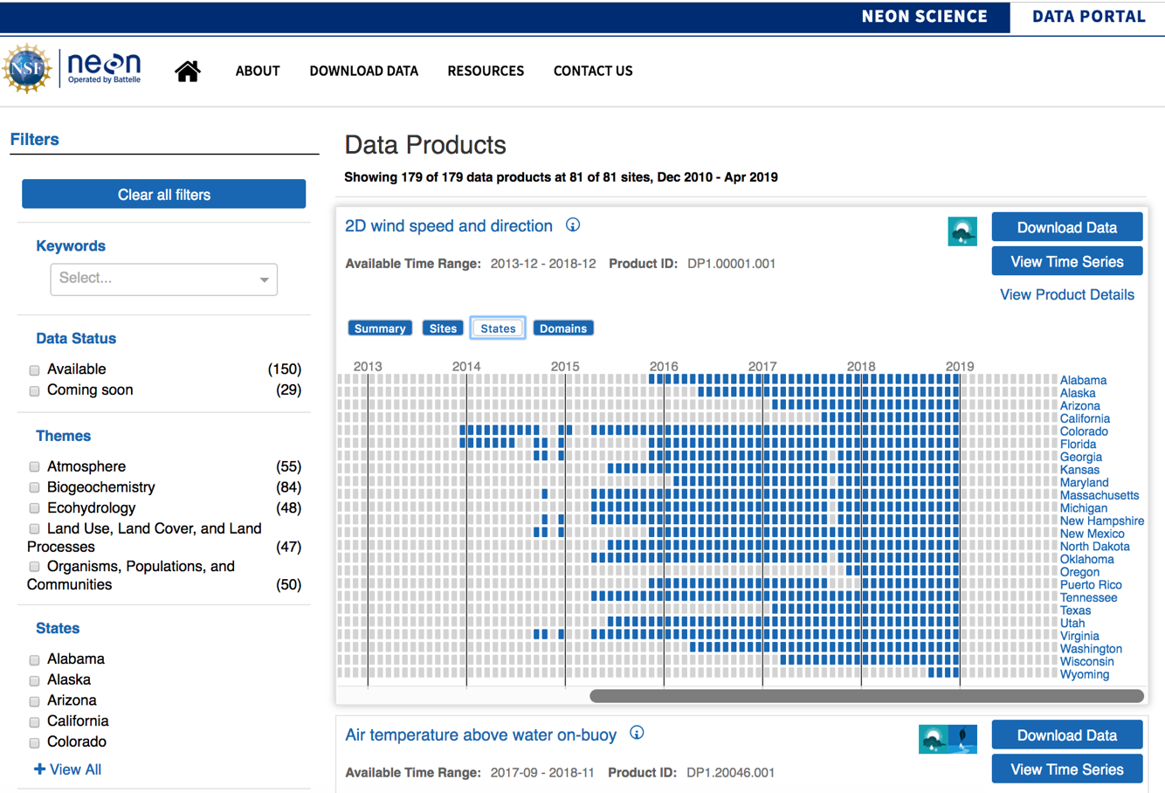
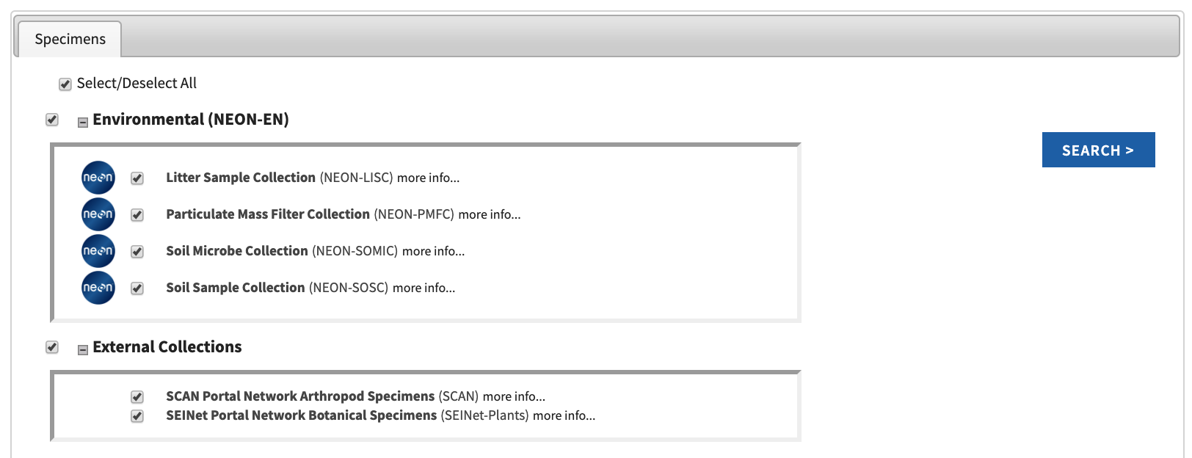
Making data findable and accessible
Allow data to be discovered online and downloaded, through portals and web services
Use open data policies where possible
https://biorepo.neonscience.org/
Notes:
One of the strengths of NEON is the highly diverse data that NEON collections, from microbial sequencing to organismal surveys and from micrometeorological measurements to remote sensing. While we can place all data online, this doesn’t automatically make our data easy to find, and so we need methodologies and online tools to help researchers discover the data they need. While NEON was being built, and as new data products were published, we focused largely on focusing our resources on 1) documenting our data using community standards, such as the ecological metadata language (EML) for data product descriptions and Darwin Core for occurrence records and 2) making sure that data quality is as high as possible while also making data available to the public. More recently, we have been focusing more intently on making these data products more discoverable, and our efforts are largely made toward public API development on top of which flexible applications may be developed. The API can be used as a stand-alone tool by the public as well. As this year progresses, we will be rolling out a modernized data catalog in which each data product is fully described in a dedicated webpage, and a number of data exploration-through-visualization tools.
We are partnering with Arizona State University to stand up a new biorepository and will be shipping along the order of 100,000 samples per year – though some of these are pooled samples that may have many individuals. In any case, we will be collecting millions of samples over the course of the Observatory. The occurrence data is coming online, except in cases of sensitive information, through a third web portal powered by Symbiota.

Slide 10
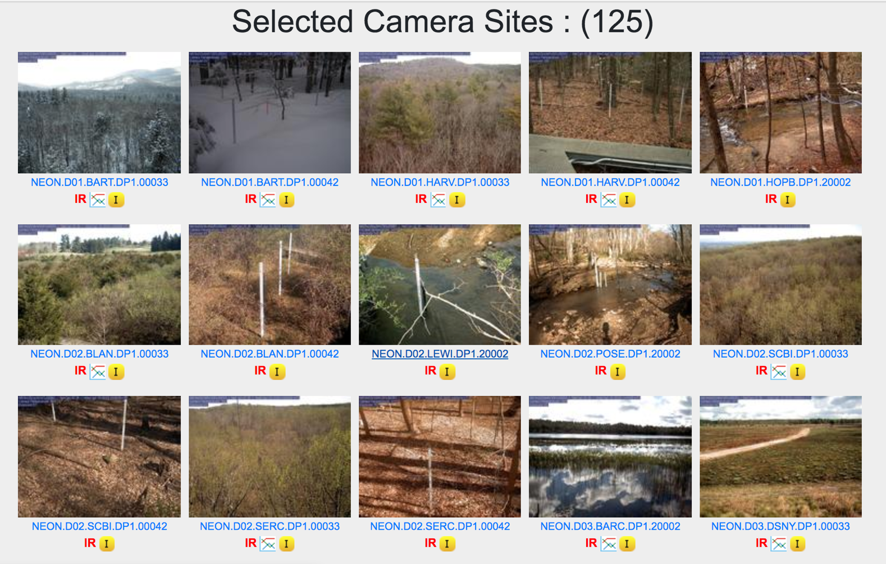
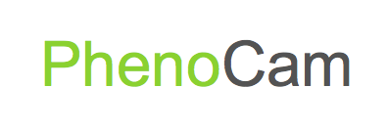

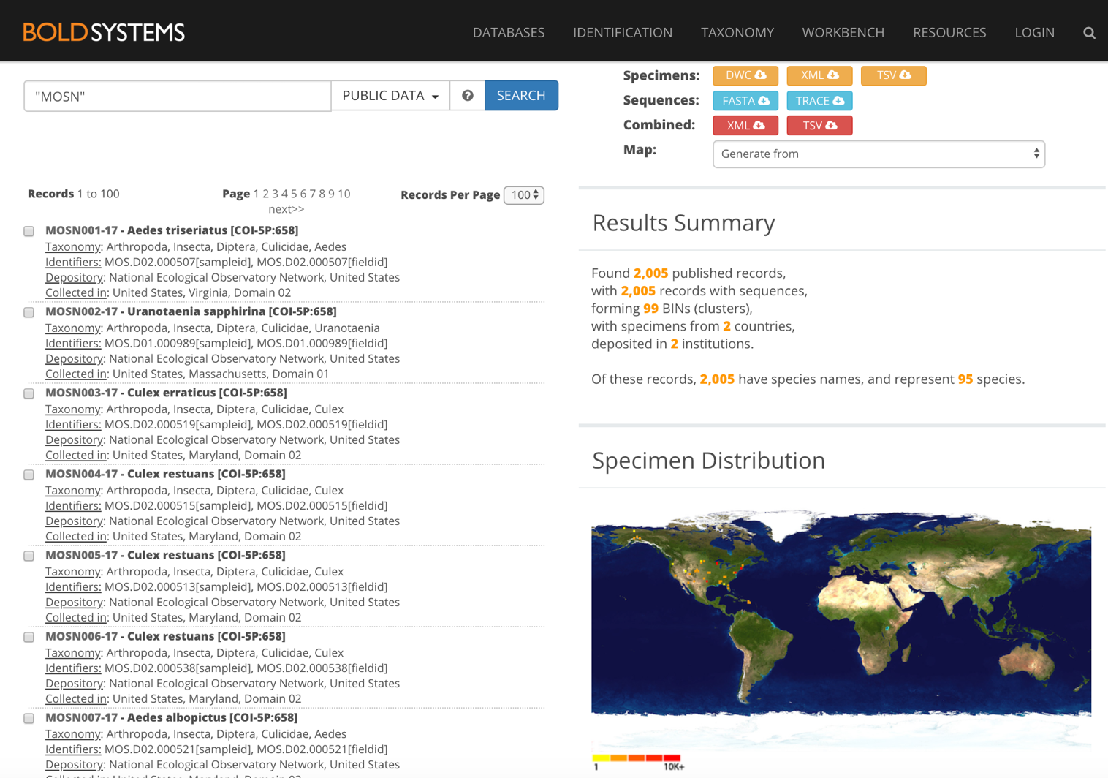
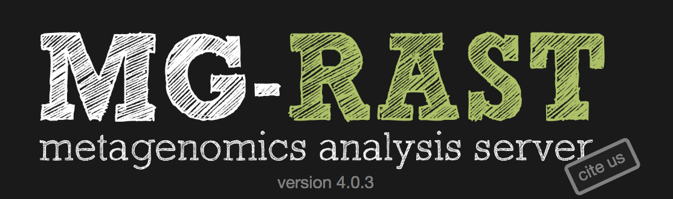

Making data findable and accessible
Leverage domain expertise to process and share data within a domain context.
Notes:
To increase exposure to data, we shouldn’t expect to always host it ourselves. Sometimes there are better online resources to handle and provide data, especially within specific research domains. In part this is why NEON shares some data products through numerous external repositories- to leverage domain expertise to process and share NEON data within a domain context. The NEON data portal provides field data as well as links to externally hosted data. Distributing data across repositories helps ensure that we organize and provide data and metadata in community supported, domain specific standards while providing domain communities extra tools of discovery and access.
Question: why might it be helpful to share data in more than one online location?

Slide 11
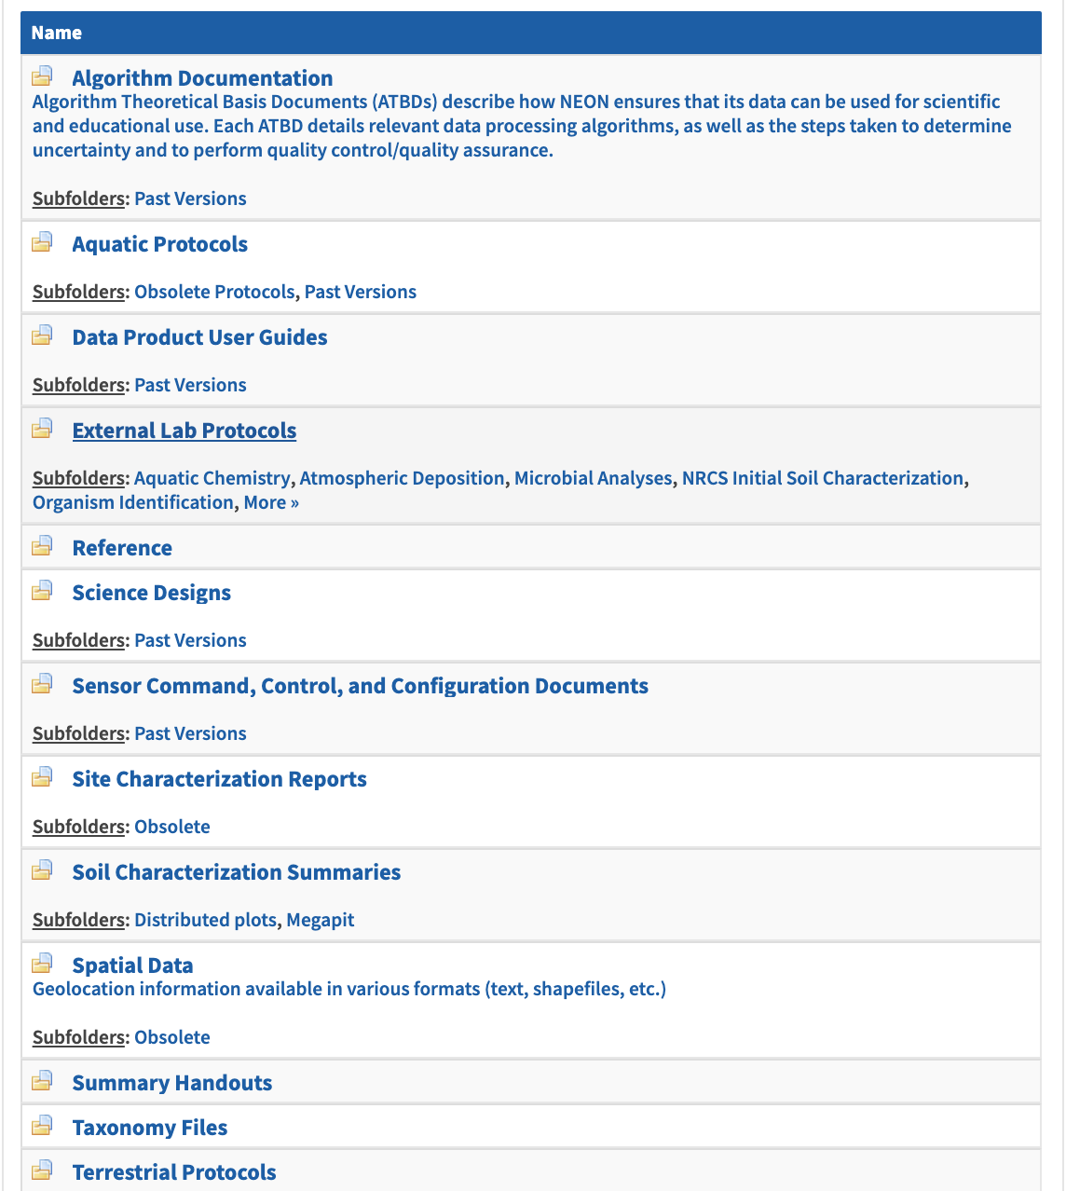
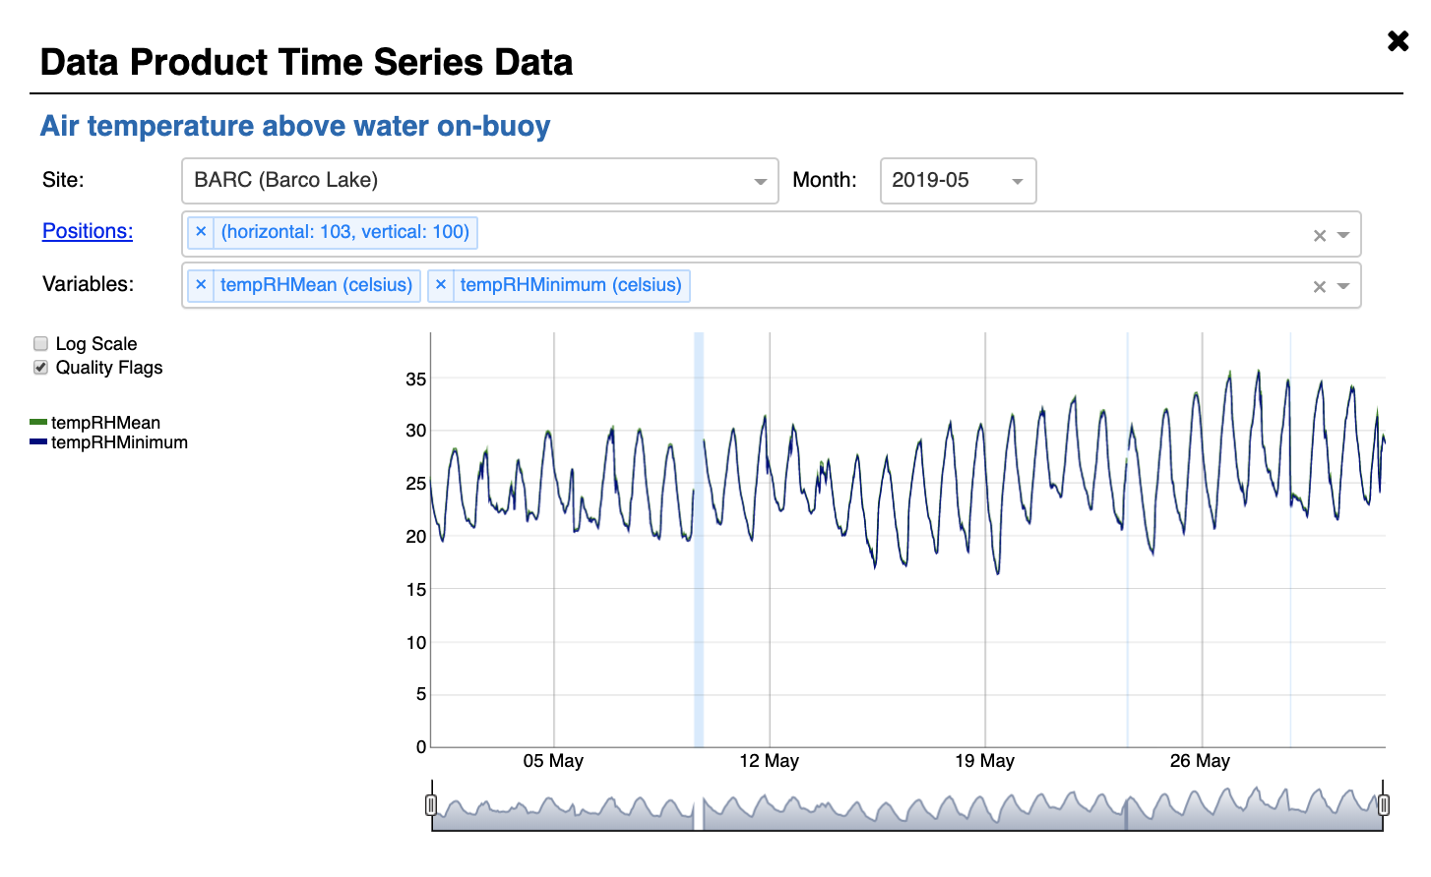
Making data interoperable and reusable
Standard vocabularies, identifiers, etc.
Enhance transparency
Fully describe how data were collected, processed, qa/qc’d, and published
Clearly flag any data with potential quality issues in the data table; document issues in more detail in an associated, easily accessible file.
Provide clear guidelines on how to cite data
Notes:
The guts of really providing open data, which can be incorporated in truly integrative research, is working to make data interoperable and reusable – in other words, reproducible. And it seems that the informatics community is really making great strides in figuring out how to build tools that will help with this enormous problem, especially in systems that rapidly produce high volume data. Here, we’re talking about the standards and identifiers that we discussed earlier, but also look at how to enhance transparency of the data. What are best methods of describing and providing data processing code? What are methods that can be used to efficiently flag data with quality concerns – with both machines and humans in the loop? And how can we provide very clear guidelines on how to attribute or cite data when it is used in any way – even beyond traditional media?

Slide 12
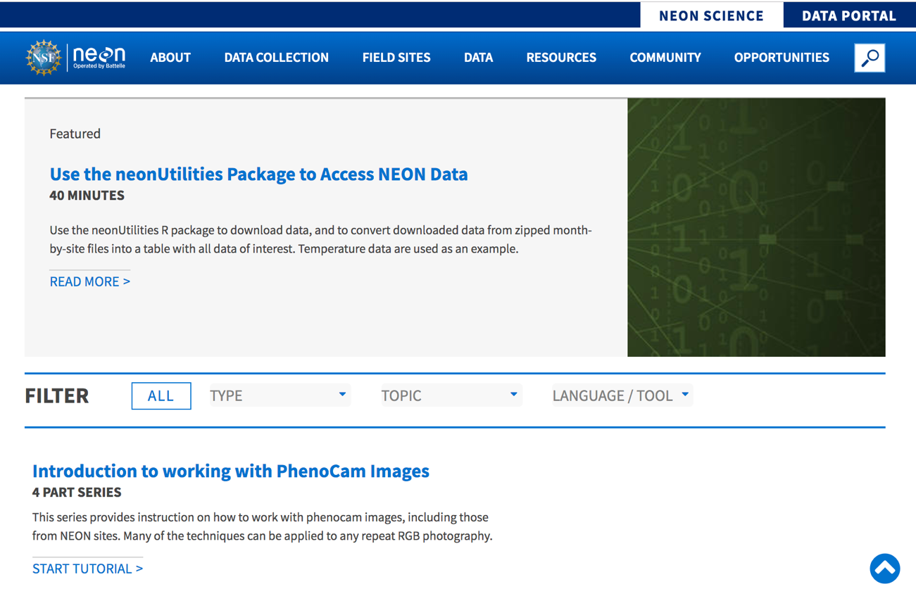
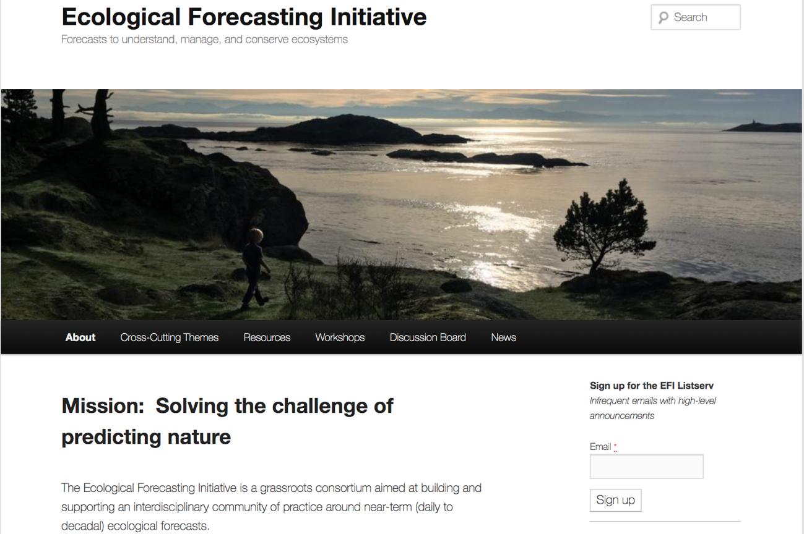
Making data interoperable and reusable
Providing clear and through documentation and tutorials for new users
Ensuring data are FAIR (+) even as open data standards/protocols and modeling practices/tools evolve
Data versioning
Link distributed data and specimens
Iteratively address user pain points
Notes:
We also have a clear sense of the need to make sure that our users understand all that we are providing, and how to leverage it. With NEON, this includes:
Providing clear and through documentation and tutorials for new users
Ensuring data are FAIR (+) even as open data standards/protocols and modeling practices/tools evolve
Generating static, persistent data releases with provenance
Linking distributed data and specimens
Listening to our users and addressing pain points
Question: what would or does incentivize you to share data?

Slide 13
DATA CITATION, ATTRIBUTION & DISCOVERABILITY
Northern slimy salamander (Plethodon glutinosus). Photo 2019 Jance via iNaturalist Research-grade Observations, licensed under CC BY-NC 4.0.
Kyle Copas | GBIF Secretariat
DATA DIALOGUES, ESA/USEEE ANNUAL MEETING LOUISVILLE, KENTUCKY, USA | 12 AUGUST 2019

Slide 14
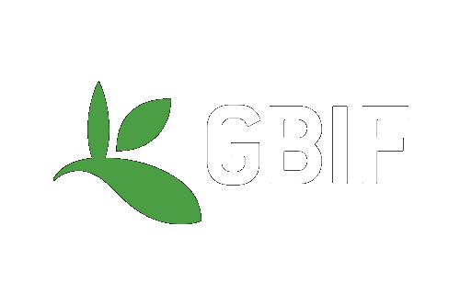
BY THE NUMBERS 28 May 2019
Species occurrence records
Datasets
1,333,686,647
45,696
Country Participants
Organizational Participants
Data-publishing institutions
58
38
1,407
Average records served per month (Jan-May 2019)
Avg monthly user sessions (Jan-June 2019)
36.9 billion
187,547
Notes:
So let’s get on with things here: Big data for biodiversity. Might be dwarfed by what commercial big data is, but it’s what we have, tiny warts and all.
It’s useful to see GBIF in its different modalities:
As a window on biodiversity
As an informatics infrastructure focused on tools and standards in service to science and society
And as a global network on bioinformatics

Slide 15
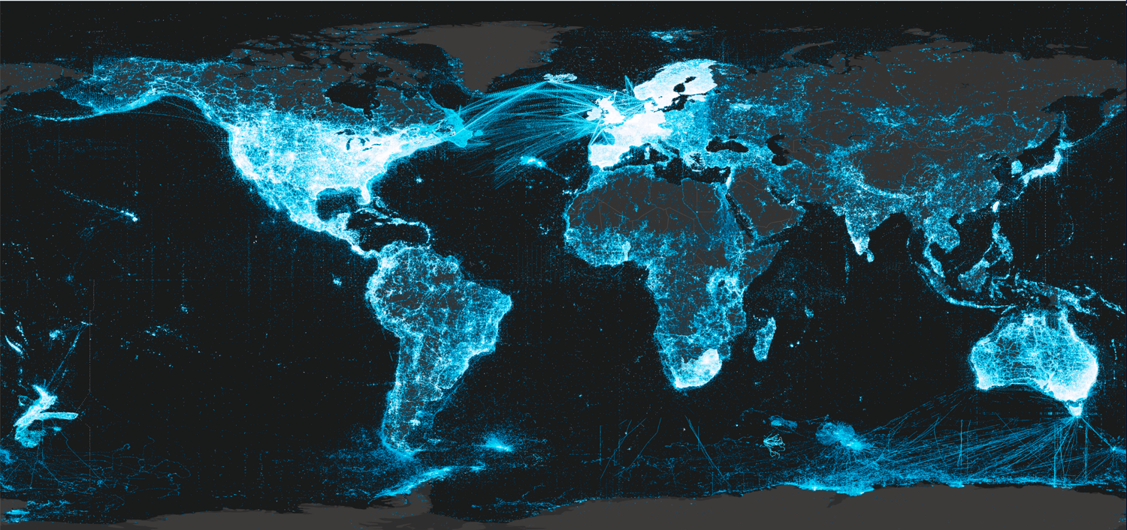
What does this map show?
https://www.gbif.org
Notes:
What does this map show?

Slide 16
Peer-reviewed USES of GBIF-mediated data through 31 July 2019
https://www.gbif.org/resource/search?contentType=literature&peerReview=true

Slide 17
DOIs: DIGITAL OBJECT IDENTIFIERS Four types of uses on GBIF.org
Use type | Date of issue | Issued by | Function
Mobilization | As close to publication event as possible | Data publisher, GBIF network host or GBIF.org | Institutional recognition of dataset through simple citation mechanism
Access | At time of user request for download from GBIF.org | GBIF | Simple citation, reproducibility, clarity of materials & methods
Bibliography | Publication date | Journal publisher | Stable identifier
Use | Data archiving before manuscript submission | Repository | Clarity of results, support reproducibility and discussion

Slide 18
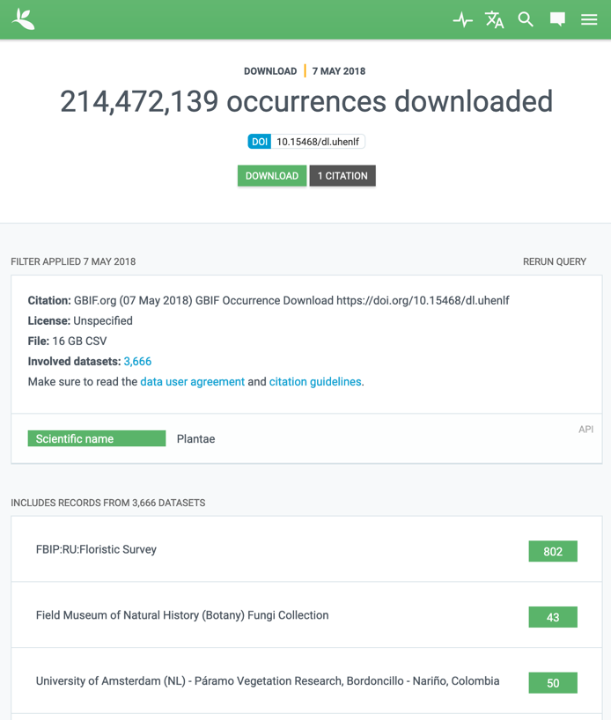
Download dois
GBIF stores each user download request and assigns a DOI resolving to a landing page that includes
Date and size of download
Terms/filters used in query
Links to download original file and to update query
Details of contributing datasets
Relationships modelled in metadata
https://doi.org/10.15468/dl.uhenlf

Slide 19
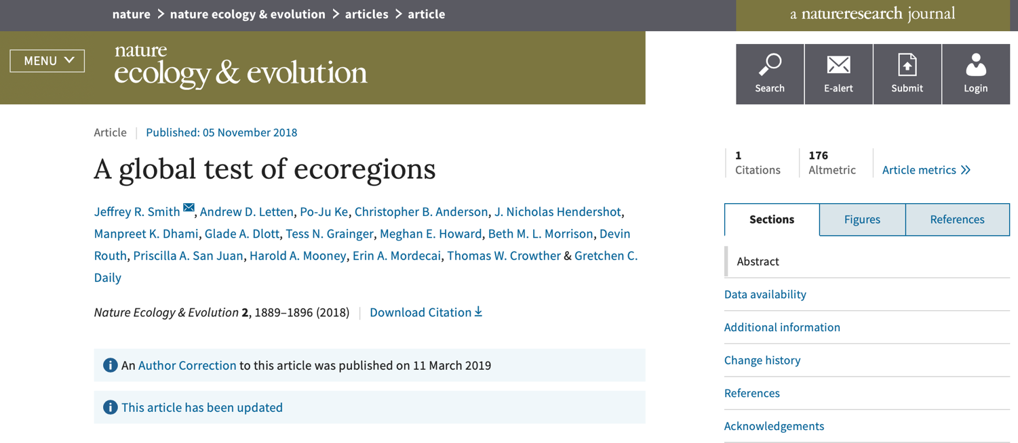
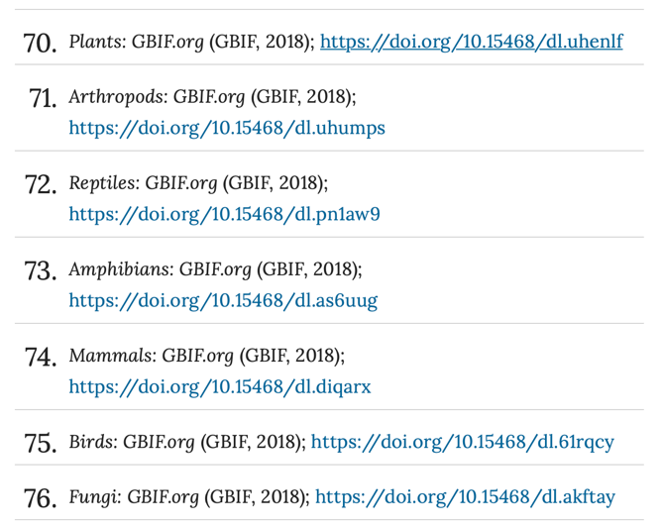
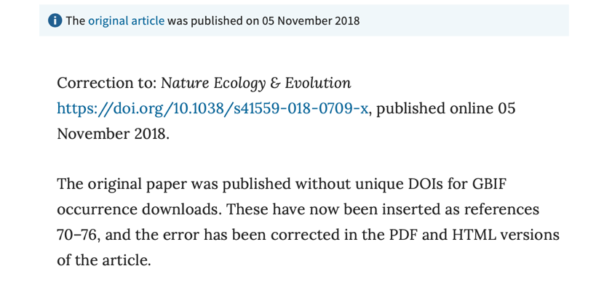
LiteraTure tracking
https://doi.org/10.1038/s41559-018-0709-x

Slide 20
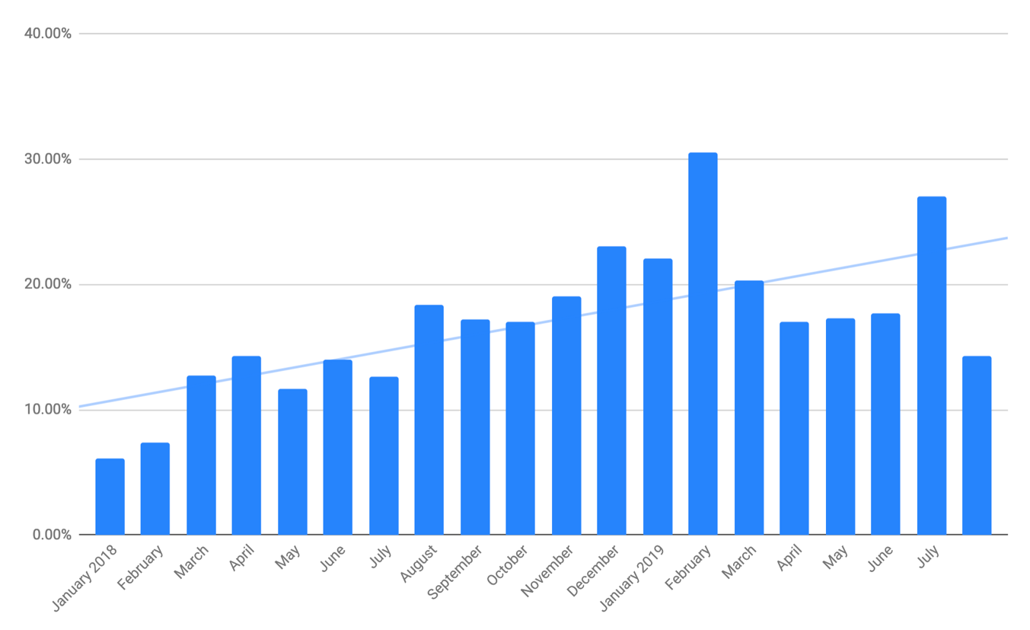
doI Citation in perspective

Slide 21
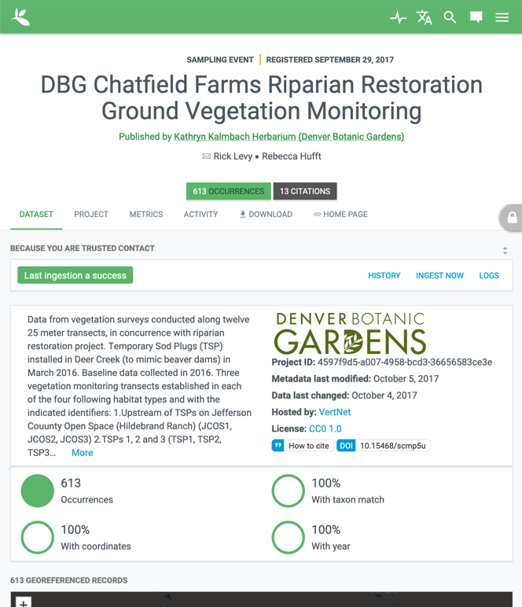
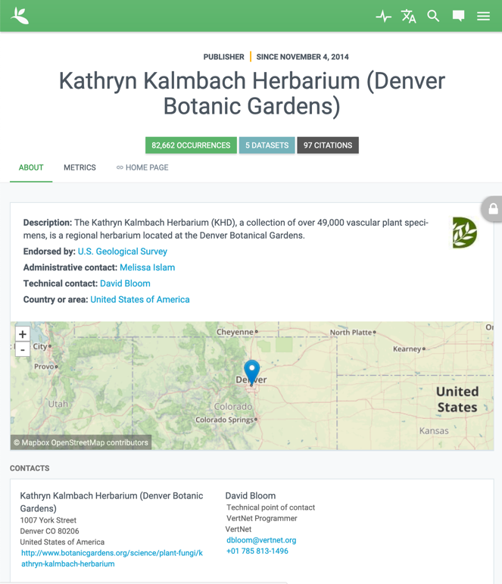
Crediting institutions
https://doi.org/10.15468/scmp5u | https://www.gbif.org/publisher/36488347-eceb-40ed-b687-406f3601d8cb

Slide 22
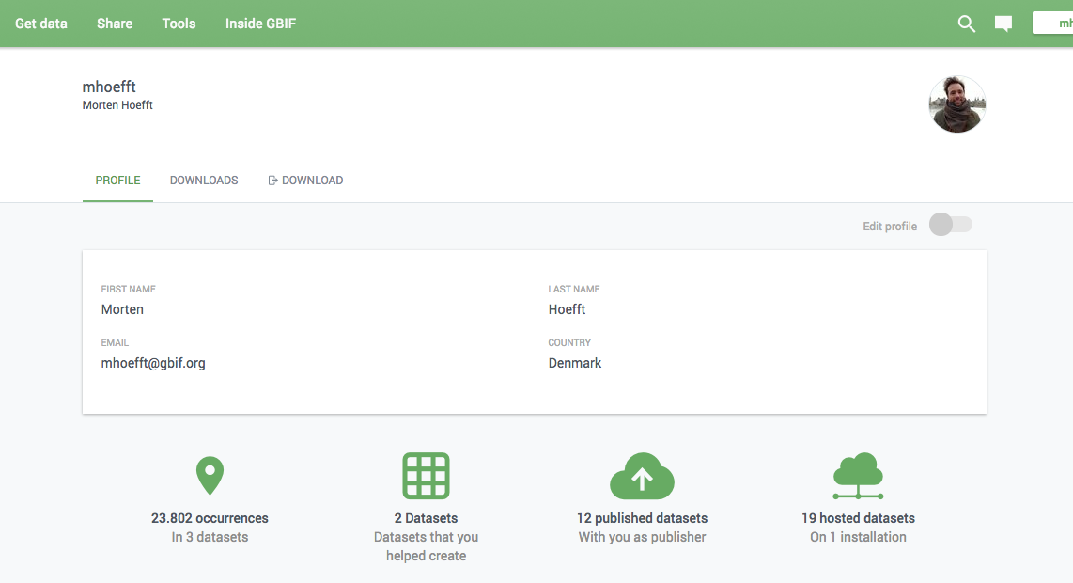
NEXT UP: Crediting individuals
https://sketch.cloud/s/3lJ7D/a/4AJ753/play

Slide 23
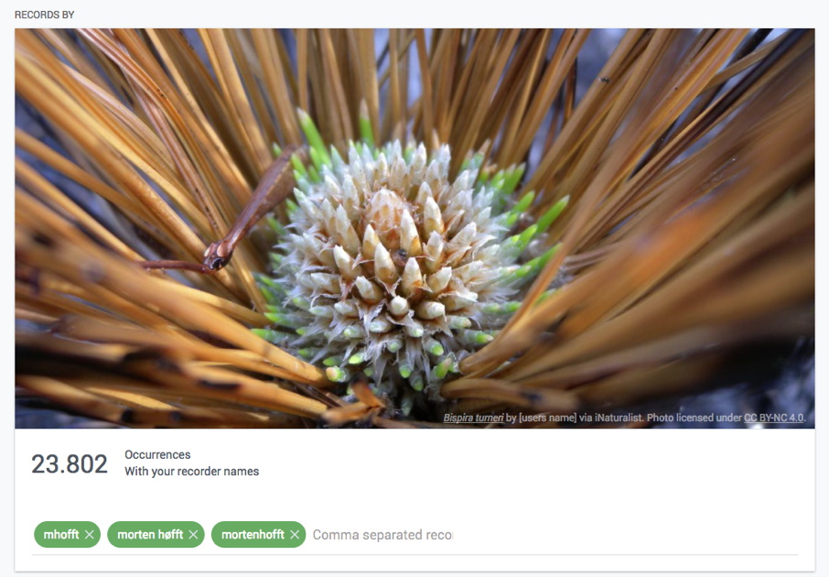
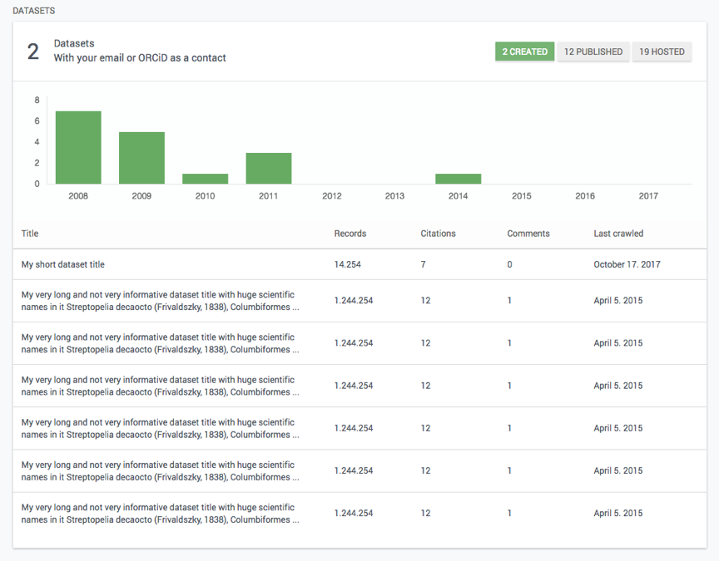
NEXT UP: Crediting individuals
https://sketch.cloud/s/3lJ7D/a/4AJ753/play

Slide 24
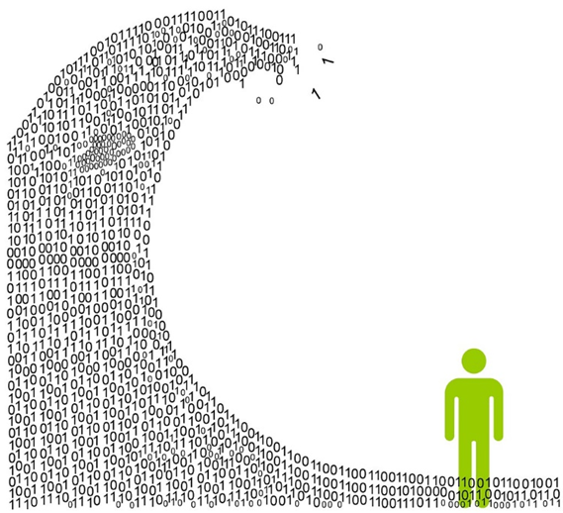


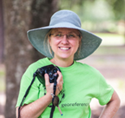
Publishing Biodiversity Data
data sharing, publishing, and using standards provide opportunities for expanded use and longer-lived data
#biodiversitydata
Ecological Society of America 2019 ESAUSSEE
Special Session: Biodiversity Data Dialogues
Presenter: Deborah L Paul, iDigBio, Digitization and Workforce Development Manager
Monday 12 August 10:15 AM - 11:30 AM | Kentucky International Convention Center L011/012
http://bit.ly/datahelpesa2019
Notes:
Biodiversity Data Dialogues, ESAUSSEE 2019
Data sharing / publishing and standards: data sharing trends, options to publish / “share” data, future-proofing data, role of data standards.
Data sharing trends
requirements to publish data
to share data openly
number of publications
options to publish / “share data”
repositories
aggregators
journals
osf / etc
future-proofing data
expanding accessibility
role of data standards
re-usability (Ciera Martinez)
data quality
assessing fitness for research purpose/question
long(er) lived data
And, we have ever more data - Yay
But, we have ever more data - Yikes
So, what helps us get the most from our data?
Actions to increase data visibility, (re)useability, and impact.
https://c1.staticflickr.com/9/8151/7537238368_a0bf8fa717_b.jpg
https://denniskneale.com/taming-the-big-data-wave/845

Slide 25

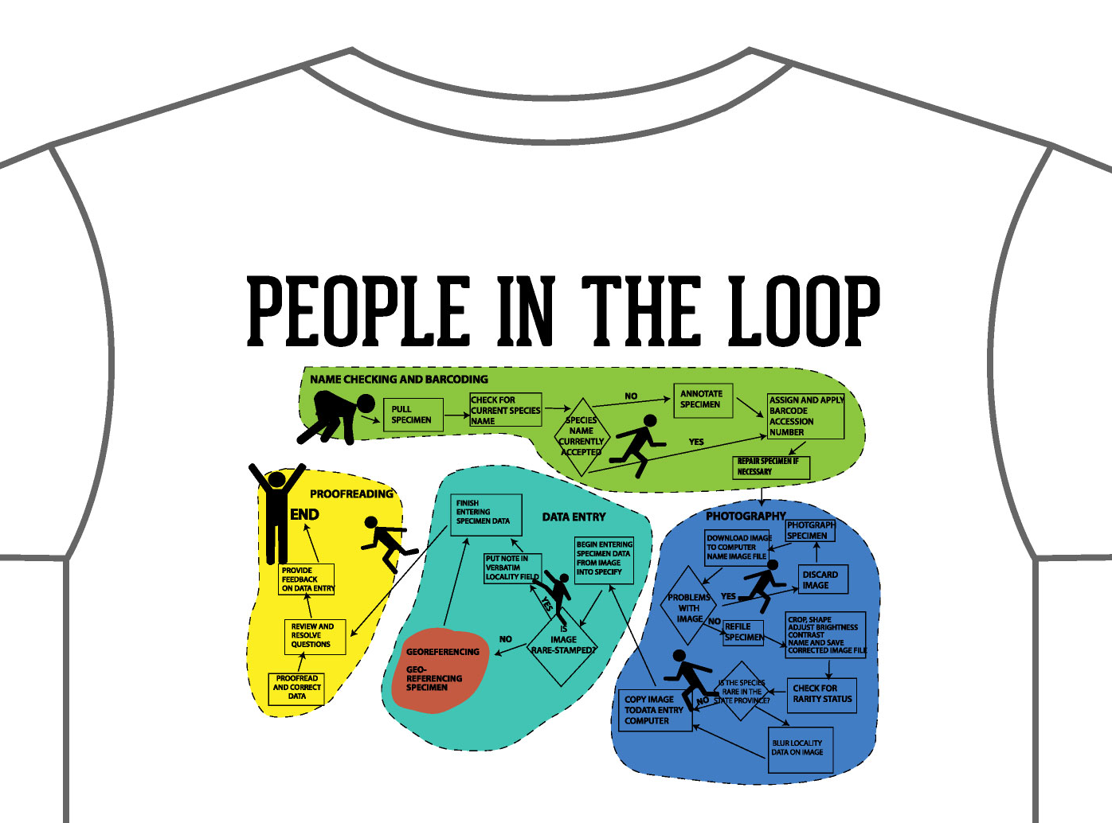
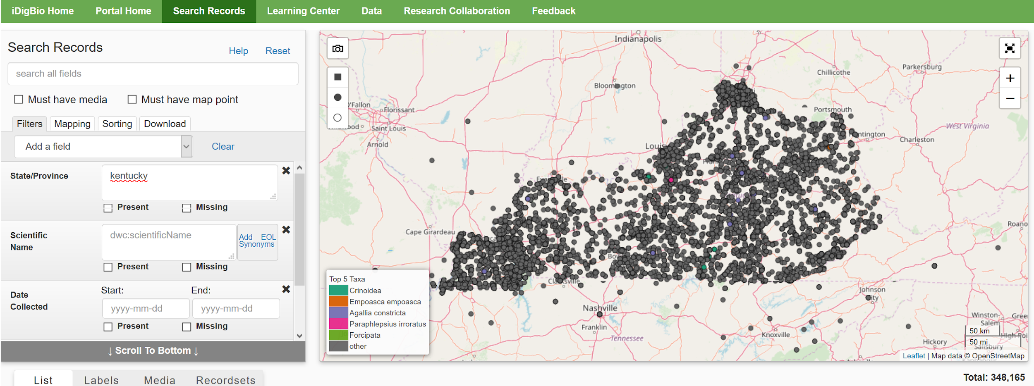
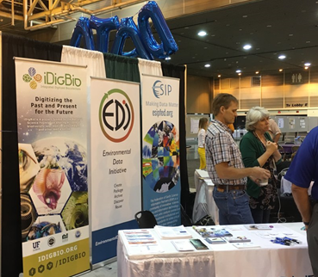
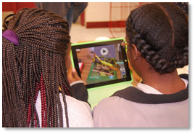
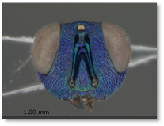
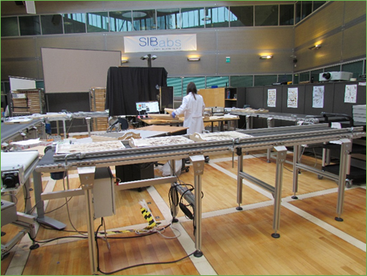
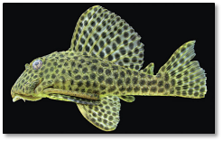

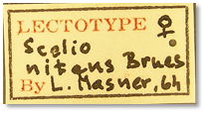
Advancing the Digitization of Biological Collections
iDigBio Hub and Thematic (Museum) Collection Networks
(Meta)data Aggregator
Community Building
Collections Data
total: 119,768,942
Digitization
Workflows & Protocols
Dissemination
Research Use
Cyberinfrastructure
Tool collaboration
Portal development
ENM workshop
Research focus
Data quality
APIs
Training
Biodiversity informatics
Data skills and literacy
Collections software
Imaging
Project Management
www.idigbio.org
people graphic by Dorothy Allard
Education Outreach
Citizen Science
K-12 materials
Undergraduate
Fossil Clubs
Mentor teachers
Methods
Workshops
Webinars
Symposia
Conferences
Working Groups
Short Courses
Adobe Connect
Listservs
Publications
Social Media
@idigbio
Notes:
Welcome to Integrated Digitized Biocollections (iDigBio), the National Resource for Advancing Digitization of Biodiversity Collections (ADBC) funded by the National Science Foundation. Through ADBC, data and images for millions of vouchered biological specimens are being made available in electronic format for the research community, government agencies, students, educators, and the general public.
Community (esp capacity) building is our core theme
We reach out to museum networks, individuals, and many organizations, such as the society for the preservation of natural history collections (SPNHC), VertNet, GBIF, and the Entomological Collections Network (ECN), and others to work together and contribute to best practices, develop tools, and transform museum specimen data worldwide into a virtual searchable dataset. Through activities such as workshops, webinars, working groups, symposia, and publications we collaborate to digitize and mobilize collections data and enable research use of this data. Workflows, Workshop Materials, Lesson Plans, Outreach Materials, Research Highlights and Tools are all at iDigBio – for everyone to use – all made possible by NSF funding.
Note that iDigBio, GBIF, and the Atlas of Living Australia are also working together to provide researchers and data providers with harmonized data quality information. We encourage you to share your collections-based materials for collections digitization and data use. Sustainability of this entire effort is something we are working on together. See Biodiversity Next meeting in Leiden in Oct 2019.

Slide 26

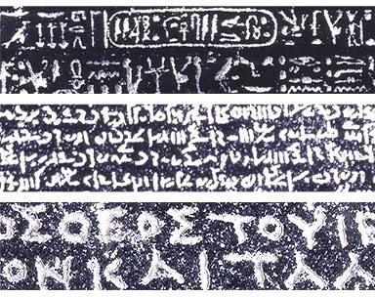
Why use standards?
your data
my data
our (standard) data
http://www.britishmuseum.org/images/rosettawriting384.jpg
Notes:
http://prezi.com/iib3pqk-kyd-/curators-workbench/
Why care about standards? What do they have the potential to accomplish?
Collection Managers are doing what they need to do – for themselves, their collections.
When we share, we need standards.
Data becomes useful for others / other purposes.
a common vocab is required
Feedback and Attribution become possible.
The collection gets used, more, increasing the value of the collection.
indirect, subtle
Putting identifiers on specimens --- makes more useful to others.
consistency is important!

Slide 27
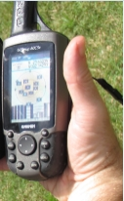
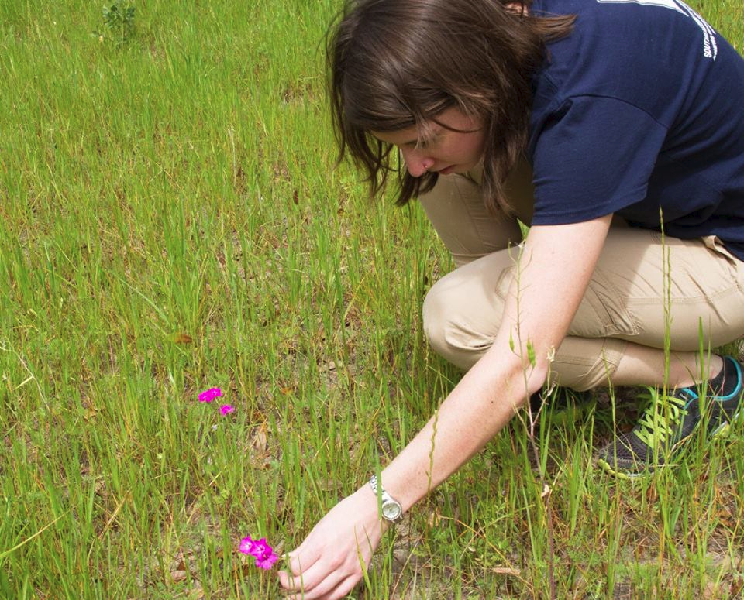
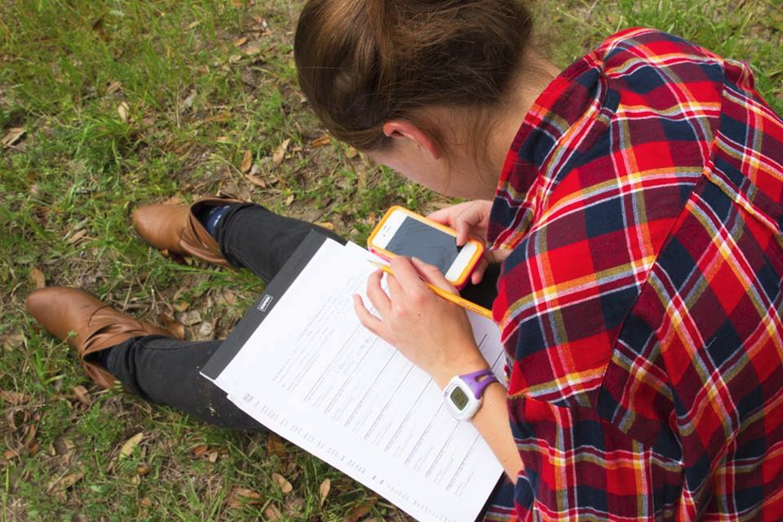
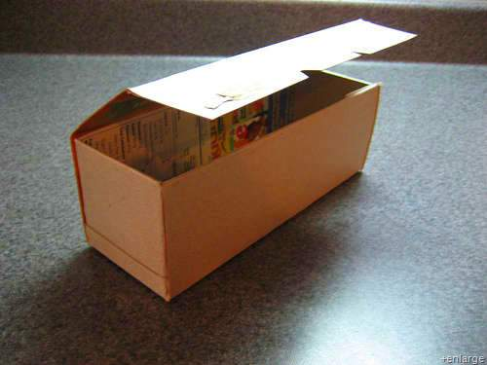

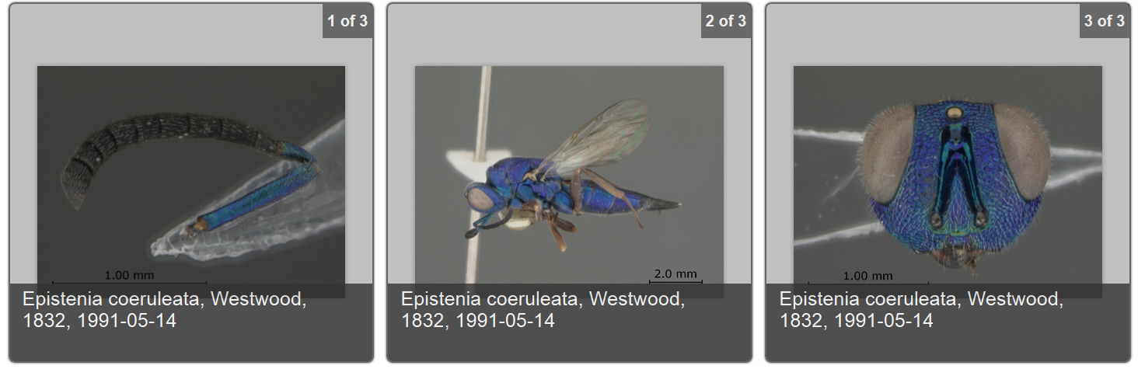



Some examples of standards for sharing biodiversity data & where do they come from?
Data
Standards
specimens & observations
specimen & observation
datasets
media
derivatives
Darwin Core (DwC)
Ecological Metadata Language (EML)
Audubon Media Core
Material Sample Core and GGBN Extensions, ...
WHO, WHAT, WHERE, WHEN
Notes:
These are some of the standards currently being used in the life sciences for sharing data.
Sharing media
What’s in the image, recording, video? Where was it taken?
Who took the photo, made the recording, created the SEM, CT scan?
Is the media under copyright? Or is it public domain?
Where can more / different formats of the media resource be found?
Management, Attribution, Agents, Content Coverage, Geography, Temporal Coverage,
Taxonomic Coverage, Resource Creation, Related Resources, Service Access Point
See more about these images at https://www.idigbio.org/portal/mediarecords/b9dc0746-e2b8-4bae-a301-b20b054f9117
For GGBN info see http://ggbn.org/ The category of information pertaining to the physical results of a sampling (or subsampling) event. In biological collections, the material sample is typically collected, and either preserved or destructively processed. Created 2 Apr 2014 with all Simple Darwin Core ratified terms.
GGBN Amplification Extension
GGBN DNA Cloning Extension
GGBN Gel Image Extension
GGBN Loan Extension
GGBN Material Sample Extension
GGBN Permit Extension
GGBN Preparation Extension
GGBN Preservation Extension

Slide 28

Data publishing - why do it?
Are you sharing yet?
add to global knowledge
collaborative discovery
enhance institution visibility
impact metrics for use of data
meet data-sharing requirements
https://www.gbif.org/en/publishing-data
Notes:
https://www.gbif.org/en/publishing-data
How many of you are sharing data?
How many of you are re-using data / creating synthetic datasets?

Slide 29
Data publishing
what, who, how, where, when
https://www.gbif.org/en/publishing-data
some classes of data you might data publish
resource metatdata
checklist
occurrence-only data
sampling event
who might publish datasets
individual
research team
citsci
organization/institution
government
find out about
how
where and when at the #datahelpdesk
Notes:
https://www.gbif.org/en/publishing-data
https://www.researchgate.net/profile/Lyubomir_Penev/publication/265422943_Pensoft_Data_Publishing_Policies_and_Guidelines_for_Biodiversity_Data/links/5410c8a00cf2f2b29a411603/Pensoft-Data-Publishing-Policies-and-Guidelines-for-Biodiversity-Data.pdf

Slide 30




Data uptake
use going up
uses expanding
methods development
data fitness measures
reviewing SOP
required to share FAIR
GBIF Data Trends 2008 to 2019
all, animalia, plantae
iDigBio portal data use*
GBIF data - annual peer-reviewed articles
Notes:
https://www.gbif.org/en/analytics/global
Data sharing trends
requirements to publish data
to share data openly
number of publications
linking data

Slide 31
Data use trends
Collections Biodiversity Data - expected and emerging uses
Important Human Uses
Emerging Research Angles
Evolutionary medicine,
Disease discovery, tracking, and treatment
Food security,
Biodiversity conservation and sustainability,
Computation,
Design,
Evolution and justice,
New types of biodiversity theories to facilitate use of newly emerging data streams.
Supplementing existing datasets with digital layers to enhance niche and species distribution modeling,
Use of 3D/CT data for generating and testing new hypotheses,
Implementation of convolutional neural networks (CNN) and deep learning in the analysis of image,
Data for taxonomic determination and specimen curation,
Delineation of traits in specimen images,
Determination and identification to genus or species from, sediment-deposited pollen grains.
Nelson G, Ellis S. 2018. The history and impact of digitization and digital data mobilization on biodiversity research. Philosophical Transactions of the Royal Society B Volume 374 Issue 1763 https://doi.org/10.1098/rstb.2017.0391

Slide 32

Data publishing conversation
Exercise: for the ecologist, collector, policy maker, or other downstream user of biodiversity data (e.g. collections), what issues do you see when considering publishing your datasets
Exercise: for the ecologist, collector, policy maker, or other downstream user of biodiversity data (e.g. collections), what issues need to be addressed before you can use published biodiversity data?
List three major challenges
Actions, tools, and influence
List three major challenges
Actions, tools, and influence
Notes:
list as many challenges as you can think of and then group them.
b. share your findings
c. any actions you can take to improve any of these issues? which are in your control or influence? who else or what tool might be able to help?
For ecologists, what do you think data sharing and publishing will be like in 25 years?

Slide 33

How many of you think data should be shared?
How many of you are sharing data?
How many of you are re-using data / creating synthetic datasets?
What are your top two issues that come to mind when considering publishing to share your data?
For ecologists, what do you think data sharing and publishing will be like in 25 years?
How many of you collect data / samples as you learned originally? How often do you review your data collection / sampling protocols? Do you review your SOP > “systematically review, analyze and specify how data can most efficiently be supplied to fit the needs of these primary biodiversity-monitoring processes.”

Slide 34



ESAUSSEE Data Help Desk
Who we are and how to find us (in the exhibit hall)
Amber Budden, @aebudden, @DataONEorg, aebudden@nceas.ucsb.edu
Christina Alba, @botanic, christina.alba@botanicgardens.org
Christine Laney, @cmlaney, @NEON_sci, claney@battelleecology.org
Deborah Paul, @idbdeb, @idigbio, dpaul@fsu.edu
Dmitry Schigel, @dschigel, @GBIF, dschigel@gbif.org
Jeanette Clark, @sjeanetteclark, @ArticDataCtr, jclark@nceas.ucsb.edu
Karl Benedict, @kbene, @ESIPfed, kbene@unm.edu, president@esipfed.org
Kelsey Yule, @kmyule, biorepo.neonscience.org, kmyule@asu.edu
Kristin Vanderbilt, @vanderbik, @EDIgotdata, krvander@fiu.edu
Kyle Copas, @kylecopas, @GBIF, kcopas@gbif.org
Laura Brenskelle, @lbrensk, @idigbio, lbrensk@ufl.edu
Margaret O'Brien @obrienmobb, @EDIgotdata, margaret.obrien@ucsb.edu
Megan Jones, @MeganAHJones, @NEON_sci, mjones01@battelleecology.org
Nico Franz, @taxonbytes, biorepo.neonscience.org, nico.franz@asu.edu
Rebekah Wallace, www.eddmaps.org, bekahwal@uga.edu
Stevan Earl, @StevanEarl, stevan.earl@asu.edu
William Michener, @DataONEorg, william.michener@gmail.com
Stevan
William

Slide 35

Using botanical collections to find uncommon species and spark new research hypotheses
Chrissy Alba, Richard Levy, Rebecca Hufft
Denver Botanic Gardens

Slide 36




Biomass
Nutrient cycling
Fire regimes
Invasion dynamics
Main contributions to richness
Abundance
Species new to science
Endemic or T&E species
Incipient invaders
1
10
300
Species Rank
Notes:
Use species-rank abundance curve to get ecologists thinking about where they concentrate their sampling (abundant species) and where botanists often concentrate their sampling (capturing uncommon species along the long tail in this graph). Some examples of the different foci of ecologists (biomass by treatment, nutrient cycling effects of fire, etc.) versus botanists (building floras, finding species new to science, finding T&E species, etc.). The different foci lead to some siloing of ecologists/botanists and we could all benefit from working together.

Slide 37
Think about any ecological question that you study.
Distill one of your most interesting/critical hypotheses
Think about where your sampling design places you on this continuum (i.e., from abundant to rare species).
Brainstorm how knowing something about the species on a different part of the continuum could inform your research.
Notes:
Interactive slide. As people to consider their own research questions. Where do they fall on the abundance continuum? What new information or patterns might they see if they got more information about the less abundant species at their research sites?

Slide 38





71-mile recreation trail
Runs from the foothills to the plains
Variation in land use
Notes:
Give quick overview of an example of what I mean using the High Line Canal greenway as an example.

Slide 39

Comparison of approaches:
Richness estimates
78 Families
288 Genera
40 Families
99 Genera
Notes:
Graph shows how many species are captured by botanical collectors versus ecologists working on transects or plots.

Slide 40






~50% of cover comprises three introduced grasses
Canal contains nearly 20% of all species found in Colorado
Abundance
Smilax lasioneura
Bouteloua gracilis
Euonymus
europaeus
1
Species Rank
300
Notes:
What different kinds of information were we able to generate by looking at both the abundant species and the uncommon species? Hypothesis generation about species on the long tail of the curve.

Slide 41

Notes:
Best option would be to collaborate on the ground. But short of that, can use SEINET as a tool to explore species in your work area. Might help to put some of those more uncommon species on your radar.

Slide 42

Notes:
Example of a specimen search that includes the High Line Canal greenway talked about previously. Great way to mine data on species presence that already exists.

Slide 43

Benefits of openess
Increases the efficiency of research Promotes scholarly rigor and quality of research Enables tracking of data use and data citation through DOIs Expands the spectrum of academic products through data papers Enhances visibility and scope for engagement Enables researchers to ask new research questions Enhances collaboration and community-building Increases the economic and social impact of research International conventions and requirements from funding agencies
Piwowar et al. 2007

Slide 44
Data sharing
SHORT TERM
LONG TERM
perspective
RESEARCH PHASE
DISSEMINATION PHASE
PRESERVATION
PHASE
file formats
ownership
metadata
storage
backups
share with whom?
embargo?
licensing
metadata
repository?
long-term manager?
Sophie Kay 2013 (Open Science Training Initiative) CC-BY 3.0.

Slide 45

Notes:
Hello,
My name is Joe Miller, I am Executive director of the Global Biodiversity Information Facility, GBIF.
What you see in the background is the map of the digitally known biodiversity, 1.3 billion records of fungi, plants, animals and other organism. These data were compiled, cleaned and published in 20 years of existence of GBIF.

