Slide 1
Business Process Management and Modeling

Slide 2
Two Key Aspects
Tools for Today: Utilize effective methods to gather information and model workflows
Tools for Ongoing Operations: Review/Refine and maintain effective processes (i.e., continuous workflow improvement)
Improve Throughput, Cost, Other Key Metrics
Efficient use of personnel and physical resources (reduce idle time)
Sufficient redundancy and risk mitigation (risk management at each step)

Slide 3
Tools for Today
Difficult to draw a workflow diagram as the initial step
Break the activity into manageable chunks
Modules (various modules for various circumstances; reproducible across disciplines)
Task Groups
Create a numbered task list (Work Breakdown Structure)
Contains all tasks for the discrete unit
Order is initially unimportant (brainstorm)
Number the tasks within each module or task group (Example: “M1, T1”)
After tasks have been identified, identify dependencies
List the task number(s) that are dependencies for each task (if applicable)
Identify the dependency type
Finish-to-Start (FS): Task B cannot begin until Task A has been completed. This is the most common. Example: “Photograph Specimen” (B) cannot start until “Position Specimen for Imaging” (A) has finished
Start-to-Finish (SF): Task A must begin before Task B can finish. Extremely rare, and likely not to be utilized in any workflow
Start-to-Start (SS): Task A must begin before Task B can begin. Example: “Identify Specimens to be Digitized” (A) must begin before “Remove Specimens from the Collection” (B) can begin
Finish-to-Finish (FF): Task A must finish before Task B can finish. Rare. Example: “Train Workers to Retrieve/Return Specimens” (A) must finish before “Digitized Specimens Returned to the Collection” (B) can finish
Identify resource(s) required for the task – both human resources and physical resources
Identify any required lag times involved between dependent tasks.
Example: placing a wet herp specimen in a shallow tank (Task A) for imaging (Task C) has a ~30-second lag time (waiting for ripples to diminish before taking the image)
May also be expressed as a separate task (i.e., Task B = wait for ripples to diminish)
Hint: Tasks that don’t have strict dependencies enable workforce flexibility, feeding the social motivation factors

Slide 4
Tools for Ongoing Operations
Workflow optimization techniques are numerous, but all have core similarities
Plan/Design/Document the process
Measure the process, end-to-end (observation, self-reporting, automated data collection points, log sheets)
Review the measurements and identify issues (excessive queue times, idle resources)
Identify opportunities for improvement and implement (include employee input, root causes may be separated from the symptom by several steps)
Rinse, repeat #2 - #4
Objective, data driven, analytical
Well-documented workflows can seed checklists
Time-centric, but can readily be converted to cost-centric measurements
The duration of a workflow cannot be decreased unless the duration of the Critical Path (your longest chain of dependent events) is decreased
Break some tasks into smaller units that can run in parallel
Simplify/automate tasks
Reassign resources
Bottlenecks off the Critical Path “don’t matter”
You will always have a Critical Path

Slide 5
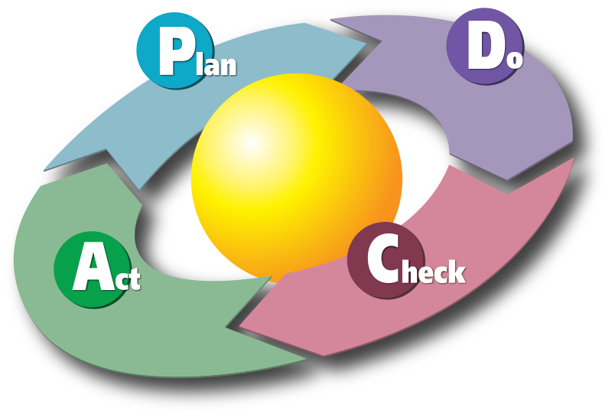
Plan-Do-Check-Act (Deming Cycle)

Slide 6
Tools for Ongoing Operations
Six Sigma DMAIC
Define
Write down what you currently know. Seek to clarify facts, set objectives and form the project team. Define the following:
A problem statement, the customer(s), Critical to Quality (CTQs) — what are the critical process outputs?, the target process and other related business processes, project targets, project boundaries
Measure
This is the data collection step. The team decides on what should be measured and how to measure it. This forms a data collection plan. It is usual for teams to invest a lot of effort into assessing the suitability of the proposed measurement systems. Good data is at the heart of the DMAIC process:
Define the process critical Xs (inputs) and Ys (outputs)
Define the measurement plan
Test the measurement system
Collect the data
Analyze
The data collected in the Measure step is analyzed to determine root causes of defects.
Identify gaps between current performance and goal performance
Identify how the process inputs (Xs) affect the process outputs (Ys)
List and prioritize potential opportunities to improve
Identify sources of variation
Improve
Identify creative solutions to fix and prevent process problems
Create innovate solutions, focus on the simplest and easiest solutions, test solutions, deploy improvements
Control
Monitor the improvements to ensure continued success, create a control plan, update documents/business process/training records as required.

