Slide 1
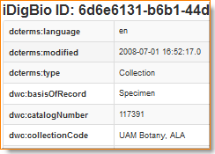
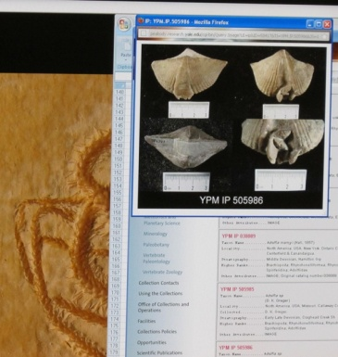
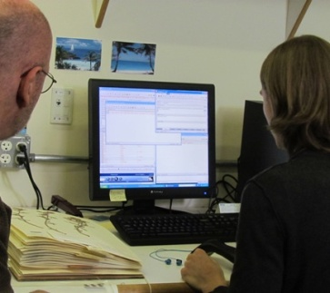
Sharing Data
decisions - opportunities - options
Deborah Paul, Gil Nelson
Digitization Workshop September 17 – 18, 2012
support from NSF grant: Advancing Digitization of Biological Collections Program (#EF1115210)

Slide 2
Sharing Data
the big picture
GUIDS and associated identifiers
a common language
data export - data import
where to share
We look forward to your input & your data!
Notes:
revisualization
decisions / opportunities / options
enhanced / curated data
data quality / data enhancement / data discovery

Slide 3
Notes:
Sharing Data.
specimen database
aggregators / portals – iDigBio, GBIF, EOL
ontologies- BioPortal
publications
maps
databases – GenBank, BOLD
provider websites – a museum may have their own portal
data repatriation, enhancement – Filtered PUSH
data cleaning / cleansing – Kepler Kurator, Google Refine

Slide 4
FilteredPUSH
Kepler Kurator
D I S C O V E R L I F E
Notes:
Sharing Data.
specimen database
aggregators / portals – iDigBio, GBIF, EOL
ontologies- BioPortal
publications
maps
databases – GenBank, BOLD
provider websites – a museum may have their own portal
data repatriation, enhancement – Filtered PUSH
data cleaning / cleansing – Kepler Kurator, Google Refine

Slide 5
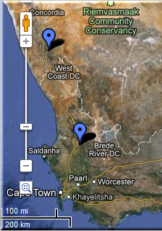
FilteredPUSH
GenBank ®
Kepler Kurator
D I S C O V E R L I F E
Cladistics ®
Notes:
Sharing Data.
specimen database
aggregators / portals – iDigBio, GBIF, EOL
ontologies- BioPortal
publications
maps
databases – GenBank, BOLD
provider websites – a museum may have their own portal
data repatriation, enhancement – Filtered PUSH
data cleaning / cleansing – Kepler Kurator, Google Refine

Slide 6
FilteredPUSH
GenBank ®
Kepler Kurator
D I S C O V E R L I F E
Cladistics ®
Notes:
Sharing Data.
specimen database
aggregators / portals – iDigBio, GBIF, EOL
ontologies- BioPortal
publications
maps
databases – GenBank, BOLD
provider websites – a museum may have their own portal
data repatriation, enhancement – Filtered PUSH
data cleaning / cleansing – Kepler Kurator, Google Refine

Slide 7
GUIDs are key Maintaining and Sharing Identifiers
1 to many IDs known for a given object
store and share the ones you know about
Specimen RecordID 19537
Specimen Previous Catalog Number 212345
Specimen Catalog Number / bar code bbbrc000123
Darwin Core Triplet (DwC) InstitutionCode:CollectionCode:bbbrc000123
DwC OccurrenceID urn:catalog:institutionCode:collectionCode:bbbrc000123
Specimen GUID of type lsid urn:lsid:biocol.org:bbbrc:bbbrc000123
Specimen Opaque Identifier (UUID) 424854d7-baec-42cf-a142-805b64117b9f
*Specimen GUID of type URI http://ids.flmnh.ufl.edu/herb/bbbrc000123
Notes:
For more on GUIDs for upload to iDigBio,
see our suggestions / policy at:
https://www.idigbio.org/sites/default/files/iDigBio-GUID-Statement20MAR2012.pdf

Slide 8
GUIDs are key Maintaining and Sharing Identifiers
apply a given id to only one object ever
if something happens and that object no longer exists in the physical collection –
never reassign the identifier to another object in the collection
iDigBio’s GUID Policy and Suggestions
Notes:
For more on GUIDs for upload to iDigBio,
see our suggestions / policy at:
https://www.idigbio.org/sites/default/files/iDigBio-GUID-Statement20MAR2012.pdf
For more about how GUIDs will make all of this work for us
See biscicol
http://biscicol.blogspot.com/2012/08/the-biscicol-project-team-has-had-busy.html

Slide 9
GUIDs
FilteredPUSH
Kepler Kurator
GenBank ®
D I S C O V E R L I F E
Cladistics ®
Notes:
Sharing Data.
GUIDs are the Key
specimen database
aggregators / portals – iDigBio, GBIF, EOL
ontologies- BioPortal
publications
maps
databases – GenBank, BOLD
provider websites – a museum may have their own portal
data repatriation, enhancement – Filtered PUSH
data cleaning / cleansing – Kepler Kurator, Google Refine
provider sites – http://herbarium.bio.fsu.edu
consortium websites through portals: http://symbiota.org/tiki/tiki-index.php?page=Data+Nodes
SERNEC, North American Bryophyte and Lichen Consortia, SEINet
Revisualization - discovery
Unforseen errors revealed
Taking it in stride
Opportunities, Benefits, Decisions
Specify’s Scatter-Gather-Reconcile (SGR)
duplicates found
dataset for checking is increasing in size
example, at least 50% dupes
lending credence to the skeletal dataset concept
Filtered PUSH (works with Specify, Symbiota and Morphbank)
finding dupes
the benefits of shared datasets
lending credence to the skeletal dataset
finding annotations (determinations, general comments)
to import or not to import

Slide 10
Sharing Data
the big picture
GUIDS and associated identifiers
a common language – data standards
data export - data import
where to share
We all look forward to your questions & your data!
Notes:
revisualization
decisions / opportunities / options
enhanced / curated data
data quality / data enhancement / data discovery

Slide 11
Darwin Core Standard
http://rs.tdwg.org/dwc/terms/
Darwin Core (often abbreviated to DwC) is a body of data standards which function as an extension of Dublin Core for biodiversity informatics applications, establishing a vocabulary of terms to facilitate the discovery, retrieval, and integration of information about organisms, their spatiotemporal occurrence, and supporting evidence housed in biological collections. It is meant to provide a stable standard reference for sharing information on biological diversity^{[1]}
Does Darwin Core cover every field possible? – No
Don’t panic! There are extensions and other options.

Slide 12
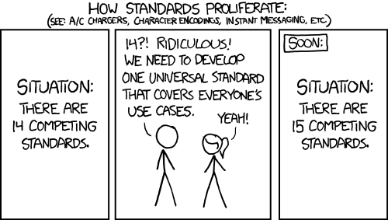
http://xkcd.com/927/

Slide 13
Data Mapping & Export
Herbarium A Herbarium B Darwin Core
barcode == accessionNumber == catalogNumber
collectorNumber == collection Number == recordNumber
collector == collectedBy == recordedBy
All mapped up and ready to go – now what?
Data Export Example.
How do you get your data out of your database?
Schema Mapper tool
Data Exporter tool > creates a temporary table in your database
Data Exporter > tab-delimited text file for import into IPT
Install IPT, Register at GBIF using the IPT
Use the text file with the IPT for upload to GBIF, some mapping may be required
Publish your data
Extensions for more data types: e.g. Audubon Core for Media files
Notes:
http://www.slideshare.net/nielsklazenga/specify-6byandybentley-2

Slide 14
Import & Export Clean Data
Workbench-type strategies
No matter the chosen database
clean the data first e.g.
Kepler Kurator
Google Refine
SQL, Reports,
(as discussed in pre / post digitization)

Slide 15
Data Export
General users download occurrence data from search page as Darwin Core CSV files or raw Symbiota
Data managers
create backup file as a compressed set of Symbiota CSV files (occurrences, determination history, and image links)
IPT instances are set up for the portals on the Symbiota servers (lichens, bryophytes, SCAN, and MycoPortal).
each collection can choose to send data to GBIF themselves or
via the portal.
Future: Symbiota
automated packaging of data as Darwin Core archive files.
Control panel, collection managers refresh the DwC archive whenever they wish.
the ability to turn on or off publishing.
Notes:
From Ed Gilbert
General data users can download occurrence data from the search page as Darwin Core CSV files or raw Symbiota
Data managers can save a backup file as a compressed set of Symbiota CSV files (occurrences, determination history, and image links)
We (Symbiota) have setup IPT instances for the portals on the Symbiota servers (lichens, bryophytes, SCAN, and MycoPortal). We are now going to ask each collection if they want us to publish their data to GBIF in their name. Collections that are already publishing their data on their own will not be published again through the portal.
Future: Symbiota will have the built-in capability of packaging data as Darwin Core archive files. Through the control panel, collection managers will have the ability to refresh the DwC archive whenever they wish. They will also have the ability to turn on or off publishing.

Slide 16
Data Export
Each NHM client
initial mapping process with EMu staff
mapping to DwC 1.2 (aka v2)
use Automated Export to create desired file
CSV
text
Crystal Report
use DwC CSV file with IPT to create DwC-A file
DwC-A file is shared with GBIF
GBIF – harvests periodically and replaces an old dataset with a newer one.
data is replaced (a new cache) not stored and versioned.

Slide 17
DwC-A and the IPT
DwC-A = Darwin Core Archive – contains 3 or more files
GUIDs make this possible
IPT = Integrated Publishing Toolkit creates the DwC-A
csv file – e.g. your specimen data records
meta.xml – a file that explains the contents of each column in the csv file
eml.xml – information about the data provider and what data is provided
extensions – extending what the IPT can do.
image records for the specimens
http://tools.gbif.org/
http://tools.gbif.org/dwca-assistant/
Notes:
Ecological Markup Language – EML

Slide 18
DwC-A
mySpecimenData.csv
occurrenceID,recordedBy,scientificName,field name,field name,field name
http://www.ids.flmnh.edu/herb/123555,C L Barkley,Carex maritima,value,value,value
http://www.ids.flmnh.edu/herb/123556,Aaron Thompson,Carex maritima,value,value,value
http://www.ids.flmnh.edu/herb/123559,Marsha Corwin,Carex maritima,value,value,value,
eml.xml
https://code.google.com/p/gbif-indexingtoolkit/source/browse/trunk/harvest-webapp/src/test/resources/org/gbif/harvest/dwcarchive/ebird/eml.xml?r=1676
meta.xml
<archive xmlns="http://rs.tdwg.org/dwc/text/" xmlns:xsi="http://www.w3.org/2001/XMLSchema-instance" xsi:schemaLocation="http://rs.tdwg.org/dwc/text/ http://rs.tdwg.org/dwc/text/tdwg_dwc_text.xsd"> <core encoding="UTF-8" fieldsTerminatedBy="\t" linesTerminatedBy="\n" fieldsEnclosedBy='' ignoreHeaderLines="0" rowType="http://rs.tdwg.org/dwc/terms/Taxon"> <files> <location>taxa.txt</location> </files> <id index="0" /> <field index="2" term="http://rs.tdwg.org/dwc/terms/recordedBy"/> <field index="3" term="http://rs.tdwg.org/dwc/terms/scientificName"/> <field index="4" term="http://rs.tdwg.org/dwc/terms/fieldName"/> <field index="5" term=" http://rs.tdwg.org/dwc/terms/fieldName "/> <field index="6" term="http://rs.tdwg.org/dwc/terms/fieldName"/> </core>
images.csv
occurrenceID,identifier, field,field name,field name,field name
http://www.ids.flmnh.edu/herb/123555,http://www.myimages.org/images/herb123555.jpg
http://www.ids.flmnh.edu/herb/123556,http://www.myimages.org/images/herb123556.jpg
http://www.ids.flmnh.edu/herb/123559,http://www.myimages.org/images/herb123559.jpg
http://www.ids.flmnh.edu/herb/123559,http://www.myimages.org/images/herb123560.jpg

Slide 19
the difference
Full record-level information discovery and delivery
Metadata harvesting protocols
GUID per record with persistence
Attribution metadata with all data records
Media information ala Audubon Core
Bi-directional portal
Feed back from data users to providers (e.g. data quality)
Usage analytics
Attribution to providers from analysis
Annotation management
Active repository technology
Cloud computing infrastructure
We will be a GBIF cyber infrastructure partner
E.g. IPT extension for Audubon Core
Darwin Core Archive delivery of query results

Slide 20
the difference
Ingest all contributed data with emphasis on GUIDs, not only a restricted set of selected data elements
Maintain persistent datasets and versioning, allowing new and edited records to be uploaded as needed
Ingest textual specimen records, associated still images, video, audio, and other media
Ingest linked documents and associated literature, including field notes, ledgers, monographs, related specimen collections, etc.
Provide virtual annotation capabilities and track annotations back to the originating collection
Facilitate sharing and integration of data relevant to biodiversity research
Provide computational services for biodiversity research
Active repository technology
Cloud computing infrastructure
We will be a GBIF cyber infrastructure partner
E.g. IPT extension for Audubon Core
Darwin Core Archive delivery of query results

Slide 21
Import to iDigBio
iDigBio
CSV files, DwC-A file + extensions, and…
goal to allow all possible data w/o limitations from a given standard
“if a field is valuable – it will someday be in a standard” (Schuh 2012)
standards

Slide 22
Sharing with Morphbank 2* methods
Excel Workbook
map your fields to Morphbank fields
external ids required
Specify > Morphbank plug-in
xml mapping to Morphbank XML schema
external ids required

Slide 23
More Ways to Share Data
Thematic Collection Networks (TCNs)
have data ready to share?
fits a current TCN theme?
Partners to Existing Networks (PENs)
join the effort
Through an existing portal or repository
Symbiota
VertNet
Morphbank
GBIF
Help is everywhere!

Slide 24
Many thanks to you from
We look forward to your input at iDigBio. We need your voices. Here’s to getting your collection’s data online available to everyone!
Valdosta State University (VSU)
and all participants at the iDigBio Vascular and Non-vascular Plant Digitization Workshop, September 17 – 18, 2012 hosted by Valdosta State University

Slide 25
Data Feedback, Corrections, Options
Revisualization - discovery
Unforseen errors revealed
Recent Morphbank – SERNEC Symbiota Portal example
Taking it in stride
Opportunities, Benefits, Decisions
Specify’s Scatter-Gather-Reconcile (SGR)
duplicates found
dataset for checking is increasing in size
example, at least 50% dupes
lending credence to the skeletal dataset concept
Filtered PUSH (works with Specify, Symbiota and Morphbank)
finding dupes
the benefits of shared datasets
lending credence to the skeletal dataset
finding annotations (determinations, general comments)
to import or not to import

Slide 26
Evaluating Protocols Hardware – Software – Data Entry
Avoid stove-piping & N-I-H
utilize existing protocols
find the best fit, edit to suit
share your changes / new strategies / logic
https://www.idigbio.org/content/digitization-workflows
Developing , Writing Evaluating Protocols
engage staff
engage the community
“learn from each others point-of-view and approach to the material.” Enterprise 2.0

