Slide 1

Pre & Post Digitization Curation
decisions - opportunities - options
Deborah Paul, Gil Nelson
Valdosta State University, September 17 – 18, 2012
iDigBio Digitizing Vascular and Non-vascular Plant Collections Workshop
support from NSF grant: Advancing Digitization of Biological Collections Program (#EF1115210)

Slide 2
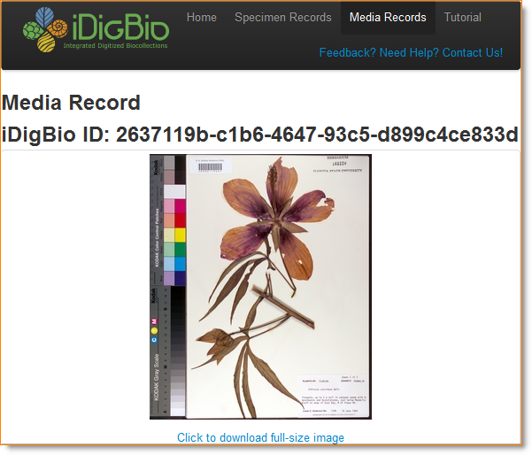
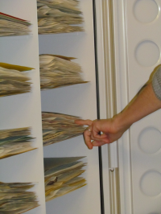
Pre & Post Digitization Curation
Notes:
Specimens from here to eternity – no –
from your collection into a database into ours, and lots of other databases
and into papers, publications, websites,…

Slide 3
Overview
5 task clusters
Pre-digitization curation
Decisions / Opportunities / Options
Key point: specimen handling is an opportunity
Post-digitization curation
Revisualization is revealing
Data Quality / Data Enhancement / Data Discovery

Slide 4
Characterizing Workflows
We can divide activities into coherent groups Task Clusters
pre-digitization curation
data capture & processing
imaging capture
image processing
image storage
The entire workflow process
Data Quality
Data Integrity
Notes:
Concern for and attention to data “fitness for use” is a concern of the entire process of making data digitally accessible.

Slide 5
DROID Workflows Workshop
Developing Robust Object to Image to Data Workflows
Workflows by storage type
DROID1 – flat sheets
Module 1 – Pre-digitization Curation
Notes:
DROID Workflows Workshop
ongoing work to typify workflows by collection storage type
creating modules for the design of efficient workflows
Check out the NEDCC.
See the following document at iDigBio for tasks of pre-digitization curation of specimens on “flat sheets.”
Many of the steps can be seen as optional. The purpose of these lists is to help collections design
efficient workflows, pointing out what can be done and what the ramifications are downstream of different choices to do a task “now” or put it off until later.
https://www.idigbio.org/sites/default/files/sites/default/files/Module_1_Pre-digitization_Curation_Tasks_0.pdf

Slide 6
DROID1 – Pre-Digitization Module
Pre-digitization Curation for Flat Sheets
each module has tasks, T1, T2, T3, T4, …
designed to help projects choose steps appropriate to their collection and digitization project
ff-fb (again)
Notes:
https://www.idigbio.org/sites/default/files/sites/default/files/Module_1_Pre-digitization_Curation_Tasks_0.pdf

Slide 7
Pre-Digitization Module Tasks
T1 – apply storage locator barcodes
T2 – selecting what to digitize
T3 – apply machine readable barcodes at collection level
T4 – locate specimens (flag cabinets)
T5 – pull specimens from cabinet*
*(optional) sort by collector, date, geography
T6 – curate collection in place (check nomenclature and annotations)
Notes:
See https://www.idigbio.org/sites/default/files/sites/default/files/Module_1_Pre-digitization_Curation_Tasks_0.pdf
for details of each task, associated options and comments.

Slide 8
Pre-Digitization Module Tasks
T7 – transport specimen to imaging station
T8 – placeholder to flag pulled specimens
T9 – sort to remove any already imaged / barcoded
T10 – separate specimens needing conservation work before imaging
T11 – apply barcodes
T12 – create skeletal database record
Notes:
See: https://www.idigbio.org/sites/default/files/sites/default/files/Module_1_Pre-digitization_Curation_Tasks_0.pdf
for details for these pre-digitization module tasks.

Slide 9
Pre-Digitization Opportunities
evaluate collection health
aka “collection profiling”
Profiling Natural History Collections: A Method for Quantitative and Comparative Health Assessment
hard data for museum directors & administrators
“an important tool in reinvigorating collection management and in particular providing data to support funding requests.”
finding unknown unknowns and lost material
experts or non-experts?
high-hanging fruit (or tasks perhaps long put off)
cabinet reorganization
equipment updates
loan returns
specimen repair

Slide 10
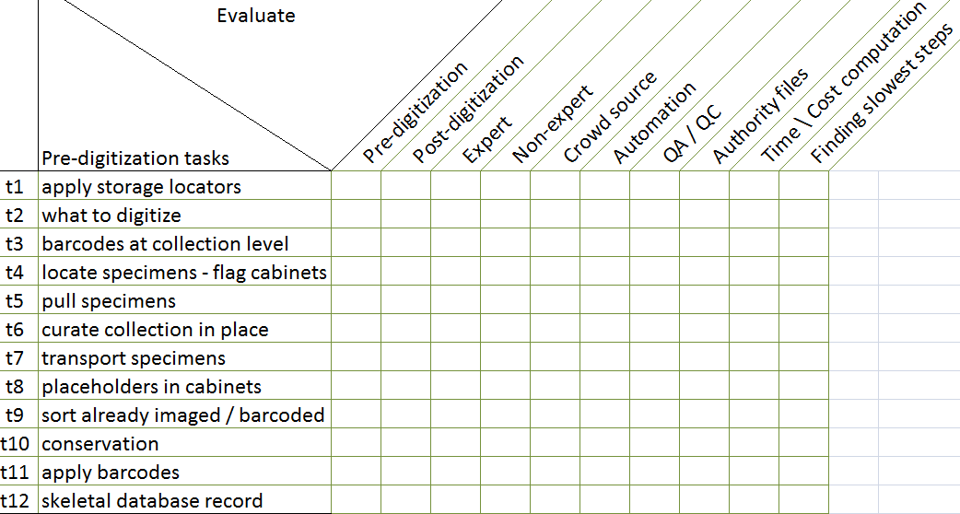
Evaluate Pre-Digitization Module Tasks
Keep staffing in mind as well as
new developments
track issues / document
decisions, opportunities, options

Slide 11
Factors for Task Order
are experts needed?
where will conservation fit in?
how will materials from conservation get back into the digitization workflow?
“filed as” or up-to-date taxonomy?
collection size factor
isolating steps that can be done after digitization
reliance on the database
“imaged” written in ink or pencil on specimen?
*how many are actively using the collection?
*how do those using the collection cooperate in this process?
Notes:
Example, using the “filed as” strategy saves a lot of time up front, but plans need to be put in place to deal with feedback from exposed exported data and update of the data after digitization.
Issues discussed with Dorothy Allard at the Reception for this workshop.
Would Yammer help those using the collection (but not seeing each other in the herbarium) help?

Slide 12
Overview
5 task clusters
Pre-digitization curation
Decisions / Opportunities / Options
Key point: specimen handling is an opportunity
Post-digitization curation
Revisualization is revealing
Data Management
Data Quality / Data Enhancement / Data Discovery
Notes:
Data Management – Curating the Digital Collection

Slide 13
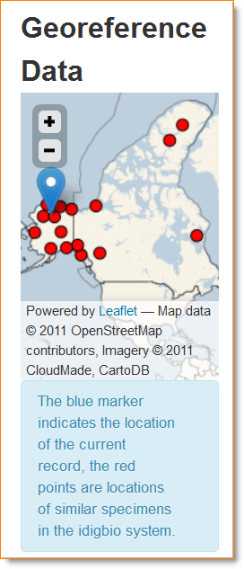
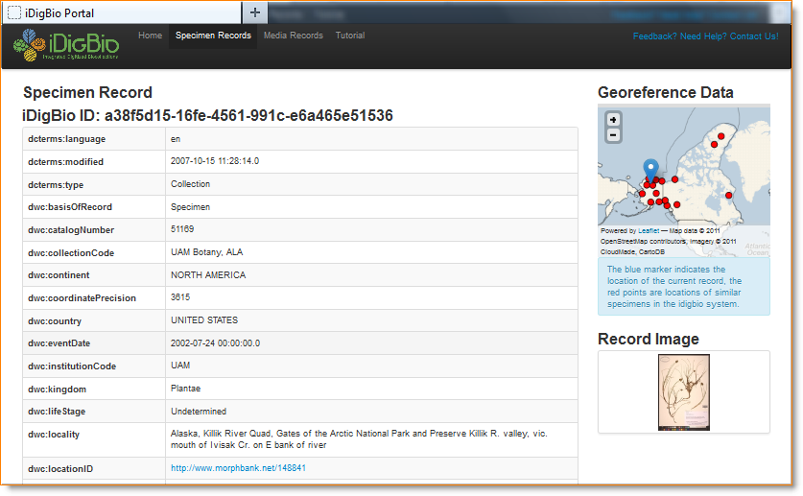
Revisualization
Notes:
Carex maritima

Slide 14
Post-Digitization Data Curation – Data Management
Revisualization is revealing
Querying dataset to find / fix errors
filename errors
typos
georeferencing errors
taxonomic errors
guid errors
format errors (dates)
mapping (from Workbench for example)

Slide 15
Post-Digitization
Using new tools
Kepler Kurator – Data Cleaning, Data Enhancement
Google Refine, desktop app
from messy to marvelous
http://code.google.com/p/google-refine/
remove leading / trailing white spaces
standardize values
Query / Report / Update features of Databases
Learn how to query your databases effectively
Learn MySQL
Notes:
Check out more about Kepler Kurator
http://daks.ucdavis.edu/?page_id=205
Specimen Curation Workflow with Kepler: http://www.youtube.com/watch?v=DEkPbvLsud0
From Kepler posting on web at: http://daks.ucdavis.edu/?page_id=205
Diverse services and tools can be conveniently integrated into a workflow through the actors, helping data curation in various dimensions: e.g. there are visualization services (Google Maps) which help spot quality problems in input datasets; domain-specific services (e.g., GeoLocate, IPNI, GNI, FNA) can be used to identify and correct, for example, geo-reference errors, scientific name errors, etc.; common curation operations like duplicate identification and consensus; and other useful utility services like authentication/authorization services (e.g. OAuth), data sharing services (e.g. Google Spreadsheet) and communication services (e.g. E-Mail and SMS Text Messaging) are provided as well.
Apple Pie is a project of Filtered PUSH. Annotate Specimen, Remote Data Capture, , Find Duplicates
Filtered PUSH uses Kepler Kurator.
Symbiota, Specify, Morphbank, are connected in test versions to prove the concept works.

Slide 16
Post-Digitization
Exposing Data to Outside Curation – Yipee! Feedback
Data Discovery
dupes, grey literature, more complete records, annotations of many kinds, georeferenced records
Filtered PUSH Project
Scatter, Gather, Reconcile – Specify
iDigBio
Planning for Ingestion of Feedback – Policy Decisions
re-determinations & the annotation dilemma
to re-image or not to re-image
“annotated after imaged”
to attach a physical annotation label to the specimen from a digital annotation or not (Flora of North America)
Notes:
Annotations coming back to a collection manager from the outside.
To accept or not?
If accepted – uploaded into the database as a newer determination (or historical legacy annotation) for the specimen. Place a label on the physical specimen? Re-image or not due to new annotation?

Slide 17
Post-Digitization
Managing Data Enhancement
Crowd-Sourcing
completing skeletal records
georeferencing
multi-keying
Geolocate
Symbiota
Opportunities for
Data Quality
Data Integrity
Data Enhancement
Sharing the data (the other presentation).
Everyone is looking forward to lots of new datasets!

Slide 18
Assessing Digitization Tasks
Reed Beaman, James Macklin, Michael Donoghue, James Hanken. 2007. Overcoming the Digitization Bottleneck in Natural History Collections: A summary report on a workshop held 7 – 9 September 2006 at Harvard University.
ĺñigo Granzow-de la Cerda and James H. Beach. December 2010. Semi-automated workflows for acquiring specimen data from label images in herbarium collections. Taxon 59 (6): 1830-1842
Bryan Kalms. Digitisation: A strategic approach for natural history collections. Canberra, Australia, CSIRO, 2012.
John Tann & Paul Flemons. 2008. Report: Data capture of specimen labels using volunteers. Australian Museum
Ana Vollmar, James Alexander Macklin, Linda Ford. 2010. Natural History Specimen Digitization: Challenges and Concerns. Biodiversity Informatics 7 (1): 93 – 112
Favret C, Cummings KS, McGinley RJ, Heske EJ, Johnson KP, Phillips CA, Phillippe LR, Retzer ME, Taylor CA, Wetzel MJ. 2007. Profiling Natural History Collections: A Method for Quantitative and Comparative Health Assessment. Collection Forum 22(1–2): 53 - 65
Nelson G, Paul D, Riccardi G, Mast AR 2012. Five task clusters that enable efficient and effective digitization of biological collections. In: Blagoderov V, Smith VS (Ed) No specimen left behind: mass digitization of natural history collections. ZooKeys 209: 19–45. doi: 10.3897/zookeys.209.3135
iDigBio Developing Robust Object to Image to Data (iDigBio DROID) Workshop – May 30 – 31, 2012

Slide 19

Thank You from
American Museum of Natural History (AMNH)
Botanical Research Institute of Texas (BRIT)
Florida Museum of Natural History (FLMNH)
Florida State University (FSU)
Harvard Herbarium (HUH)
Museum of Comparative Zoology (Harvard)
New York Botanical Garden (NYBG)
Yale Peabody Museum (YPM)
Southeast Regional Network of Expertise and Collections (SERNEC)
Specify Software Project (University of Kansas)
Symbiota Software Project (Arizona State University)
Tall Timbers Research Station and Land Conservancy (TTRS)
Tulane University Museum of Natural History
University of Kansas Biodiversity Institute Entomology Department
Valdosta State University (VSU)
and all participants at the iDigBio Digitizing Vascular and Non-vascular Plant Collections Workshop hosted by Valdosta State University, September 17 – 18, 2012

Slide 20
Post-Digitization
Revisualization of data is revealing
obvious example is lat / long data columns vs a map of data points.
Data Quality
(mapping data for import / export)
data formats
data integrity
Data Enhancement
annotations
georeferencing
Data Discovery
duplicates
grey literature
Expect issues – these are opportunities again
ff-fb again
Data Management – efficient tools
filtered PUSH
Kepler Kurator
Scatter Gather Reconcile
Workbench tools, example: Specify Workbench
Report features, example: EMu
More decisions
to import or not
Store those GUIDs
Adding Value to the collection, digital and physical

