Slide 1
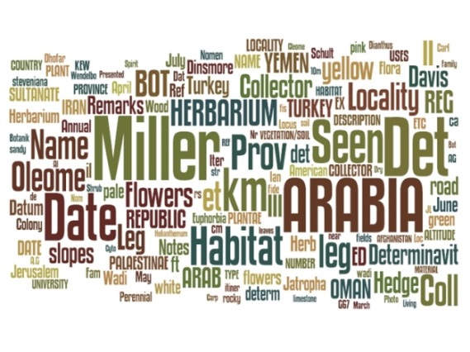
Explore the data…SORT!
SORT images:
ML, NLP, handwriting, label-finding, sort (collector, country, place, language, researcher)
set creation takes advantage of
human learning (mastery)
geography, handwriting, morphology
human preferences (autonomy, purpose)
humans are in-the-digitization-loop
faster transcription with ordered datasets (RBGE)
humans like ordered datasets (RBGE)
transcription 30 % faster than typing alone (SALIX)
PARSE getting better, share algorithms!
label type dependent
New Tool for parsing output of OCR output coming.
iDigBio aOCR wg
MaCC TCN
SALIX
Deb Paul, iDigBio aOCR WG
Notes:
The use of optical character recognition (OCR) in the digitisation of herbarium specimens October 2013 Biodiversity Information Standards (TDWG) 2013 Conference. Florence, Italy. Robyn E Drinkwater, Robert Cubey, Elspeth Haston

