Slide 1
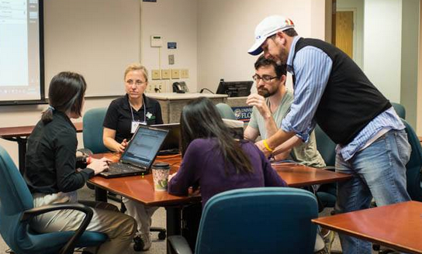
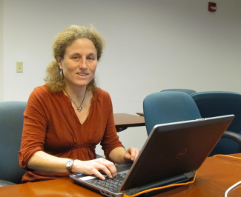
Enhancing NfN using Text Analytics and Visualization
Deb Paul, Andrea Matsunaga, Miao Chen, Jason Best, Reed Beaman, Sylvia Orli, William Ulate
iDigBio – Notes From Nature Hackathon December 2013
Increasing Citizen Science Participation in Museum Specimen Digitization

Slide 2
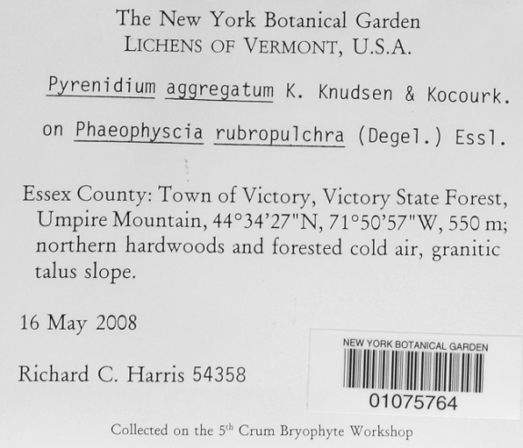
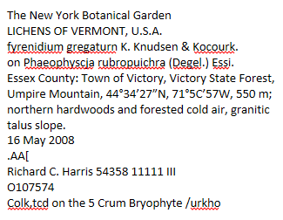
Text Clusters
What
Preprocess specimen label images with OCR
Remove (and use!) noise from text
Utilize OCR text
create word cloud linked to record ids
differentiate hand-written from typed labels
Allow transcribers to choose terms from word cloud to create individual sets
Allow validators to choose sets to clean

Slide 3
Reasons for Cluster Methodology
Enhance user experience
User Happiness!
Leverage user expertise
Improve speed
Reduce Errors
Enables ditto function
Why

Slide 4
User Stories
Who
Users like ordered datasets
Transcription
faster with ordered/sorted sets
less error prone with sorted sets

Slide 5
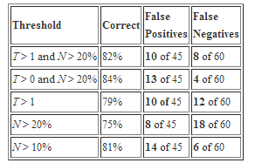
Handwriting vs. Typed
Segregate hand-written from typed labels
Ben Brumfield code uses regex to sort out garbage (higher garbage = higher likelihood hand-written)
Read all about it at Ben’s blog!
Code is at GitHub
Humanities community using now!
Let transcriber choose label format
Typed?....go to word cloud workflow

Slide 6
Estimating OCR confidence
extract character-level n-gram from a corpus (the OCR corpus + an external good corpus, ideally)
obtain a list of character-level n-gram
e.g. bi-gram looks like th, sh, ph ...
given a word, compute its probability based on the n-gram probability
this is used for computing the final OCR confidence score
can use standard dictionary in computing the score (if time allows)

Slide 7
Word Cloud Workflow

Slide 8
Word Cloud http://aocr1.acis.ufl.edu/datasets/lichens/silver/ocr/WebrootDatasetsLichensSilverOcr.txt

Slide 9
SOLR Index
aOCR iDigBio – BRIT Hackathon Lichen Dataset
Lichen Label
Images
200
hand-typed
200
hand-parsed
Comparison
Analysis
Scoring
Parsing
10,000
Gold txt
Gold csv
200
silver OCR
200
silver-parsed
Comparison
Analysis
Scoring
Silver txt
Silver csv
Word
Cloud
Crowd!
Stop/not useful words removed

Slide 10
aOCR iDigBio – BRIT Hackathon NYBG Herbarium Dataset
Herbarium Sheet
Images
100
hand-typed
100
hand-parsed
Comparison
Analysis
Scoring
5,000
Gold txt
Gold csv
100
silver OCR
100
silver-parsed
Comparison
Analysis
Scoring
Parsing
Silver txt
Silver csv
Word
Cloud
Crowd!

Slide 11
aOCR iDigBio – BRIT Hackathon CalBug Entomology Dataset
CalBug Entomology
Images
Comparison
Analysis
Scoring
Segmentation
Sorting
100
hand-typed
100
hand-parsed
500
Gold txt
Gold csv
100
silver OCR
100
silver-parsed
Comparison
Analysis
Scoring
Silver txt
Silver csv

Slide 12
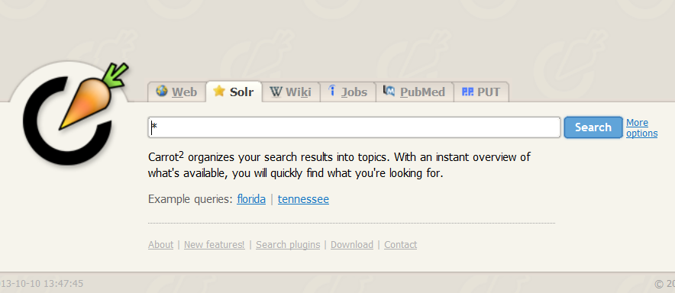
Word Cloud using Solr + Carrot²
http://ammatsun.acis.ufl.edu:5901/carrot2-webapp-3.8.1/

Slide 13
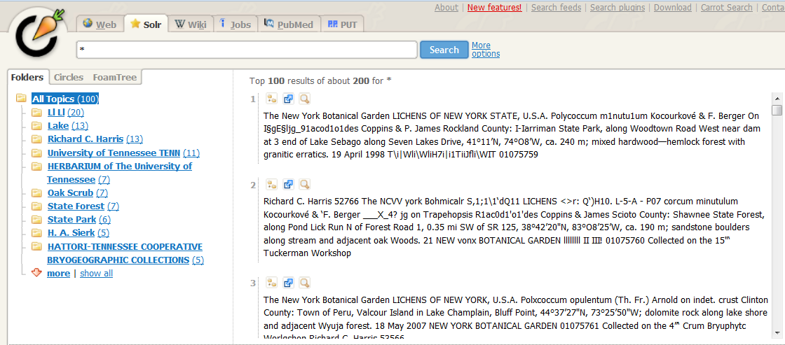
Folder View of Search

Slide 14
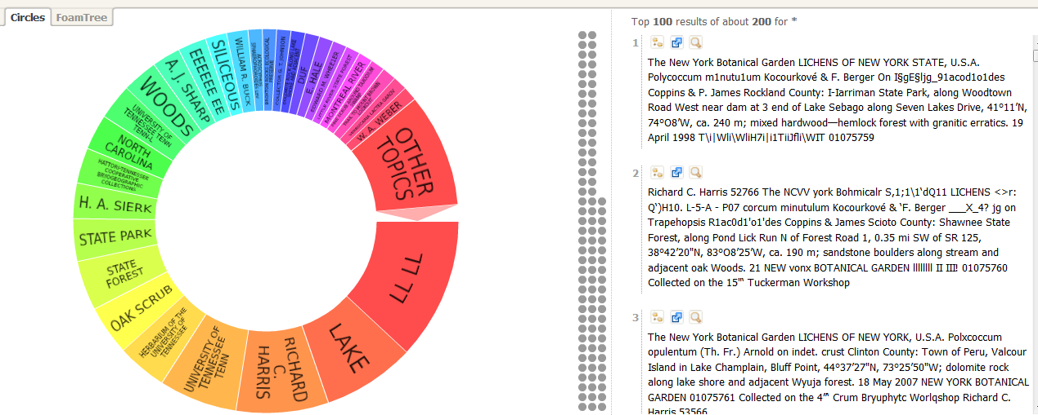
Circles Visualization of Search

Slide 15
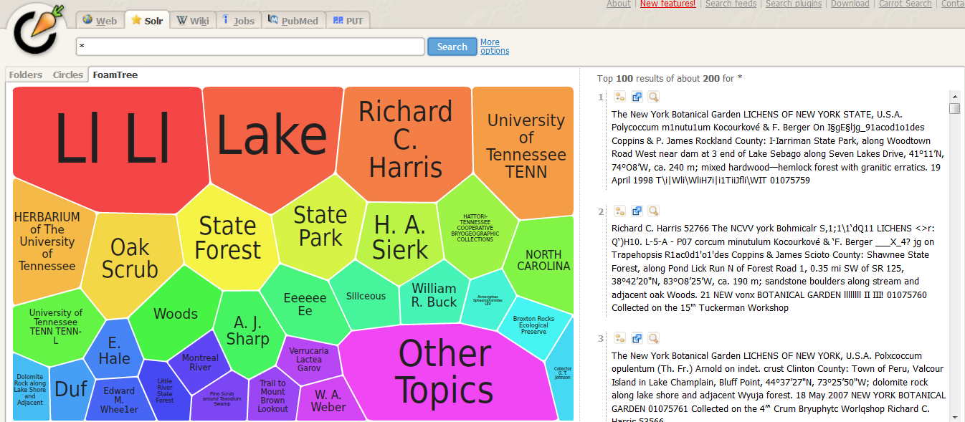
Foam Tree Visualization of Search

Slide 16
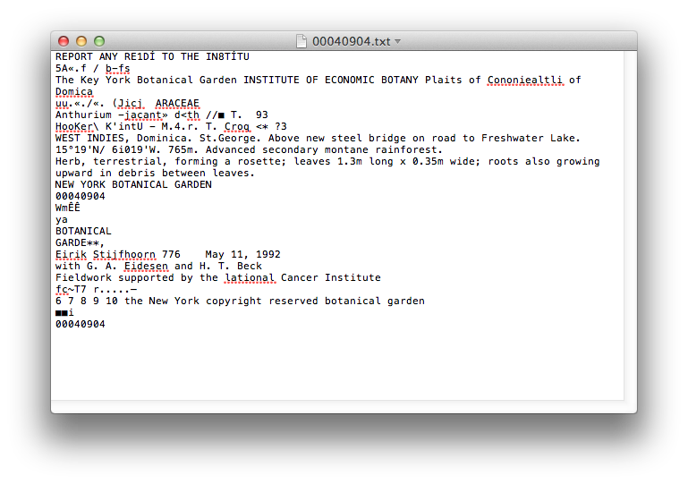
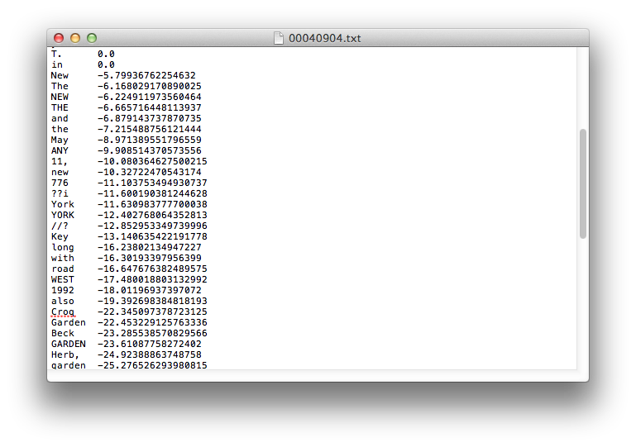
OCR Confidence Estimation

Slide 17
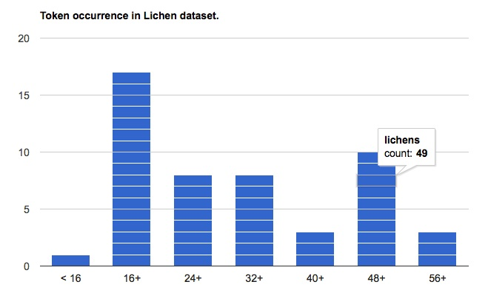
Token Histogram – Google Charts

Slide 18
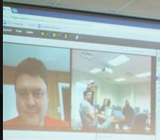
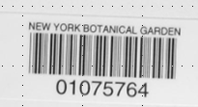
Using OCR output to enhance the transcription process
Ll Ll Team!

Slide 19
Word Clouds using N- gram Scoring, Faceting, Solr + Carrot²
Data Sets
silver (ABBYY) OCR output from 200 lichen packet images
all ABBYY OCR output from 10,000 lichen packet images
silver and gold (ABBYY, Tesseract) OCR output from 100 herbarium sheets
OCR output from 5000 herbarium sheets
SI BVP dataset

Slide 20
Word Cloud using Solr + Carrot²
Index OCR text output using SOLR
http://ammatsun.acis.ufl.edu:5900/solr/#/lichenssilver/schema-browser?field=content
Using Carrot² to visualize data http://ammatsun.acis.ufl.edu:5901/carrot2-webapp-3.8.1/

Slide 21
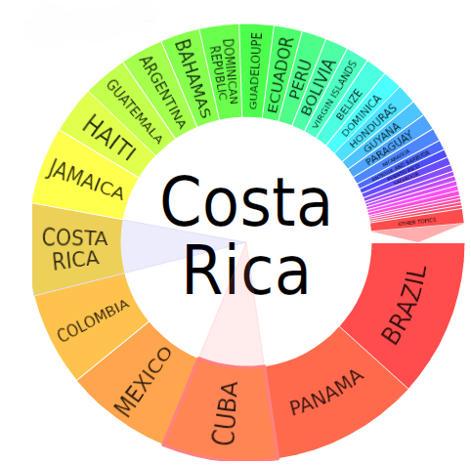
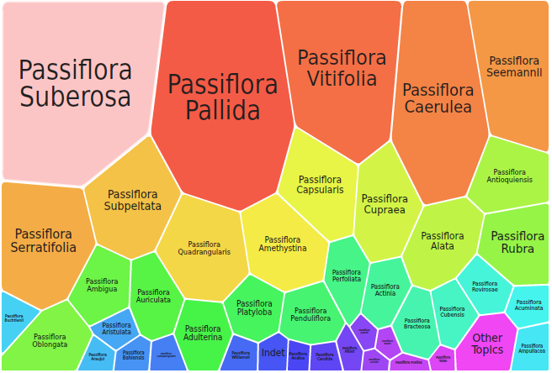
Imagine Integration with NfN/BVP
Use for initial sort or validation

Slide 22
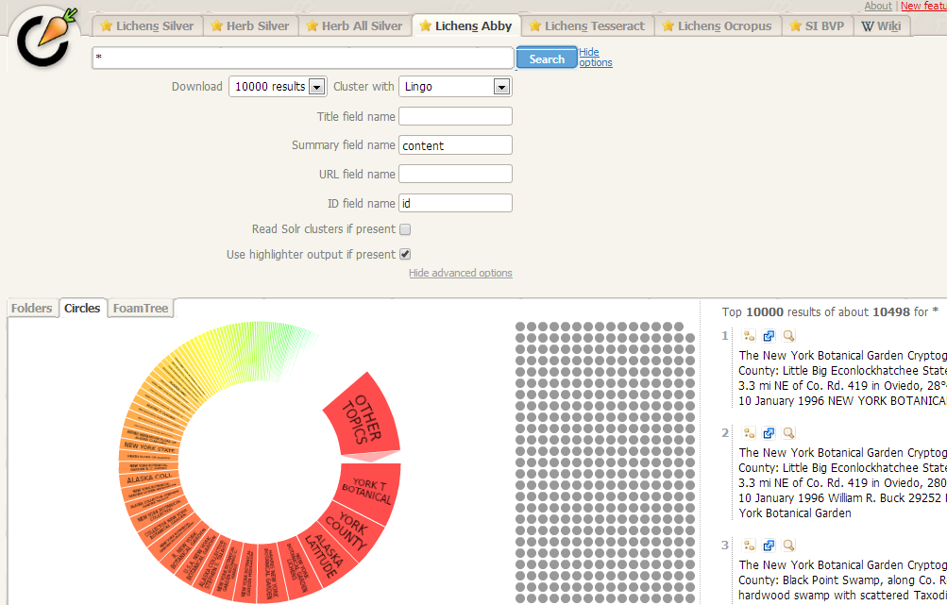
10,000+ records sample

Slide 23
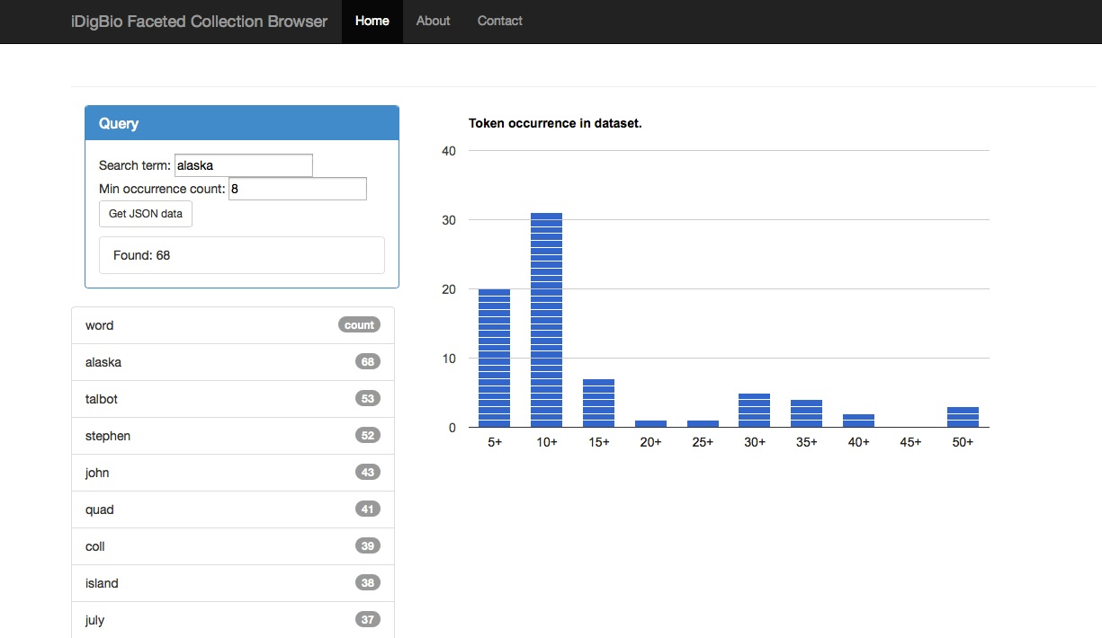
iDigBio Faceted Collection Browser
discovery
how many documents have this issue

Slide 24
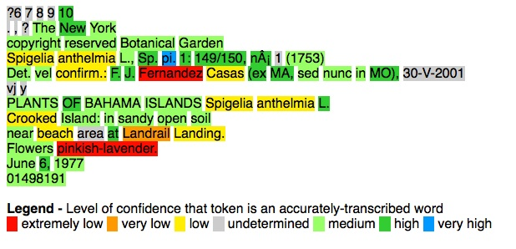
iDigBio Faceted Collection Browser
discovery
how many documents have this issue

Slide 25
Visualizing OCR Confidence
early triage
score each document
score transcriptions
low scores to human
high scores to automated parsing
humans check
human correct
transcription errors
ocr errors
Why

Slide 26
N-grams probability model
Herb silver
PLANTS OF BAHAMA ISLANDS
Test Set
Herb gold
Training Set
PLA
LAN
ANT
NTS
TS
S O
OF
OF
F B
BA
BAH
AHA
HAM
…
AMA
MA
A I
IS
ISL
SLA
LAN
AND
NDS
…
100 docs
100 docs
3-grams

Slide 27
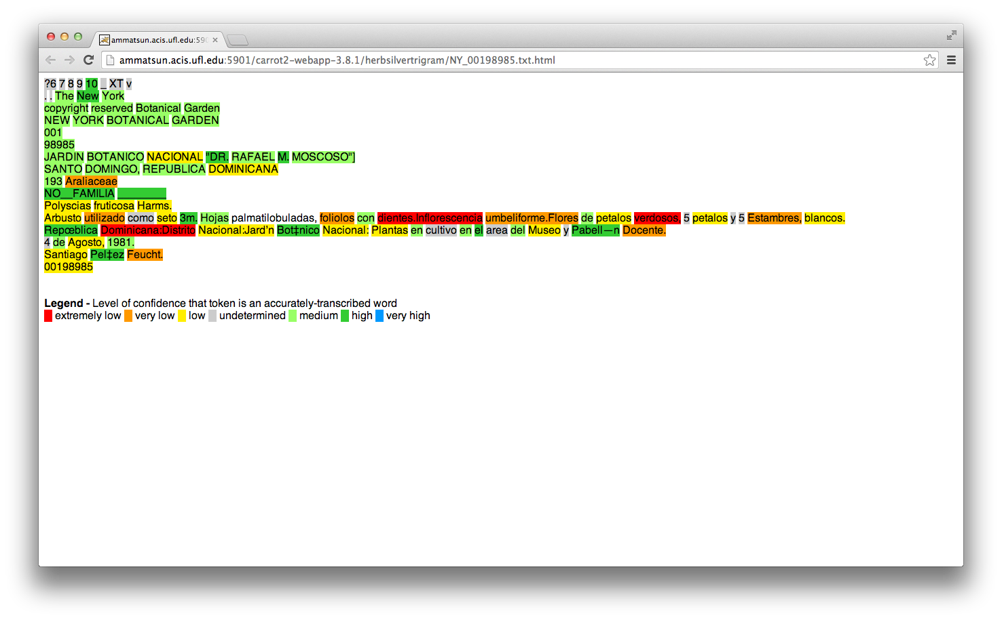
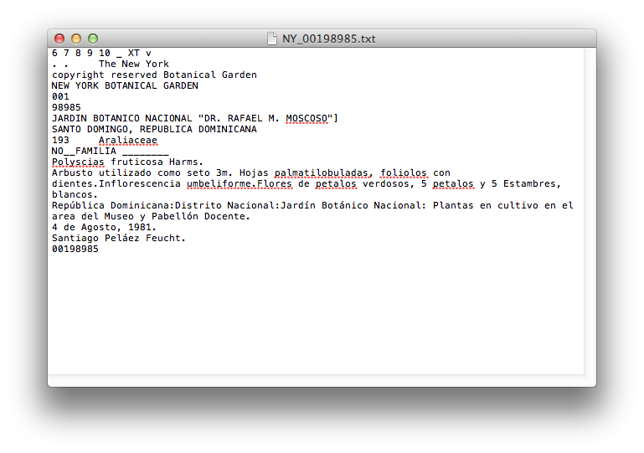
Visualizing OCR Confidence

Slide 28
5000 OCR html files See it for yourself!
herb_allsilver_trigram_html.zip

Slide 29
Let’s make it happen!
Use for initial sort or validation

Slide 30
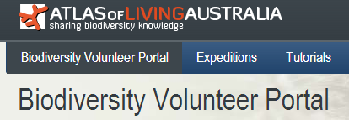
Happy HoLlidays!
Ll Ll Team!

