Slide 1
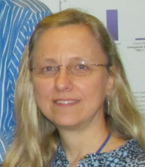
Identifiers
are forever (hopefully)
The Field Museum - Chicago, Illinois
iDigBio Entomology Digitization Workshop
Deborah Paul, iDigBio
April 25, 2013

Slide 2
Identifiers
We’ve come a looooooong way
What good are identifiers?
Examples and Use
Specimen (Collection Object) Identifiers
Providing IDs
Annotations and Feedback

Slide 3
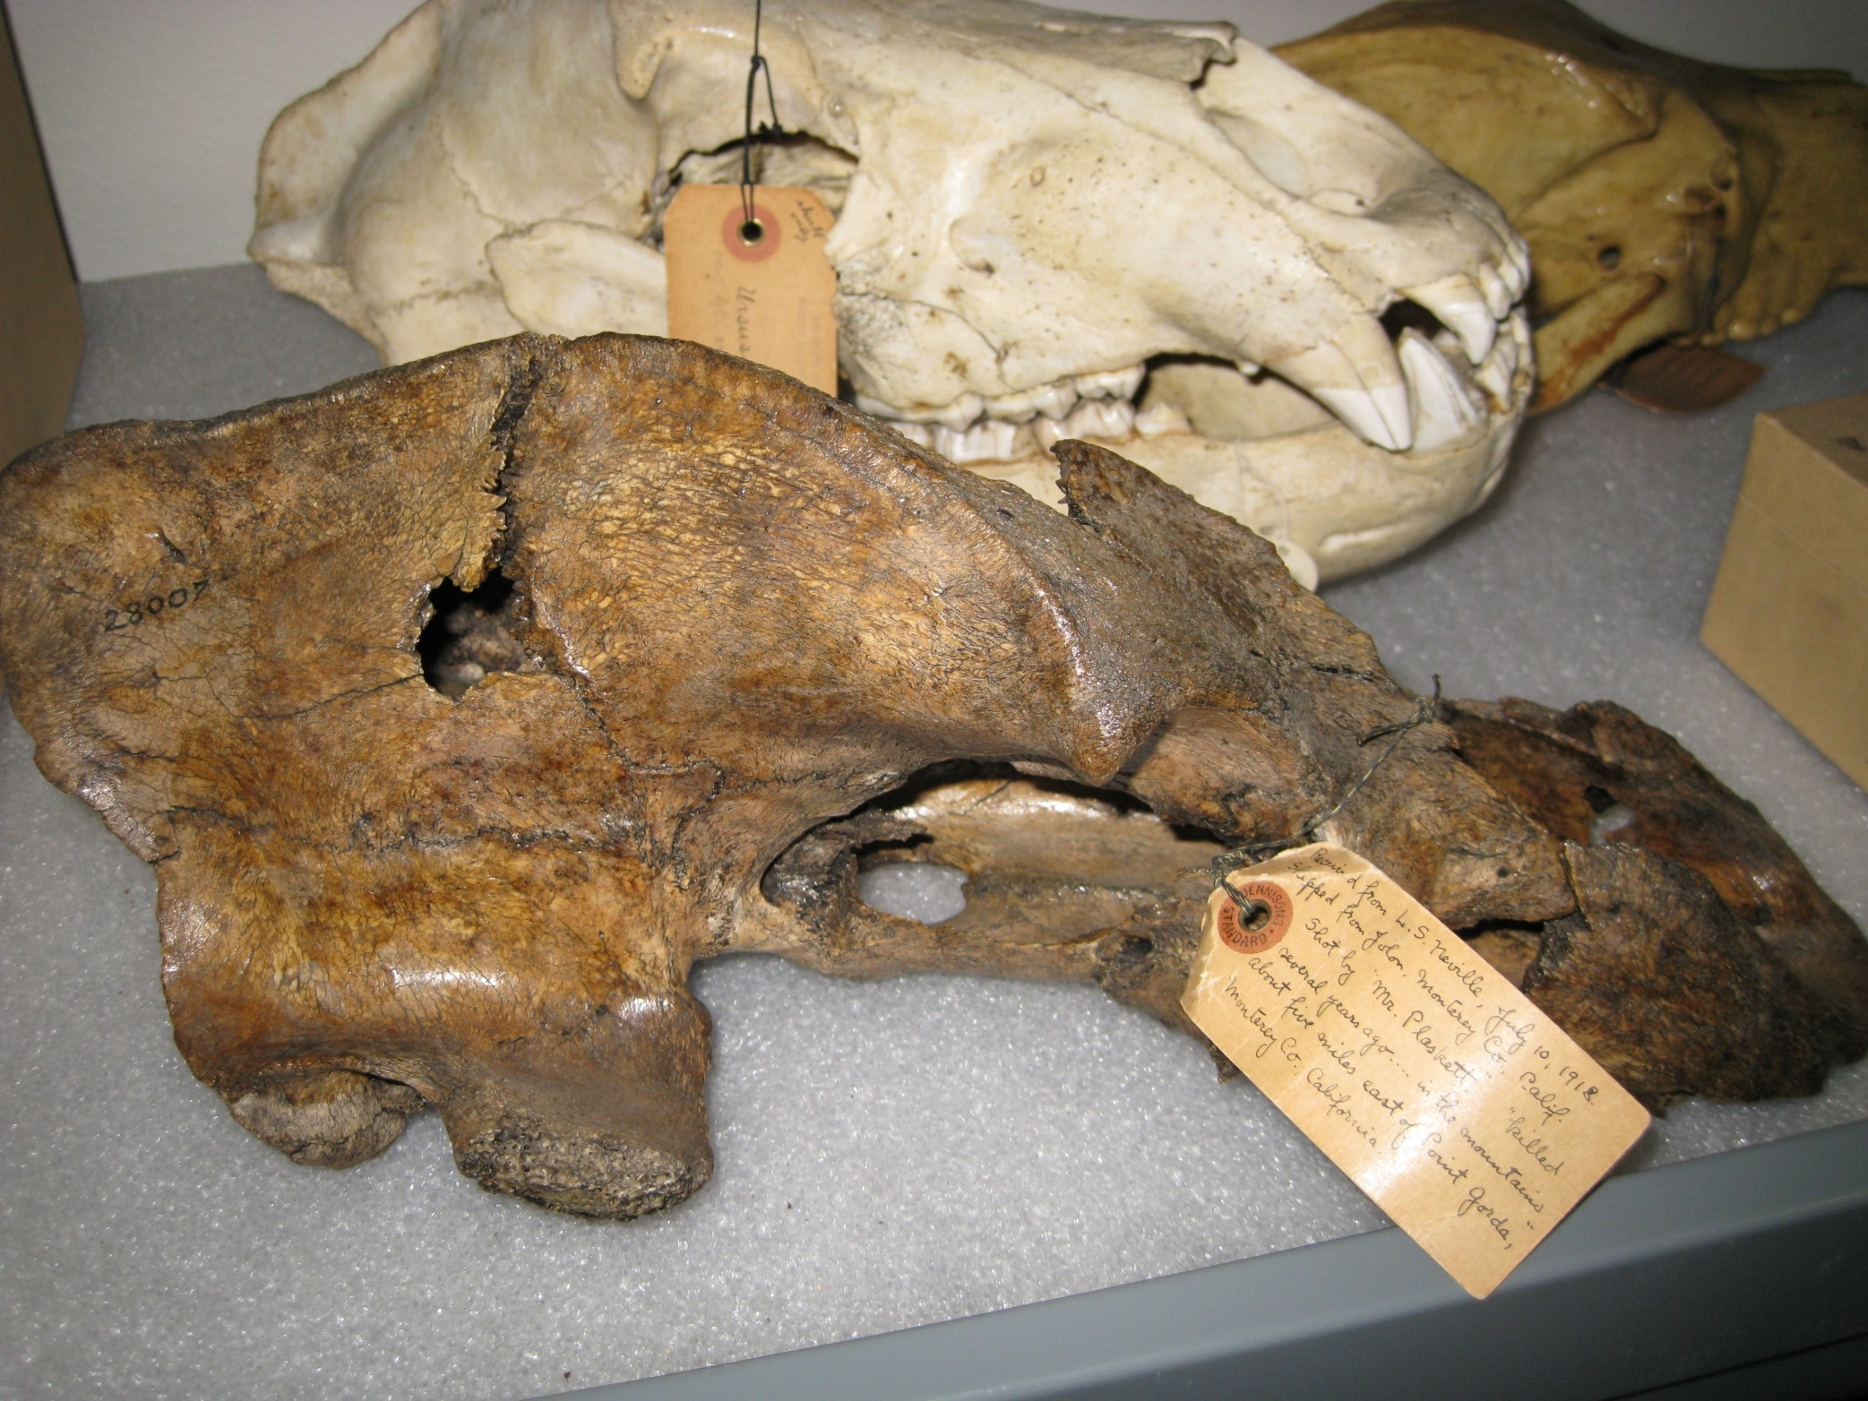
Received from L. S. Nelville, July 10, 1918
Shipped from Jolon, Monterey Co.California
Shot by Mr. Plaskett “…killed several years ago… in the mountains about 5 miles east of Point Gorda” Monterey Co. California.
http://microecos.wordpress.com/2009/03/

Slide 4
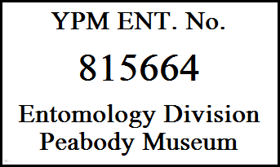
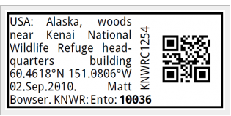
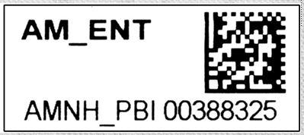
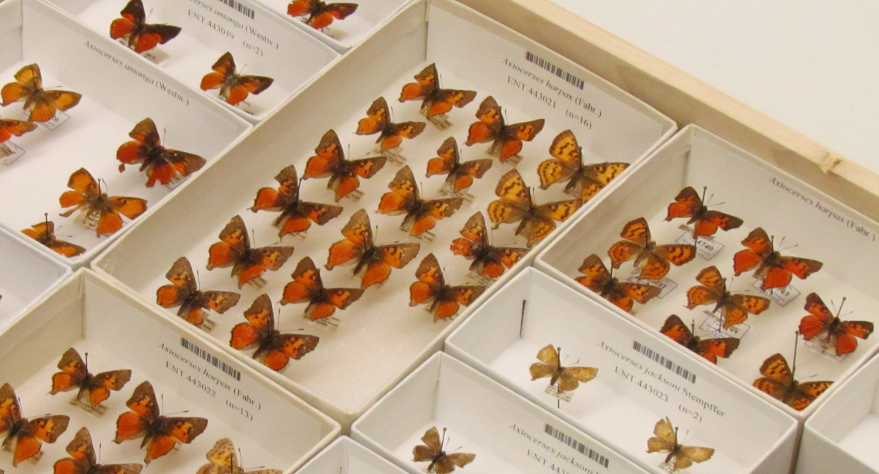

Slide 5
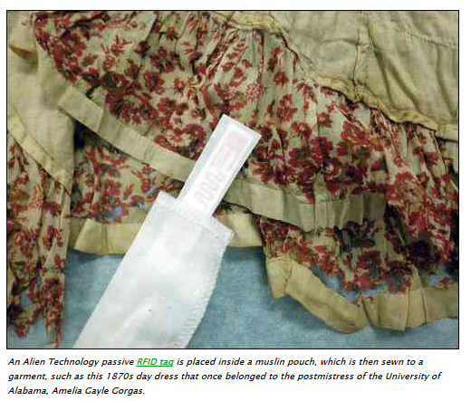
University of Alabama Tags Historical Garments Collection
Staff, students and volunteers are tagging thousands of items so they can be identified through a closed box, without being handled, by means of handheld RFID readers.
http://www.rfidjournal.com/articles/view?9505

Slide 6
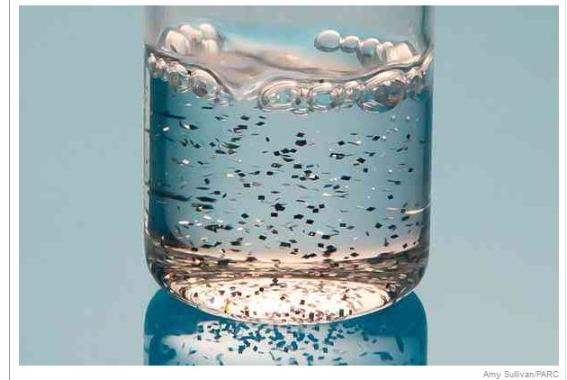
Chiplets
http://nyti.ms/17nmeQ9

Slide 7
What good is identification? I.
Aggregation
If you get info from 2 sources that are about the same object, you can combine the info
Resolution (finding information about object)
Types of resolution
Determine where to get information
Determine how to get information
Proxy request
http://dx.doi.org/10.1038/ng0609-637

Slide 8
DOI example
The DOI is
10.3897/zookeys.209.3135
URI (for aggregating & display) is
doi:10.3897/zookeys.209.3135
A URL for information retrieval (proxy resolution) is
http://dx.doi.org/10.3897/zookeys.209.3135
Information fetched (in html format):
http://www.pensoft.net/journals/zookeys/article/3135/abstract/five-task-clusters-that-enable-efficient-and-effective-digitization-of-biological-collections
Notes:
Not comingled. Identifier and resolution (proxy) are separate
The consumer has to know somewhere to look for info
Requires organization to manage allocation of id space and proxy resolution
Members pay for service

Slide 9
What good is identification? II.
Aggregation
Resolution
Citation
the site
the specimen/s
Biodiversity specimen occurrence data published by: Tall Timbers Research Station, Tallahassee, Florida (Accessed through Integrated Digitized Biodiversity Collections (iDigBio), portal.idigbio.org, 2013-04-22). specimen OccurrenceID=[put provider's occurrenceID here]
Find locally
Feedback, Update and Linking

Slide 10
Identifier examples
record id 112234
uuid urn:uuid:954c8760-e1a6-4b4b-ab82-6bf7311c25f3
lsid urn:lsid:zoobank.org:act:8BDC0735-FEA4-4298-83FA-D04F67C3FBEC
http - uri http://ids.flmnh.ufl.edu/herb/abcd12345678
ezid ark:/87286/B2954c8760-e1a6-4b4b-ab82-6bf7311c25f3
doi doi:10.1038/ng0609-637
catalog urn urn:catalog:FSU:Herbarium:000023905
Proxy request http://dx.doi.org/10.1038/ng0609-637
Notes:
The standard for identification advocated by W3C is to use Universal (uniform) Resource Identifiers (URIs).
-- a URI is a string that begins with a scheme name (or protocol). (http, https, mailto, doi, ftp, urn).
UUID (sometimes GUID)
definitely unique
E.g. 954c8760-e1a6-4b4b-ab82-6bf7311c25f3
Hard to type in
Not resolvable
Not always DB friendly
Opaque
urn:lsid:authority:namespace:identifier
http://lsid.tdwg.org/urn:lsid:authority:namespace:identifier
note that the http-uri could have any domain name (does not have to be resovlable) and the collection identifier
best practice would be to use one from biorepositories / biocollections index
this collection identifier needs to be stored in the providers database and
this collection identifier needs to be shared when the data is shared with aggregators.

Slide 11
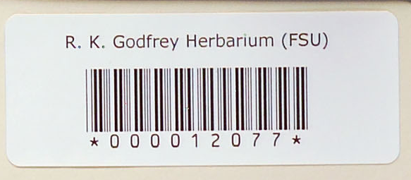
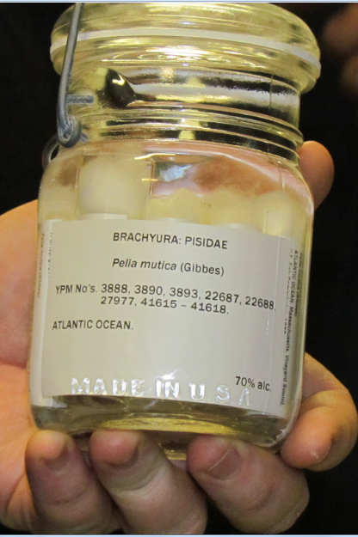
Specimen Identifiers?
Identifier on the specimen?
readable text
encoded data
barcode is a contextual identifier
database record contains?
barcode = 0000014097
catalog number = ?
collector’s number = 7113
record ID = 112234
specimenId = urn:uuid:954c8760-e1a6-4b4b-ab82-6bf7311c25f3
persistent
unique (globally)
actionable (resolvable) maybe
Notes:
What are you providing / sharing?
The standard for identification advocated by W3C is to use Universal Resource Identifiers (URIs).
-- a URI is a string that begins with a scheme name (or protocol). (http, https, mailto, doi, ftp, urn).
Second URI has hex encoding of “0014097”
UUID (sometimes GUID)
Assured unique
E.g. d6610130-5248-11e1-b86c-0800200c9a66
Hard to type in
Not resolvable
Not always DB friendly
Opaque
apply a given id to only one object ever
if something happens and that object no longer exists in the physical collection –
never reassign the identifier to another object in the collection

Slide 12
Identifiers
Opaque identifiers
specimenId = urn:uuid:954c8760-e1a6-4b4b-ab82-6bf7311c25f3
No where, which , who or how
Smith No. 1153
Importance of Registration
Institution Code, Collection Code, Owner Institution ID
http://www.biorepositories.org/
Global Registry of Biorepositories (GRB) – COMING SOON!
Finding Specimens
Globally
Locally
Darwin Core OccurrenceID
Uniquely identifies the specimen
Globally

Slide 13
Identifiers: Curating, Providing, Using
Store the ones you know about
Database changes to accommodate identifiers (global or not)
Analogous to determination history
Analogous to ownership history
How are identifiers stored in your database?
Sharing is Key
Facilitate finding / BiSciCol / relationship illumination
Filtered PUSH
Scatter - Gather - Reconcile
Standards (Darwin Core) to share identifiers
Resource Relationship
Cite
What do you cite in your papers? Policy on your web sites?
Metrics for administrative justification?
Metrics for tenure credit?

Slide 14
Feedback with IDs
Annotations
Target of annotation
http://www.morphbank.net/818505
Repatriation
Filtered PUSH
Scatter Gather Reconcile (SGR)
Linked Data, aka the Semantic Web
BiSciCol
updating the database
be(a)ware
store and share other IDs
Notes:
‘target’ is a property of the annotation

Slide 15
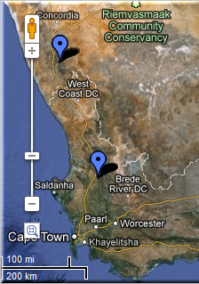
FilteredPUSH
Identifiers
GenBank ®
D I S C O V E R L I F E
Kepler Kurator
Cladistics ®
Notes:
Sharing Data.
GUIDs are the Key
specimen database
aggregators / portals – iDigBio, GBIF, EOL
ontologies- BioPortal
publications
maps
databases – GenBank, BOLD
provider websites – a museum may have their own portal
data repatriation, enhancement – Filtered PUSH
data cleaning / cleansing – Kepler Kurator, Google Refine
provider sites – http://herbarium.bio.fsu.edu
consortium websites through portals: http://symbiota.org/tiki/tiki-index.php?page=Data+Nodes
SERNEC, North American Bryophyte and Lichen Consortia, SEINet
Revisualization - discovery
Unforseen errors revealed
Taking it in stride
Opportunities, Benefits, Decisions
Specify’s Scatter-Gather-Reconcile (SGR)
duplicates found
dataset for checking is increasing in size
example, at least 50% dupes
lending credence to the skeletal dataset concept
Filtered PUSH (works with Specify, Symbiota and Morphbank)
finding dupes
the benefits of shared datasets
lending credence to the skeletal dataset
finding annotations (determinations, general comments)
to import or not to import

Slide 16
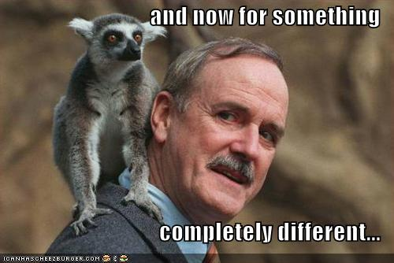
iDigBio is funded by a grant from the National Science Foundation's Advancing Digitization of Biodiversity Collections Program (#EF1115210). Views and opinions expressed are those of the author not necessarily those of the NSF.

Slide 17
Bits and Pieces
How to get (globally) unique identifiers?
Service
Add an http://domain (does not have to resolve)
Generate uuids
register!
Education & Outreach
ideas to share?
plans in place?
iDigBio E & O wants to know.
Example Protocols and Workflows please!
Want to know how to get involved?
Working Group Participation
Propose / Host / Co-host or Co-Sponsor a Workshop or Symposium
Contribute by participation
List serves
Wiki

Slide 18
Change Management
process
people
culture
http://www.jiscinfonet.ac.uk/infokits/change-management/aspects-of-change

Slide 19
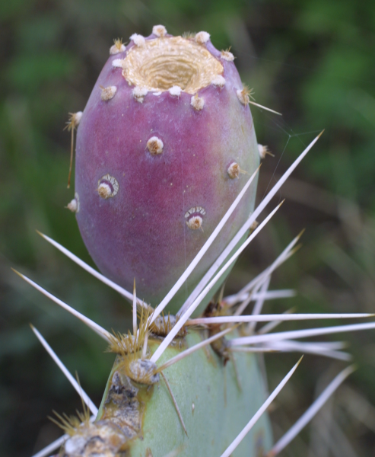
The irrational side of change management
what motivates you ≠ what motivates others
we’re better off listening, rather than telling
we need the + and the –
leaders mistakenly believe that they already “are the change”
not about the leader
it’s about how receptive “society” is to the ideas
$ = most expensive way to motivate people.
satisfaction equals perception minus expectation.
small unexpected rewards can have disproportionate effects.
process and outcome have to be fair to get buy-in
Aiken & Keller, 2009 in The McKinsey Quarterly
Notes:
Some research on Change Management to keep in mind when thinking about
social issues in workflows, at the organization and individual levels.
why “common sense” doesn’t work.
http://www.abettercity.org/docs/sustainability/McKinsey%20-%20Irrational%20Side%20of%20Change%20Management%202010.pdf
Ties nicely into the next conversation about what research says about what motivates us?
We need to motivate ourselves and each other, right?
Note that when change is implemented across an organization, it succeeds only 30% of the time!
The irrational side of change management
Aiken & Keller, 2009 in The McKinsey Quarterly
what motivates you ≠ what motivates others
we’re better off listening, rather than telling
we need the + and the –
leaders mistakenly believe that they already “are the change”
it’s not just about the leader, it’s about how receptive “society” is to the ideas
money is the most expensive way to motivate people.
satisfaction equals perception minus expectation.
small unexpected rewards can have disproportionate effects.
process and outcome have to be fair to get buy-in

Slide 20
Overview
Darwin Core
Collaborating with TCNs and PENs
Contributing to iDigBio
Data Aggregators

Slide 21
Darwin Core Standard
http://rs.tdwg.org/dwc/terms/
Darwin Core (often abbreviated to DwC) is a body of data standards which function as an extension of Dublin Core for biodiversity informatics applications, establishing a vocabulary of terms to facilitate the discovery, retrieval, and integration of information about organisms, their spatiotemporal occurrence, and supporting evidence housed in biological collections. It is meant to provide a stable standard reference for sharing information on biological diversity[1] .

Slide 22
Darwin Core Standard
http://rs.tdwg.org/dwc/terms/
Darwin Core (often abbreviated to DwC) is body of data standards which function as an extension of Dublin Core for biodiversity informatics applications, establishing a vocabulary of terms to facilitate the discovery, retrieval, and integration of information about organisms, their spatiotemporal occurrence, and supporting evidence housed in biological collections. It is meant to provide a stable standard reference for sharing information on biological diversity[1] .
Does Darwin Core cover every field possible? – No
Don’t panic! There are extensions and other options.

Slide 23
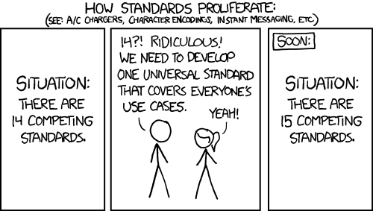
http://xkcd.com/927/

Slide 24
DwC-A and the IPT
DwC-A = Darwin Core Archive – contains 3 or more files
Identifiers make this possible
IPT = Integrated Publishing Toolkit creates the DwC-A
csv file – e.g. your specimen data records
meta.xml – a file that explains the contents of each column in the csv file
eml.xml – information about the data provider and what data is provided
extensions – extending what the IPT can do.
image records for the specimens
resource relationships
measurement or fact
http://tools.gbif.org/
http://tools.gbif.org/dwca-assistant/
Notes:
Ecological Markup Language – EML

Slide 25
Inside a DwC-A
occurrenceID, recordedBy, scientificName, field name,
http://www.ids.flmnh.edu/herb/123555, C L Barkley, Carex maritima, value,
http://www.ids.flmnh.edu/herb/123556, Aaron Thompson, Carex maritima, value,
http://www.ids.flmnh.edu/herb/123559, Marsha Corwin, Carex maritima, value,
mySpecimenData.csv
https://code.google.com/p/gbif-indexingtoolkit/source/browse/trunk/harvest-webapp/src/test/resources/org/gbif/harvest/dwcarchive/ebird/eml.xml?r=1676
eml.xml
<archive xmlns="http://rs.tdwg.org/dwc/text/" xmlns:xsi="http://www.w3.org/2001/XMLSchema-instance" xsi:schemaLocation="http://rs.tdwg.org/dwc/text/ http://rs.tdwg.org/dwc/text/tdwg_dwc_text.xsd"> <core encoding="UTF-8" fieldsTerminatedBy="\t" linesTerminatedBy="\n" fieldsEnclosedBy='' ignoreHeaderLines="0" rowType="http://rs.tdwg.org/dwc/terms/Taxon"> <files> <location>taxa.txt</location> </files> <id index="0" /> <field index=“1" term="http://rs.tdwg.org/dwc/terms/recordedBy"/> <field index=“2" term="http://rs.tdwg.org/dwc/terms/scientificName"/> <field index=“3" term="http://rs.tdwg.org/dwc/terms/fieldName"/> </core>
meta.xml
occurrenceID, identifier, field name, field name, field name, field name
http://www.ids.flmnh.edu/herb/123555,http://www.myimages.org/images/herb123555.jpg,,,
http://www.ids.flmnh.edu/herb/123556,http://www.myimages.org/images/herb123556.jpg,,,
http://www.ids.flmnh.edu/herb/123559,http://www.myimages.org/images/herb123559.jpg,,,
http://www.ids.flmnh.edu/herb/123559,http://www.myimages.org/images/herb123560.jpg,,,
images.csv

Slide 26
Ways to Share Data
Thematic Collection Networks (TCNs)
have data ready to share?
fits a current TCN theme?
Partners to Existing Networks (PENs)
join the effort
Through an existing portal or repository
Symbiota
VertNet
Morphbank
iDigBio
GBIF
Help is everywhere!

Slide 27
Sharing data with iDigBio
Mapping data to Darwin Core (or other Standard)
Custom export
CSV files
DwC-A files
DwC-Extensions
MeasurementOrFact
ResourceRelationship
AudubonCore
Specimen Identifiers
Record Identifiers
Other Identifiers

Slide 28
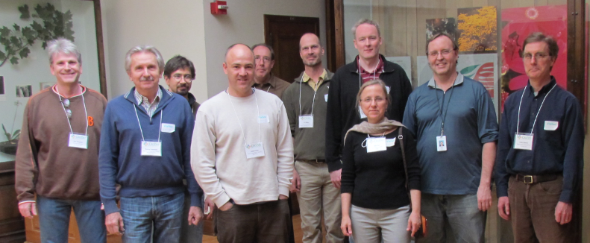
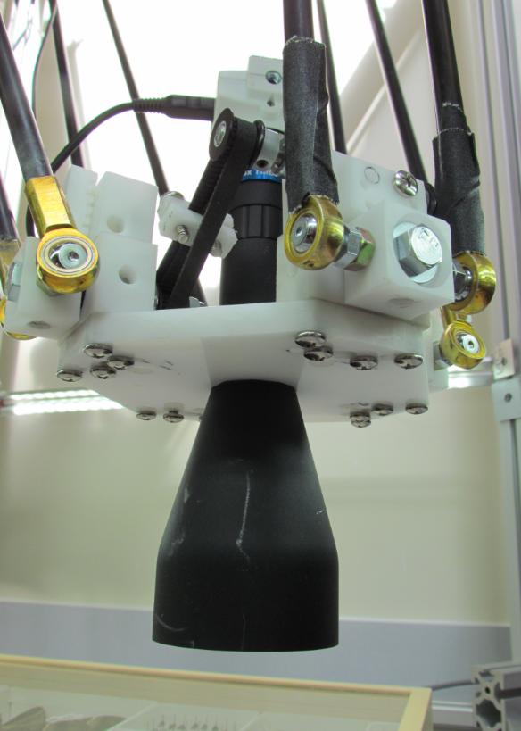
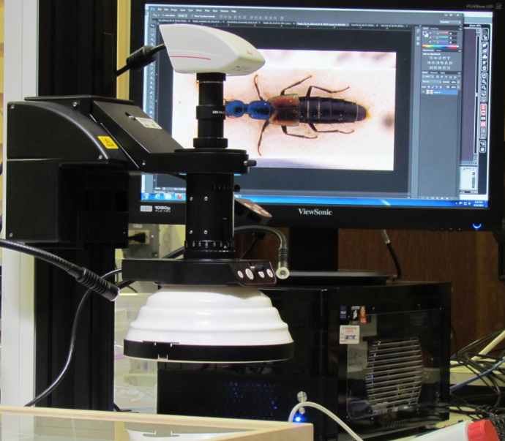
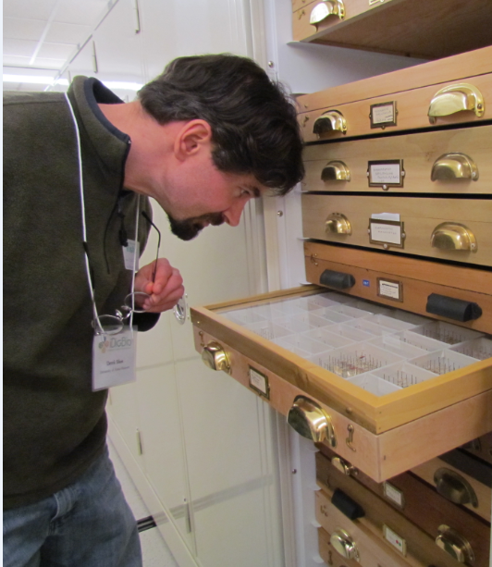
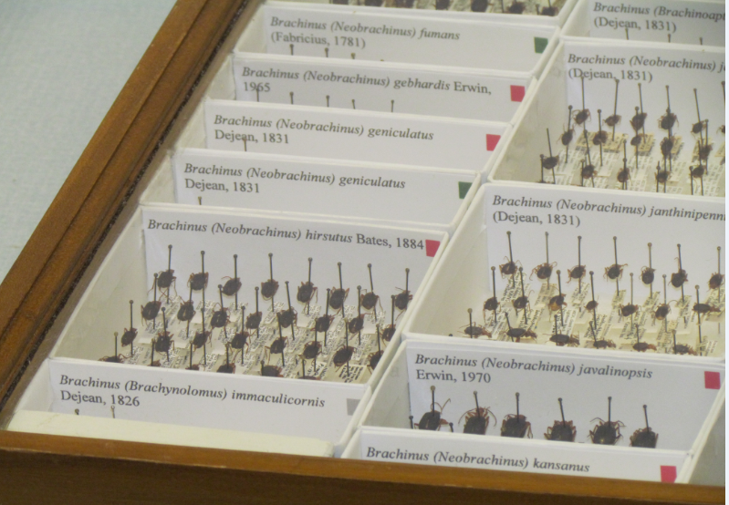
iDigBio is funded by a grant from the National Science Foundation's Advancing Digitization of Biodiversity Collections Program (#EF1115210). Views and opinions expressed are those of the author not necessarily those of the NSF.

