Slide 1
Implementing Optical Character Recognition in Herbarium Digitization: current practices and challenges
Stephen Gottschalk, Anthony Kirchgessner,
Kimberly Watson
IDigBio July, 2012

Slide 2
Caribbean Workflow
Curation and rapid barcoding of specimens
Fieldbook Data
Manual keying of specimen data
Specimen Catalog
Record
Specimen imaging
Optical Character
Recognition (OCR)
and data parsing

Slide 3
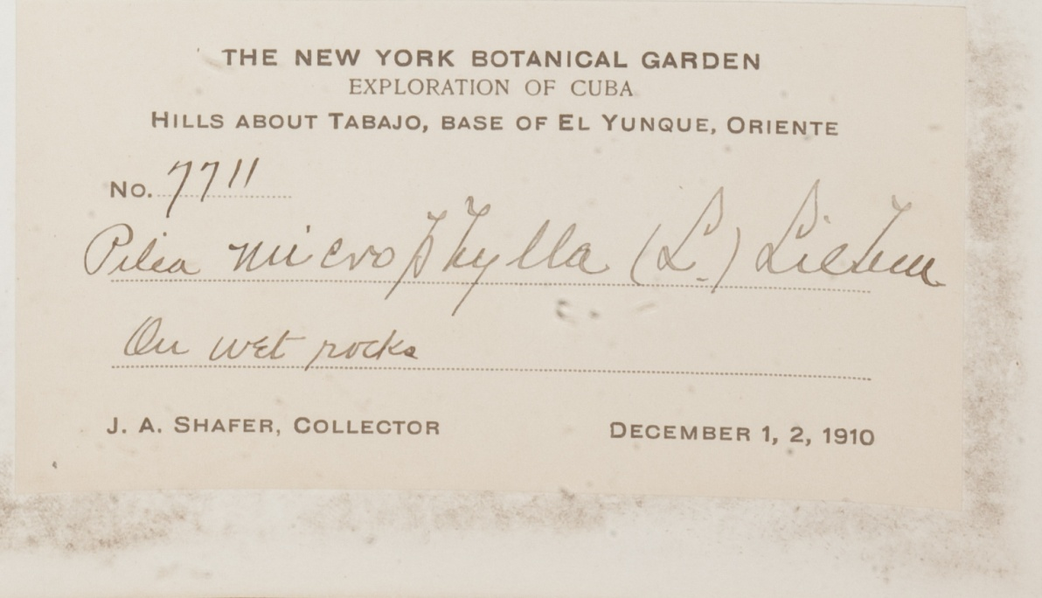
What is OCR?
Image
Output

Slide 4
Processing Considerations
Image Processing:
Image size
Color = ~10 mb
Grayscale = ~1 mb
Processing time
Images cropped to label can be OCR’d ~10 x faster than uncropped

Slide 5
Optically Recognizing
with ABBYY
Corporate edition allows for batch processing large numbers of images at once
Unique identifiers link the specimen OCR data and the image
Option for pattern training to enhance OCR quality

Slide 6
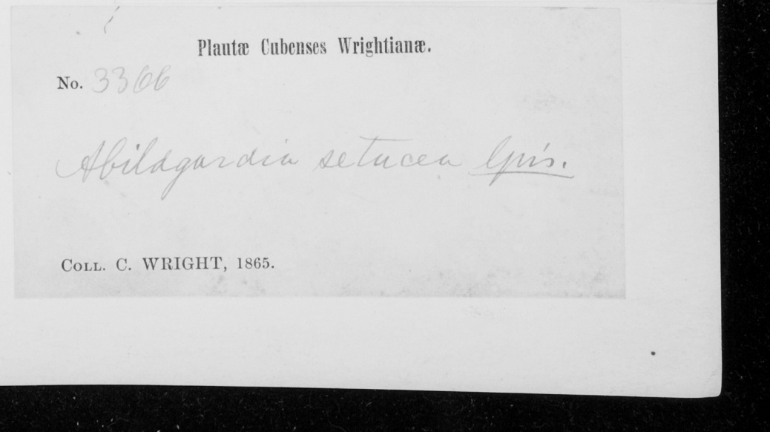
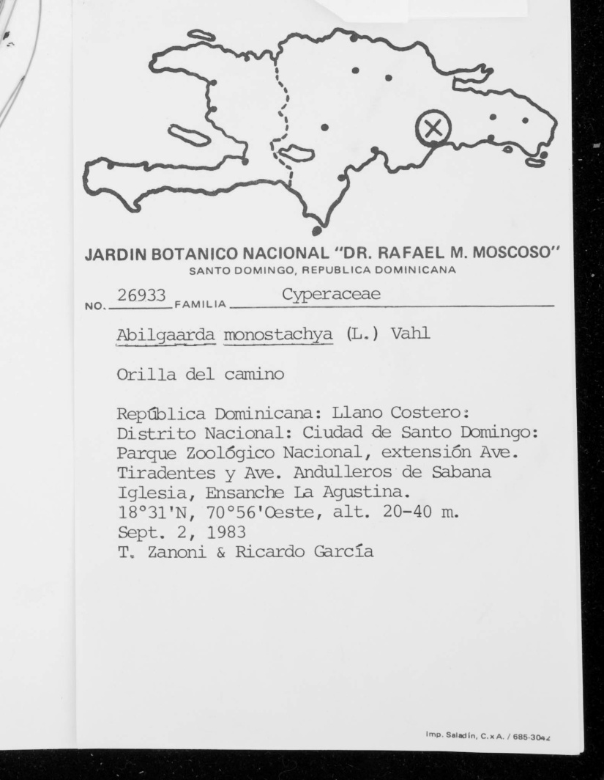
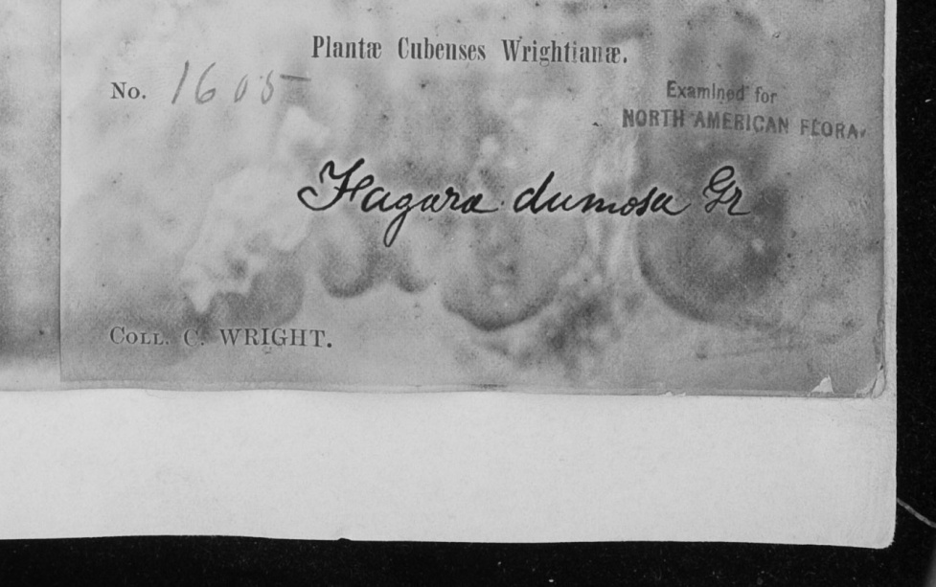
A Case Study
162 Charles Wright, Cuba labels and 114 Tom Zanoni, Dominican Republic labels
Wright labels chosen because they are difficult to read with OCR, have the most room for improvement
Zanoni labels are in general more legible, but also contain much more text
Label headings are unique to each label type, changes in OCR accuracy can be tracked across trials

Slide 7
OCR Parameters
Both label types put through the same set of OCR trials
Wright Labels
Zanoni Labels
Trial 1: Built-in parameters
Trial 2: Train Pattern Recognition
on one label
*Trial 3: Train PR on multiple labels
Trial 4: Train PR on Zanoni label type
Trial 1: Built-in parameters
Trial 2: Train Pattern Recognition
on one label
Trial 3: Train PR on multiple labels
Trial 4: Train PR on Wright label type
Trial 5: Train PR on both label types
*Trial 6: add ‘æ’ to English language, train PR on multiple labels

Slide 8
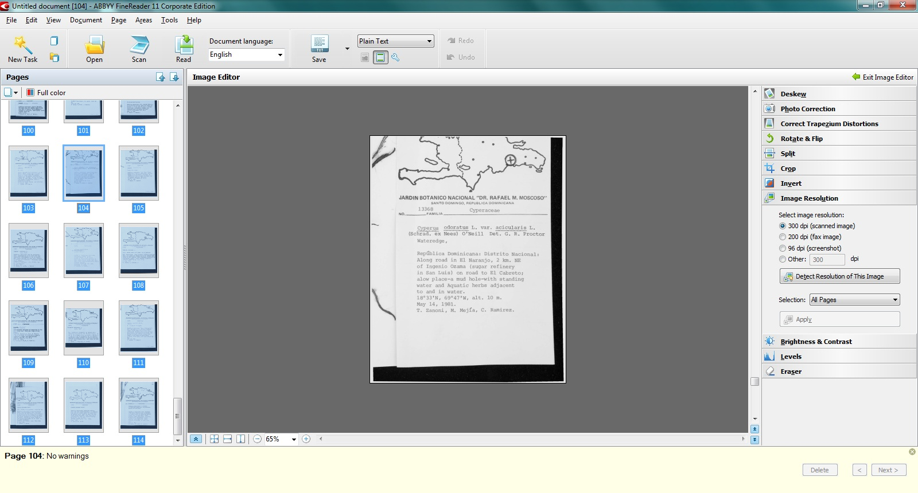
Trials
Step 1: all images set to 300 dpi, cropped to label, language = autoselect

Slide 9
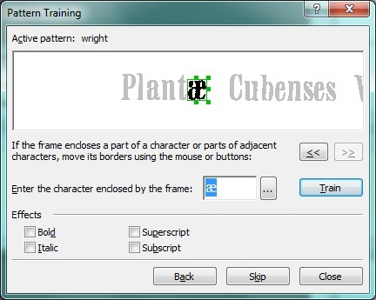
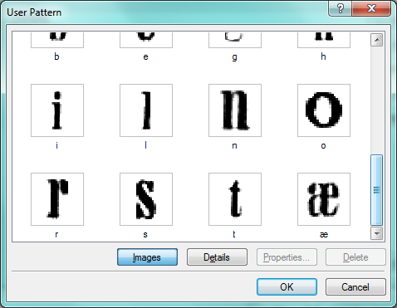
Trials
Step 2: Pattern Recognition is carried out

Slide 10
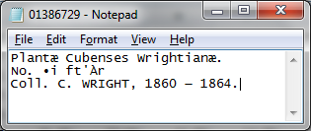
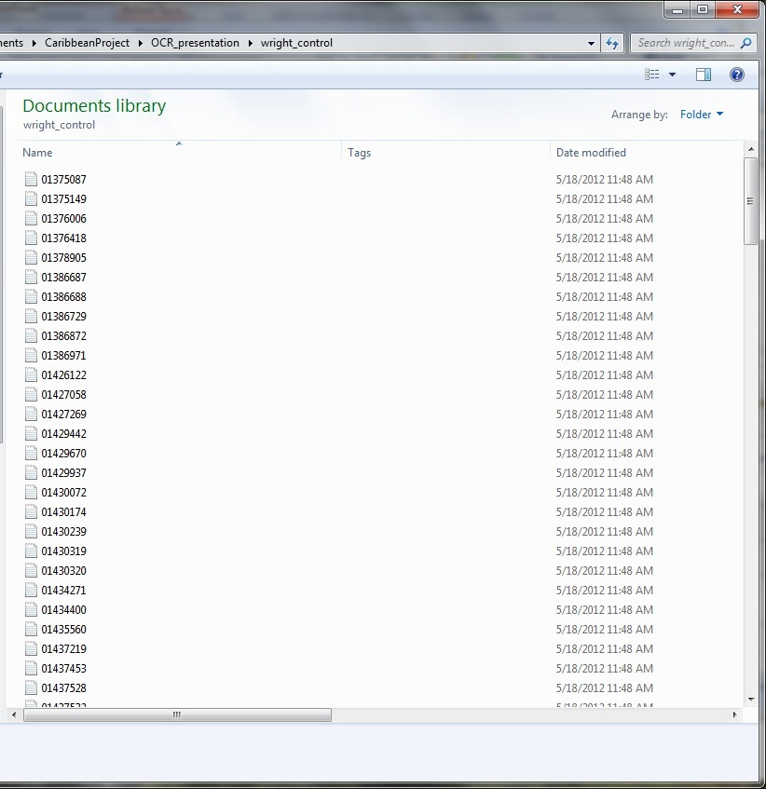
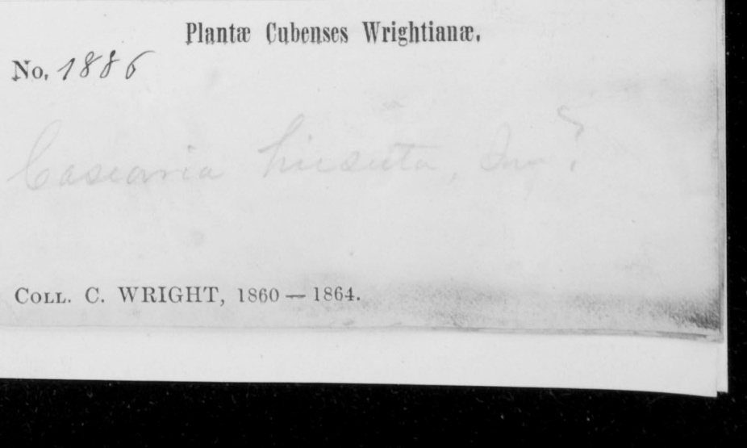
Trials
Step 3: Run the OCR!
(trained multiple)
(built in)

Slide 11
Trial Results: Wright Labels
162 Labels total
Percentage of labels read correctly
Pattern recognition trial

Slide 12
Trial Results: Zanoni Labels
114 Labels Total
Percentage of labels read correctly
Pattern recognition trial

Slide 13
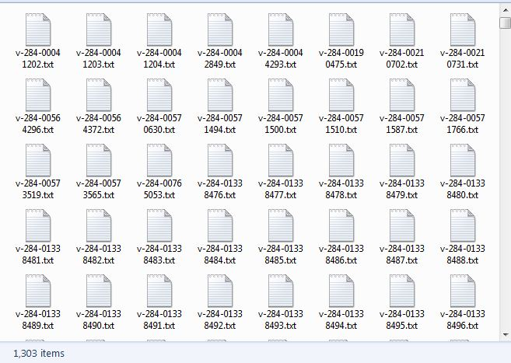
OCR Text and Next Steps
How to get the individual text files into a database

Slide 14
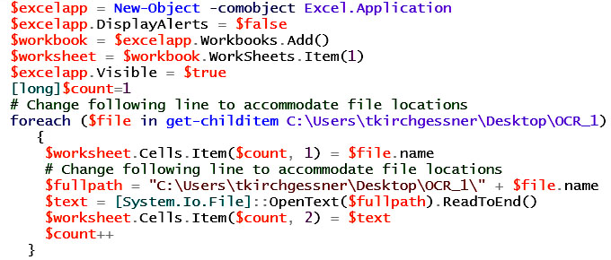
OCR Text and Next Steps
How to get the individual text files into a database
Step 1. Read the file name and text into Excel using a Powershell script.

Slide 15
OCR Text and Next Steps

Slide 16
OCR Text and Next Steps
How to get the individual text files into a database
Step 1. Read the file name and text into Excel using a Powershell script.
Step 2. Parse the file name and migrate to database of choice.
File names are created with a pattern, so that unique barcodes are easily parsed:
v-284-00041202.txt -> 41202

Slide 17
OCR Text and Next Steps
Finally, what we end up with is:
Skeletal data with some data parsed into fields (e.g. barcode, taxon, image).
Images associated with these records.
OCR data associated with the images and database records.
OCR data parsed into fields within database records.

Slide 18
OCR Text and Next Steps
Natural Language Processing, Machine Learning and data parsing through Symbiota, Salix, etc. are emerging technologies being explored to complete the catalog records directly from OCR text.

Slide 19
Acknowledgements
National Science Foundation
Digitization of Caribbean Plants and Fungi in The New York Botanical Garden Herbarium
Digitization TCN: Collaborative Research: Plants, Herbivores, and Parasitoids: A Model System for the Study of Tri-Trophic Associations
Barbara Thiers, Robert Naczi, Michael Bevans, Melissa Tulig, Nicole Tarnowsky, Vinson Doyle, Jessica Allen, Elizabeth Kiernan, Annie Virnig, Brandy Watts, Charles Zimmerman
Visit the Virtual Herbarium: http://sciweb.nybg.org/science2/vii2.asp

