Slide 1
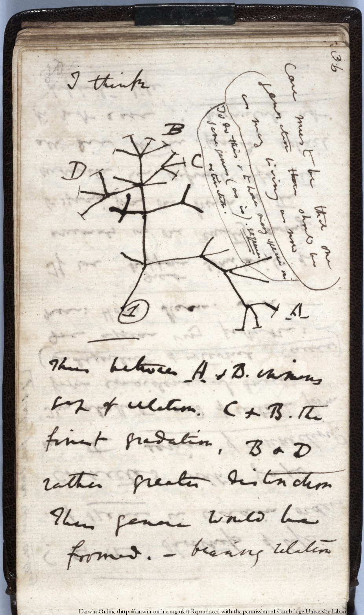
iPlant's Taxonomic Name Resolution Service
Naim Matasci
BIO5 / The iPlant Collaborative
tnrs.iplantc.org

Slide 2

What is iPlant?
Notes:
Bringing a culture of computing to the Plant Sciences.

Slide 4
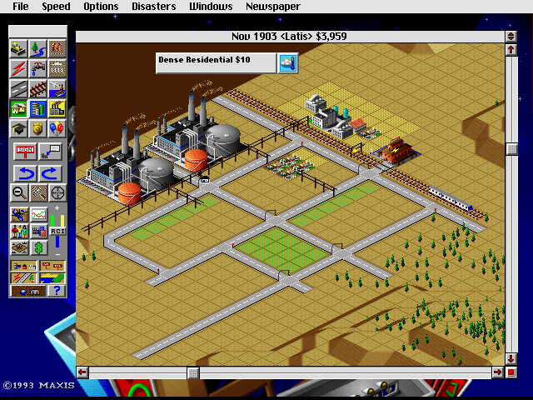

Slide 5

Empowering a New Plant Biology

Slide 6
http://www.ncbi.nlm.nih.gov/Genbank/genbankstats.html

Slide 7
TMU* Growth of Biological Collections
(1600 – 2012)
*TMU: Totally Made Up

Slide 8
If you can't find it, it doesn't exist

Slide 9
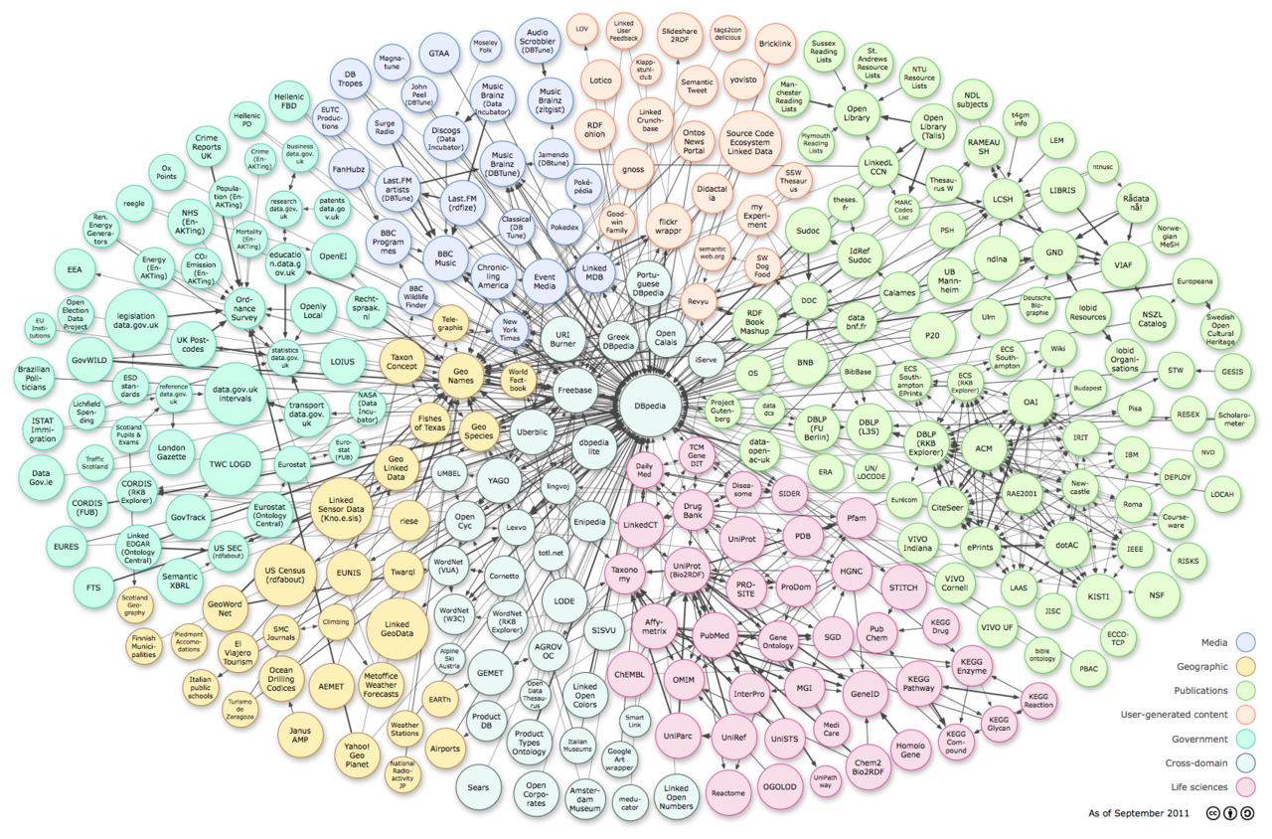

Slide 10
Data Reuse
What's the correlation between leaf morphology and leaf economy (R. Walls)?
Evolution of pit domatia (M. Donoghue)

Slide 11
iPlant Data Store
Based on iRODS
  Metadata driven
  Storing, Sharing and Distributing
Redundant (mirrors at TACC and UoA)
Really, really, really big (6 PB + 40 PB LTS)
Really, really, really fast

Slide 12


iPlant Data Store Performance
UC Berkeley to iDS
100GB: 29m15s
1 GB / 17.5 seconds
Source | Destination | Copy Method | Time (seconds)
CD | Desktop PC | cp | 320
Berkeley Server | Desktop PC | scp | 150
External Drive | Desktop PC | cp | 36
USB 2.0 Flash | Desktop PC | cp | 30
iDS | Desktop PC | iget | 18
Desktop PC | Desktop PC | cp | 15
Desktop PC (UA): Mac with 7.2K Internal Hard Drive
External Drive: USB 2.0: 5.4k Hard Drive
Flash Drive: USB 2.0 Patriot XT
https://pods.iplantcollaborative.org/wiki/display/start/How+fast+is+the+iPlant+Data+Store
Notes:
Comparison to other means of copying data

Slide 13
PhytoBisque features
Rich internet application (completely web based)
Draws upon features from popular large scale photo sharing sites and high resolution aerial imagery (google maps)
Ability to import and export over 100+ image formats, movies
Ability to import extremely large image sets using iPlant data store
Can display 20Kx20K image using standard web browser
Manage data sets with tags, metadata management
Utilizes distributed computing (connected to iPlant execute environment)

Slide 14
Taxonomic uncertainty
Non-existent names
  Misspellings
  Contamination
    Annotations
    Morphospecies
    Digitization issues (frame shifts, character encoding)Lexical variants (digitization conventions)
Synonymy
  Nomenclatural synonyms
  Taxonomic synonyms / concepts
Misidentifications, incomplete identifications

Slide 15
Non-existent names:
Herbarium specimens
Total specimens: | 1.1 million
Unique species names: | 53,052
Published names (legitimate & illegitimate): | 44,532
Misspelled names: | 9371 (18%)
Specimens with misspelled names: | 101,237 (9%)
*New World plant specimens, 34 herbaria, simple match against IPNI and TROPICOS, excluding authors

Slide 16
Taxonomic Name Resolution Service
Computer assisted standardization of plant names
Corrects spelling errors and alternative spellings to a standard list of names
Convert out-of-date names to currently accepted names

Slide 17
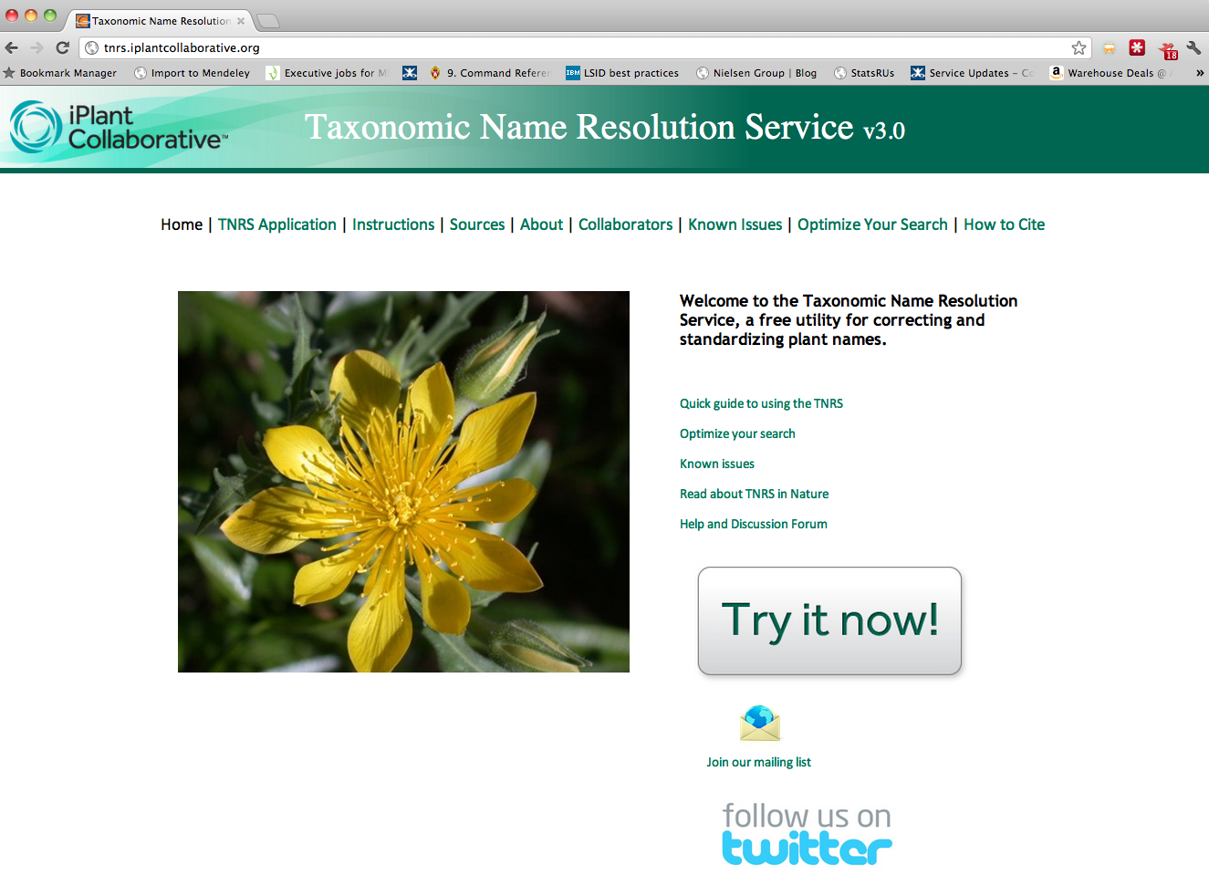

Slide 18
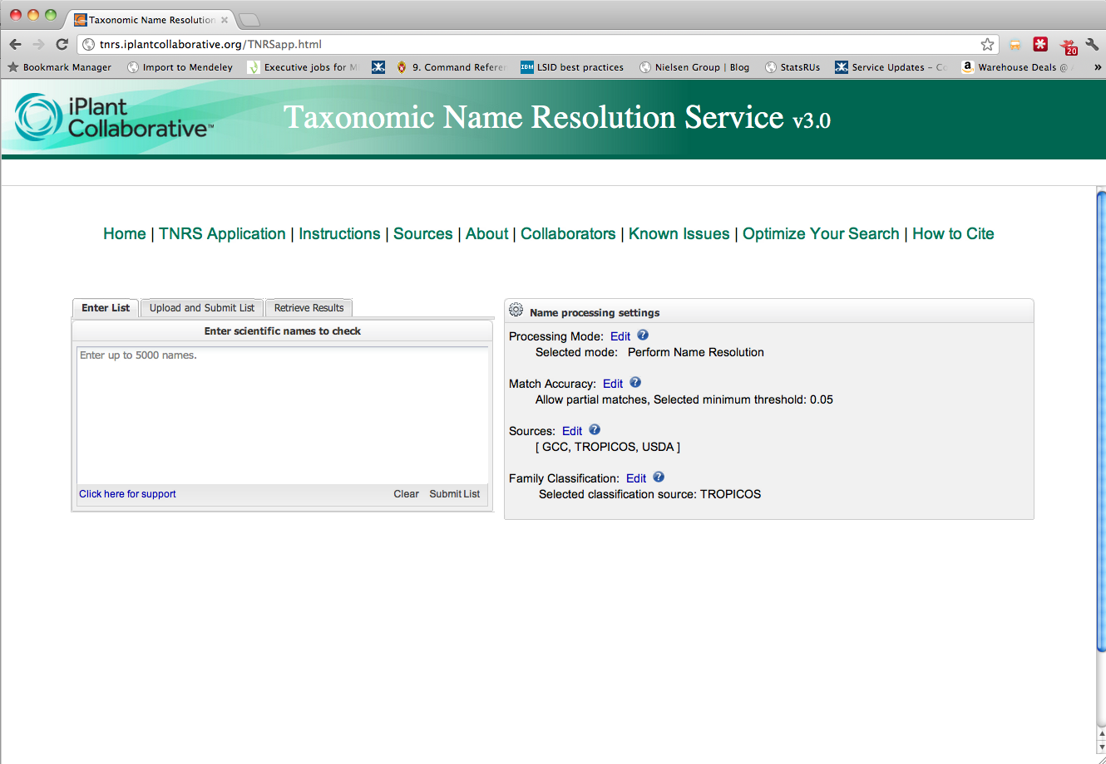

Slide 19
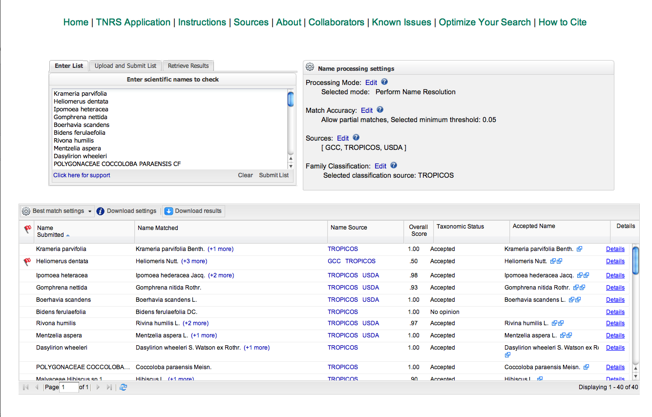

Slide 20
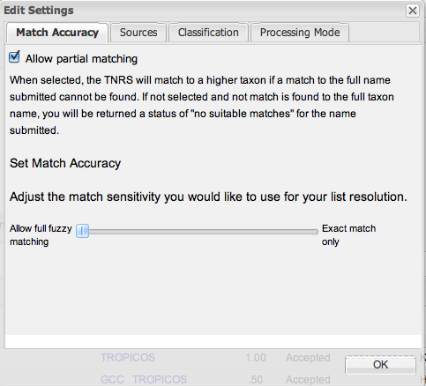
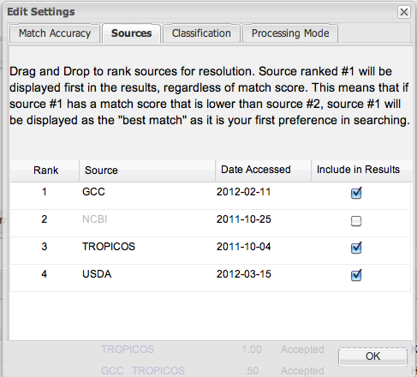
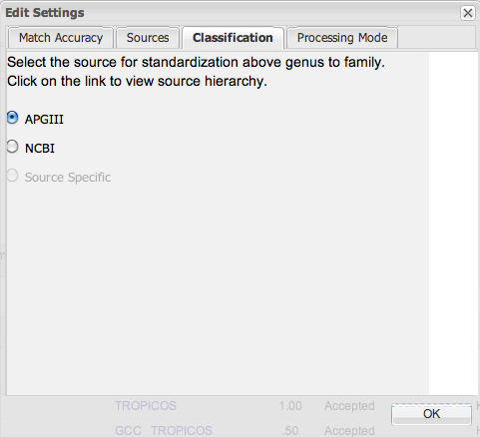
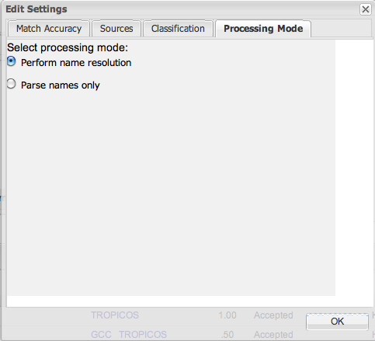

Slide 21
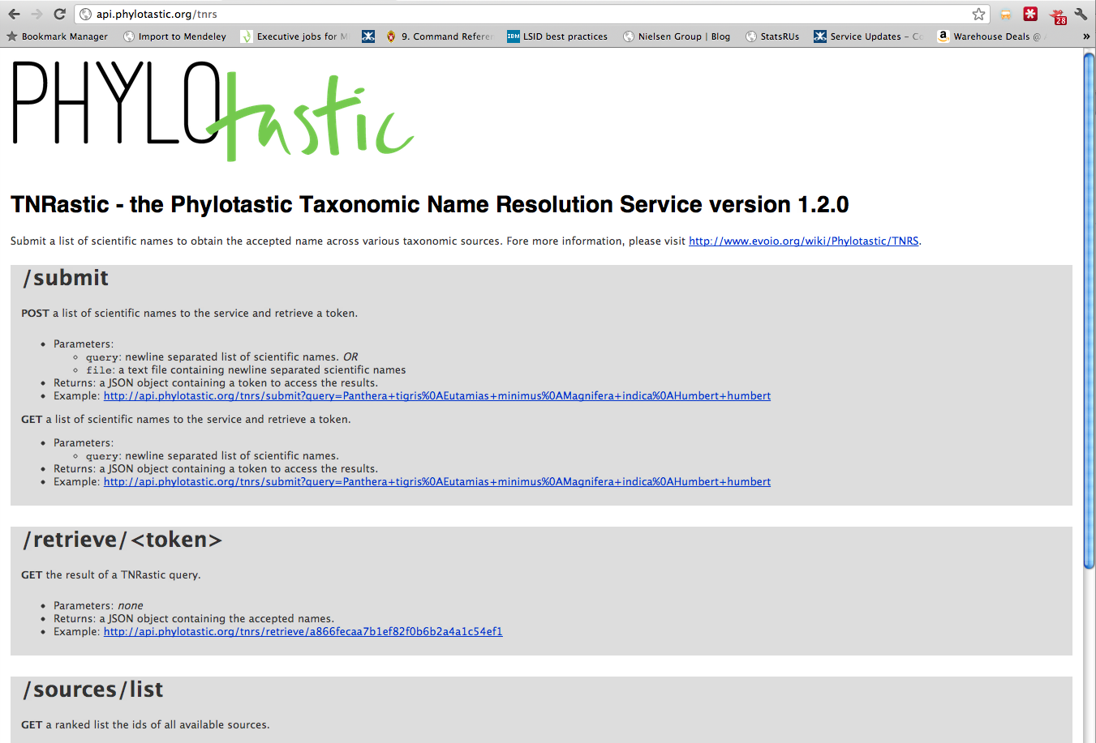

Slide 22
Future
More sources
  Standard source import with DwC support
Better performance
TNRastic API
Integration with Global Names components

Slide 23
Web: http://tnrs.iplantc.org/
Code: https://github.com/iPlantCollaborativeOpenSource/TNRS
API (provisional): http://goo.gl/XnUiH
TNRastic API: http://goo.gl/Z7Fkc

Slide 24
Brad Boyle
Brian Enquist
Juan Antonio Raygoza Garay
Nicole Hopkins
Zhenyuan Lu
Martha Narro
Shannon Oliver
William Piel
Jill Yarmchuk
Bob Magill (Missouri Botanical Garden)
Chris Freeland (Missouri Botanical Garden)
Chuck Miller (Missouri Botanical Garden)
Peter Jorgensen (Missouri Botanical Garden)
Amy Zanne (University of Missouri, St. Louis)
Peter Stevens (Missouri Botanical Garden)
Jay Paige (Missouri Botanical Garden)
Bob Peet (University of North Carolina at Chapel Hill)
Paul Morris (Harvard University)
Alan Paton (Kew Royal Botanic Gardens and their International Plant Names Index)
Tony Rees (Commonwealth Scientific and Industrial Research Organisation)
Michael Giddens (www.silverbiology.com)
Dmitry Mozzherin (Global Biodiversity Information Facility)
David Remsen (Global Biodiversity Information Facility)
David Patterson (Encyclopedia of Life)
Cam Webb (Harvard University)
Missouri Botanical Garden (Tropicos)
Funding provided by the National Science Foundation Plant Cyberinfrastructure Program (grant #DBI-0735191).

