Slide 1
Databasing and Digitization of a Smaller Herbarium at a Smaller Institution
it CAN be done and funded, too

Slide 2
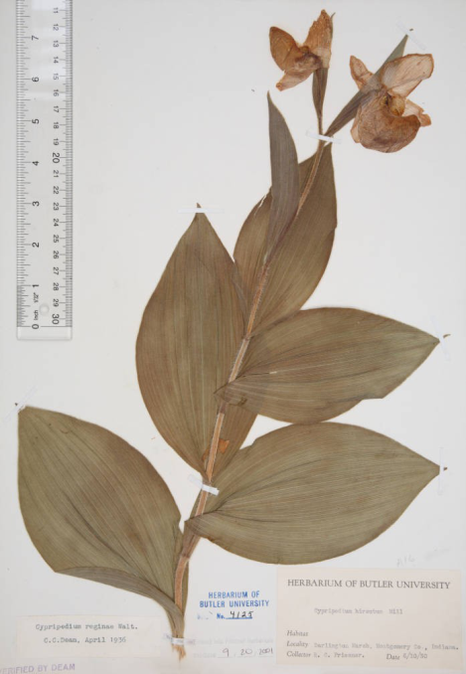
Digitization of Butler University’s Friesner Herbarium Indiana Specimens
A joint project of Butler’s
Friesner Herbarium and Irwin Library

Slide 3
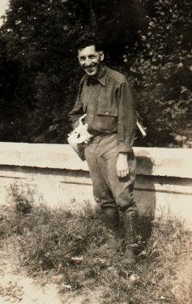
Ray C. Friesner
(1894-1952)
BUT
ca. 105,000 specimens
ca. 44,000 from Indiana
Butler - 1⁰ undergraduate
4,000 students
BUT staff = me

Slide 4
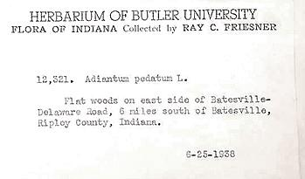
Herbarium specimen sheet and label

Slide 5
Funding Source
Institute of Museum and Library Services under the provisions of the Library Services and Technology Act $56,282 over 4 years (1/2 of Indiana sheets)
administered by the Indiana State Library and Butler University
Indiana Memory digital library http://www.in.gov/memories/
Subcontractor – IUPUI Library
10% match Max = 20k/yr

Slide 6
Herbarium Digitization Project
Goal: to increase access to, awareness of and use by all Indiana citizens of the valuable historical botanical information contained with the Friesner Herbarium.

Slide 7
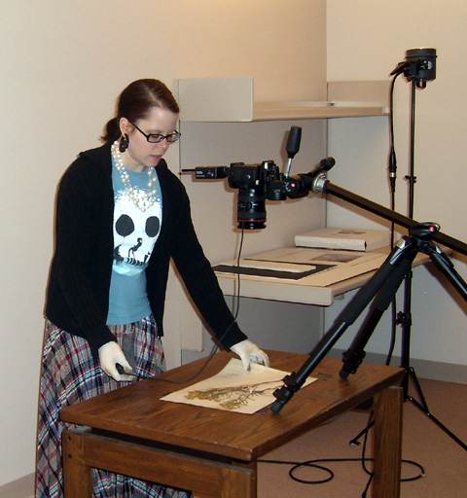
Imaging of Specimens
IUPUI Library Digital Initiatives Technician Anna Proctor and her assistant, Lucy Grogg, capture an image of each Herbarium sheet and store the images on a portable hard drive which is returned to Butler for loading into CONTENT.dm

Slide 8
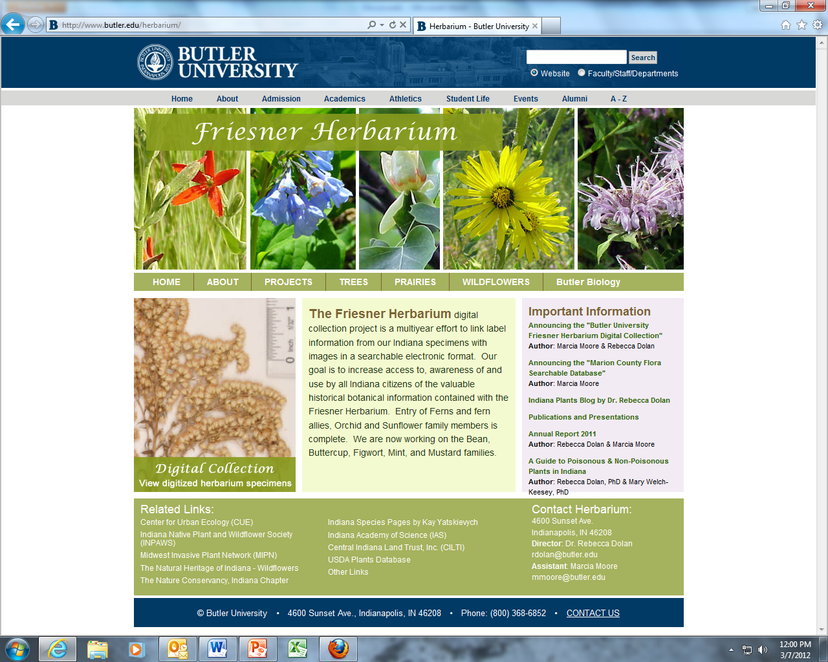

Slide 9
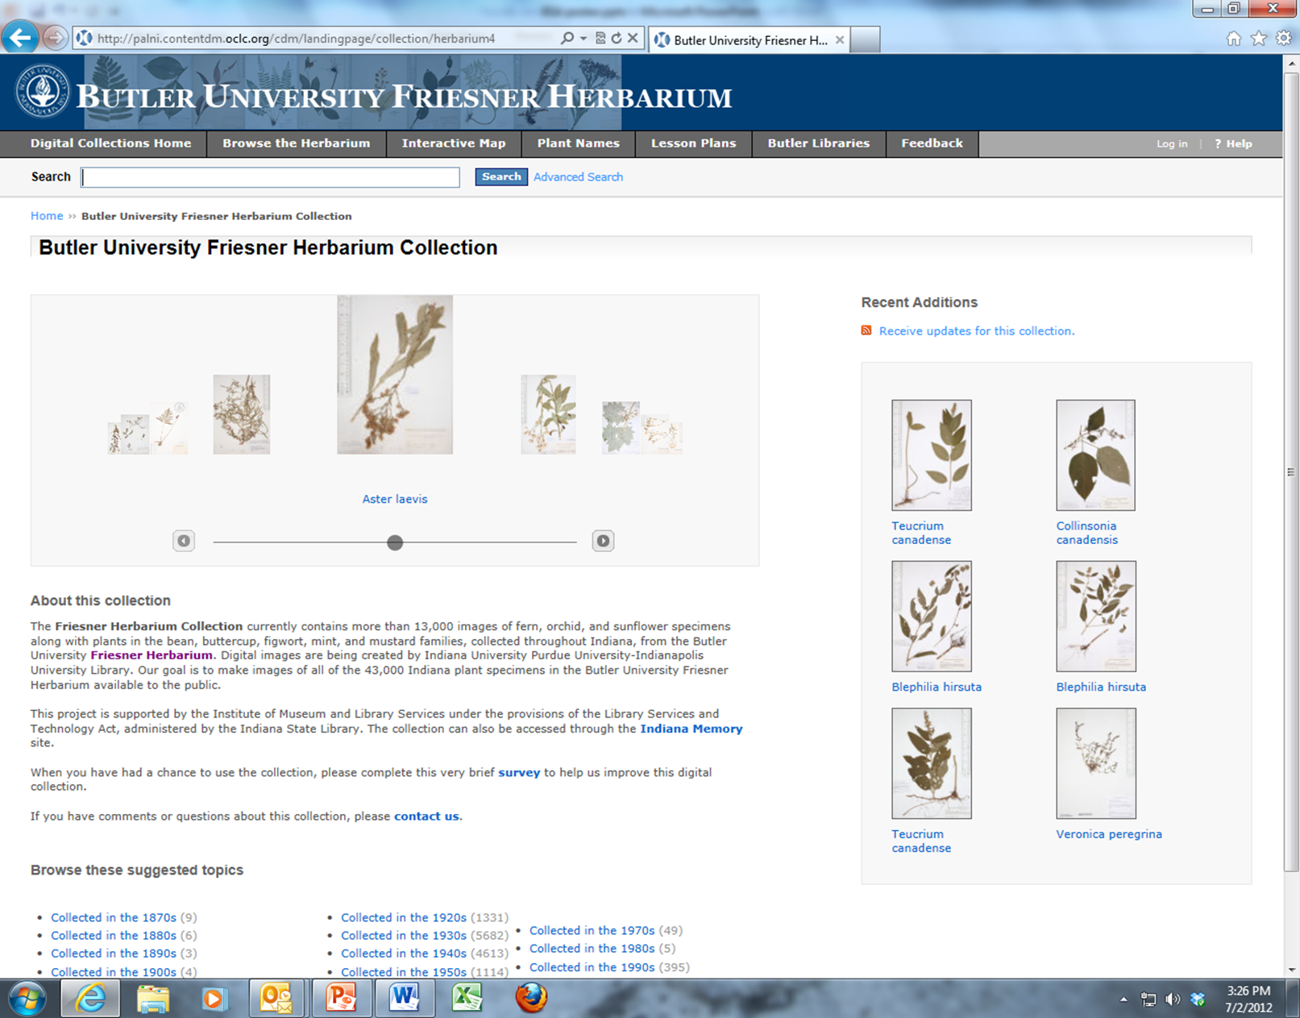

Slide 10
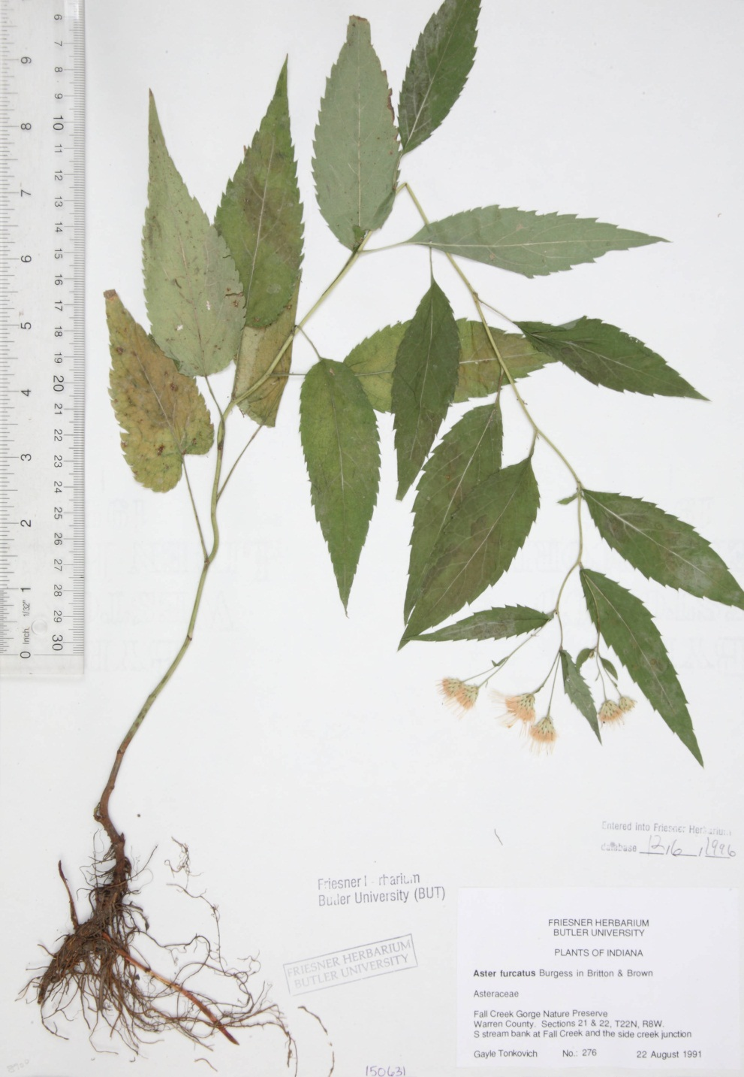

Slide 12
Digital Collection Usage (Views)
April - 7,185
March – 3,863
February – 1,684
January – 1,410
December – 452
November – 266
October – 1,263
Average use of physical
collection over last 4 years:
Visitors – 4
Loans – 1
Inquiries – 15

Slide 13
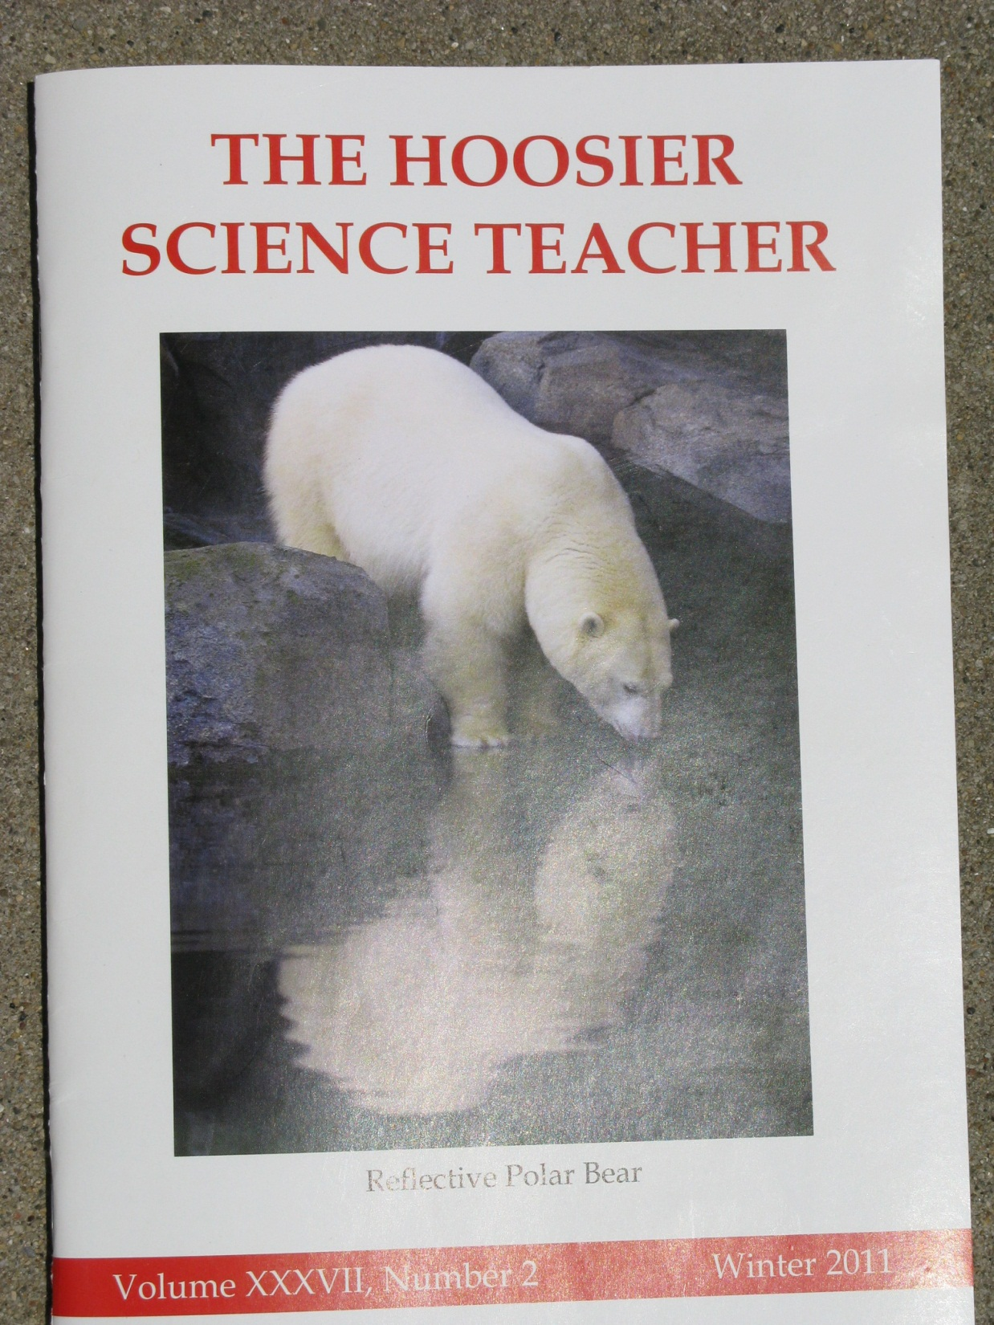
Press release led to:
-Local NPR interview
-Articles in newspapers
statewide

Slide 14
Strategies for Additional Funding
Ca. 50% done – selected families
Local philanthropic foundation – based on increased access for environmental ed.
Donors to Herbarium

Slide 15
Documenting effects of urbanization on flora using herbarium records

Slide 16
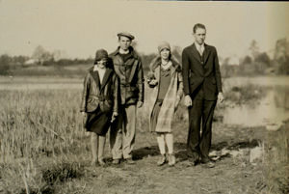
1928 Plant Ecology class trip to Bacon’s Swamp

