Slide 1
SWITCH (SouthWest Idaho: The Comprehensive Herbarium)
Alexa DiNicola, The College of Idaho
Dr. Don Mansfield, The College of Idaho
Dr. James Smith, Boise State University

Slide 2
Introduction
Southwest Idaho: high desert, northern Rockies, Intermountain region
Area falls between major floras

Slide 3
Introduction
Region not covered by one large herbarium
Instead, several smaller collections:
Harold M. Tucker Herb., College of Idaho (CIC)
Snake River Plains Herb., Boise State Univ. (SRP)
Herbaria of 5 land-management agencies: BLM, Forest Service, Idaho Fish & Game
Total of ~112,000 specimens

Slide 4
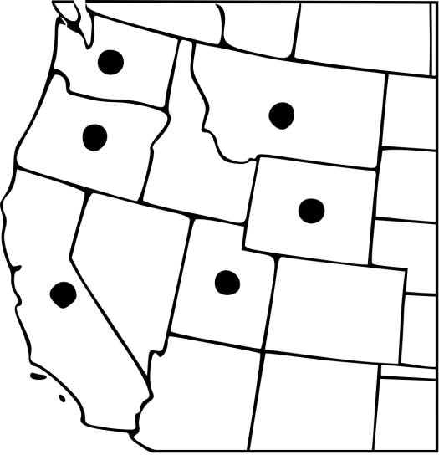
Introduction
Herbaria and region frequently overlooked.
Result: “doughnut holes” in distribution maps.

Slide 5
Carex vesicaria
Left: CIC’s collections from Idaho (7)
Right: SRP’s collections from Idaho (5)
Inset (center): Excerpt from FNA distribution map (emphasis added)

Slide 6
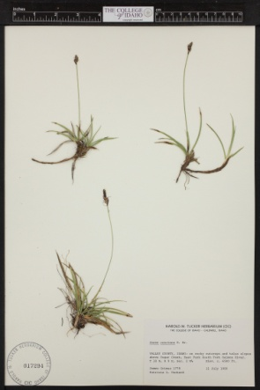
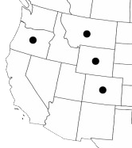
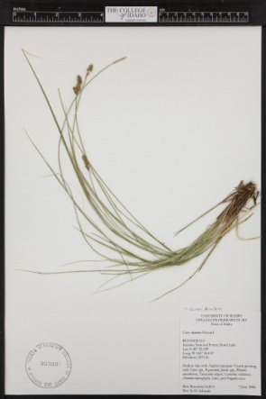
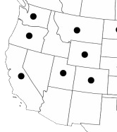
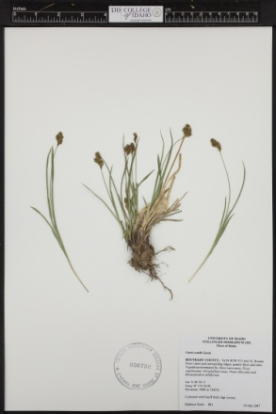
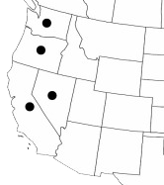
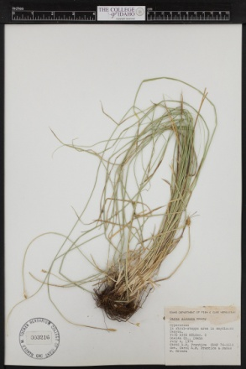
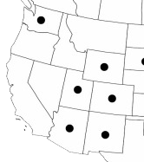
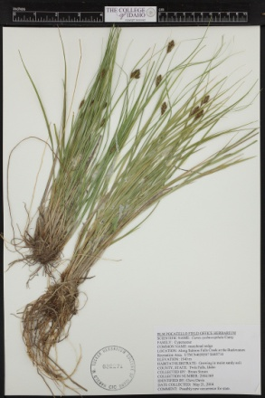
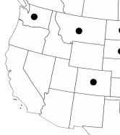
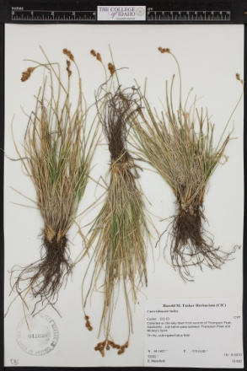
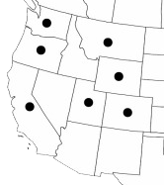
Introduction
Carex spp. (partial list):
All specimens from CIC, imaged by SWITCH
All distribution maps from FNA (emphasis added)
Carex concinna
Carex diandra
Carex ovalis
Carex siccata
Carex sychno-cephala
Carex tahoensis

Slide 7
Introduction
Solution: digitization.
CIC and SRP’s joint NSF grant
SWITCH (SouthWest Idaho: The Comprehensive Herbarium)
Partnered with the Consortium of Pacific Northwest Herbaria (CPNWH)

Slide 8
Objectives
To produce a virtual herbarium for SW Idaho and adjacent Oregon & Nevada
To capture the following for every specimen at the SWITCH institutions:
searchable label data
high-resolution specimen images
georeferences

Slide 9
Benefits of Digitization
The general benefits are well-known: easier access to the data.
Particularly helpful for small, remote herbaria like ours.

Slide 10
Benefits of Digitization
Stimulate research of all kinds:
Local floras & checklists
Taxonomic studies
Larger projects: FNA, GBIF
Work outside botany
Encourage use of collections unique to our herbaria

Slide 11
Benefits of Digitization
Provide better data for land-management decisions
Improve usability for the general public:
Post-secondary teaching
Citizen science groups
People who wouldn’t otherwise consider herbaria

Slide 12
Methods
Pre-imaging specimen preparation
Nomenclature checks
Specimen repairs, if necessary
Georeferencing: TOPO!, GEOLocate

Slide 13
Methods
Imaging: the CPNWH system
Photographed in lightbox
Metadata capture: custom scripts
Data sent to UTW for uploading
SRP’s imaging station, in use by student staff member Sandelle Shaw

Slide 14
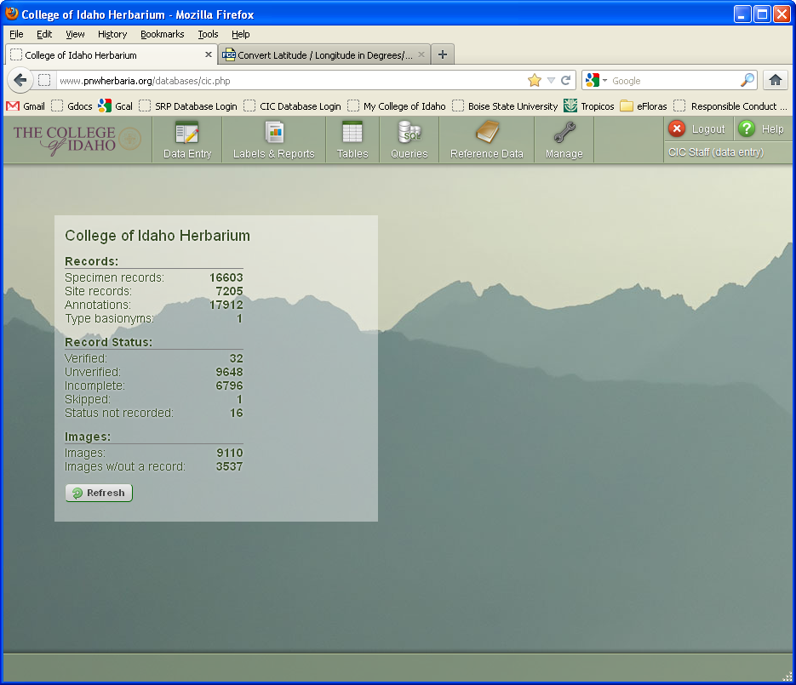
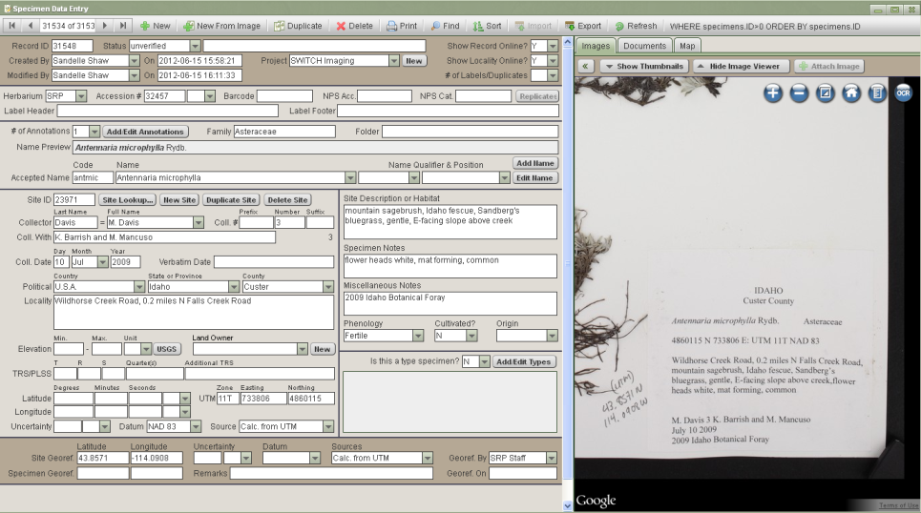
Methods
Databasing: the CPNWH system
Access through Web application
Images linked to legacy records by accession number
Label data captured by student staff

Slide 15
Current Progress
Well ahead of schedule (June 2012):
34,000 imaged (238% of planned)
48,000 databased (100% of planned)
Of those, 25% georeferenced at CIC and 10% at SRP
Not yet accessible online

Slide 16
Current Progress
Data already being used
Environmental contractors
Monograph preliminary research
Student staff also benefiting
Botany, local flora, curatorial skills
Connections for research
Student staff members Brendan Eckert, Brittni Brown, and Jessica Hansen examining CIC specimen data in the field

Slide 17
Conclusion
There’s no question: we will finish on time
More likely to finish early. What then?
Cover more, even smaller herbaria?
Expand geographic range?
???

Slide 18
Thank you
...to the Consortium of Pacific Northwest Herbaria and especially to Ben Legler, for developing an excellent digitization system and taking on SWITCH as a partner
...to the staff of the College of Idaho and Boise State University, for their aid and support
...to Brendan Eckert, Brittni Brown, Jessica Hansen, Sandelle Shaw, and Carly Prior, for posing for photos
...to all the SWITCH student staff, especially the volunteers

Slide 19
Thank you for listening.
Any questions?

