Slide 1
iPlant's Taxonomic Name Resolution Service
Naim Matasci
BIO5 / The iPlant Collaborative

Slide 2
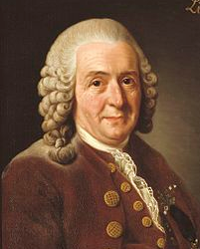
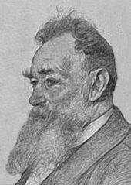
The Problem – Taxonomic Uncertainty
Lycopersycon esculentum
Solanum lycopersicum
Lycopersycon lycopersicum
Solanum lycopersicon?

Slide 3
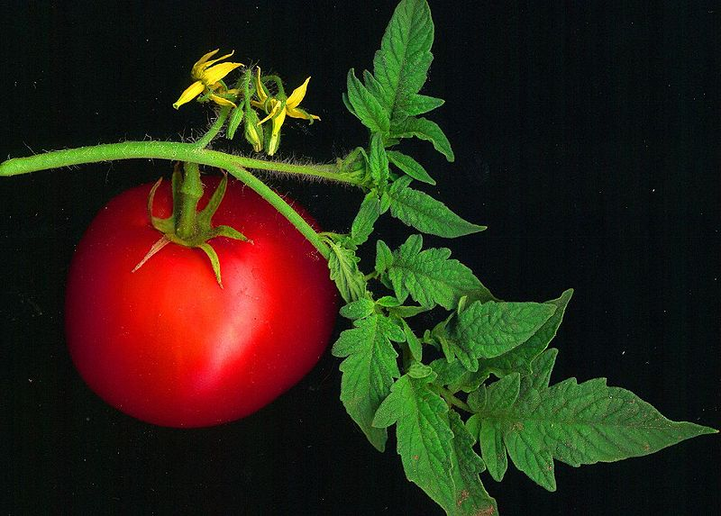

Slide 4
Taxonomic uncertainty
Non-existent names
Misspellings
Contamination
Annotations
Morphospecies
Digitization issues (frame shifts, character encoding)Lexical variants (digitization conventions)
Synonymy
Nomenclatural synonyms
Taxonomic synonyms / concepts
Misidentifications, incomplete identifications

Slide 5
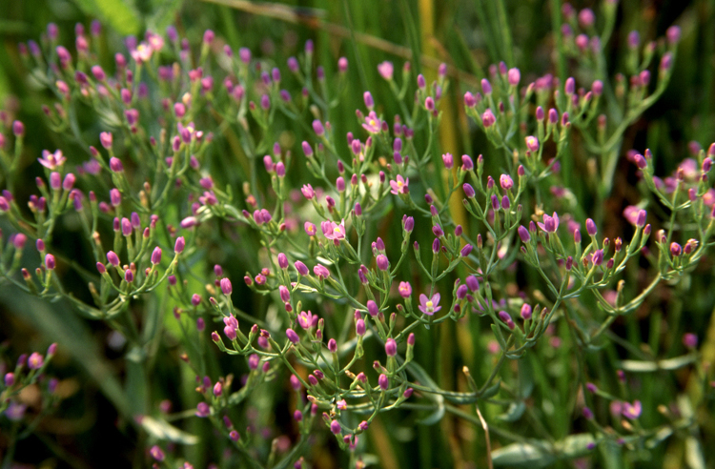
a) Centaurium curvistamineum (Wittr.) Abrams (1951)
b) Centaurium minimum (Howell) Piper (1915)
c) Centaurium muhlenbergii (Griseb.) Wight ex Piper (1906)
d) Centaurium muhlenbergii (Griseb.) Wight ex Piper forma albiflorum (Suksd.) St. John (1937)
e) Centaurium muhlenbergii (Griseb.) Wight ex Piper var. albiflorum Suksd. (1927)
f) Centaurodes muhlenbergii (Griseb.) Kuntze (1891)
g) Erythraea curvistaminea Wittr. (1886)
h) Erythraea minima Howell (1901)
i) Erythraea muhlenbergii Griseb. (1839)
Image: Gordon Leppig & Andrea J. Pickart

Slide 6
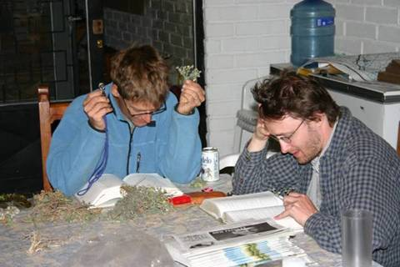
How to figure that out?
…or ask around at My-Plant.org

Slide 7
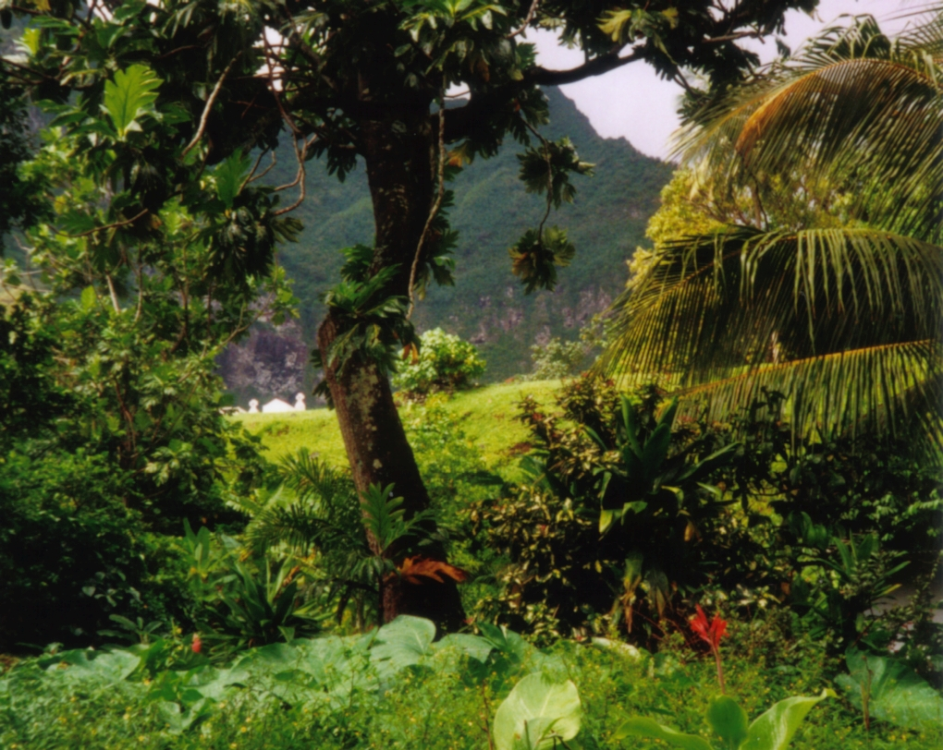
Original Use Case – Density Plots (BIEN/NCEAS)
Makemake at de.wikipedia

Slide 8
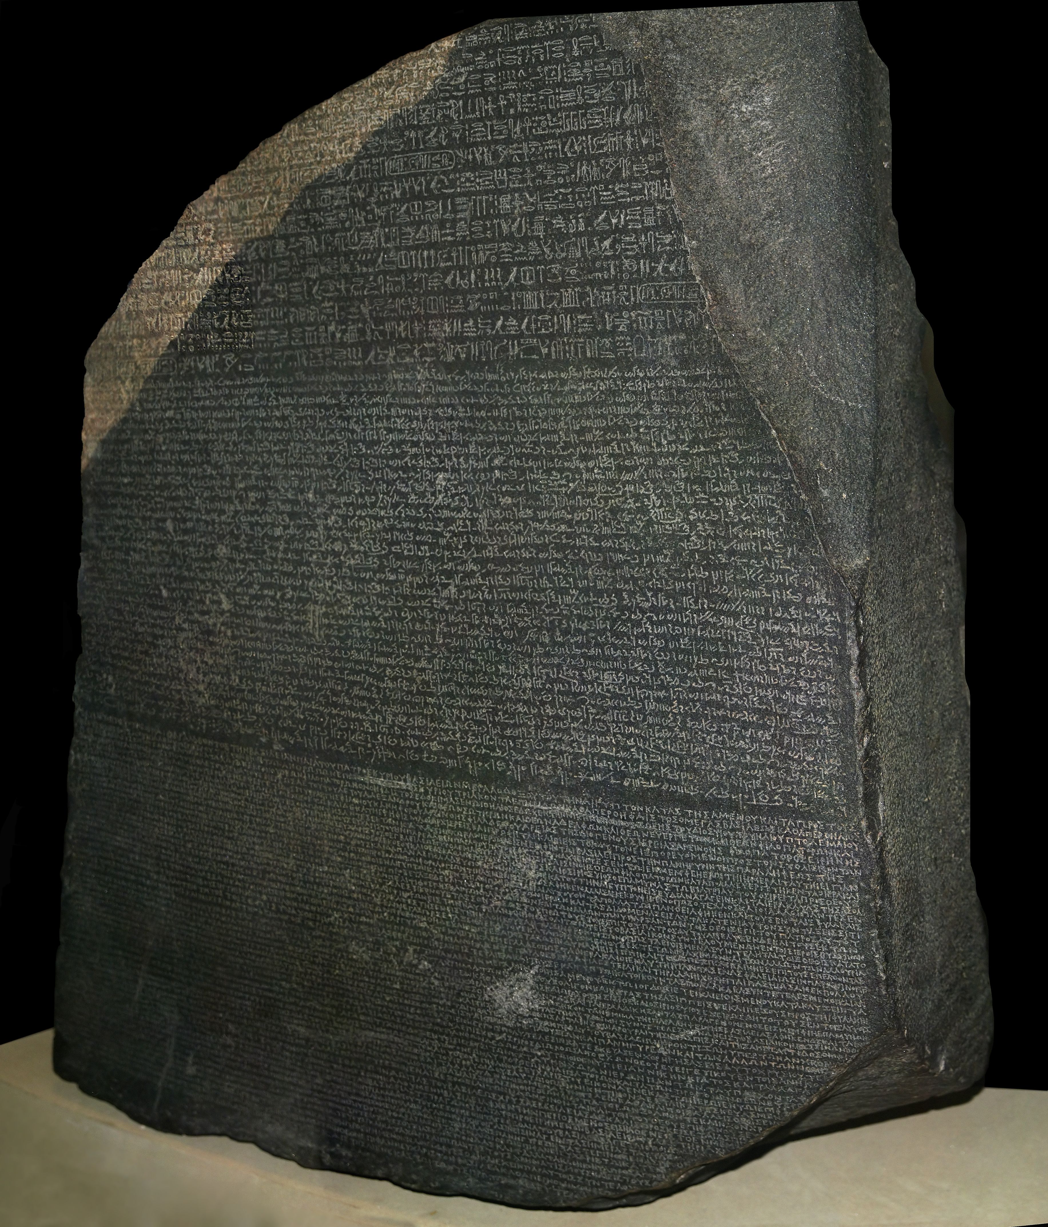
Hans Hillewaert

Slide 9
Taxonomic Name Resolution Service
Computer assisted standardization of plant names
Corrects spelling errors and alternative spellings to a standard list of names
Convert out-of-date names to currently accepted names

Slide 10
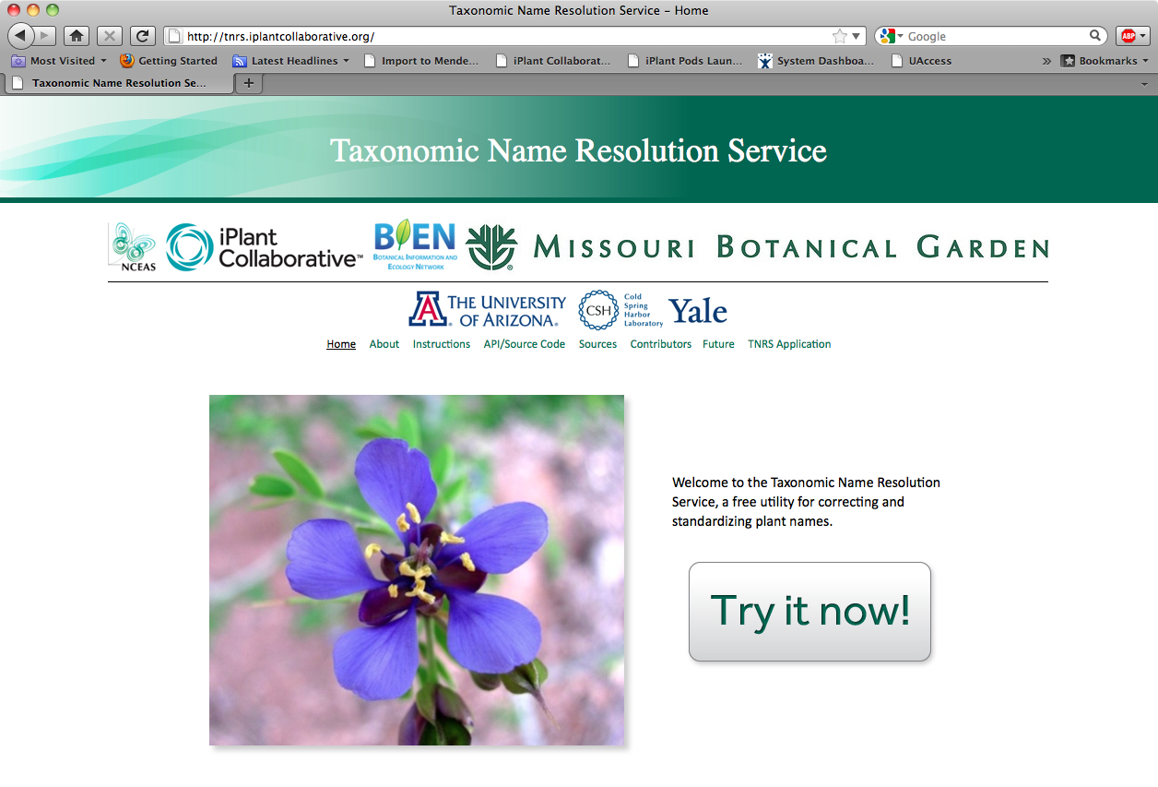

Slide 12
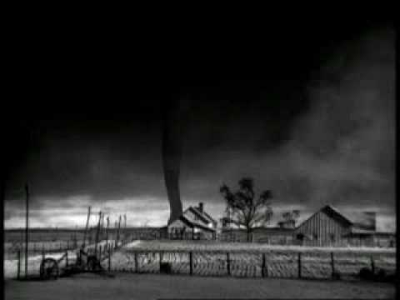

Slide 13
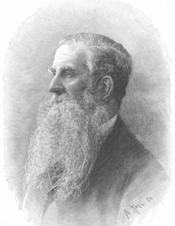
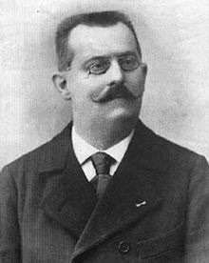
It's all wrong!!!
Where is my plant!!!

Slide 15
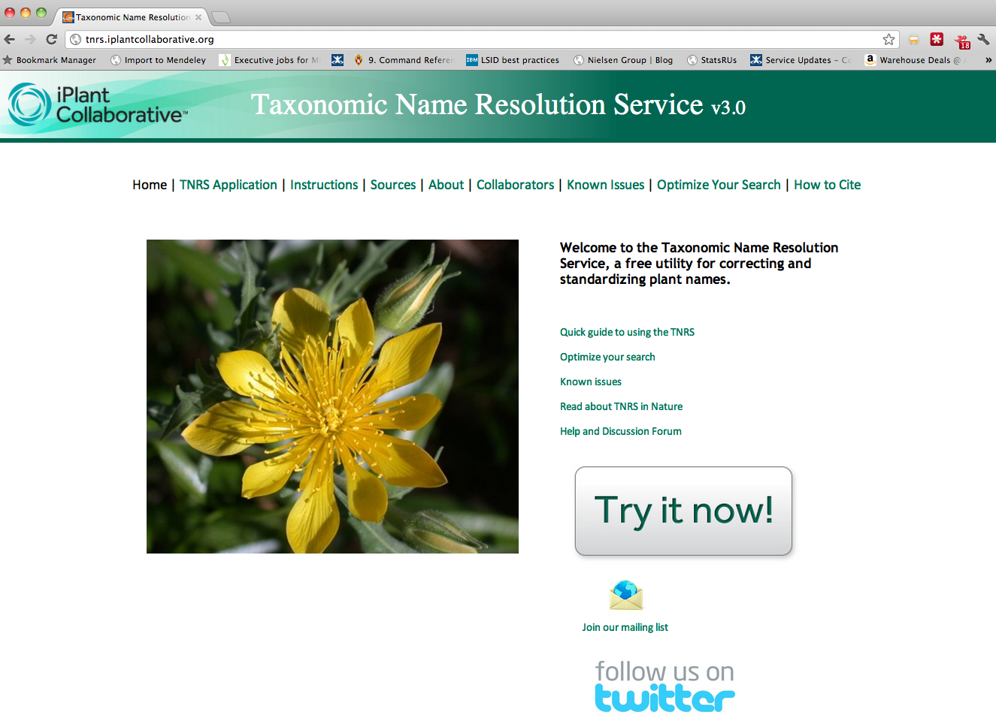

Slide 16
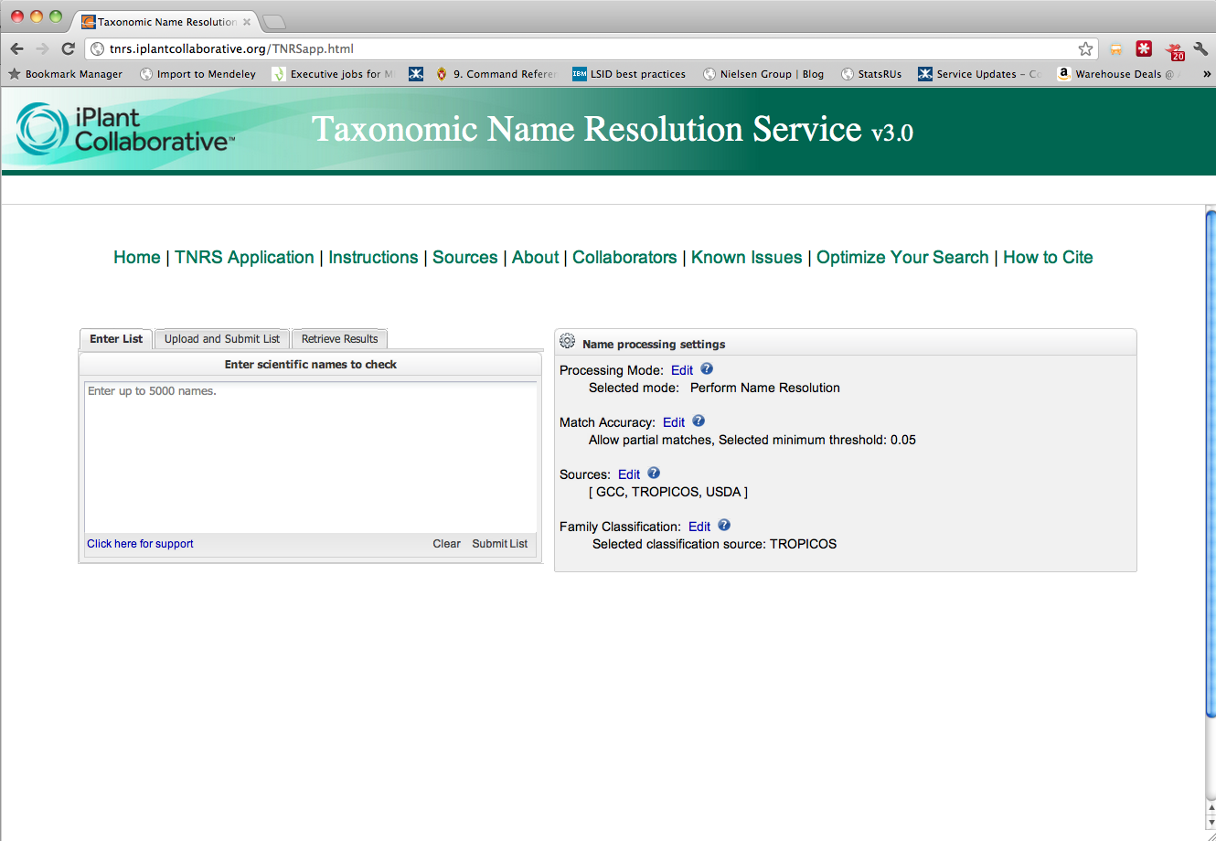

Slide 17
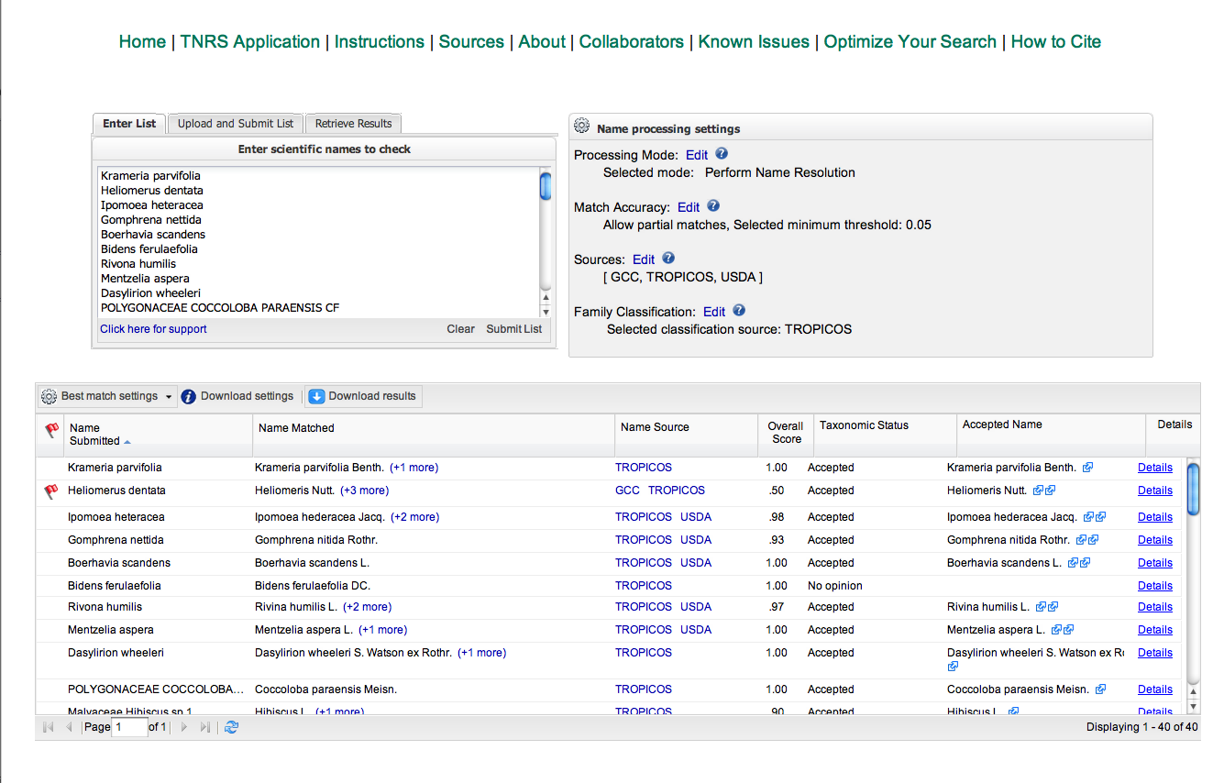

Slide 18
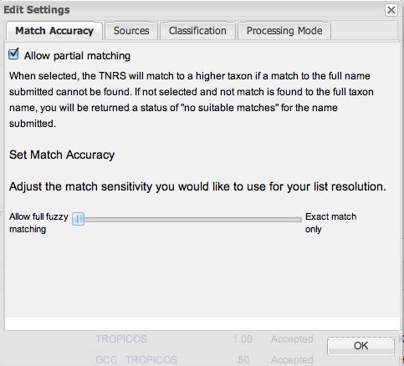
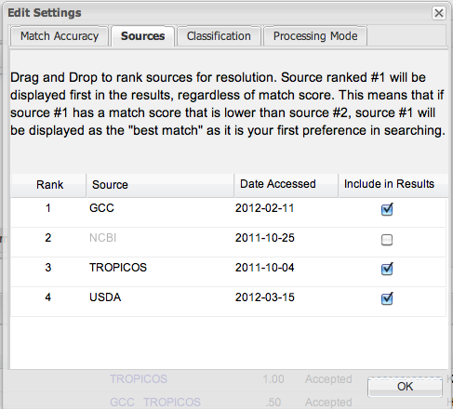
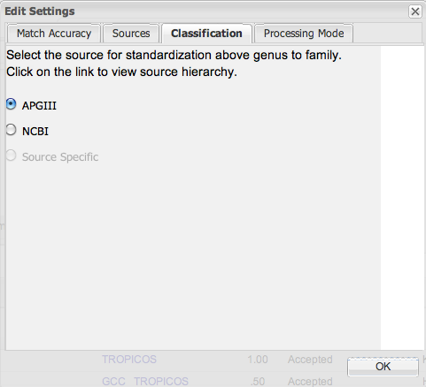
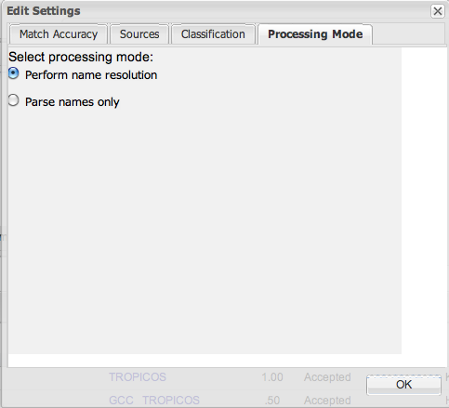

Slide 19
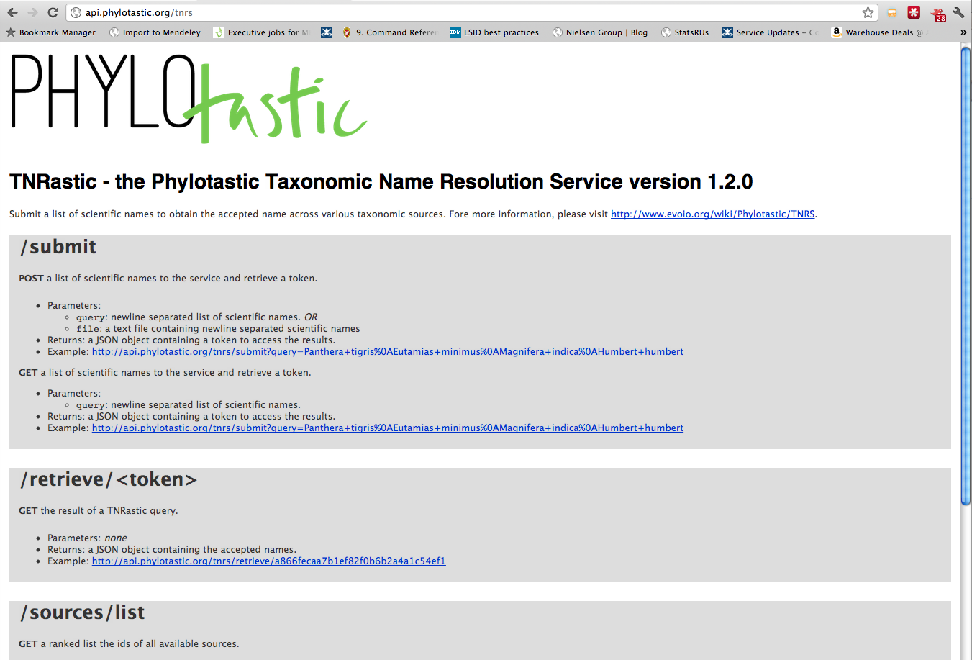

Slide 20
Future
More sources
Standard source import with DwC support
Better performance
TNRastic API
Integration with Global Names components

Slide 21
Web: http://tnrs.iplantc.org/
Code: https://github.com/iPlantCollaborativeOpenSource/TNRS
API (provisional): http://goo.gl/XnUiH
TNRastic API: http://goo.gl/Z7Fkc

Slide 22
Brad Boyle
Brian Enquist
Juan Antonio Raygoza Garay
Nicole Hopkins
Zhenyuan Lu
Martha Narro
Shannon Oliver
William Piel
Jill Yarmchuk
Bob Magill (Missouri Botanical Garden)
Chris Freeland (Missouri Botanical Garden)
Chuck Miller (Missouri Botanical Garden)
Peter Jorgensen (Missouri Botanical Garden)
Amy Zanne (University of Missouri, St. Louis)
Peter Stevens (Missouri Botanical Garden)
Jay Paige (Missouri Botanical Garden)
Bob Peet (University of North Carolina at Chapel Hill)
Paul Morris (Harvard University)
Alan Paton (Kew Royal Botanic Gardens and their International Plant Names Index)
Tony Rees (Commonwealth Scientific and Industrial Research Organisation)
Michael Giddens (www.silverbiology.com)
Dmitry Mozzherin (Global Biodiversity Information Facility)
David Remsen (Global Biodiversity Information Facility)
David Patterson (Encyclopedia of Life)
Cam Webb (Harvard University)
Missouri Botanical Garden (Tropicos)
Funding provided by the National Science Foundation Plant Cyberinfrastructure Program (grant #DBI-0735191).

