Slide 1
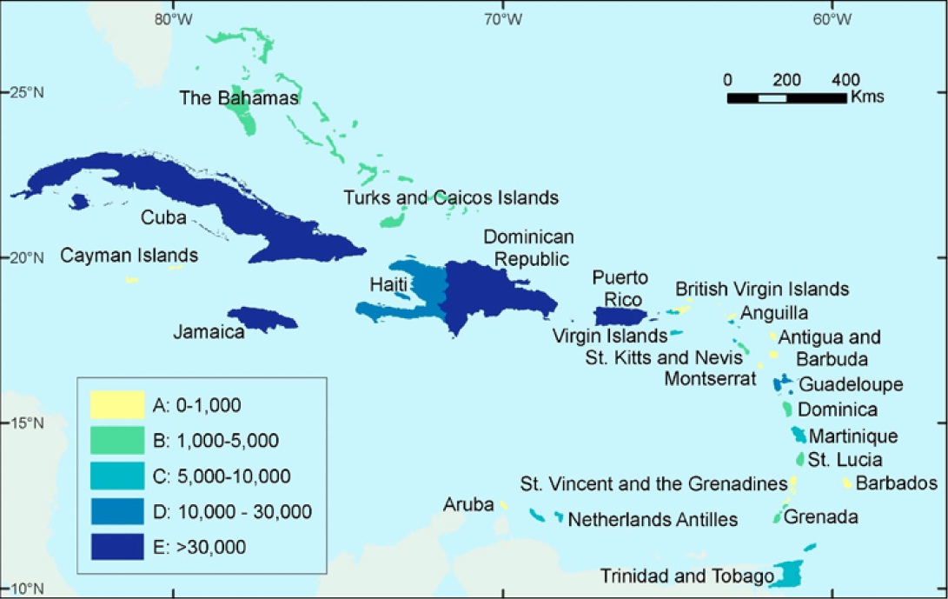
OCR implementation in The Caribbean Plants Digitization Project
A project to image and catalog over 150,000 Caribbean specimens at the New York Botanical Garden
The New York
Botanical Garden
*Legend: estimated number of specimens per country
Presented by: Stephen Gottschalk

Slide 2
NYBG’s Caribbean Collections
More than 100 expeditions sponsored by the garden since 1895.
Notable and prolific collections by current and former Garden staff including the Garden’s founder, Nathaniel Lord Britton
Approximately 75 % of the specimen data could be digitized from field books at NYBG and other institutions, or from published itineraries which provide the same information

Slide 3
Caribbean Project workflow summary:
Curation and rapid barcoding of specimens
Field book entries
Optical Character
Recognition (OCR)
and data parsing
Specimen Catalog
Record
Specimen imaging
Manual keying
of specimen
data

Slide 4
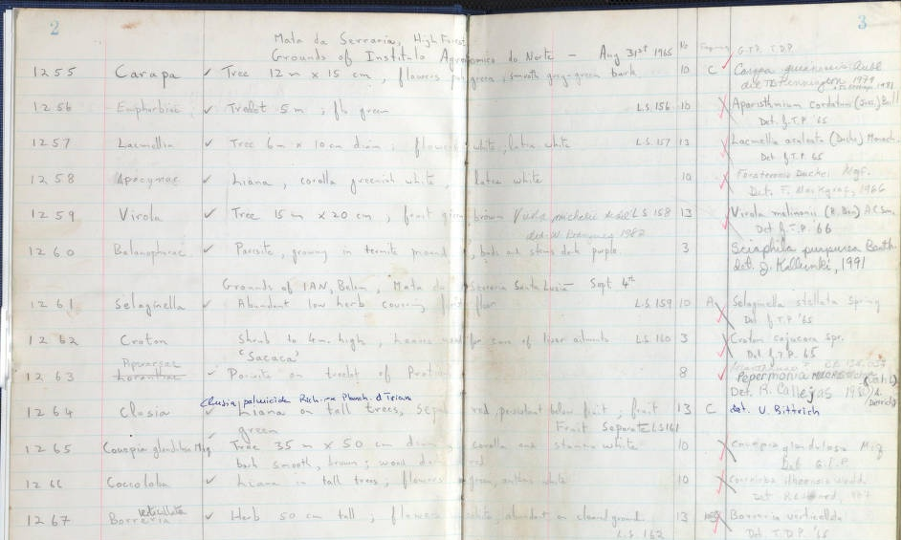
Sample ideal fieldbook:
Plant family
Collection locality
Collection date
Determination
Collection no.
Plant description
Habitat
No. of duplicates

Slide 5
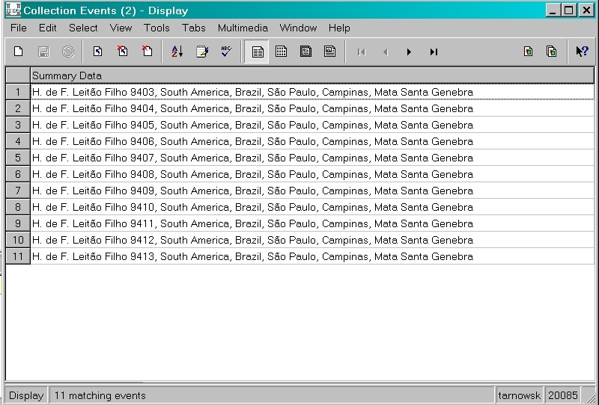
Sample fieldbook - the product:

Slide 6
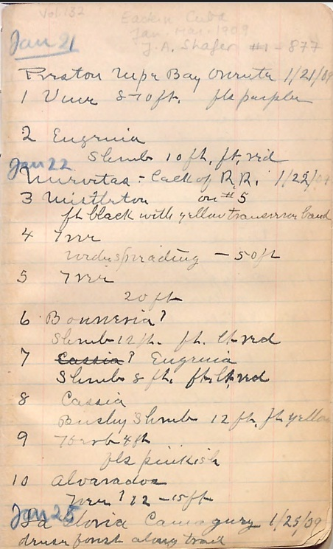
Sample Caribbean fieldbooks, less than ideal:
Vol 132, J. A. Safer, 1909
Vol. 69, Van Hermann, 1904

Slide 7
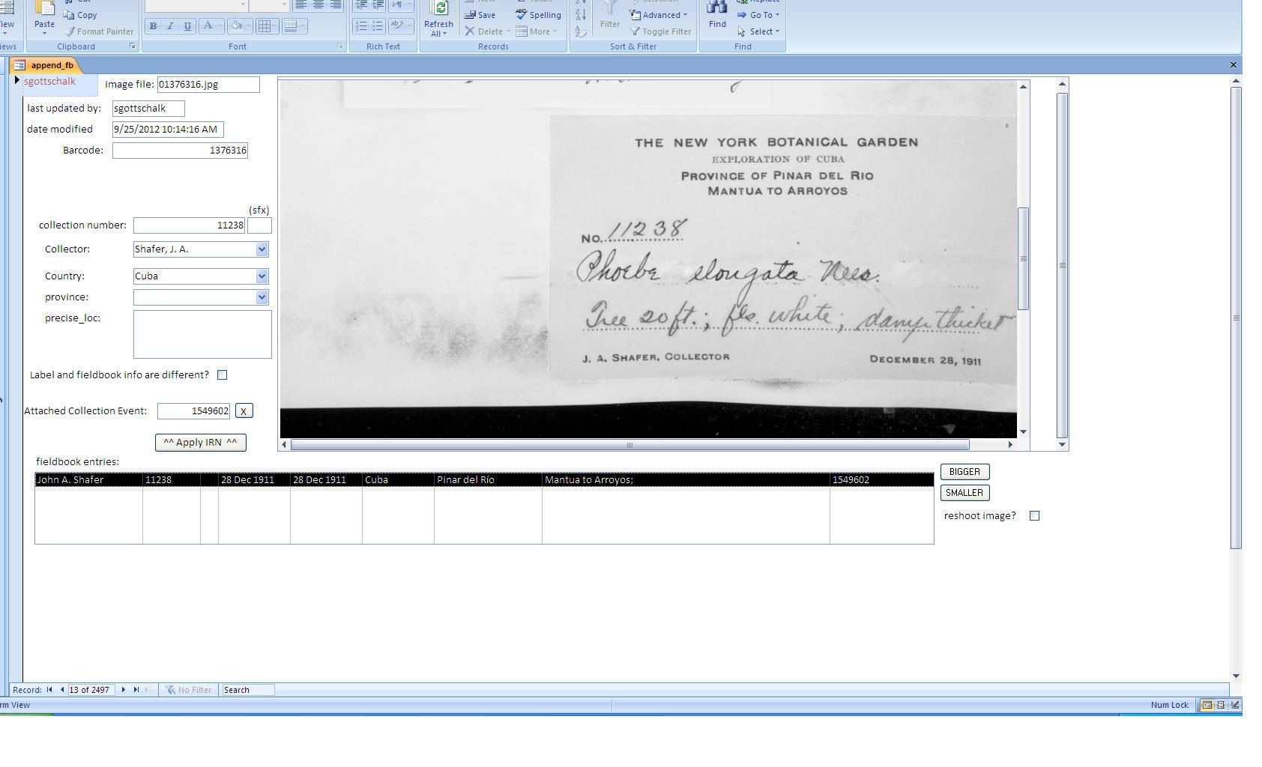
OCR assists in attaching fieldbook records:
user input
OCR derived fields
IRN
Fieldbook entries

Slide 8
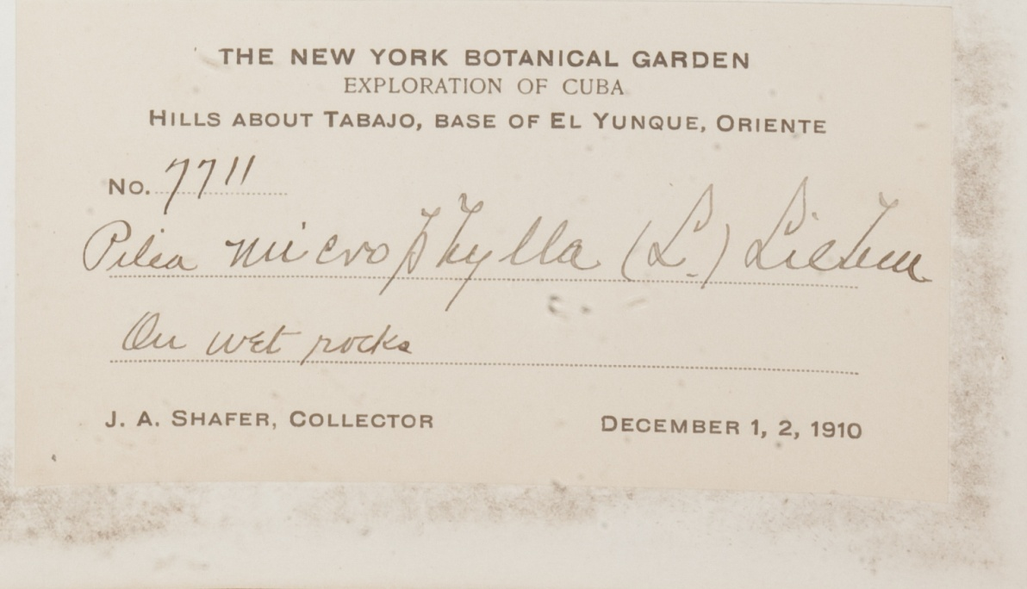
Using OCR to populate fields:
User detects pattern to update fields
Query raw OCR to
extract records
of a given label type
Python script finds
line of query term
SELECT *
FROM OCR_all
where label like "*New*Yor*Bot*Gar*Exp*Cub*";
Example:

Slide 9
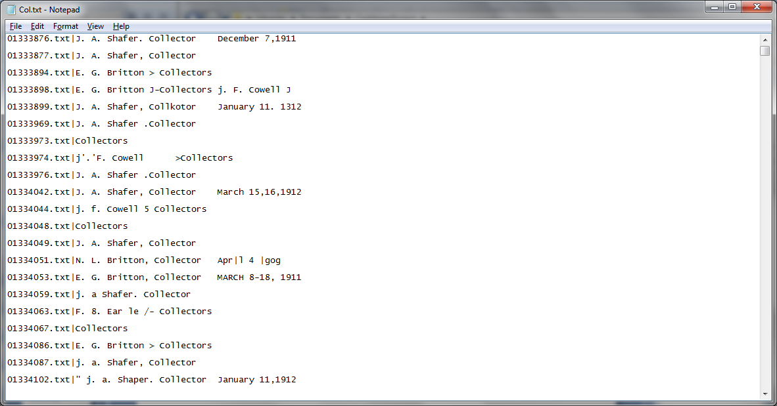
Using OCR to populate fields:
User detects pattern to update fields
Query raw OCR to
extract records
of a given label type
Python script finds
line of query term
Return line containing “Col”
Example:

Slide 10
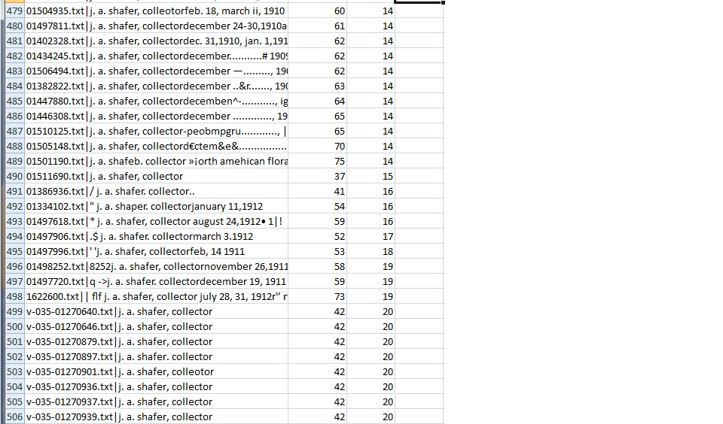
Using OCR to populate fields:
User detects pattern to update fields
Query raw OCR to
extract records
of a given label type
Python script finds
line of query term
Length of string
Find position of “j. a.”
find “sha”
Find “afer”
Example:
J. A. Shafer collections!

Slide 11
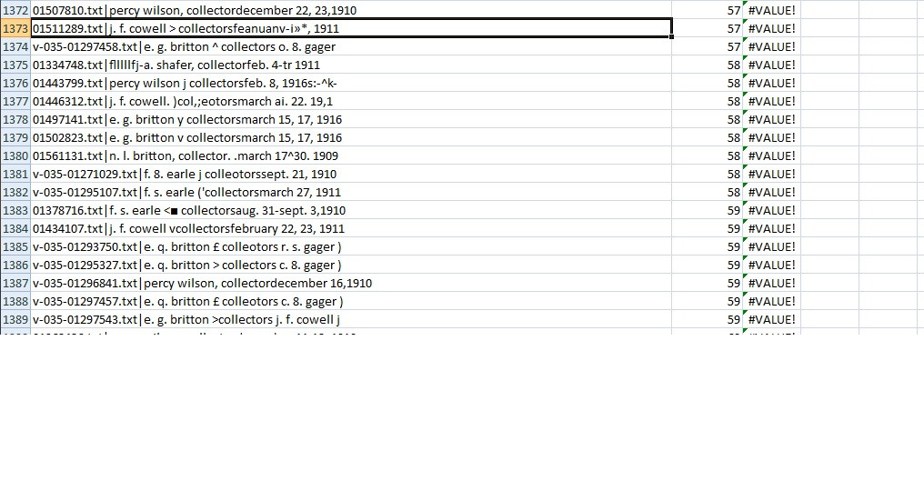
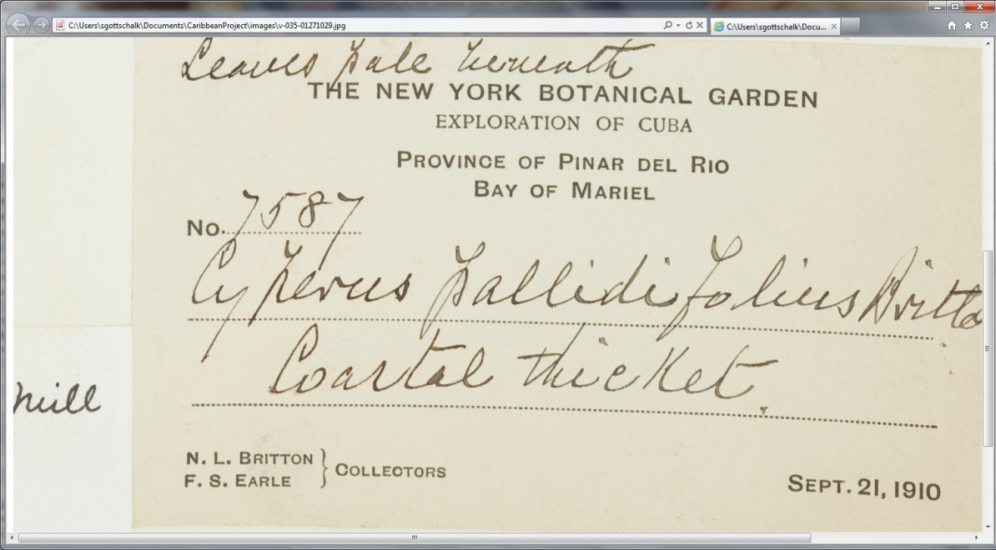
Avoid false positives:
F. S. Earle – no!

Slide 12
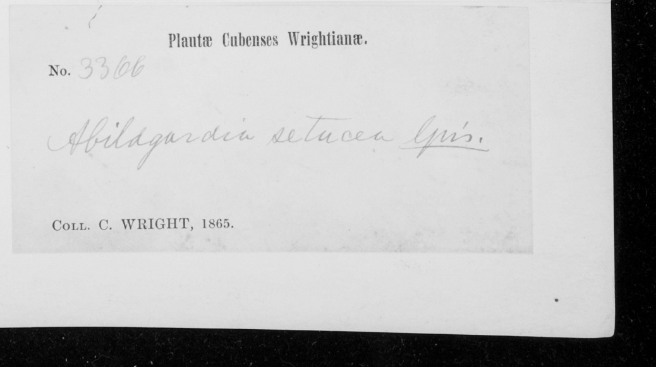
Consider pattern training and a second OCR pass:
Wright Labels, 162 total, generally low quality:
Percentage correctly OCR’d
OCR Pattern Training Used

Slide 13
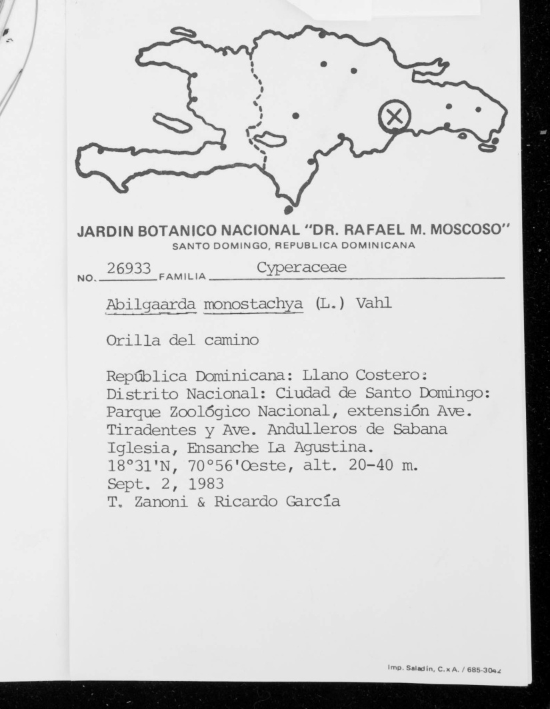
Consider pattern training and a second OCR pass:
Zanoni Labels, 114 total, generally typed:
Percentage correctly OCR’d
OCR Pattern Training Used

Slide 14
Closing thoughts:
OCR plus human parsing works well with very little programming.
Works well for large, self contained data sets but maybe not for partial or changing data sets – automation would be helpful for addressing this.
Allows for creation of “digital” fieldbooks (ie order by collector, collection number and place).

Slide 15
Acknowledgements
National Science Foundation
Barbara Thiers, Jacquelyn Kallunki, Michael Bevans, Anthony Kirchgessner, Melissa Tulig, Benito Santos, Nicole Tarnowsky, Tom Zanoni, Benjamin Saracco, Stephen Sinon, Vinson Doyle, Jessica Allen, Sarah Dutton, Lane Gibbons, Elizabeth Kiernan, Brandy Watts, Charles Zimmerman
Visit the Virtual Herbarium: http://sciweb.nybg.org/science2/vii2.asp

