Slide 1
Tri-Trophic Digitization:
Putting the OCR in Workflow
Plants, Herbivores, and Parasitoids
NSF ADBC Digitization TCN
Kimberly Watson
iDigBio Augmenting OCR Workshop
October 1, 2012
Notes:
Project Coordinator at the New York Botanical Garden for the Tri-Trophic Digitization TCN.
I’ll be talking about our overall workflow for digitizing a large collection of plants and insects across several collaborating institutions, and how we’ll be using OCR software in the process.

Slide 2
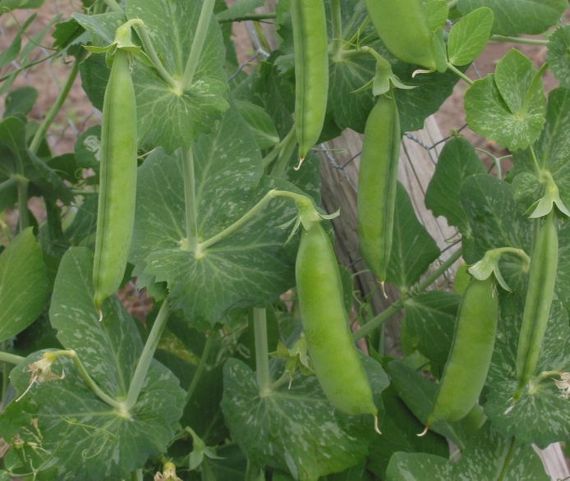
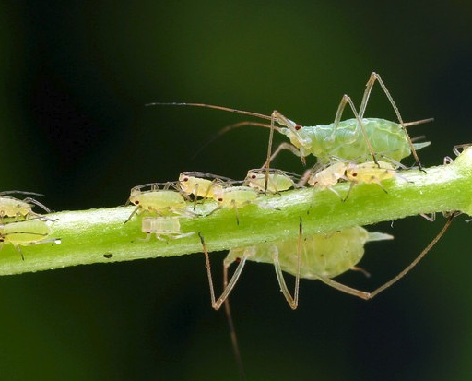
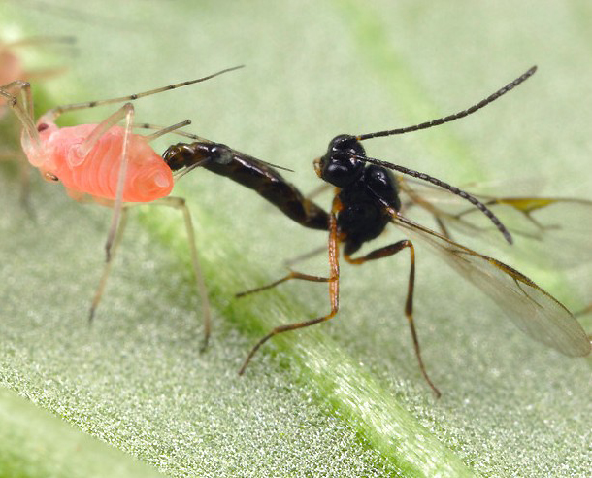
A Tri-Trophic Example
Plants
Herbivores
Parasitoids
Crop Plants
Hemiptera (e.g. Aphids)
Hymenoptera (Parasitoid wasps)
Produce fruits and tubers of significant agricultural and economic importance.
Poaceae: corn, wheat, rice
Fabaceae: soybean, hay
Solanaceae: tomato, potato
Pierce plant stems and leaves; specialize on one species or numerous.
Reduce plant vigor, transmit disease, reduce harvest yield.
Lay eggs inside aphid; larva consumes host from the inside out; emerges from “mummy” as an adult.
Photo: www.alexanderwild.com
Photo: www.alexanderwild.com
Notes:
In a nutshell, the goal of the Tri-Trophic TCN is to digitize, integrate, and make available online the data of three major groups of organisms:
The Hemiptera, which are a large group of insect herbivores, including mealy bugs and aphids
The plant taxa commonly eaten by Hemiptera, many of which are important economically and agriculturally
And the parasitoid Hymenoptera, which parasitize the herbivores by laying their eggs inside them, thereby killing the herbivore.

Slide 3
Species of Interest: North American Biota
Plants
Herbivores
Family | # species
Apiaceae | 250
Asteraceae | 2,400
Chenopodiaceae | 250
Cupressaceae | 30
Cyperaceae | 850
Fabaceae | 850
Fagaceae | 97
Grossulariaceae | 53
Juglandaceae | 17
Lamiaceae | 240
Oleaceae | 35
Pinaceae | 66
Poaceae | 1,400
Polygonaceae | 440
Rhamnaceae | 75
Rosaceae | 360
Salicaceae | 123
Scrophulariaceae | 430
Solanaceae | 85
Zygophyllaceae | 15
Total | 8,066
Hemiptera | # species
Coccoidea (scale insects) | 986
Aphidoidea (plant lice) | 1,532
Psylloidea (jumping plant lice) | 176
Auchenorrhyncha (cicadas, hoppers) | 4,629
Heteroptera | 3,827
Total | 11,150
Parasitoids
Hymenoptera | # species
Aphelinidae | 212
Encyrtidae | 490
Mymaridae | 187
Signiphoridae | 19
Trichogrammatidae | 131
Total | 1,039
Notes:
Over the course the project, 14 botanical institutions will digitize herbarium specimens from 20 plant families, including just over 8000 species, while 18 entomological institutions will digitize insect collections from just over 11,000 species of Hemiptera and 1000 species of Hymenoptera.

Slide 4
Insect Specimen Digitization
Institutions (18) | Specimens databased | % Georeferenced | Prior funding | Specimens to be databased
American Museum of Natural History | 30,000 | 100 | NSF-PBI | 333,000
B. P. Bishop Museum, Honolulu | 0 | 0 |  | 70,000
California Academy of Sciences | 4,000 | 100 | NSF-PBI | 40,000
California Dept. Food & Agriculture | 1,000 | 100 | NSF-PBI | 75,000
Carnegie Museum, Pittsburgh | 0 | 1 |  | 15,000
Colorado State University | 0 | 1 |  | 15,000
Cornell University | 0 | 1 |  | 30,000
Illinois Natural History Survey | 36,000 | 100 | NSF-REVSYS | 73,000
Mississippi State University | 0 | 0 |  | 50,000
North Carolina State University | 1,000 | 100 | NSF-BRC | 75,000
Oregon State University | 1,000 | 100 |  | 40,000
Texas A&M University | 15,000 | 100 | NSF-PBI | 150,000
Univ. of California, Berkeley, Essig Museum | 12,000 | 92 | NSF-PBI, NSF-BRC | 45,000
University of California, Riverside | 14,000 | 100 | NSF-PBI, NSF-DBI | 75,000
University of Delaware | 2,000 | 0 |  | 20,000
University of Kansas | 0 | 0 |  | 50,000
University of Kentucky | 0 | 0 |  | 35,000
University of Massachussetts, Amherst | 10,000 | 0 |  | 15,000
Total | 126,000 |  |  | 1,206,000
Grand Total |  |  |  | 1,332,000
Notes:
The entomologists will catalog roughly 1.2 million specimens by manually entering complete collection data into a centralized database hosted by AMNH which allows for remote access and data entry via an online interface. I don't anticipate that they will be using OCR software for any data entry.

Slide 5
Plant Specimen Digitization
Institutions (14) | Specimens databased | % Georeferenced | Prior funding | Specimens to be databased
Eastern Michigan University | 0 | 0 |  | 10,000
Illinois Natural History Survey | 308,000 | 17 |  | 94,000
Iowa State University | 46,000 | 0 |  | 102,000
Miami University | 14,000 | 5 |  | 35,000
Missouri Botanical Garden | 247,000 | 25 | NSF-BRC | 101,000
New York Botanical Garden | 102,000 | 30 | NSF-BRC, NSF-PBI | 274,000
University of Colorado | 51,000 | 0 |  | 67,000
University of Illinois | 0 | 0 |  | 30,000
University of Kansas | 129,000 | 65 |  | 97,000
University of Maine | 100,000 | 0 |  | 34,000
University of Michigan | 26,000 | 0 |  | 115,000
University of Minnesota | 93,000 | 10 | NSF- BRC | 70,000
University of Texas | 105,000 | 10 |  | 105,000
University of Wisconsin | 120,000 | 50 |  | 90,000
Total | 1,341,000 |  |  | 1,224,000
GRAND TOTAL |  |  |  | 2,565,000
Notes:
The botanists will catalog 1¼ million herbarium specimens, adding to their existing 1¼ million complete specimen records, yielding a total of more than 2½ million records.
Many herbarium specimen labels are typed or printed, so we will not initially keystroke complete collection label data into a database, but instead use OCR software to transcribe data from digital images.

Slide 6
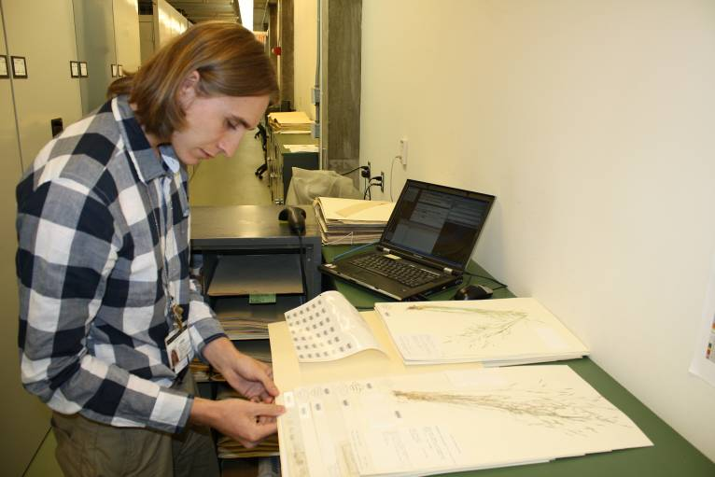
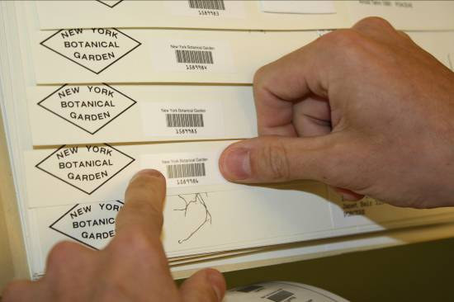
Rapid Data Entry
Catalog skeletal records
Barcode
Scientific (“Filed As”) name
Use Tropicos® authority files
Average ±150-200/hr
Send existing data to NY
Complete records
Georeferenced (if available)
Darwin Core format
Notes:
The workflow begins with each herbarium creating a skeletal database of their specimens, meaning each collection label on a sheet is given a barcode and a skeletal database record containing at least that barcode # and the scientific name under which the specimen is filed in the herbarium.
On average at NY we generate ±150-200 skeletal records per hour.
Additionally, the participating herbaria will send to NY an export of their existing complete specimen records in Darwin Core format.

Slide 7
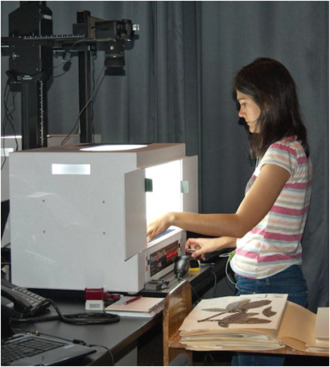
Rapid Image Capture
Photograph every specimen
21 megapixel DSLR camera
Macro lens, 55 mm
Photo-Box, even illumination
Barcode = Image file name
Average ±80-120/hr
Send JPG images to NY
Notes:
Next, every specimen is photographed using a 21 MP DSLR camera, and the image file renamed as the barcode number. At NY we capture an average ±90-120 exposures per hour.
Each herbarium will retain a set of archival images and send a set of JPG derivatives to NY.

Slide 8
Batch Image Post-Processing
JPG images compiled at NY
>1 barcode per sheet
Crop to lower right
Crop to label
Export JPGs of labels
Notes:
As the JPGs arrive at NY, they’re batch imported into Adobe Photoshop Lightroom.
There the specimen images having more than 1 barcode are flagged to be handled individually.
The remaining images are batch-cropped to the lower right corner where the label usually occurs.
And if after cropping the label is not captured, the images are cropped individually.
After cropping is complete, the label images are Exported as JPGs.

Slide 9
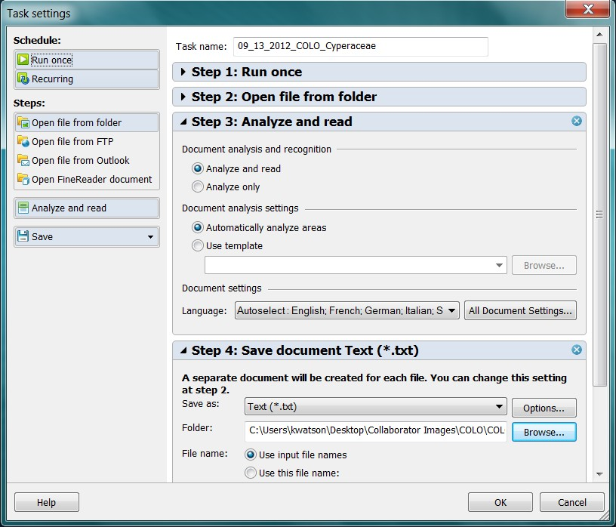
Batch OCR
ABBYY FineReader 11 Corporate Edition
ABBYY Hot Folder
Run Once/Recurring
Automatically Analyze
Autoselect Language
Save as text files
Barcode.txt
Notes:
These JPGs are then run through the OCR software. We opted to use ABBYY FineReader, Corporate Edition, as it allows for batch processing with the Hot Folder.
Set it to run at a particular time (or have it continually running)
Direct it to the folder containing the label images
Select to have the software automatically analyze each image individually and automatically select the language.
Select to have each file saved as an individual text file, retaining the barcode number as the file name.

Slide 10
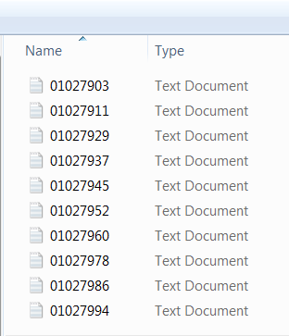
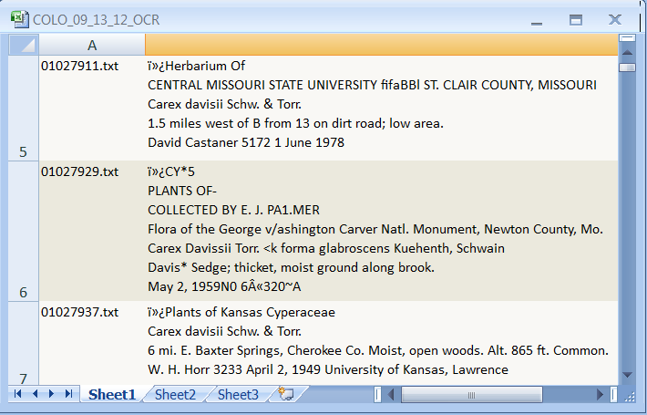
Using the OCR data
Merge individual text files into single Excel worksheet using a Powershell script
Search, group, enter data for several collections at once
Notes:
Then, using a Powershell script, the individual text files are merged into a single Excel worksheet, where the data can be searched, grouped, and parsed into fields for import into the main database.

Slide 11
Plant Specimen Digitization Workflow
Partner Institutions | NYBG | AMNH
Skeletal Data
Barcode
“Filed-As” Name
Populate records from images
7
Complete Plant
Data
+
Complete Insect
Data
Image Crop
DATABASE
Complete Data
Skeletal Data
Images
OCR.txt
Image
specimens
barcode.jpg
7
Duplicate
matching
OCR
barcode.txt
7
Data sort & parse
Existing Complete Data
7
Crowd Sourcing
Complete and skeletal records combined at NYBG
Populate skeletal records using OCR data, duplicate matching, crowd sourcing
Notes:
Not all the labels will yield great OCR results that can be easily parsed, but at least in many cases it will help to organize the images for more efficient data capture.
Ideally I’d like to be able to automate the parsing of OCR data in batches.
In addition to using the OCR output, many skeletal records will be populated using duplicate matching, and some will have to be keystroked, either by me or through the help of Crowd Sourcing, volunteers, or interns.
Once the plant records are complete, they’ll be sent to Katja Seltmann, the Project Manager at AMNH, where she’ll combine them with the insect data to be georeferenced.

Slide 12
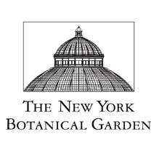


Tri-Trophic TCN Partners
ENTOMOLOGY
  Randall Schuh, American Museum of Natural History
  Christine Johnson, American Museum of Natural History
  Christiane Weirauch, University of California, Riverside
  John Heraty, University of California, Riverside
  Charles Bartlett, University of Delaware
  Benjamin Normark, University of Massachusetts, Amherst
  Katja Seltmann, American Museum of Natural History
  Neal Evenhuis, BP Bishop Museum, Honolulu
  David Kavanaugh ,California Academy of Sciences
  Stephen D. Gaimari ,California Dept. Food and Agriculture
  Chen Young, Carnegie Museum, Pittsburg
  Boris C. Kondratieff, Colorado State University
  James K. Liebherr, Cornell University
  Dmitry Dmitriev, Illinois Natural History Survey
  Richard Brown, Mississippi State University
  Andy Deans, North Carolina State University
  David Maddison, Oregon State University
  Christopher Marshall, Oregon State University
  John Oswald, Texas A&M University
  Kipling Will, University of California, Berkeley
  Caroline Chaboo , University of Kansas
  Michael Sharkey , University of Kentucky
  John Pickering, University of Georgia
Data Contributors
  Canadian National Collection, Ottawa
  University of California, Davis
  Kansas State University
BOTANY
  Robert Naczi, New York Botanical Garden
  Robert Magill, Missouri Botanical Garden
  Richard Rabeler, University of Michigan
  Melissa Tulig, New York Botanical Garden
  Barbara Thiers, New York Botanical Garden
  Kim Watson, New York Botanical Garden
  Margaret Koopman, Eastern Michigan University
  Loy Phillippe, Illinois Natural History Survey
  Deborah Lewis, Iowa State University
  Michael Vincent, Miami University
  Timothy Hogan, University of Colorado
  Mary Ann Feist, University of Illinois
  Craig Freeman, University of Kansas
  Christopher Cambell, University of Maine
  Anita Cholewa, University of Minnesota
  Beryl Simpson, University of Texas
  Kenneth Cameron, University of Wisconsin
Data Contributors
  Consortium of Pacific Northwest Herbaria
  Consortium of California Herbaria
  Southwest Biodiversity Consortium
NSF Award#1115104
Notes:
With that, I’d like to say thanks to all the collaborating institutions, data contributors, NSF, and to all of you for listening.

