Slide 1
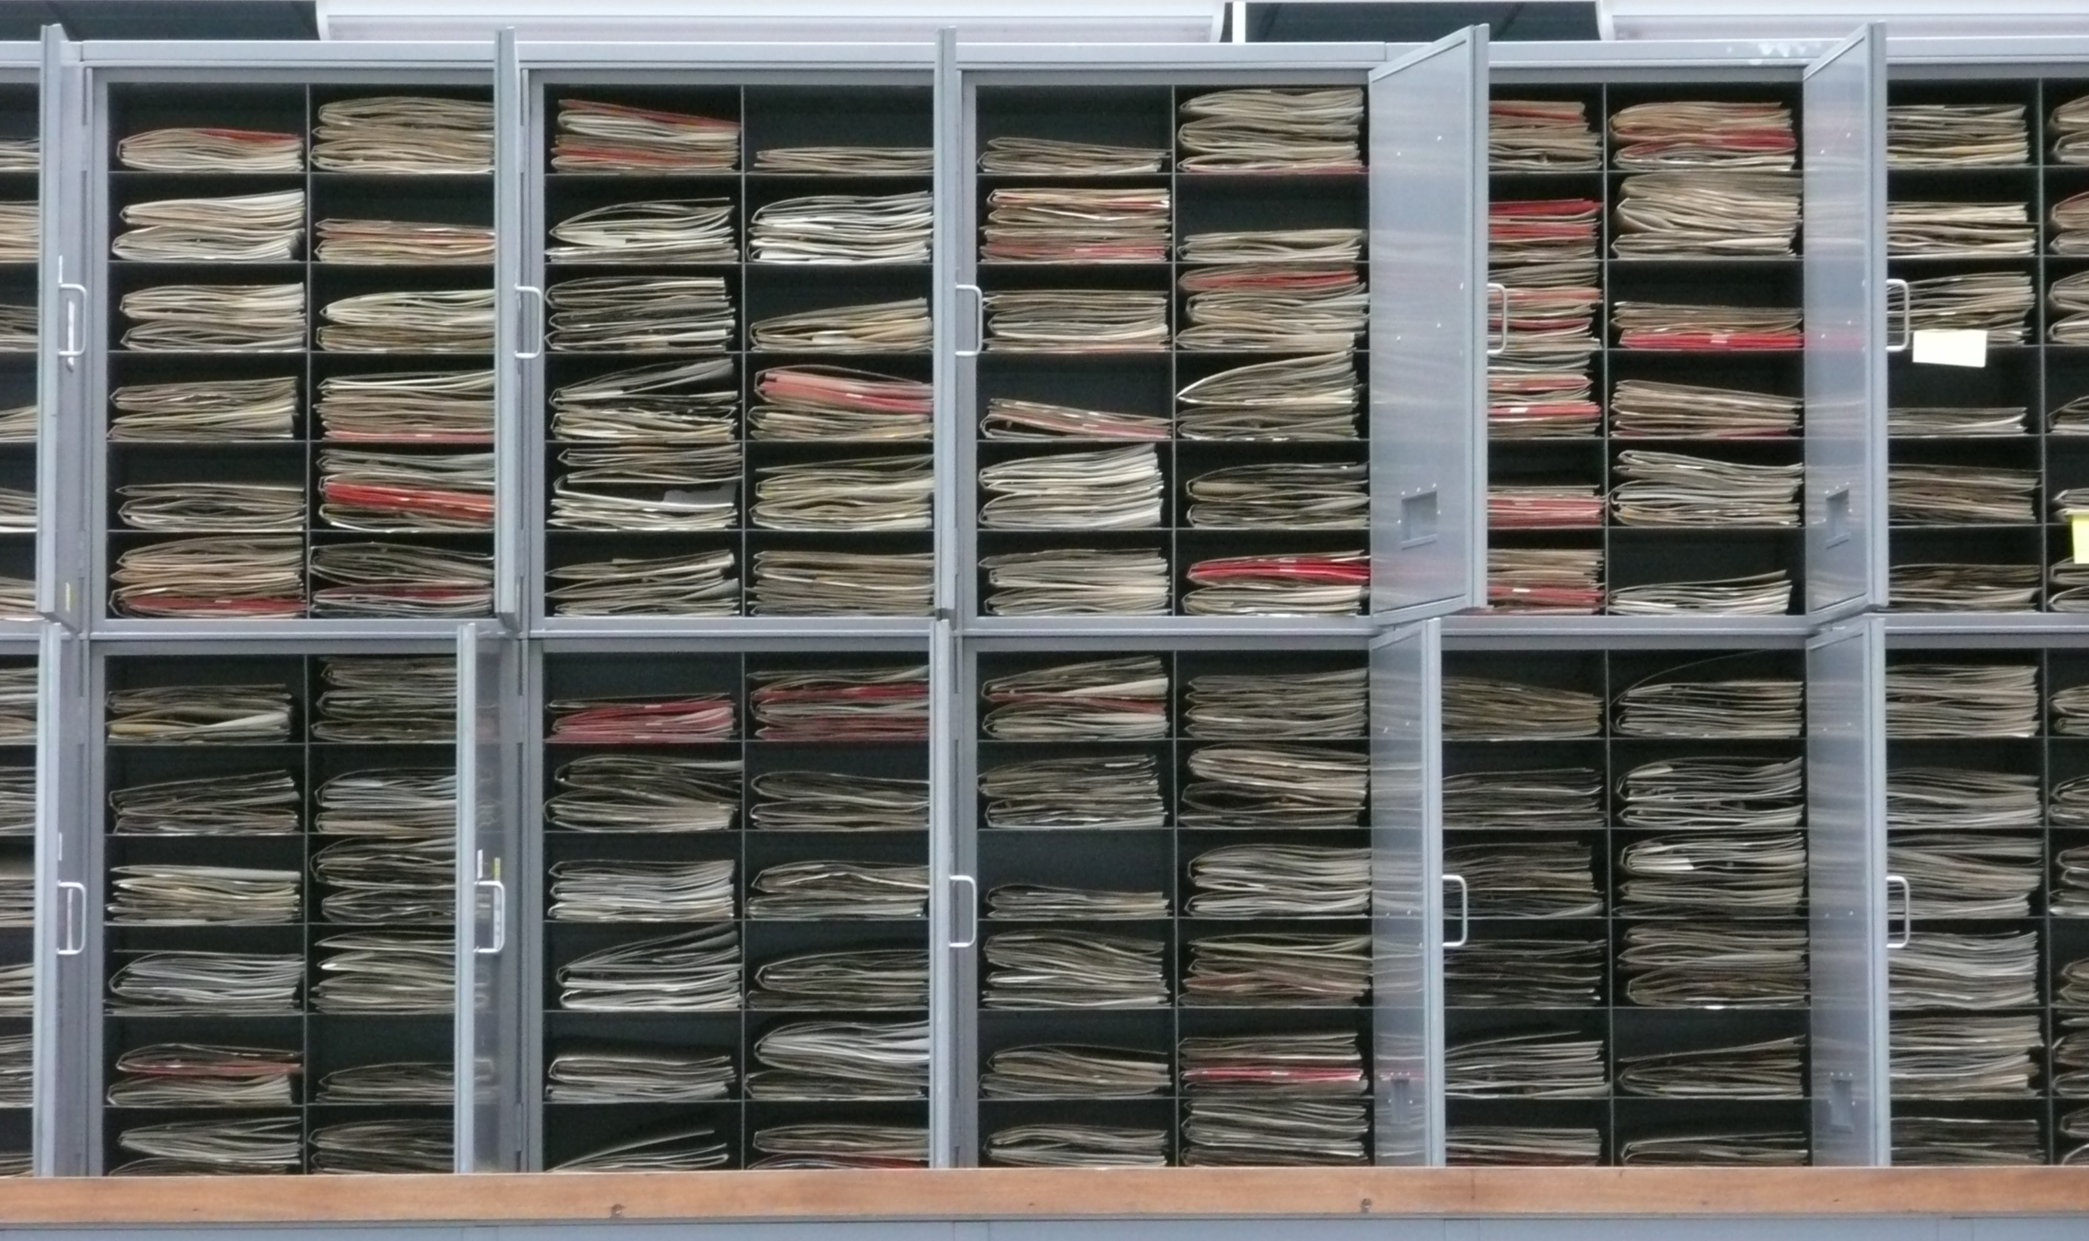
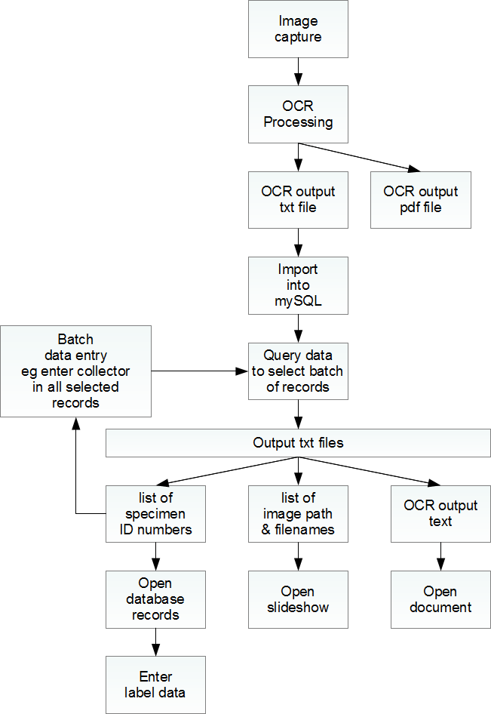
OCR within the digitisation workflow at RBGE
Elspeth Haston, Hannah Atkins, Rob Cubey, Robyn Drinkwater, David Harris, Katherine O’Donnell, Martin Pullan

Slide 2
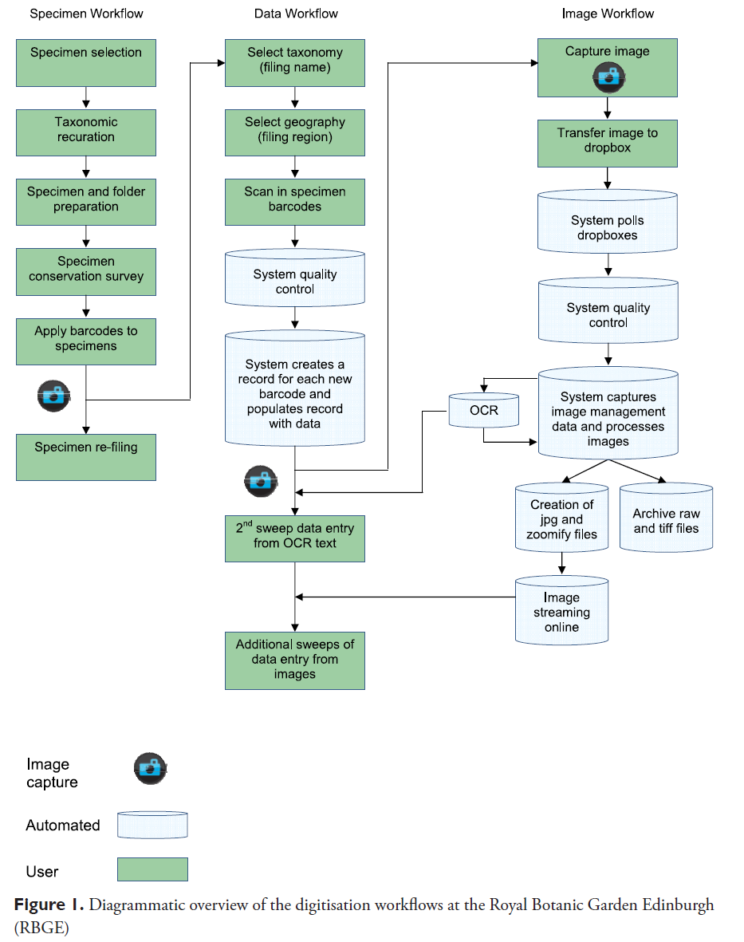

Slide 6


Slide 10
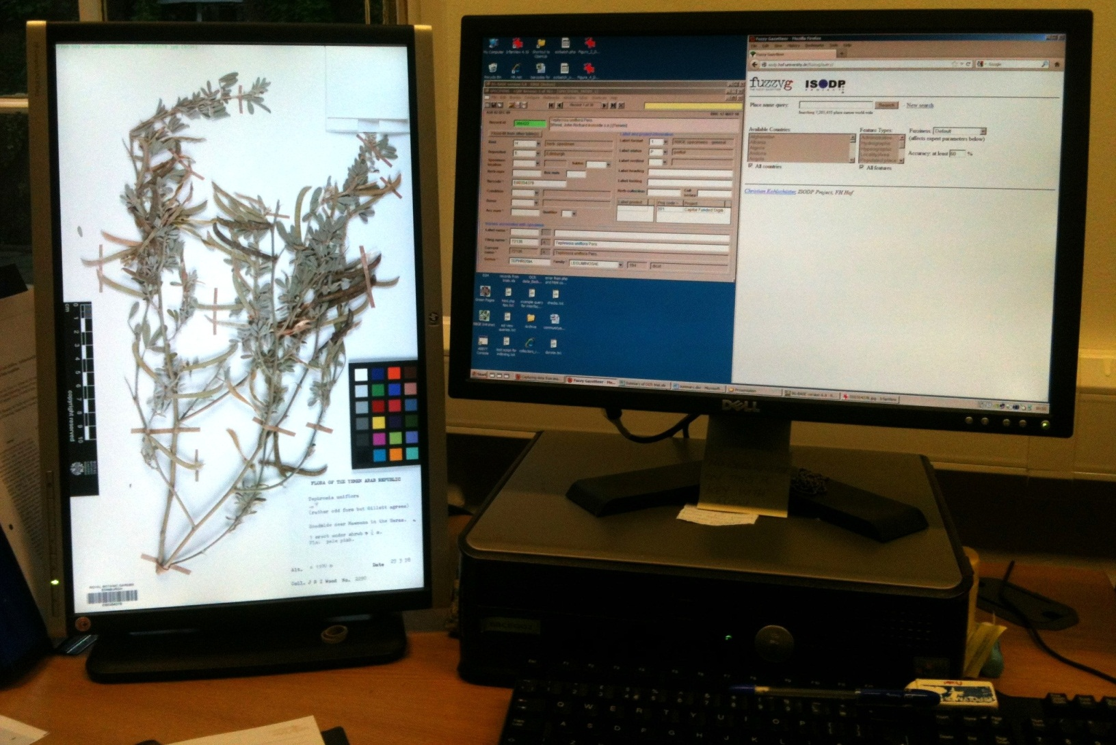
Entering label data to the specimen records

Slide 11
Thank you
Acknowledgments:
The digitisation team at RBGE (Nicky Sharp, Esther Nieto Blazquez, David Braidwood, Cliodhna Ni Bhroin, Rebecca Camfield, Muhammad Ghazali, Lorna Glancy, Dorota Jaworska, Natalia de la Torre)
Duncan Reddish, Alan Sneath, Lee Cooper
Kerry Walter
The Andrew W. Mellon Foundation
The Scottish Government

