Slide 1
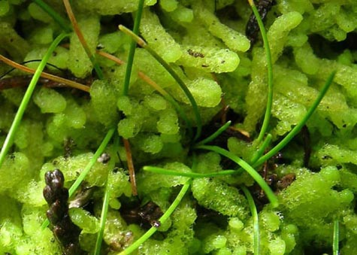
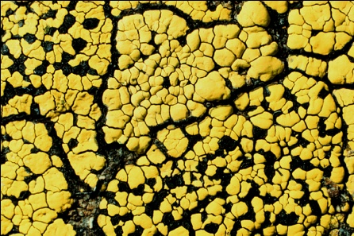
Lichens, Bryophytes and Climate Change
Edward Gilbert
Corinna Gries
Thomas H. Nash III
Robert Anglin

Slide 2
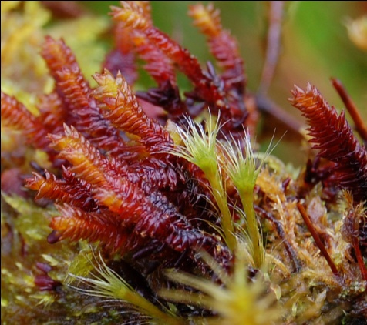
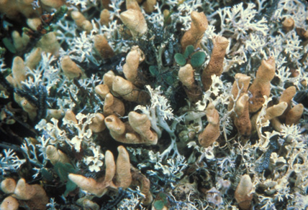
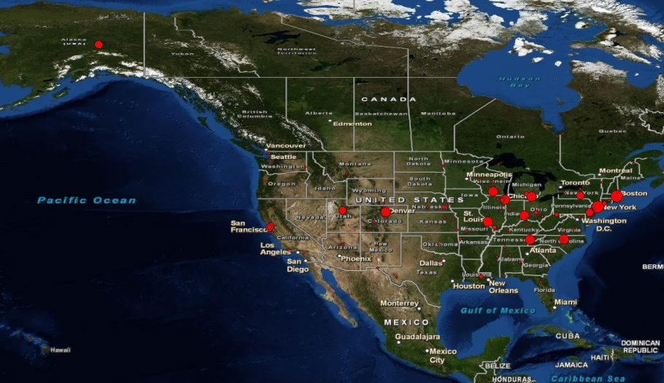
Goals and Scope
16 digitization centers
> 60 non-governmental US herbaria (95%)
Mexico, US, Canada
~ 2.3 million specimen
90% of all specimens
900,000 lichens
1.4 million bryophytes

Slide 3
Project Information
http://lbcc.limnology.wisc.edu/

Slide 4
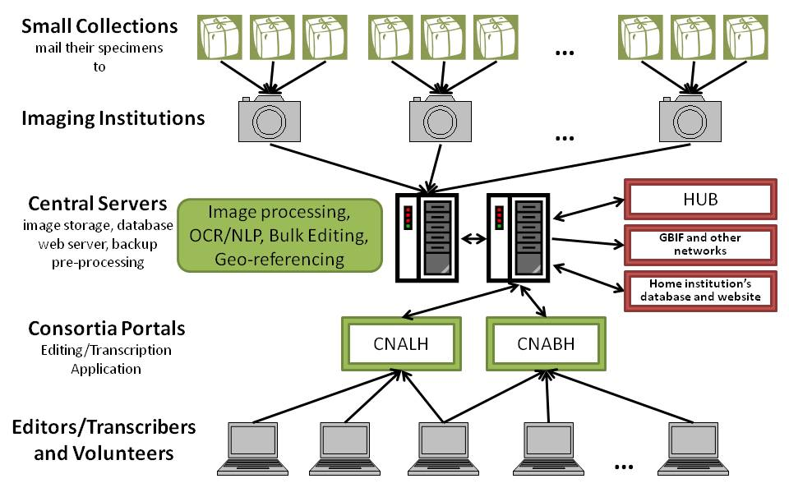
Digitization Workflow

Slide 5
National Portals
Lichen Consortium
http://lichenportal.org
Started in 2009
24 Collections
~ 797,916 Records
Bryophyte Consortium
http://bryophyteportal/
Started in 2010
16 Collections
1,059,063 Records

Slide 6
Image URLs
Existing Herbarium Database
Image processing extract barcode, create web versions, map to portal DBs
Imaging Stage
Upload to FTP server
Existing Record
simply link image
Capture Image
barcode in file name
Create Skeleton File
barcode, species name, exsiccati, etc.
Upload to FTP server
Create New Record barcode, image, skeletal data
Manage / Review Records in Portal
Symbiota
Editor
review, edit, keystroke, and finalize
Automated Processing
OCR / NLP / Georeferencing
augmented with raw OCR, parsed fields, coordinates, etc.
Duplicate Harvesting
Manage Specimen Data in Portal

Slide 7
LBCC: Workflow Overview
Image all specimen / specimen labels
Collect and load skeletal data
Barcode, scientific name, country, state
Upload to portal
Record exists => link image to existing record
Record absent => create empty “unprocessed” record
Automated OCR label
Block of raw text => database
Automated NLP (field parsing)
Review data
Keystroke full record
Collector name & number => look for dups
Reparse full record => learnable parsers

Slide 8
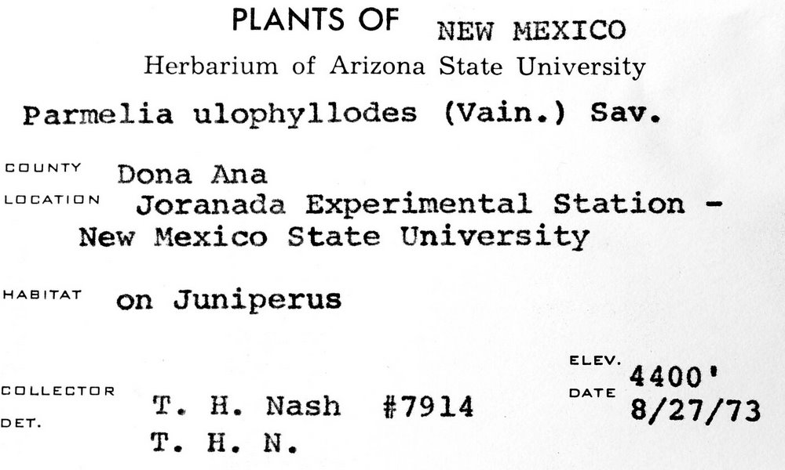
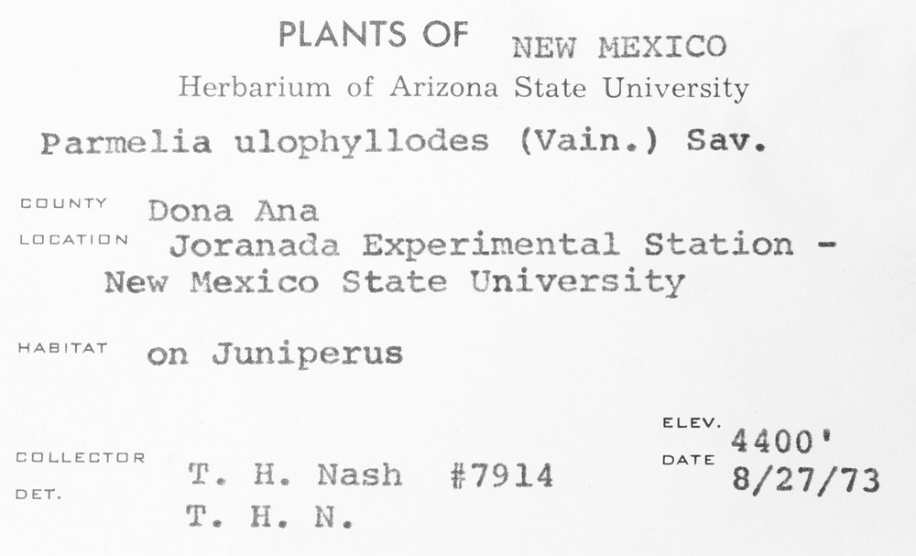
Optical Character Recognition
Tesseract V3
Dual cycle
Automatic
Manual review
Expected hurtles
Handwritten labels
Old fonts
Faded labels
Form labels
Adjustable image variables
Â¢_].L.|Â»â€˜Â¢ .'Â».f.'._..â€˜~,(.J
fin-xâ€˜*\'a:"511z:1 wf .~\:'i/.onli State University
P.â€™~.r"~2= ,_. gg J:.2 " J*J*" â€ (=:\â€˜-â€œax "Â»..'\-12
â€˜ â€œ "â€˜ ;T~;â€˜~7i?Â»-1_1_\f;>sf`;,' ESX
ZÂ»ie+â€˜-Â». â€œ~'.Â»te;~:i_.t<Â» ff`t;~f3":.f.â€œ
Â» Â»4 xx, ,
"""â€˜â€œâ€T"â€™ <1;-.rs f3'a,1.z>.t;;aÂ¢f~rus â€™
V4 J 'if . rÂ°'Â° M '1?nies ivain.) Sav.
neutal Station - " '1 ~Â»r';;4-\P ` 1.
T11 ./P.. ,J ..-.
ELEV. ' `.fJL_\ LATL Q _â€˜ 1 _ Yâ€™ DATE
_ ,. W5. (> f- , -:â€˜; i f>i_T ~~ . A 1:
Â». v\ .-v Â»~. 4. a xvala 8/27/73
PLANTS OF NEW r~1ExIco
Herbarium of Arizona State University
Parmelia ulophyllodes (Vain.) Sav.
COUNTY â€œÂ°â€â€œâ€œ
Joranada Experimental Station -
New Mexico State University
"â€œâ€œâ€œ' on Juniperus
ELEV. ‘ 4400
EEILLEETUR DATE
DU T. H. Nash #7914 8/27/73
T. H. N.

Slide 9
Auto-Processing: OCR
Iterate through new “unprocessed” images
81439 bryophytes images
147122 lichens images
OCR via Tesseract (version 3)
Untreated image
Treated image (contrast, brightness, etc)
Store raw text linked to skeletal record
Progress to next step
Low OCR return => hand processing
“Unprocessed-OCR” => NLP

Slide 10
Auto-Processing: NLP
Iterate through raw OCR text blocks
147122 lichen OCR blocks
81439 bryophyte OCR blocks
Collector, number, and date
Attempt duplicate harvesting
Field-by-field parsing
Full-parsing
Parsing based on NLP profiles
E.g. targeted label formats

Slide 11
NLP: Duplicate Harvesting
Extract collector data
Last name, number, date
Harvest duplicates from consortium DB
Exact duplicates
Duplicate events
Compare return field-by-field
Compare fields with raw OCR
Populate fields that have high similarity indexes
Processing status: “pending review”

Slide 12
NLP: Targeted Parsing Profiles
Premise: Target similar label formats
Use raw OCR to locate “Nash” labels
Need to exclude:
Determined by Nash
Author of scientific name
Associated collector
Test for similarity to target label format
Targeted parsing algorithms

Slide 13
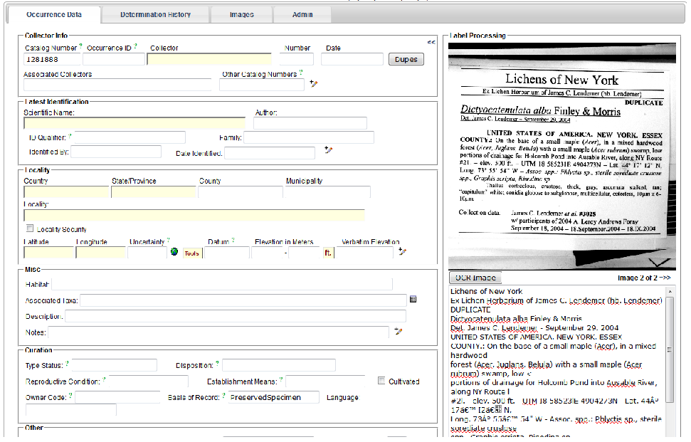
Label Review

Slide 14
