Slide 1
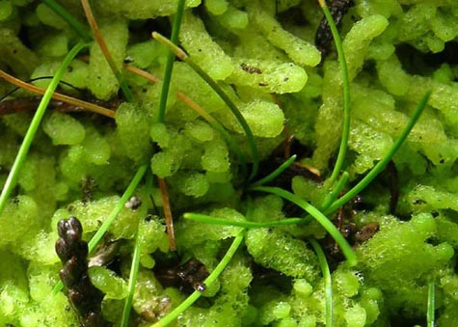
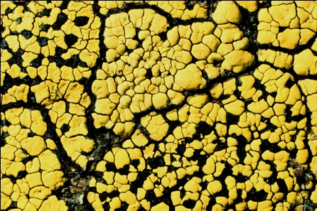


Integrating OCR and NLP to Digitize 2.3 Million Lichen and Bryophyte Specimens
Edward Gilbert
Corinna Gries
Thomas H. Nash III
Robert Anglin

Slide 2
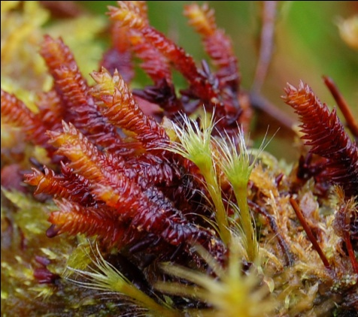
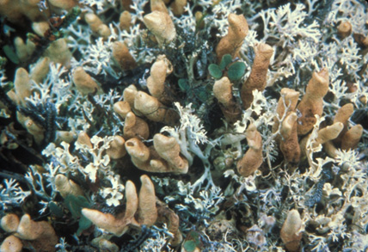
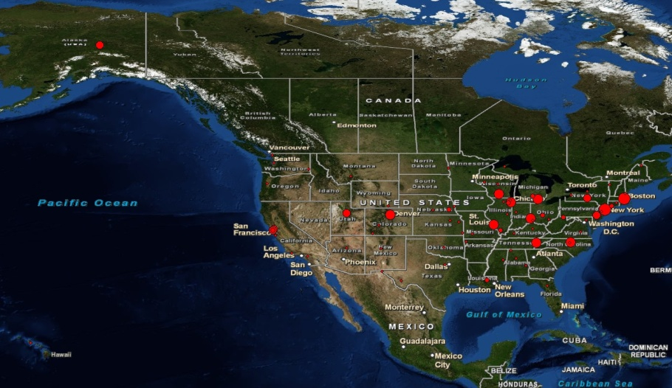
Goals and Scope
NSF ADBC (#1115116)
~ 2.3 million specimen
90% of all specimens
900,000 lichens
1.4 million bryophytes
> 60 non-governmental US herbaria (95%)
Mexico, US, Canada
16 digitization centers

Slide 3
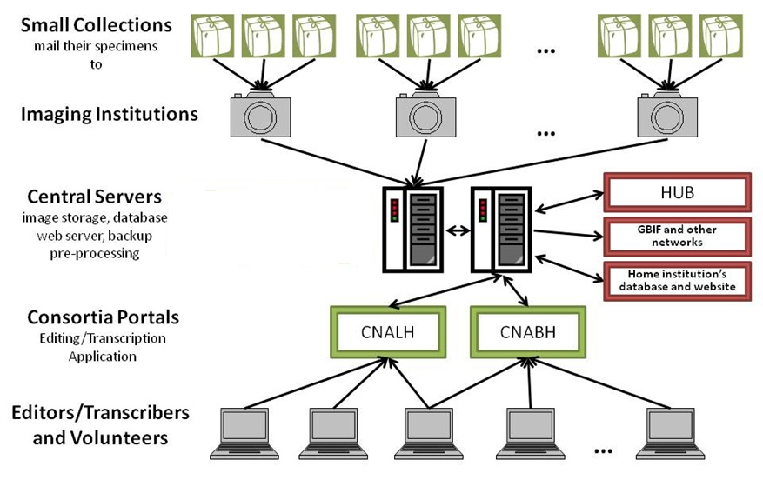
Digitization Workflow

Slide 4
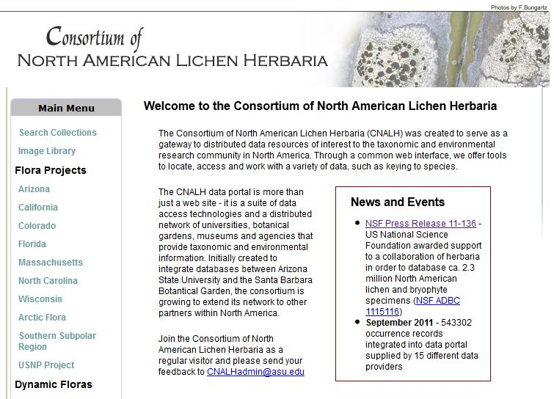
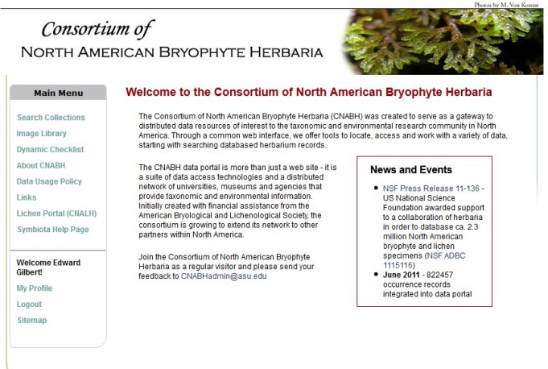
National Portals
Lichen Consortium
http://lichenportal.org
34 Collections
902,664 Records
Bryophyte Consortium
http://bryophyteportal/
26 Collections
1,300,135 Records
Symbiota software

Slide 5
Image URLs
Herbarium Database
Image processing extract barcode, create web versions, map to portal DBs
Imaging Stage
Upload to FTP server
Existing Record
simply link image
Capture Image
barcode in file name
Create Skeleton File
species name, country, state, exsiccati, etc.
Upload to FTP server
Create New Record barcode, image, skeletal data
Manage / Review Records in Portal
Symbiota
Editor
review, edit, keystroke
Automated OCR
Tesseract, ABBYY
Manage Specimen Data in Portal
Automated NLP
Darwin Core Parsing

Slide 6
Automated OCR
Iterate through “unprocessed” images
OCR via Tesseract (version 3)
In focus, good lighting, minimal noise
Resolution: >20px x-height
Database raw text block
Progress to next step
Low OCR return => hand processing
Natural Language Processing

Slide 7
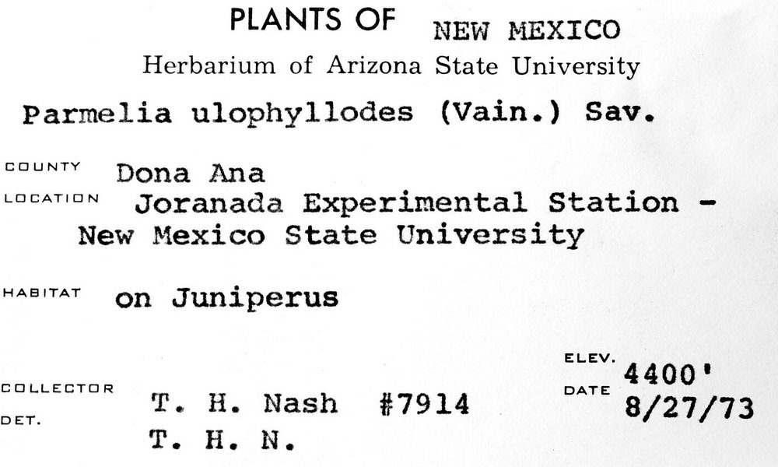
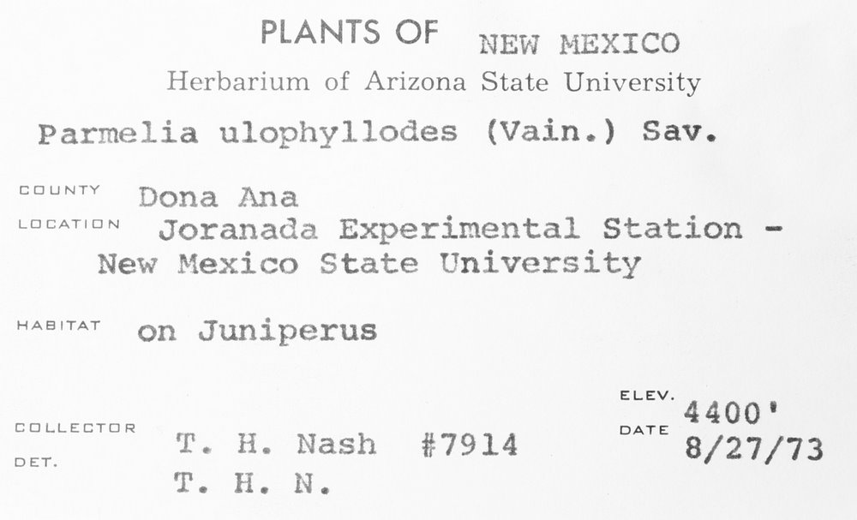
OCR Challenges
Issues
Old fonts
Faded labels
Form labels
Handwritten labels
Specialized terms
Solutions
Image treatments
OCR tuning
Dictionaries
Consensus OCR
Â¢_].L.|Â»â€˜Â¢ .'Â».f.'._..â€˜~,(.J
fin-xâ€˜*\'a:"511z:1 wf .~\:'i/.onli State University
P.â€™~.r"~2= ,_. gg J:.2 " J*J*" â€ (=:\â€˜-â€œax "Â»..'\-12
â€˜ â€œ "â€˜ ;T~;â€˜~7i?Â»-1_1_\f;>sf`;,' ESX
ZÂ»ie+â€˜-Â». â€œ~'.Â»te;~:i_.t<Â» ff`t;~f3":.f.â€œ
Â» Â»4 xx, ,
"""â€˜â€œâ€T"â€™ <1;-.rs f3'a,1.z>.t;;aÂ¢f~rus â€™
V4 J 'if . rÂ°'Â° M '1?nies ivain.) Sav.
neutal Station - " '1 ~Â»r';;4-\P ` 1.
T11 ./P.. ,J ..-.
ELEV. ' `.fJL_\ LATL Q _â€˜ 1 _ Yâ€™ DATE
_ ,. W5. (> f- , -:â€˜; i f>i_T ~~ . A 1:
Â». v\ .-v Â»~. 4. a xvala 8/27/73
PLANTS OF NEW r~1ExIco
Herbarium of Arizona State University
Parmelia ulophyllodes (Vain.) Sav.
COUNTY â€œÂ°â€â€œâ€œ
Joranada Experimental Station -
New Mexico State University
"â€œâ€œâ€œ' on Juniperus
ELEV. ‘ 4400
EEILLEETUR DATE
DU T. H. Nash #7914 8/27/73
T. H. N.

Slide 8
Automated NLP
Iterate through raw OCR text blocks
Parse text block
Darwin Core
Populate database
Review
Adjust content
Approve
Handwritten => keystroke

Slide 9
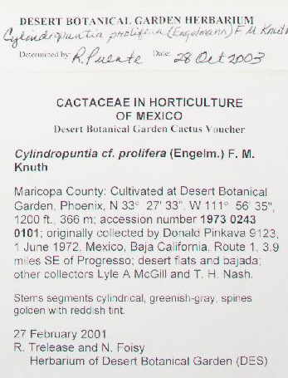
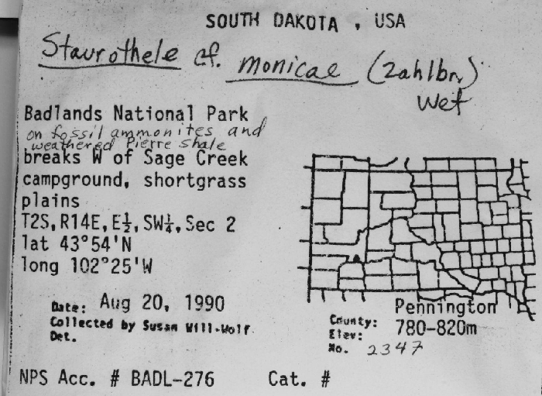
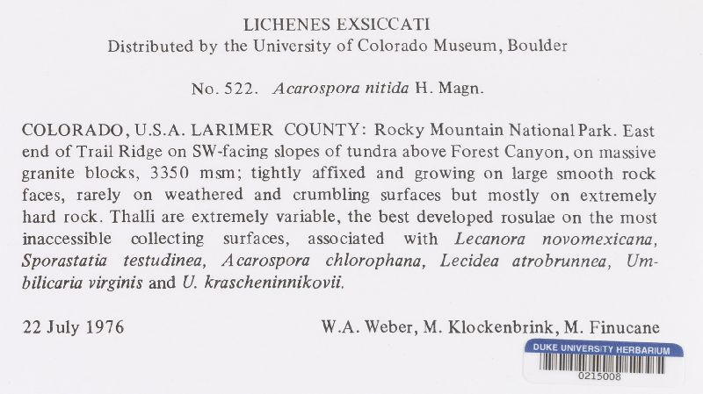
NLP Challenges
Issues
Variable layouts
Loose standards
OCR error
Solutions
Authority tables
Levenshtein distance
Word stats
Format recognition
Parsing profiles
Duplicate harvesting

Slide 10
NLP: Duplicate Harvesting
Extract collector data
Last name, number, date
Harvest duplicates from consortium DB
Exact duplicates
Duplicate events
High similarity indexes
OCR block comparison
Consensus record

Slide 11
NLP: Targeted Parsing Profiles
Target similar label formats
Use raw OCR to locate “Nash” labels
Targeted parsing algorithms
Exclude:
Determined by Nash
Author of scientific name
Associated collector
County

Slide 12
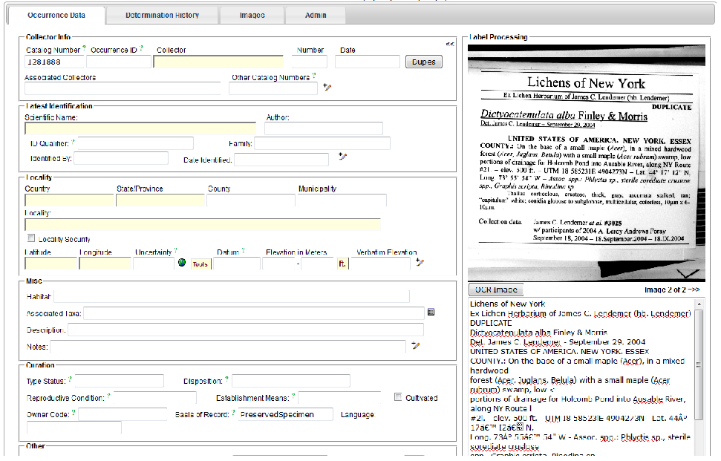
Label Review

Slide 13
Thank You
Michael Adamo
Bruce Allen
Meredith Blackwell
Bill Buck
Alina Freire-Fierro
John Freudenstein
Alan Fryday
David Giblin
Karen Hughes
Steffi Ickert-Bond
Timothy James
Jennifer S. Kluse
Matt Von Konrat
Ben Legler
Tatyana Livshultz
Robert Lücking
Francois Lutzoni
Bob Magill
Andrew Miller
Brent Mishler
Donald Pfister
Richard Rabeler
Malcolm Sargent
Edward Schilling
Michaela Schmull
Blanka Shaw
Jon Shaw
Carol Shearer
Larry StClair
Barbara Thiers
Funded by the NSF ADBC program

