Slide 1
iDigBio OCR Hackathon
Initial Results – Rest API
Paul & Robin Schroeder

Slide 2
Have Code, Will Process…
For those hackathoners who want to test their own OCR engine
A REST API to access URLs of iDigBio Hackathon images
For those who have Parsing Scripts
A REST API to access OCR Results (from multiple engines)
For those who have Post-script Results
A REST API to access the human parsed results to compare

Slide 3
What is REST? Time for a nap? REST = Representational State Transfer
REST-style Distributed Architectures use http to pass requests from a client to a server and back again.
Truly accessible to ANY programming language
Loosely Coupled, Less Strongly Typed than SOAP
Nouns and Verbs, no XML Parsing
Accessible through HTTP

Slide 4
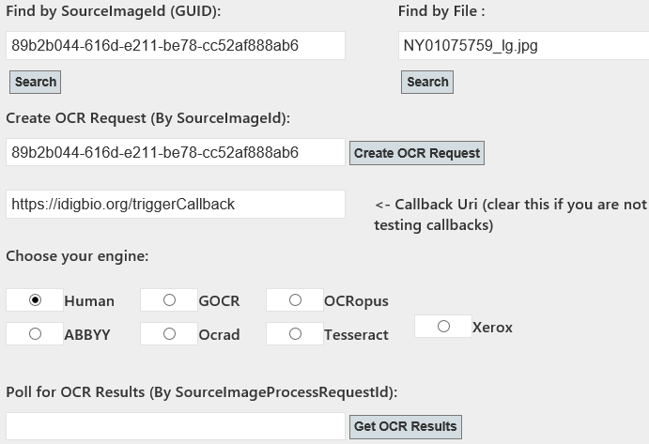
iDigBio REST API
http://168.61.49.123:83/

Slide 5
Scenario A: I know my file name is "NY01075759_lg.jpg", but I do not know the UUID.
REST call: http://www.yourserver.org/api/SourceImages?fileName=NY01075759_lg.jpg
Response Format (JSON):
[{"sourceImageId":"89b2b044-616d-e211-be78-cc52af888ab6", "sourceImageRepositoryId":"7392b8ce-606d-e211-be78-cc52af888ab6", "fileName":"NY01075759_lg.jpg", "url":"http://storage.idigbio.org/ny/lichens/BATCH1/NY01075759_lg.jpg", "alternateId":"904653","createdUTCDateTime":"2013-02-05T14:10:28.383", "OCRCachedResults":[],"SourceImageProcessRequests":[],"SourceImageRepository":null}]

Slide 6
What is JSON?
JavaScript Object Notation (JSON), is a text-based open standard designed for human-readable data interchange. It is derived from the JavaScript scripting language for representing simple data structures and associative arrays, called objects. Despite its relationship to JavaScript, it is language-independent, with parsers available for many languages. - Wikipedia
An example of where this is used is web services responses. In the 'old' days, web services used XML as their primary data format for transmitting back data, but since JSON appeared (The JSON format is specified in RFC 4627 by Douglas Crockford), it has been the preferred format because it is much more lightweight. - StackOverflow

Slide 7
Scenario B: I know my sourceImageId (UUID) is "89b2b044-616d-e211-be78-cc52af888ab6" and I want to know the file name, URL, or alternate ID.
REST call: http://www.yourserver.org/api/SourceImages?sourceImageId=89b2b044-616d-e211-be78-cc52af888ab6
Response Format (JSON):
[{"sourceImageId":"89b2b044-616d-e211-be78-cc52af888ab6", "sourceImageRepositoryId":"7392b8ce-606d-e211-be78-cc52af888ab6", "fileName":"NY01075759_lg.jpg", "url":"http://storage.idigbio.org/ny/lichens/BATCH1/NY01075759_lg.jpg", "alternateId":"904653","createdUTCDateTime":"2013-02-05T14:10:28.383", "OCRCachedResults":[],"SourceImageProcessRequests":[],"SourceImageRepository":null}]

Slide 8
Scenario C: I want to simulate submission of an OCR request and use the polling method to get human-parsed results
REST call (POST): http://www.myserver.org/api/ImageProcessRequest
Request Body Parameters (JSON format):
{"sourceImageId":"89b2b044-616d-e211-be78-cc52af888ab6", "processEngineId":“7", ← this is Human Parsed
"callbackUri":"", ← No Callback Uri = Polling Method
"userName":"iDigBio_Hackathoner"}

Slide 9
Scenario C: Example using JQuery & AJAX
function createOCRRequest() {
clearResults();
// Build up the Request
var jsonDataString = JSON.stringify({
sourceImageId: "89b2b044-616d-e211-be78-cc52af888ab6",
processEngineId: “7”, //HUMAN
callbackUri: “”,
userName: "iDigBio_Hackathoner“
});
// Make our server-side call
var request = $.ajax({
url: "api/ImageProcessRequest",
type: "POST",
data: jsonDataString,
contentType: "application/json;charset=utf-8",
dataType: "json"
});
// When the request is done, collect results
request.done(function (data) {
displaySourceImageProcessRequest(data); //do something here
setTimeout(getSourceImageProcessRequest, 1000);
});
//Display any errors
request.fail(function (jqXHR, textStatus) {
$('#sourceImageHeader').text('Error: ' + jqXHR.responseText);
});
}
RESPONSE:
{"sourceImageProcessRequestId":"c96eb582-67b9-4723-a35d-0484cd7e3200",
"sourceImageId":"89b2b044-616d-e211-be78-cc52af888ab6",
"processEngineId":7,"callbackUri":"","ipAddress":“xxx.xxx.xxx.xxx",
"resultValue":" The New York Botanical Garden LICHENS of NEW YORK STATE, U.S.A. Polycoccum minutulum Kocourková & F. Berger on Trapelia placodioides Coppins & P. JamesRockland County: Harriman State Park, along Woodtown Road West near dam at S end of Lake Sebago along Seven Lakes Drive, 41º11'N, 74º08'W, ca. 240 m; mixed hardwood-hemlock forest with granitic erratics.19 April 1998Richard C. Harris 42164 NEW YORK BOTANICAL GARDEN 01075759",
"resultCreatedUTCDateTime":"2013-02-05T22:03:23.09","createdByUserName":"iDigBio_Hackathoner","createdUTCDateTime":"2013-02-05T22:03:21.903","ProcessEngine":null,"SourceImage":null}

Slide 10
Scenario E: I want to simulate submission of an OCR request with a CALLBACK (not polling) to get ABBYY OCR results
REST call (POST): http://168.61.49.123:83/api/ImageProcessRequest
Request Body Parameters (JSON format):
{"sourceImageId":"89b2b044-616d-e211-be78-cc52af888ab6", "processEngineId":“1", ← this is ABBYY "callbackUri":"http://www.myserver.org/myCallbackPage", "userName":"iDigBio_hackathoner"}

Slide 11
Scenario E: Example using JQuery & AJAX
function createOCRRequest() {
clearResults();
// Build up the Request
var jsonDataString = JSON.stringify({
sourceImageId: "89b2b044-616d-e211-be78-cc52af888ab6",
processEngineId: “1”, //ABBYY
callbackUri: “http://www.myserver.org/myCallbackPage",
userName: "iDigBio_Hackathoner“
});
// Make our server-side call
var request = $.ajax({
url: "api/ImageProcessRequest",
type: "POST",
data: jsonDataString,
contentType: "application/json;charset=utf-8",
dataType: "json"
});
// When the request is done, collect results
request.done(function (data) {
displaySourceImageProcessRequest(data); //do something here
setTimeout(getSourceImageProcessRequest, 1000);
});
//Display any errors
request.fail(function (jqXHR, textStatus) {
$('#sourceImageHeader').text('Error: ' + jqXHR.responseText);
});
}
RESPONSE:
{"sourceImageProcessRequestId":"c96eb582-67b9-4723-a35d-0484cd7e3200",
"sourceImageId":"89b2b044-616d-e211-be78-cc52af888ab6",
"processEngineId":1,"callbackUri":"http://www.myserver.org/myCallbackPage","ipAddress":“xxx.xxx.xxx.xxx",
"resultValue":" The New York Botanical Garden Lichens of New York State, U.S.A. Polycoccum minutulurn Kocourkova & F. Berger on Trapelia piacodioides Coppins & P. James Rockland County: Harriman State Park, along Woodtown Road West near dam at S end of Lake Sebago along Seven Lakes Drive, 41°11’N, 74°08’W, ca. 240 m; mixed hardwood-hemlock forest with granitic erratics. 19 April 1998 Richard C. Harris 42164 newyorkbotan,calgarden 01075759",
"resultCallbackUri":"The remote server returned an error: (404) Not Found.",
"resultCreatedUTCDateTime":"2013-02-05T22:03:23.09","createdByUserName":"iDigBio_Hackathoner","createdUTCDateTime":"2013-02-05T22:03:21.903","ProcessEngine":null,"SourceImage":null}

Slide 12
OCR, Data Entry & The Big Picture
With random song lyrics taken out
of context to help keep your attention… ☺

Slide 13
This is the end, my only friend, the end. --The Doors, 1967 Let’s Begin at the End
I need to find…
Verbascum specimens from the Mohave, with associated sequence data, above 1,800 meters.
Search…
‘Verbasum’, latitude 35.083° N and 35.13° N, longitude 115.475° W and 117.25° W,
limit to a maximum elevation of 1,800 meters.
Find…
Occurrence Records, linking to specimen data, links to online images, sequence data, any derivatives, what institutions have the physical specimens and where, within that institution, where they stored, related citations, type specimens, etc…

Slide 14
OData
A REST-based protocol for data operations (querying strongly-typed data)
Cross-platform, Web-based
Easy to understand and use/consume

Slide 15
O Data Mock Example
http://www.myserver.org/api?select=DwC,Images&$filter=Latitude gt 35.083N and Latitude lt 35.13N and Longitude gt 115.475W and Logitude lt 117.25W and Elevation lt 200M
*for illustrative purposes (not 100% accurate)
A URI used by an OData service has up to three significant parts: the service root URI, resource path and query string options.

Slide 16
And you may ask yourself…. Well, how did do I get here? - Talking Heads “Once in a Lifetime” 1980
Robust – Strongly-Typed
Complete – One System of Record
“Sticky” (iPhylo, Rod Page)
Unique Identifiers, assigned at the source and flowing downstream, linking derivatives & dupes
“No mandata left behind”
“Garbage in, garbage out”
Strongly-typed, query-friendly data fields (datetime, numeric-compatible, precise decimals)
Precise & Accurate

Slide 17
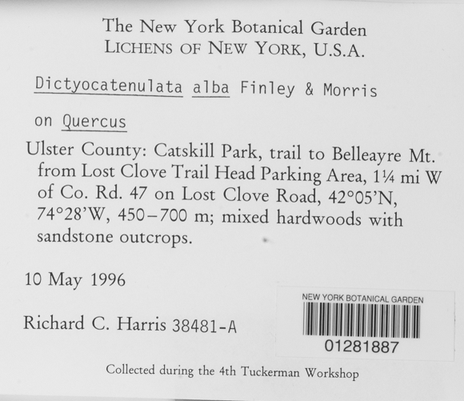
More than one way to skin a cat… Digitization Workflows
First OCR, then PARSE
Get Label Image
Digital DwC Record –
limited to those fields you can parse.
First PARSE, then OCR
Get Label Image
Digital DwC Record –
only limited by user excavation
Get OCR Results for whole label
Parse OCR Results into DwC Fields
Parse image into ‘excavated images’
that represent DwC fields
Get OCR results for excavated images
txt
txt
DB
DB

Slide 18
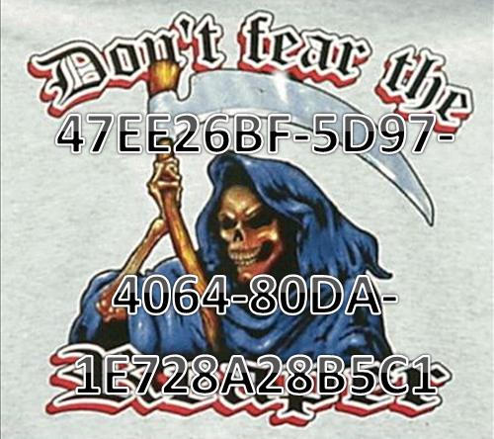
(Don't Fear) The Reaper -Blue Öyster '76 Start out ‘Sticky’
Start out Sticky –
Assign Unique Identifiers at the source
link up specimen derivatives immediately, starting with the label image
Let those guids flow downstream to portals and other data consumers.
Don’t fear the GUID!!!

Slide 19
How OCR/Data Entry is Important to the Big Picture
Most of the decisions that happen during the data entry process ultimately determine how useful your data is.
Robust (strongly typed) data allows for range queries, complex date queries, GIS searches, etc.
Accurate and Precise – no one can do quality research without quality data
Make your Data Sticky – assign a GUID at the source and let it flow downstream, so duplicates and derivates can be linked together.
Complete – how much of the label will we capture?

Slide 20
Time After Time – Cyndi Lauper
But that would be labor intensive…
We don’t have enough funding…
We don’t have enough qualified people…
We don’t have enough time….
We can always go back and finish later…

Slide 21
ScioTR & ScioQualis
ScioTR: A touch-enabled Win8, rapid data entry application, using OCR
ScioQualis.com: Natural History Collections Management in the Cloud

Slide 22
ScioTR: ‘Excavating’ A Collections Label
The user draws a line over a piece of imaged label text
The user clicks on a field to assign the excavate image
Excavated images can be adjusted in many ways, if needed.
Multiple images can be associated with each ‘set’/occurrence record

Slide 23
ScioTR: Editing
Users can enter data into more fields than just those represented on the imaged label
Previous images/results are compared to this record to produce more accurate results.
OCR results can be edited
{This step will eventually be optionally crowdsourced}

Slide 24
ScioTR Review & Export
The DwC fields are presented in the same order as they appear in the original image label for human review before they are exported to the online system of record, ScioQualis.

Slide 25
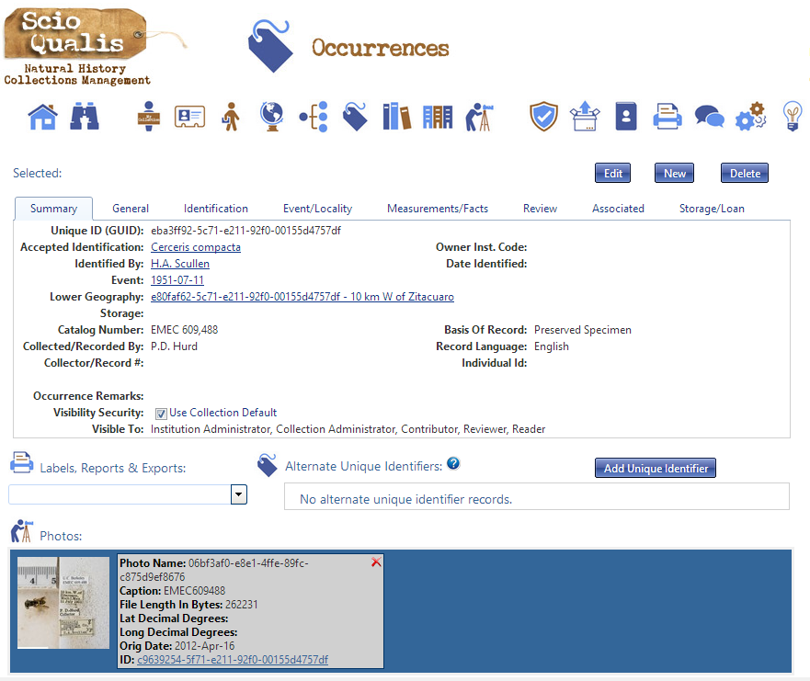
ScioQualis.com: Management
New occurrence record is linked with existing Collector, Locality, Event and Taxon records
Original imaged label is associated with new occurrence record

Slide 26
Look, if you had One Shot - "Lose Yourself“ Eminem
You probably aren’t going to get funding to digitize a collection twice
Making good decisions during the data entry process can help unlock potential
Capture as much data as possible
Concentrate on Accuracy & Precision
Assign GUIDs at the source and let them flow downstream
Aim for Strongly Typed data, where possible

