Slide 1
1st iDigBio – BRIT Hackathon
iDigBio Augmenting Optical Character Recognition Working Group (AOCR wg)
February 13 – 14, 2013

Slide 2
Overview
Introductions
Deb – what is iDigBio / who is the AOCR wg? / why are we here?
Take Note! http://tinyurl.com/AOCRhackNotes
Alex – the metrics
Everyone – your results
The work begins…
Kim – Putting it all together

Slide 3
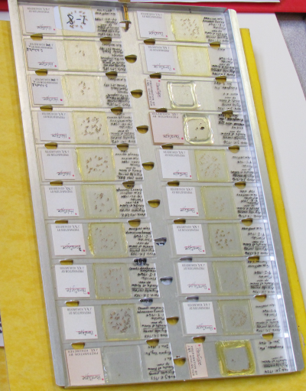
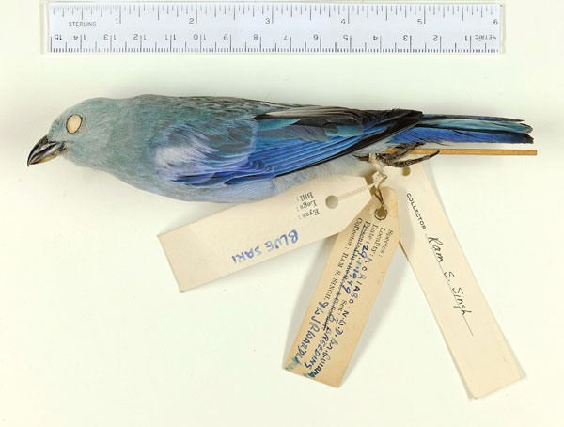
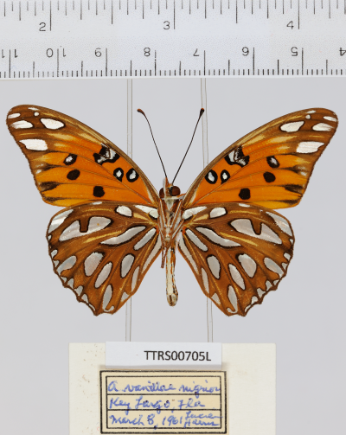
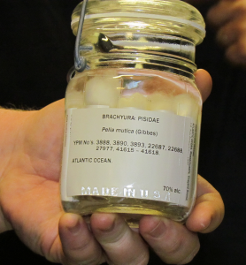
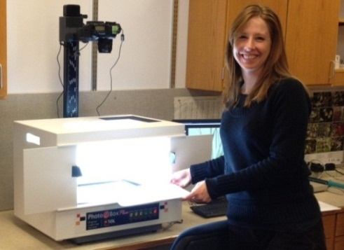
University of Florida
Florida State University
NSF - Advancing Digitization of Biological Collections (ADBC)
www.iDigBio.org
Notes:
goal: digitize and make available via the Web at least 1 billion biological and paleontological records over the 10-year life of the project.

Slide 4
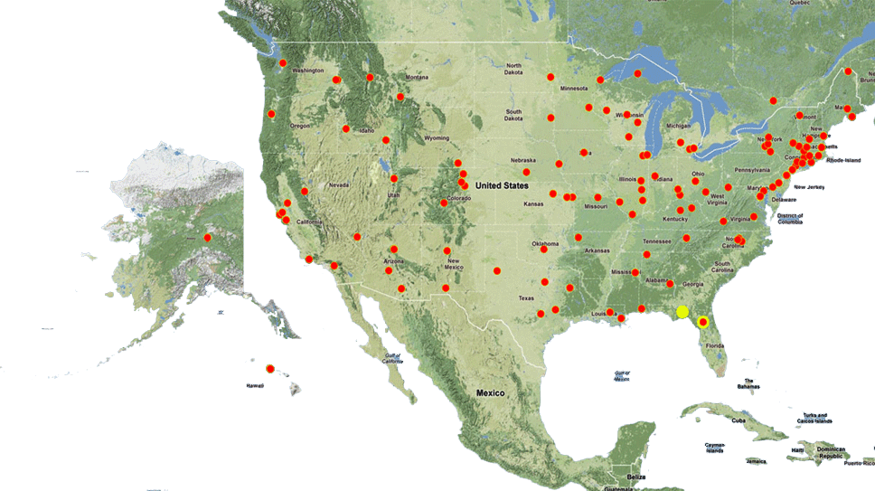
Where are the Specimens?
7 Thematic Collections Networks (TCNs) with 130 participating institutions
www.iDigBio.org

Slide 5
Seven Thematic Collections Networks (TCNs)
InvertNet– An Integrative Platform for Research on Environmental Change, Species Discovery and Identification (University of Illinois)
Plants, Herbivores, and Parasitoids: A Model System for the Study of Tri-Trophic Associations (American Museum of Natural History/New York Botanical Garden)
North American Lichens and Bryophytes: Sensitive Indicators of Environmental Quality and Change (University of Wisconsin – Madison)
Digitizing Fossils to Enable New Syntheses in Biogeography-Creating a PALEONICHES (University of Kansas)
The Macrofungi Collection Consortium: Unlocking a Biodiversity Resource for Understanding Biotic Interactions, Nutrient Cycling, and Human Affairs (NYBG)
Mobilizing New England Vascular Plant Specimen Data to Track Environmental Change (Yale)
Southwest Collections of Arthropods Network (SCAN): A Model for Collections Digitization to Promote Taxonomic and Ecological Research (Northern Arizona University)

Slide 6
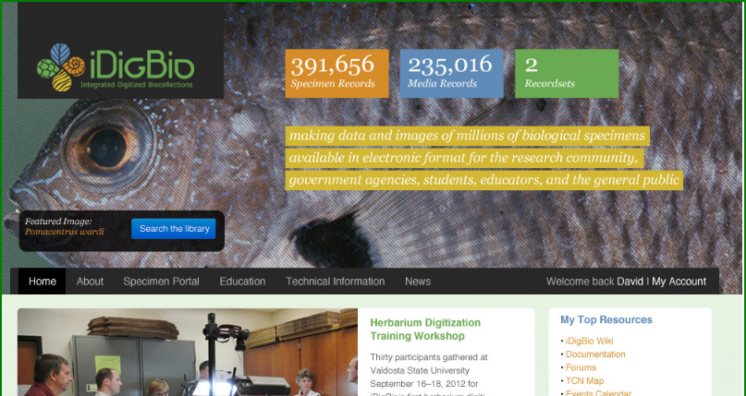
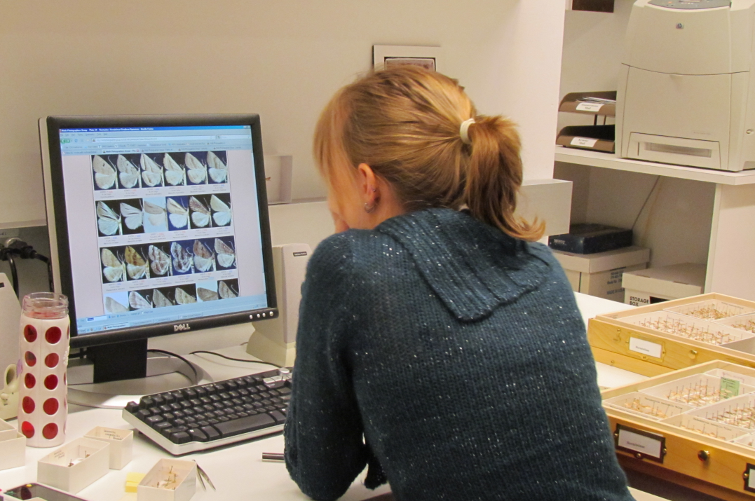
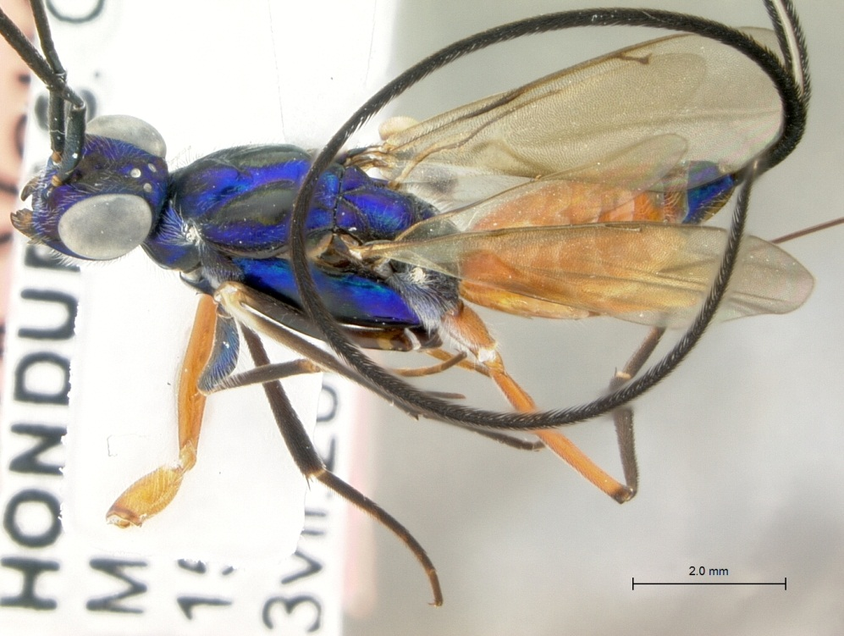
Mandate and Responsibility
Provide portal access to collections data
Make information available and discoverable
Label Data and images
Enable digitization and research
Facilitate digitization workflows
Oversee implementation of standards
and best practices for digitization
Allow for data discovery across organismal groups
Be a client of digitization projects/networks
Actively seek partners and data sources
Respond to cyberinfrastructure needs
Engage communities
Collections
Research
Citizen science and education
Support ADBC goals
Access to information
Support for collections
Grand Challenge
Develop a cloud computing infrastructure that links biological data from collections across the U.S. into a single unified web interface, overcoming the “data silos” that currently exist across the country.

Slide 7
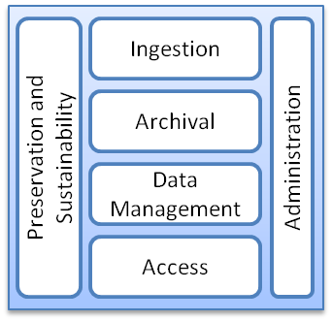
Interface Model for iDigBio and TCNs
SQL
UTF-8
. . .
REST WS
SAML
WS-I
TAPIR
. . .
TDWG
XML
Archiving
Data Collections
Wiki
Workshop Resources
Workflow Engines
Taxonomic Validation
Learning Modules
Structured Data Services
Storage
Non-structured Data Services
Geographical Mapping
Data Conversion
Virtual Appliances
Machines
Networking
Collaboration Tools
iDigBio + Resources
TCP
OCCIWG
HTTP
RDF
JPEG2000
X.509
OpenID
XMPP
ODBC
National History Museums
Federal Collections
Applied Innovations
Microsoft Azure
Amazon EC2/S3
Google Apps
Microsoft Live
Google App Engine
iPlant
NCBI
EOL
LifeMapper
ALA
XSEDE
TCNs
DataONE
Academic Clouds
NESCent
Infrastructure Providers, National/Global Data Aggregators, Domain Service Providers, Domain Data Consumers

Slide 8
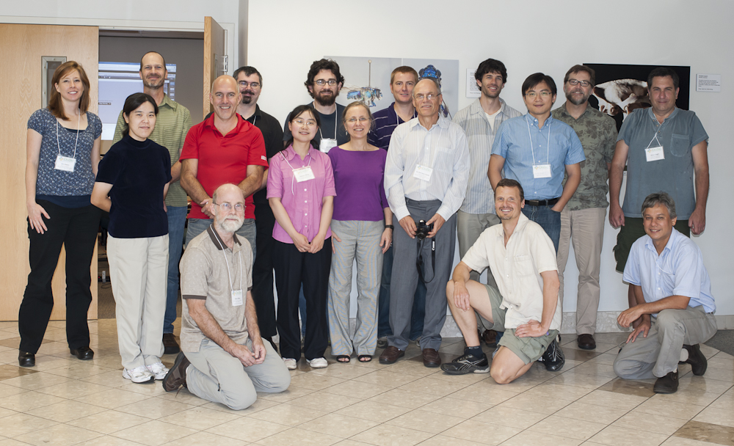
The Augmenting OCR WG?
Bryan Heidorn, Director, School of Information Resources and Library Science, University of Arizona
Robert Anglin, LBCC TCN Developer
Reed Beaman, iDigBio Senior Personnel, FLMNH
Jason Best, Director Bioinformatics, Botanical Research Institute of Texas
Renato Figueiredo, iDigBio IT
Edward Gilbert, Symbiota Developer, LBCC and SCAN TCNs
Nathan Gnanasambandam, Xerox
Stephen Gottschalk, Curatorial Assistant, NYBG
Peter Lang, Pre Sales Engineer, ABBYY
Deborah Paul, iDigBio User Services
Elspeth Haston, Royal Botanic Garden, Edinburgh
Daryl Lafferty, SALIX Arizona State University
Anna Saltmarsh, Royal Botanic Gardens, KEW
Nahil Sobh, Developer, InvertNet
Alex Thompson, iDigBio Developer
Kimberly Watson, Curatorial Assistant NYBG
Qianjin Zhang, Graduate Student, University of Arizona
Notes:
Formation
Who / Where / What
Goals
Wiki
Forum

Slide 9
AOCR wg history
initiated at iDigBio Summit 1 in 2011
meeting since Spring 2012
Working Group Meeting in October of 2012
update on OCR progress
update on Handwriting analysis
began AOCR wg Wiki pages
began planning this hackathon
parsing selected as a “do-able” scope for 2-day hackathon
iSchools iConference2013: poster, paper, workshop, alternative event
more topics-of-keen-interest that need development
user interfaces (workflows)
algorithms, interoperability and services
data standards
community outreach & citizen science

Slide 10
Parsing Baseline
What is possible, right now?
ABBYY, Tesseract, GOCR/JOCR, OCRad, Xerox,…
Sharing expertise and ideas
Publicizing the findings
help collections make workflow decisions
help focus future efforts on goals that have the most promise for faster, more efficient digitization

Slide 11
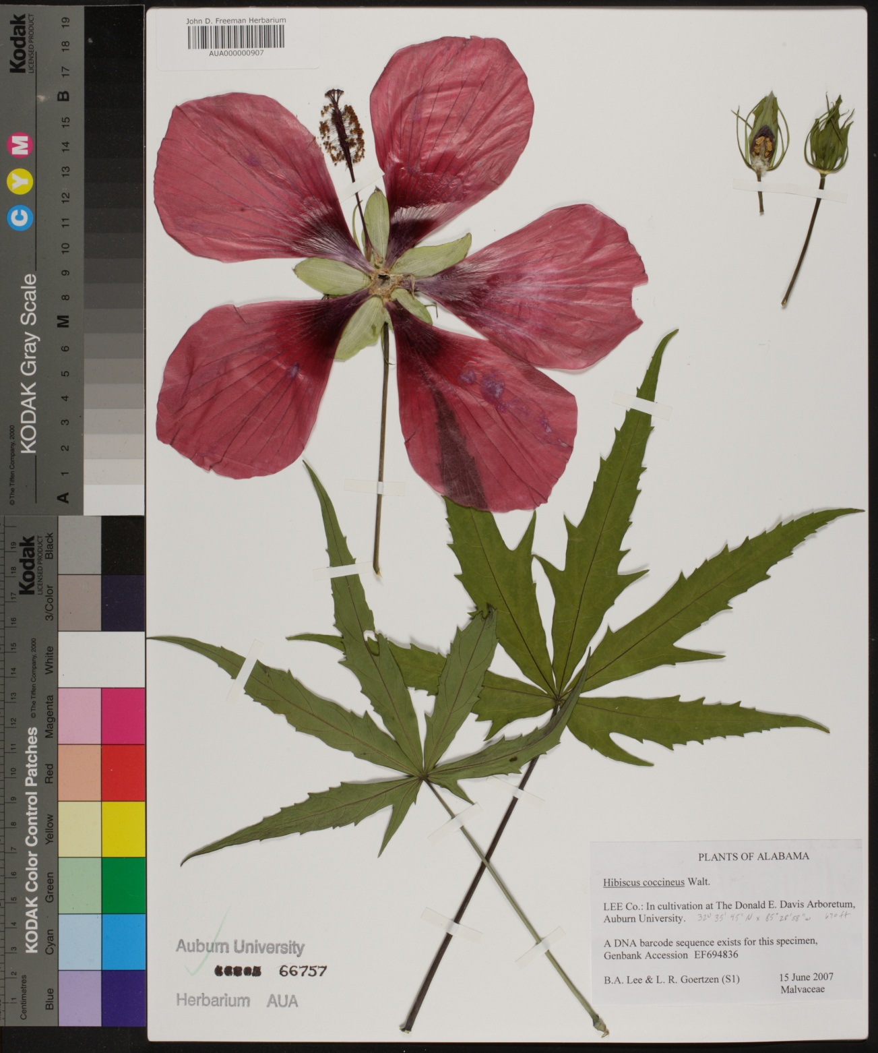
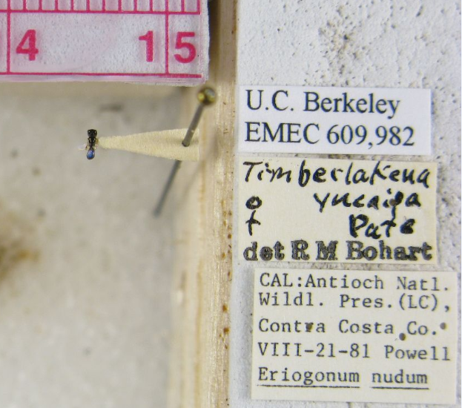
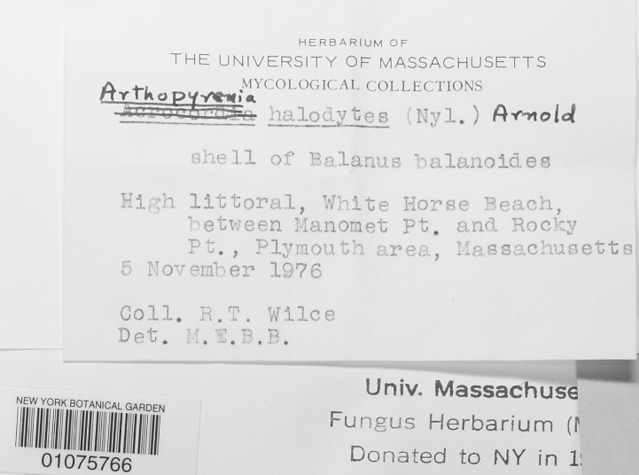
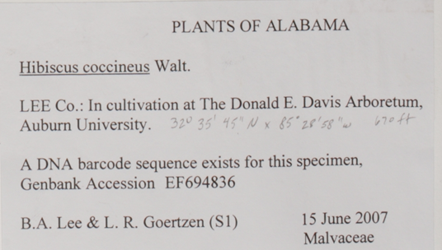
Three Data Sets
Easy?
Medium
Hard!

Slide 12
Three Data Sets
Easy?
Medium
Hard!
Darwin Core Fields chosen
finding duplicates
locality data

Slide 13
Who is here?
Programmers, scripters, parsers, documentarians, web developers, scientists, graduate students, computer vision researchers, educators,…
Where do we come from?
TCNs, Private Industry, Independent Programmers, Museums, Universities, Information Science,
Sharing your results
Sharing your expertise to see how far we can get with parsing and image processing
Focus on the future
It’s your turn…

Slide 14
Keeping Track
Group Notes:
http://tinyurl.com/AOCRhackNotes
Hackathon Wiki:
http://tinyurl.com/aocrhackathonwiki
Logistics:
http://tinyurl.com/aocrLogistics
AOCR VM (at UFL)
aocr1.acis.ufl.edu
user name: aocr
password: augment
AOCR at github, please put your code here...
https://github.com/idigbio-aocr

Slide 15
Talks
Hackathon Overview Deborah Paul
Parsing Dataset 1 Daryl Lafferty
Parsing Datasets 1 / 3 Ben Brumfield
Image Segmentation Phuc Nguyen
Parsing Dataset 1 Robert Anglin
Parsing Dataset 1 Bryan Heidorn & Qianjin Zhang
Parsing Dataset 2 Dmitry Mozzherin
Services & Workflow UI Paul & Robin Schroeder
Workflow John Pickering
DarwinScore & Apiary Jason Best

Slide 16
Thank you from the iDigBio AOCR Working Group
iDigBio is graciously funded by a grant from the National Science Foundation's Advancing Digitization of Biological Collections Program (#EF1115210). Any opinions, findings, and conclusions or recommendations expressed in this workshop are those of the author(s) and do not necessarily reflect the views of the NSF. Thank you, one and all, for your participation and contributions to our efforts
Notes:
#608CB8 R:96 G:140 B:184

