Slide 1
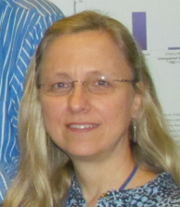
Of People & Data
Association for Southeastern Biologists (ASB) 2013
Charleston West Virginia
iDigBio Digitization & Workflows Workshop
Deborah Paul, iDigBio
April 13, 2013

Slide 2
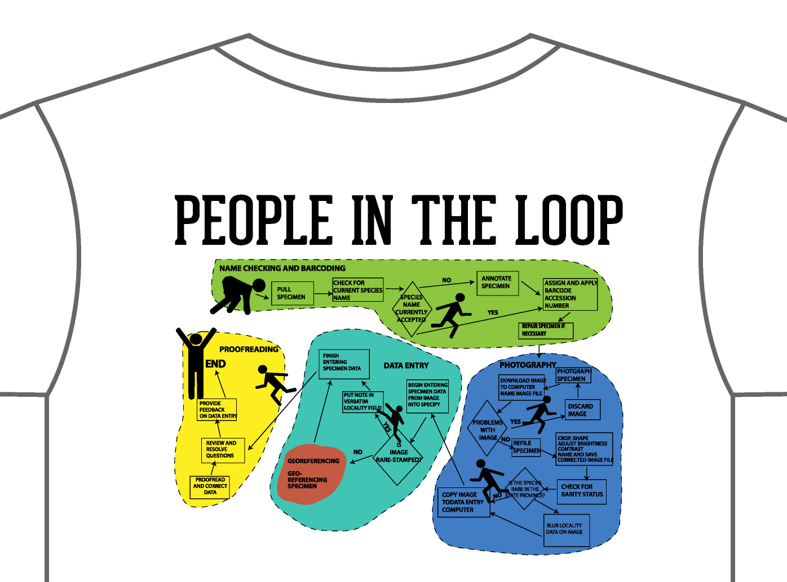
Design by Dorothy Allard, Pringle Herbarium

Slide 3
Of People & Data Overview
Social issues (People)
Specimen Identifiers
CollectionObject
Share!
Excel ≠ database
Open Refine
Notes:
Social issues
Boundary issues
Focus on examples
eCollaboration
STEM
Harvard implicit bias study
In this workshop, we’re essentially reviewing (current state as / is analysis) processes being used to try and broadly define our overall digitization process. As part of the review process, we’ll be looking for redesign and perhaps in some cases, re-engineering opportunities.
“…before you start reviewing a process to ensure you correctly define what the process actually is and establish what the boundaries are.”
Joint Information Systems Committee
http://www.jiscinfonet.ac.uk/InfoKits/process-review/process-review-8
We’re looking for the broad core processes fundamental to the organization. “…no organization has more than eight core processes.” Even though, these are based on business process modeling, the ideas work. Our customers are us, as well as our stakeholders. Our audience of data collectors, data providers and data user is a large one. Keep in mind, why are we doing this in the first place? -access to fit-for-use data for research, education and outreach.
“Take the example of the process of going on holiday. Some people may say it starts when you step on the plane and ends when you collect your suitcases from the airport carousel on the your return. Others might argue it starts with looking at maps and brochures and ends when you've unpacked and exchanged your foreign currency back to sterling. Neither view is right or wrong and each way of looking at it has its advantages and disadvantages.”
Creativity
“What might happen, what might we do?" is combined with "How could we bring this action into reality?“
observing digitization workflows
social issues
business processes
change, management & motivation
some changes seen
opportunities for redesign
evaluating & redesigning workflows
digitization & cultural maturity
Overview of other topics in this talk…
Excel ≠ database
Which one will you choose?
Sorting
Formulas
Formatting
Open Refine
Importance of Specimen (CollectionObject) Identifiers
Assigning
Storing
Sharing
Share! Export your data (CSV, DwC-A, …)
GBIF
Morphbank
VertNet
ORNIS
iDigBio
Help is everywhere
“Easier to learn about the IT than for IT to learn about taxonomy, for example.”

Slide 4
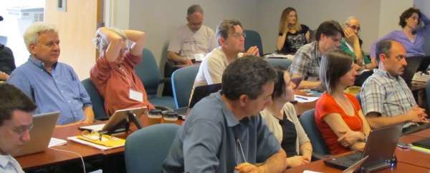
Social Issues
Why discuss people issues?
People
Technology
The invention of the wheel
Use resources wisely, effectively
Knowledge about social issues
Notes:
all of our hard problems are people problems
technology problems can be solved!
we'd like to
avoid re-inventing the wheel
use the resources we do have
in the most effective manner possible
to benefit as many as possible
take advantage of existing knowledge about social issues

Slide 5
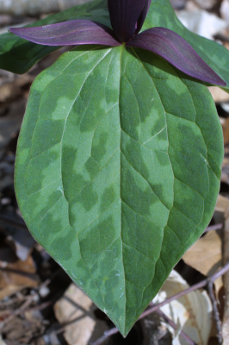
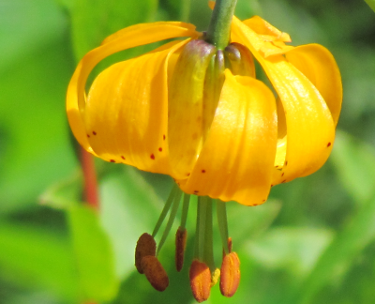
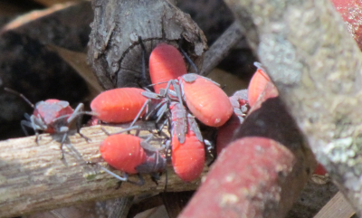
Social Issues
observing digitization workflows
social issue layers
business processes
change, management
motivation
examples
opportunities
Notes:
In this workshop, we’re essentially reviewing (current state as / is analysis) processes being used to try and broadly define our overall digitization process. As part of the review process, we’ll be looking for redesign and perhaps in some cases, re-engineering opportunities.
“…before you start reviewing a process to ensure you correctly define what the process actually is and establish what the boundaries are.”
Joint Information Systems Committee
http://www.jiscinfonet.ac.uk/InfoKits/process-review/process-review-8
We’re looking for the broad core processes fundamental to the organization. “…no organization has more than eight core processes.” Even though, these are based on business process modeling, the ideas work. Our customers are us, as well as our stakeholders. Our audience of data collectors, data providers and data user is a large one. Keep in mind, why are we doing this in the first place? -access to fit-for-use data for research, education and outreach.
“Take the example of the process of going on holiday. Some people may say it starts when you step on the plane and ends when you collect your suitcases from the airport carousel on the your return. Others might argue it starts with looking at maps and brochures and ends when you've unpacked and exchanged your foreign currency back to sterling. Neither view is right or wrong and each way of looking at it has its advantages and disadvantages.”
Creativity
“What might happen, what might we do?" is combined with "How could we bring this action into reality?“
observing digitization workflows
social issues
business processes
change, management & motivation
some changes seen
opportunities for redesign
evaluating & redesigning workflows
digitization & cultural maturity

Slide 6
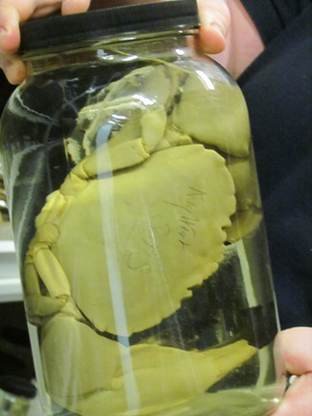
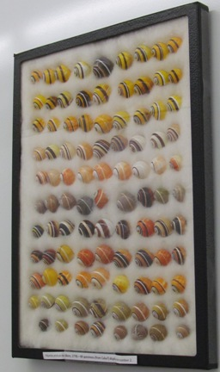
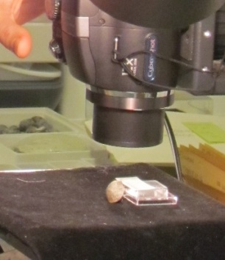
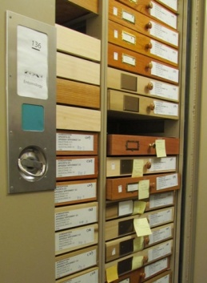
Observing Digitization & People
iDigBio’s Gil Nelson and Deb Paul visited
28 Collections in 10 different museums
Collections varied in size, kind, staffing
entomology
invertebrate paleontology
invertebrate zoology
ornithology
botany
vertebrate paleontology
zoology
Paper submitted to ZooKeys
Not about social issues
Notes:
Kinds of collections we visited
Today we’ve seen an overview of business process modeling from the information science point-of-view, in addition to Gil’s presentation about
workflows, what we’ve learned (so far) from our visits, questions we still have…
While many of the process issues (technical and manual) will continue to evolve and improve
the social issues will always be present.
What are some of these social issues?
What can we do with this information?
How does it apply to our workflows (in the community, in an organization, at the level of the individual)?

Slide 7
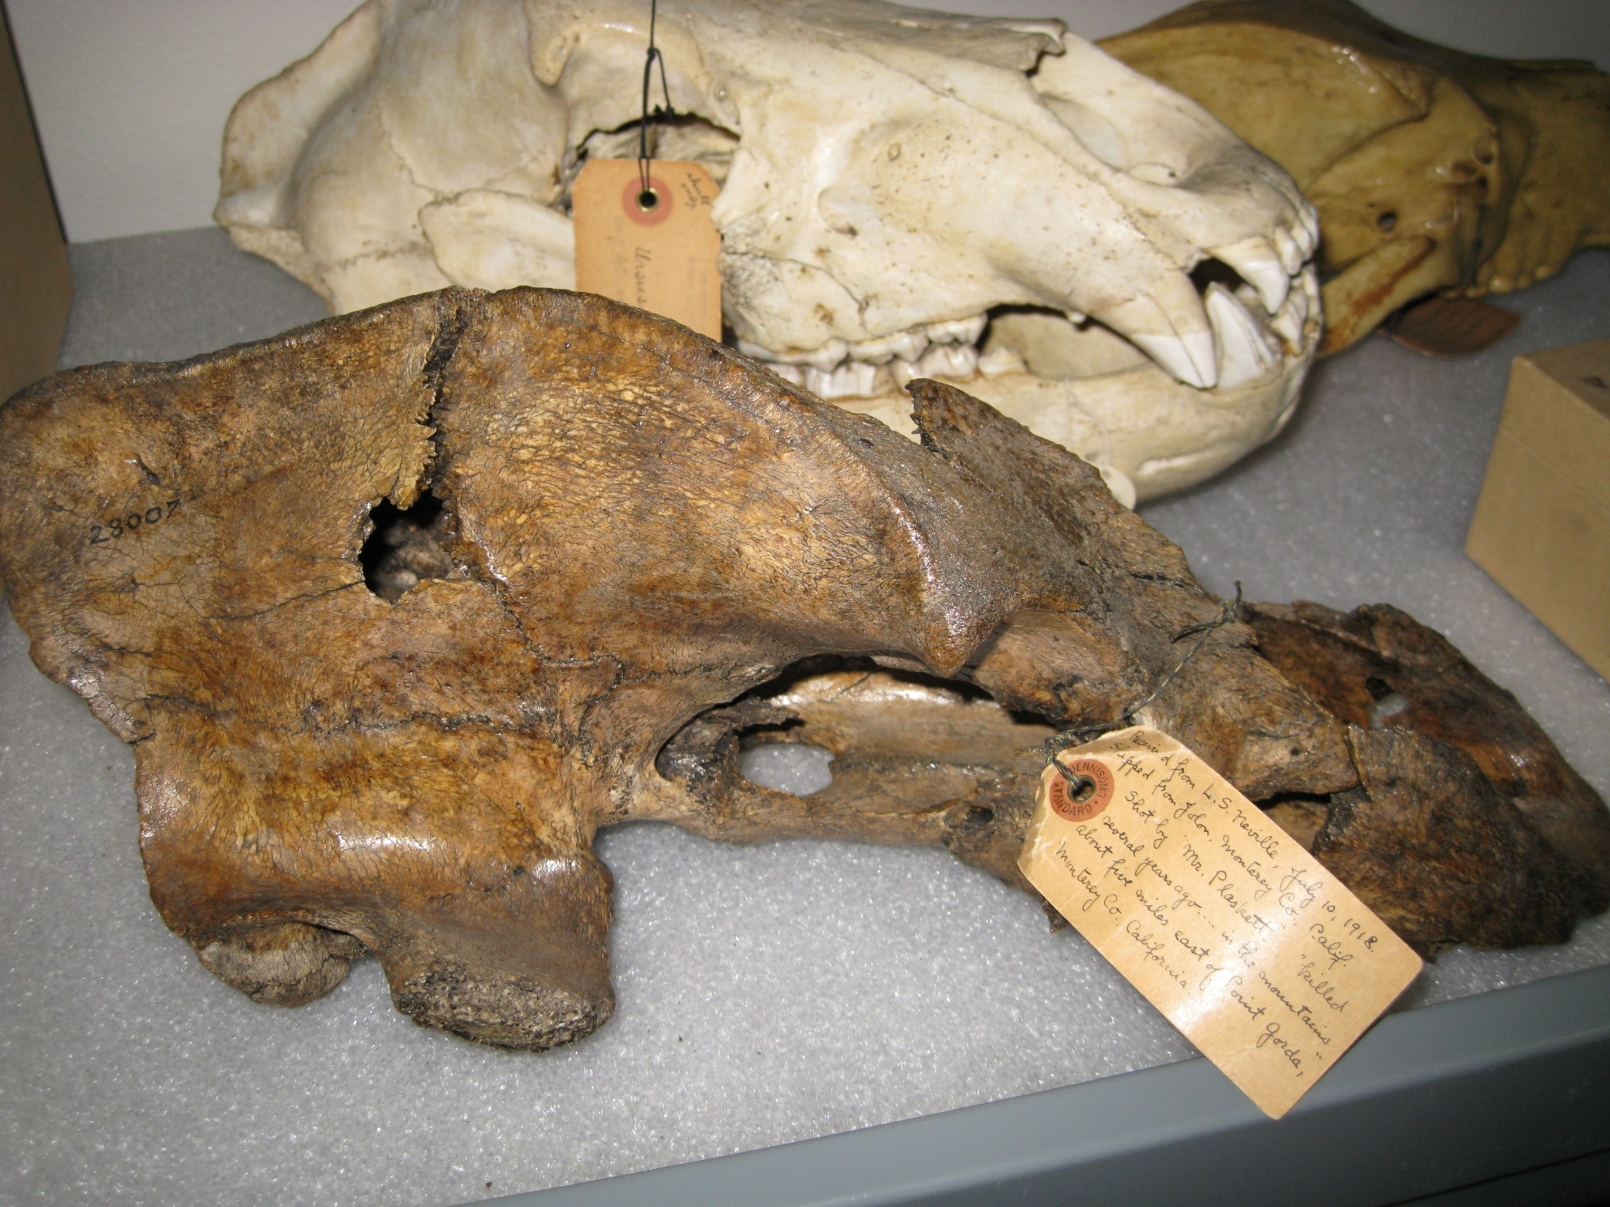
Received from L. S. Nelville, July 10, 1918
Shipped from Jolon, Monterey Co.California
Shot by Mr. Plaskett “…killed several years ago… in the mountains about 5 miles east of Point Gorda” Monterey Co. California.
http://microecos.wordpress.com/2009/03/

Slide 8
Layers
specimens as boundary objects
Community
think little science to eScience
Organization
the museum
the individual collection
The individual digitizing
Notes:
How can we divide the social layers conceptually? One possible way. Our work is about biodiversity and how we can utilize our natural history collections
more effectively to investigate the universe we inhabit. Start with the fact that our goal here is to digitize specimens.
It might be useful to think of the specimen as a boundary object.
(Star and Griesemer 1989) via the history of the Museum of Vertebrate Zoology (MVZ), UC Berkeley
In order to more effectively think about social issues and optimization (efficiency) at each level and what that might entail.
Keep these in mind during the talk…
little science to big science (is a topic for an entire workshop!) Eric T. Meyer’s work http://people.oii.ox.ac.uk/meyer/
(in private communication, Eric cautions that even though we want to avoid NiH he has seen projects go wrong where the IT staff do not involve the people who will use the products. Staff then does not want to use the products – no engagement).
studies the social implications of e-science and e-social science as part of the Oxford e-Social Science (OeSS) project. He brings an understanding of scientific collaboration from both sides: as a social scientist studying scientific behavior, and as a participant in the production of scientific knowledge. focus here on the notion that was once science done at the level of the individual researcher
data collected only for them
date now being collected in new ways
data now being shared (and shared in new ways)
at the organizational / architectural level –
museums being redesigned so the public can see the research
the collections are connecting back to each other via databases and collaborating with each other
some have, others need those with expertise in collections and biodiversity informatics
at the individual level – the social issues surrounding the persons doing the digitization work.
converging on ideas of how to collect data in the field
converging on ideas of what data to collect in the field
emerging trends and issues in data-sharing and intellectual properties
the boundaries (ours and the objects) are changing
"…to promote an organizational structure that encourages communication between scholars who are both creating and consuming information." (Barton 2005, quoted in Chern Li Liew 2009).

Slide 9
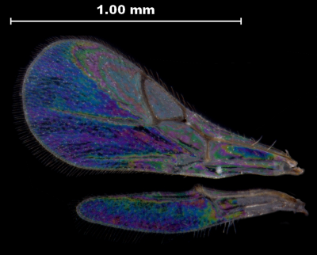
Change: the three r’s
business processes applied to
workflow process improvement
review
observe
document
evaluate
redesign
observe
document
evaluate
reengineer
layers of change
http://www.jiscinfonet.ac.uk/infokits/process-improvement
Notes:
In this workshop, we’re essentially reviewing (current state as / is analysis) processes being used to try and broadly define our overall digitization process. As part of the review process, we’ll be looking for redesign and perhaps in some cases, re-engineering opportunities.
“…before you start reviewing a process to ensure you correctly define what the process actually is and establish what the boundaries are.”
http://www.jisc.ac.uk/aboutus/strategy.aspx
Joint Information Systems Committee
a UK Initiative, now internationally known. to champion the use of digital technology to ensure the UK remains world-class in research, teaching and learning. JISC’s vision is one of easy and widespread access to information and resources, anytime, anywhere; a vision with technology and information management at the heart of research and education.
http://www.jiscinfonet.ac.uk/InfoKits/process-review/process-review-8
http://www.jiscinfonet.ac.uk/infokits/process-improvement
We’re looking for the broad core processes fundamental to the organization.
“…no organization has more than eight core processes.”
How many core processes do we have in the digitization of biodiversity collections?

Slide 10
Change Management
process
people
culture
http://www.jiscinfonet.ac.uk/infokits/change-management/aspects-of-change
Notes:
People – Culture – Change.
Change Management.
3 aspects: people, processes and culture.
While the main focus of this workshop is process, it’s people who do the work within a cultural continuum.
joint information systems committee
http://www.jiscinfonet.ac.uk/infokits/change-management/aspects-of-change
What can we learn, what questions can we ask, to help our efficiency efforts when it comes
to culture and people?
Layers of change management.

Slide 11
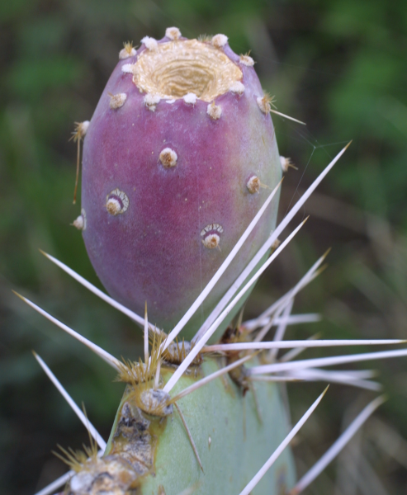
The irrational side of change management
what motivates you ≠ what motivates others
we’re better off listening, rather than telling
we need the + and the –
leaders mistakenly believe that they already “are the change”
it’s not just about the leader, it’s about how receptive “society” is to the ideas
money is the most expensive way to motivate people.
satisfaction equals perception minus expectation.
small unexpected rewards can have disproportionate effects.
process and outcome have to be fair to get buy-in
Aiken & Keller, 2009 in The McKinsey Quarterly
Notes:
Some research on Change Management to keep in mind when thinking about
social issues in workflows, at the organization and individual levels.
why “common sense” doesn’t work.
http://www.abettercity.org/docs/sustainability/McKinsey%20-%20Irrational%20Side%20of%20Change%20Management%202010.pdf
Ties nicely into the next conversation about what research says about what motivates us?
We need to motivate ourselves and each other, right?
Note that when change is implemented across an organization, it succeeds only 30% of the time!
The irrational side of change management
Aiken & Keller, 2009 in The McKinsey Quarterly
what motivates you ≠ what motivates others
we’re better off listening, rather than telling
we need the + and the –
leaders mistakenly believe that they already “are the change”
it’s not just about the leader, it’s about how receptive “society” is to the ideas
money is the most expensive way to motivate people.
satisfaction equals perception minus expectation.
small unexpected rewards can have disproportionate effects.
process and outcome have to be fair to get buy-in

Slide 12
Social Issues
observing digitization workflows
social issues layers
business processes
change, management
motivation
examples
opportunities

Slide 13
Motivation
What is known about what motivates us?
Where can we integrate what is known about motivation into our workflows?
Notes:
What motivates workers / volunteers / people? 5:07 (minutes)
pay people enough so that money is not on their minds and they can concentrate on their work.
3 factors that lead to better performance (and personal satisfaction)
Autonomy – our desire to self-direct our own lives (to get engagement) example: Atlassian (one day a quarter, employees paid to work on something interesting to them – then share (new products, soft ware fixes)
2. Mastery -- it’s fun, it’s satisfying, doing technically sophisticated work (for free), challenge and mastery – making a contribution. we care about mastery
3. Purpose – making a contribution – motivates workers and produces an inspiring place to work.
from the work Drive, the surprising truth about what motivates us by Daniel H. Pink,looking at motivation research of the last 50 years.
The 3 factors? autonomy: We can be attuned to what parts of the workflows can be done in the order chosen by the person doing the work. There are also tasks that could be accomplished in a variety of ways -- the person doing the work -- could choose the method (we've seen this in practice at Yale_ENT, for example). mastery: we can give this via training to -- volunteers / students / staff -- mastering new skills and knowledge sets purpose: this we have -- a very cool purpose, or really, many purposes for all this data! we just need to communicate these to our volunteers / students / staff / administrators...
14 May 2012

Slide 14
Evaluate a workflow I
Decide what to digitize
Decide on a database
Pull specimens
Sort specimens
Add Taxon Names to database
Curate specimens
Enter data
Repair specimens
Notes:
Make a grid.
Left column is list of workflow steps.
Top row across is a list of all the questions to ask yourself to evaluate a workflow to find places to speed it up.

Slide 15
Evaluate a workflow II Questions to ask yourself…
Must be done before digitization?
Expert needed?
Crowd Sourcing?
Automation Possible?
QA / QC step?
Physical tool?
Statistics?
Slow steps?
Formula?
Decide what to digitize
Decide on a database
Pull specimens
Sort specimens
Add Taxon Names to database
Curate specimens
Enter data
Repair specimens
Notes:
Make a grid.
Left column is list of workflow steps.
Top row across is a list of all the questions to ask yourself to evaluate a workflow to find places to speed it up.

Slide 16
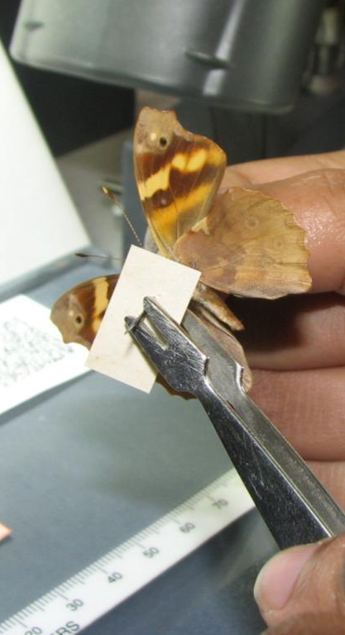
A Unique Tool for the Job: Forceps
http://www.ecnweb.org/dev/files/12_Eastwood_2010.pdf
Notes:
reduce the likelihood of specimen handling damage
reduce damage from skin oils on old, fragile labels
speed up the imaging process
increase level of comfort for specimen handling
forceps & culture ~
may also result in the wider entomology community being more willing to handle the specimens so need to continue community endeavors to share / disseminate these ideas
------
Some examples of changes we saw in various collections
as they adapt to improve their digitization.
N-i-H is “not invented here.”
Workflow Evolution ~ things people changed (adaptation)
tweezers (aka forceps)
autonomy to alleviate boredom
keystroke short cuts
ocr to validate scanned barcode entry
opportunistic use of mastery / skill sets
tracking flow
what happens when there’s a problem or question?
where do problems go?
losing information
capturing feedback from staff
Institutional level
Coordinated effort
Ready and willing to try a new strategy
Avoiding the N-i-H syndrome

Slide 17
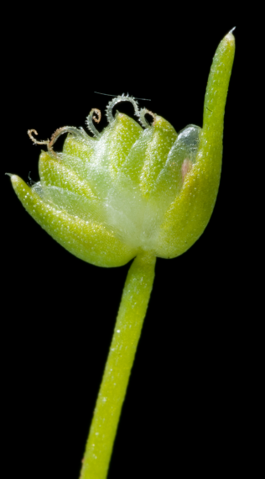
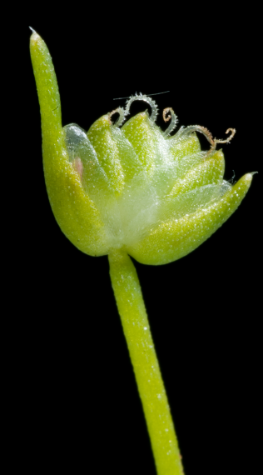
Task Order / Task Method
Task order didn’t matter
imaging ← →data entry
update taxon names ← → imaging
Task method didn’t matter
sort by collecting event
apply barcodes
Social effects
autonomy
alleviates boredom
engages worker → giving them a choice
novel strategies (mastery and purpose)
Notes:
Some examples of changes we saw in various collections
as they adapt to improve their digitization.

Slide 18
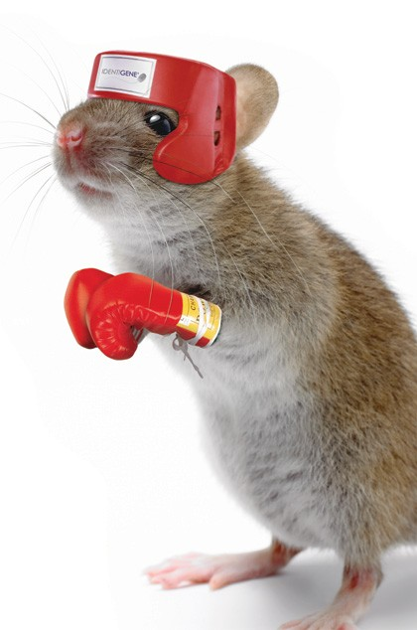
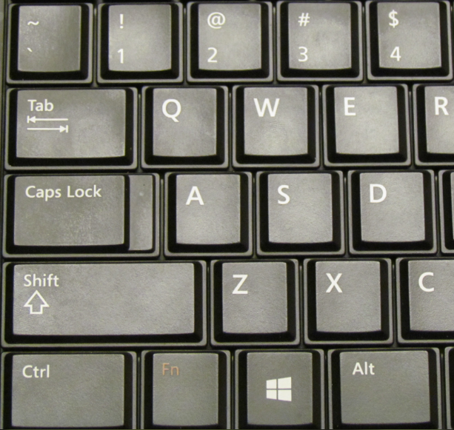
And the winner is …
vs
Social effects
seems to engage workers
steps reduced → less tedious
novel strategies
Notes:
Some examples of changes we saw in various collections
as they adapt to improve their digitization.
Keystroke more efficient than mouse
Keystroke shortcut training
Keystroke shortcuts posted prominently
Keystroke vs. mouse
Mouse image from http://macsparkytrial.squarespace.com/blog/2007/11/3/keyboard-vs-mouse.html

Slide 19
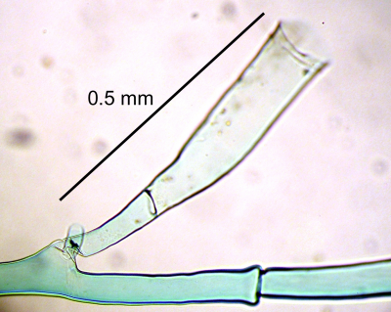
Software Automation
Barcode Capture and Validation
barcode captured 2 ways
scanner
OCR
software compares the 2 values, reports any mismatch
increases data integrity
reduces human quality control steps
Social effect
focuses human quality control steps → less tedious
Notes:
Some examples of changes we saw in various collections
as they adapt to improve their digitization.

Slide 20
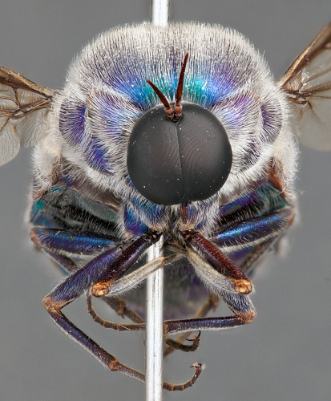
Using Skill Sets
opportunities to use individual skills
typing
imaging
language
writing
software / hardware
Русский
student is OCD
Notes:
Some examples of changes we saw in various collections
as they adapt to improve their digitization.
Openness to change (2-way barcode validation strategy – Paul Morris at Harvard ENT)

Slide 21
Using Skill Sets
opportunities to use individual skills
typing
imaging
language
writing
software / hardware
Русский
student is meticulous
taxonomy
students / staff share what works with each other
effects
efficient use of talent (resources)
engaging someone’s sense of purpose and usefulness allowing them to utilize mastery
Notes:
Some examples of changes we saw in various collections
as they adapt to improve their digitization.
Openness to change (2-way barcode validation strategy – Paul Morris at Harvard ENT)

Slide 22
Openness to Change
Visit / Observe
Be open to / invite the observations of others.*
The barcode example
Receptive to change
Implementing change
Some Effects:
increased data integrity
reduced human quality control steps
reinforced importance of observation, sharing, and openness to change.
Notes:
Some examples of changes we saw in various collections
as they adapt to improve their digitization.
Openness to change (2-way barcode validation strategy – Paul Morris at Harvard ENT)

Slide 23
Motivation: 3 keys
autonomy
possibilities
mastery
software skills
hardware skills
people skills
training (giving and receiving)
knowledge (collections, curation, content)
purpose
engagement & inspiration
the ADBC initiative is rich with purpose
http://www.danpink.com/archives/2010/06/whiteboard-magic
http://youtu.be/u6XAPnuFjJc

Slide 24
People in 5 important principles of effective workflows…
The Bioinformatics Manager is a key
People do the digitization
Processes and workflows vary
Workflows and protocols are business processes
Communication within and among projects is crucial
Notes:
There are likely more than 5 principles, but these seem to stand out the most.
Communication, Culture & Community Awareness
Visit to see what others are doing
Contribute to the process, (example): learning how to document and evaluate workflows to find our common core processes and move forward.
Comfort
Work outside your comfort zone (Judy Skog)
Ask for feedback
Work collaboratively ~ Share
social events
workshops and training events (here!)
contribute to FAQ or Q and A
wikis
Influence others, be
open
clear
transparent
Keep Enterprise 2.0 in mind…
“Let people do the work – they’ll create amazing stuff.”

Slide 25
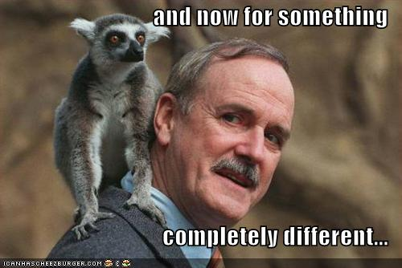

Slide 26
Of People & Data Overview
Social issues (People)
Specimen Identifiers
CollectionObject
Share!
Excel ≠ database
Open Refine
Notes:
Social issues
Boundary issues
Focus on examples
eCollaboration
STEM
Harvard implicit bias study
In this workshop, we’re essentially reviewing (current state as / is analysis) processes being used to try and broadly define our overall digitization process. As part of the review process, we’ll be looking for redesign and perhaps in some cases, re-engineering opportunities.
“…before you start reviewing a process to ensure you correctly define what the process actually is and establish what the boundaries are.”
Joint Information Systems Committee
http://www.jiscinfonet.ac.uk/InfoKits/process-review/process-review-8
We’re looking for the broad core processes fundamental to the organization. “…no organization has more than eight core processes.” Even though, these are based on business process modeling, the ideas work. Our customers are us, as well as our stakeholders. Our audience of data collectors, data providers and data user is a large one. Keep in mind, why are we doing this in the first place? -access to fit-for-use data for research, education and outreach.
“Take the example of the process of going on holiday. Some people may say it starts when you step on the plane and ends when you collect your suitcases from the airport carousel on the your return. Others might argue it starts with looking at maps and brochures and ends when you've unpacked and exchanged your foreign currency back to sterling. Neither view is right or wrong and each way of looking at it has its advantages and disadvantages.”
Creativity
“What might happen, what might we do?" is combined with "How could we bring this action into reality?“
observing digitization workflows
social issues
business processes
change, management & motivation
some changes seen
opportunities for redesign
evaluating & redesigning workflows
digitization & cultural maturity
Overview of other topics in this talk…
Excel ≠ database
Which one will you choose?
Sorting
Formulas
Formatting
Open Refine
Importance of Specimen (CollectionObject) Identifiers
Assigning
Storing
Sharing
Share! Export your data (CSV, DwC-A, …)
GBIF
Morphbank
VertNet
ORNIS
iDigBio
Help is everywhere
“Easier to learn about the IT than for IT to learn about taxonomy, for example.”

Slide 27
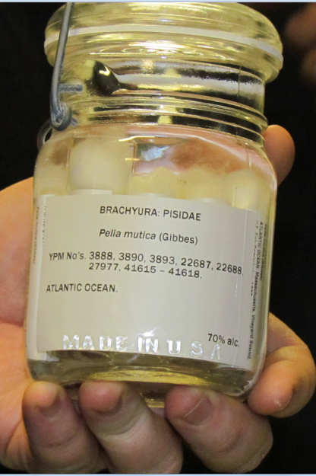
Specimen Identifiers (Collection Object)
What good is identification?
Examples and Use
Specimen identifiers
Providing IDs
Annotations and Feedback
Notes:
Types of
Storage (in database)
On specimens
Cited in papers
Used to aggregate / resolve (find globally) / cite / find locally
KEY to data sharing
Curation of
Store
Database changes to accommodate identifiers (global or not)
Share
Facilitate finding / BiSciCol / relationship illumination
Cite
What do you cite in your papers?
Where to find a specimen?
Opaque identifiers (no “where” or “which” or “how”)
Importance of Inst Code / Coll Code / OwnerInstID (Darwin Core) and registration

Slide 28
What good is identification? I
Aggregation
If you get info from 2 sources that are about the same object, you can combine the info
Resolution (finding information about object)
Types of resolution
Determine where to get information
Determine how to get information

Slide 29
What good is identification? II
Aggregate
Resolve
Cite
Find locally
Feedback

Slide 30
Identifier examples
record id 112234
uuid urn:uuid:954c8760-e1a6-4b4b-ab82-6bf7311c25f3
lsid urn:lsid:zoobank.org:act:8BDC0735-FEA4-4298-83FA-D04F67C3FBEC
http - uri http://ids.flmnh.ufl.edu/herb/abcd12345678
ezid ark:/87286/B2954c8760-e1a6-4b4b-ab82-6bf7311c25f3
doi doi:10.1038/ng0609-637
catalog urn urn:catalog:FSU:Herbarium:000023905
Proxy request
http://dx.doi.org/10.1038/ng0609-637
Notes:
The standard for identification advocated by W3C is to use Universal (uniform) Resource Identifiers (URIs).
-- a URI is a string that begins with a scheme name (or protocol). (http, https, mailto, doi, ftp, urn).
UUID (sometimes GUID)
definitely unique
E.g. 954c8760-e1a6-4b4b-ab82-6bf7311c25f3
Hard to type in
Not resolvable
Not always DB friendly
Opaque
urn:lsid:authority:namespace:identifier
http://lsid.tdwg.org/urn:lsid:authority:namespace:identifier
note that the http-uri could have any domain name (does not have to be resovlable) and the collection identifier
best practice would be to use one from biorepositories / biocollections index
this collection identifier needs to be stored in the providers database and
this collection identifier needs to be shared when the data is shared with aggregators.

Slide 31
Zoobank Uses Identifiers
Consider web page
http://zoobank.org/NomenclaturalActs/4DFD6D95-C287-4AFF-8473-E073D8960EC6
Look for identifiers
urn:lsid:zoobank.org:act:4DFD6D95-C287-4AFF-8473-E073D8960EC6
HOLOTYPE: Deposited as No. 7113, Hancock Parasitology Collection, University of Southern California
Search in google for these
Notes:
For consumer:
NOTHING! No information
Use UUID
Can’t type it, remember it, parse it, resolve it
Useful for comparison and aggregation
Equal strings (persistence)
Different strings about the same object
fetching information
Send the ID somewhere for info
digression
Careful
Id1=id2 means same object
Id1!= id2 does not mean different objects
what is it exactly in the publication?
an id?, a guid? a link to more information?
what will be cited? searched for?

Slide 32
DOI example
The DOI is
10.3897/zookeys.209.3135
URI (for aggregating & display) is
doi:10.3897/zookeys.209.3135
A URL for information retrieval (proxy resolution) is
http://dx.doi.org/10.3897/zookeys.209.3135
Information fetched from
HTML:
http://www.pensoft.net/journals/zookeys/article/3135/abstract/five-task-clusters-that-enable-efficient-and-effective-digitization-of-biological-collections
Notes:
Not comingled. Identifier and resolution (proxy) are separate
The consumer has to know somewhere to look for info
Requires organization to manage allocation of id space and proxy resolution
Members pay for service

Slide 33
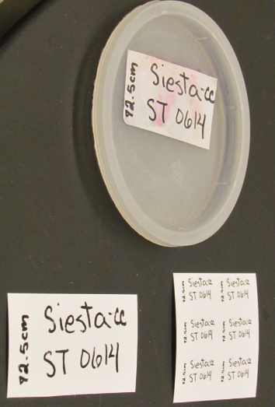
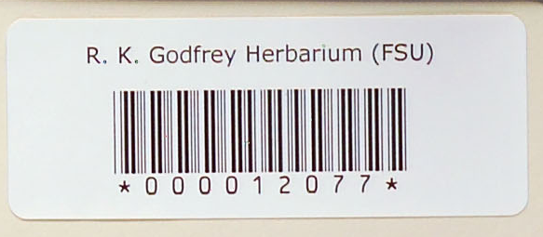
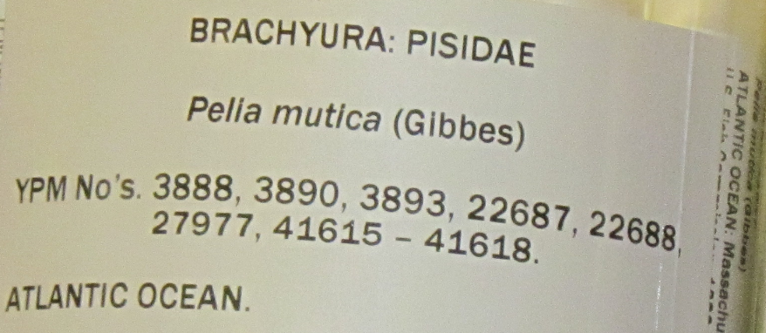
Specimen identifiers?
Identifier on the specimen?
readable text
encoded data
barcode is a contextual identifier
database record contains?
barcode = 0000014097
catalog number = ?
collector’s number =
record ID =
specimenId = urn:uuid:954c8760-e1a6-4b4b-ab82-6bf7311c25f3
persistent
unique (globally)
actionable (resolvable) maybe
Notes:
What are you providing / sharing?
The standard for identification advocated by W3C is to use Universal Resource Identifiers (URIs).
-- a URI is a string that begins with a scheme name (or protocol). (http, https, mailto, doi, ftp, urn).
Second URI has hex encoding of “0014097”
UUID (sometimes GUID)
Assured unique
E.g. d6610130-5248-11e1-b86c-0800200c9a66
Hard to type in
Not resolvable
Not always DB friendly
Opaque
apply a given id to only one object ever
if something happens and that object no longer exists in the physical collection –
never reassign the identifier to another object in the collection

Slide 34
Identifiers
Opaque identifiers
specimenId = urn:uuid:954c8760-e1a6-4b4b-ab82-6bf7311c25f3
No where, which or how
Smith No. 1153
Importance of Registration
Institution Code, Collection Code, Owner Institution ID
Finding Specimens
Globally
Locally
Darwin Core OccurrenceID

Slide 35
Identifiers: Curating, Providing, Using
Store the ones you know about
Database changes to accommodate identifiers (global or not)
Analogous to determination history
Analogous to ownership history
How are identifiers stored in your database?
Sharing is Key
Facilitate finding / BiSciCol / relationship illumination
Filtered PUSH
SGR
Standards (Darwin Core) to share identifiers
Cite
What do you cite in your papers?
Metrics for administrative justification?
Metrics for tenure credit?

Slide 36
Feedback with IDs
Annotations
Target of annotation
http://www.morphbank.net/818505
filtered PUSH
SGR
BiSciCol
linked data, aka the semantic web
updating the database
be(a)ware
store and share other IDs
Notes:
‘target’ is a property of the annotation

Slide 37
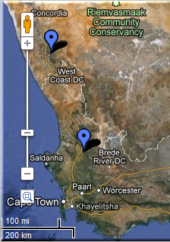
FilteredPUSH
Identifiers
GenBank ®
D I S C O V E R L I F E
Kepler Kurator
Cladistics ®
Notes:
Sharing Data.
GUIDs are the Key
specimen database
aggregators / portals – iDigBio, GBIF, EOL
ontologies- BioPortal
publications
maps
databases – GenBank, BOLD
provider websites – a museum may have their own portal
data repatriation, enhancement – Filtered PUSH
data cleaning / cleansing – Kepler Kurator, Google Refine
provider sites – http://herbarium.bio.fsu.edu
consortium websites through portals: http://symbiota.org/tiki/tiki-index.php?page=Data+Nodes
SERNEC, North American Bryophyte and Lichen Consortia, SEINet
Revisualization - discovery
Unforseen errors revealed
Taking it in stride
Opportunities, Benefits, Decisions
Specify’s Scatter-Gather-Reconcile (SGR)
duplicates found
dataset for checking is increasing in size
example, at least 50% dupes
lending credence to the skeletal dataset concept
Filtered PUSH (works with Specify, Symbiota and Morphbank)
finding dupes
the benefits of shared datasets
lending credence to the skeletal dataset
finding annotations (determinations, general comments)
to import or not to import

Slide 38
Of People & Data Overview
Social issues (People)
Specimen Identifiers
CollectionObject
Share!
Collaborating with TCNs and PENs
Contributing to iDigBio
Data Aggregators
Excel ≠ database
Open Refine
Notes:
Social issues
Boundary issues
Focus on examples
eCollaboration
STEM
Harvard implicit bias study
Excel ≠ database
Which one will you choose?
Sorting
Formulas
Formatting
Open Refine
Importance of Specimen (CollectionObject) Identifiers
Assigning
Storing
Sharing
Share! Export your data (CSV, DwC-A, …)
GBIF
Morphbank
VertNet
ORNIS
iDigBio
Help is everywhere
“Easier to learn about the IT than for IT to learn about taxonomy, for example.”

Slide 39
Ways to Share Data
Thematic Collection Networks (TCNs)
have data ready to share?
fits a current TCN theme?
Partners to Existing Networks (PENs)
join the effort
Does my collection have to be part of a TCN or PEN to contribute data?
No.
Through an existing portal or repository
Symbiota
VertNet
Morphbank
iDigBio
GBIF
Help is everywhere!

Slide 40
Sharing data with iDigBio
All specimen data welcome at iDigBio
Custom export
CSV files
DwC-A files
Integrated Publishing Toolkit (IPT)
DwC-Extensions
MeasurementOrFact
ResourceRelationship
AudubonCore
Specimen Identifiers
Record Identifiers
Expect Feedback

Slide 41
Darwin Core Standard
http://rs.tdwg.org/dwc/terms/
Darwin Core (often abbreviated to DwC) is a body of data standards which function as an extension of Dublin Core for biodiversity informatics applications, establishing a vocabulary of terms to facilitate the discovery, retrieval, and integration of information about organisms, their spatiotemporal occurrence, and supporting evidence housed in biological collections. It is meant to provide a stable standard reference for sharing information on biological diversity[1] .

Slide 42
Social Issues in Collaborative Digitization
Barton, J. 2005. “Digital libraries, virtual museums: same difference?”, Library Review, Vol. 54 No. 3, pp. 149-54
Reed Beaman, James Macklin, Michael Donoghue, James Hanken. 2007. Overcoming the Digitization Bottleneck in Natural History Collections: A summary report on a workshop held 7 – 9 September 2006 at Harvard University. [Accessed January 2012]
ĺñigo Granzow-de la Cerda and James H. Beach. December 2010. Semi-automated workflows for acquiring specimen data from label images in herbarium collections. Taxon 59 (6): 1830-1842
Bryan Kalms. 2012. Digitisation: A strategic approach for natural history collections. Canberra, Australia, CSIRO
Liew, Chern Li. 2009. Digital library research1997-2007:Organisational and people issues. Journal of Documentation 65(2): 245 – 266 http://dx.doi.org/10.1108/00220410910937606
Eric T. Meyer. 2009. Moving from small science to big science: Social and organizational impediments to large scale data sharing. In: E-Research: Transformation in Scholarly Practice. Jankowski, Nicholas W. (Ed), Routledge. 350 pp.
Susan Leigh Star and James R. Griesemer. 1989. Institutional Ecology, ‘Translations’ and Boundary Objects: Amateurs and Professionals in Berkeley’s Museum of Vertebrate Zoology, 1907 – 1939. Social Studies of Science 19: 387 – 420
John Tann & Paul Flemons. 2008. Report: Data capture of specimen labels using volunteers. Australian Museum
Ana Vollmar, James Alexander Macklin, Linda Ford. 2010. Natural History Specimen Digitization: Challenges and Concerns. Biodiversity Informatics 7 (1): 93 – 112
iDigBio Workshop: Developing Robust Object to Image to Data Workflows May 30 – 31, 2012
Notes:
papers contributing content to this presentation to add context and hopefully value to the continuing conversation…

Slide 43
Acknowledgment & Thanks
American Museum of Natural History (AMNH)
Botanical Research Institute of Texas (BRIT)
Florida Museum of Natural History (FLMNH)
Florida State University (FSU)
Harvard Herbarium (HUH)
Museum of Comparative Zoology (Harvard)
New York Botanical Garden (NYBG)
Southeast Regional Network of Expertise and Collections (SERNEC)
Specify Software Project (University of Kansas)
Symbiota Software Project (Arizona State University)
Tall Timbers Research Station and Land Conservancy (TTRS)
Tulane University Museum of Natural History
University of Kansas Biodiversity Institute
Valdosta State University (VSU)
Yale Peabody Museum (YPM)
and all participants, presenters and organizers of the iDigBio Workshop:
Workflows and Challenges in Digitization of Museum Specimens
Host: – Association of Southeastern Biologists
Marshall University
April 14, 2013 Charleston West Virginia
Notes:
Thanks! from all at iDigBio

Slide 44
Thank you
42!
iDigBio is funded by a grant from the National Science Foundation's Advancing Digitization of Biodiversity Collections Program (#EF1115210). Views and opinions expressed are those of the author not necessarily those of the NSF.

Slide 46
Of People & Data Overview
Social issues (People)
Specimen Identifiers
CollectionObject
Share!
Collaborating with TCNs and PENs
Contributing to iDigBio
Data Aggregators
Excel ≠ database
Open Refine
Notes:
Social issues
Boundary issues
Focus on examples
eCollaboration
STEM
Harvard implicit bias study
Excel ≠ database
Which one will you choose?
Sorting
Formulas
Formatting
Open Refine
Importance of Specimen (CollectionObject) Identifiers
Assigning
Storing
Sharing
Share! Export your data (CSV, DwC-A, …)
GBIF
Morphbank
VertNet
ORNIS
iDigBio
Help is everywhere
“Easier to learn about the IT than for IT to learn about taxonomy, for example.”

