Slide 1
COLLABORATIVE DIGITIZATION
WORKFLOWS WITH SPECIFY 6
ANDY BENTLEY, SPECIFY PROJECT
UNIVERSITY OF KANSAS BIODIVERSITY INSTITUTE
LAWRENCE, KS

Slide 2
What is Specify?
ALLOWS FOR efficient computerization and management of biological collections and mobilization of specimen information onto the Internet.
CONSISTS OF a highly customizable, forms-based interface, powerful querying tools and robust report designer for printed output.
AIMS TO advance biological collections computing, communication, and collaboration through software and services provided.
FREE - Distributed and licensed at no charge for non-profit collections.
http://specifysoftware.org
Notes:
ALLOWS FOR efficient computerization and management of biological collections and mobilization of specimen information onto the Internet.
CONSISTS OF a highly customizable, forms-based interface, powerful querying tools and robust report designer for printed output.
AIMS TO advance biological collections computing, communication, and collaboration through software and services.
FREE - Distributed and licensed at no charge for non-profit collections. Open source.

Slide 3
Specify 6
Many other systems out there – KeEmu,
Past Perfect, Index Kentukiensis, Collections Space, Mantis, Multi-Mimsy etc.
Most have limitations or cost prohibitions for small to medium sized museums
Cost
Flexibility and customization
All disciplines *
Open source – community driven
Wealth of features
Support and longevity
Notes:
Many other systems out there – KeEmu, Past Perfect, Index Kentukiensis, Collections Space, Mantis, Multi-Mimsy etc.
All have limitations or cost prohibitions for small to medium sized museums
Cost
Flexibility and customization
All disciplines *
Open source – community driven
Wealth of features
Support and longevity

Slide 4
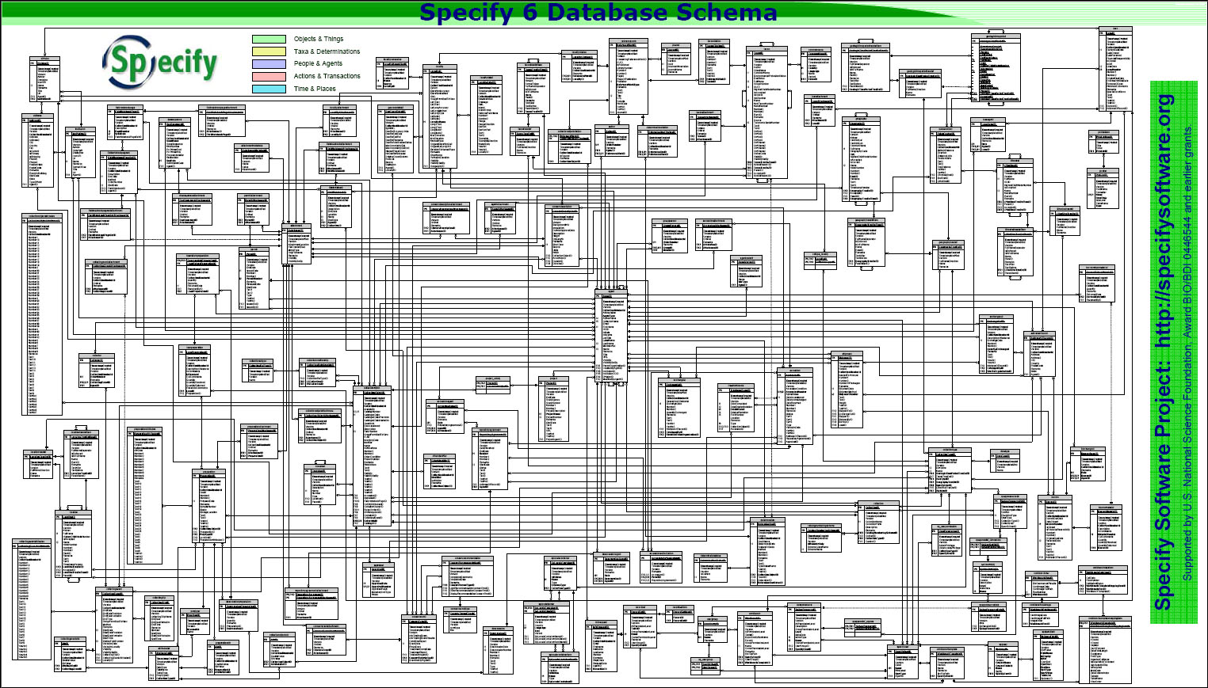
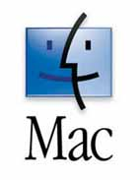
Specify
Over 15 major releases in 25 years
Increased functionality and features
Supported by the NSF since 1987
Java - Mac, PC and LINUX compatible
Database agnostic – MySQL
Open source – FOSS (GPL2)
Staff of 8 people attending to programming, development, conversions and user issues
Extensive, expanded and augmented data model
Notes:
Over 10 major releases in 15 years with extensive upgrades and new features.
Supported by the U.S. National Science Foundation since 1987.
Staff of 12 people attending to programming, development, conversions, web, DiGIR and user issues.

Slide 5
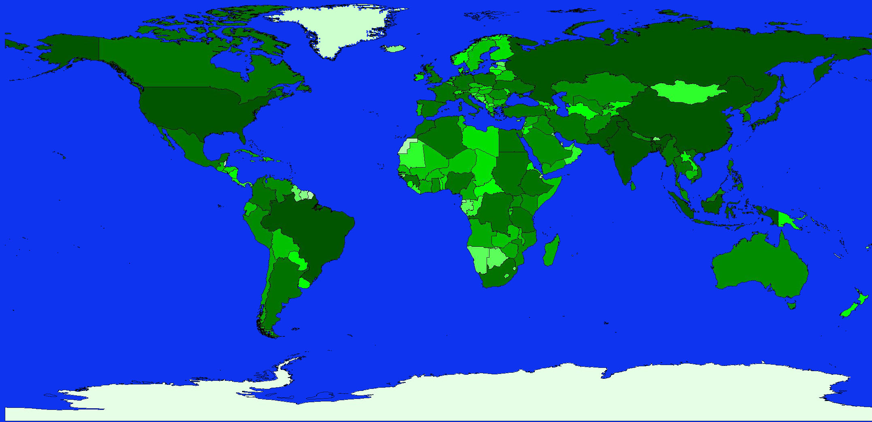
Norway
Finland
Denmark
Canada (2)
Sweden
Germany (6)
UK (2)
Poland
Hungary
Portugal (4)
Spain
Israel
Oman
Mexico
Guatemala (2)
Venezuela
India
Colombia (3)
Honduras
Malaysia
Ecuador
Kenya
Peru (2)
Brazil (9)
Chile (3)
New
Zealand
South Africa (3)
Australia (6)
Representation of all Natural History disciplines
Over 435 collections in 29 countries
Over 160 US institutions in 48 states
Over 10 million specimens cataloged
Increasing all the time
Notes:
Representation of all Natural History disciplines
Over 375 collections in 26 countries
Over 140 US institutions in 43 states
Over 10 million specimens cataloged
Increasing all the time

Slide 6
Specify 6
Collections management platform – pluggable components
Multi-collection/discipline capable
3rd party applications - GEOLocate, Google Earth
Web services and online providers – ITIS, Fishbase, Lifemapper
Strategic Partnerships – Filtered push (Harvard), botanical OCR (Michigan), image bank (MorphBank), DNA (BCoL), TCN’s
Staged, frequent releases with added functionality – smart update
Notes:
Collections management platform – pluggable components
Multi-collection/discipline capable
3rd party applications - GEOLocate, Google Earth
Web services and online providers – ITIS, Fishbase, Lifemapper
Strategic Partnerships – Filtered push (Harvard), botanical OCR (Michigan), image bank (MorphBank) and DNA (BCoL)
Staged, frequent releases with added functionality – smart update

Slide 7
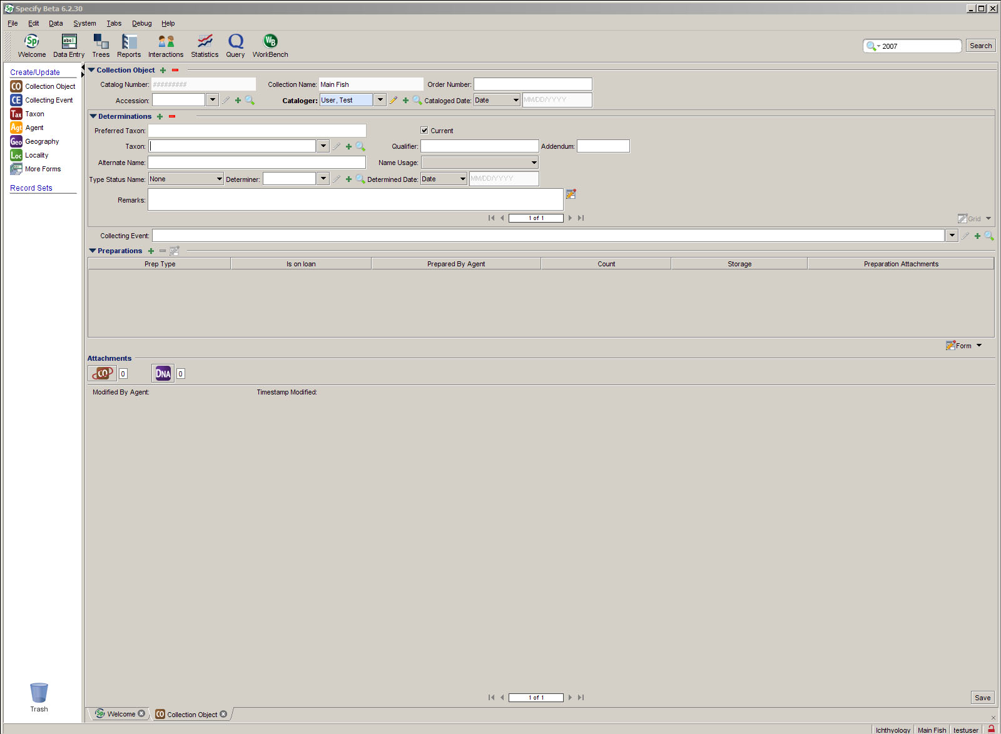
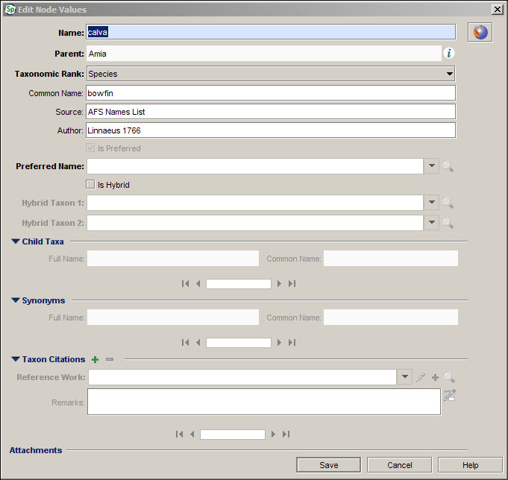
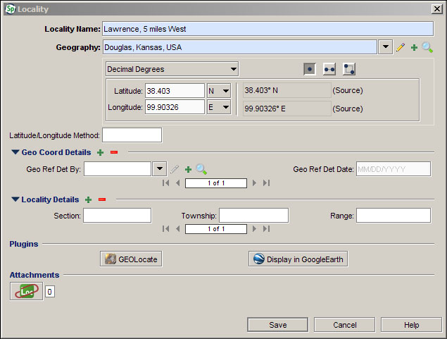
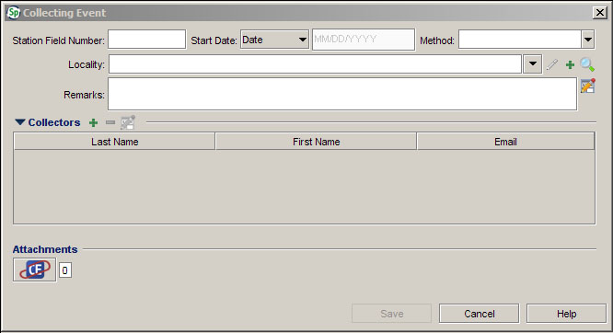
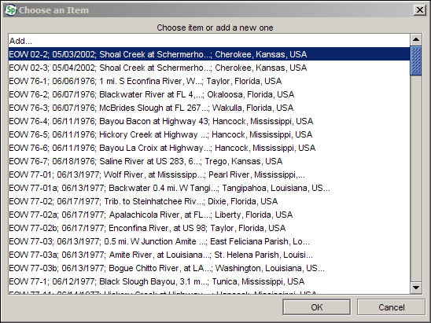
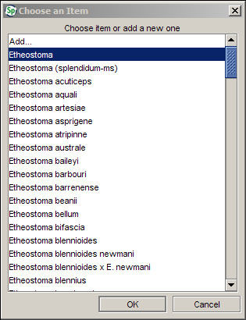
Data entry

Slide 8
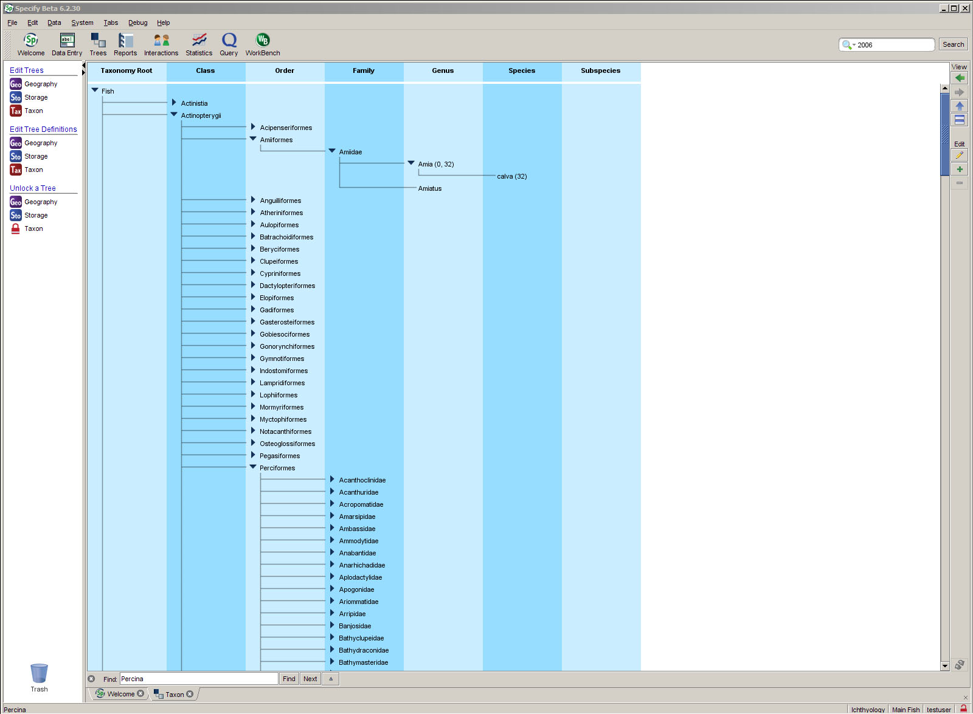
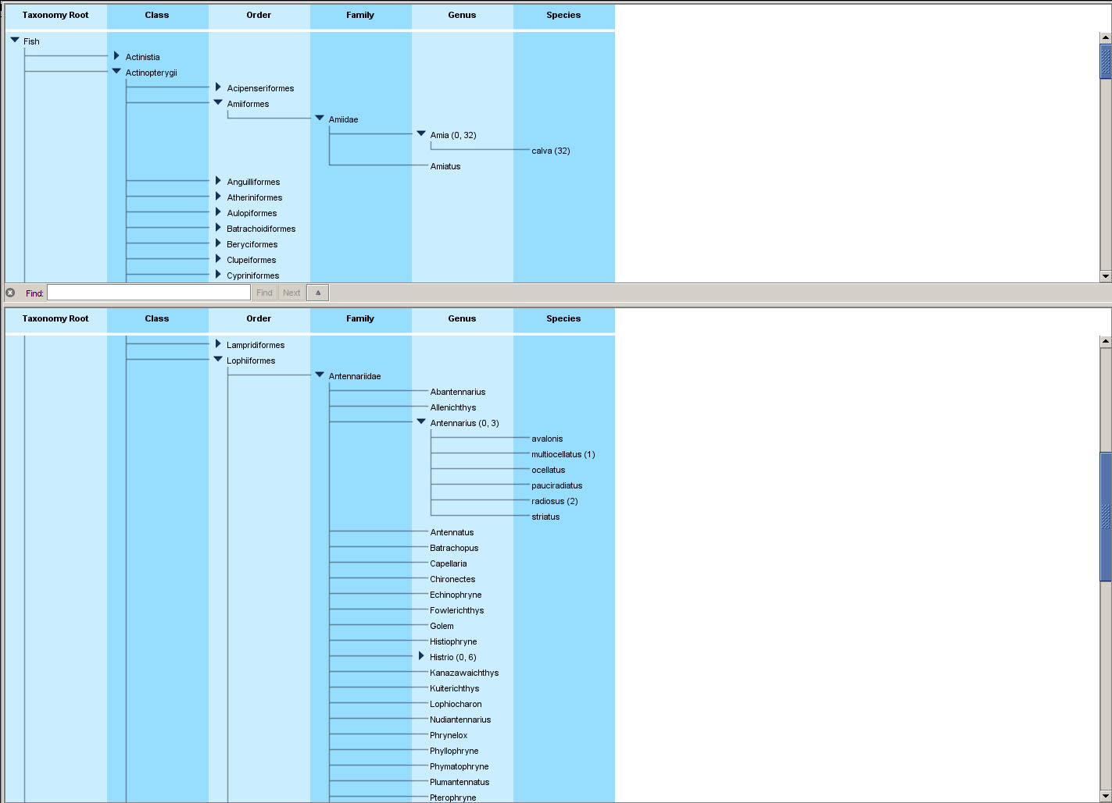
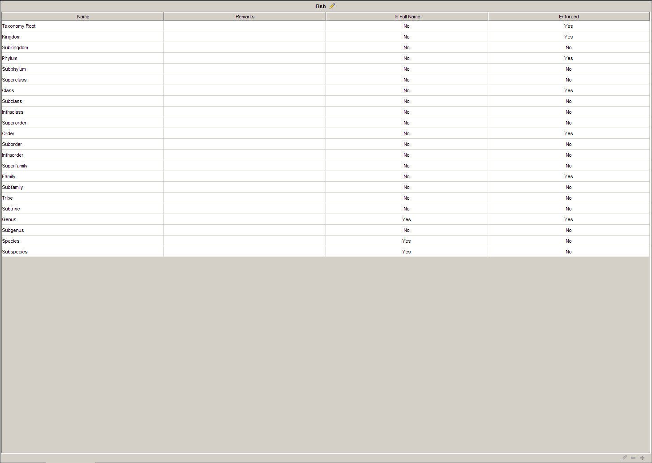
Trees
Notes:
The taxonomic tree has been reworked with additional functionality for navigation, creation of synonyms and hybrids and information on number of records etc. The geographic and storage trees will have the same functionality.

Slide 9
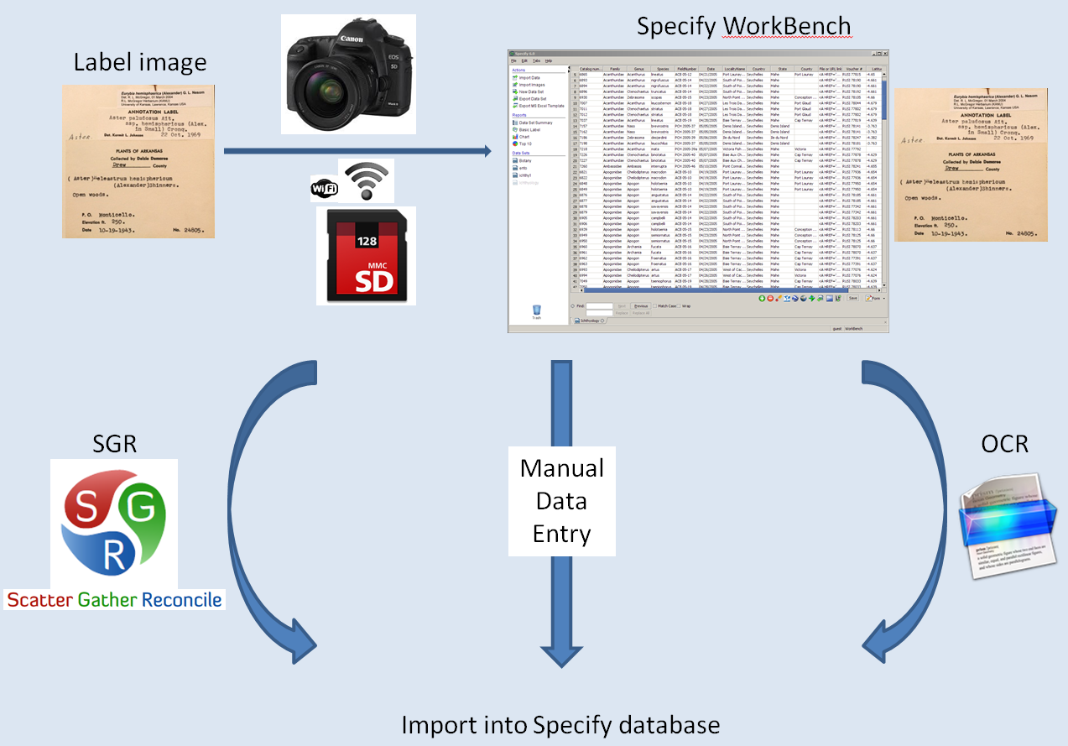
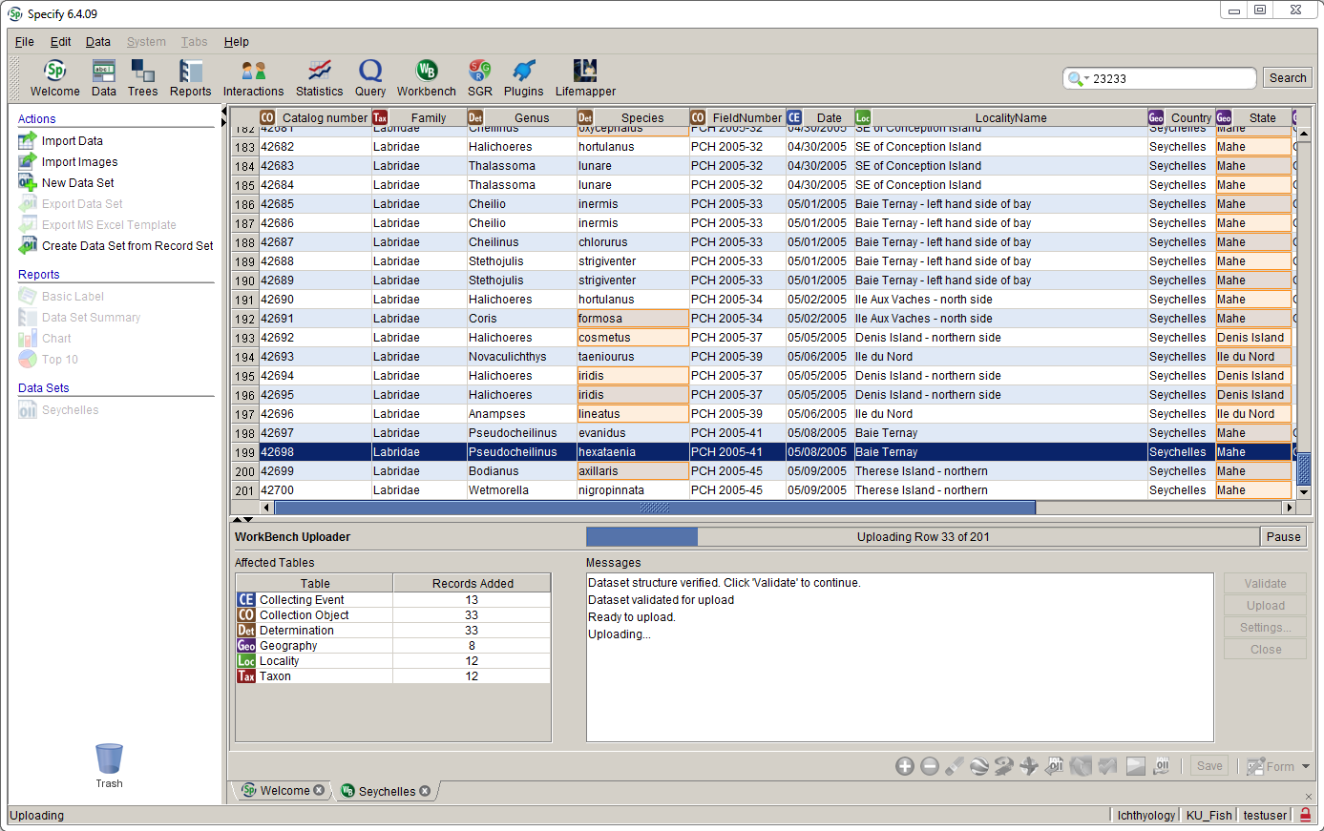
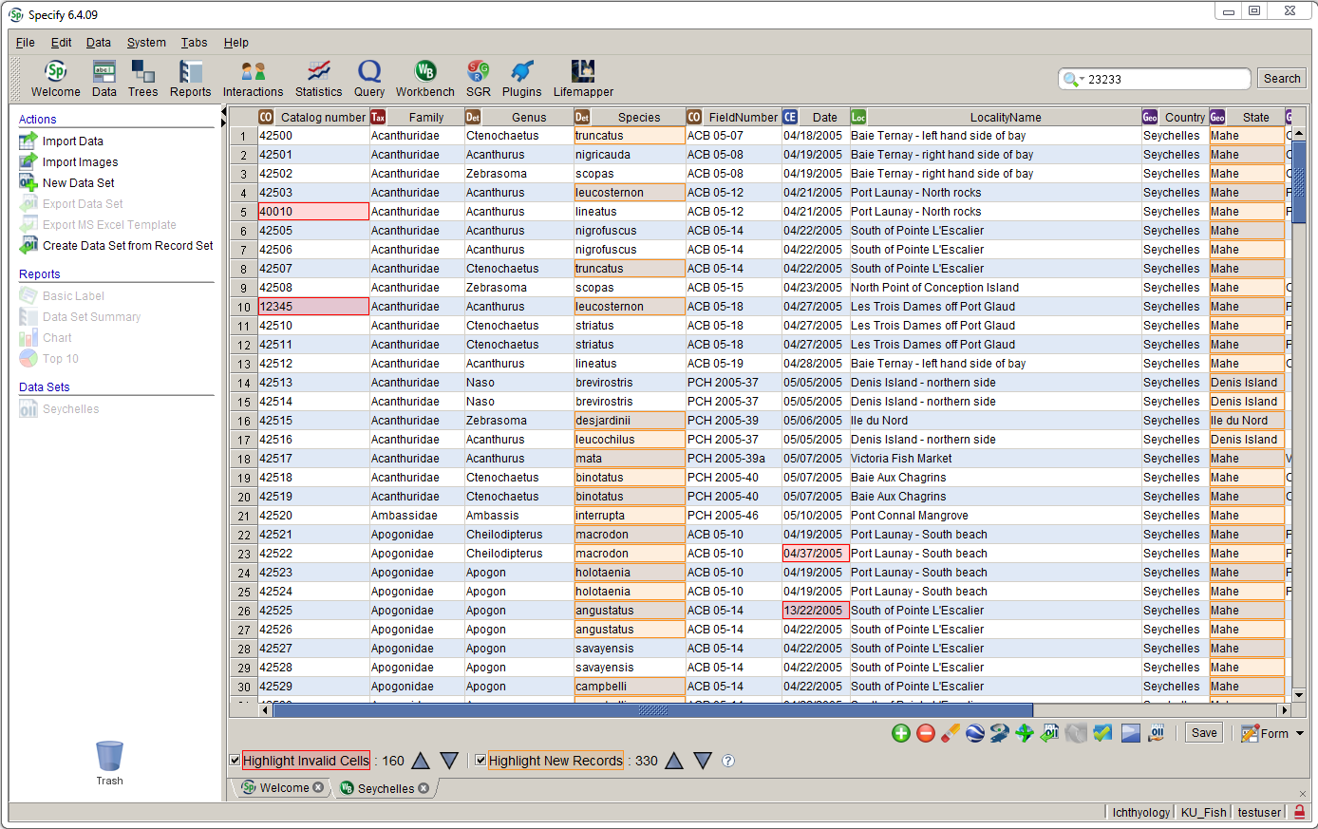
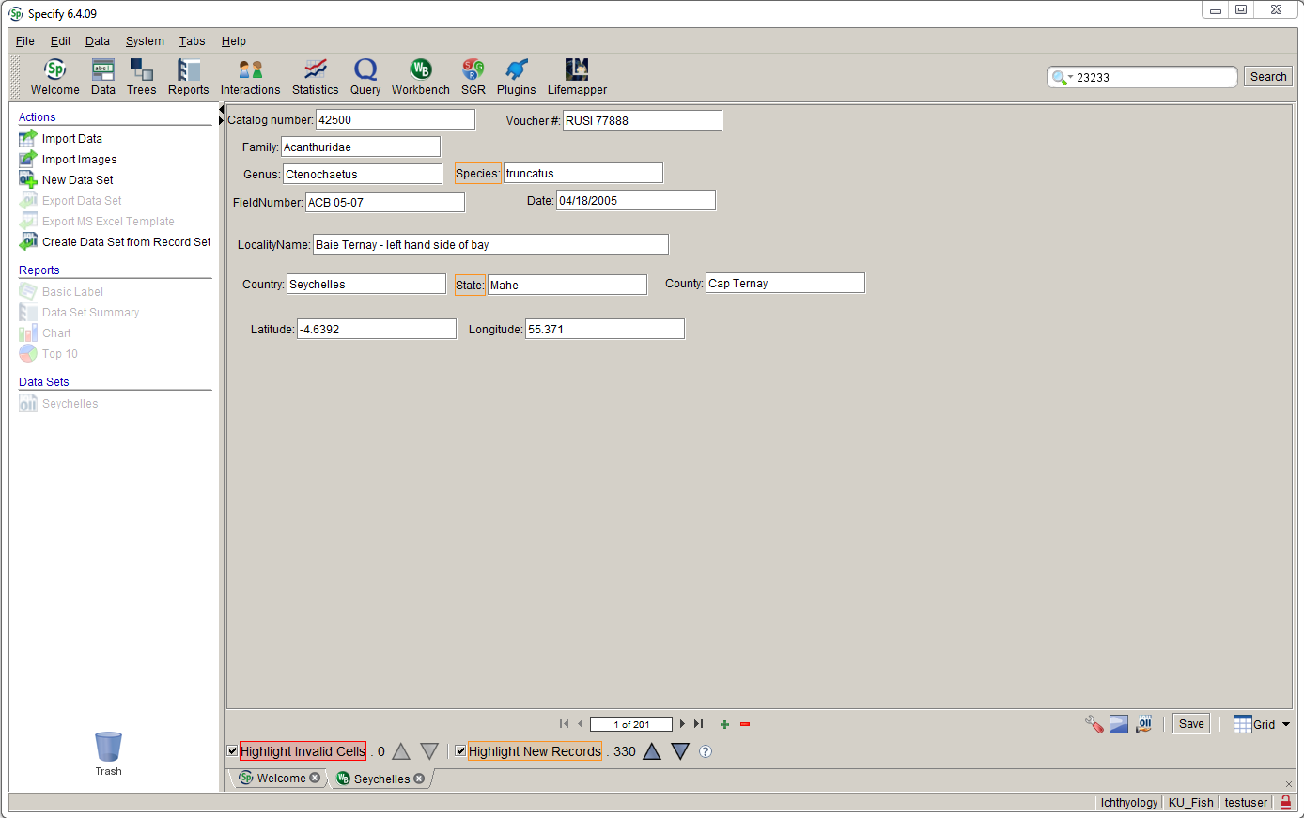
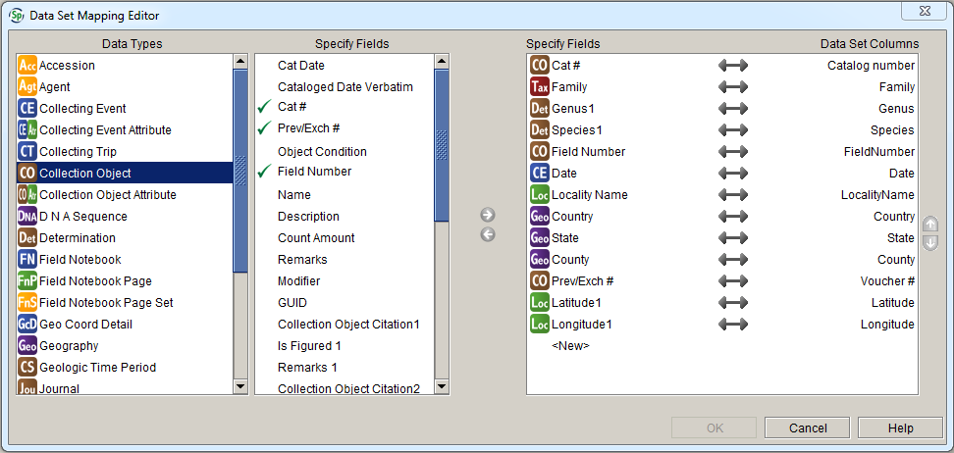
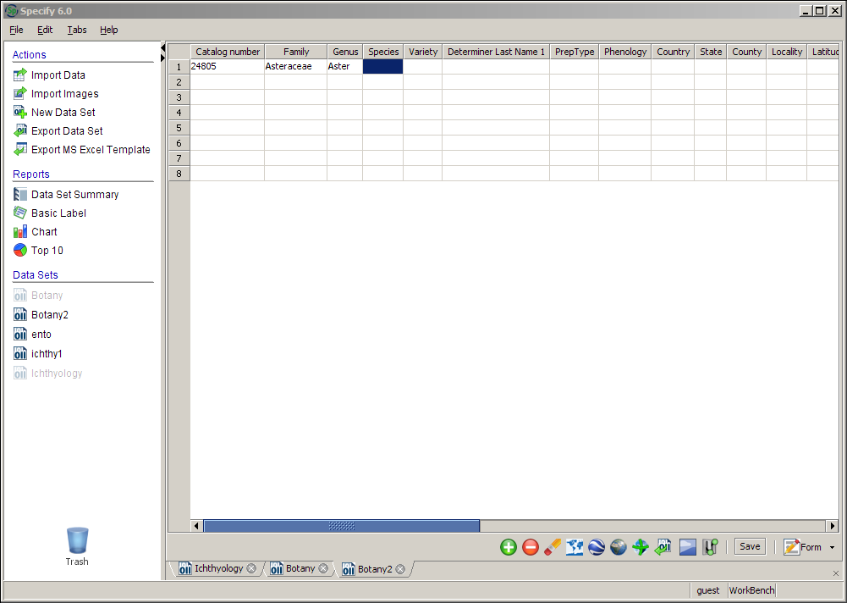
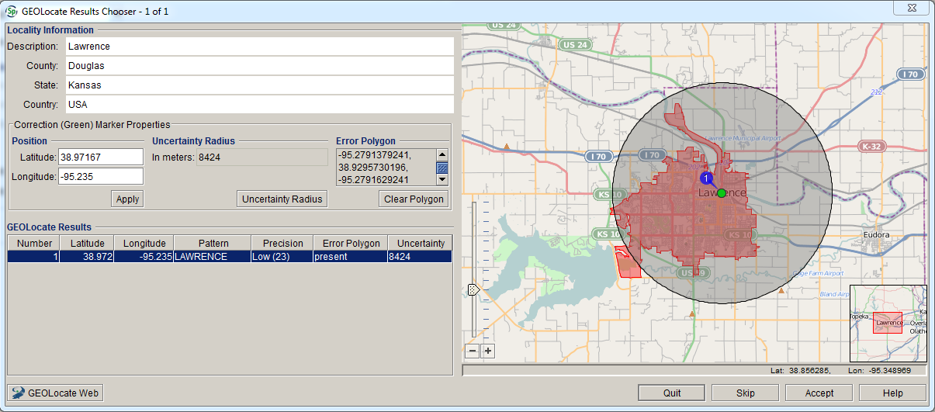
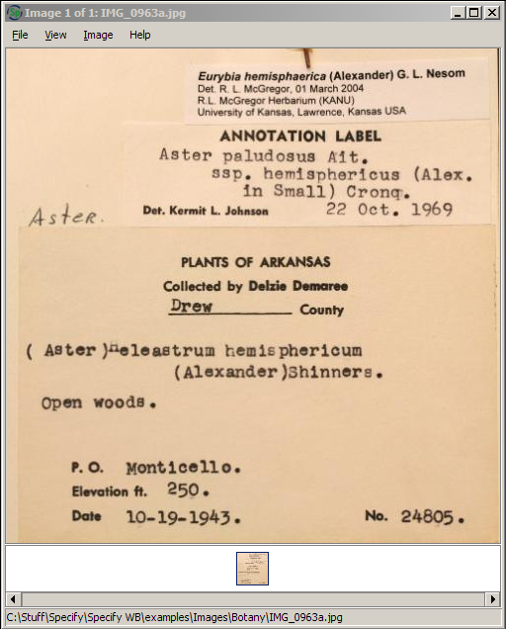
The Workbench
Allows for importing and mapping
of excel data for data manipulation
Form or grid data entry
Image association and workflow
Additional tools for data cleanup and manipulation – georeferencing and visualization
Upload
Stand-alone - no installation required – field application
Notes:
The WorkBench
Pre-release of data import tool now integral part of Specify 6
Allows for importing and mapping of excel data for data manipulation (and then re-exporting to Excel)
Form or grid data entry
Additional tools for data cleanup and manipulation – georeferencing, visualization and image association
Simple reporting
No installation required – field application

Slide 10
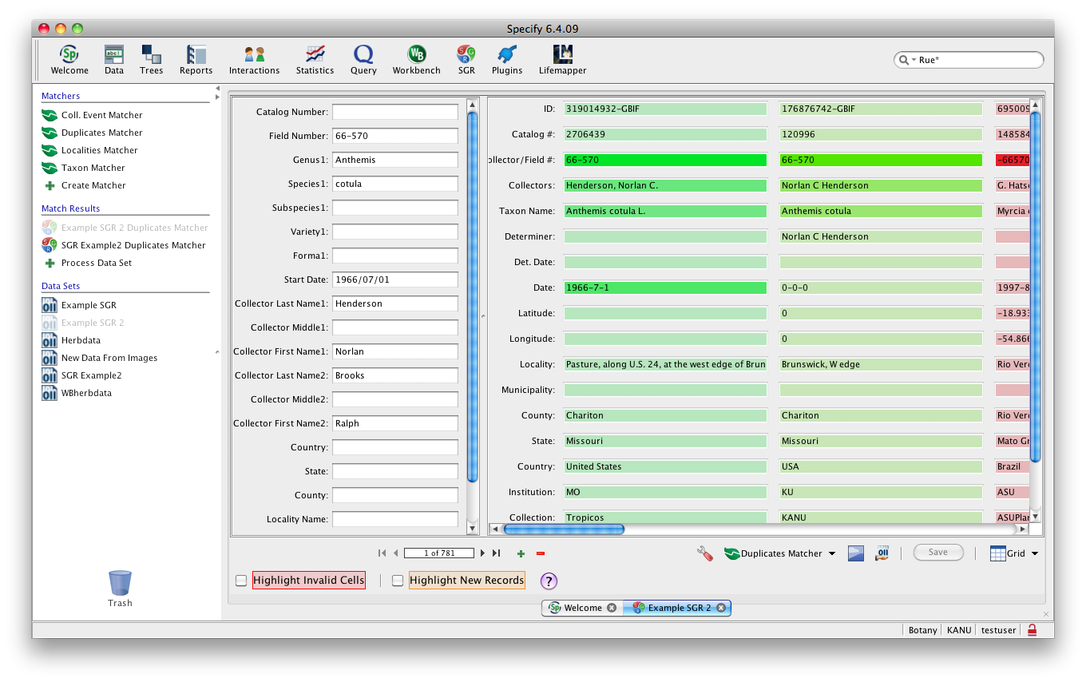
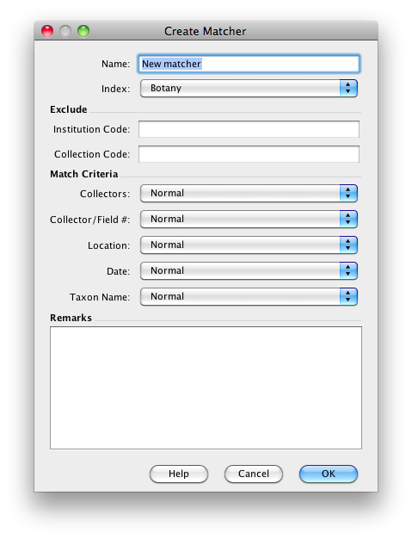
Scatter, Gather, Reconcile
SGR
Allows interrogation of existing data to facilitate databasing of duplicate material
Cache of GBIF herbarium data
32 Million records
Functions through the Workbench
Enter skeleton records
Create matcher and process data

Slide 11
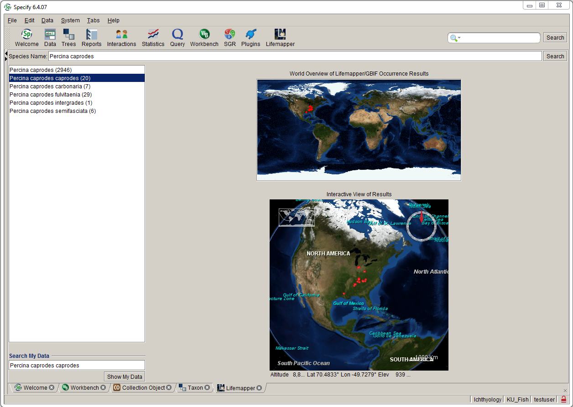
Lifemapper
http://www.lifemapper.org

Slide 12
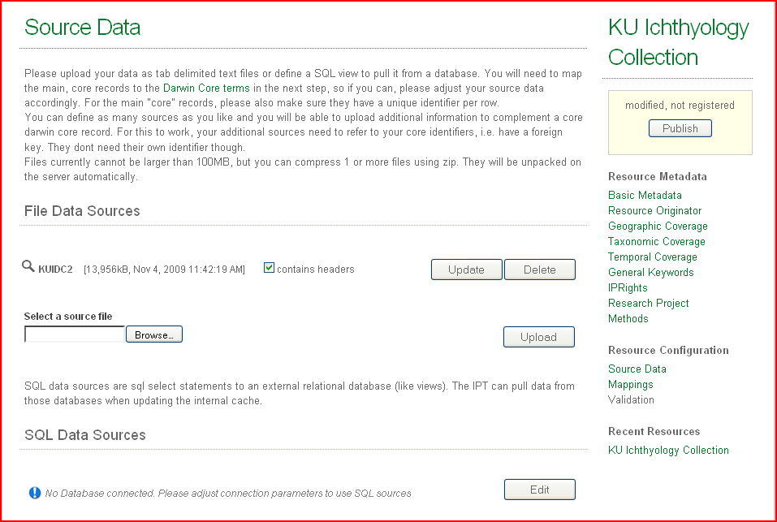
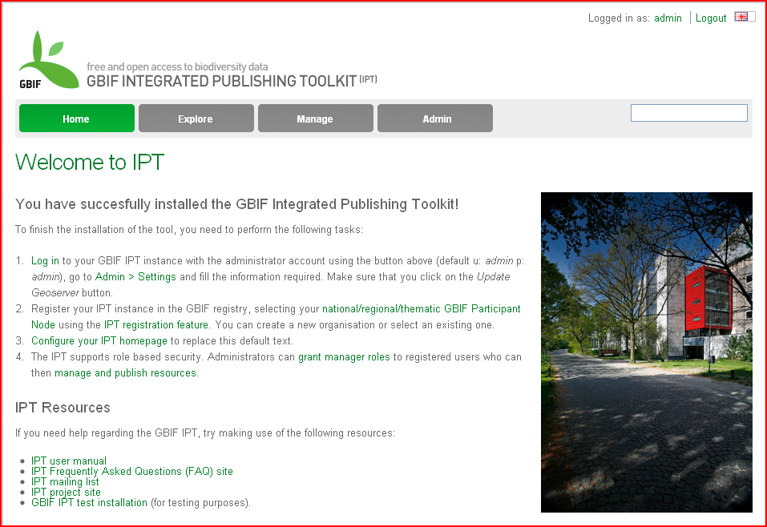
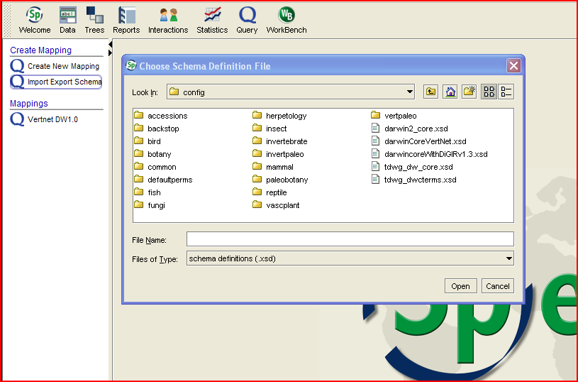
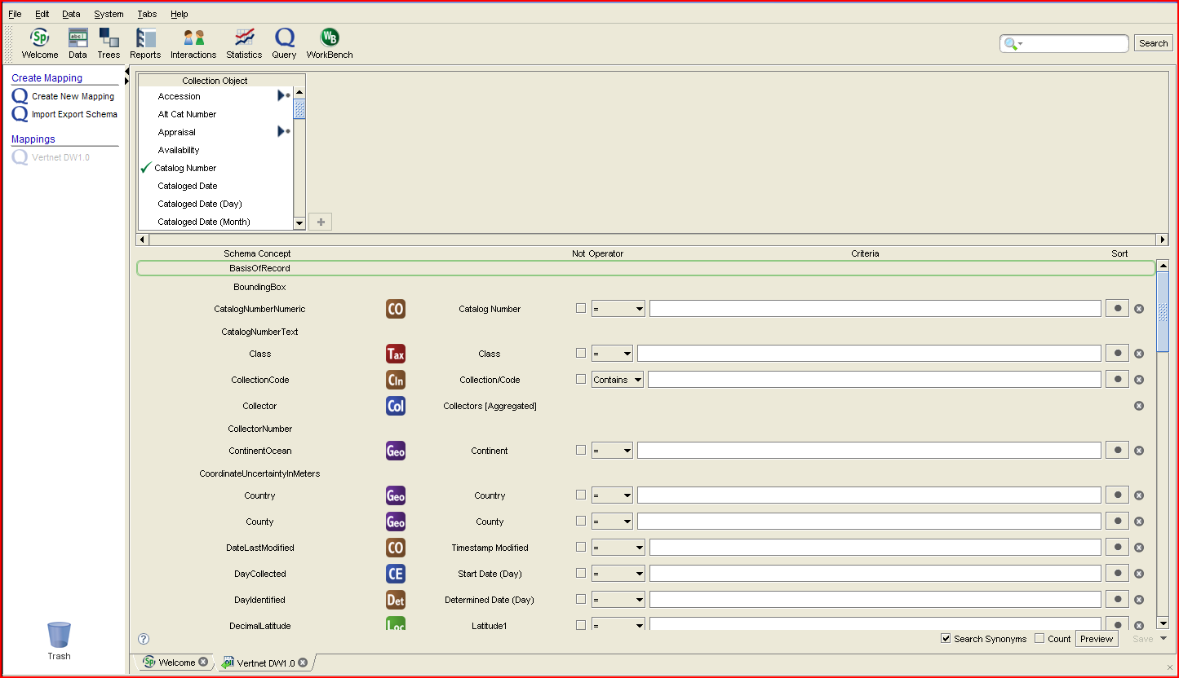
GBIF IPT
Leveraging GBIF IPT client
http://ipt.gbif.org/index.html
Selection of Darwin Core version and mapping of DC concepts
Export of data to CSV file
Import to IPT browser based client
Generation of IPT provider and publishing to GBIF and other portals
Notes:
Web and TAPIR access
Leveraging GBIF IPT client
http://ipt.gbif.org/index.html
Auto mapping of Darwin Core concepts
Mobilization of data through IPT provider
Generation of TAPIR address for portal/provider interaction

Slide 13
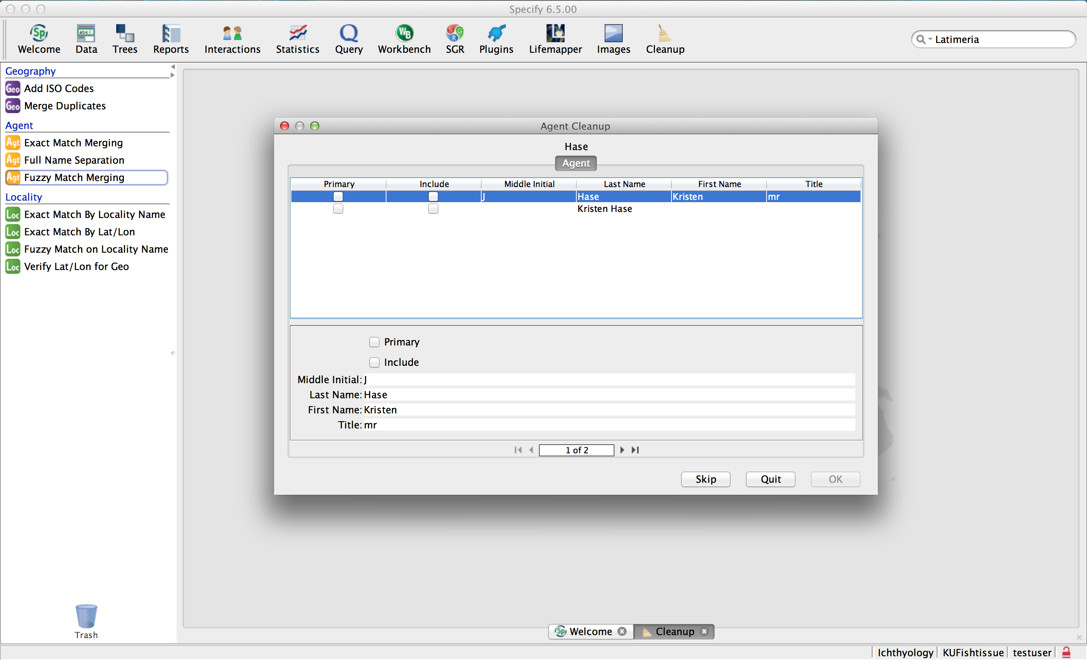
Data cleanup tools

Slide 14
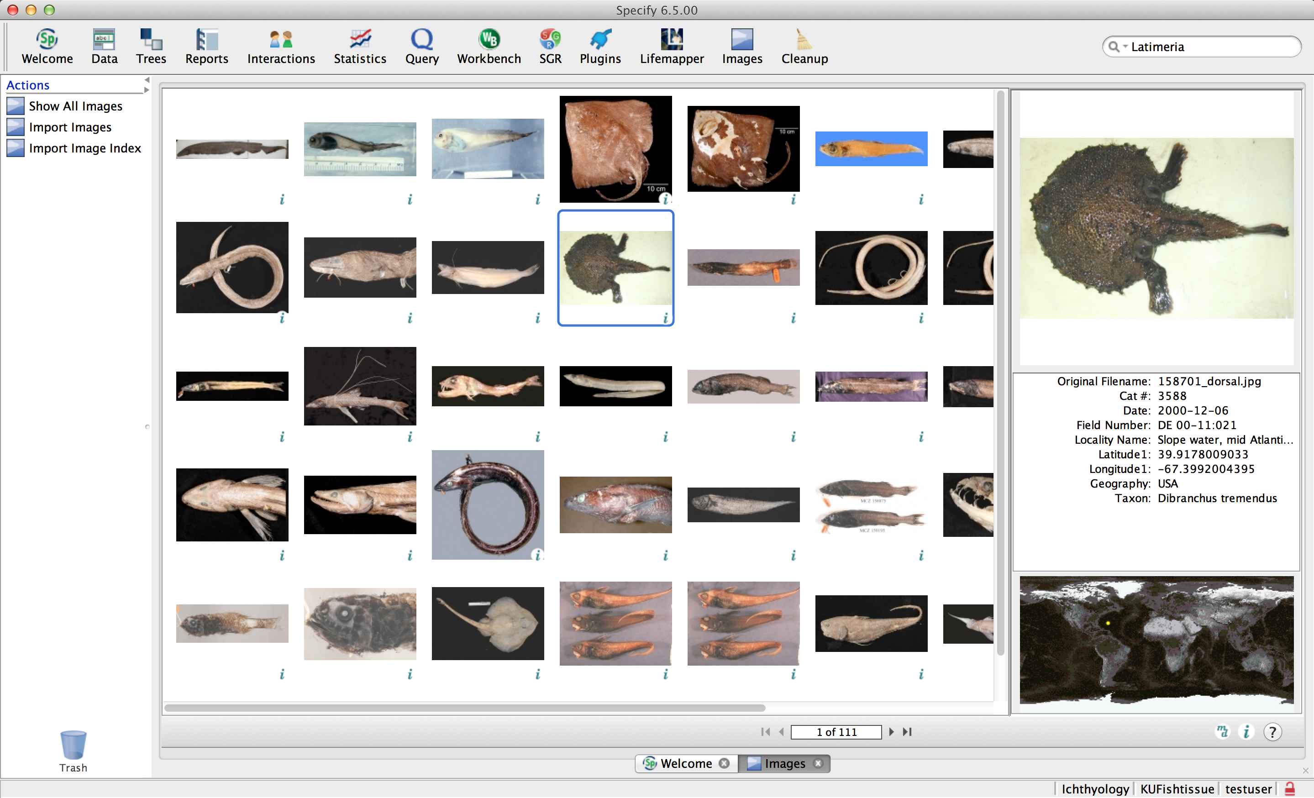
Image browsing and import

Slide 15
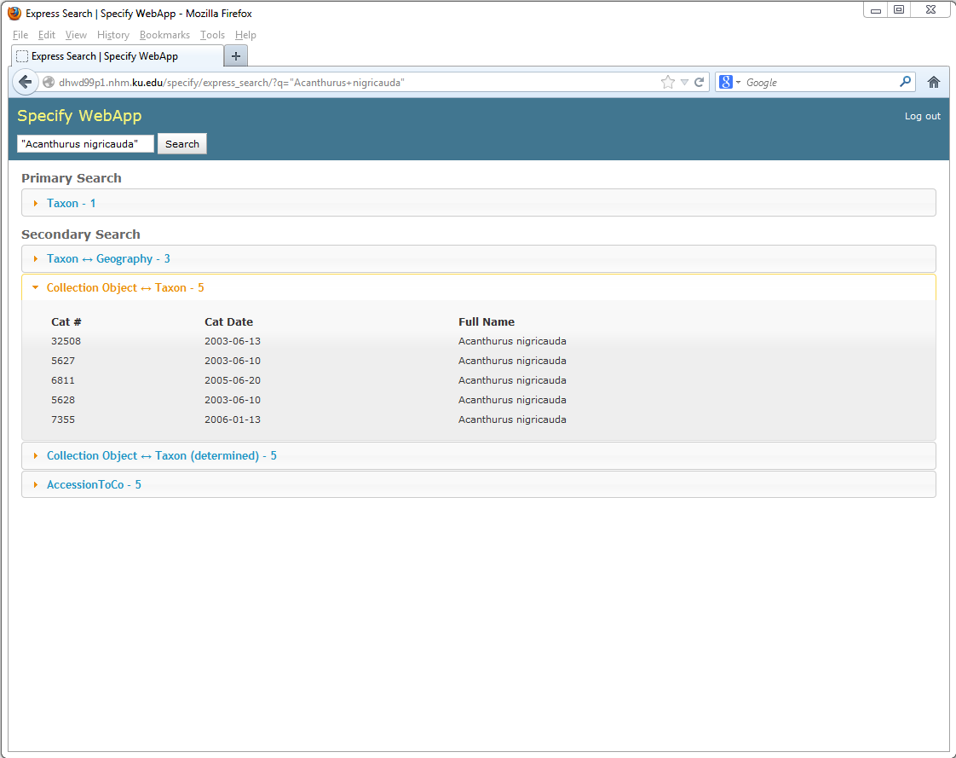
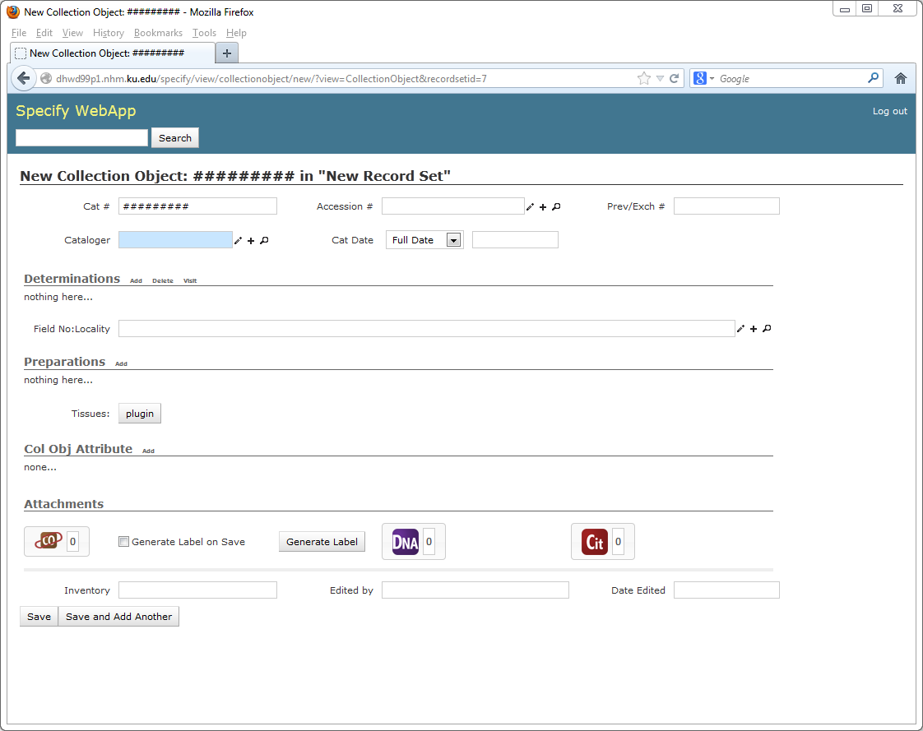
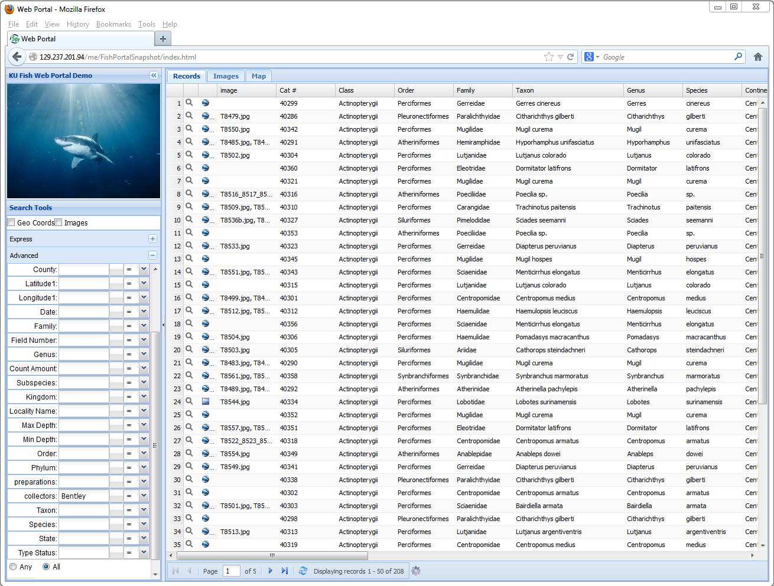
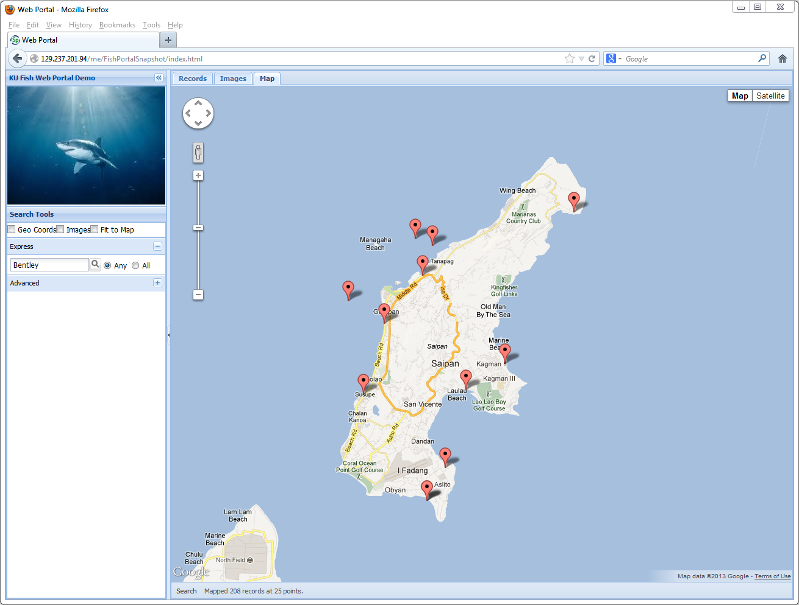
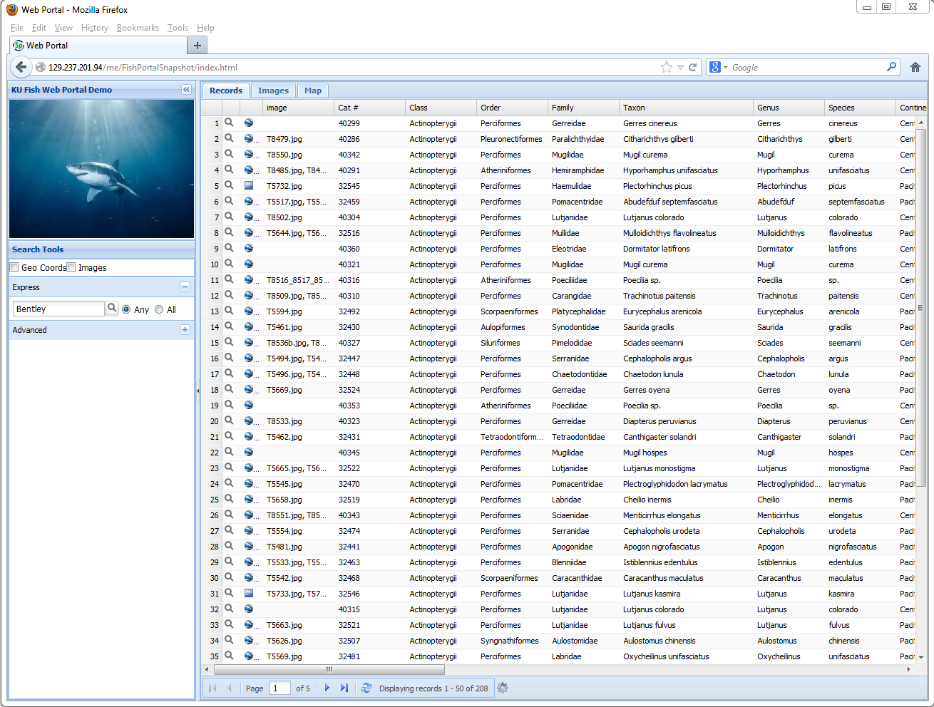
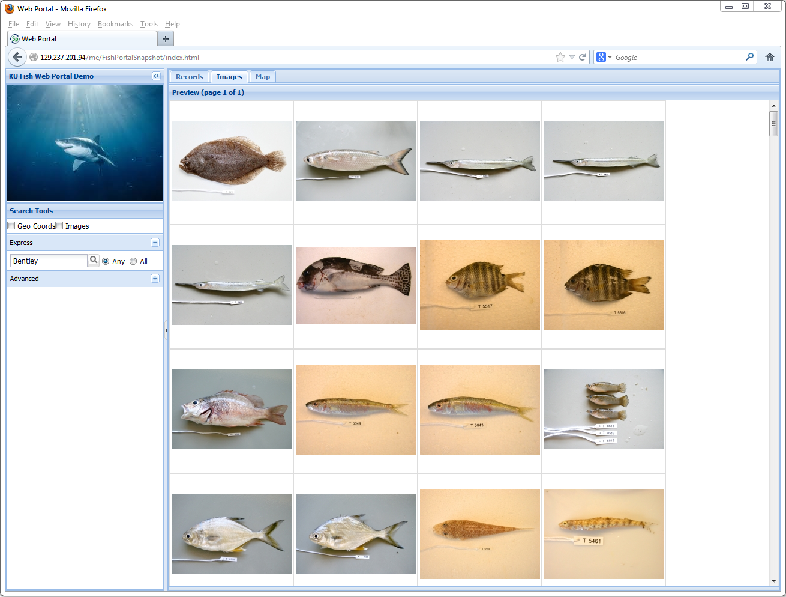
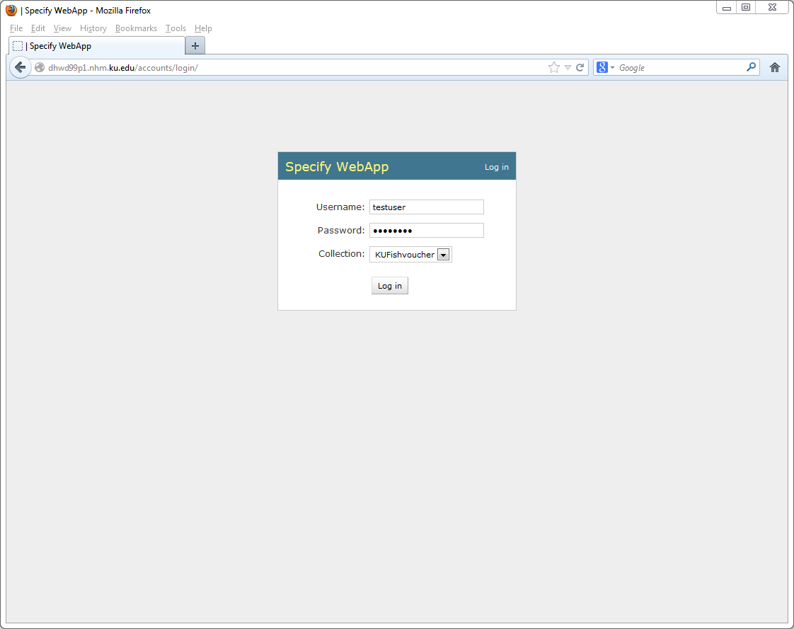
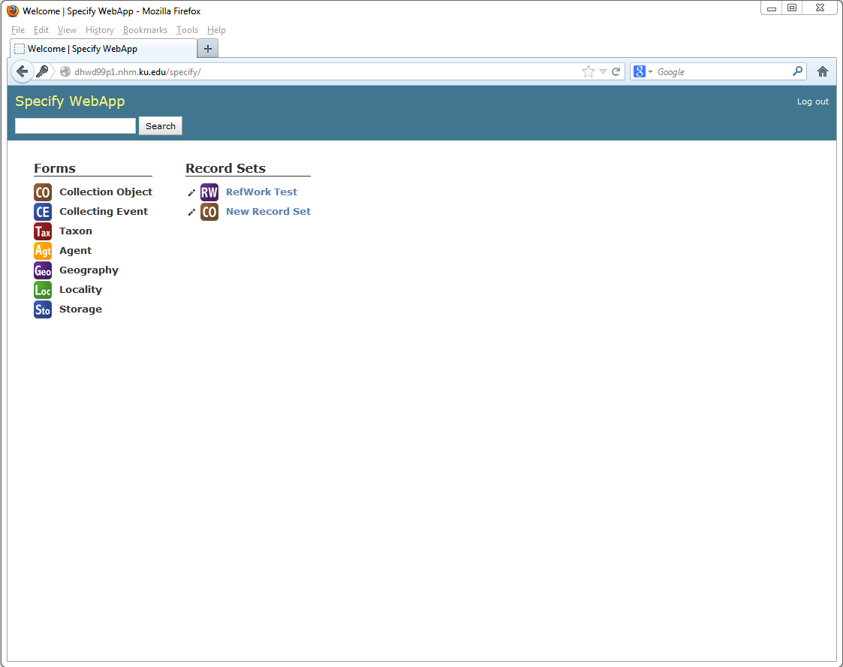
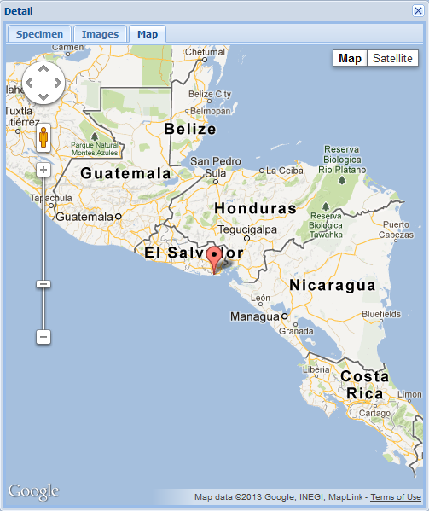
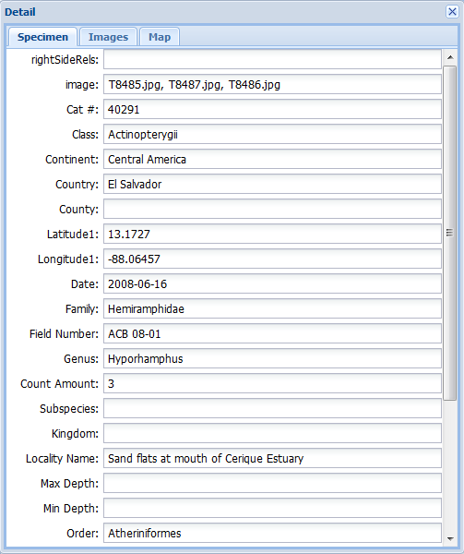
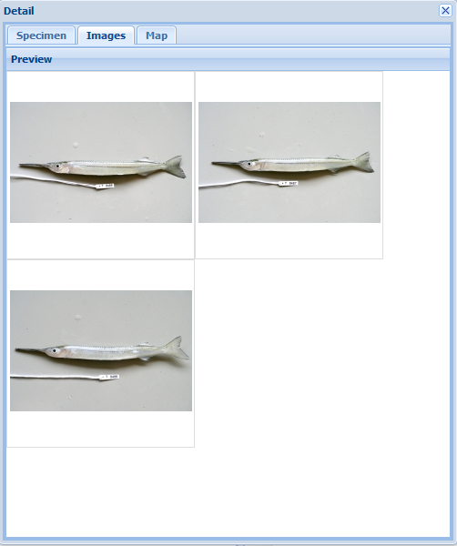
Move to the web
Browser based web portal
High performance, full text indexing for express and advanced search, browsing, mapping and images, multiple collections
Browser based thin client
Full browser based version with all capabilities
Mobility, portability, collaboration and hosting (cloud, Specify and other institutions).
Still in development and not yet available

Slide 16
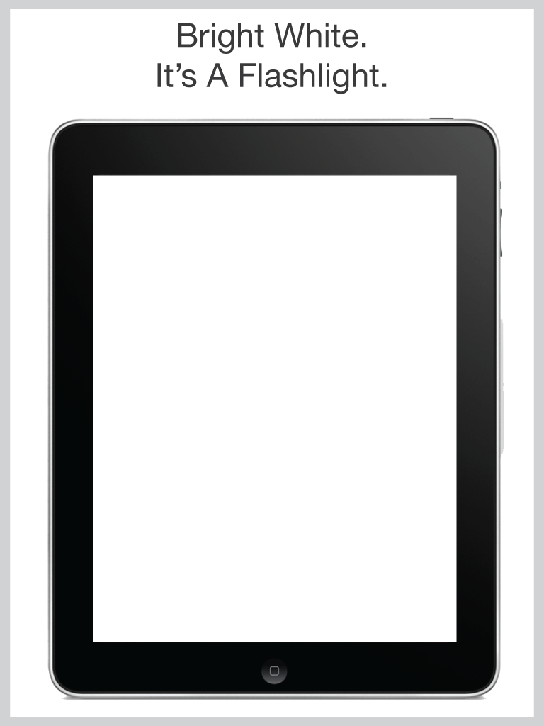
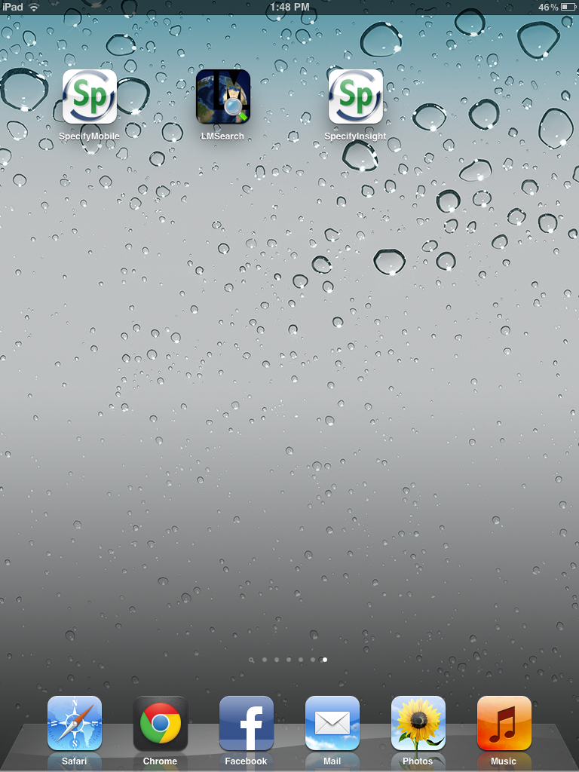
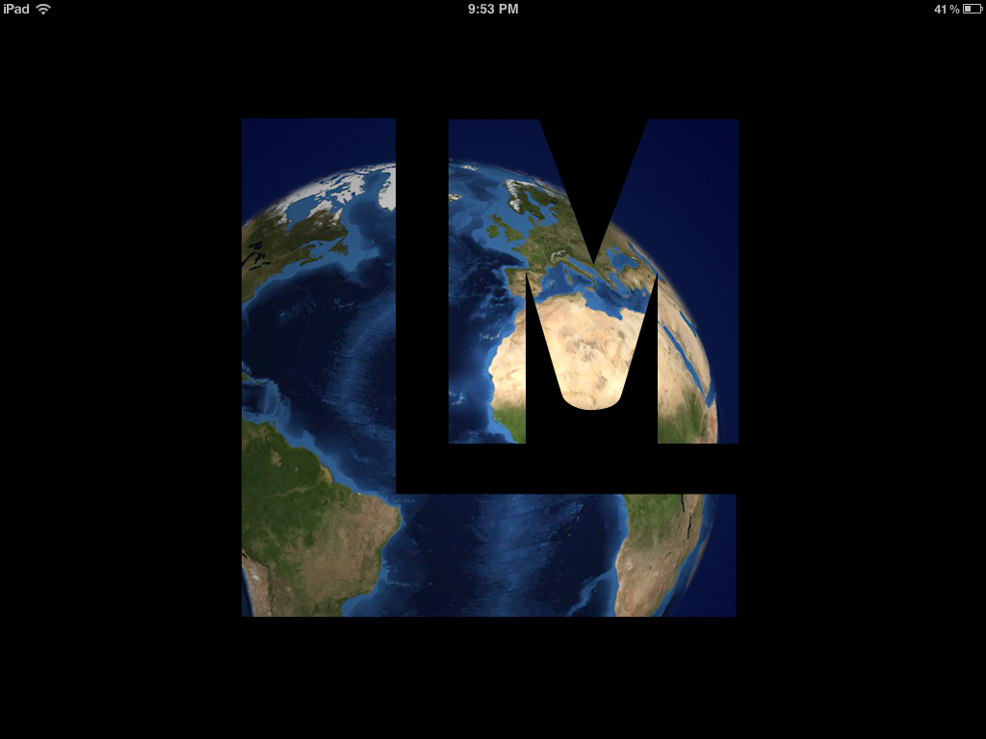
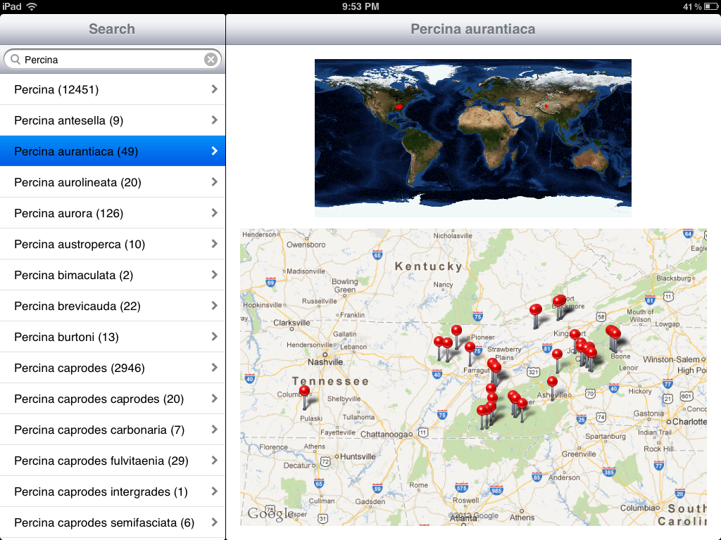
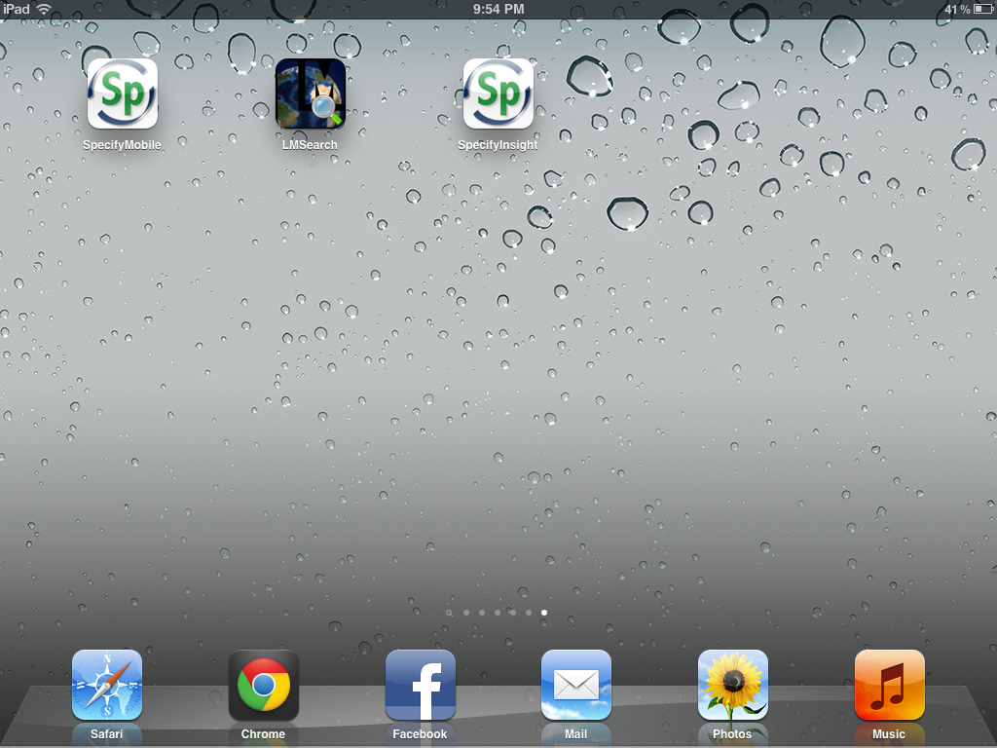
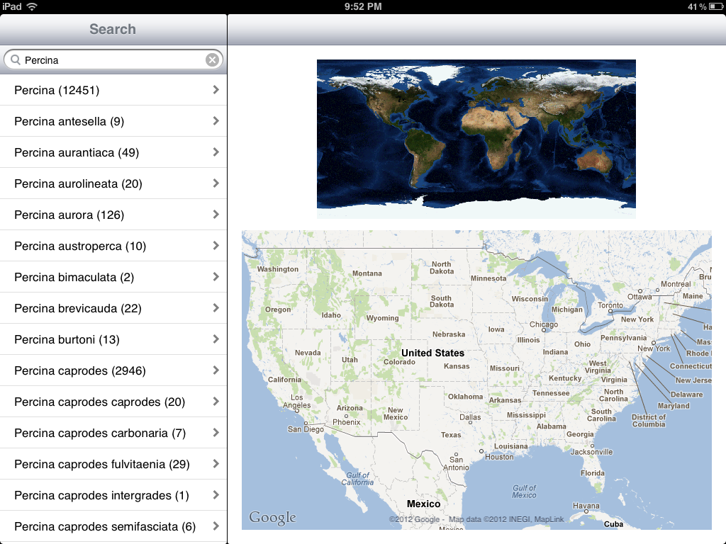
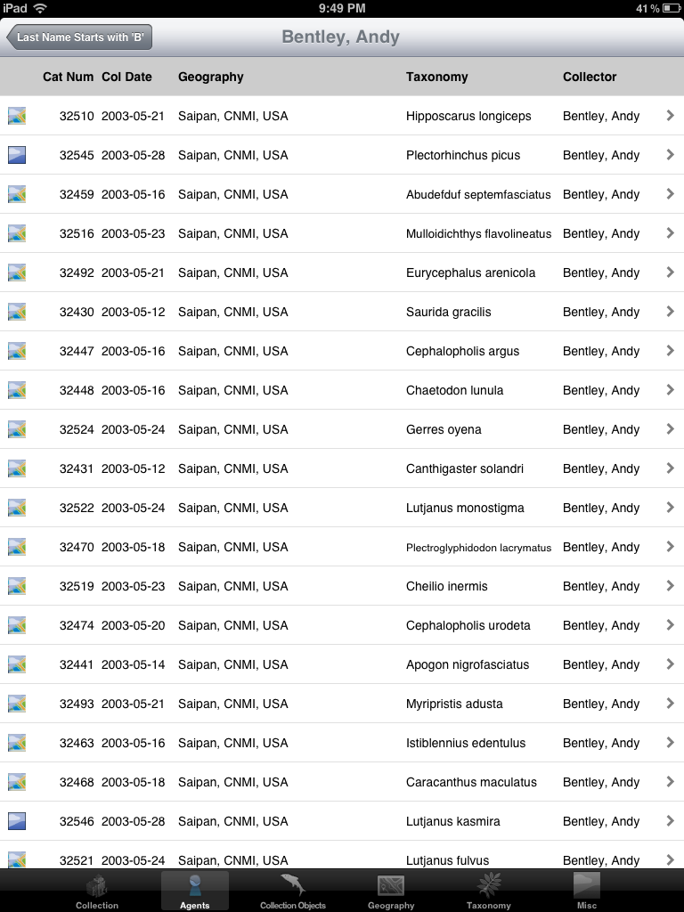
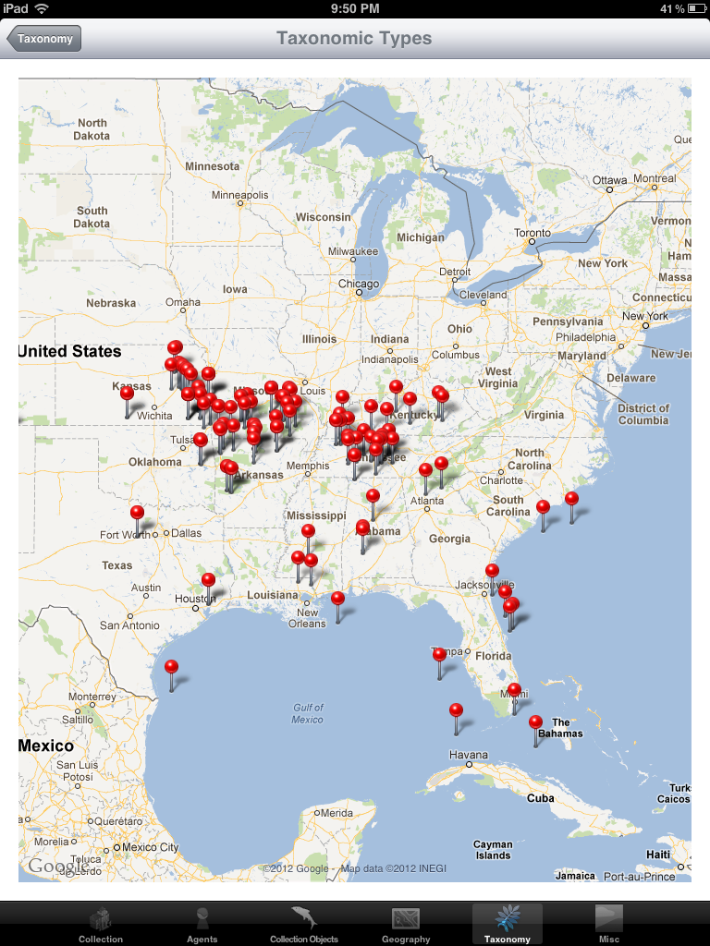
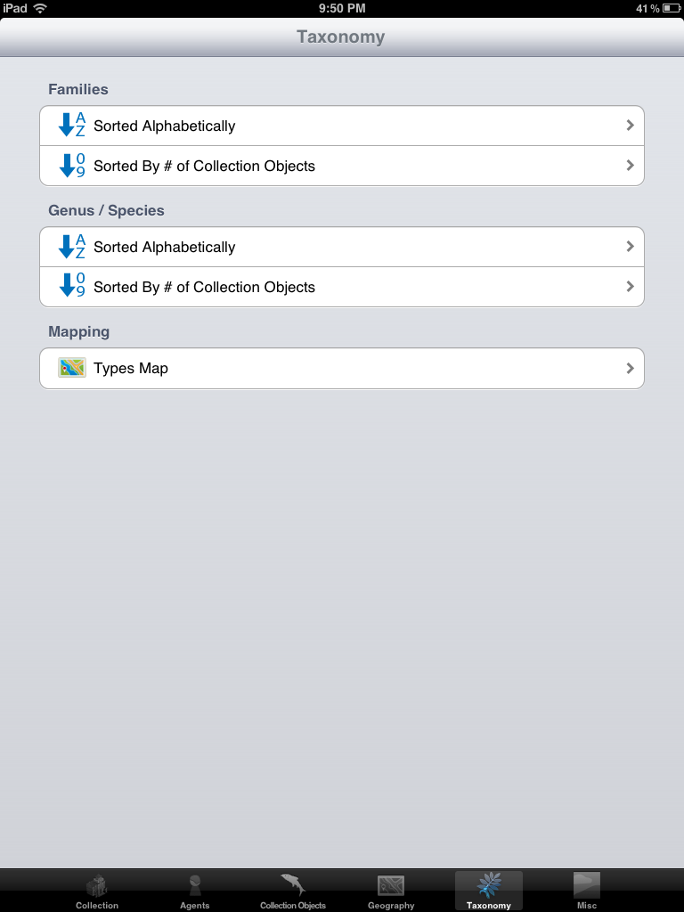
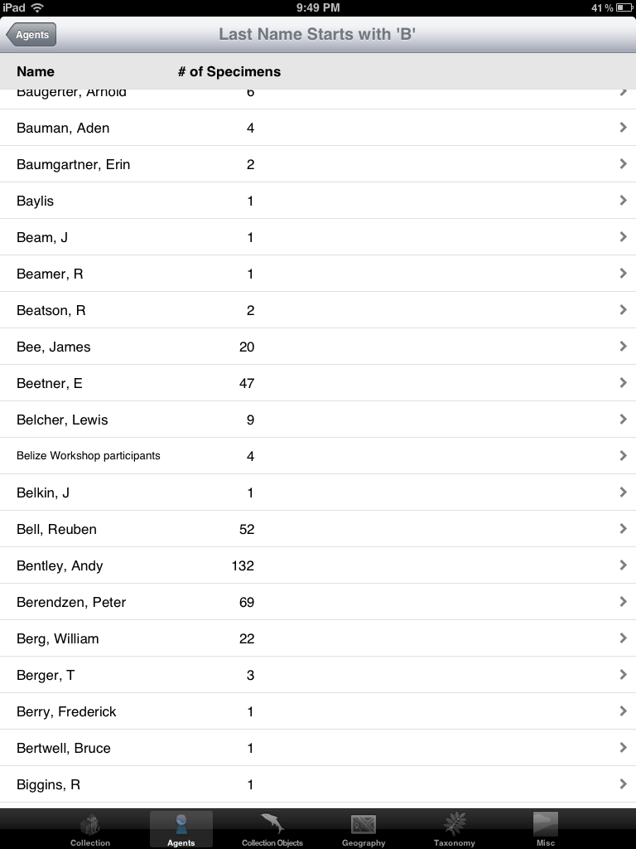
iPad applications

Slide 17
Thank you

