Slide 2
Yale University Library
Michael Friscia
Manager, Digital Library Programming Services

Slide 3
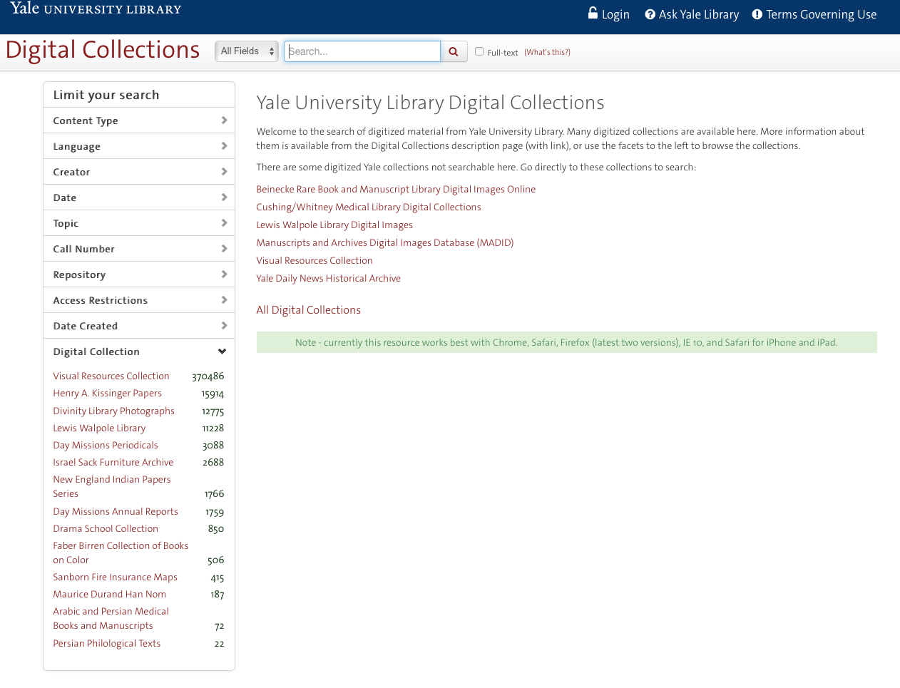

Slide 4
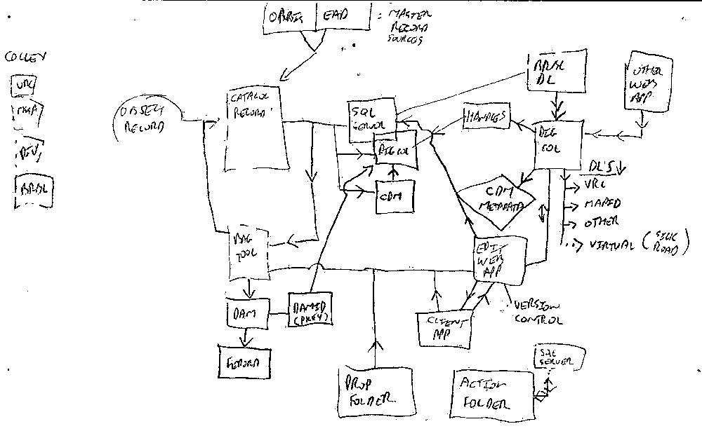

Slide 5
Create Digital Stuff
Put It Somewhere
Discover
It

Slide 6
Digital Object Creation
Digitization
Metadata creation/import
Digital file staging
Complex object design
Access conditions

Slide 7
Simple Object Design
Master TIF
JPG
Image
Access
JP2
Metadata

Slide 8
Complex Object Design
PDF
Book
Master TIF
Metadata
JPG
Page 1
Access
JP2
Access
Page 2
OCR
Page 3
Metadata

Slide 9
Hierarchical Objects
Structure
Description
Technical
ZIP
TIF
JPG
Access
JP2
OCR
Excel
MOV
MP4
*

Slide 10
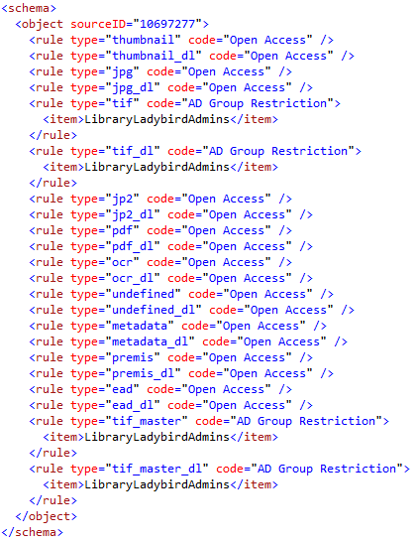
Access Conditions
Digital Object = 1 or more files
Files Require Access Controls:
  Open Access
  Yale Community
  IP Whitelists / Named Computers
  Active Directory Groups / Users
  User registration
  Embargos
  Staff only
  Staff mediated access
  No Access

Slide 11
Create Digital Stuff
Put It Somewhere
Discover
It

Slide 12

What is Hydra?
A framework for repository-powered applications, with
  multiple, tailored UIs, and a
  robust repository back end
A set of solution bundles
      One body, many heads
A community of more than 100 institutions
If you want to go fast, go alone.
If you want to go far, go together.
www.ProjectHydra.org

Slide 13
Hydra at Yale
Fedora
  Open Source repository solution
  www.FedoraRepository.org
Blacklight
  SOLR Backed discovery interface
  www.ProjectBlacklight.org
SOLR
  Enterprise search platform
  Lucene.Apache.org/solr
Hydra
  Framework combines all of the above
  www.ProjectHydra.org
www.ProjectHydra.org

Slide 14
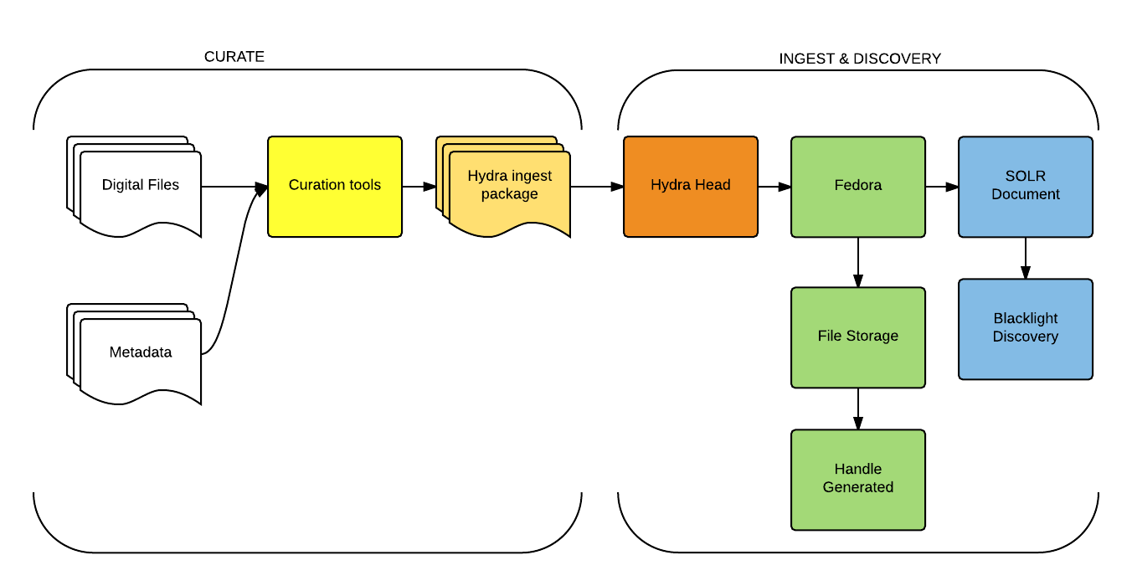
Workflow at Yale

Slide 15
Create Digital Stuff
Put It Somewhere
Discover
It

Slide 16
Demo links
Book example:
http://findit.library.yale.edu/catalog/digcoll:33849
Simple Object example:
http://findit.library.yale.edu/catalog/digcoll:553469
Hierarchical Object example:
http://findit.library.yale.edu/catalog/digcoll:554296
FindIT: http://findit.library.yale.edu

Slide 17
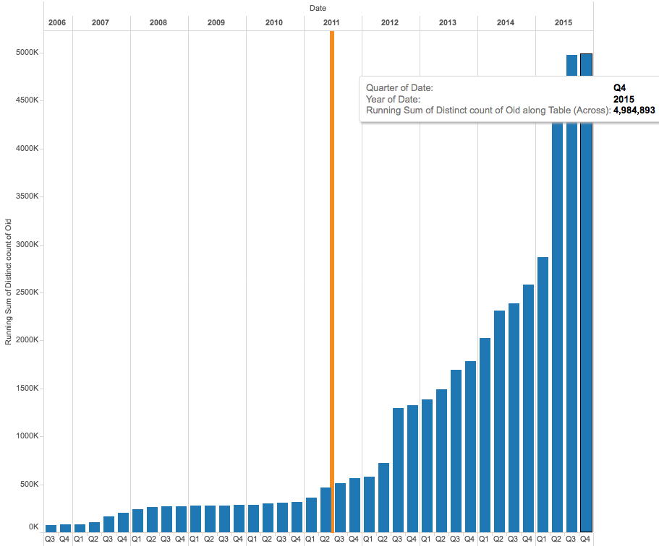
4,984,894
Catalog Records
394,297,374
Metadata Elements
340 GB of SQL Data
17 TB of Staged Content

Slide 18
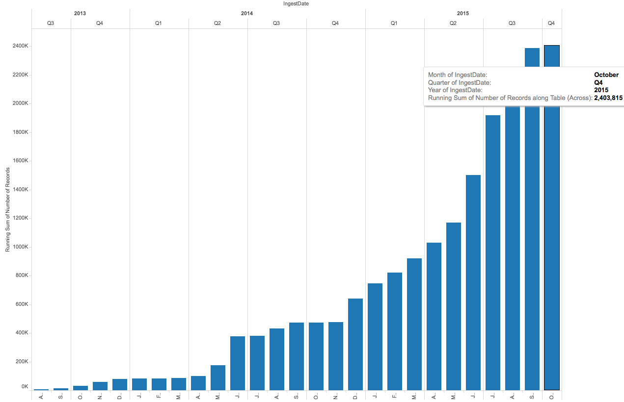
2,403,815 Digital Objects
120 TB of content stored
60+ TB of content on deck

Slide 19
Selection Considerations
Workflow/Business Process Management
Proven to scale to fits your needs
Used by peers
Vibrant user community
Vendor support for OpenSource development
Vendor flexibility, clear roadmap for purchased systems
Solution for auditing content
Accessibility/usability
Security
Exit strategy

Slide 20
Team Members, Partners & Collaborators
Matthew Beacom
Dominique Bourassa
Mary Caldera
Maureen Callahan
Sarah Coe
Lisa Conathan
Mark Custer
Osman Din
Steve DiSorbo
Arcadia Falcone
Mike Friscia
Ray Frohlich
Kevin Glick
Rebecca Hirsch
Eric James
Yue Ji
Cliff Johnson
Tracy MacMath
Scott Matheson
Anju Meenattoor
Youn Noh
Jenn Nolte
George Ouellette
Bob Rice
Lakeisha Robinson
Steelsen Smith
Kalee Sprague
Kieko Suzuki
Steve Wieda
Melissa Wisner
Questions?

