Slide 1
Digital Asset Management Systems and Digital Preservation
Euan Cochrane – Digital Preservation Manager
Yale University Library

Slide 2
Digital Asset Management
“Digital Asset Management (DAM) consists of management tasks and decisions surrounding the ingestion, annotation, cataloguing, storage, retrieval and distribution of digital assets”
i.e. How you responsibly look after your valuable digital content assets

Slide 3
Long Term Digital Preservation (LTDP)
“The people processes and technology required to preserve digitally dependent content (information) through technological change”

Slide 4
Long Term Digital Preservation: Why?

Slide 5
Large and growing permanent digital collections in Yale’s Libraries
Digitized content
(Content with no viable physical master)
Fortunoff video archive
Rare preservation-digitized monographs from general collections
South Africa Now video archive
Miscellaneous digitized video from MSSA and Beinecke RBML
Audio archives
Born digital content
Authors’, politicians, artists, alumni’s digital archives
Digital Art
Architectural design files (CAD)
Email , databases, spreadsheets, documents, presentations
Software
Video Games
~1+ Petabytes
& growing

Slide 6
Digital Preservation Challenges

Slide 7
“Digital Information lasts forever or 5 years, whichever comes first”
Jeff Rothenberg. Scientific American, January 1995.

Slide 8
Notes:
Digital Preservation is about maintaining access to digital objects over time.
Digital objects are quite different to physical objects.
Obviously they have far fewer physical attributes. But they can be much more complex.
Most people in the field these days view digital objects as performances.
It is through the interaction of data files, with software and hardware that users get presented with information that they finally consume. Each part of these complex objects presents challenges to maintaining access to them over time.
We need to maintain the basic data files.
We need to overcome software obsolescence issues
We need to overcome hardware obsolescence issues.
We need to be able to provide access to the final objects and ensure that they are discoverable.

Slide 9
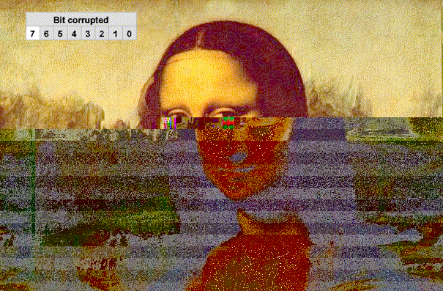
Digital Preservation Challenge: Bit-preservation

Slide 10
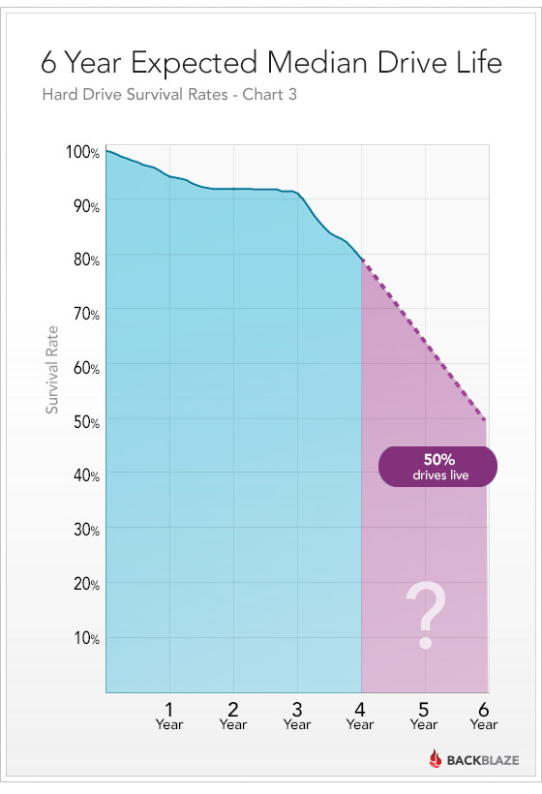
Digital Preservation Challenge: Hardware failure

Slide 11
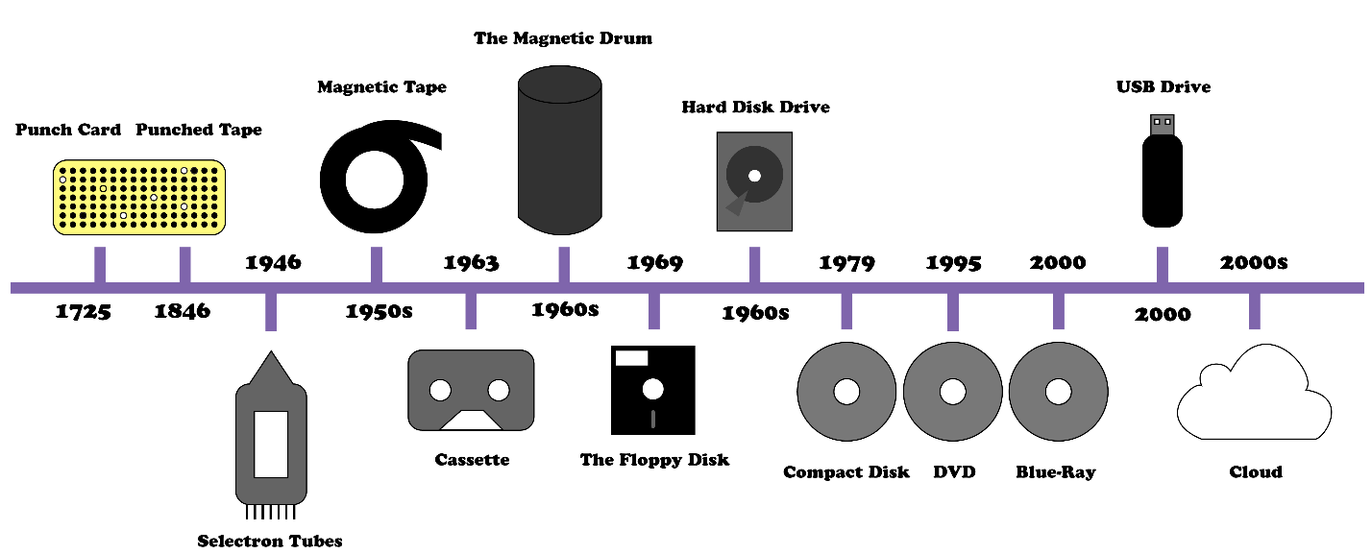
Digital Preservation Challenge: Hardware Obsolescence

Slide 12
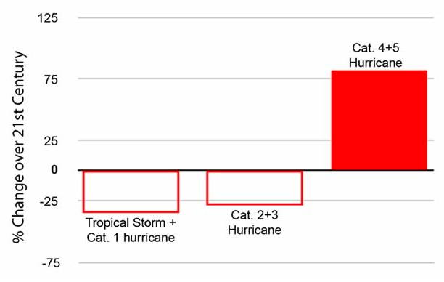
Digital Preservation Challenge: Natural Disasters

Slide 13
Digital Preservation Challenge: Software Obsolescence

Slide 14
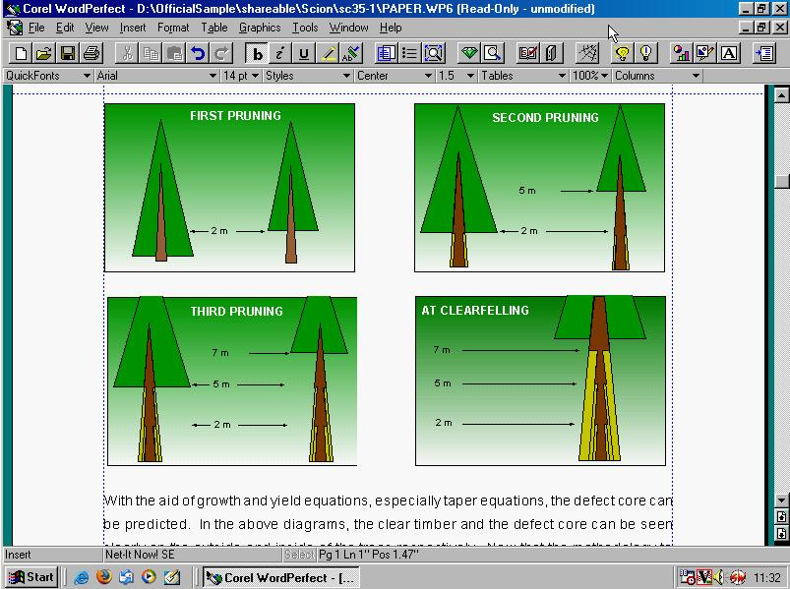
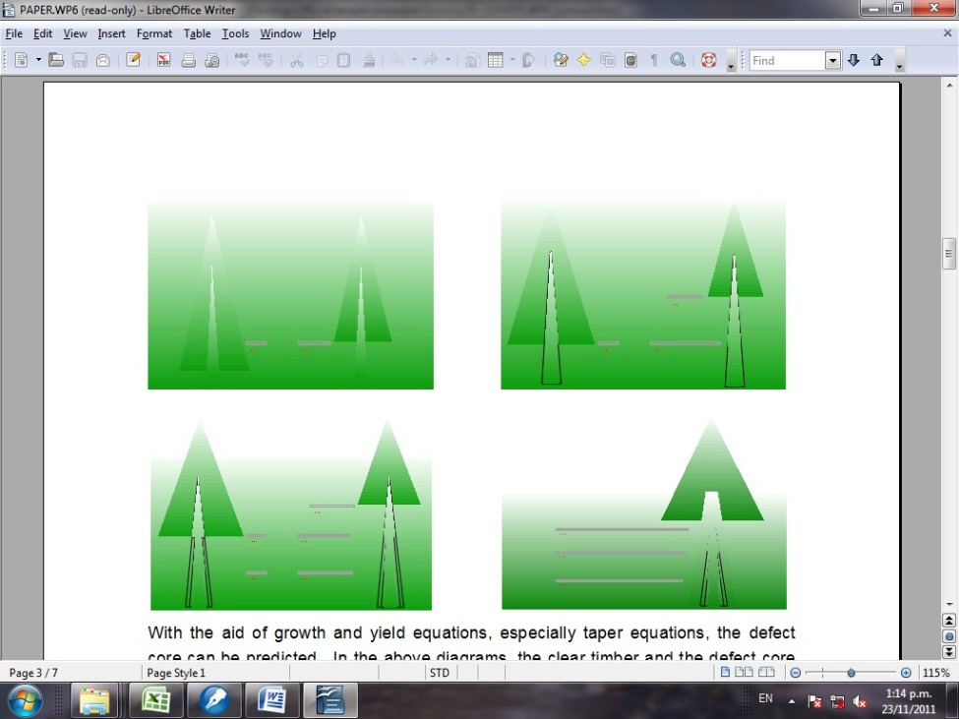
Old software is required to authentically render old content
Original content in original software (WordPerfect in Windows 95)
Original content in newer software (LibreOffice Writer in Windows Vista)

Slide 15
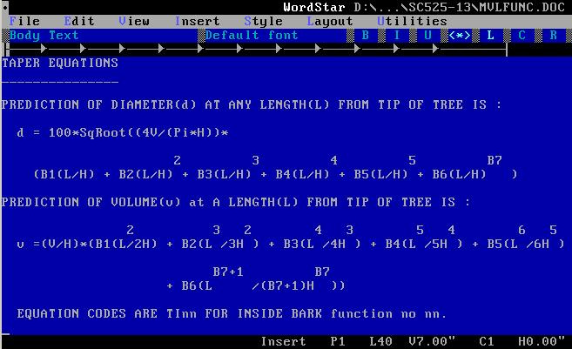
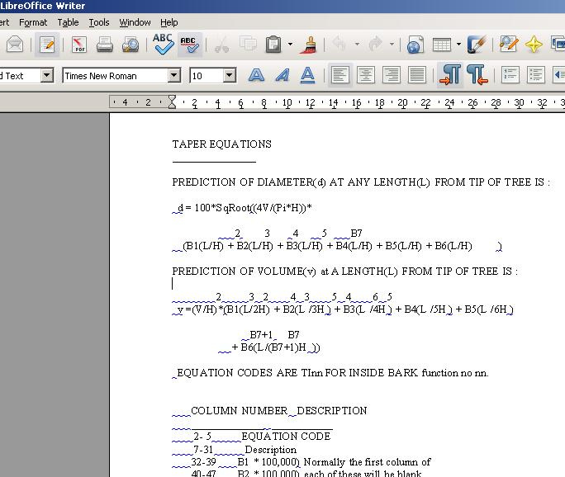
Research results are at risk of loss without original software
Original content in original software
(WordStar for DOS in Microsoft DOS)
[NB: equation predicting tree growth rates includes exponents documented using upper line of text]
Original content in newer software
(LibreOffice Writer in Windows Vista)
[NB: equation layout and meaning changed]

Slide 16
Addressing the challenges: Establishing LTDP functions at YUL
Bit Preservation
Obsolescence Monitoring
Authenticity and Integrity Assurance
Automated Migration at Scale
Hardware
Archiving
Software Archiving
Emulation at Scale

Slide 17
Digital Preservation System Needs
Centralized digital asset management & reporting
Provide LTDP functions
Trustworthy & secure
Auditable
Scalable
Flexible
Clear exit strategy

Slide 18
Benefits of Preservica

Slide 19
Preservica System Benefits
Centralized, reliable, management & reporting for digital content
Open APIs
Yale controls data storage technology
Content stored unencumbered
Clear exist strategy
Secure & Trustworthy
Auditable
Scalable
Flexible
Open metadata documentation

Slide 20
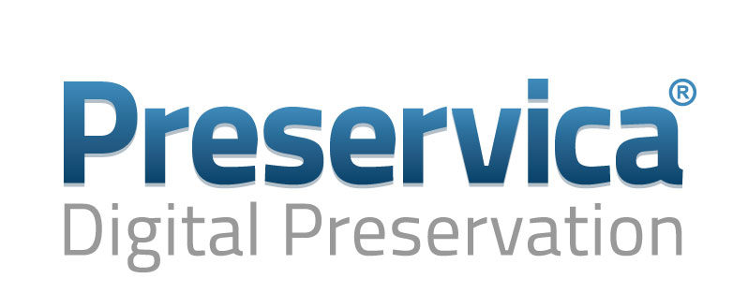
Preservica Provides Long Term Digital Preservation Functions
Bit Preservation
Obsolescence Monitoring
Authenticity and Integrity Assurance
Automated Migration at Scale
Hardware
Archiving
Software Archiving
Emulation at Scale

Slide 21
Relevant Preservica features
Digital asset management
Authenticity assurance
Bit Preservation & storage management & reporting
Format identification, characterization and analysis
Preservation planning
Obsolescence monitoring
Content agnostic (accepts everything)
Scalable
Configurable and customizable ingest workflows
Multiple access/discovery options and APIs
Security – comprehensive data tracking and auditing.
Storage flexibility – content can be tagged at any level for storage on specific set of infrastructure (e.g. differentiate storage of low value vs high value content).

Slide 22
Long Term Digital Preservation Storage Infrastructure
Automated integrity checking & Reporting
Storage rules assigned to submission packages
Automated Routing based on storage policies
Hard Drive Infrastructure
(Yale ITS)
Preservica Interface
Ingest Mechanisms
Tape Infrastructure (YUL IT)
Cloud
(Amazon/Oracle)

Slide 23
Demo
(time permitting)

Slide 24
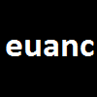
Thank you
Euan Cochrane
Digital Preservation Manager
Yale University Library
New Haven, CT
E euan.cochrane@yale.edu
P (203) 432 1721
http://twitter.com/euanc

