Slide 1
Practices, standards, and data infrastructure for digitization
iDigBio Paleocollections Workshop,
27-28 April, 2012
Reed Beaman
Florida Museum of Natural History
University of Florida

Slide 2
Computer Science
Experimental Biology
Biological Informatics
Information Technology
Analysis & Visualization

Slide 3
Distributing data
FLMNH
Web
Geospatial services
WCS, WMS, WFS
RESTful Services
FLMNH Database
iDigBio
DiGIR-esque
Paleo-portal
IPT
BiSciCol
Vertnets
GBIF
FishNet

Slide 4
Notes:
Add EXIF

Slide 5
XKCD on Standards

Slide 6
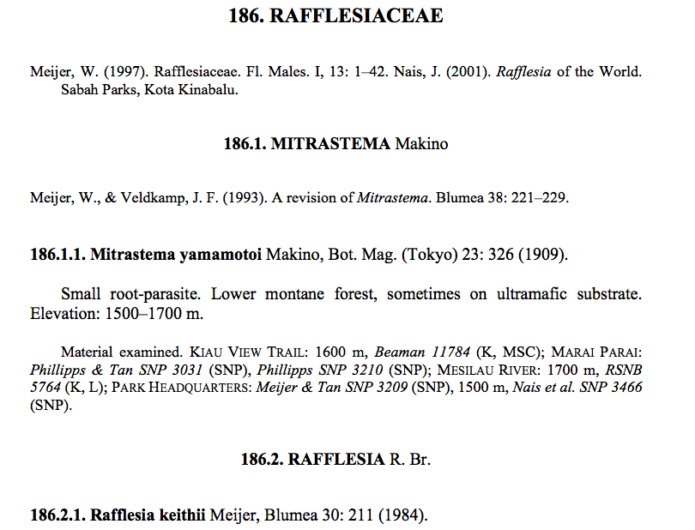
Standards predicated on use
Data discovery
Data sharing, interchange, and [distributed] access
Web publication
Collections management
Formal publication
Accessibility
Differing levels of interoperability
Controlled vocabularies
Dictionaries

Slide 7
Darwin Core
Ratified TDWG standard, updated irregularly
Vocabulary and Concept definitions for organism
Based on Dublin Core terms and principles
Implementation independent
http://rs.tdwg.org/dwc/
http://code.google.com/p/darwincore/
Darwin Core Classes
Record-level Terms
Occurrence Terms
Event Terms
GeologicalContext Terms
Location Terms
Identification Terms
Taxon Terms
ResourceRelationship Terms
MeasurementOrFact Terms
Type Vocabulary Terms

Slide 8
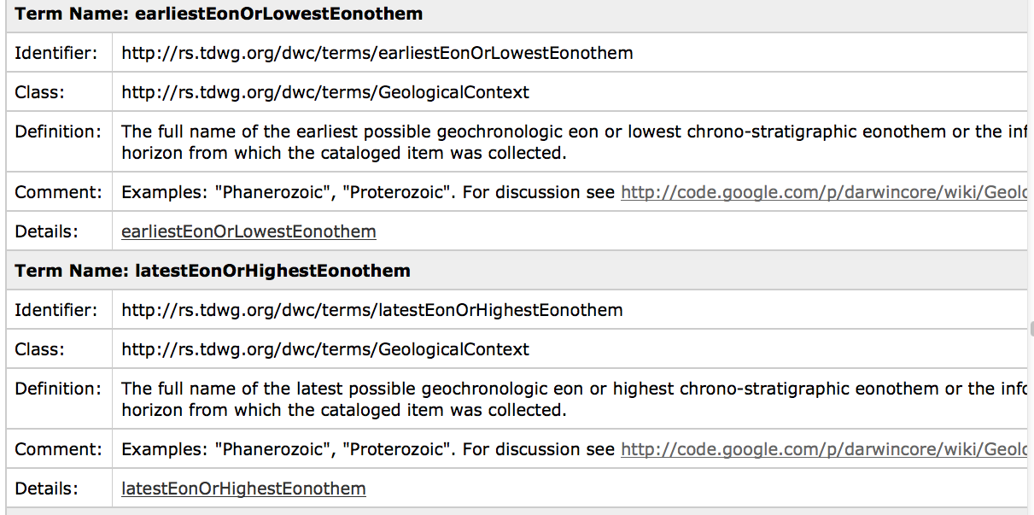
Darwin Core in plain English

Slide 9
Beyond biodiversity
Generic digital resources – e.g., images files, library books, satellite images
Initially core metadata for simple and generic resource descriptions
Recent focus on application profiles –
specialized vocabularies (e.g., Darwin Core) can use Dublin Core to meet particular implementation requirements.

Slide 10
Flexible approaches to interoperability
Representation
Implementation
Communication
Tab delimited
Event 1
Event 2
HTTP
Specimen a
Specimen b
CSV
JSON
XML
SOAP
RDF
Fedex
Collectors x, y, z
Carrier pigeon
RDBMS
Darwin, Dublin, Adubon Cores
NoSQL
Vocabulary, attributes, relationships
Payload
Protocols

Slide 11
Representation: Implementation and communication independent
Need to understand
Vocabulary
Attributes and concepts
Relationships
Community process and practice
Representation
Event 1
Event 2
Specimen a
Specimen b
Collectors x, y, z
Darwin, Dublin, Adubon Cores
Vocabulary, attributes, relationships

Slide 12
Implementation: Independent, but not really for human consumption
Implementation
Tab delimited
CSV
XML
RDF
RDBMS
NoSQL

Slide 13
Linked data at large
A larger audience improves
Discovery
Accessibility
Relevance
Needs
Namespaces and terms
GUIDs
[standards]

Slide 14
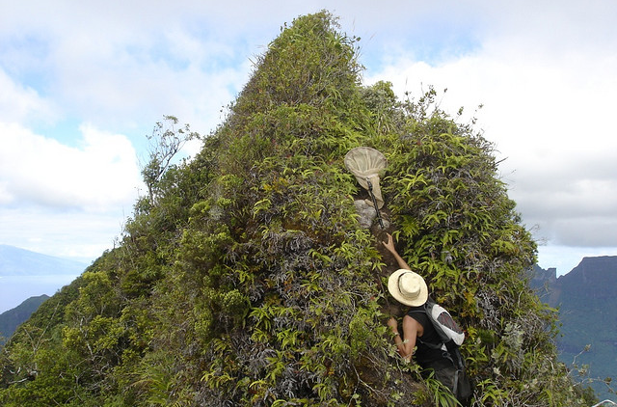
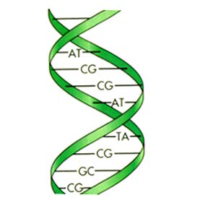
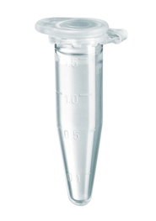
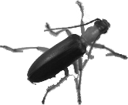
How do we Track Biological Objects and their Relations Across Distributed, Heterogeneous systems?
Taxon
(Taxon)
Taxon*n
Taxon
Key
(Key)
Blast*n
Blast
(Biocode Event)
(metagenomic
Sequencing)
(CAMERA
Gut Sample Event)
(Essig Museum Specimen)
(Genbank Sequence)

Slide 15
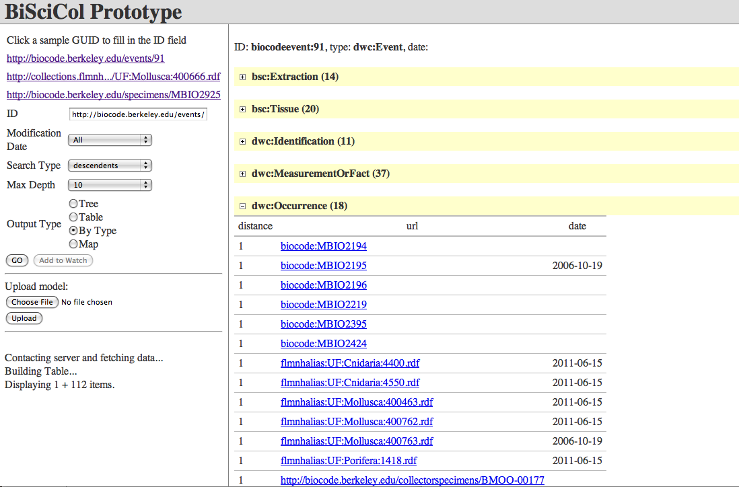
Biological Science Collections Tracker

Slide 16
Data automation in digitization workflows
iDigBio Paleocollections Workshop,
27-28 April, 2012
Reed Beaman
Florida Museum of Natural History
University of Florida

Slide 17
Digital workflows
Part of human mediated processes
Field collection
Accession
Ongoing curation
Domain differences
Software tools and services are the actors
Can be
modular
data and computationally intensive

Slide 18
All or none?
Complete capture digitization efforts focused on assembling very complete data records
access to researchers and public granted only after extensive quality control.
Now: not every element of a collection record needs to be recorded in a single digitization event.
Additions, modifications can be treated as ongoing annotations

Slide 19
Modular approach
Digital capture events
Image
Determination (filed under and histories)
georeferencing
Morphological ecological observations, etc.
Treat as annotations
Orient around research questions at hand.
Data capture, like data curation, can be costly when it involves expert judgments.

Slide 20
Recognition Terms
OCR: Optical Character Recognition
Typed and typeset text
NLP: Natural Language Processing
Markup of structured and unstructured information
ICR: Intelligent Character Recognition
Handwriting in forms
NHR: Natural Handwriting Recognition
IWR: Intelligent Word Recognition

Slide 21
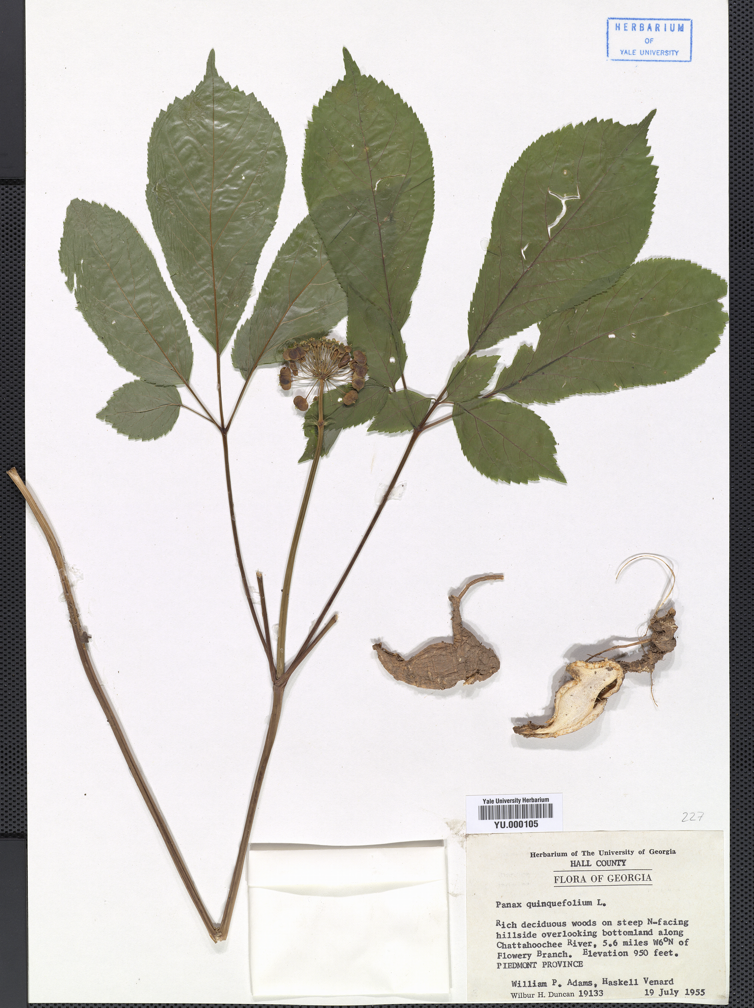
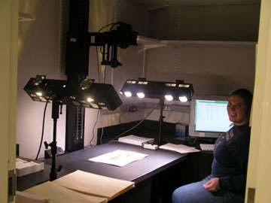
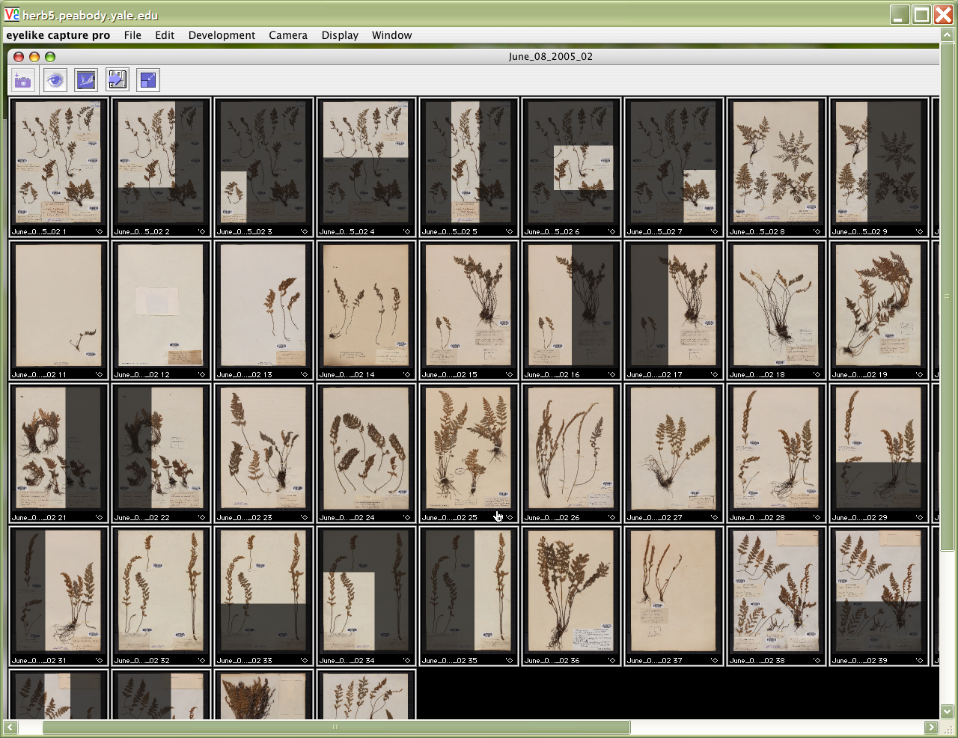
Herbarium Digitization Simplified Workflow
SPECIMEN
DATABASE
OCR
NHR
DK
success
failure
NLP
Web services
Web interface

Slide 23
NLP: Natural Language Processing
Well known example: Georeferencing
Supervised Machine Learning: A set of computer programs that “discover” useful patterns in a set of classified examples and that generalize these pattern to new examples.
Regular Expressions recognition over known vocabularies

Slide 24
Vocabulary of a label
Determination
Taxonomy & Synonymy
Typestatus
Collector
Date
Location
Habitat
….

Slide 25
Learning Architecture
Training Phase
Marked-up
Specimens
Machine
Learner
Trained
Model
Application Phase
Unmarked-up
Specimens
Segments Text
Machine
Classifier
Marked-up
Specimens
Chunker -
Segmentor
Source: B. Heidorn

Slide 26
Define the Representation: XML
<bc> - barcode
<bt> - barcode text
<cm> - common/
colloquial name
<cn> - collection number
<co> - collector
<cd> - collection date
<fm> - family name
<ft> - footer info
<gn> - genus name
<hd> - header info
<In> - infra name
<Ina> - infra name author
<lc> - location
<pd> - plant description
<sa> - scientific name author
<sp> - species name

Slide 27
BAKIUM
<bt>Yale University Herbarium</bt>
<bc>YU.000081</bc>
<bc>YU.000081</bc>
<hd>Herbarium of Yale University Plants of San Luis, Peten, Guatemala</hd>
No: 301 Family:<fm>Boraginaceae</fm>
Scientific Name: <gn>Heliotropum</gn> <sp>angiospermum^</sp>
Mopan Mayan Name: <cm>U p'ot kutz</cm> Colloquial Spanish Name: <cm>mOCO de chompipe</cm>
Location: <lc>in pueblo (village) along path</lc> <cd>2 9 May 1976</cd>
Comments:<pd>herbaceous plant reaching 60 cm. small yellow flowers</pd> (det.L.Brown)
Collected by <co>Pierre Ventur</co>, <ft>Yale Department of Anthropology</ft>
Notes:
Notice the different format and titles typed in the card, which is different from the next one. This example shows that using titles like “scientific name” and “location” can be used to help machine learning to recognize them. But the next several examples show that it is much complicated.

Slide 28
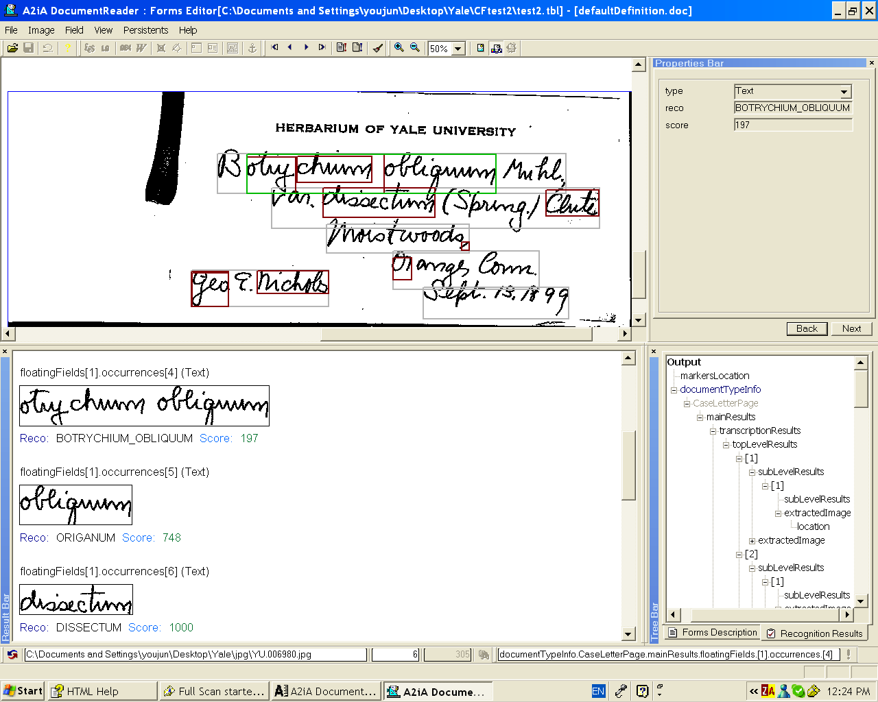
Natural Handwriting Recognition

Slide 29
Web Services (or appliances)
Java Client
JP2
Thumbnails
Linux
OS X
OCR Optimized JPEG
Text
Win XP
HTTP request/response
Tomcat Web Server
Axis – SOAP management framework
OCR Service
NHR Service
NLP Service

Slide 30
Additional Options
Voice recognition
Capture data while handling specimens
Crowd sourcing
Public, volunteer, and eduction
Outsourcing – keying services
Integrate data capture into
“Captcha” like tools
games

Slide 31
The innovation/development curve
Sustainable infrastructure
Georeferencing
Machine written text capture (OCR)
Development
Handwritten text capture (NHR)
Machine Learning
Innovation

