Slide 1
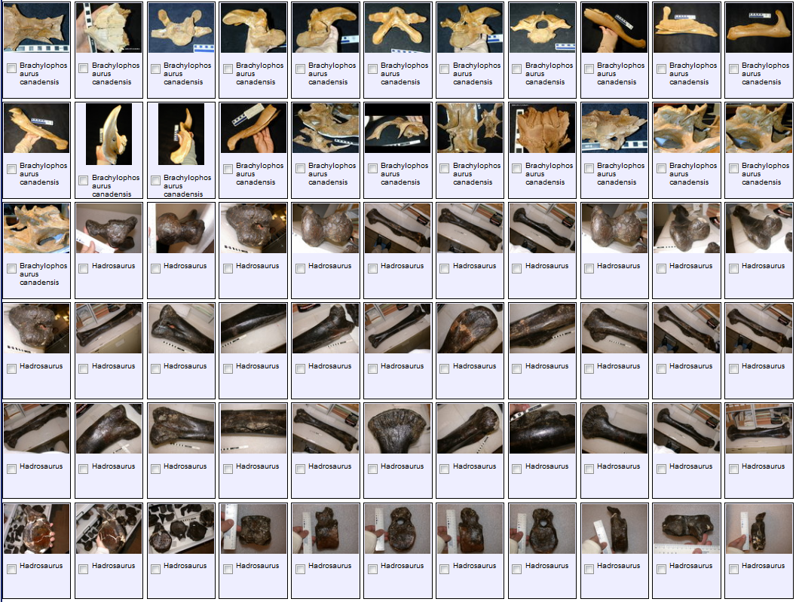
www.morphbank.net
Morphbank
Image Repository Plus…
Paleocollections Workshop
April 26 – 28, 2012
Deborah L. Paul
Support from NSF grants:
Biological Databases and Informatics (BDI) Program (Grant DBI-0446224)
Advancing Digitization of Biological Collections Program (#EF1115210)
Advancing Biological Informatics (ABI) (Grant #0851313)
Notes:
Morphbank Powerpoint presentation for iDigBio PaleoCollections workshop, April 26 – 28th, 2012, Gainesville Florida.
This talk is designed as an overview, an introduction to Morphbank an specifically focuses on main features of Morphbank and using the custom workbook to allow paleontologists to share / store all pertinent metadata desired / required.

Slide 2
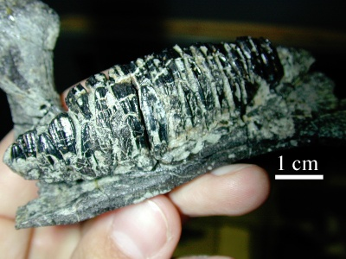
Topics
Morphbank Overview
Morphbank Features
Linking Data & Images
Collections
Annotations
Papers, GoogleMaps, Ontologies,…
Upload to Morphbank
Coming up Next at Morphbank
http://www.morphbank.net/?id=475541
Notes:
Topics, the current state of Morphbank and plans for the future. An overview (review for some) of the website user-interface. Introduce of new features like services and how to use them to get to data in Morphbank and return that data in the format desired (xml, ids, thumbnails, geolocated). Encouraging the use of uids and fields from acceoted standards to facilitate data-sharing between systems (EoL provider).
Moving in the excel workbook direction to allow future uploads via services. Moving overall towards services – and thinking about interoperability.
Changes in progress:
Fewer required fields,
Display restricted to group items by default
New features:
new workbook enabling User-defined fields,
Unique identification from provider,
Morphbank as an Image provider through services

Slide 3
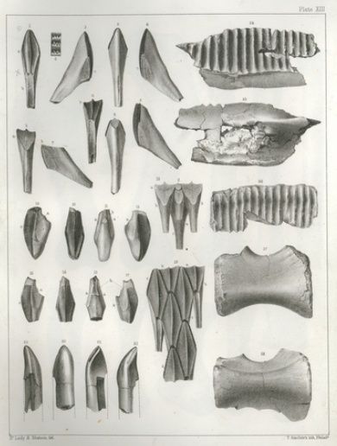
Morphbank overview
Morphbank: a collaborative tool.
an open web repository of biological images serving the scientific research community.
First developed in 1998 by a Swedish-American-Spanish consortium as an open ftp site.
Additional installations in Sweden, Finland, and Australia.
Morphbank’s home:
The Institute for Digital Information and Scientific Communication (iDigInfo) at Florida State University (FSU) with support from FSU’s Department of Scientific Computing
Current staff members:
Greg Riccardi, PI
Austin Mast, Co PI
Deborah Paul, Data Analyst
Robert Bruhn, Programmer (PHP)
Guillaume Jimenez, Programmer (Java, Web Services)
Notes:
The background of Morphbank as well as notice that there are other installations …and new installations planned.

Slide 4
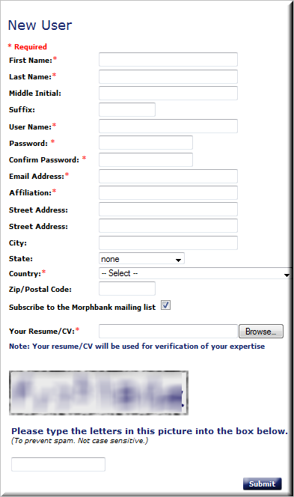
Morphbank overview
Morphbank: a collaborative tool.
an open web repository of biological images serving the scientific research community.
First developed in 1998 by a Swedish-American-Spanish consortium as an open ftp site.
Additional installations in Sweden, Finland, and Australia.
Morphbank’s home:
The Institute for Digital Information and Scientific Communication (iDigInfo) at Florida State University (FSU) with support from FSU’s Department of Scientific Computing
Current staff members:
Greg Riccardi, PI
Austin Mast, Co PI
Deborah Paul, Data Analyst
Robert Bruhn, Programmer (PHP)
Guillaume Jimenez, Programmer (Java, Web Services)
Automated Account Creation
http://www.morphbank.net/ > tools > login > request account
Notes:
The background of Morphbank as well as notice that there are other installations …and new installations planned.

Slide 5
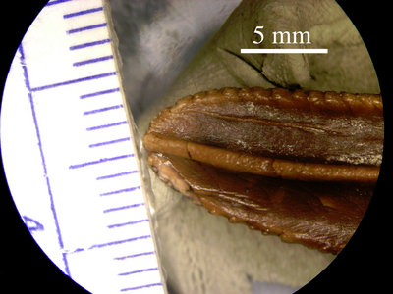
Morphbank Features
Over 352,000 images
over 19,000 distinct taxa
Animalia over 8,500 distinct taxa
Plantae over 10,400 distinct taxa
594 members
from 45 countries
Each image has a context:
specimen, taxon, locality, specimen part, view angle, etc.
Encyclopedia of Life (EoL) provider
Repository of information related to the images
Specimens, localities, taxa, annotations, collections
Contributor, submitter, group, date, permissions
Unique identity for each object
http://www.morphbank.net/?id=475541
Notes:
Overview of how many Images in Morphbank and what the range of coverage is:
geographically
taxonomically
number of members

Slide 6
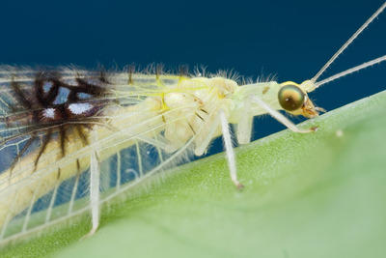
Morphbank Features
Browse / Search My Manager
Keyword search via metadata from a Google-like search box
Limit search results to group / contributor
Security model
Private vs. public data (‘unpublished’ and ‘published’)
Contributor controls date-to-publish
Group access, group roles, user-managed
Upload & edit
Via Web, Excel Workbook, & XML
Specify client plug-in (prototype)
User support
help desk
online users manual and FAQ
validation service
web services
Open source code
Off site backup
Notes:
The background of Morphbank as well as notice that there are other installations …and new installations planned.
Security model
Private vs. public data (‘unpublished’ and ‘published’)
Contributor controls date-to-publish
Group access, group roles, user-managed
Upload & edit
Via Web, Excel Workbook, & XML
Specify client plug-in (in beta test)
User support
help desk
Online users manual and FAQ

Slide 7
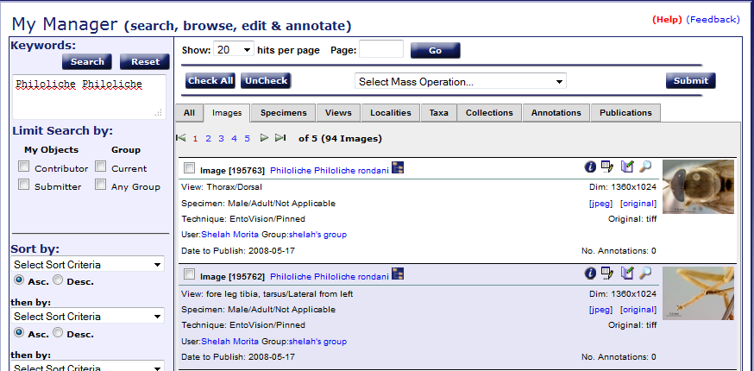
Morphbank Features
Browse / Search My Manager
Keyword search via metadata from a Google-like search box
Limit search results to group / contributor
Notes:
Tabs
the “I”
keyword search
limit to contributor / group
create collections
annotate
open image
http://www.morphbank.net/?id=464656
http://www.mapress.com/zootaxa/2009/f/zt02157p033.pdf
Shaun Winterton

Slide 8
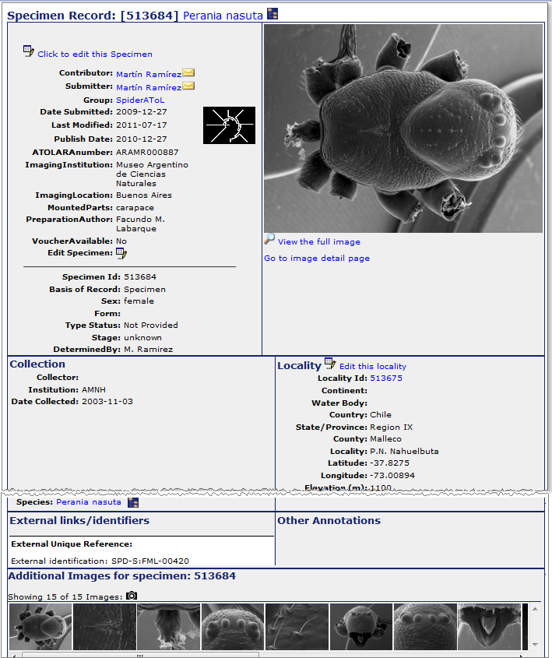
Morphbank Features
Image
Specimen
View
Locality
Notes:
The details stored for an object (an image, a specimen record, a locality record)…
Note there are 15 images for this specimen record.

Slide 9
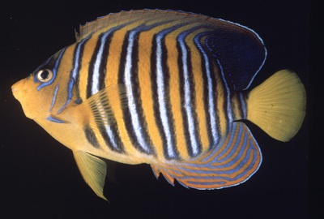
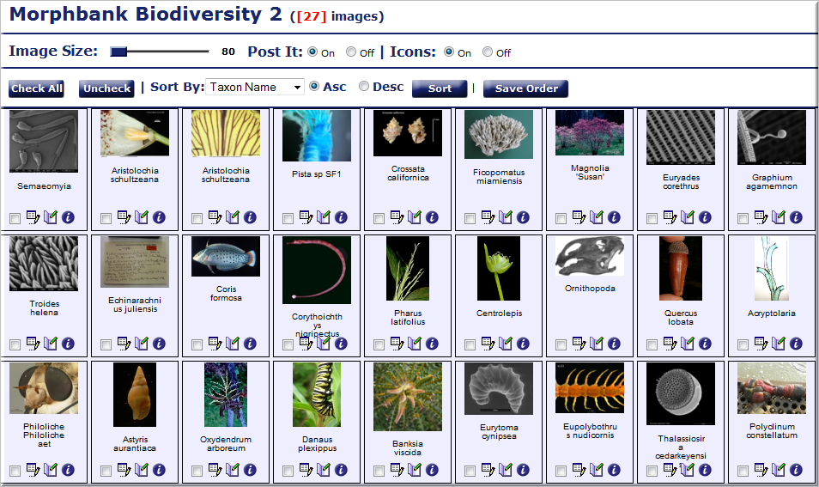
Collections in Morphbank
http://www.morphbank.net/?id=796533
Notes:
One of the most used features of Morphbank, the collection.
Users create them and a unique id is assigned to that collection.
The URL can then be used, for example, in a paper to link the user reading the paper back to the collection in Morphbank to see more images and have the ability to make comments (i.e., annotations).

Slide 10
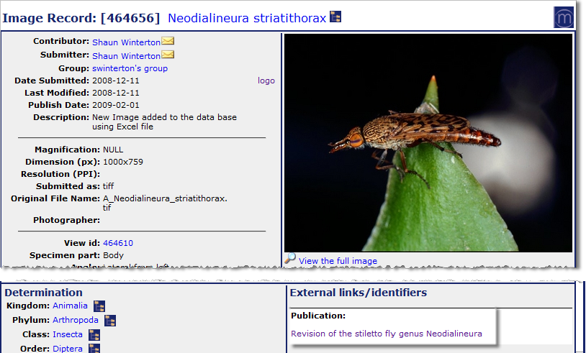
Link Papers and Images
http://www.morphbank.net/?id=464656
Notes:
An image (and related data) stored in Morphbank, linked to a paper. (the paper is linked back to the images in Morphbank).
http://www.morphbank.net/?id=464656
http://www.mapress.com/zootaxa/2009/f/zt02157p033.pdf

Slide 11
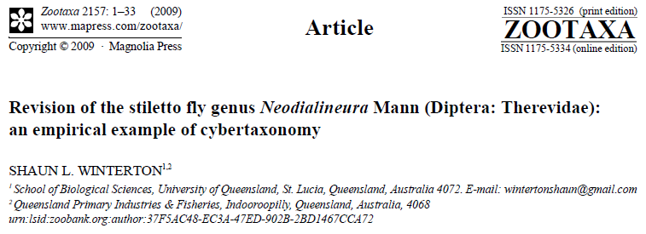
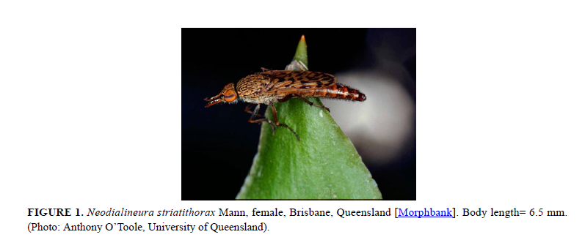
Link Papers and Images
http://www.morphbank.net/?id=464656
http://www.mapress.com/zootaxa/2009/f/zt02157p033.pdf
Notes:
http://www.morphbank.net/?id=464656
http://www.mapress.com/zootaxa/2009/f/zt02157p033.pdf

Slide 12
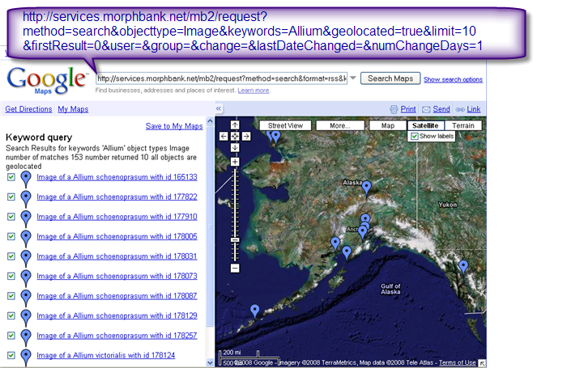
GoogleMaps - Images
Notes:
The format of the services request is shown above. Clicking on any of the blue links or bubbles will open a link to that record in Morphbank. As an aside, this ability to visualize the lat / lon data is also a very good way to check the data for any errors (Australia upside down example).
NOTE: USE
http://services.morphbank.net/mb3/

Slide 13
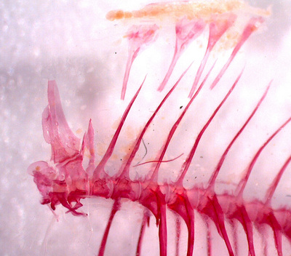
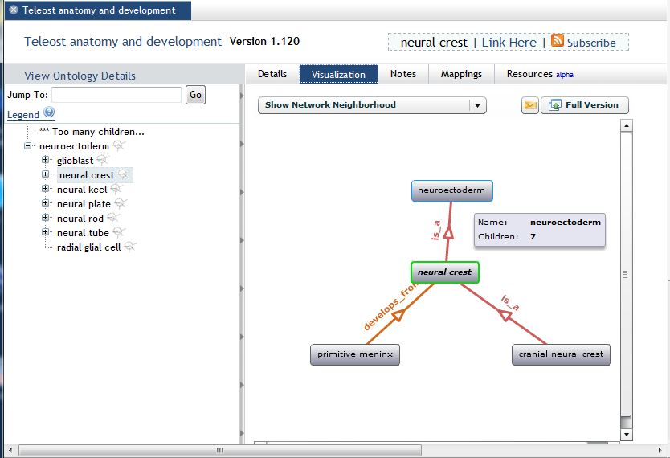
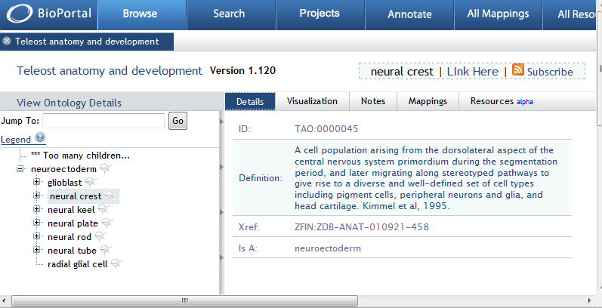
Linking to Ontologies
Cypriniform Tree of Life (CToL)
CToL example
http://www.morphbank.net/?id=459818
Notes:
Images in Morphbank can be linked to hosted ontologies like those at bioportal to illustrate the terms in the hierarchical structure.
The Cypriniform Tree of Life project (CToL) is an example…their Teolost Anatomy Ontology (TAO) is at BioPortal. Images in Morphbank link to the TAO ontology as illustrated in this slide.

Slide 14
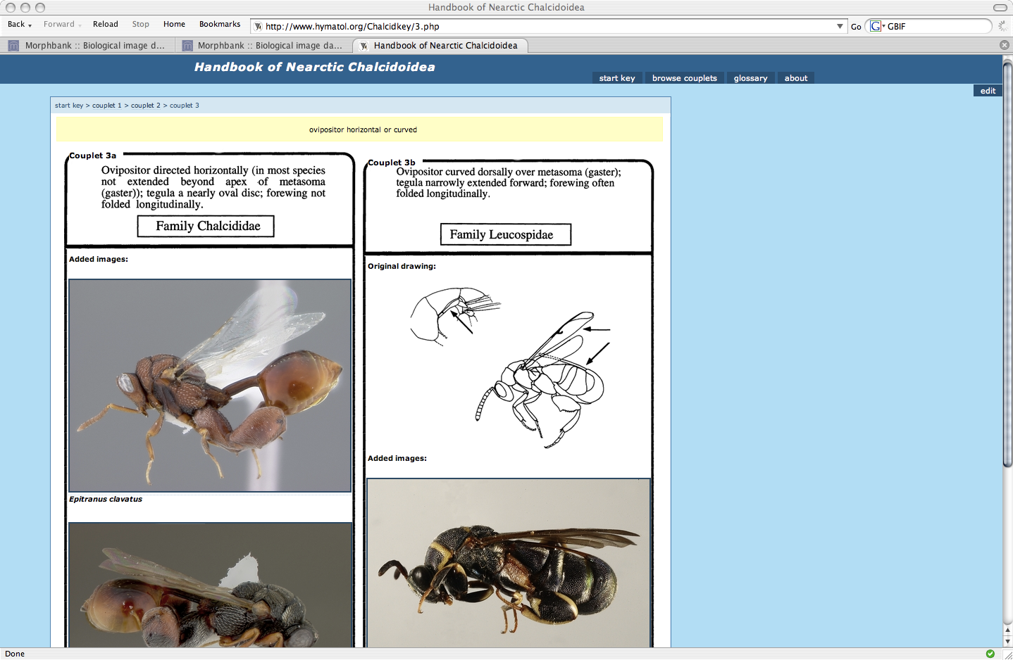
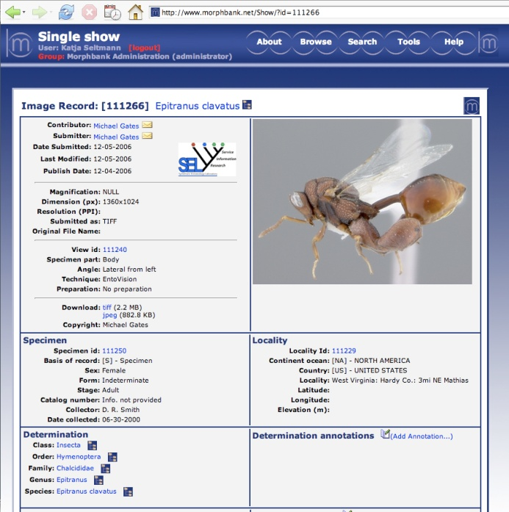
Linking to Morphbank Images
E. Grissell, M. E. Schauff & Mike Gates
http://www.morphbank.net/?id=111266&imgType=jpeg
Notes:
Here’s an example of an online illustrated key. The images are linked to data records in Morphbank.
The image records in Morphbank are linked back to the key.

Slide 15
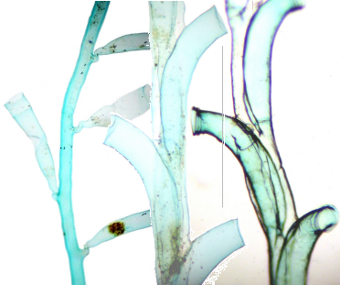
Upload to Morphbank
3 ways to upload
the web
Excel original workbook
new enhanced version
Custom Excel workbook
best option to support paleontology community
validation service http://services.morphbank.net/mb3/validateXls.jsp
Send images and validated workbook
shared folder
dvd
hard drive
Notes:
Moving in the excel workbook direction to allow future uploads via services. Moving overall towards services – and thinking about interoperability.
Changes in progress:
Fewer required fields
Display restricted to group items by default
New features:
automated account creation
new workbook enabling User-defined fields,
Unique identification from provider,
Morphbank as an Image provider through services
Validation of workbooks
Upload via the web (for system administrators).

Slide 16
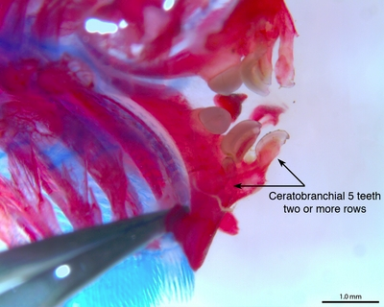
Future Developments
2 new Upload methods
from Specify (prototype)
working on upload from a DwC-A file
new Morphbank shared folder service
in development
FilteredPUSH testing
in progress
Morphbank V4 (Drupal, noSQL)
Notes:
Moving in the excel workbook direction to allow future uploads via services. Moving overall towards services – and thinking about interoperability.
Changes in progress:
Fewer required fields
Display restricted to group items by default
New features:
automated account creation
new workbook enabling User-defined fields,
Unique identification from provider,
Morphbank as an Image provider through services
Validation of workbooks
Upload via the web (for system administrators).
Filtered PUSH to return annotations to providers.

Slide 17
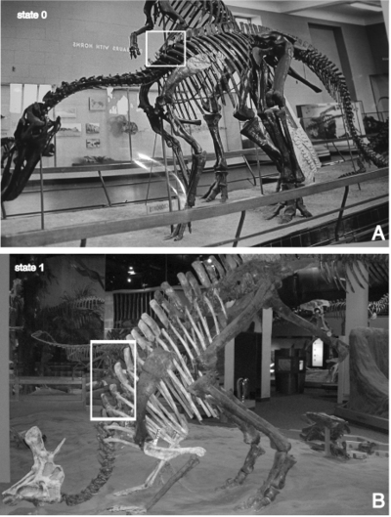
Acknowledgements
All Morphbank Contributors & Collaborators > CBG, AToL, PEET, PBI, MX, HERBIS, CToL, PlantCollections Project, SERNEC, FSU, PlatyPBI, SAIN, UAM, EoL, Specify, USMS, TTRS, Bioimages, Auburn, Troy, Ohio State, …

Slide 18
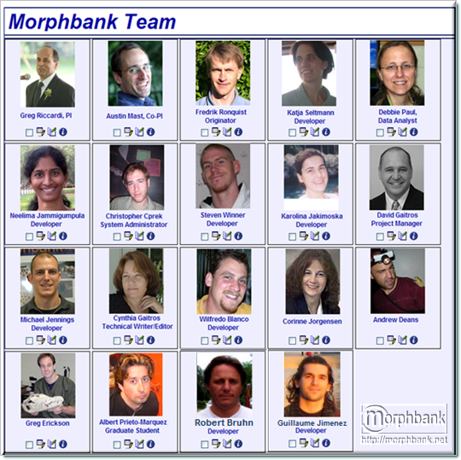
Thanks from the Morphbank Team ~ 2012
Greg Riccardi
Austin Mast
Fredrik Ronquist
Debbie Paul
Robert Bruhn
Guillaume Jimenez
Steven Winner
Katja Seltmann
Albert Prieto-Marquez
Corinne Jorgensen
Michael Jennings
Neelima Jammigumpula
Karolina Jakimoska
David Gaitros
Cynthia Gaitros
Greg Erickson
Andrew Deans
Christopher Cprek
Wilfredo Blanco
Notes:
Persons highlighted in bold are currently active with Morphbank in 2012.

