Slide 1
Workflow Optimization for Digitization and Digital Curation
Mark V. Sullivan and Laurie N. Taylor

Slide 2
Our Workflows
Notes:
Any notes/feedback/updates from everyone on documenting and sharing workflows.
NOTE: any specific points to highlight from workflows
Discussion of general digitization workflow issues
Metadata good metadata is "constructed, constructive, and actionable“
imaging – done to national standards
post-capture clean-up (level, crop page images) - maybe or maybe not do it for different projects/materials, what are the goals and issues
metadata creation ( preqc )
quality control of images
Loading
Archiving

Slide 3
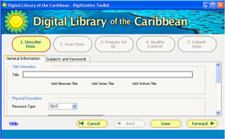
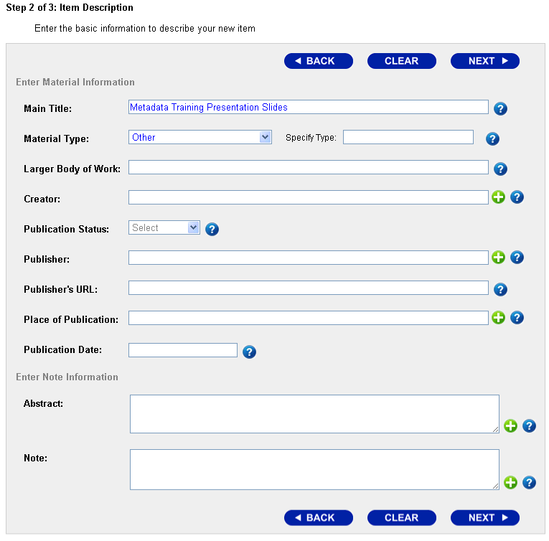
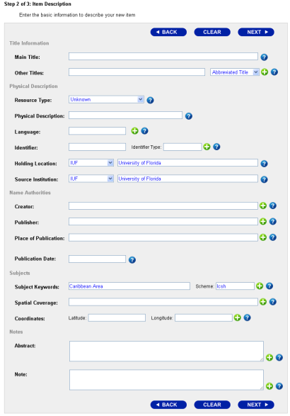
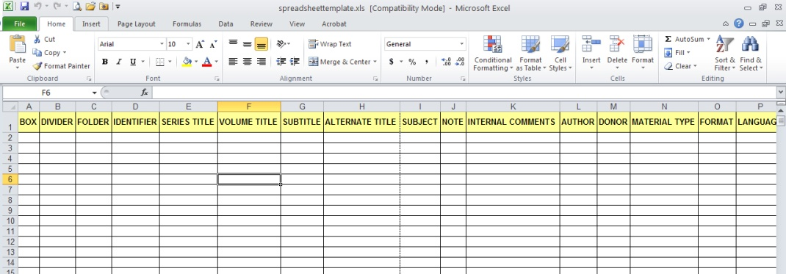
Our Workflows
Notes:
Brief discussion of our workflow (for a biological item.. i.e., including darwinCore )
Discussion of library standards and library archival standards we use that are useful for the biological community

Slide 4
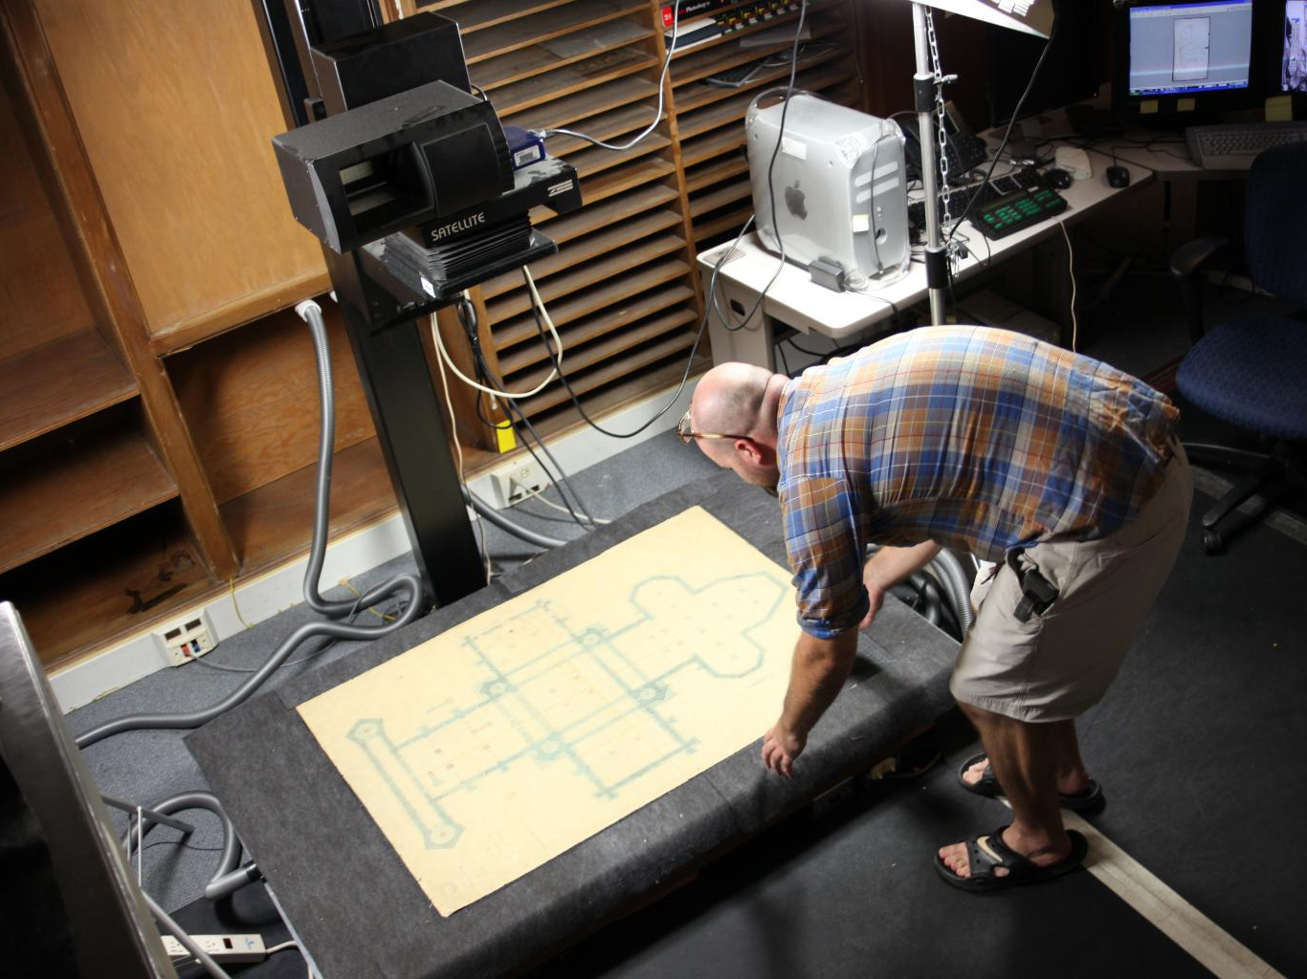
Our Workflows
Notes:
Brief discussion of our workflow (for a biological item.. i.e., including darwinCore )
Discussion of library standards and library archival standards we use that are useful for the biological community

Slide 5
Metadata
Notes:
Again, good metadata is "constructed, constructive, and actionable“
Actionable for online use and for internal workflows for digital and non-digital objects
Production and product
http://www.flickr.com/photos/29515734@N04/5709538963/

Slide 6
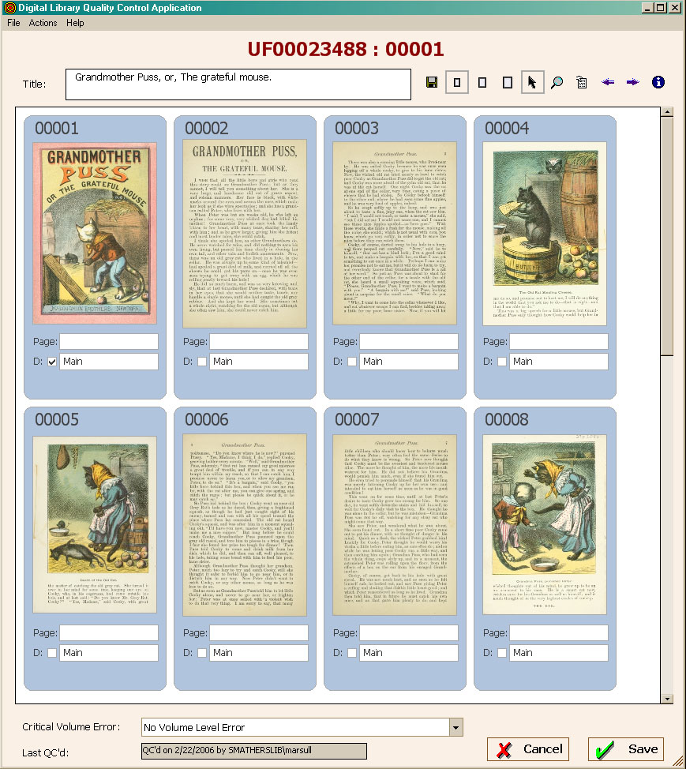
Evaluations of Our Workflows
Average Times:
Bound books | 7 hours
Disbound books | 2 hours
archival/photos | 11 pages / hour
large format | 2.5 hours
born digital | 50 pages / hour
print newspapers | 40 pages / hour
vended digitization, newspapers on microfilm, NDNP-compliant | 210 pages / hour
vended digitization, newspapers on microfilm, non-compliant | 29 pages / hour
oral histories, 30 min; born digital; PDF transcript | 1 set (audio and PDF) / hour
Notes:
Examples: Old paper sheets with times for all activities
Old tracking system with start/end time/date
Problem – overhead and no one used it
Some things remain static+fixed cost: QC – this is where we have first non-manual metrics
Some things have fixed needs: Metadata
Ingest of existing sources continues to be refined, but always need to connect existing metadata. Again, good metadata is "constructed, constructive, and actionable“ so it must be interoperable from and across system
Requires investment of programming time
How we’ve thought to improve our workflows
Barcodes for all stages of the imaging, which would support metrics before QC
But, concerns again with this in terms of programming time to develop this, labor to do this for each item and each stage, managing to make sure it’s done, and assessing the results

Slide 7
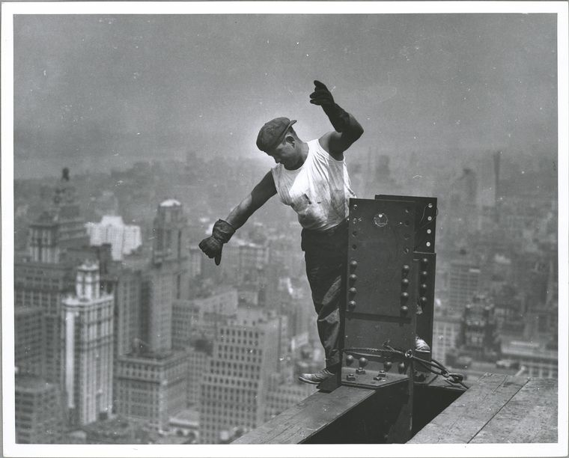
Scale Changes Everything
Notes:
Scale changes everything – this could be easy to do with a person or a few; hard to do in our operations with 10 production staff and 30-50 student workers/volunteers and with the process divided into multiple stages with different workers assigned to each
Most recent improvement in imaging workflow has been adding a paper student sign-in sheet for ease of comparison with work produced and time here (time also in Peoplesoft, but less easy to check); this was not a good add-on before we had the shared SAN for processing when we were on external hard drives because we had to spend the resources on managing the hard drives and files on those
http://digital.uflib.ufl.edu/technologies/documentation/average_times.htm
http://digitalgallery.nypl.org/nypldigital/dgkeysearchdetail.cfm?trg=1&strucID=131297&imageID=79874&total=555&num=0&word=empire%20state&s=1&notword=&d=&c=&f=&k=0&lWord=&lField=&sScope=&sLevel=&sLabel=&sort=&imgs=20&pos=8&e=w
Image ID: 79874
Worker on Empire State building, signaling the hookman (1931)

Slide 8
Big, radical ideas are rarely needed to succeed. More often, it’s a handful of basic, solid, good ideas – applied correctly – that are needed.
Making Things Happen: Mastering Project Management
Notes:
Use of checklists in complicated work like surgery and flights. Using a checklist is a simple idea that has major impact.
Digitization, the way most cultural heritage and research institutions do it and especially with many other simultaneous projects, is complicated like surgery and like flying.
The goal is to make the process as simple and affordable as possible, which means having it integrate with existing workflows and be fault tolerant.
(from page 98)

Slide 9
Core Concepts
Integrate / support overall operations
Digital curation lifecycle
Leverage capacity where it exists
Constraints
Given enough eyeballs, all bugs are shallow
Tasks, processes, and projects; parts, flows, and wholes
Impacts / Concerns
Beware of false optimization (how to ensure reliability)
Managing multiple projects
Scale changes everything
Tools
Schedules
Documentation
Notes:
So, to frame the rest of our discussion, we’ll start with some core concepts.

Slide 10
Digital curation lifecycle
Notes:
Integration with Overall Operations
Digital Curation Lifecycle
How is the digitization work supporting your overall goals and operations?
Where are the digitized files?
How are they being presented to the public and preserved?
“if it’s not online, it doesn’t exist”
- Blue ribbon taskforce on sustainable digital preservation
- Archivist of the US in the DPLA planning meetings
Maybe and maybe not, but if it’s not online, it doesn’t count in your favor and you can’t build on it very easily.
Image: http://digitalcuration.blogspot.com/2008/11/curation-services-based-on-dcc-curation.html

Slide 11
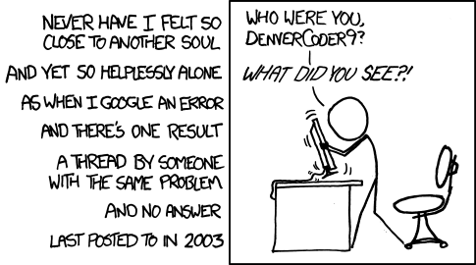
Leverage capacity where it exists; (Why to love) Constraints
Notes:
Integration with Overall Operations
Leverage Capacity Where it Exists
Existing documents show need for translation across different groups. Project Management terminology is used widely in IT, academia, and other areas. Jason is PMP certified and a six sigma green belt, and the PMP language is familiar to and translates well for IT and many scholars, like DH and eResearch more generally.
Mark and I will use some project management terminology, but will defer to Jason for accurate usage and aid in translation across different groups.
Community knowledge: iDigBio communities; medical imaging; others
Large-scale communities that can be accessed productively (can undergraduate students at UF contribute at scale in a manner that benefits all equally?)
Constraints:
Constraints are beneficial.
What other workflows inform, shape, and dictate your digitization workflows? Who’s doing the work for digitization and the related workflows?
In evaluating workflows, constraints are productive. What is a firm barrier? What is a limit that can be extended? What is a constraint based on the way the workflow is currently implemented?
Image: http://www.xkcd.com/979/

Slide 12
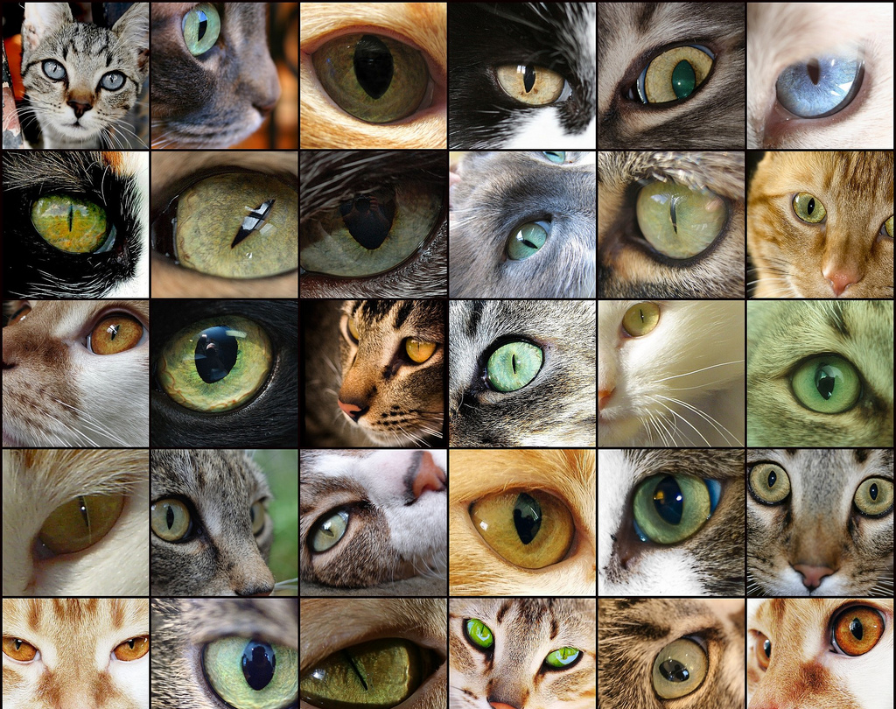
Given enough eyeballs,
all bugs are shallow
Notes:
Integration with Overall Operations
“Given enough eyeballs, all bugs are shallow” – Linus’ law
Importance of sharing resources with the community for community feedback.
Which is being done through this workshop and can be done in many ways.
We don’t mean crowdsourcing. Instead, think of traditional peer review. Materials go through the official process and, after validation and improvement, are published. Your specimens are going through your process, which could be seen as akin to the official peer review process. They will also benefit from other readers or users in the larger community if they can then be published. This should be part of your workflow.
Putting materials “out there” will elicit feedback. This is very helpful to inform your workflow processes and it can stimulate problems/requests coming in earlier. You want more feedback early on so that your processes can be improved before it takes more work to change them.
Sharing your operations is part of your workflow for other areas, so how can digitization also be integrated within those areas?
Image from: http://www.flickr.com/photos/learnscope/2548299926/sizes/l/in/photostream/

Slide 13
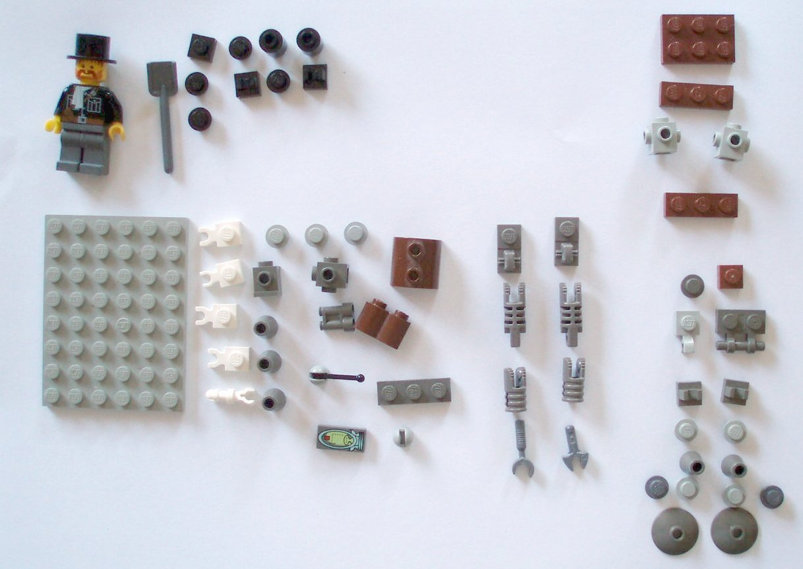
Tasks, process, and projects;
parts, flows, and wholes
Notes:
Integration with Overall Operations
Tasks and projects; parts, wholes, and flows
A project has a defined scope and end.
Tasks are activities, like image capture. Tasks can be completed, but are incomplete parts of the whole.
In evaluating your workflows, when is your work complete? When can you have a checklist where the task could be marked as complete where you can trust that it won’t need to be redone?
This is a question of the full process for a single item with dependencies and impacts.
For instance, how are your tracking image capture for the e-loans of specimens instead of physical items. Is this an area where you could integrate that image capture into the deliverables for iDigBio?
Many libraries and archives have found that one-off digitization is cheaper and easier to do as one-offs and not to try and capture the benefits of that work. (“Scan and Deliver: Managing User-initiated Digitization in Special Collections and Archives)
http://www.flickr.com/photos/kaptainkobold/3771497484/sizes/o/in/photostream/

Slide 14
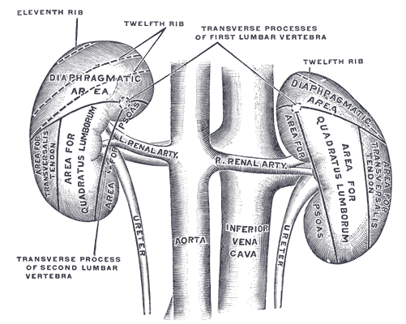
Impacts/Concerns
Beware of false optimization
Managing multiple projects
Scale changes everything
Notes:
Beware of false optimization,
This could be stated “how to ensure reliability and fault tolerant systems”
In our workflows, we’ve repeatedly seen how the cost of an error can dramatically outweigh the cost of optimizing the workflow for the actual requirements, which can include some redundancy.
2 kidneys, but dropping one to save weight is a bad idea
Automate whenever it ensures accuracy, but redundancy is good in ensuring continuity that then supports consistency. Human communication is redundant and complicated workflows need to redundantly communicate, support, and shape actions and communications.
Example of how xerox machines and workflows are designed
Managing multiple projects
Workflows need to be fault tolerant for dependencies and impacts within the workflows and from related operations that impact the project workflows and resources.
For instance, how does your workflow address disruptions? If the #1 researcher in the world comes in to look at your specimen for that area and wants to physically handle it while it’s in process, and if the person working on the item has done the image capture but then went home sick, how do you support the researcher? What if the onsite researcher wants 20 items that are all in process?
What if a remote researcher needs access to digital files for 20 different items; what do you do to the in-process items? Do you have a labeled shelf where in-active, but in-queue things sit?
Scale changes everything
This is one of my favorite quotes because something that works at once scale fails at 10x that and explodes at 100x.
Most of us won’t have to deal with massive changes in scale, but even relatively small changes can have minor impacts.
Is your workflow being done for a scale of 1 full time person doing the work full time?
5 people working simultaneously on different areas? 5 people all working on 1 area?
Are they full time or part time?
The time allocation per person will directly impact your workflow productivity levels.
Even if people are allocated full time, they still won’t be full time because of holidays, vacation time, sick time, meetings, and overhead.
Image from: http://upload.wikimedia.org/wikipedia/commons/f/f0/Gray1123.png

Slide 15
Schedules as Tools
Communication
Forcing Function
Tracking/Assessing
Notes:
Schedules are tools. Schedules help to communicate:
Processes
Expectations
Connections
dependencies
Schedules make things happen.
A forcing function is anything that, when put in place, forces a change in perspective, attitude, or behavior – Making Things Happen
Schedules provide a method for tracking and assessing work.
(Photo from: http://demigods.wikia.com/wiki/Gremlins ; Gremlin feeding schedule is the connection)

Slide 16
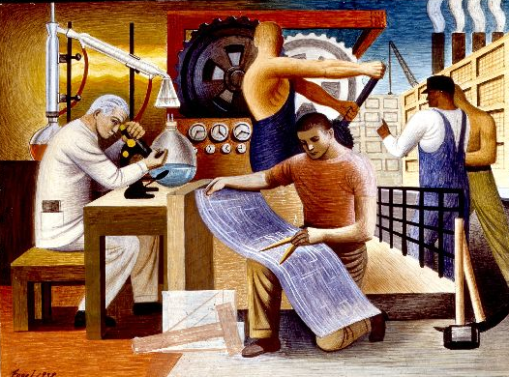
Scheduling Resources
Fixed Resources: Equipment; Software; Space
Human Resources: Production (tasks and complete process); Project Management
Notes:
Defining your resources and plotting them on a schedule can be very informative for workflows, impacts, and options. It will create some of your constraints that you can account for to work around, or can find ways through.
For ease, I normally think of these as fixed resources – things that are more difficult for me to change, unlike the reallocation of people activities.
So, here I have “fixed resources” for anything other than human resources.
The fixed resources like equipment and space are relatively easy to deal with because they aren’t as complicated and are well defined. They can form part of your constraints to refine your workflows.
Human resources are much more challenging.
While human resources can be more flexible than equipment, there are fixed requirements. For most digital projects, an additional 33-66% of the production time will be required for project management.
(http://ufdc.ufl.edu/WOLF000461/00001?search=wpa)

Slide 17
Human Resources
Notes:
Also, in planning, projecting, and tracking human resources, there are a number of impact factors depending on who is doing the work and what type of worker they are. Many factors can be improved in the production area at a cost in terms of overhead and management, and that has to be structured properly for success or else it can mean trading high quality, expert labor for basic, low-cost labor. Depending on the balance, it can mean more errors as well.
Full time:
40 hrs/wk * 52 wks/year= 2,080 hours (173 /mo)
Of the full 2,080 hours per year:
Minus:
Training time, often 5% of total (104 hours per year)
Conferences /travel, often 5% of total (104 hours per year)
Holidays (UF, 15 days or 120 hours this year)
Vacation time (176 hours per year)
Sick time (104 hours per year)
Subtotal: 1,472 hours per year (122/mo)
Minus: standard meetings and activities
Minus other overhead if many people being trained and re-trained as can be the case with volunteers.
Image of miners from WPA, FIU Wolfsonian Digital Collections: http://ufdc.ufl.edu/WOLF000386/00001?search=wpa

Slide 18
Productivity
Production/line/digitization work = n
Project Management = n * 33-66%
Total = n * 166%
Full time = 122 hours / month
Project Management, 66%
Production = 73 hours
Project management = 48 hours
Project Management, 33%
Production = 92 hours
Project management = 30 hours
Notes:
So, full time is not a maximum of 173 hours a month, but 122 hours a month. That’s ideal, before meetings and general operations.
Of that, any time on production requires time for project management, which can vary from 33-66%. Many projects exceed 66% early on.

Slide 19
Creating Schedules
Notes:
Provide reasonable time for activities
Account for minor errors and their corrections
Frequent minor errors, or anything worse, causes major impact
Deviation from schedules due to errors can isolate problems in the workflow
Develop based on available data and refine with new information
Image: http://ufdc.ufl.edu/AA00009652/00001/5?search=fail
From the Earth to the Moon direct in ninety-seven hours and twenty minutes, and a trip round it

Slide 20
Estimating Workflow Times
Time per task for:
1) a single item
2) a set of similar items
Notes:
Pull and prepare an item
Image capture
Image processing
Data capture
Image storage/loading (automatic, or manual)
Return physical materials
Verify completed process
Other activities
In the libraries, there can be full time people assigned to pulling books from the closed stacks. This is not a trivial task and time should be included.
In estimating workflow times, test for:
Time for processing 1 full item
Time for processing 10 full items
(http://ufdc.ufl.edu/UF00031557/00001)

Slide 21
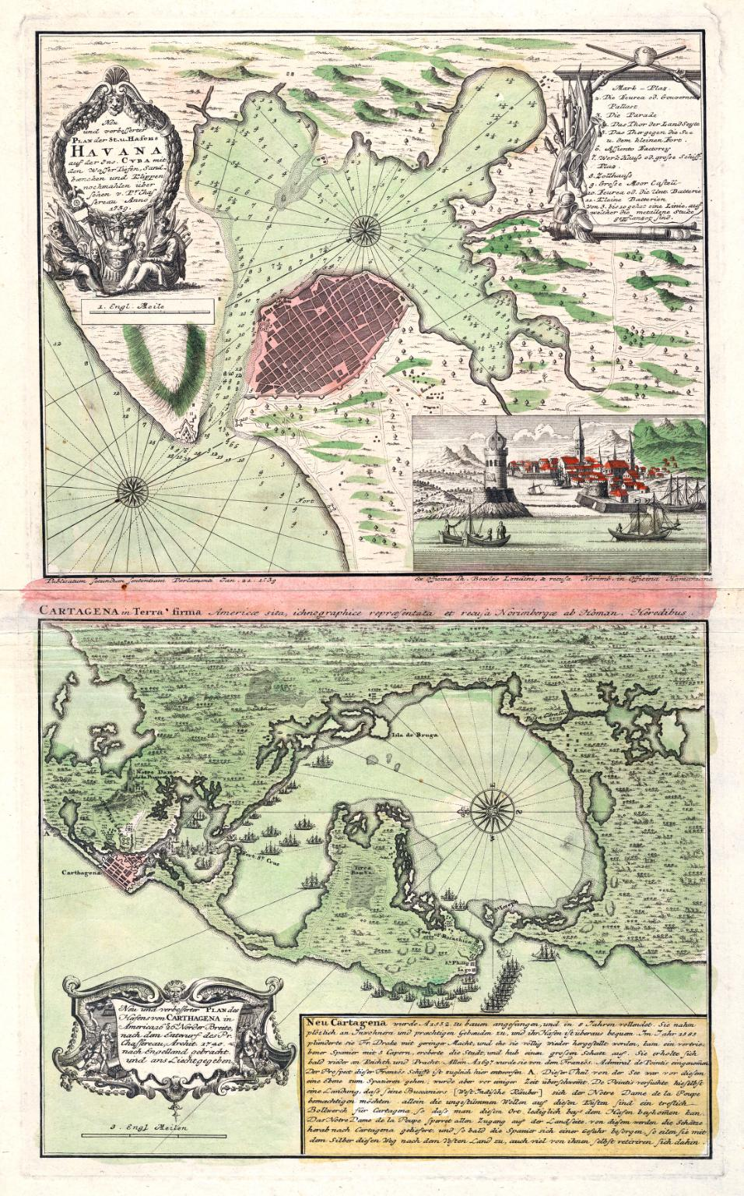
Questions for Workflow Evaluation
What task requires the most time?
What task presents the most risk (likely to fail itself or area between tasks that can fail)?
What are the dependencies for each task?
What are the impacts for other areas?
Where are the checkpoints (alpha, omega, in between)?
Notes:
Beware of false optimization bears repeating here.
Something that seems to take a long time, if it works consistently, may be a great option.
We spend at least 5 minutes for tracking for every item. It’s worth it. We don’t lose things, people don’t get confused on where things are, we don’t have meetings on how materials will be handled for security, we don’t get blamed when other people make mistakes, we don’t have to worry if an item comes in within a batch without an inventory – we’ve planned the time and we don’t get disrupted. We don’t impact other areas. We don’t need or to optimize this further because, even at 5 minutes each, it supports a variety of tasks and ensures that the overall workflow works.
Impacts for Other Areas
All activities have to be understood in terms of your overall operations.
If you place materials online to get user feedback, do your data sharing policies support it? What are your security concerns? Are these endangered things where too much information, like location, is a security concern?
Example with antique maps and information on rips and the metadata hold back.
Image:

Slide 22
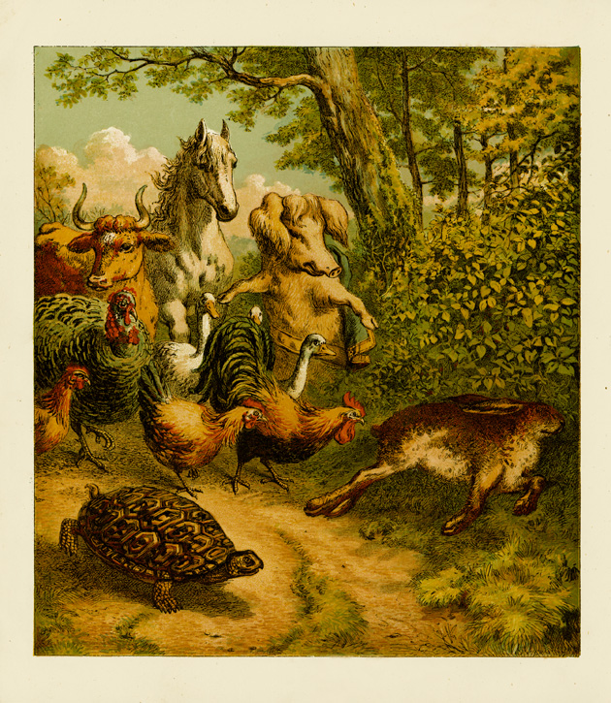
Testing the Workflow on a Schedule
Notes:
Production schedule
Check points
Major milestones
http://ufdc.ufl.edu/UF00023909/00001/8?search=tortoise

Slide 23
Questions?
marsull@uflib.ufl.edu and laurien@ufl.edu

