Slide 1
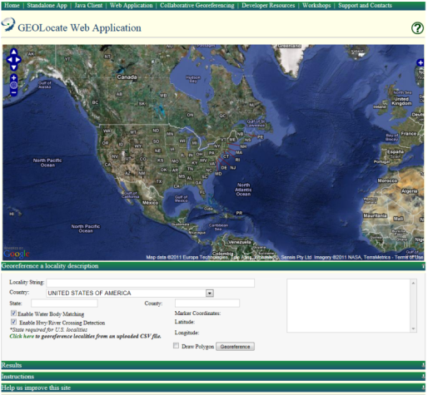
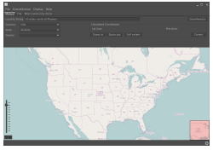
Software & services for georeferencing of natural history collections data
automated georeferencing
verification & correction
multi-lingual
kml export
interoperability
soap & rest api
batch processing
training
geographic visualization
google, bing, openstreet, wms
uncertainty determination
collaborative georeferencing

Slide 2
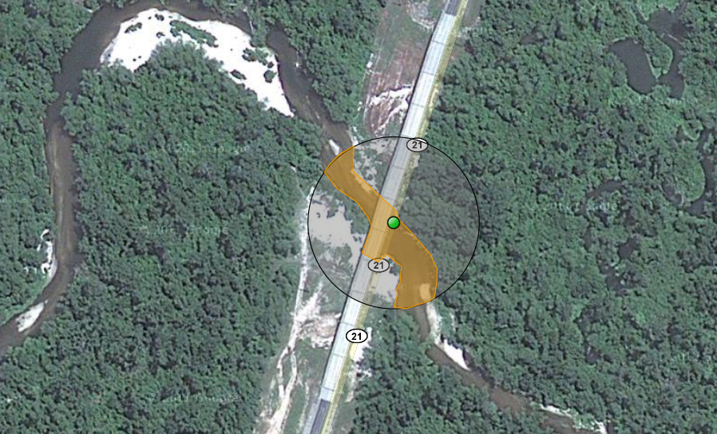
What is Georeferencing
pushepatapa creek, trib. to pearl river, 7.8 miles north of bogalusa at hwy 21; Washington; LA; USA
latitude: 30.88797 longitude: -89.83601 uncertainty radius: 48m uncertainty polygon: 30.88823,-89.83641, 30.88815,-89.83634, 30.88808,-89.83622…

Slide 3
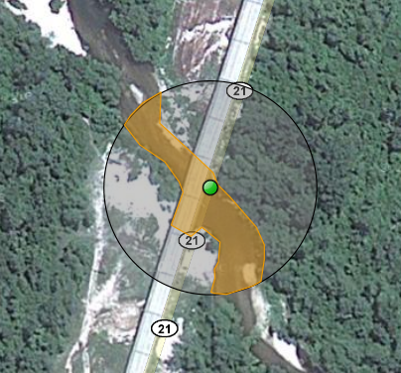
Typical Workflow
pushepatapa creek, trib. to pearl river, 7.8 miles north of bogalusa at hwy 21; Washington; LA; USA
Data Preparation
Automated Processing
Automated Georeferencing
Human
Participation
Verification/adjustment of output coordinates & uncertainties
latitude: 30.88797 longitude: -89.83601 uncertainty radius: 48m uncertainty polygon: 30.88823,-89.83641, 30.88815,-89.83634, 30.88808,-89.83622…

Slide 4
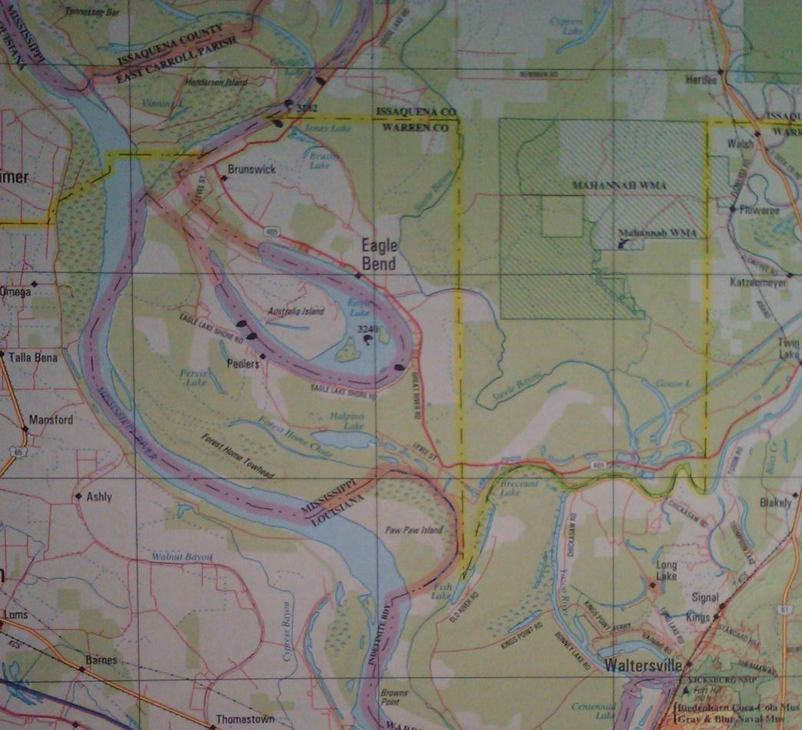
Representation of Uncertainty
Eagle Lake, Warren County, Mississippi,
USA

Slide 5
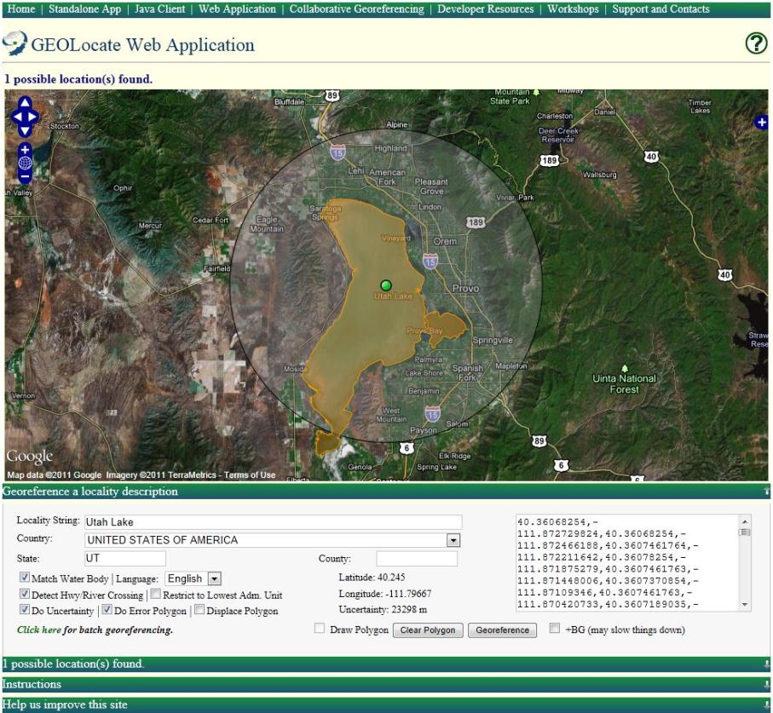
Uncertainty within GEOLocate
Point radius and polygonal uncertainties
Point radius represented as a distance in meters from georeferenced point
Polygons represented as a comma delimited array of vertices using latitude and longitude
Supports auto-detection and generation of polygons (web app only, in development for desktop app)

Slide 6
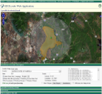
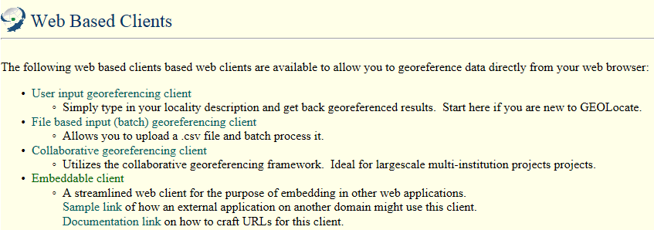
Choices: Web vs. Desktop?

Slide 7
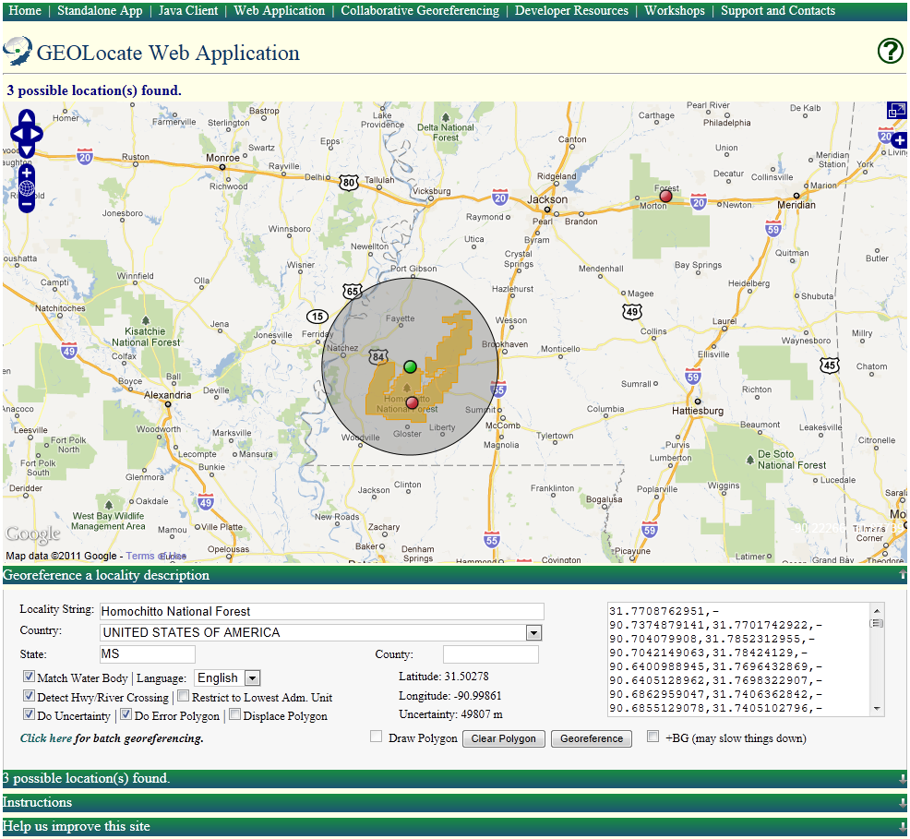
Web Client Walkthrough

Slide 8
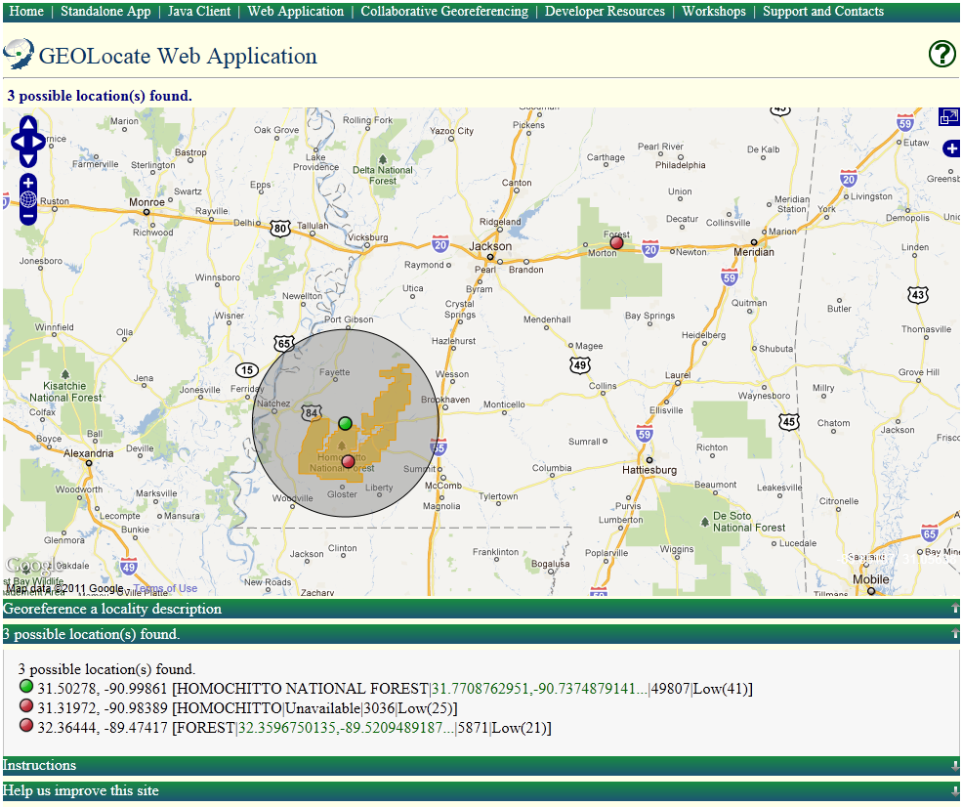

Slide 9
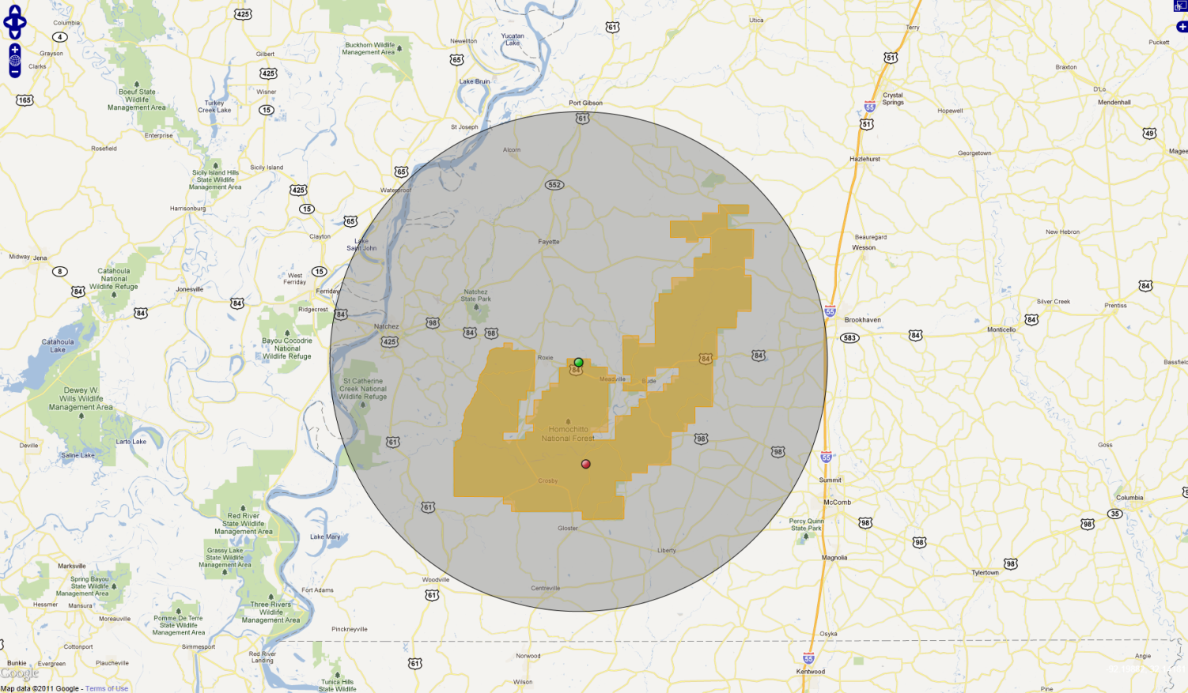
Homochitto National Forest; MS; USA

Slide 10
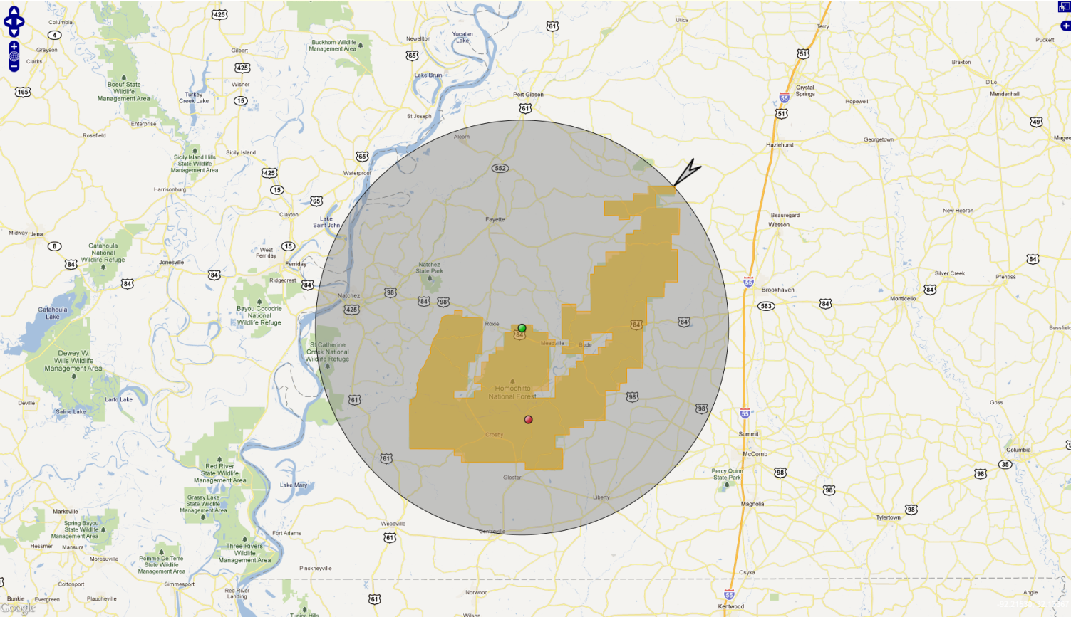
Homochitto National Forest; MS; USA

Slide 11
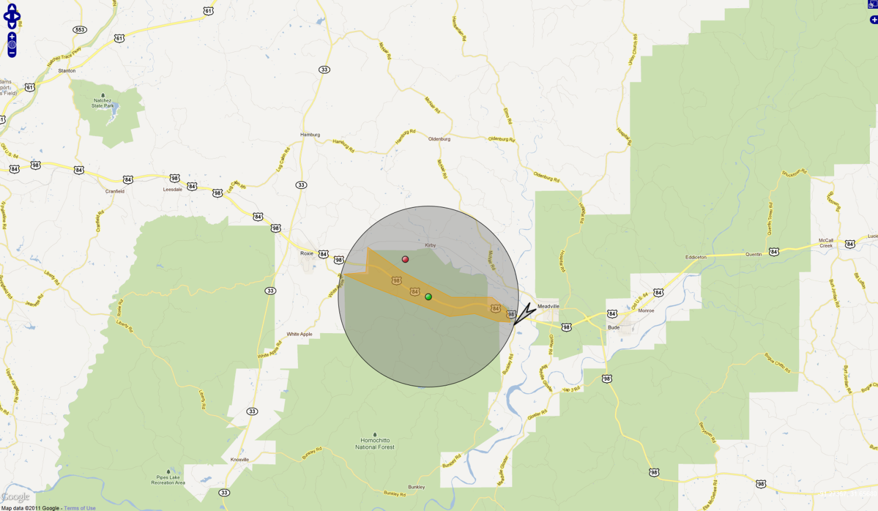
Homochitto National Forest; MS; USA
Along Highway 84

Slide 12
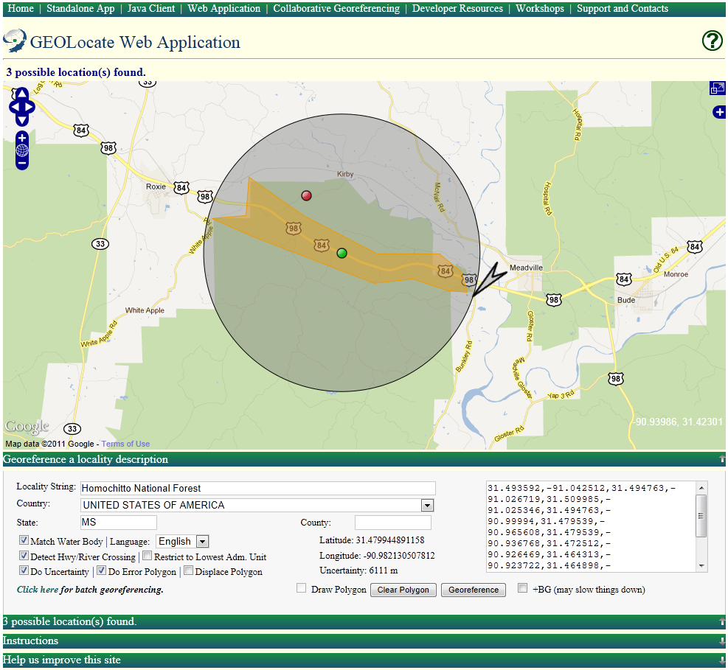

Slide 13
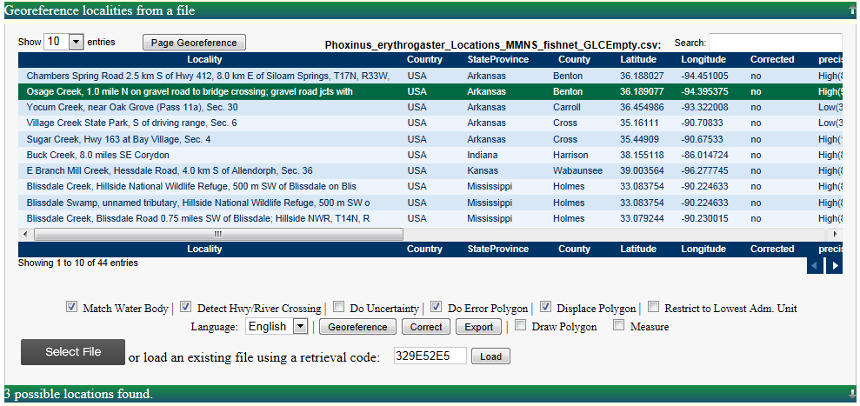
Batch Georeferencing

Slide 14
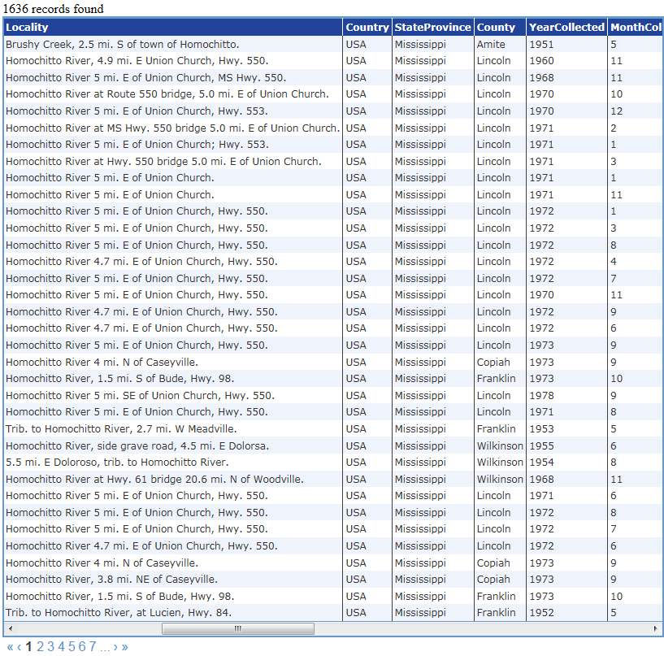
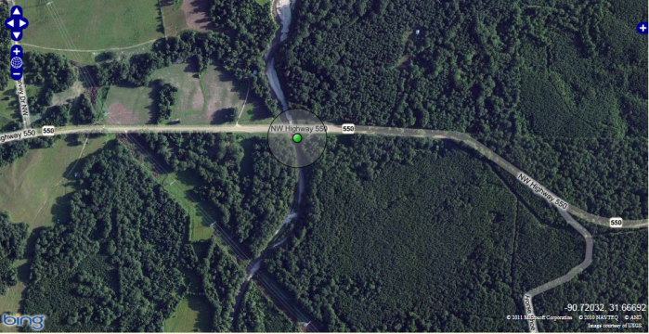
Collaborative Georeferencing: Sharing Data

Slide 15
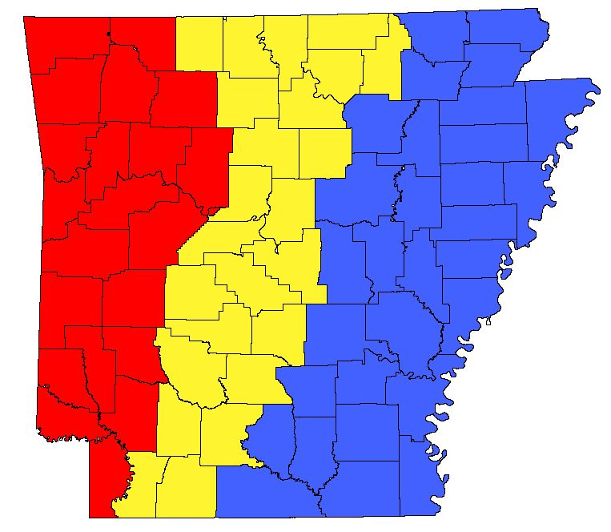
Collaborative Georeferencing: Distributed Workloads

Slide 16
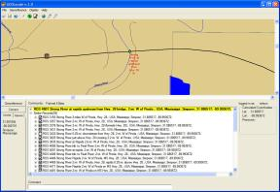
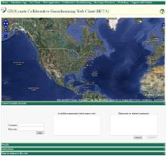
A Framework for Collaborative Georeferencing
DiGIR Service
Remote
Data Source
CSV Upload
Cache Update Web
Service
CoGe Web Portal Application
Data Retrieval Web
Service
Data Store
CoGe Client Application (Desktop or Web)
Insert Correction Web
Record Processor
Service
Georeferencing Web
Service

Slide 17
Collaborative Georeferencing Management Portal

Slide 18
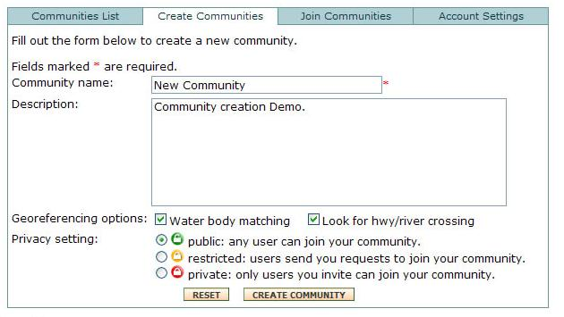
Georeferencing Communities
Create Communities
Data Sources
Add New Users & Link Out

Slide 19
Georeferencing Communities
Data Sources

Slide 20
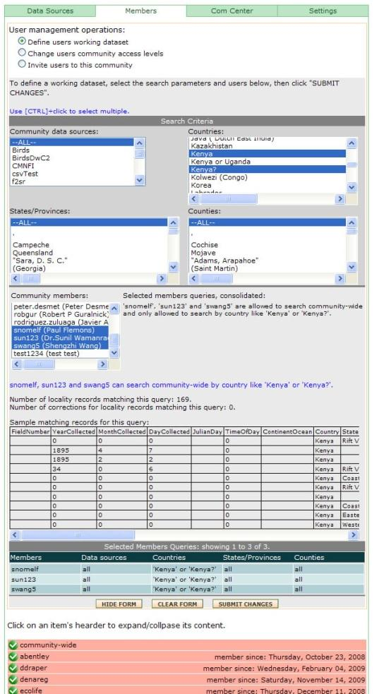
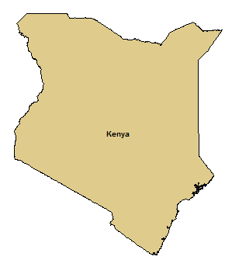
User Management:
Task Assignment
Assign all records from Kenya to
experts on East African regions

Slide 21
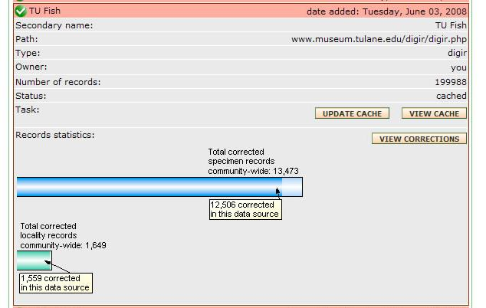
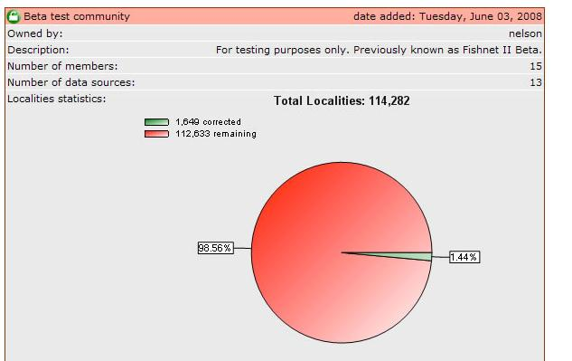
Monitoring & Managing Progress

Slide 22
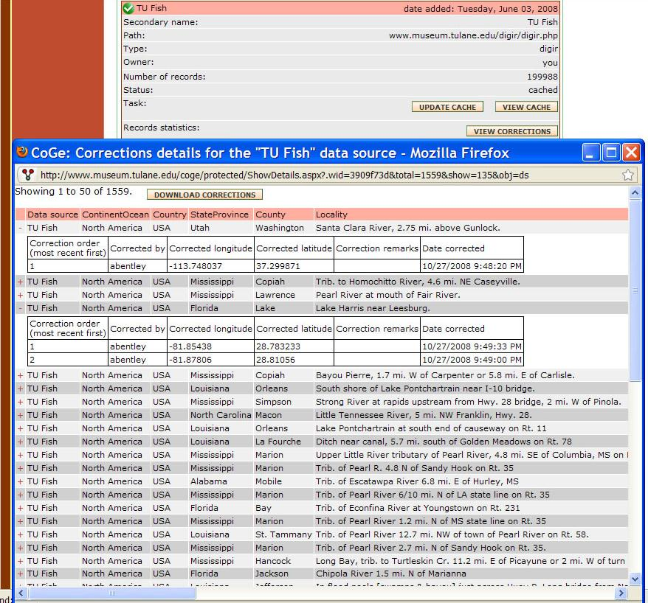
Data Repatriation

Slide 23
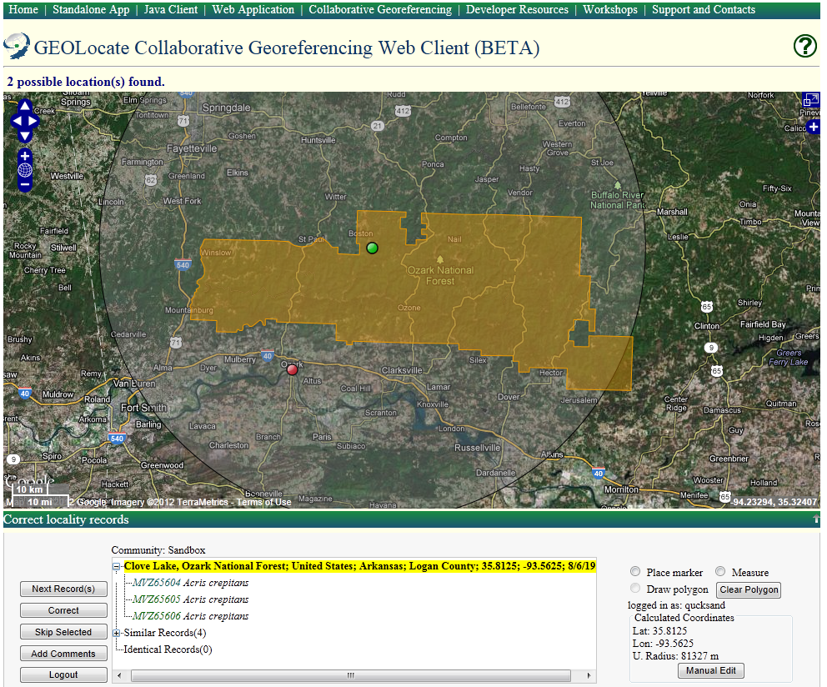
Collaborative Web Client
Optional Hyperlink

Slide 24
Interoperability
Embeddable Web Client
Georeferencing Web Services

Slide 25
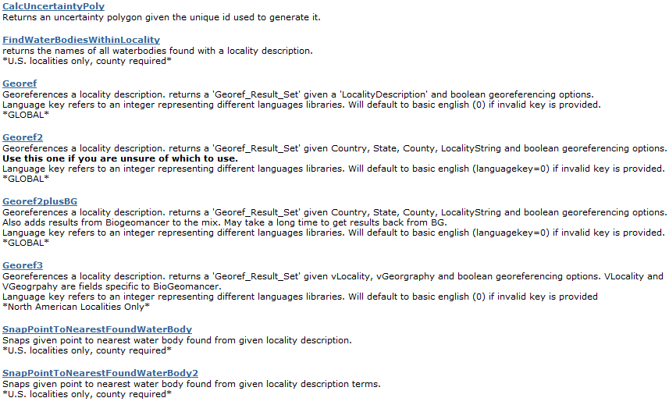
Georeferencing Services: GEOLocate v2
SOAP & HTTP Get/Post
http://www.museum.tulane.edu/webservices/geolocatesvcv2/geolocatesvc.asmx

Slide 26
HTTP/1.1 200 OK
Content-Type: text/xml; charset=utf-8
Content-Length: length
<?xml version="1.0" encoding="utf-8"?>
<Georef_Result_Set xmlns="http://www.museum.tulane.edu/webservices/">
<EngineVersion>string</EngineVersion>
<NumResults>int</NumResults>
<ExecutionTimems>double</ExecutionTimems>
<ResultSet>
<WGS84Coordinate>
<Latitude>double</Latitude>
<Longitude>double</Longitude>
</WGS84Coordinate>
<ParsePattern>string</ParsePattern>
<Precision>string</Precision>
<Score>int</Score>
<UncertaintyRadiusMeters>string</UncertaintyRadiusMeters>
<UncertaintyPolygon>string</UncertaintyPolygon>
<ReferenceLocation>string</ReferenceLocation>
<DisplacedDistanceMiles>double</DisplacedDistanceMiles>
<DisplacedHeadingDegrees>double</DisplacedHeadingDegrees>
<Debug>string</Debug>
</ResultSet>
<ResultSet>
.
.
.
</ResultSet>
</Georef_Result_Set>
Version 2 Get Response
georef2()

Slide 27
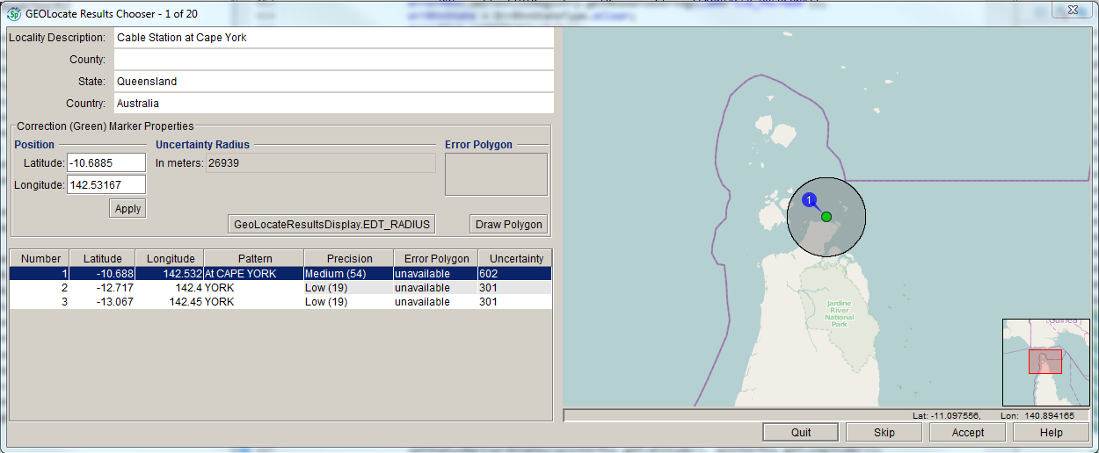

Slide 28
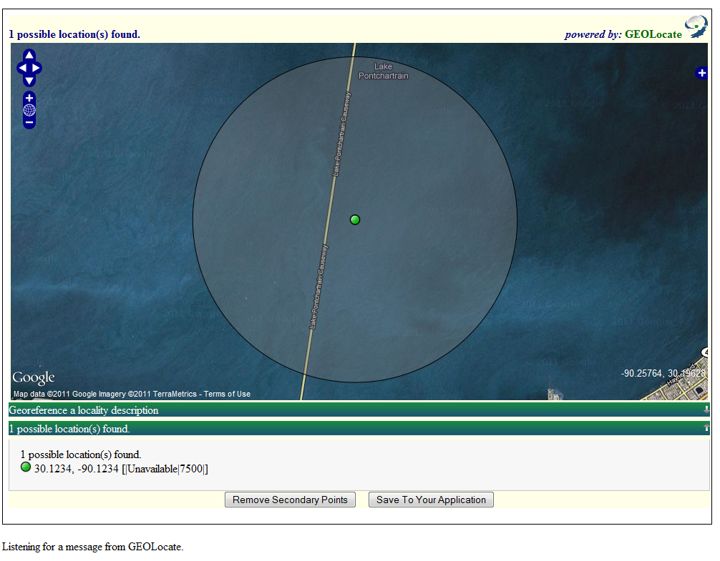
Application Service: Embeddable Client
Lightweight web based client, specifically designed for embedding into other web applications.
Requires JavaScript postMessage – compatible with all modern browsers.
Internet Explorer 8.0+
Firefox 3.0+
Safari 4.0+
Google Chrome 1.0+
Opera 9.5+

Slide 29
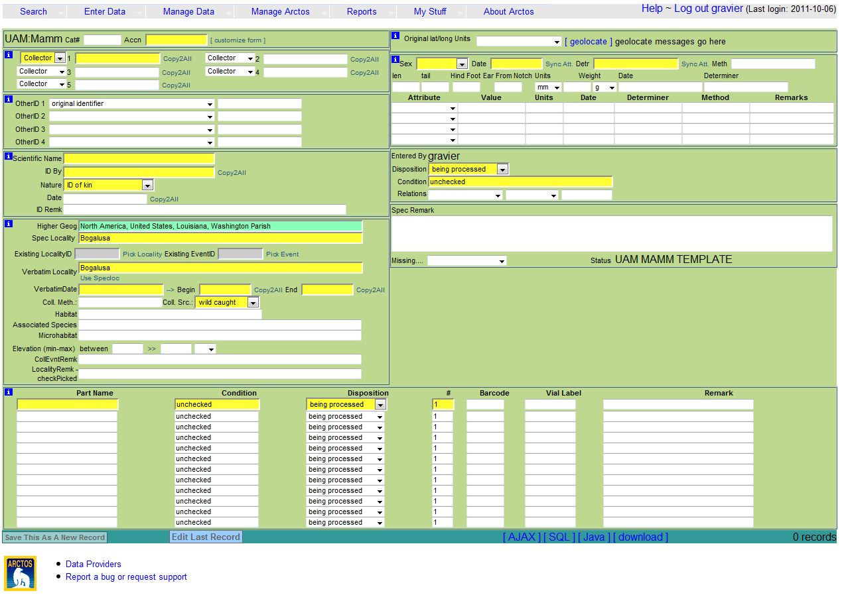
Arctos

Slide 30
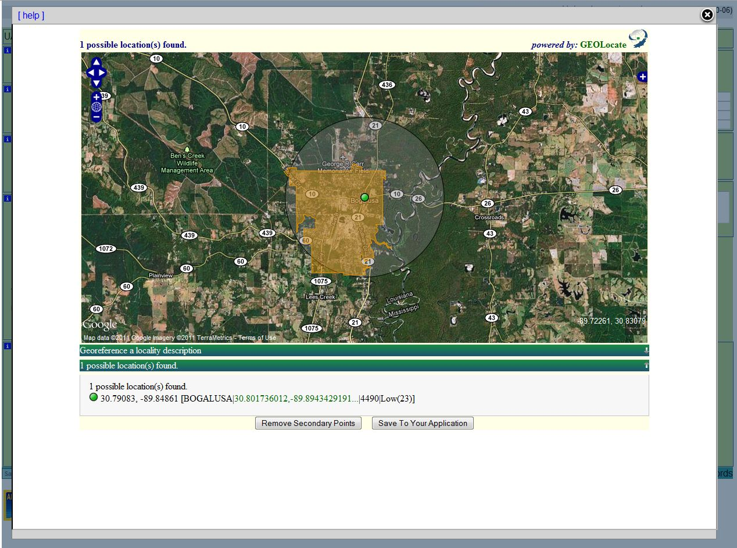

Slide 31
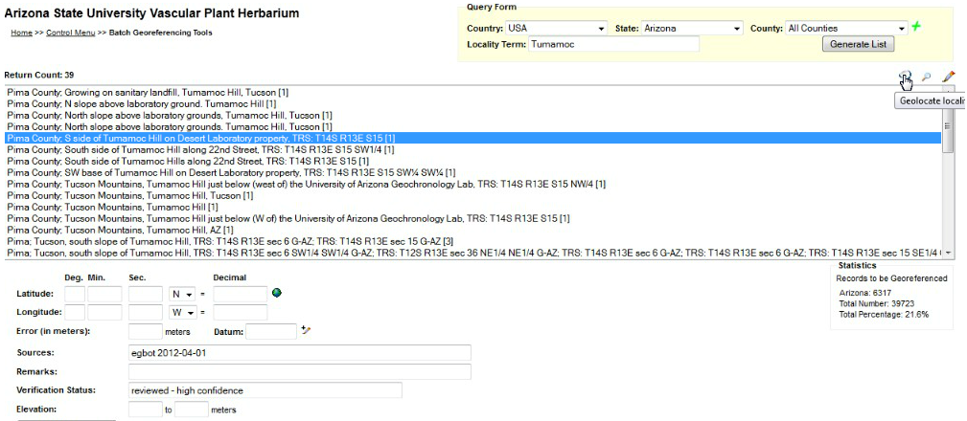

Slide 32
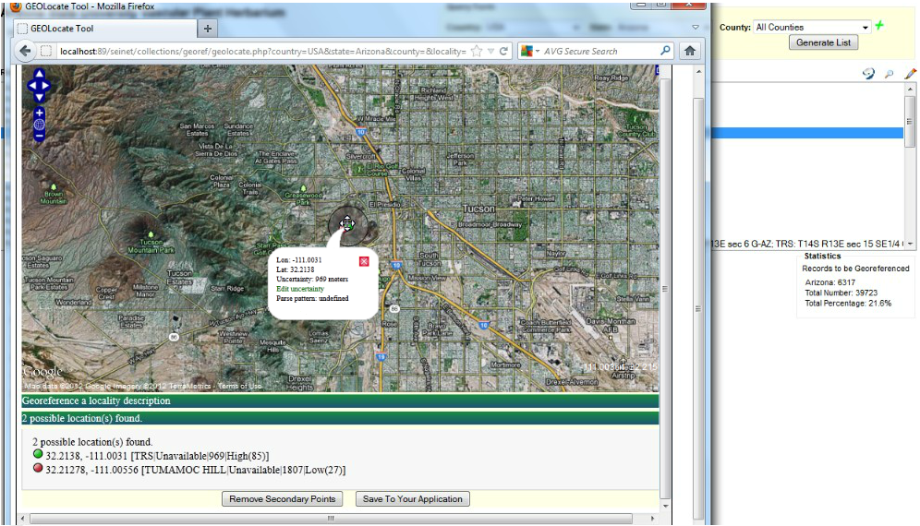

Slide 33
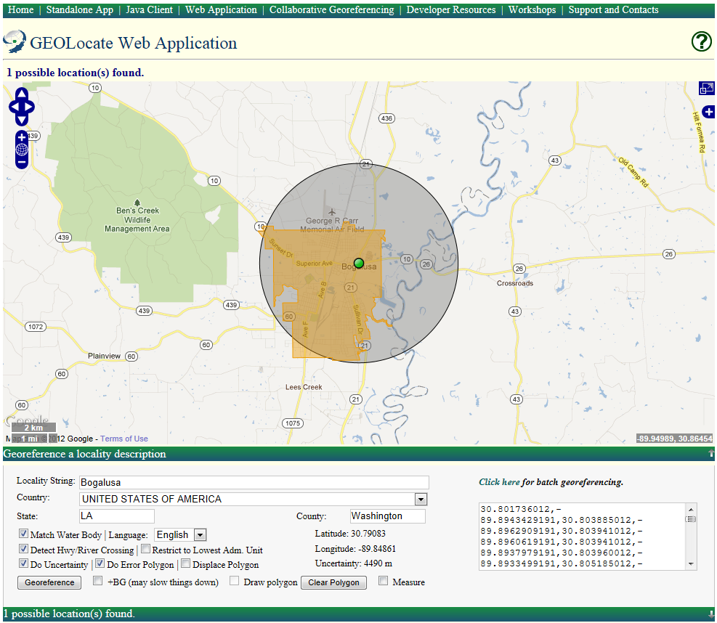
Excel
http://www.museum.tulane.edu/geolocate/web/WebGeoref.aspx? v=1&Country=USA&State=LA&County=Washington&Locality=Bogalusa&georef=run

Slide 34
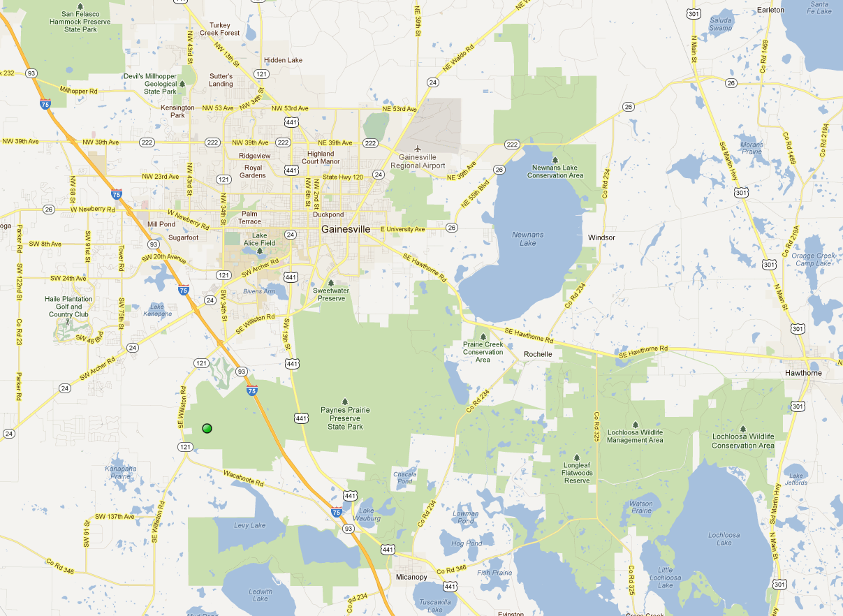
Future Work: Broad Crowdsourcing
Paynes Prairie Preserve State Park, near Gainesville. Alachua; FL; USA
Clustering based upon spatial variance, uncertainties & user skill level.

Slide 35
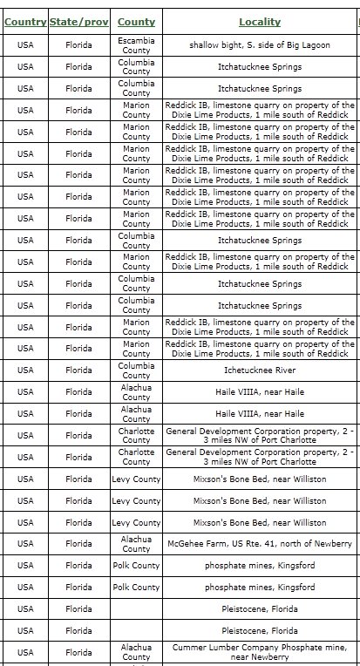
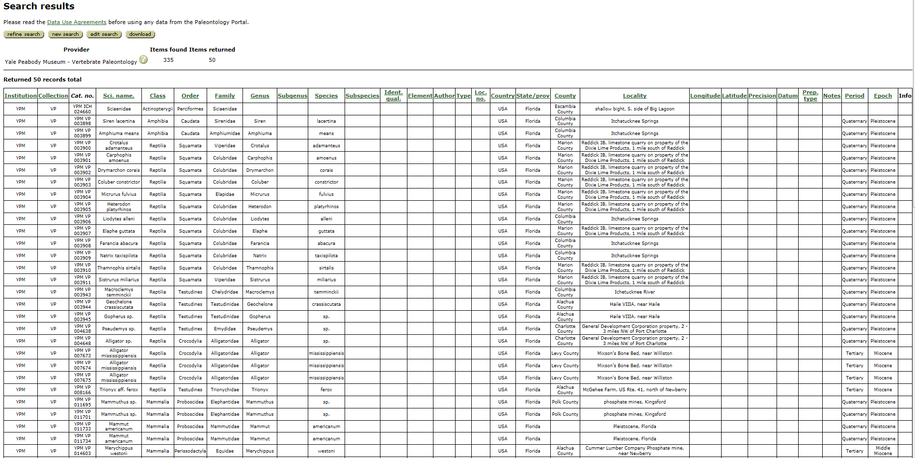
Paleontology Data: Gazetteers Needed?

Slide 36
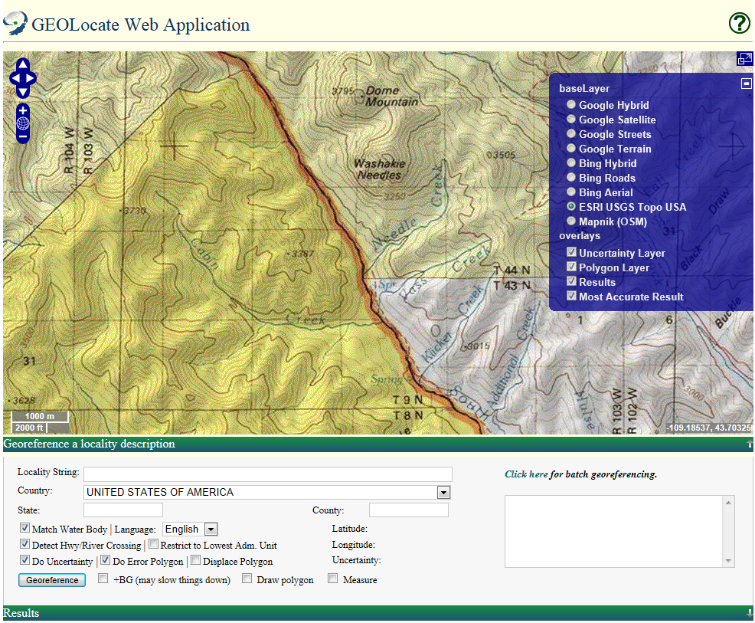
Paleontology Data: Base Layers Needed?

