Slide 1

SMALL IS BEAUTIFUL: Where do you divide among research-teaching-outreach?
Melanie DeVore
Department of Biological and Environmental Sciences & GCSU Natural History Museum

Slide 2
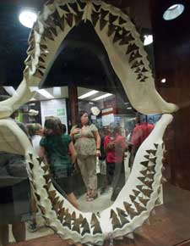
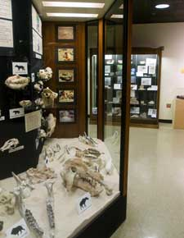
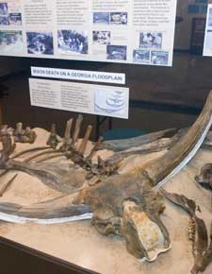
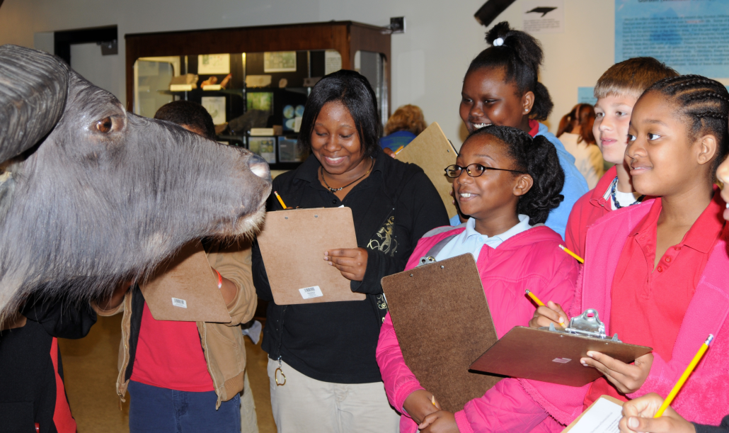
http://www.gcsu.edu/nhm/collections.htm

Slide 3
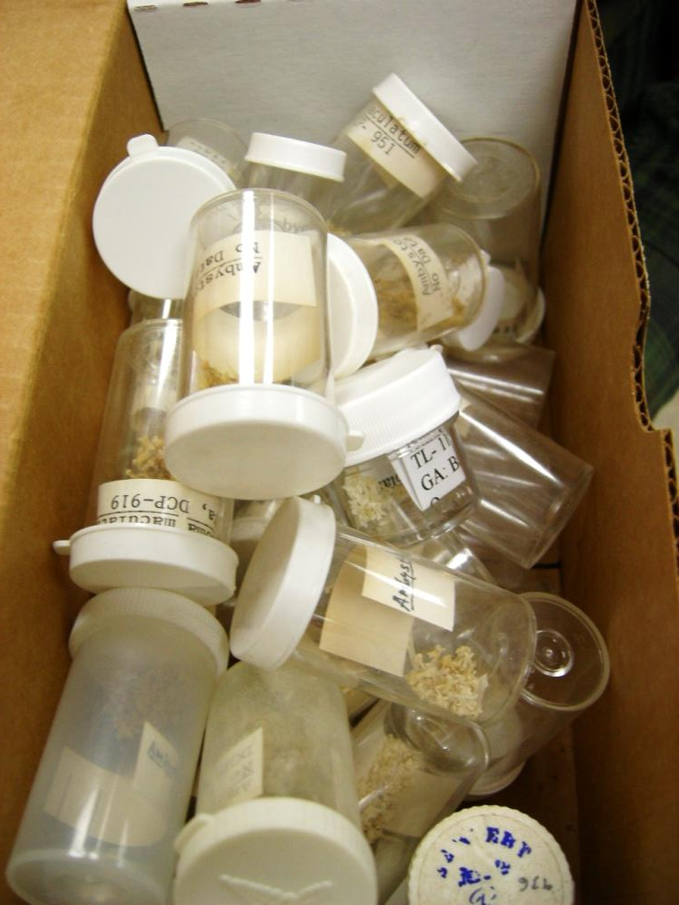
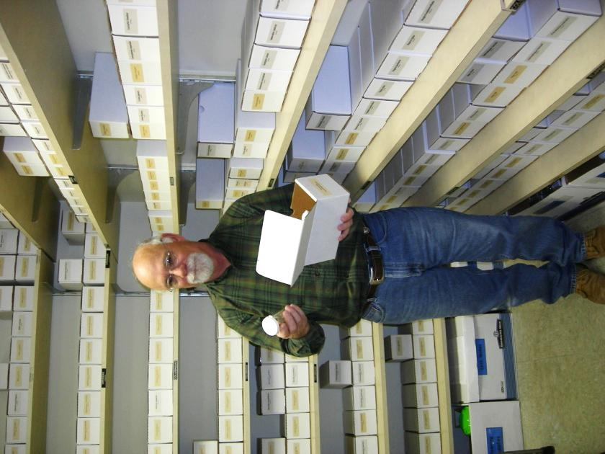

Slide 4
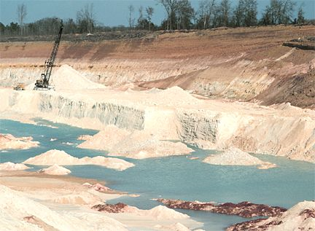
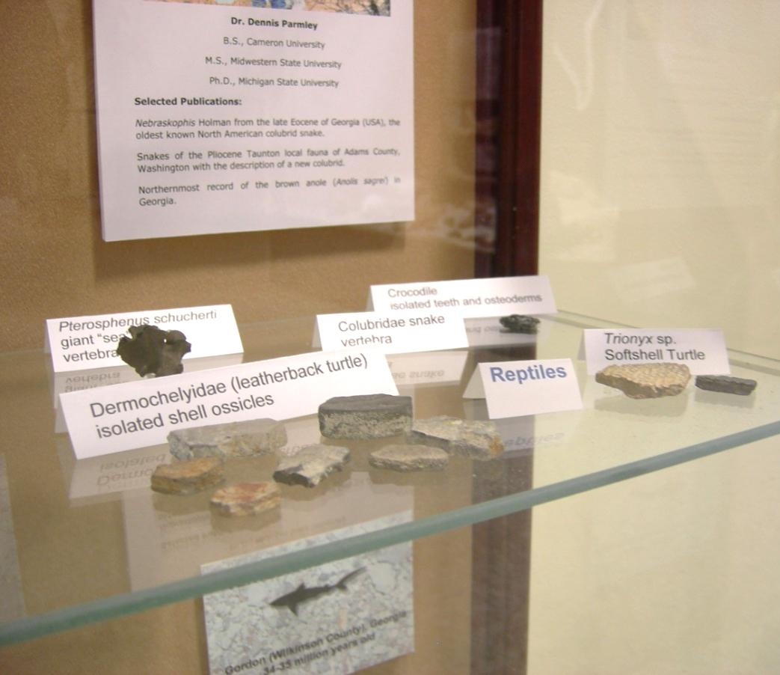

Slide 5
COLLECTING NEAR THE TERMINUS OF THE RAREFACTION CURVE CAN YIELD REWARDS FOR SYSTEMATIC AND BIOGEOGRAPHIC STUDIES
Hundreds of GCSU students from biology and geology classes, school groups, geology clubs, and colleagues wishing to add to teaching collections were responsible for some key discoveries
Baco and Smith, 2003. Mar Ecol Prog Ser
260: 109-114.

Slide 6
Chandler, R.M., and D. Parmley. 2003. The earliest North American record of an auk (Aves: Alcidae) from the Late Eocene of central Georgia, Hardie Mine, Gordon, Georgia. Oriole 68:7-9.
Palaeopheid Snakes from the Late Eocene Hardie Mine Local Fauna of Central Georgia
Dennis Parmley^{1,}and Melanie DeVore¹ 2005
D. Parmley and J. A. Holman. 2003. Nebraskophis Holman from the Late Eocene of Georgia (USA), the oldest known North American colubrid snake. Acta Zoologica Cracoviensia 46(1):1-8

Slide 7
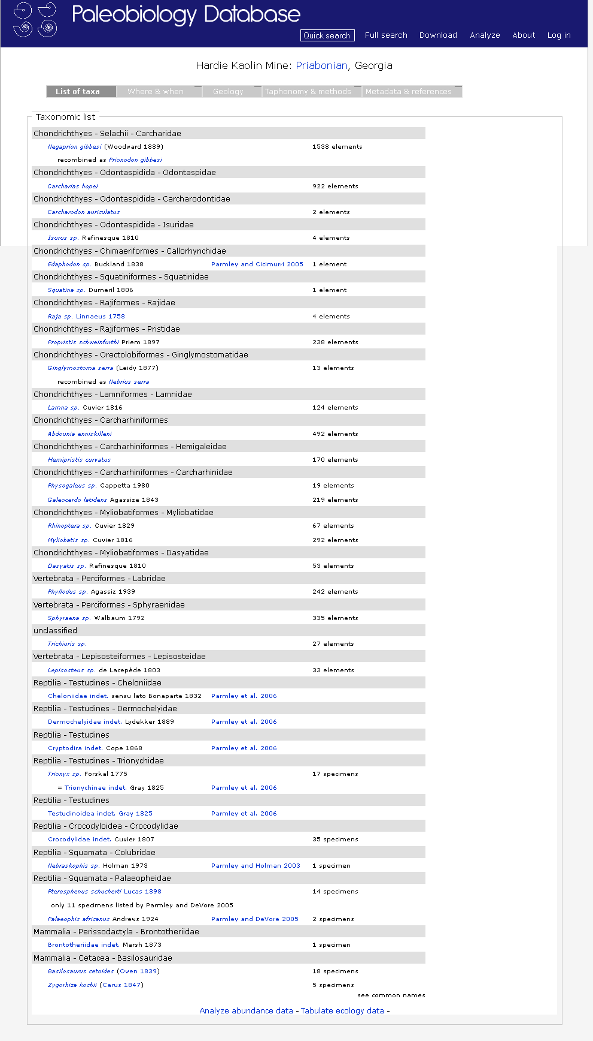

Slide 8
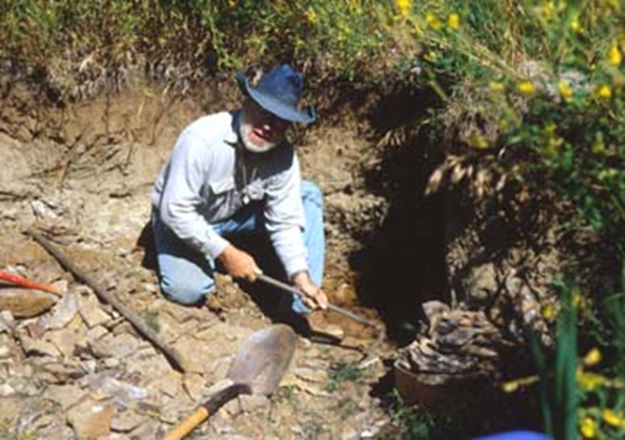
John Curtis UW Stevens Point

Slide 9
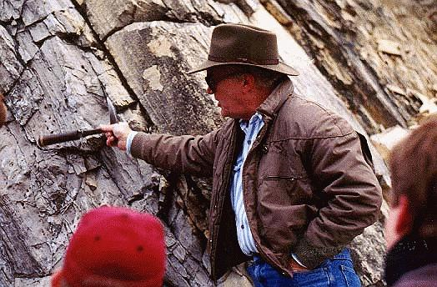
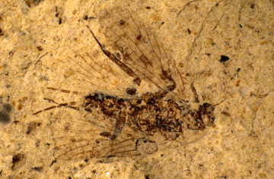
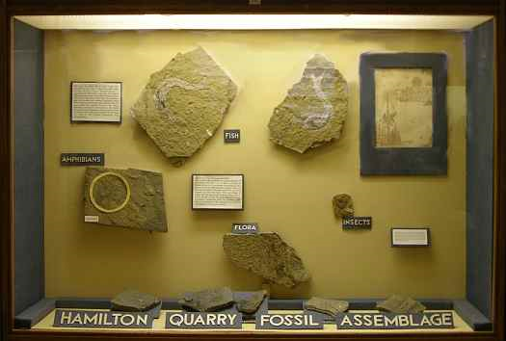
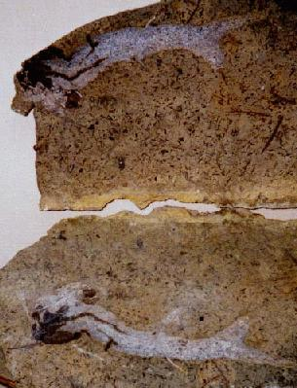
http://www.kgs.ku.edu/Extension/fossils/insect.html
Paul Johnston Emporia State University

Slide 10
Why small university collections are important
Small institutions often have material not duplicated in larger collections
Small collections have research collections based on the faculty curator’s interest
Small institutions miles away from a flag ship institution have the best collections of local sites

Slide 11

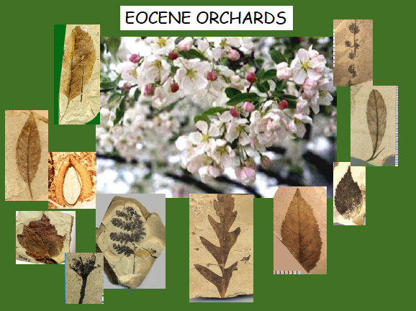
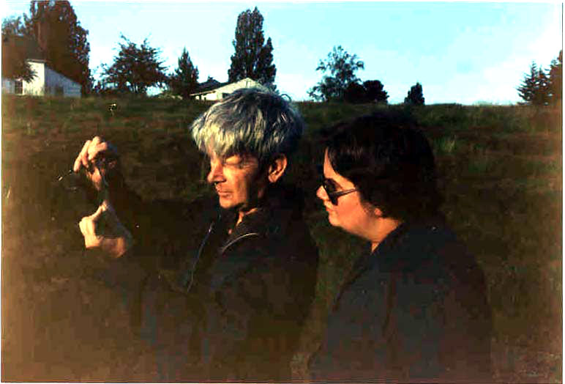
Wes Wehr’s Eocene Orchards

Slide 12

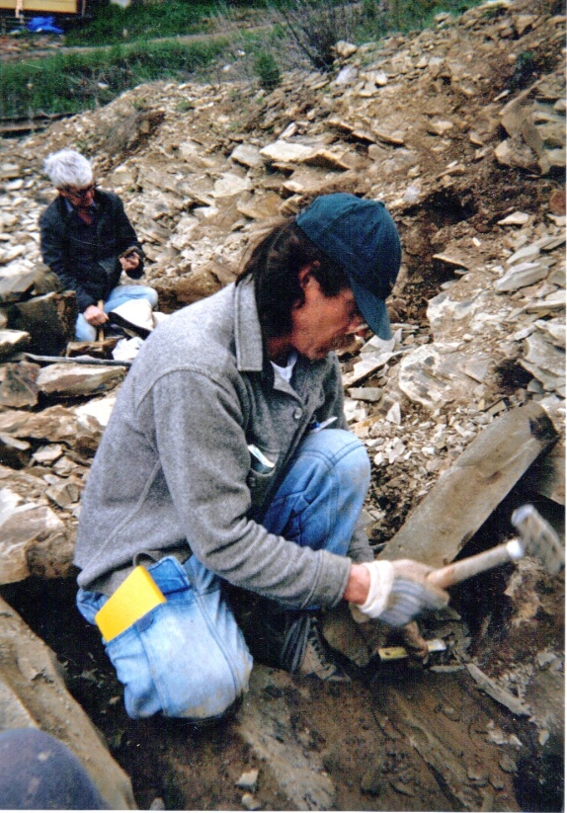
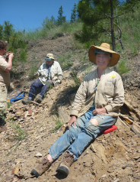
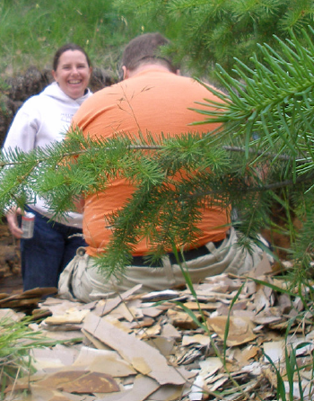
Maintains sites and coordinates collecting opportunities

Slide 13
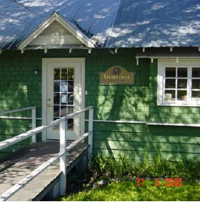
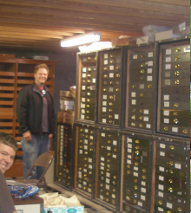
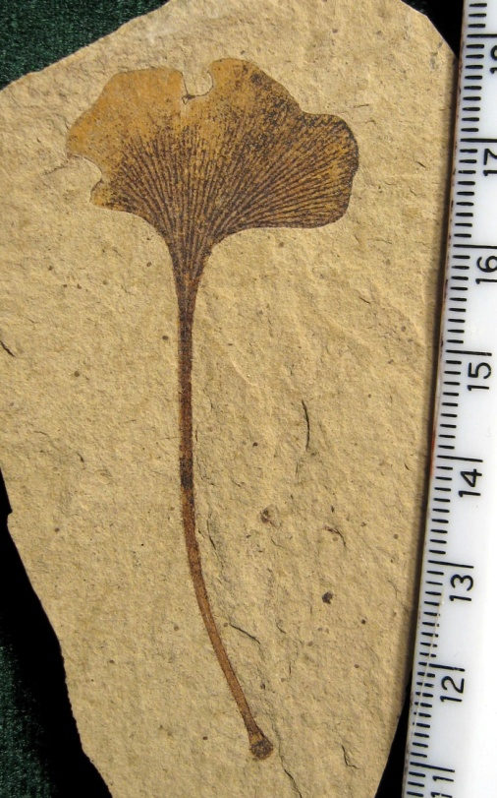
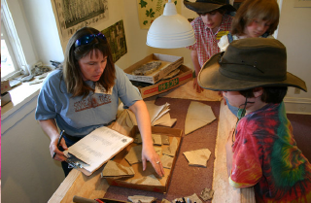
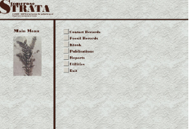
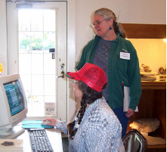

Slide 14
STONEROSE INTERPRETIVE CENTER AND EOCENE FOSSIL SITE
HAS AN ECONOMIC IMPACT ON FERRY COUNTY
YEAR | TOTAL VISITORS TO FERRY COUNTY | VISITING JUST FOR STONEROSE | NO. NIGHTS VISITORS STAYED LOCALLY | NO. STATES REPRESENTED BY VISITORS
2009* | 4836 | 1318 | 1160 | 27
2008 | 7450 | 3547 | 2348 | 31
2007 | 8181 | 2724 | 2306 | 40
2006 | 6832 | 2171 | 2176 | 36
2005 | 9084 | 1997 | 2665 | 36
TOTAL | 36,383 | 11,757 | 10,655

Slide 15
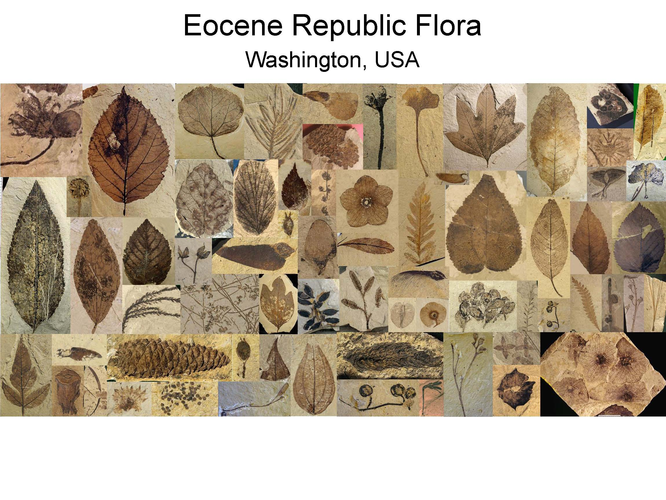

Slide 16
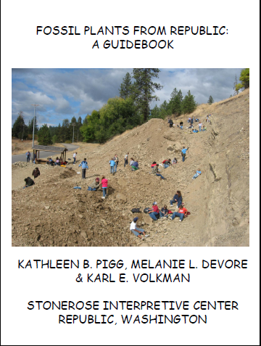
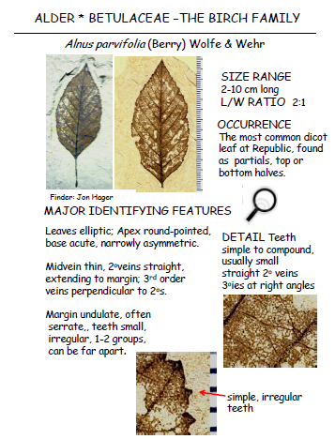

Slide 17
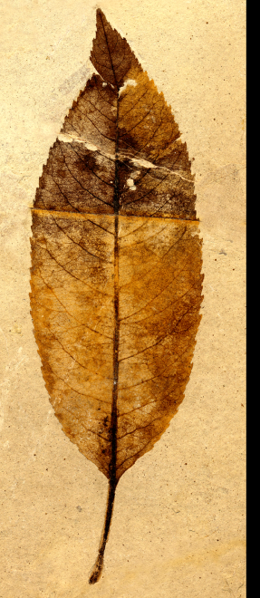
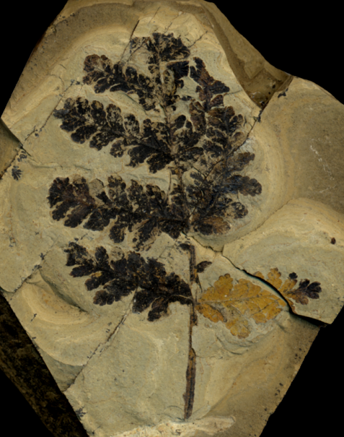
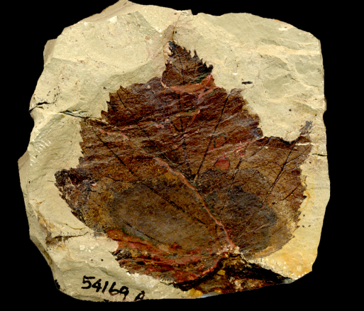
Rosaceae from Republic and the Okanogan Highlands
Published taxa:
Photinia pagae Wolfe & Wehr 1987 Leaves
Stonebergia columbiana Wolfe & Wehr 1988 Leaves
Nevuisia dunthornei DeVore, Moore, Pigg & Wehr 2003 Leaves
Prunus cathybrownae Benedict, DeVore & Pigg 2011 Flowers & young fruits
Oemleria janhartfordae Benedict, DeVore & Pigg 2011 Flower

Slide 18
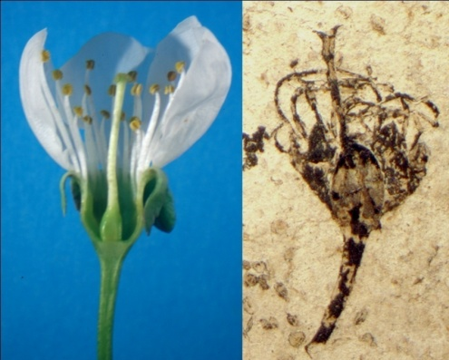
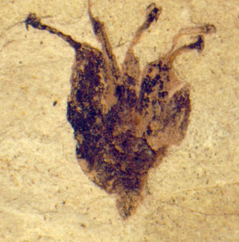
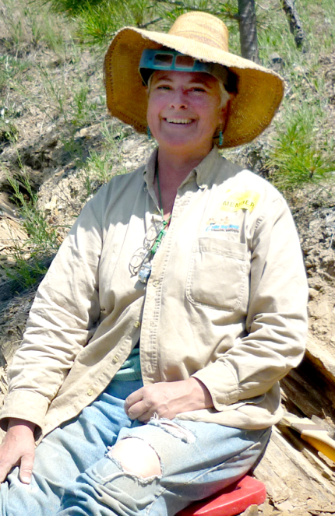

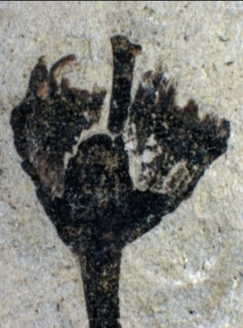
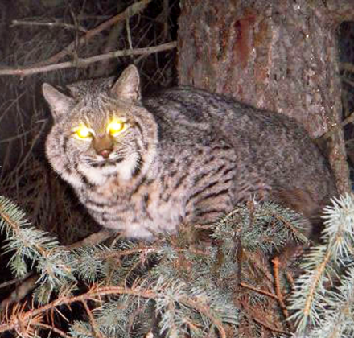
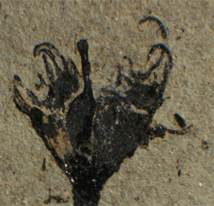
Prunus and Oemleria flowers from Republic
Clementine, Evelyn & Cathy Brown
Jan Hartford and friend
Benedict et al., 2011, International Journal of Plant Sciences

Slide 19
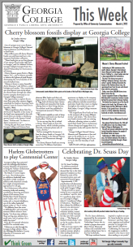
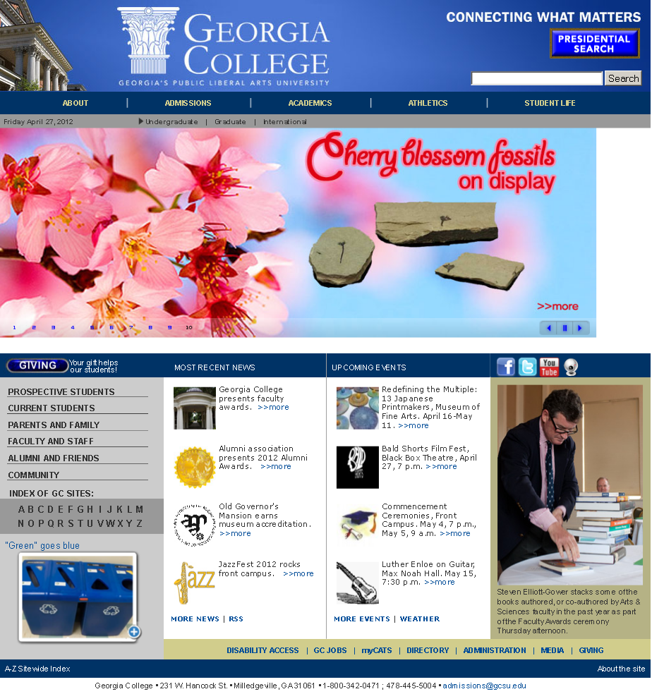

► 2:43► 2:43

Slide 20
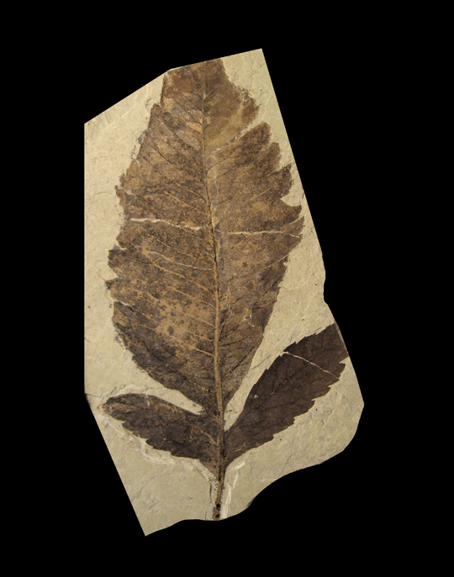
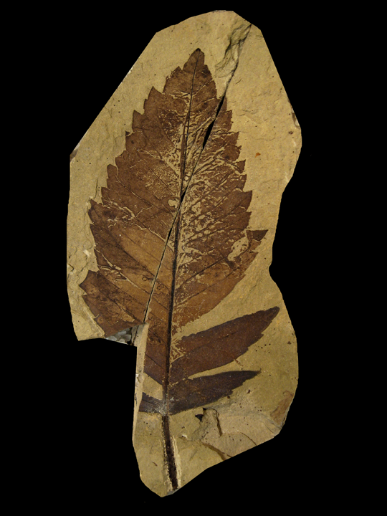
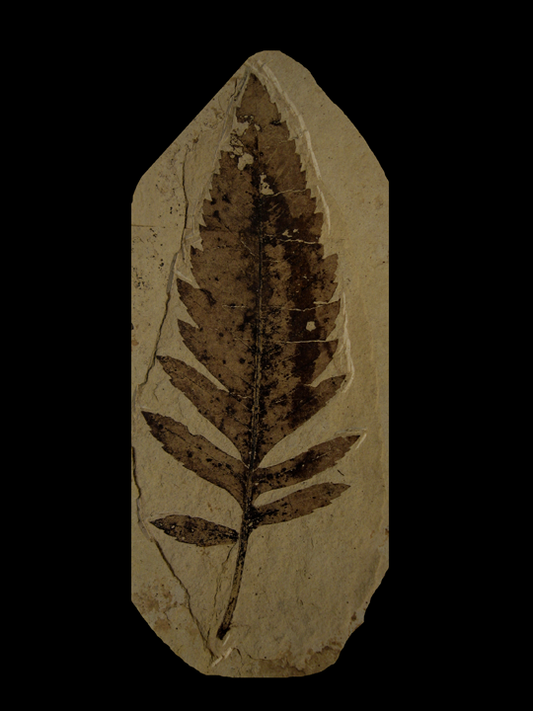
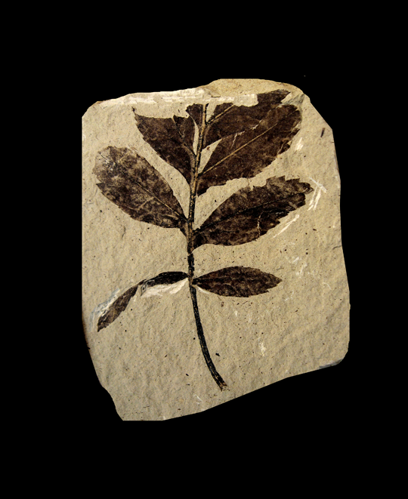
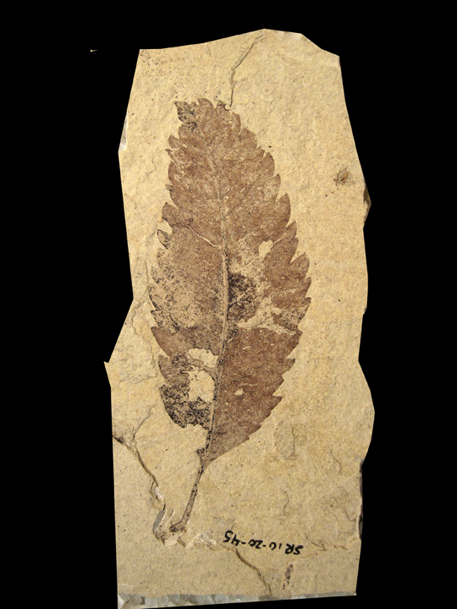
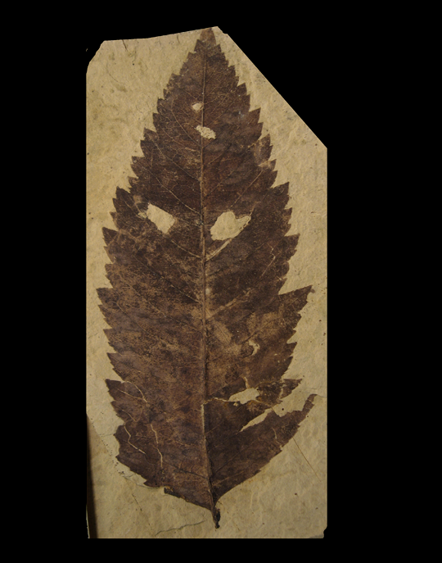
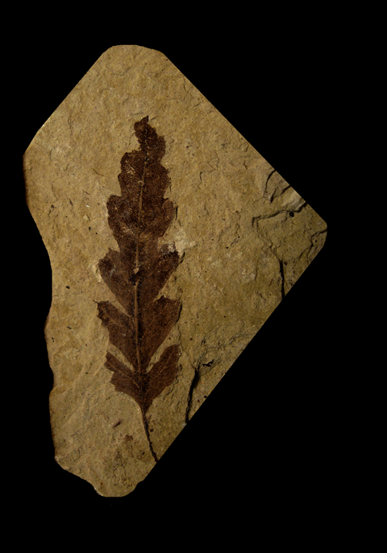
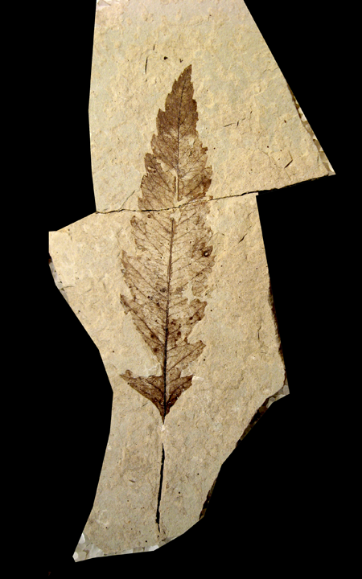

Slide 21
Smaller universities place a selection pressure on an individual to find a way to integrate your research with both teaching and outreach
Smaller universities create a natural environment for interdisciplinary research
Smaller universities provide an educational framework that is essential
for training the next generation of biodiversity specialists

