Slide 1


Smithsonian Fossil Collections and the Paleobiology Database
Peter Wagner
Dept. of Paleobiology
Smithsonian

Slide 2
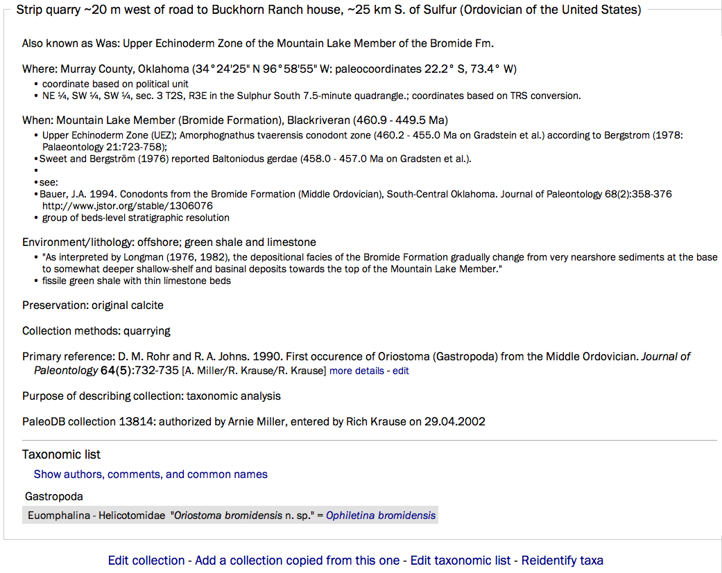
Locality 13184
Notes:
Information about fossiliferous localities often includes taxonomic revisions subsequent to the original publication.

Slide 3
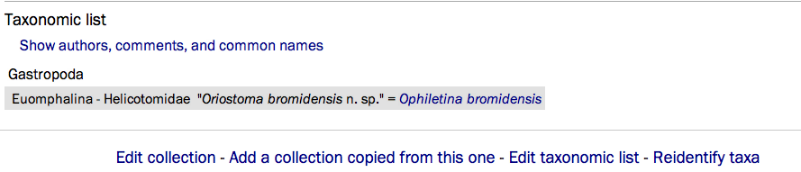
Locality 13184

Slide 4
The Common Problem for Research & Curation Databases
Oriostoma bromidensis and Ophiletina bromidensis are the same species.
Research: want both names tallied as one species and one genus;
Curation: want researcher to find specimen under either name.

Slide 5
Locality 13184

Slide 6
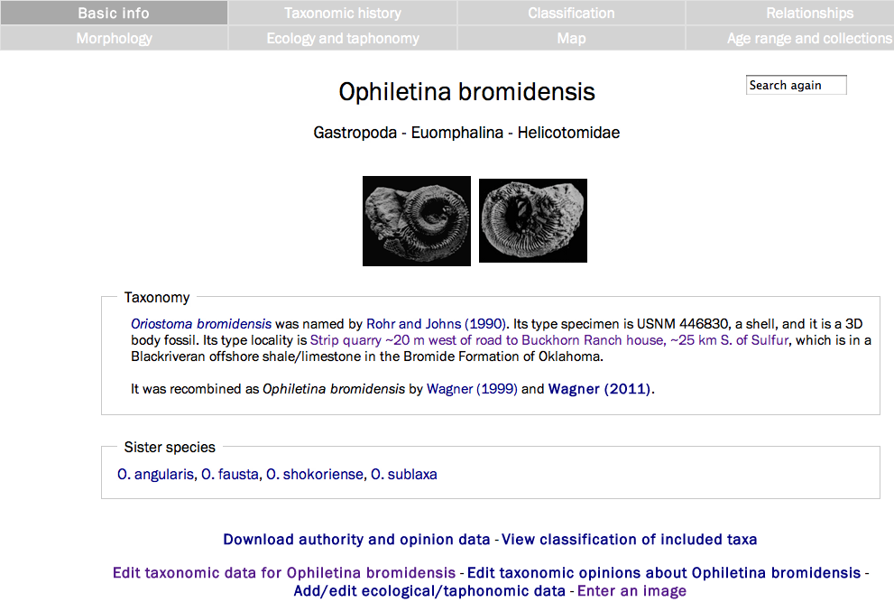
Basic Taxonomic Information
Notes:
Information about species includes links to original taxonomic data plus subsequent opinions. (This allows for editing and additional entry.)

Slide 7
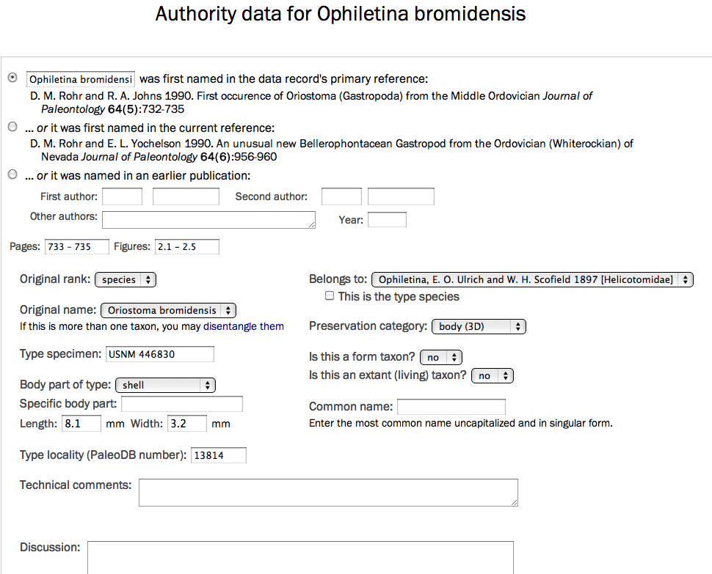
Authority Record
Notes:
Information relevant to museum collections included.

Slide 8
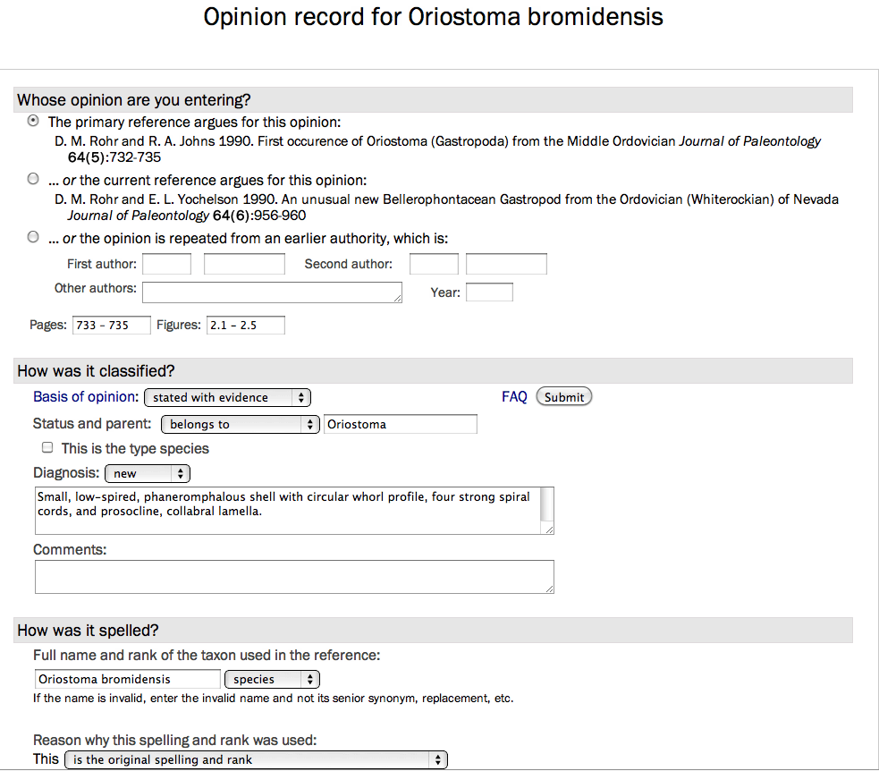
Opinion Record
Notes:
All opinions all for diagnoses and comments to be entered.

Slide 9
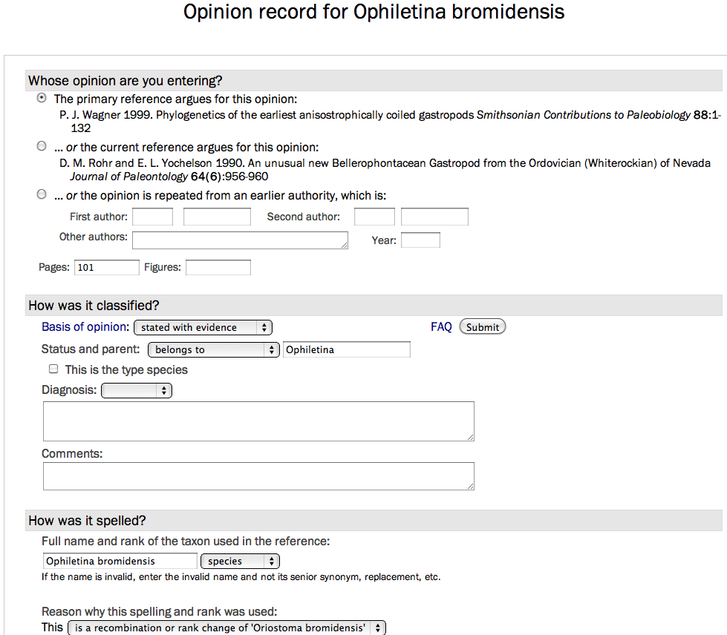
Opinion Record
Notes:
New genus species combinations (plus some general rating of the “quality” of that revision) entered in subsequent opinions.

Slide 10
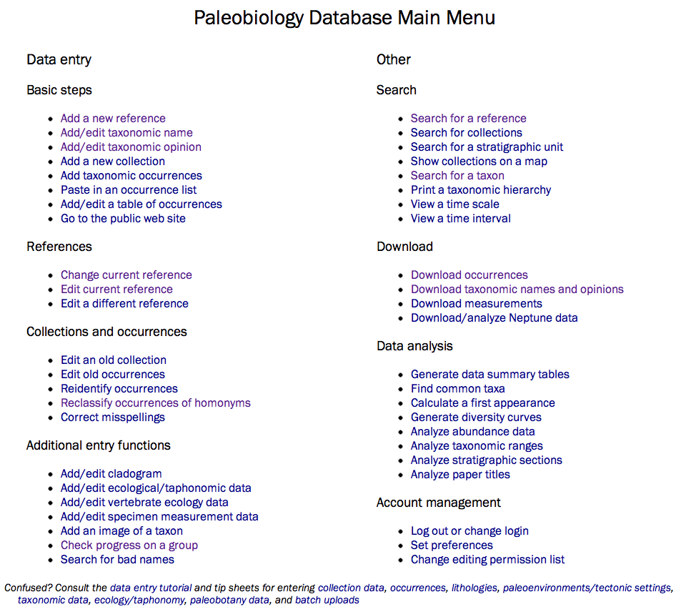
Getting Started: Main Menu
Notes:
The main menu allows novel species (or “fresh” opinions) to be entered.

Slide 11
Entered Species & Species Opinions
Clade | Species | (Invalid) | Opinions | Refs
Anthozoa | 6,306 | (500) | 9,780 | 757
Arthropoda | 19,125 | (886) | 25,211 | 2,712
Brachiopoda | 6,129 | (309) | 11,700 | 918
Mollusca | 31,186 | (2,334) | 69,796 | 10,127
Echinodermata | 2,540 | (143) | 5,967 | 2,397
Vertebrata | 20,922 | (4,661) | 67,850 | 16,261
Plantae | 337 | (14) | 438 | 101
Notes:
Coverage very heterogeneous so far.

Slide 12
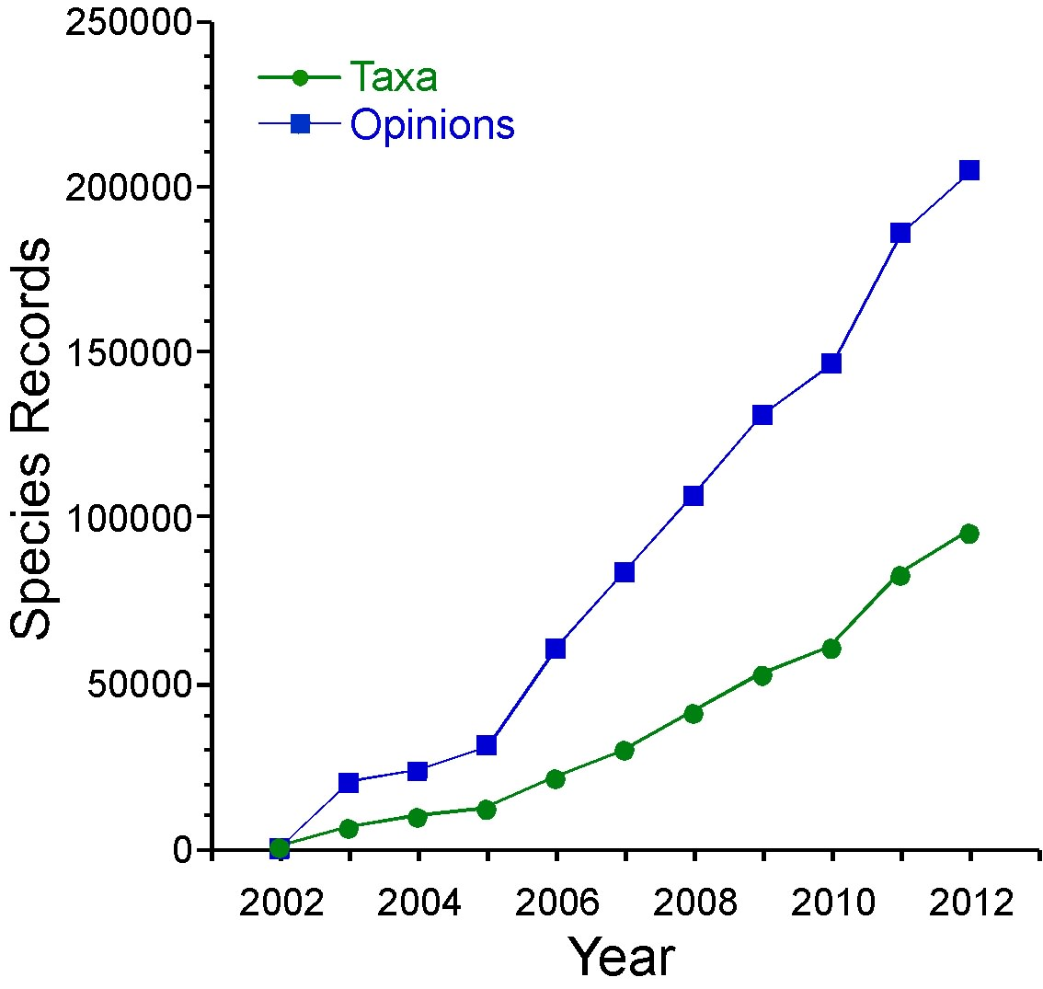
Taxonomic Data Entry:
Species and Species Opinions
Numbers of original species names and opinions attached to those names
(downloaded 24-04-2012).
Notes:
Taxonomic entry did not begin until 2002, but has proceeded at a good rate since then.

Slide 13
Getting Data: Main Menu
Notes:
Anybody can download the taxonomic data that we have.

Slide 14
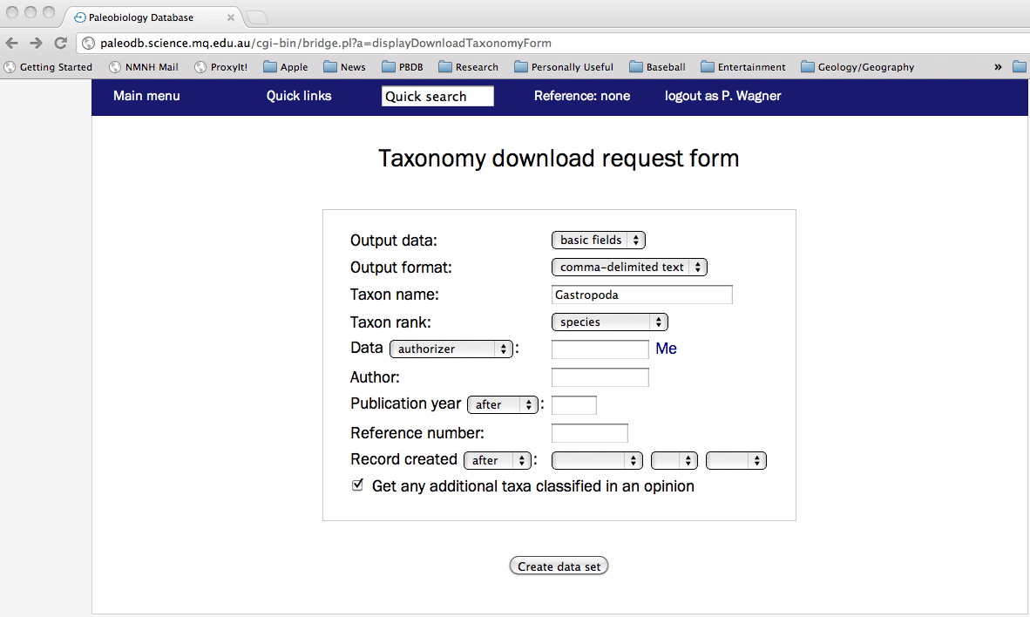
Taxonomic Downloads
Notes:
Simple form: allows you to choose from breadth of information, text file style, taxa, taxonomic rank, etc.

Slide 15
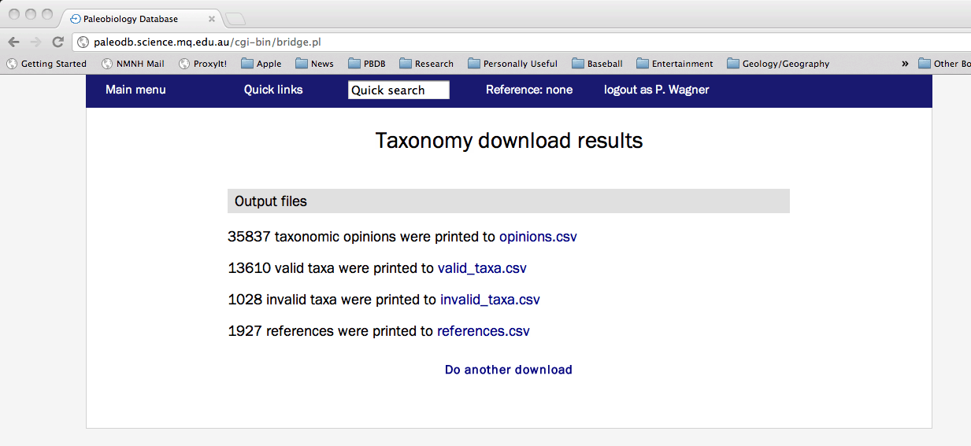
Taxonomic Downloads

Slide 16
Getting Data: Main Menu
Notes:
Collections are attached to these names.

Slide 17
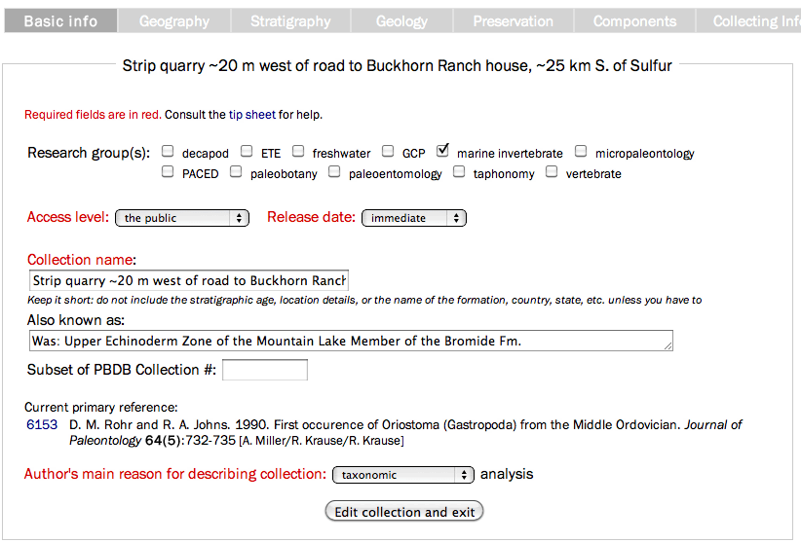
Locality Data
Notes:
General names similar to those on museum labels.

Slide 18
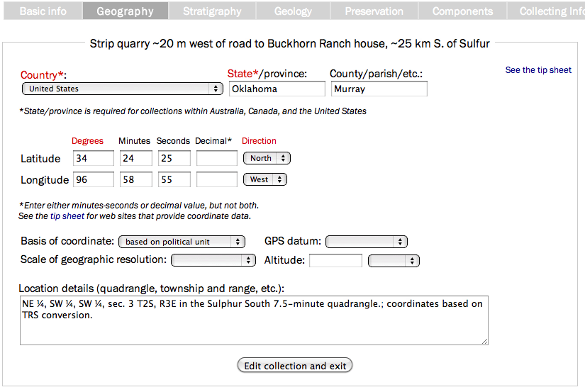
Locality Data
Notes:
Fairly detailed geographic information must be entered. (The PBDB can later convert this to paleo-coordinates.)

Slide 19
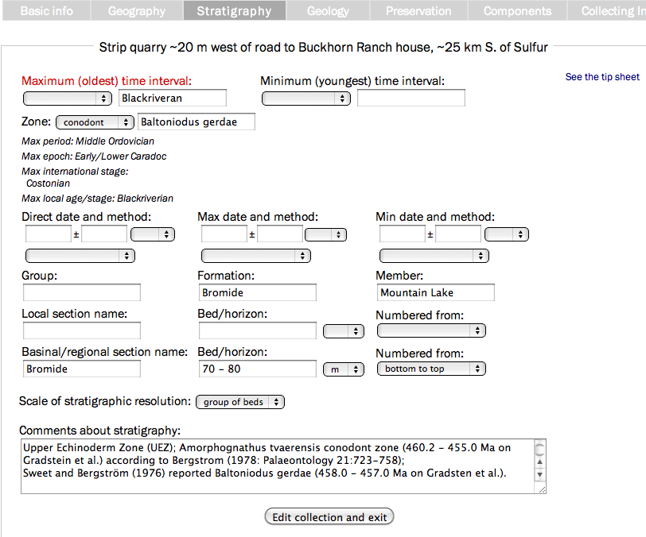
Locality Data
Notes:
Stratigraphic data can make the locality very exact: here, it is a range of beds over a 10m interval, but it can be as exact as individual beds. (Thus, one locality might have several collections.) Note that local stratigraphic scales can (and should) be used.

Slide 20
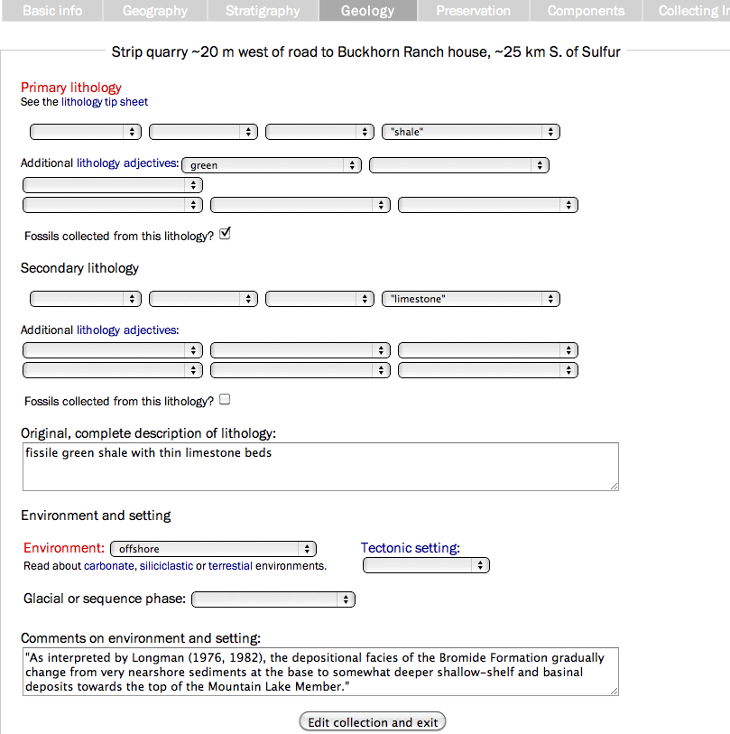
Locality Data
Notes:
Fairly detailed lithographic descriptions can (and should!) be entered.

Slide 21
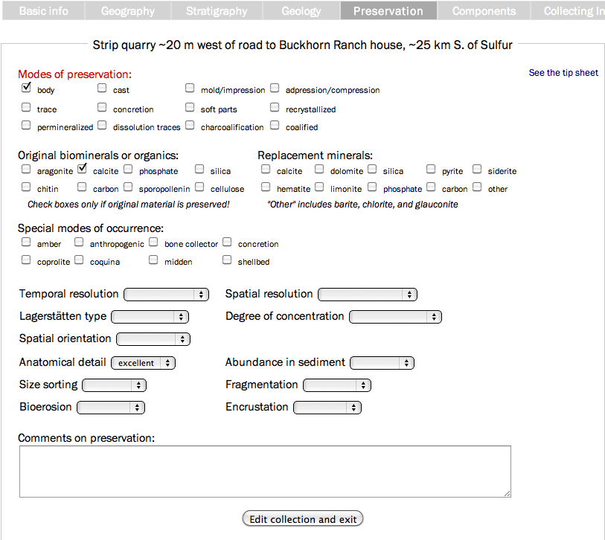
Locality Data
Notes:
Taphonomic/diagenetic information also can be entered.

Slide 22
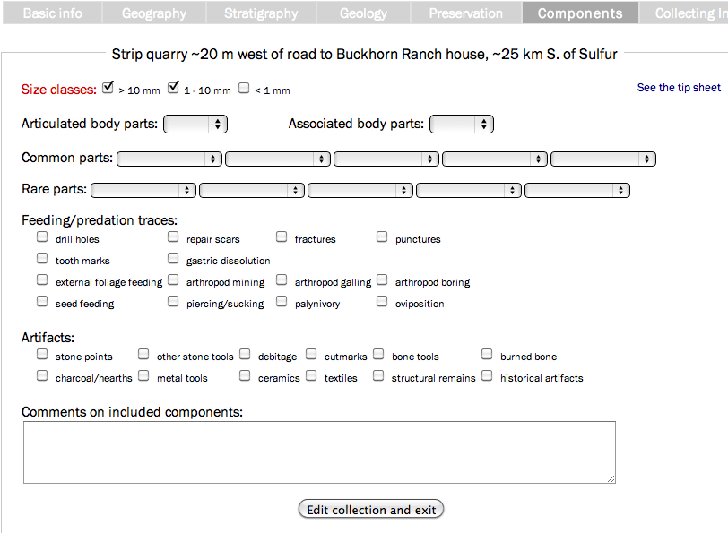
Locality Data

Slide 23
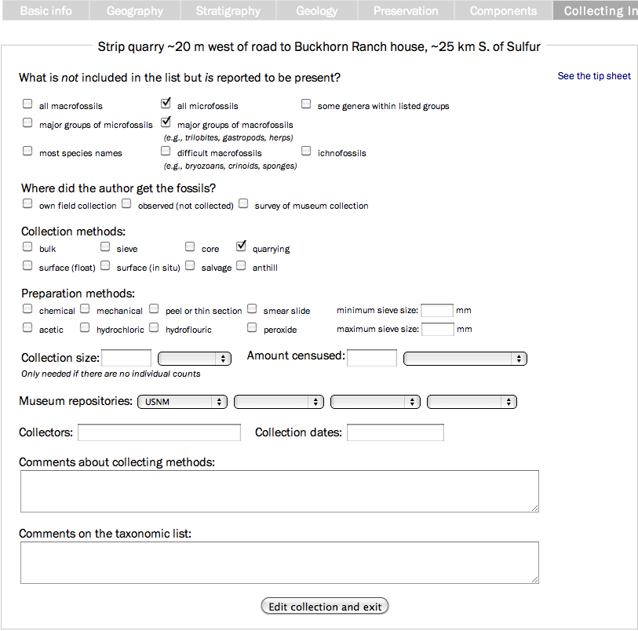
Locality Data
Notes:
Finally, where specimens reside can be entered.

Slide 24
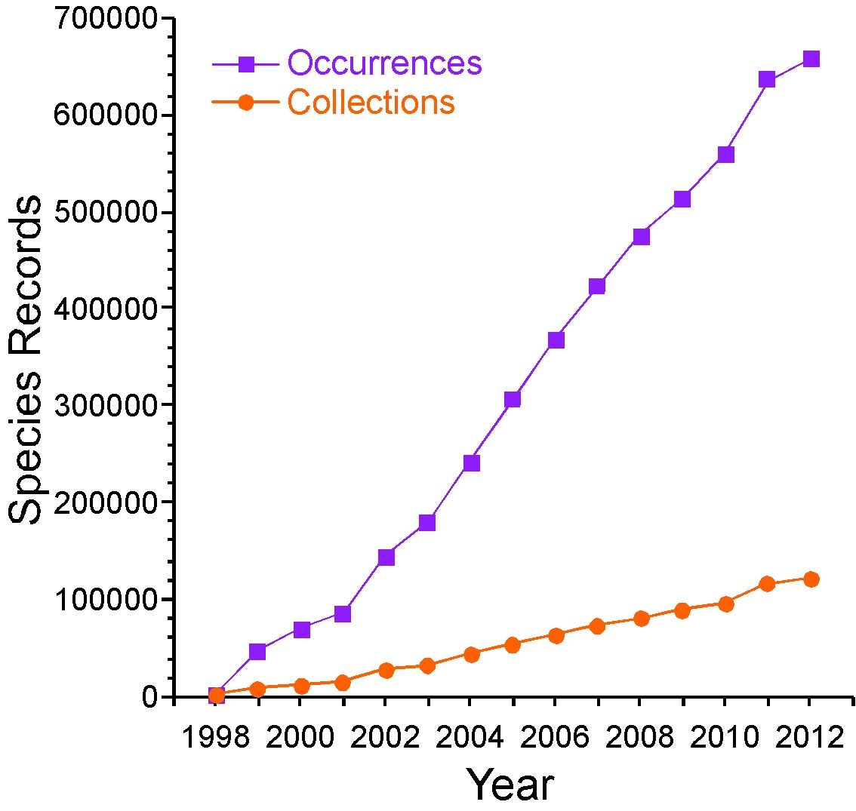
Taxonomic Data Entry:
Species and Species Opinions
Numbers of species occurrences and collections including identified species (downloaded 24-04-2012).
Notes:
Occurrence = 1+ finds of a species in a collection. (Genus sp. occurrences are omitted here.) Only collections including identified species are included here.

Slide 25
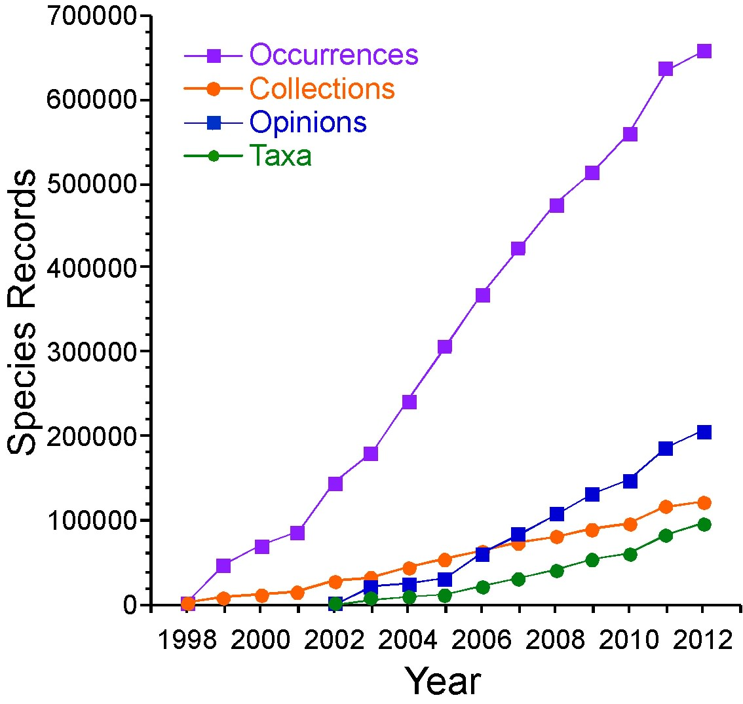
Taxonomic Data Entry:
Species and Species Opinions
All relevant PBDB data as of 24-04-2012.
Notes:
Occurrence = 1+ finds of a species in a collection. (Genus sp. occurrences are omitted here.) Only collections including identified species are included here.

