Slide 1
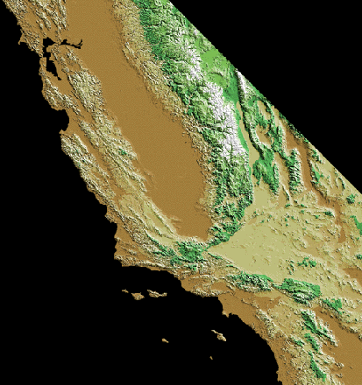
Switching Plates
*
NA
Searching for the History of Life
Jere H. Lipps
UCMP
Cooper Center
Pac
*

Slide 2
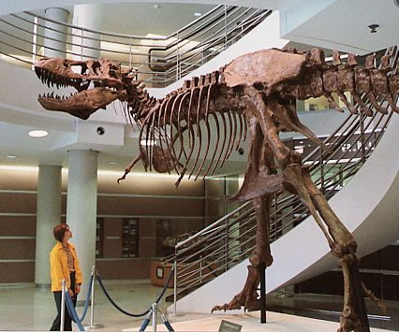
University of California Museum of Paleontology
The History of Life

Slide 3
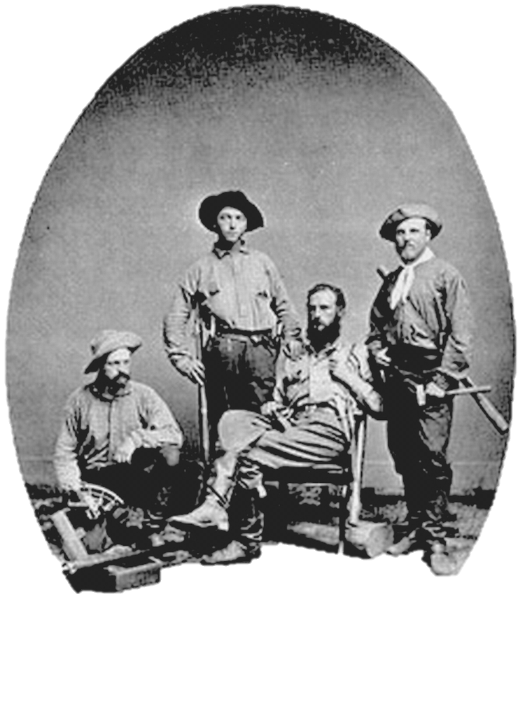
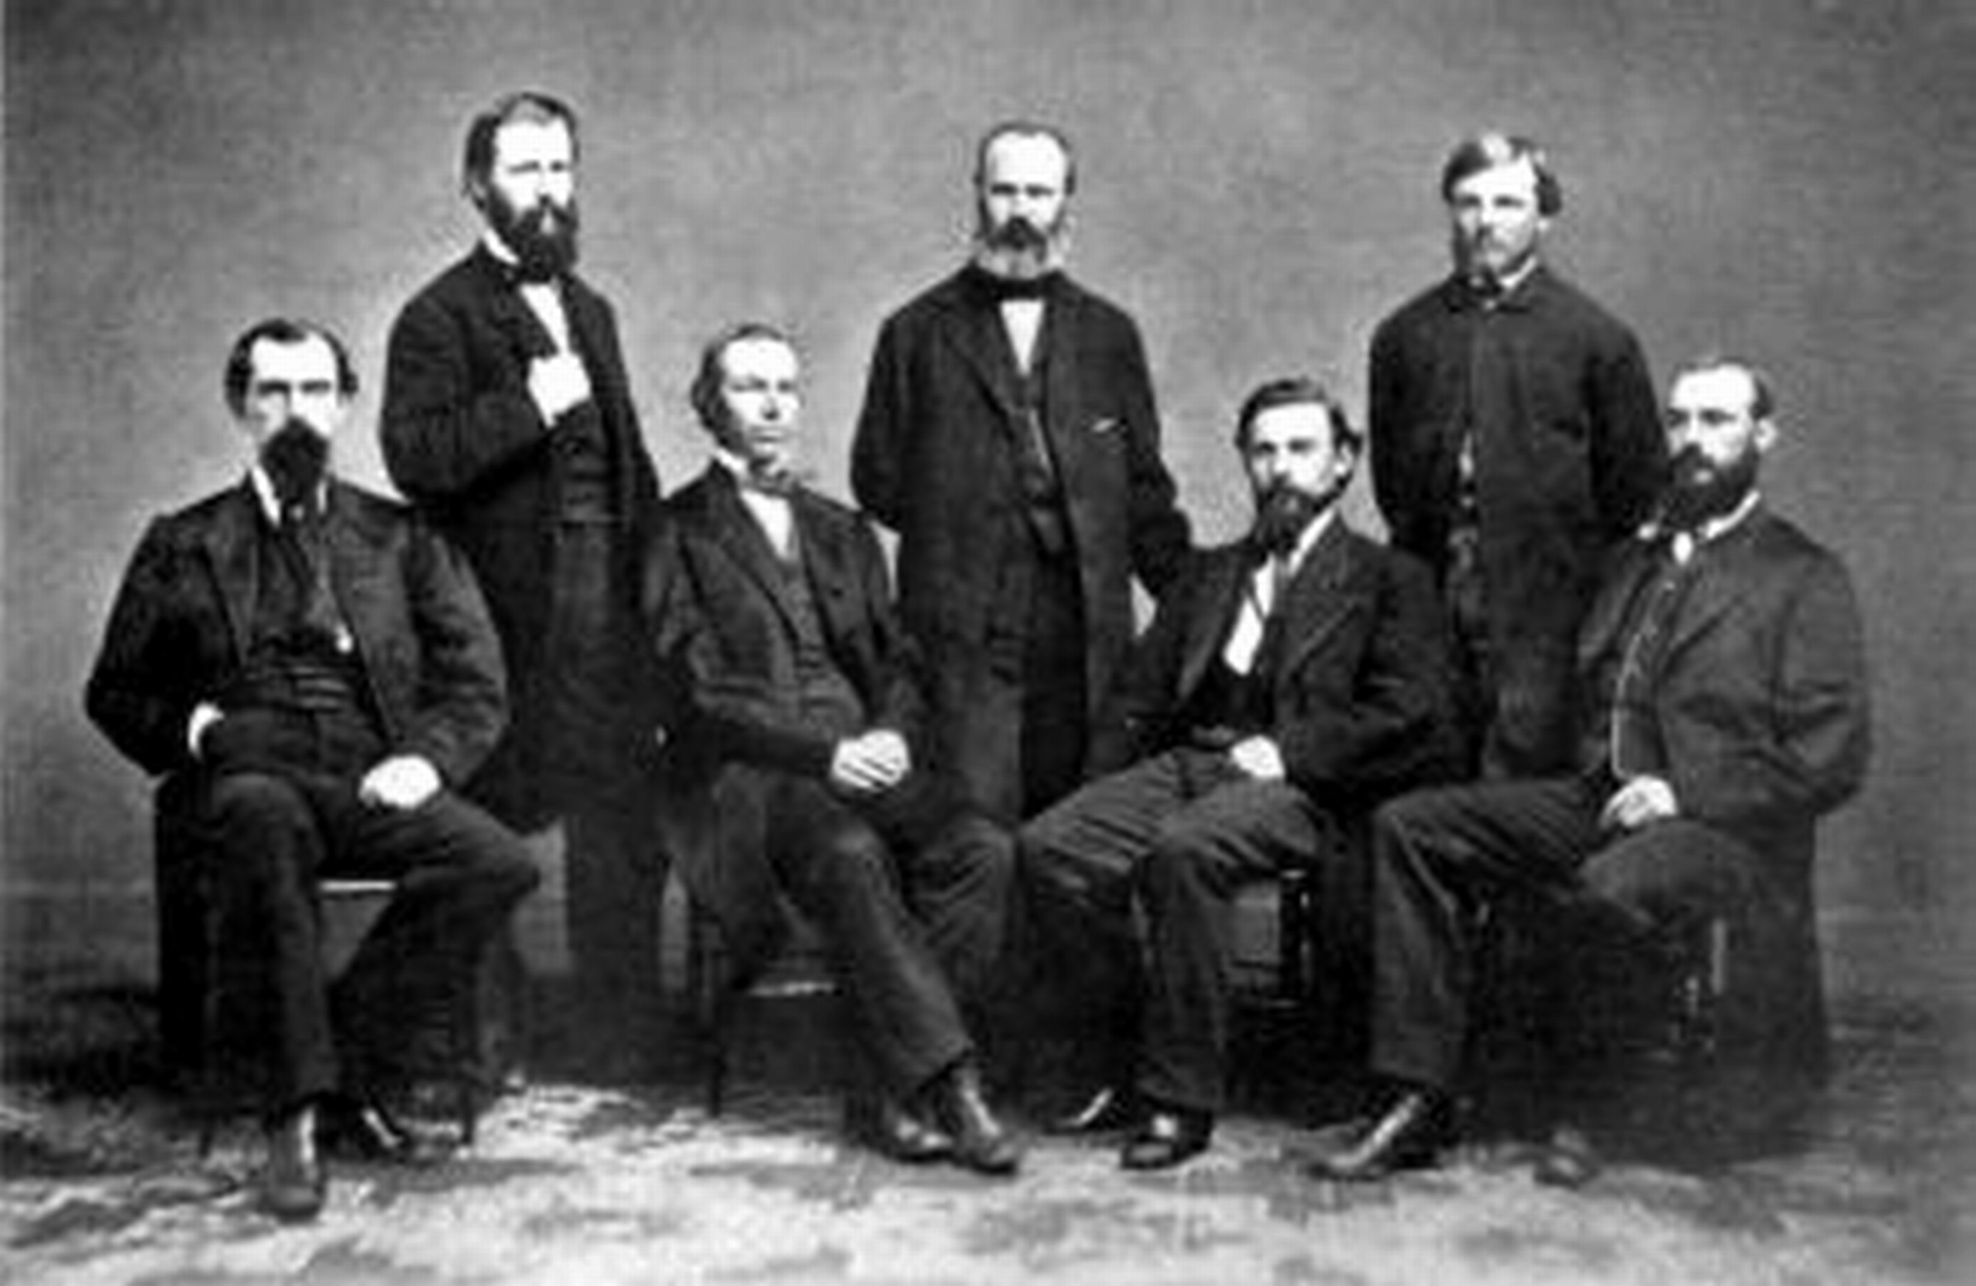
University of California Museum of Paleontology
Why?

Slide 4
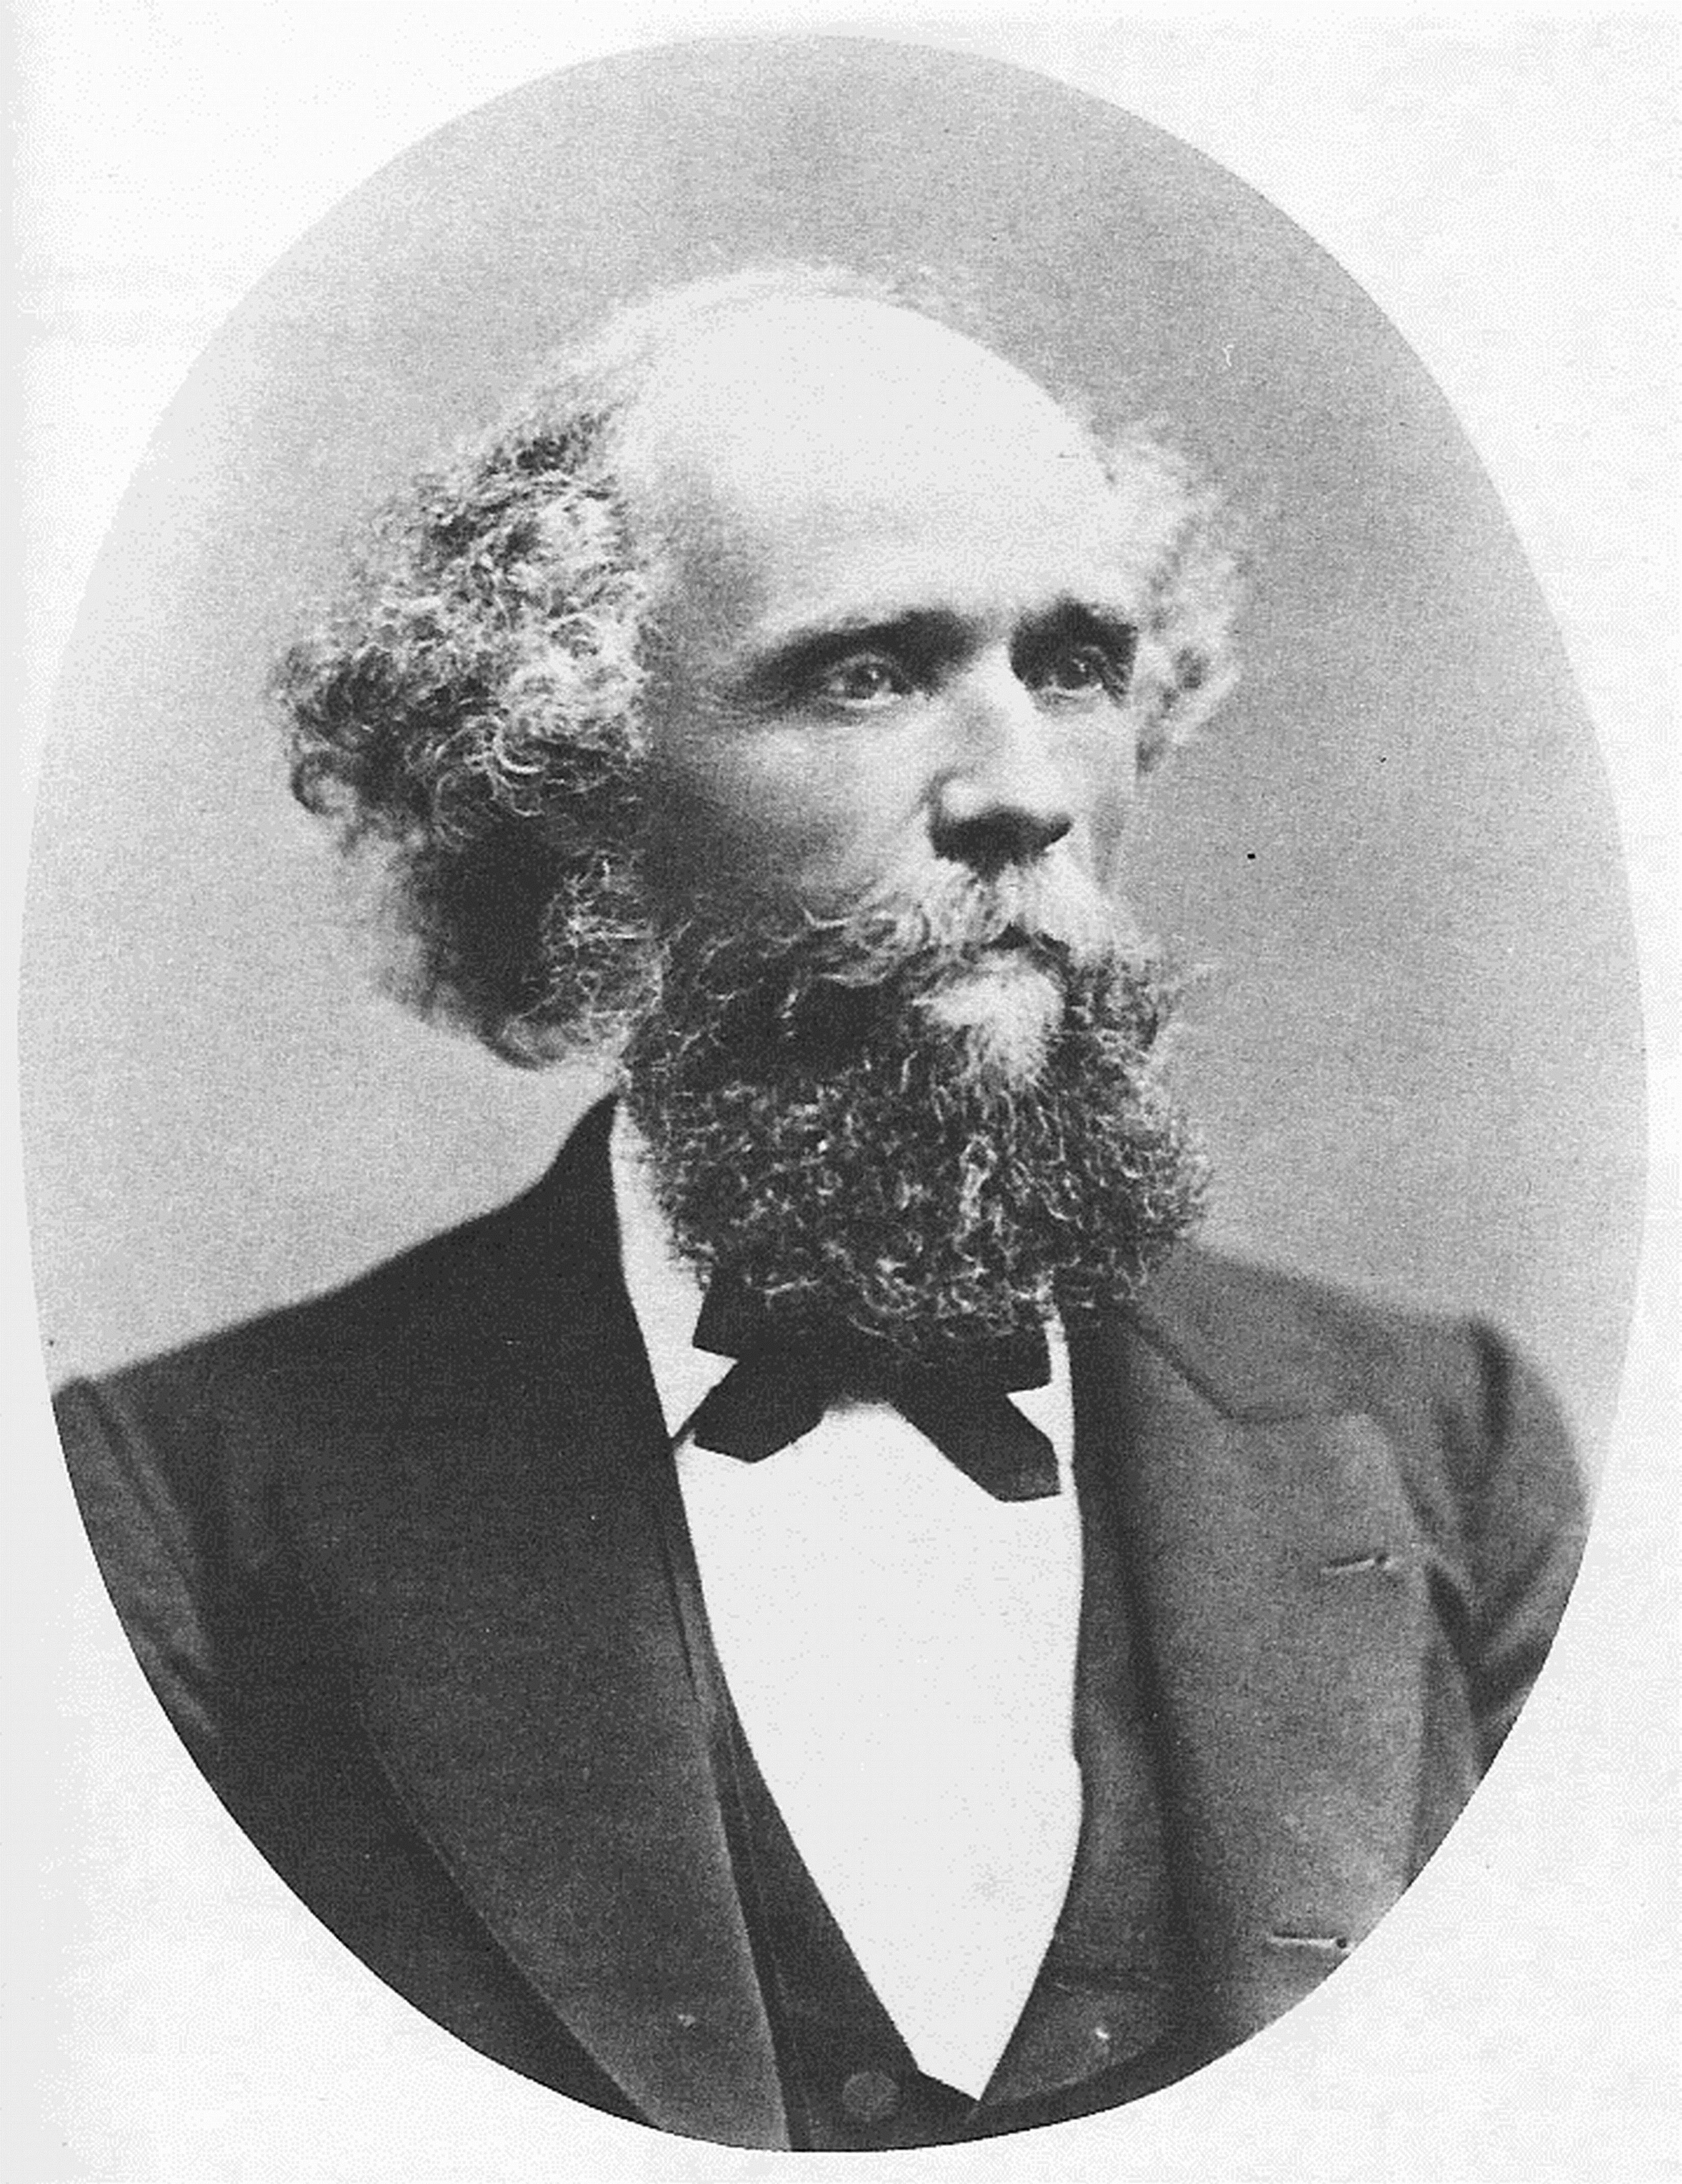
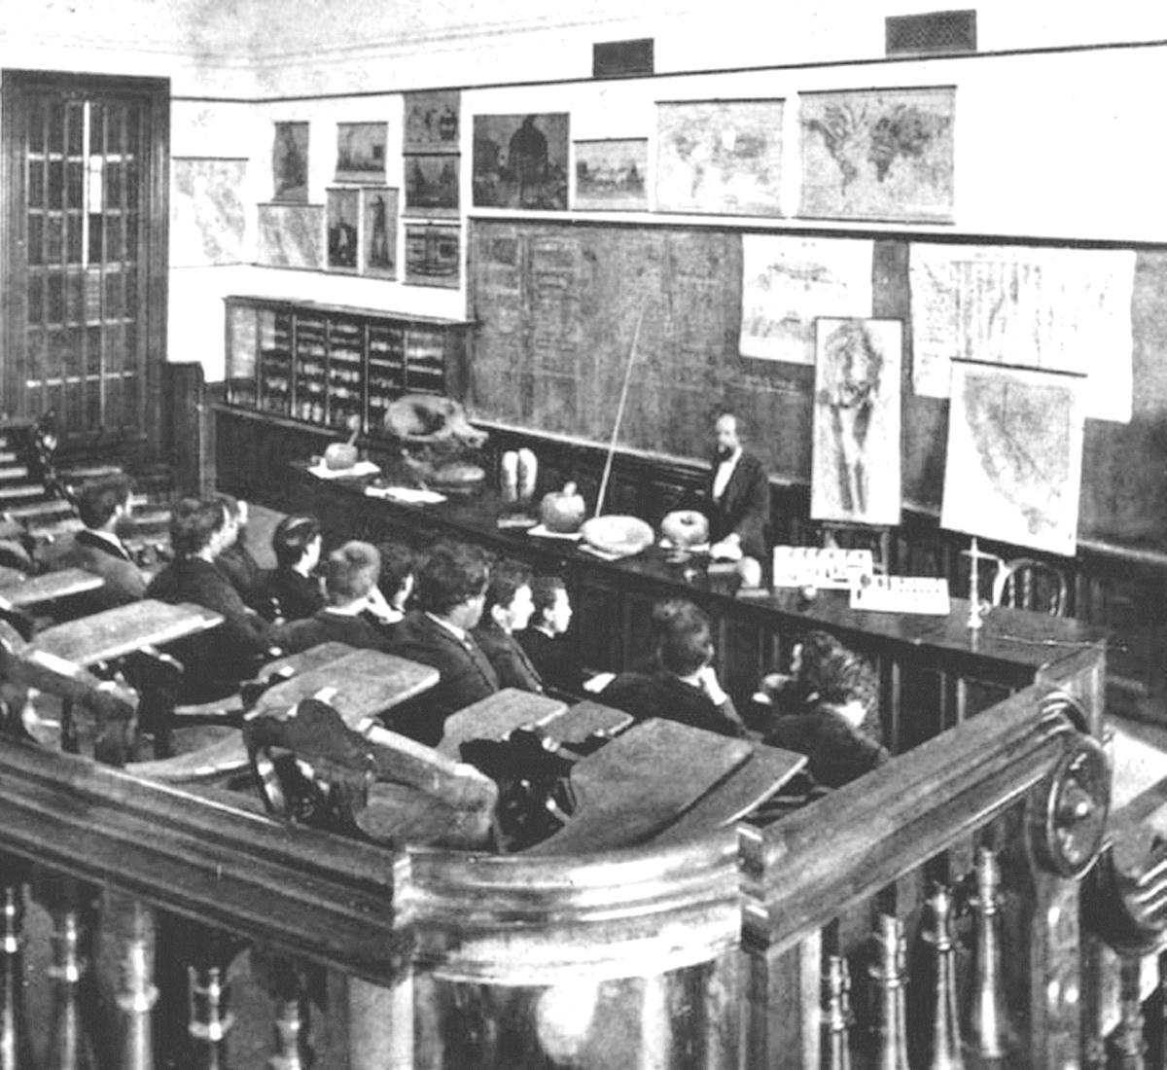
University of California Museum of Paleontology
Who? LeConte 1868-1901

Slide 5
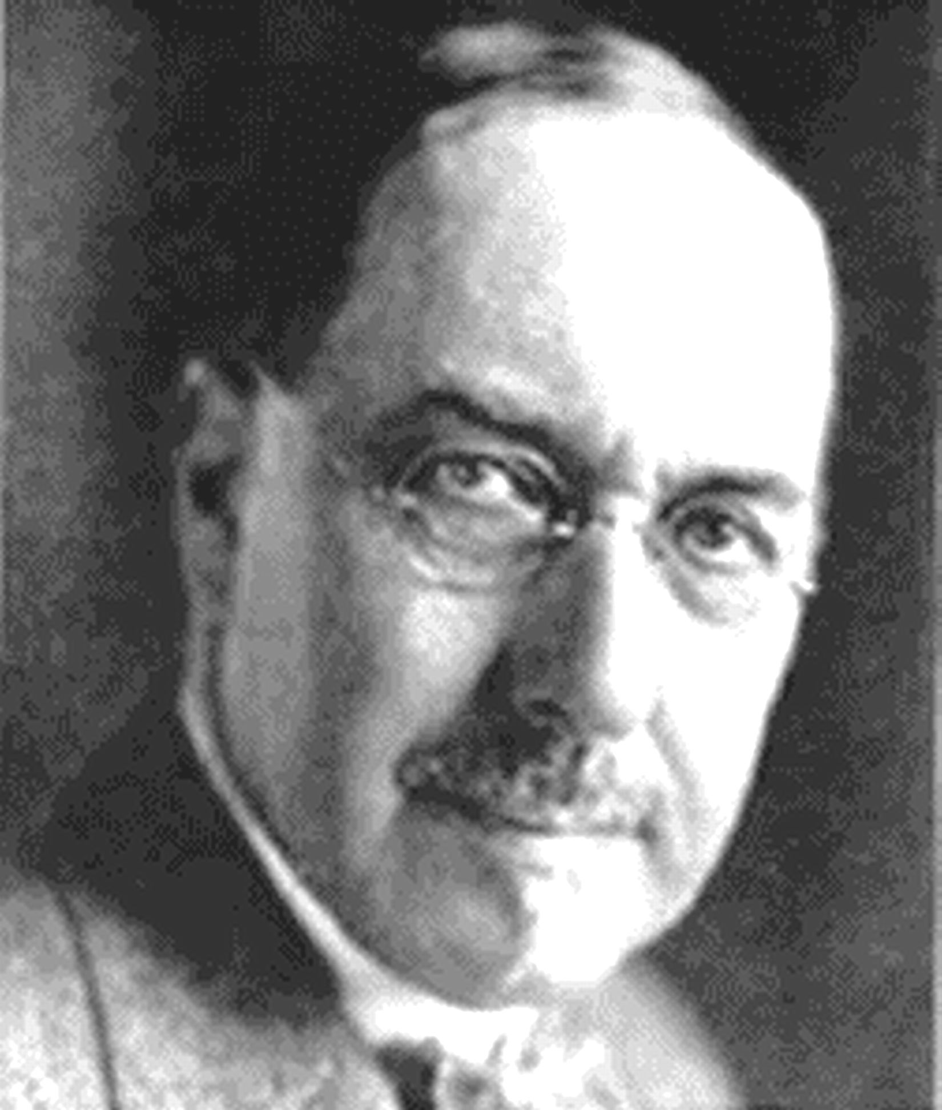
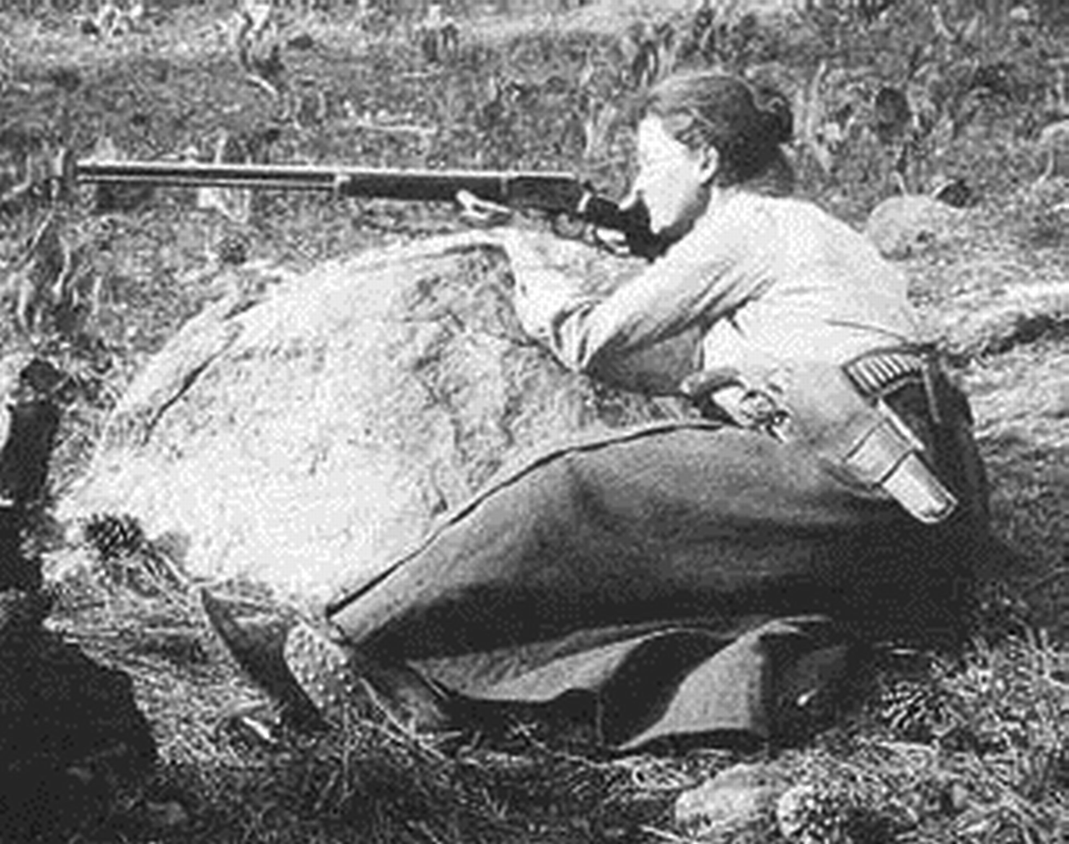
John C. Merriam Annie Alexander

Slide 6
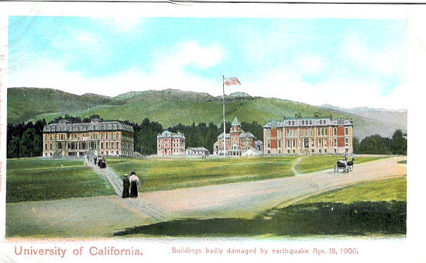
Where has UCMP been?

Slide 7
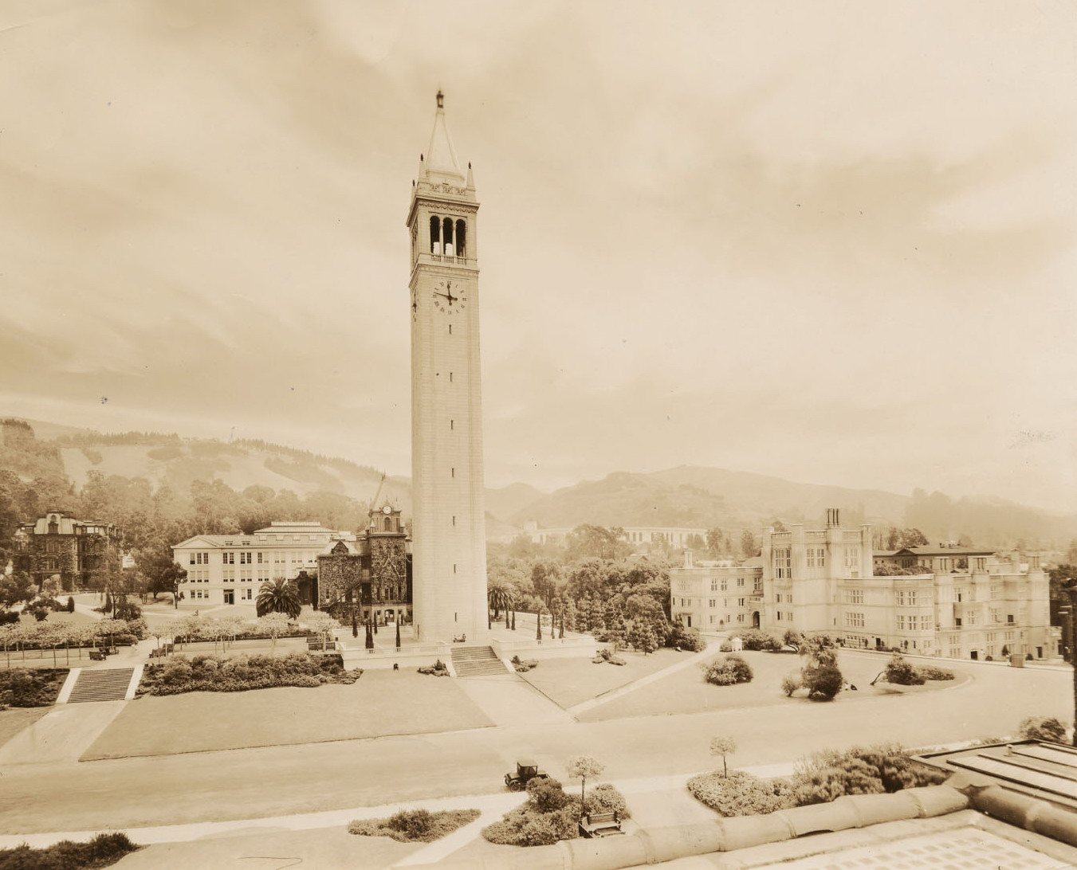
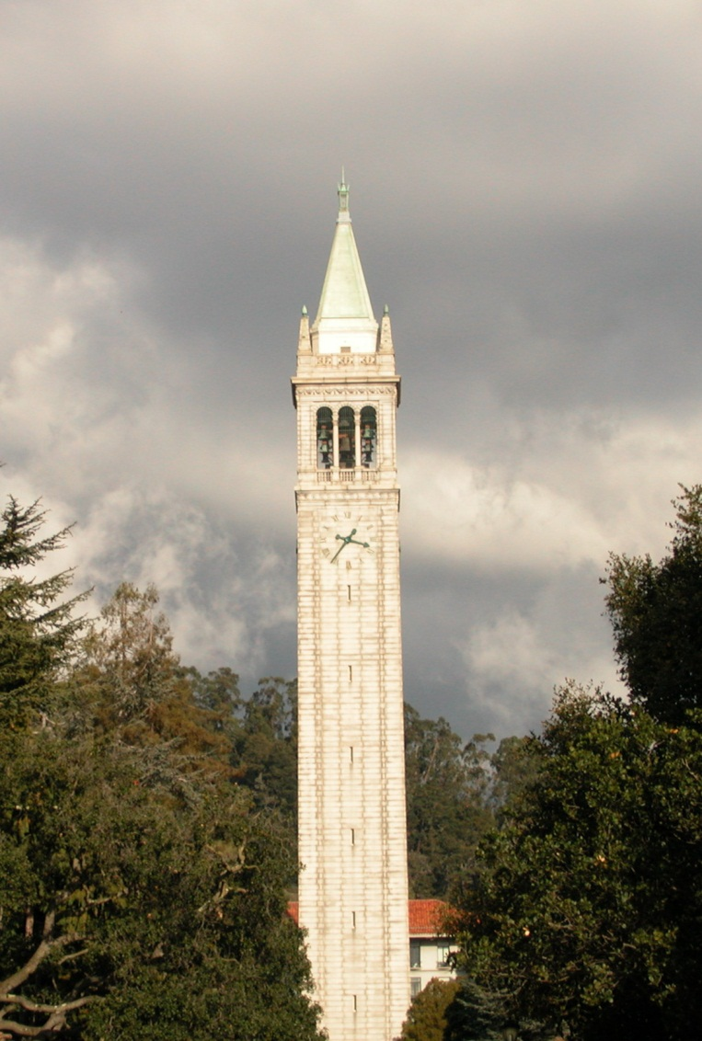
Where has UCMP been?
1924
2009

Slide 8
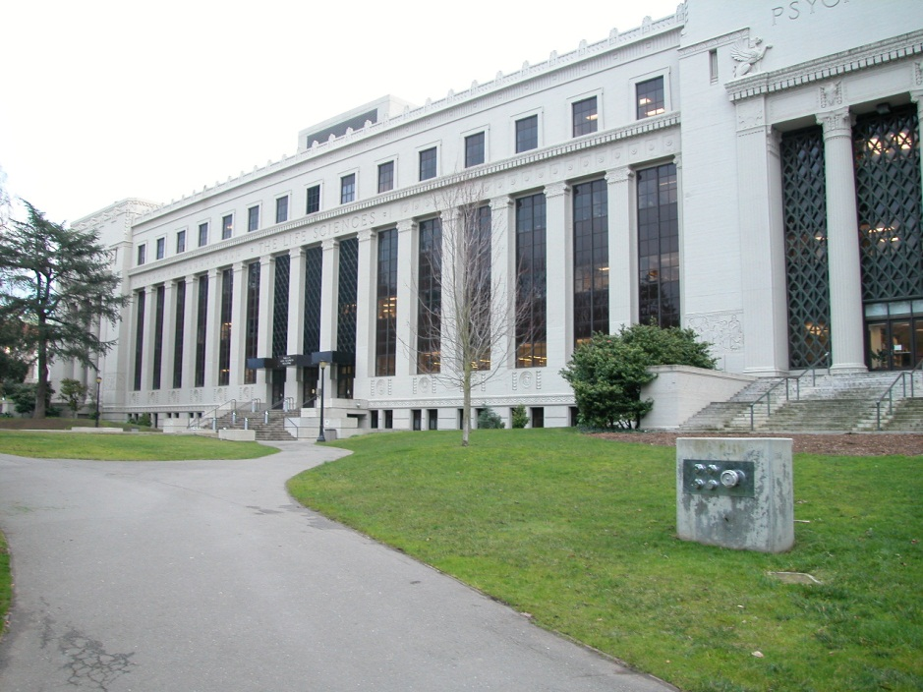
UCMP Now

Slide 9
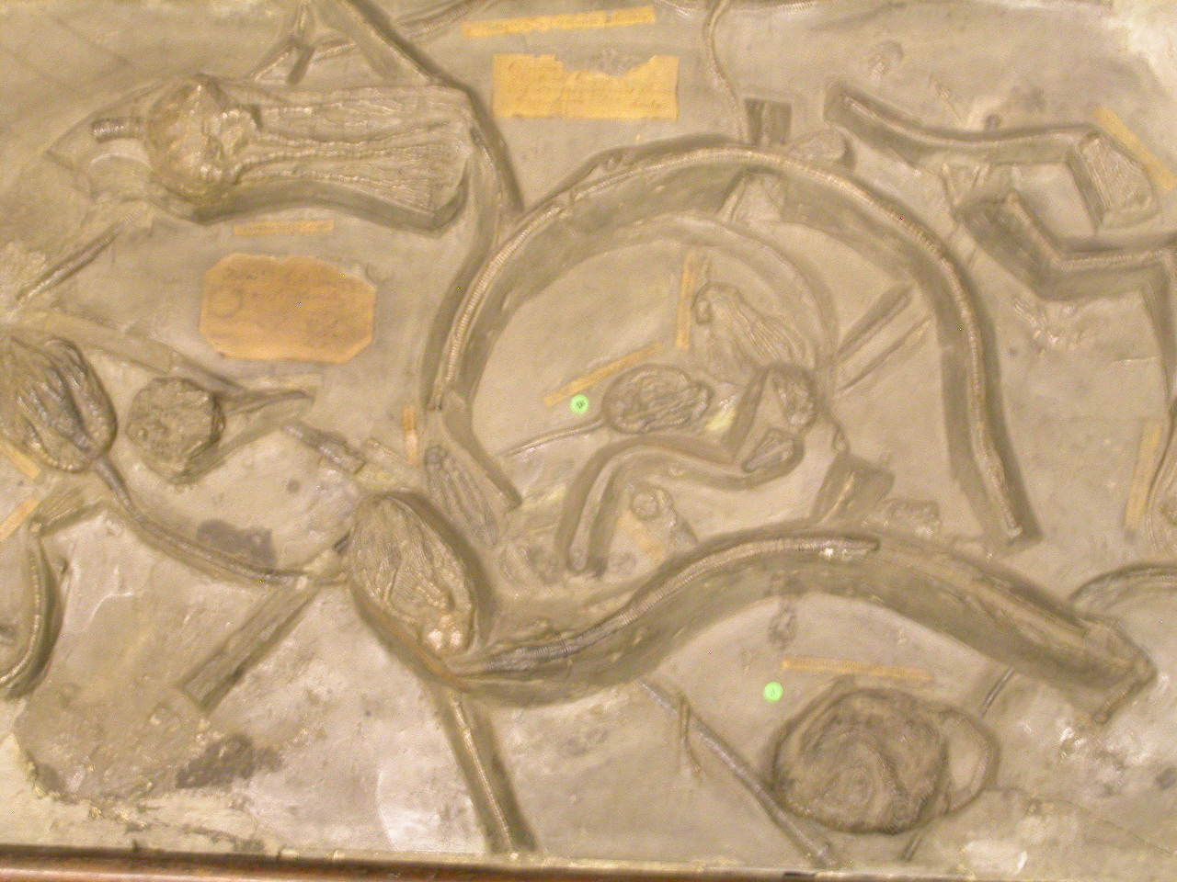
Research Website Database New hires Histology Lab Micropaleo Lab ESEM Moved collection Outreach Student services Exhibits--T. rex, other sites International Collaborations Integration across campus

Slide 10
John D. Cooper Archaeology & Paleontology Center
The History of Life in Southern California

Slide 11
John D. Cooper Archaeology & Paleontology Center
Jere H. Lipps, Director
Jeannine Pedersen, Curator of Archaeology
Meredith Rivin, Curator of Paleontology
Edward Knell, Faculty Curator of Archaeology James Parham, Faculty Curator of Paleontology
Sarah Rieboldt, Outreach Coordinator (NSF)

Slide 12
John D. Cooper Archaeology & Paleontology Center
Aims: To care for OC’s fossils, Native American artifacts & historic items recovered from any construction projects or in other ways. Objectives: Research, outreach, education from K-graduate students, and exhibits. Funding: Orange County, CSUF, donors, mitigation companies, developers, and government agencies.

Slide 13
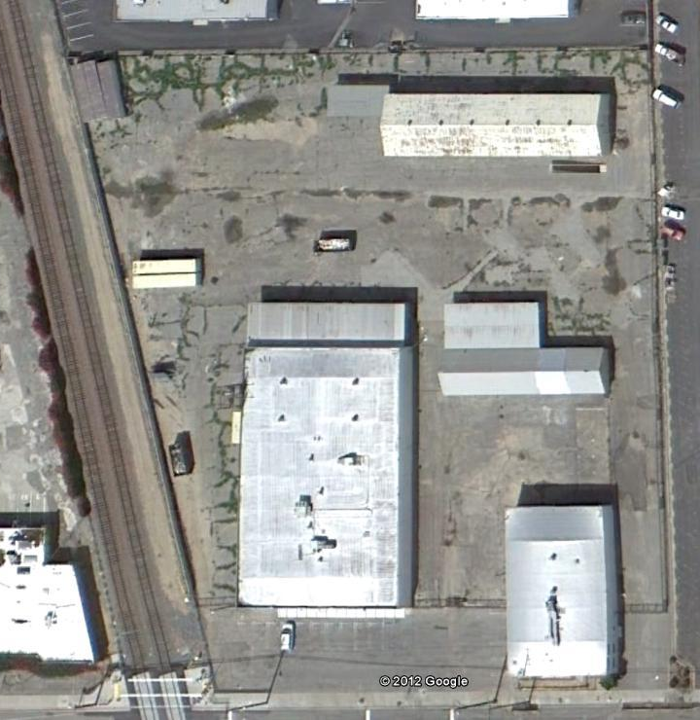
John D. Cooper Archaeology & Paleontology Center

Slide 14
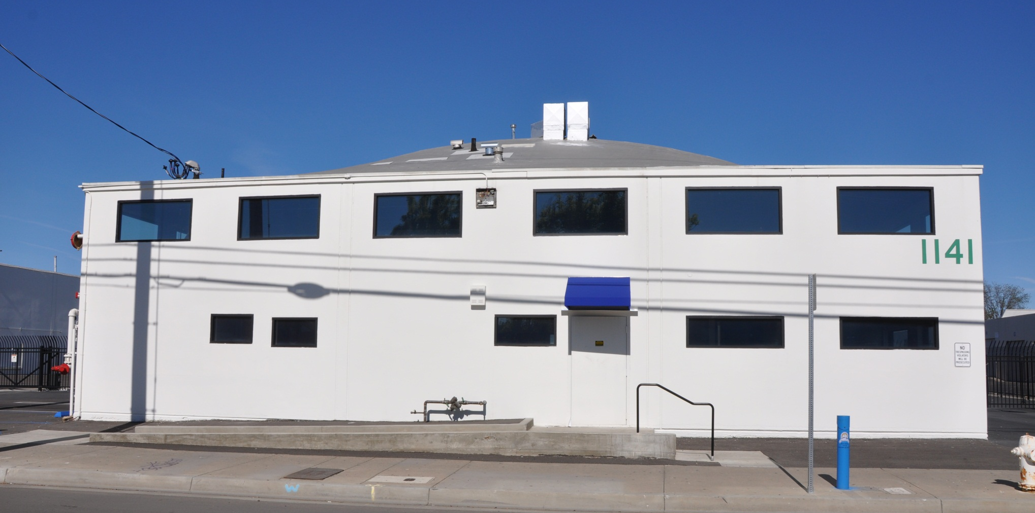
John D. Cooper Archaeology & Paleontology Center

Slide 15
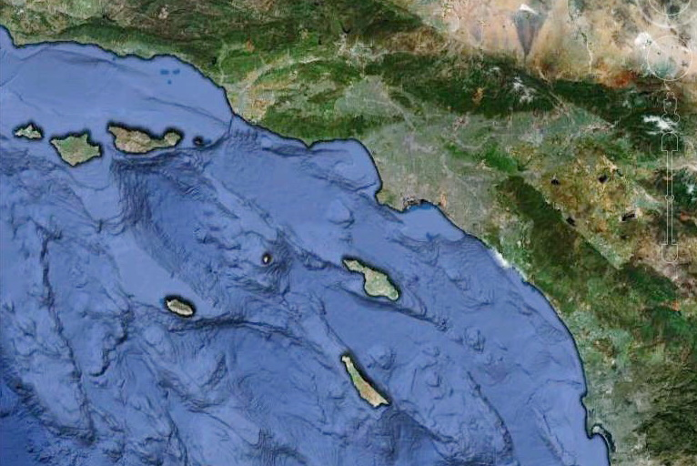
Cooper Center Areas of Interest

Slide 16
Mitigation Collections
Joaquin

Slide 17
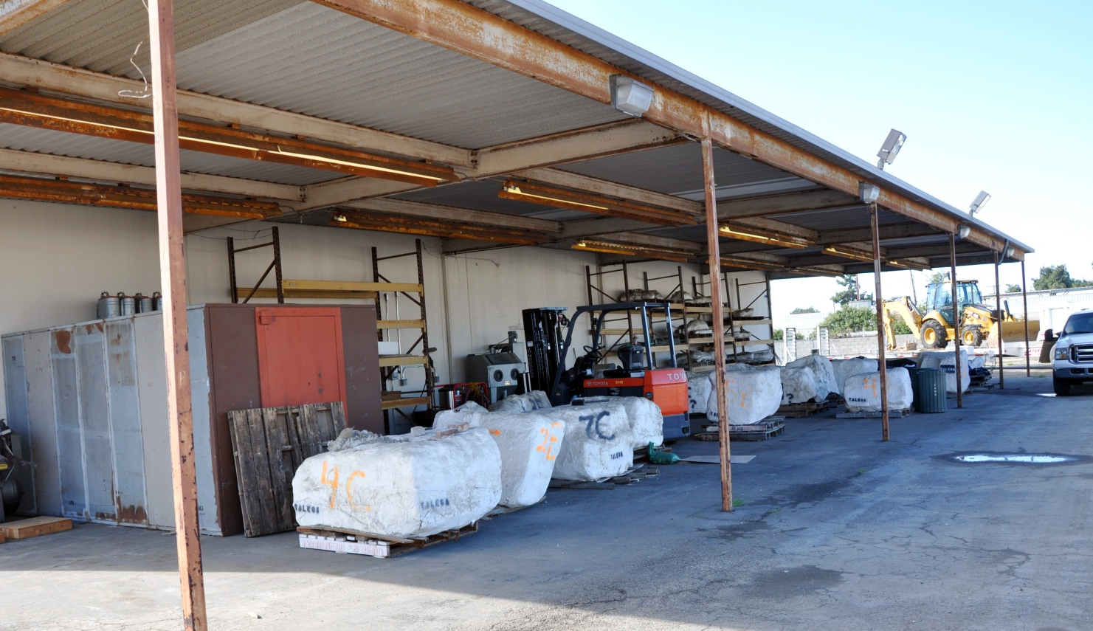
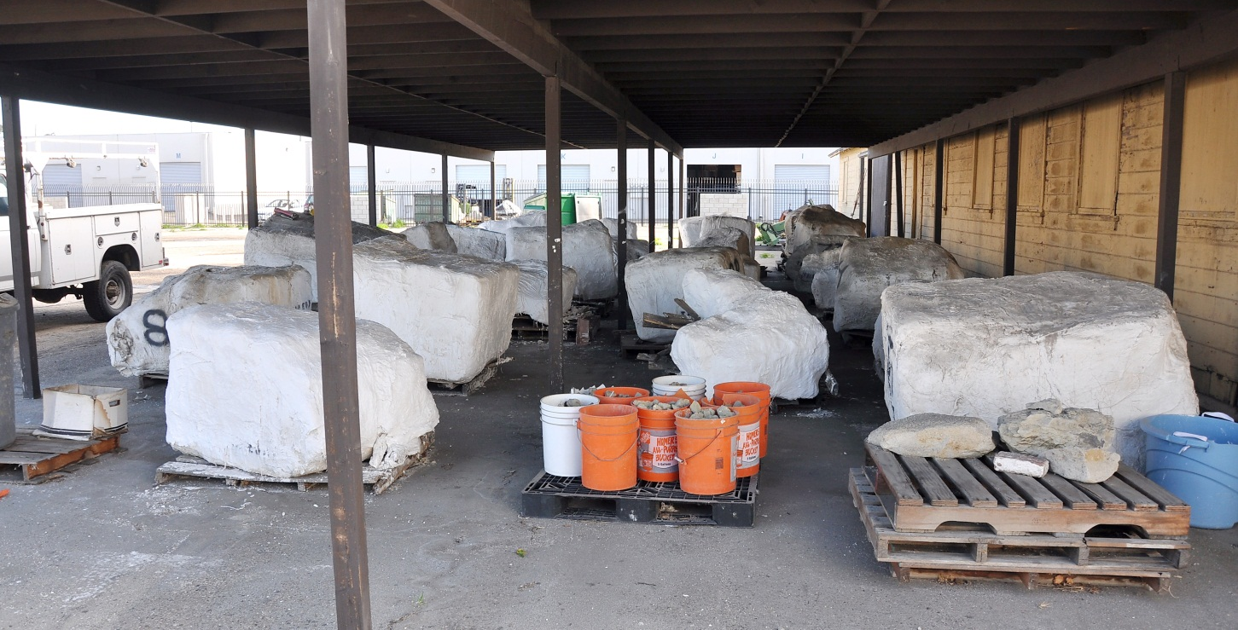

Slide 18
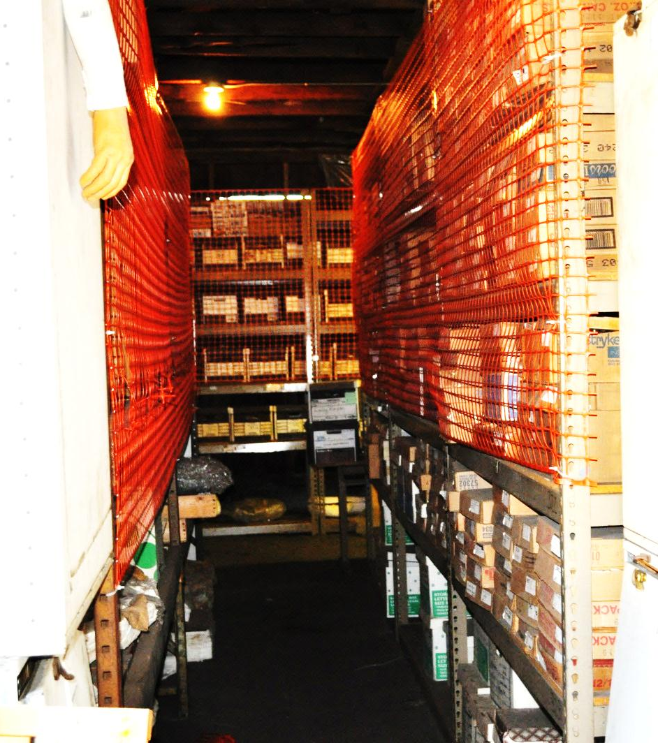
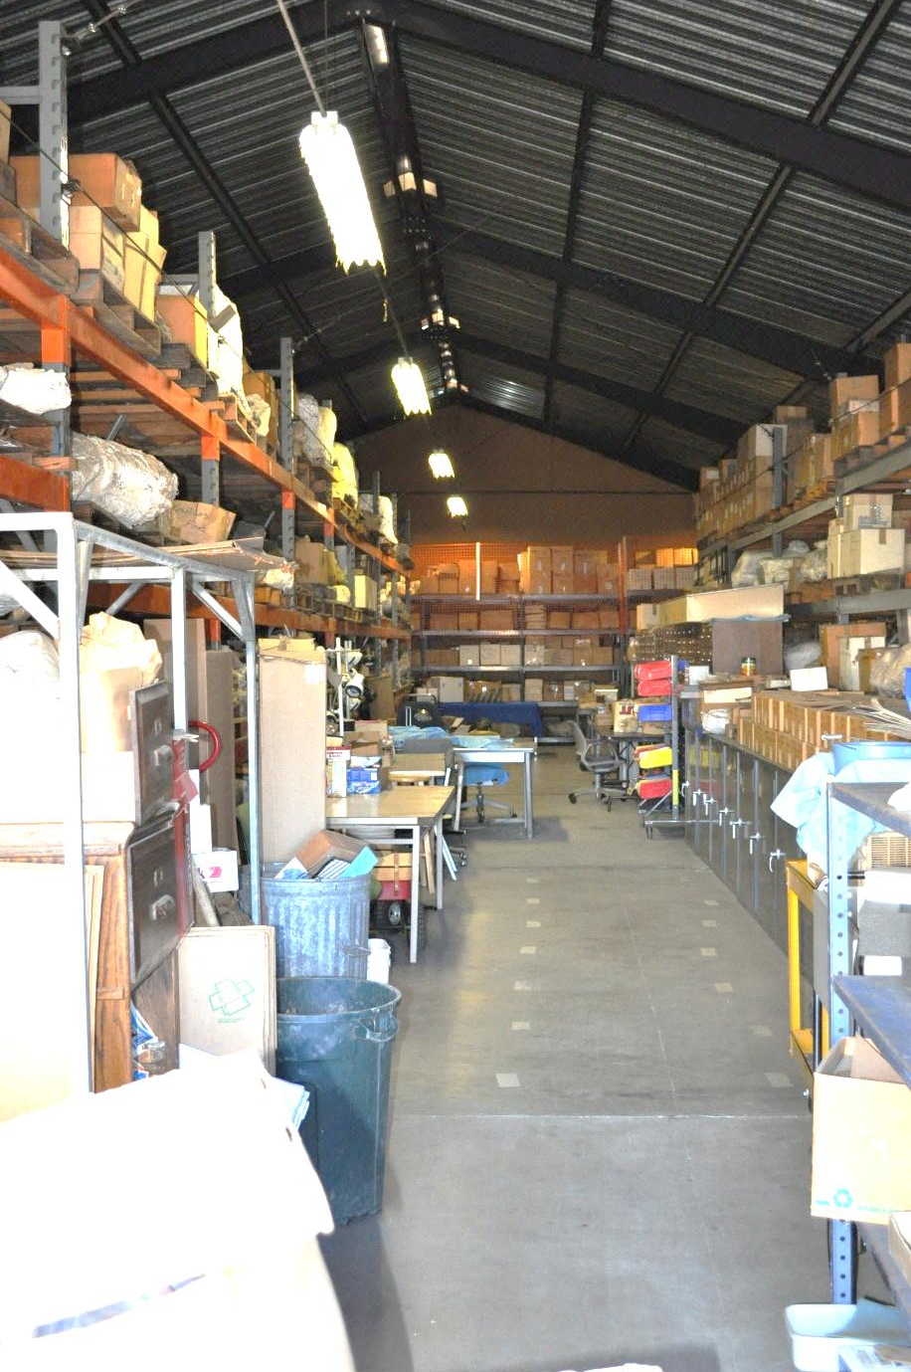

Slide 19
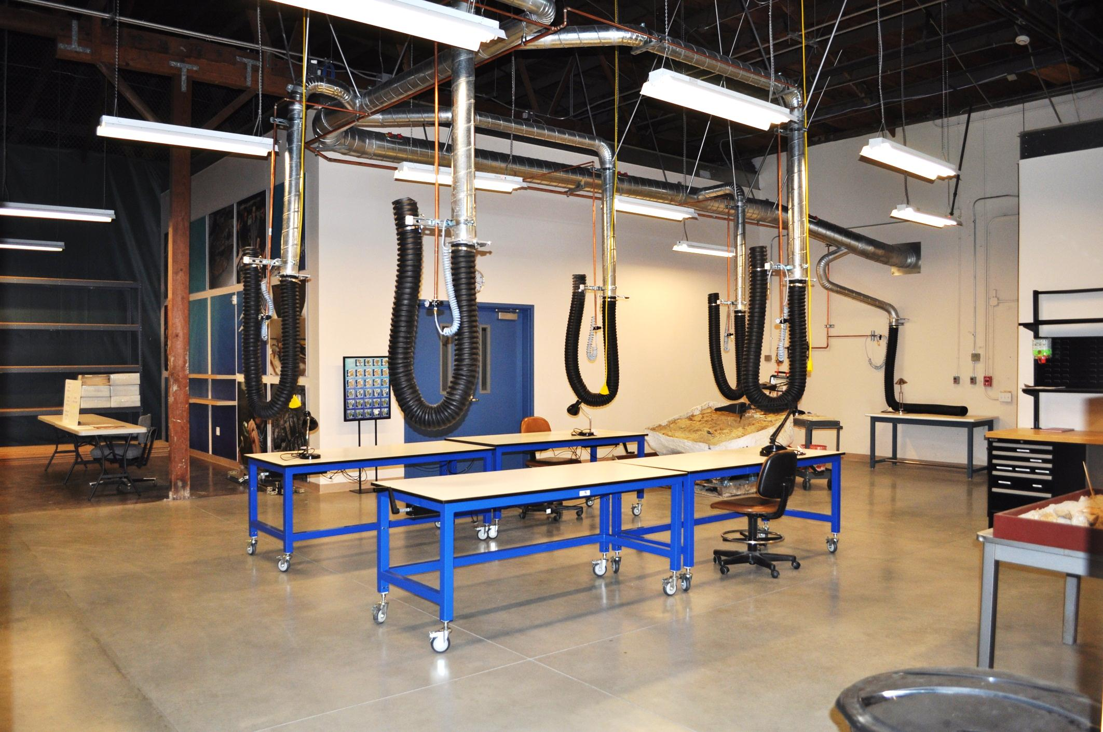

Slide 20
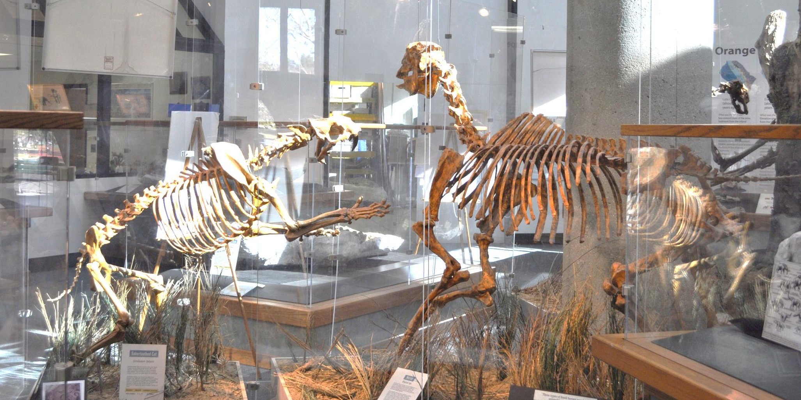
Ralph B. Clark Park

Slide 21
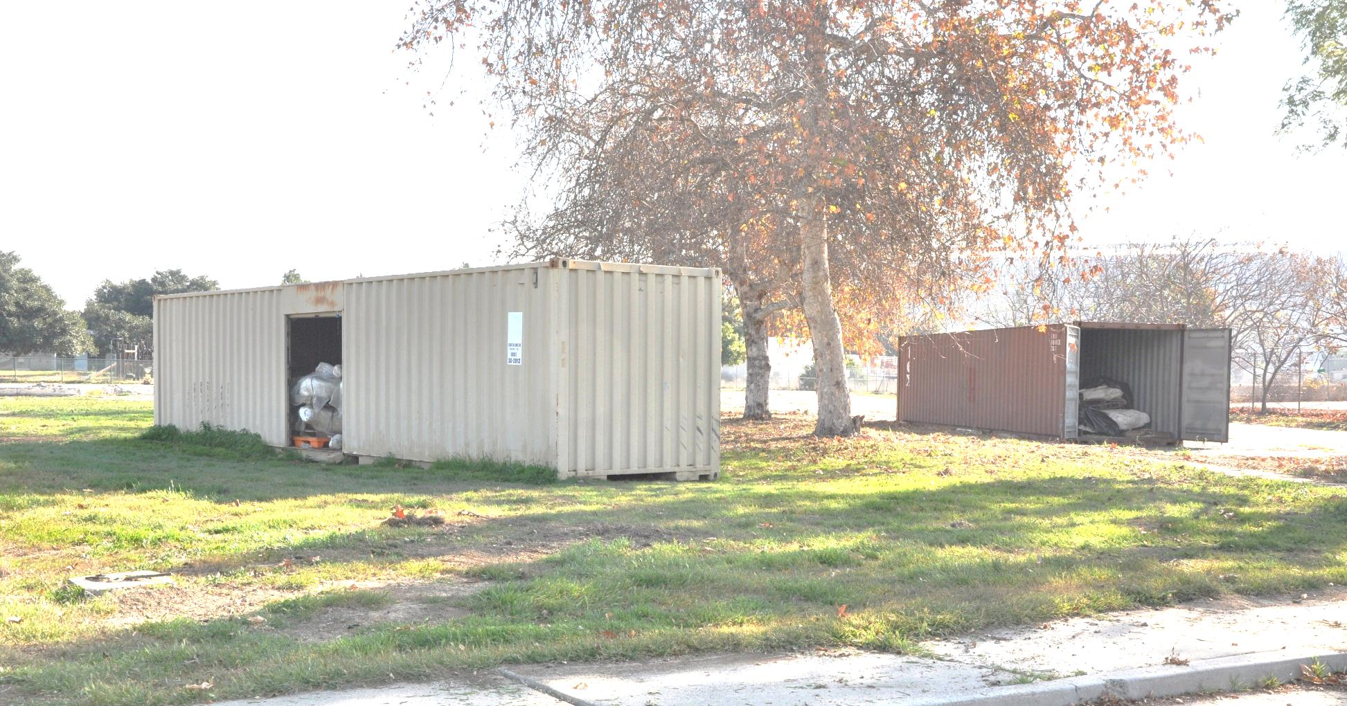
Other Cooper Center Fossils South County Community Colleges

Slide 22
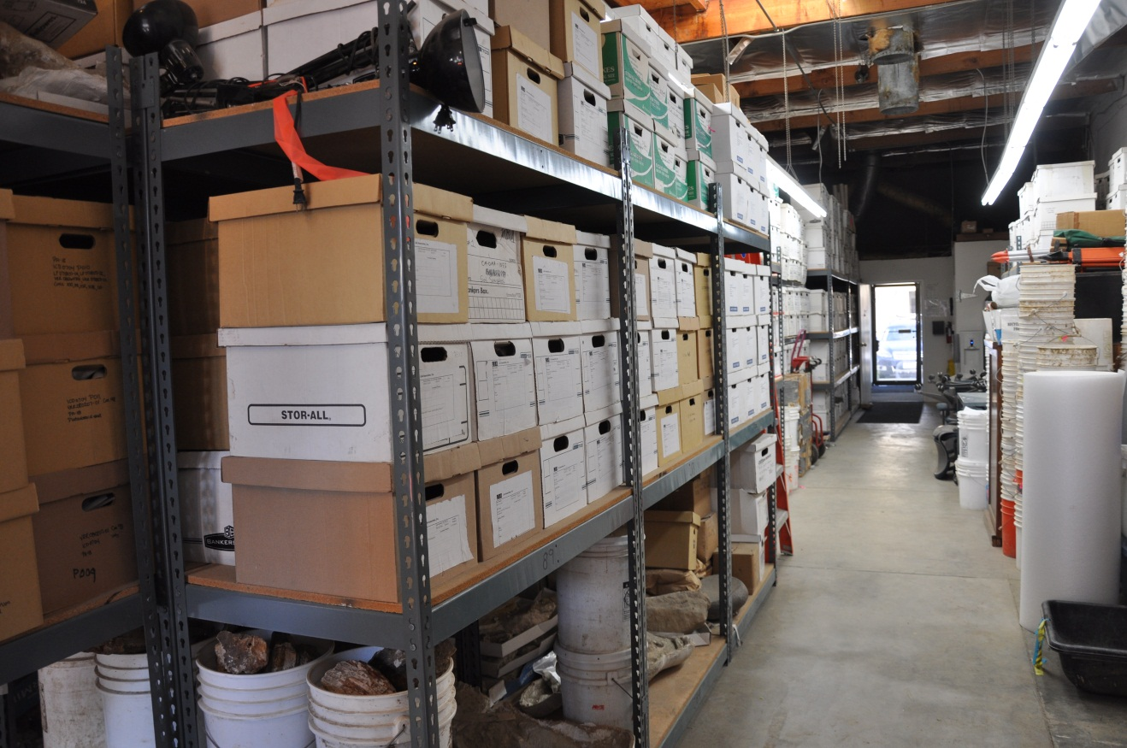
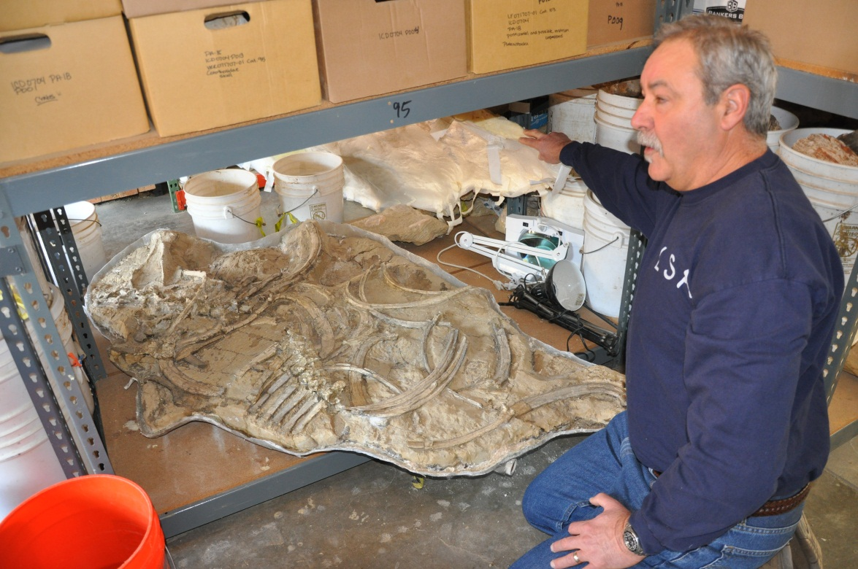
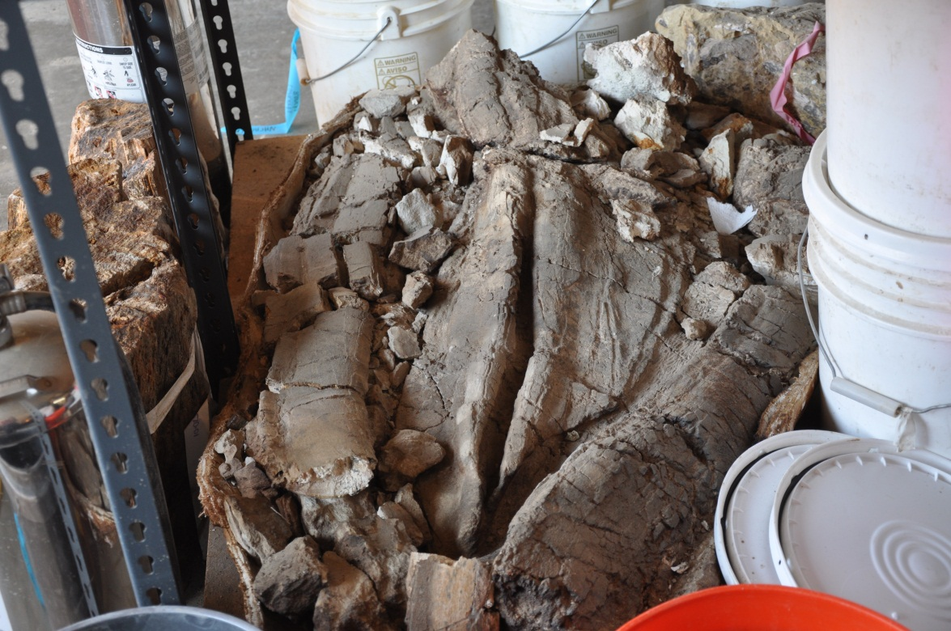
Other Cooper Center Artifacts & Fossils Mitigation Companies

Slide 23
Orange County Dinosaurs
The Toll Roads office lobby, Irvine, CA
Natural History Museum of LA County

Slide 24
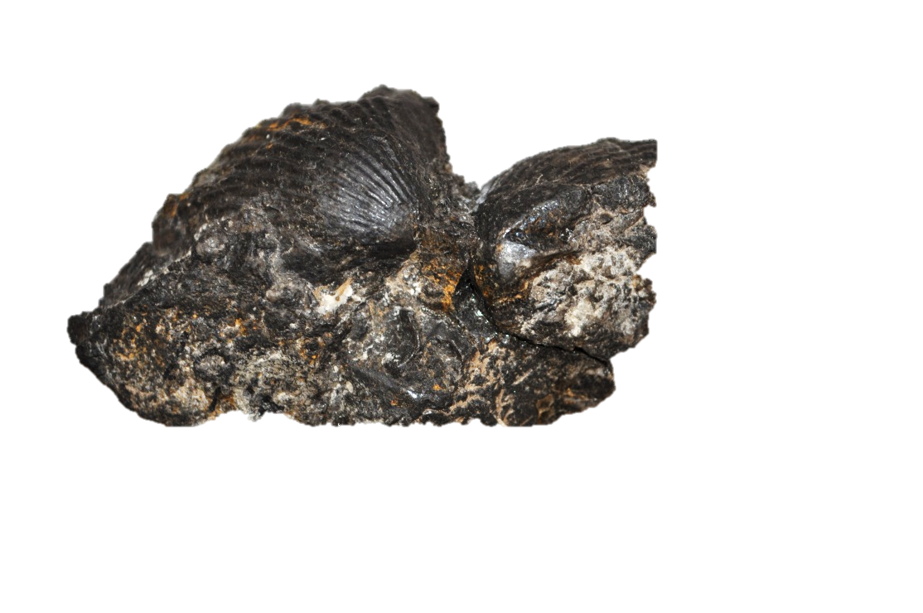
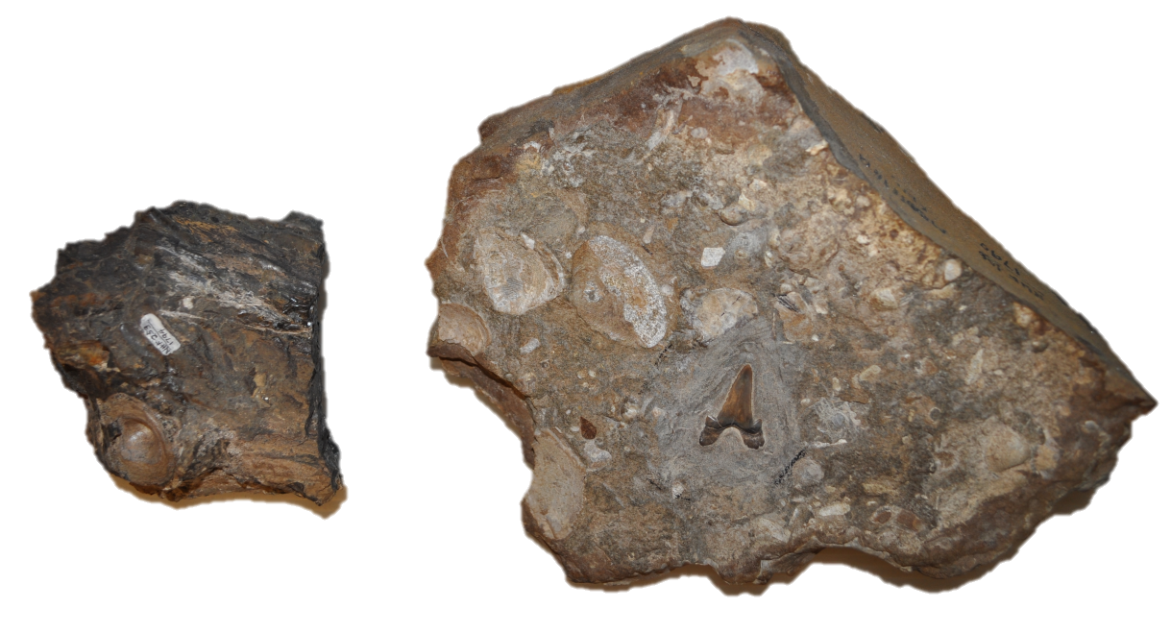
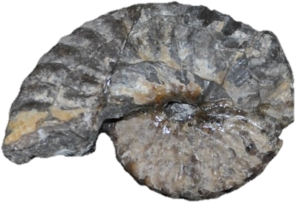
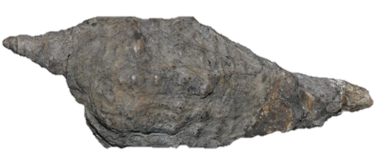
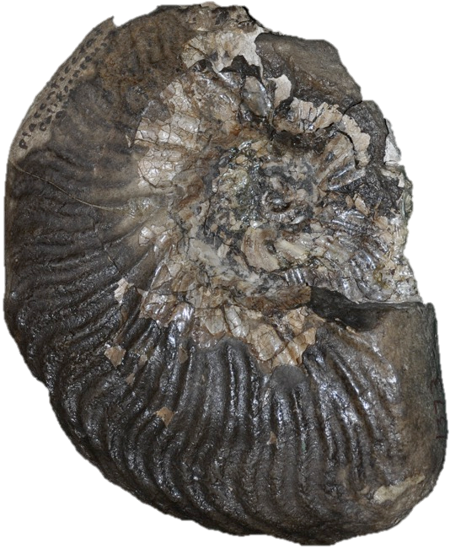
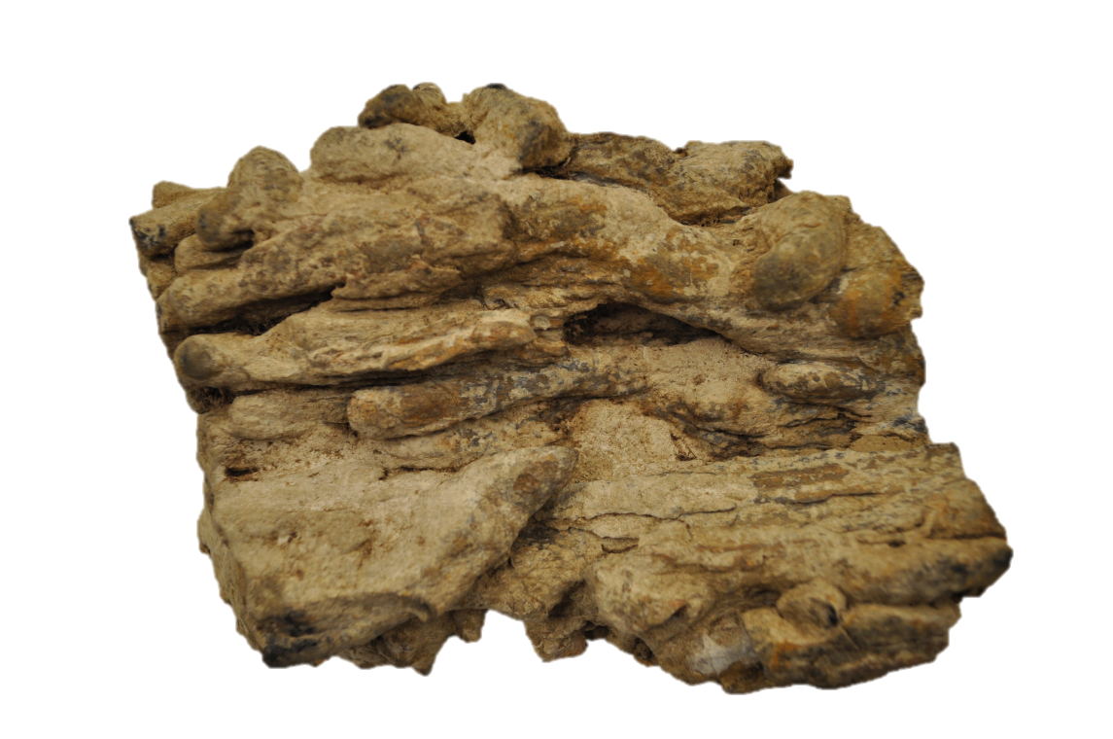
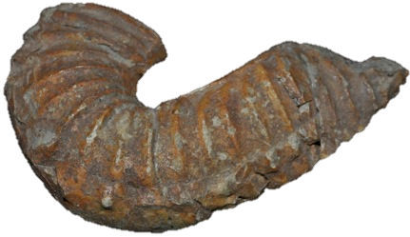

Slide 25
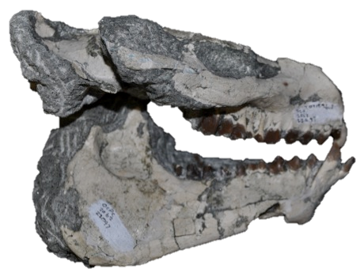
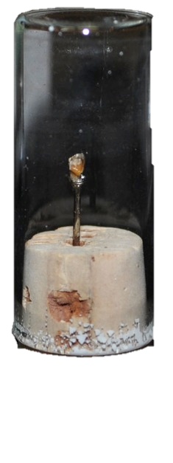
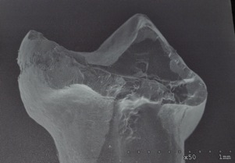
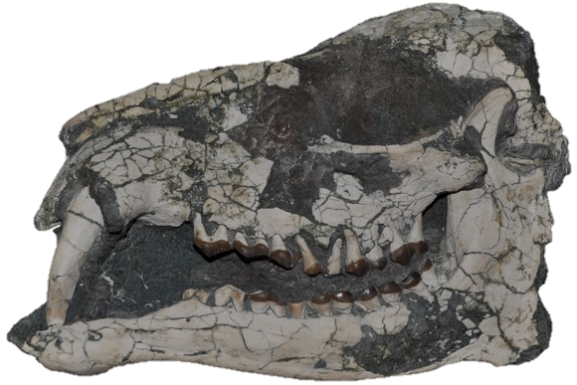

Slide 26
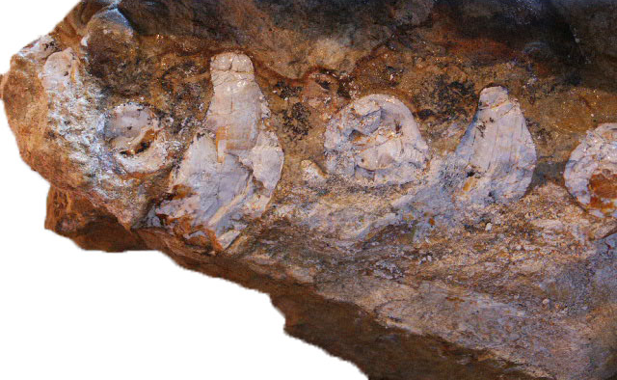
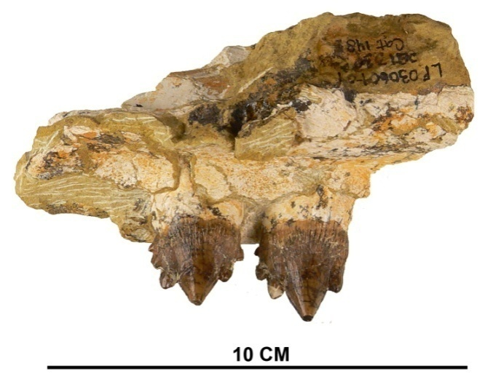
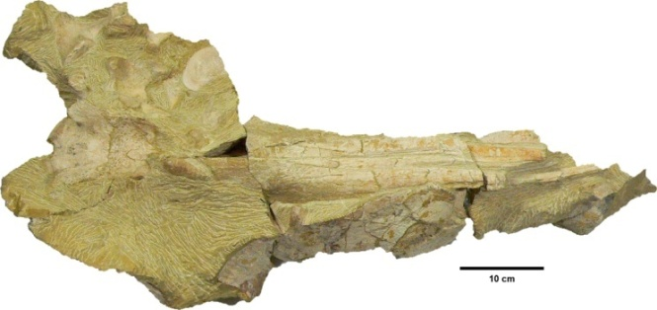
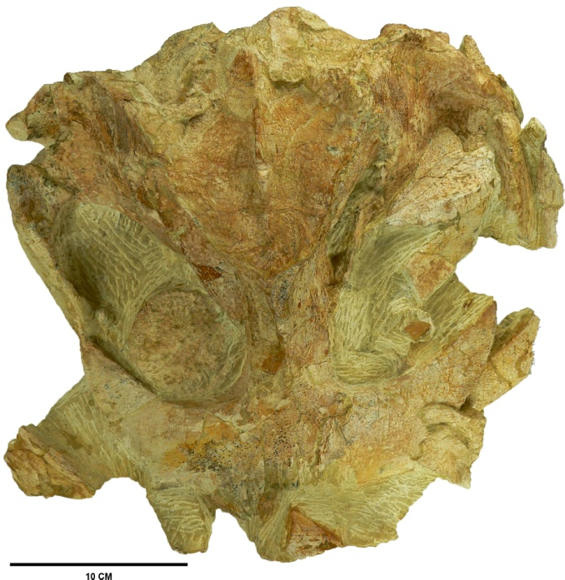
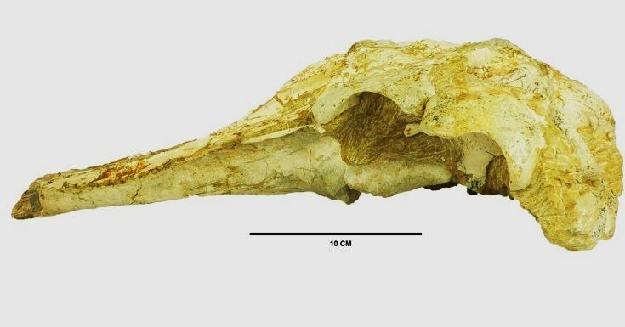
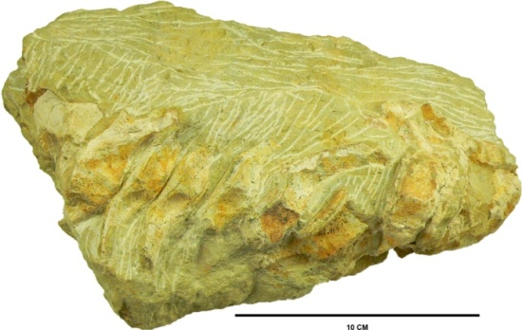
LAGUNA CANYON LOCAL FAUNA
*All scale bars are 10 cm

Slide 27
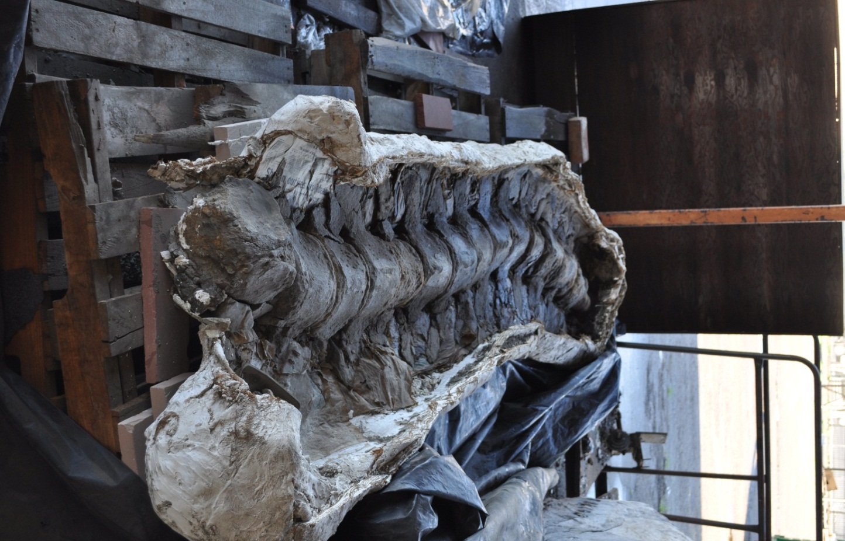
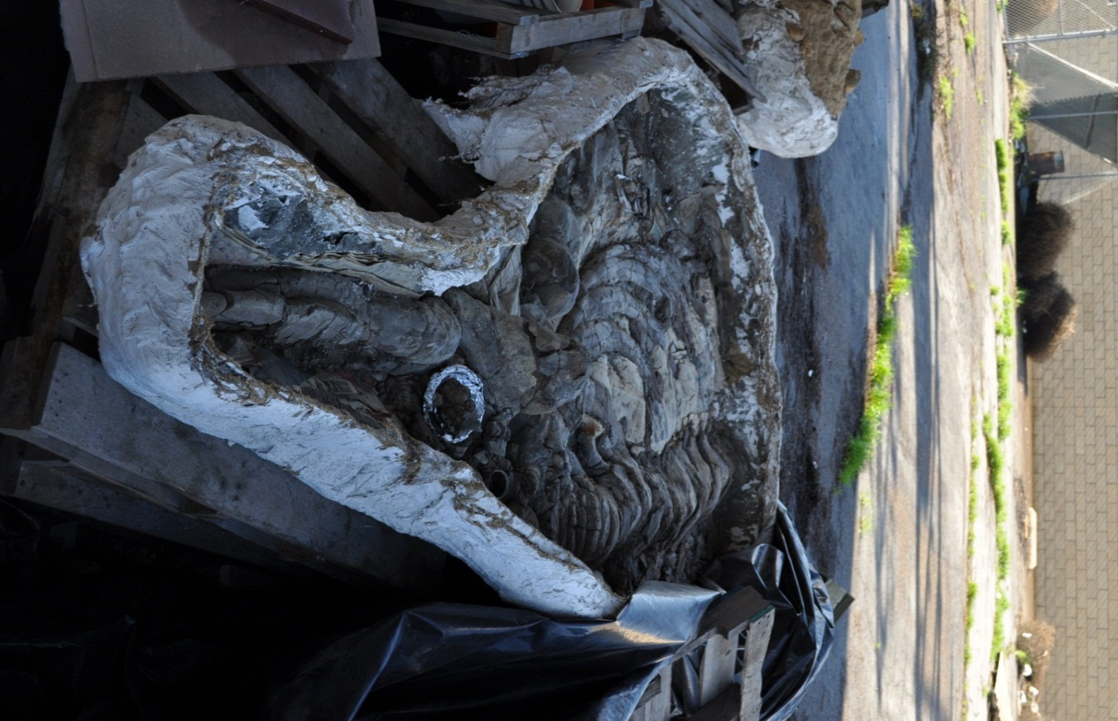
Miocene Baleen Whale

Slide 28
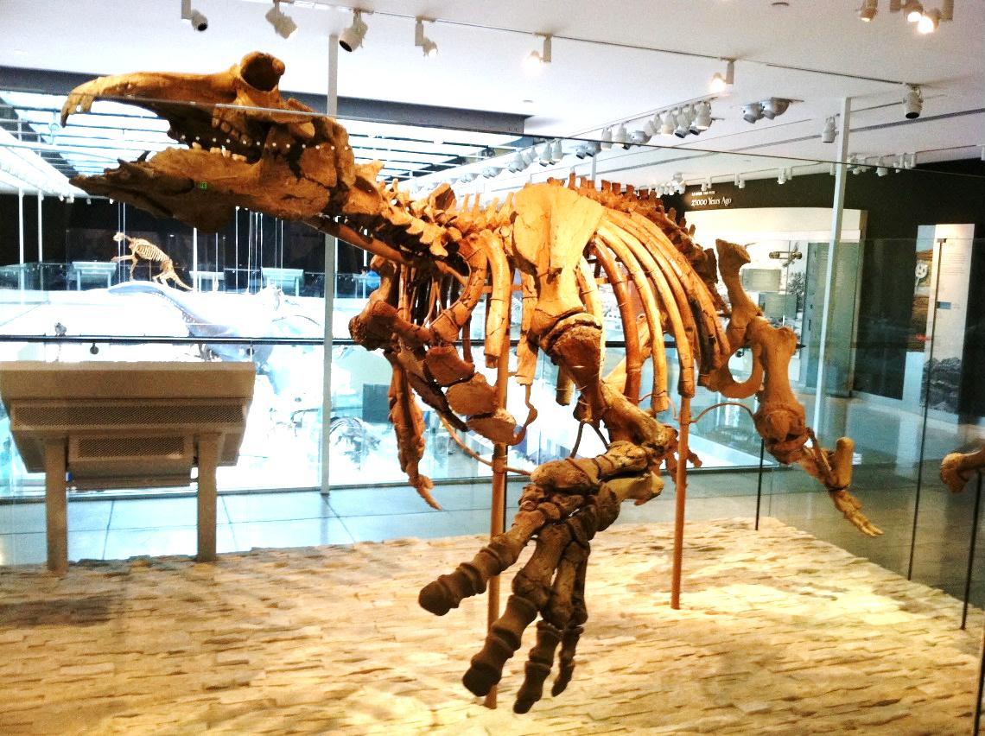
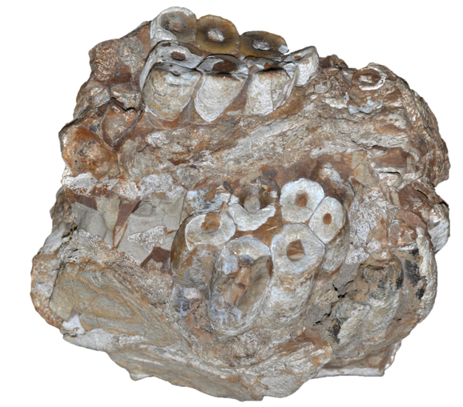
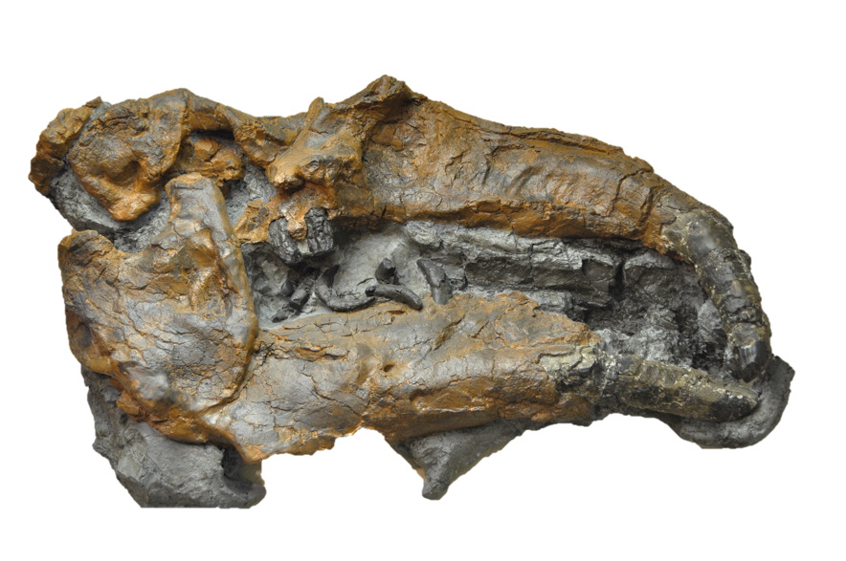
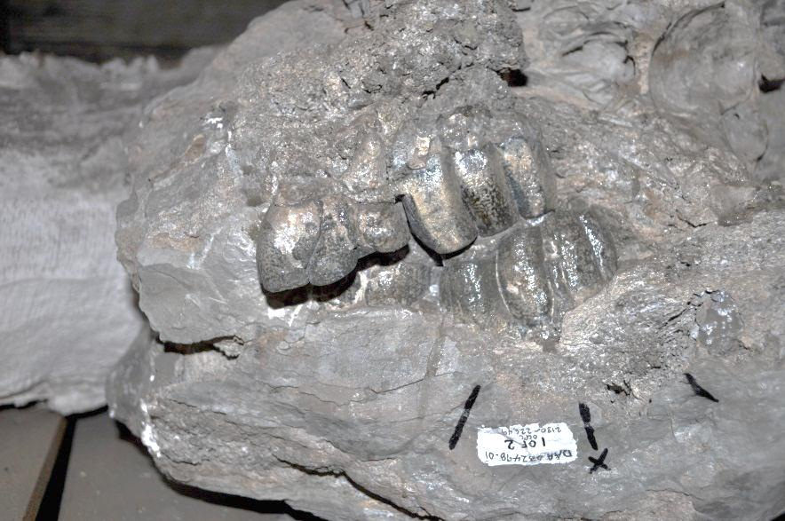

Slide 29
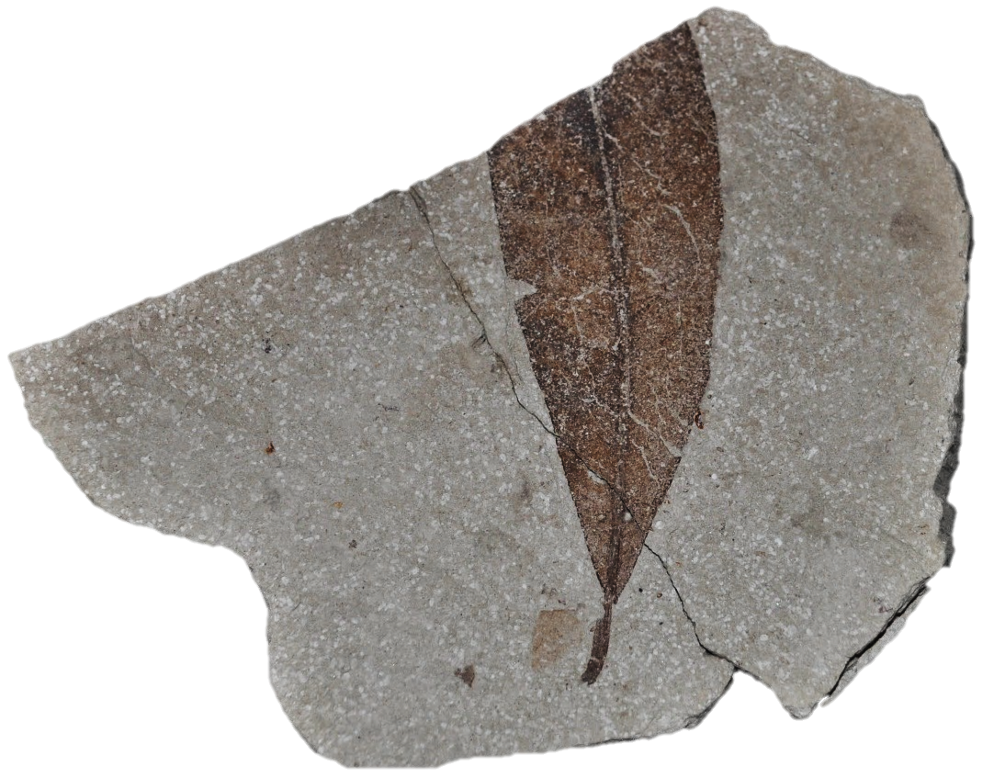

Slide 31
1 meter long

Slide 32
Future of Cooper Center
History of Life in Orange County
Relationship to Pac Rim & World biotas
Special projects: Histories of climate change, tsunamis, sea level, human occupation, and others of OC.
International Research Institute
Undergraduate & Master’s students
Doctoral students
A Post-doc destination
Public outreach
K-16 education
Web development

Slide 33
jlipps@fullerton.edu Thanks!
Protentella prolixa Lipps Miocene Newport Back Bay Orange County

Slide 35
Other Cooper Center Fossils South County Community Colleges

Slide 37
Other Cooper Center Fossils Orange County Parks

Slide 38
Ralph B. Clark Park

Slide 39
John D. Cooper Archaeology & Paleontology Center

Slide 41
Human artifacts & historical items.
From 10,000 to 50 years ago.

Slide 42
Cogstones
Points
Human artifacts
From 10,000 years ago

Slide 43
Accomplishments at Cooper Center in 2011-12
Lab fully functioning
~30 volunteers recruited
Over 2000 objects added to databases
Recruited and hired a director, a curator, a faculty curator & an outreach coordinator (CSUF)
Safety & security upgrades (OCParks, CSUF)
Outreach lectures presented
Two proposals for funding ($600,000) pending
Funding sources identified
Three exhibits underway (OCParks, Crystal Cove, GSA)
CSUF computer science students designed web site
Relocation of fossils from Yellow Building prior to its demolition

Slide 44
Needs of Cooper Center
Additional Curation and Storage Space
Additional Funding (Naturally!) Curation (NSF, OCParks, fees) Research (NSF, NASA, foundations) Outreach (NSF, foundations, donors) Education: K-16, graduate. (NSF, foundations, donors) Exhibitry (OCParks, “Discovery centers”, JW Airport, commercial sites) Web development (NSF, NASA, donors)
Additional exhibit venues in Orange Co.
Increased Involvement with CRM, construction & development firms.

Slide 45
The Talega Rhino Quarry

Slide 49
Ralph B. Clark Park

