Slide 1
Social Issues in Collaborative Digitization:
People, Culture, Change

Slide 2
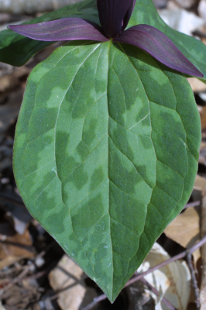
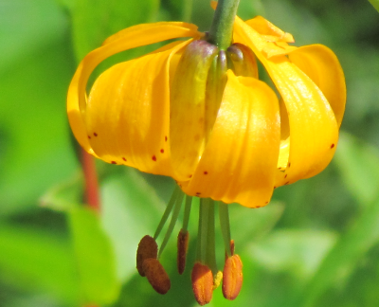
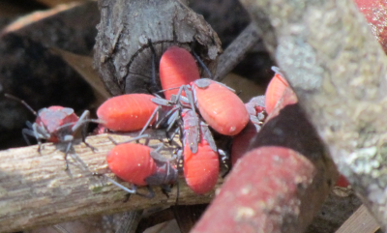
Overview
observing digitization workflows
social issues
business processes
change, management & motivation
some changes seen
opportunities for redesign
evaluating & redesigning workflows
digitization & cultural maturity
interesting bits seen here already
Notes:
In this workshop, we’re essentially reviewing (current state as / is analysis) processes being used to try and broadly define our overall digitization process. As part of the review process, we’ll be looking for redesign and perhaps in some cases, re-engineering opportunities.
“…before you start reviewing a process to ensure you correctly define what the process actually is and establish what the boundaries are.”
Joint Information Systems Committee
http://www.jiscinfonet.ac.uk/InfoKits/process-review/process-review-8
We’re looking for the broad core processes fundamental to the organization. “…no organization has more than eight core processes.” Even though, these are based on business process modeling, the ideas work. Our customers are us, as well as our stakeholders. Our audience of data collectors, data providers and data user is a large one. Keep in mind, why are we doing this in the first place? -access to fit-for-use data for research, education and outreach.
“Take the example of the process of going on holiday. Some people may say it starts when you step on the plane and ends when you collect your suitcases from the airport carousel on the your return. Others might argue it starts with looking at maps and brochures and ends when you've unpacked and exchanged your foreign currency back to sterling. Neither view is right or wrong and each way of looking at it has its advantages and disadvantages.”
Creativity
“What might happen, what might we do?" is combined with "How could we bring this action into reality?“

Slide 3
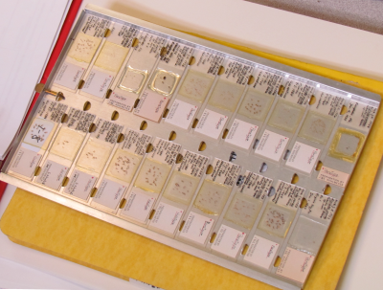
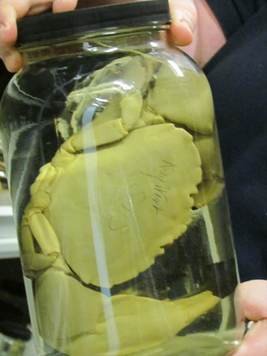
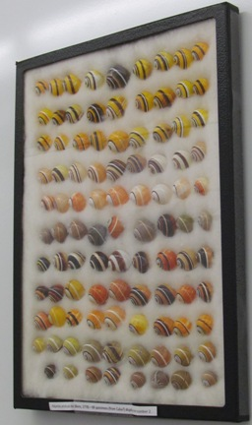
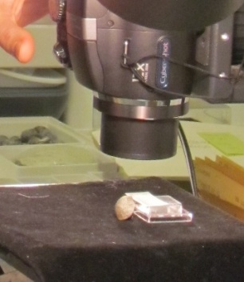
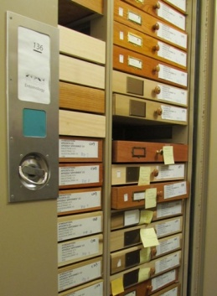
Observing Collections Digitization
iDigBio staff visited
28 Collections in 10 different museums
Collections varied in size, kind, staffing
entomology
invertebrate paleontology
invertebrate zoology
ornithology
botany
vertebrate paleontology
zoology
Paper submitted to ZooKeys
Not about social issues
Notes:
Kinds of collections we visited
Establish credibility as someone who has been studying digitization
Today we’ve seen an overview of business process modeling from the information science point-of-view, in addition to Gil’s presentation about
workflows, what we’ve learned (so far) from our visits, questions we still have…
While many of the process issues (technical and manual) will continue to evolve and improve
the social issues will always be present.
What are some of these social issues?
What can we do with this information?
How does it apply to our workflows (in the community, in an organization, at the level of the individual)?

Slide 4
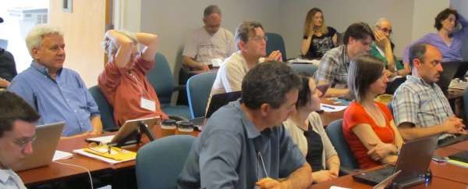
Why discuss ~ the social issues?
all of our hard problems are people problems
Technology problems can be solved!
we'd like to
avoid re-inventing the wheel
use the resources we do have
in the most effective manner possible
to benefit as many as possible
take advantage of existing knowledge about social issues

Slide 5
[Barton 2005] “collaboration between the museum and library communities is essential if solutions to the problems of cross-domain searching are to be found and its potential to facilitate new knowledge creation fully exploited.”
Notes:
What’s our goal? our overall purpose of all our digitization efforts?
Specimen data to address biodiversity questions in science.

Slide 6
Social Issue Layers
specimens as boundary objects
Community
think small science to big science
Organization
the museum
the individual collection
The individual digitizing
Notes:
How can we divide the social layers conceptually? One possible way. Our work is about biodiversity and how we can utilize our natural history collections
more effectively to investigate the universe we inhabit. Start with the fact that our goal here is to digitize specimens.
It might be useful to think of the specimen as a boundary object.
(Star and Griesemer 1989) via the history of the Museum of Vertebrate Zoology (MVZ), UC Berkeley
In order to more effectively think about social issues and optimization (efficiency) at each level and what that might entail.
Keep these in mind during the talk…
little science to big science (is a topic for an entire workshop!) Eric T. Meyer’s work http://people.oii.ox.ac.uk/meyer/
(in private communication, Eric cautions that even though we want to avoid NiH he has seen projects go wrong where the IT staff do not involve the people who will use the products. Staff then does not want to use the products – no engagement).
studies the social implications of e-science and e-social science as part of the Oxford e-Social Science (OeSS) project. He brings an understanding of scientific collaboration from both sides: as a social scientist studying scientific behavior, and as a participant in the production of scientific knowledge. focus here on the notion that was once science done at the level of the individual researcher
data collected only for them
date now being collected in new ways
data now being shared (and shared in new ways)
at the organizational / architectural level –
museums being redesigned so the public can see the research
the collections are connecting back to each other via databases and collaborating with each other
some have, others need those with expertise in collections and biodiversity informatics
at the individual level – the social issues surrounding the persons doing the digitization work.

Slide 7
Overview
observing digitization workflows
social issues
business processes
change, management & motivation
some changes seen
opportunities for redesign
evaluating & redesigning workflows
digitization & cultural maturity
interesting bits seen here already

Slide 8
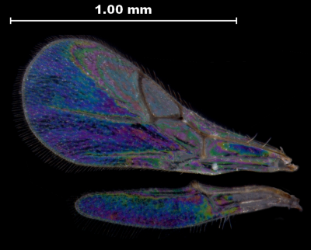
the three r’s
business processes applied to
workflow process improvement
review
observe
document
evaluate
redesign
observe
document
evaluate
reengineer
layers of change
http://www.jiscinfonet.ac.uk/infokits/process-improvement
Notes:
In this workshop, we’re essentially reviewing (current state as / is analysis) processes being used to try and broadly define our overall digitization process. As part of the review process, we’ll be looking for redesign and perhaps in some cases, re-engineering opportunities.
“…before you start reviewing a process to ensure you correctly define what the process actually is and establish what the boundaries are.”
http://www.jisc.ac.uk/aboutus/strategy.aspx
Joint Information Systems Committee
a UK Initiative, now internationally known. to champion the use of digital technology to ensure the UK remains world-class in research, teaching and learning. JISC’s vision is one of easy and widespread access to information and resources, anytime, anywhere; a vision with technology and information management at the heart of research and education.
http://www.jiscinfonet.ac.uk/InfoKits/process-review/process-review-8
http://www.jiscinfonet.ac.uk/infokits/process-improvement
We’re looking for the broad core processes fundamental to the organization.
“…no organization has more than eight core processes.”
How many core processes do we have in the digitization of biodiversity collections?

Slide 9
3 aspects of change management
process
people
culture
http://www.jiscinfonet.ac.uk/infokits/change-management/aspects-of-change
Notes:
Change Management.
3 aspects: people, processes and culture.
While the main focus of this workshop is process, it’s people who do the work within a cultural continuum.
joint information systems committee
http://www.jiscinfonet.ac.uk/infokits/change-management/aspects-of-change
What can we learn, what questions can we ask, to help our efficiency efforts when it comes
to culture and people?
Layers of change management.

Slide 10
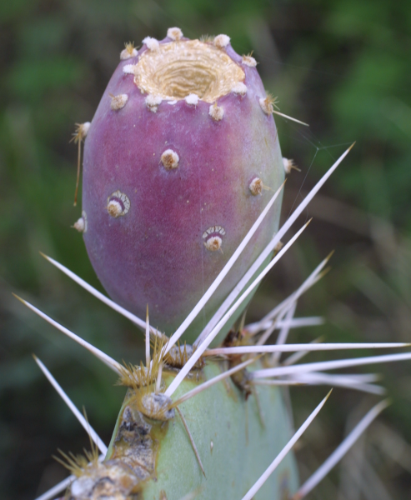
Change
The irrational side of change management
Aiken & Keller, 2009 in The McKinsey Quarterly
what motivates you ≠ what motivates others
we’re better off listening, rather than telling
we need the + and the –
leaders mistakenly believe that they already “are the change”
it’s not just about the leader, it’s about how receptive “society” is to the ideas
money is the most expensive way to motivate people.
satisfaction equals perception minus expectation.
small unexpected rewards can have disproportionate effects.
process and outcome have to be fair to get buy-in
Notes:
Some research on Change Management to keep in mind when thinking about
social issues in workflows, at the organization and individual levels.
why “common sense” doesn’t work.
http://www.abettercity.org/docs/sustainability/McKinsey%20-%20Irrational%20Side%20of%20Change%20Management%202010.pdf
Ties nicely into the next conversation about what research says about what motivates us?
We need to motivate ourselves and each other, right?

Slide 11
Motivation
What is known about what motivates us?
Where can we integrate what is known about motivation into our workflows?
autonomy
if task order doesn’t matter
collecting and integrating feedback
are you doing this?
if not, you are losing information
does task method matter?
mastery
software skills
hardware skills
people skills
training (giving and receiving)
knowledge (collections, curation, content)
use mastery where you can
purpose
engagement & inspiration
the ADBC initiative is rich with purpose > capitalize on this
http://www.danpink.com/archives/2010/06/whiteboard-magic
http://youtu.be/u6XAPnuFjJc
Notes:
What motivates workers / volunteers / people? 5:07 (minutes)
pay people enough so that money is not on their minds and they can concentrate on their work.
3 factors that lead to better performance (and personal satisfaction)
Autonomy – our desire to self-direct our own lives (to get engagement) example: Atlassian (one day a quarter, employees paid to work on something interesting to them – then share (new products, soft ware fixes)
2. Mastery -- it’s fun, it’s satisfying, doing technically sophisticated work (for free), challenge and mastery – making a contribution. we care about mastery
3. Purpose – making a contribution – motivates workers and produces an inspiring place to work.
from the work Drive, the surprising truth about what motivates us by Daniel H. Pink,looking at motivation research of the last 50 years.
The 3 factors? autonomy: We can be attuned to what parts of the workflows can be done in the order chosen by the person doing the work. There are also tasks that could be accomplished in a variety of ways -- the person doing the work -- could choose the method (we've seen this in practice at Yale_ENT, for example). mastery: we can give this via training to -- volunteers / students / staff -- mastering new skills and knowledge sets purpose: this we have -- a very cool purpose, or really, many purposes for all this data! we just need to communicate these to our volunteers / students / staff / administrators...
14 May 2012

Slide 12
Overview
observing digitization workflows
social issues
business processes
change, management & motivation
some changes seen
opportunities for redesign
evaluating & redesigning workflows
digitization & cultural maturity
interesting bits seen here already

Slide 13
Workflow Evolution ~ things people changed (adaptation)
tweezers (aka forceps)
autonomy to alleviate boredom
keystroke short cuts
ocr to validate scanned barcode entry
opportunistic use of mastery / skill sets
tracking flow
what happens when there’s a problem or question?
where do problems go?
losing information
capturing feedback from staff
Institutional level
Coordinated effort
Ready and willing to try a new strategy
Avoiding the N-i-H syndrome
Notes:
Some examples of changes we saw in various collections
as they adapt to improve their digitization.

Slide 14
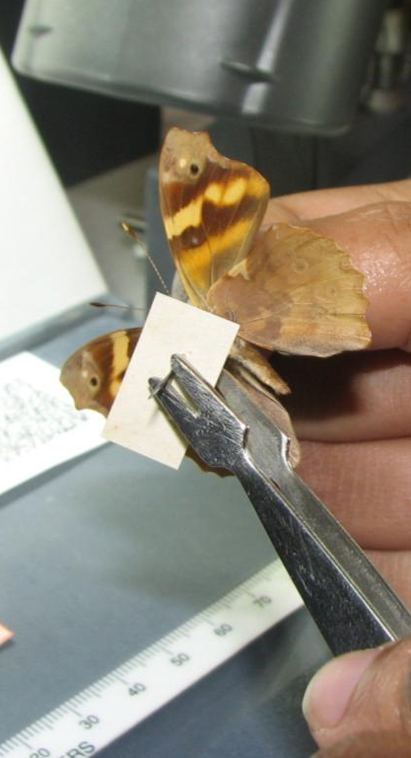
A Unique Tool for the Job: Forceps ~
http://www.ecnweb.org/dev/files/12_Eastwood_2010.pdf
Notes:
reduce the likelihood of specimen handling damage
reduce damage from skin oils on old, fragile labels
speed up the imaging process
increase level of comfort for specimen handling
forceps & culture ~
may also result in the wider entomology community being more willing to handle the specimens so need to continue community endeavors to share / disseminate these ideas

Slide 15
A Unique Tool for the Job: Forceps ~
reduce the likelihood of specimen handling damage
reduce damage from skin oils on old, fragile labels
speed up the imaging process
increase level of comfort for specimen handling
Forceps & culture ~
may also result in the wider entomology community being more willing to handle the specimens so need to continue community endeavors to share / disseminate these ideas.
http://www.ecnweb.org/dev/files/12_Eastwood_2010.pdf
Notes:
reduce the likelihood of specimen handling damage
reduce damage from skin oils on old, fragile labels
speed up the imaging process
increase level of comfort for specimen handling
forceps & culture ~
may also result in the wider entomology community being more willing to handle the specimens so need to continue community endeavors to share / disseminate these ideas

Slide 16
Task Order / Task Method
Task order didn’t matter
imaging ← →data entry
update taxon names ← → imaging
Task method didn’t matter
sort by collecting event
apply barcodes
Social effects
autonomy
alleviates boredom
engages worker → giving them a choice
novel strategies (mastery and purpose)
Notes:
Some examples of changes we saw in various collections
as they adapt to improve their digitization.

Slide 17
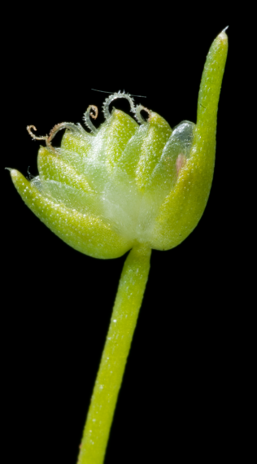
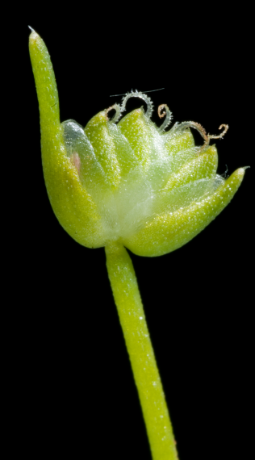
Keystroke Shortcuts
Keystroke more efficient than mouse
Keystroke shortcut training
Keystroke shortcuts posted prominently
Keystroke vs. mouse
Social effects
seems to engage workers
steps reduced (no mouse) → less tedious
novel strategies
Notes:
Some examples of changes we saw in various collections
as they adapt to improve their digitization.

Slide 18
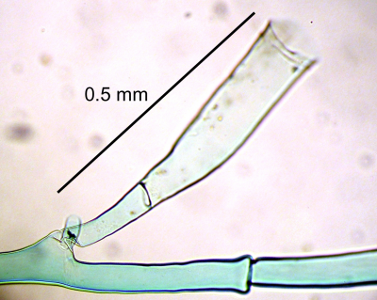
Software Automation
Barcode Capture and Validation
barcode captured 2 ways
scanner
OCR
software compares the 2 values, reports any mismatch
increases data integrity
reduces human quality control steps
Social effect
focuses human quality control steps → less tedious
Notes:
Some examples of changes we saw in various collections
as they adapt to improve their digitization.

Slide 19
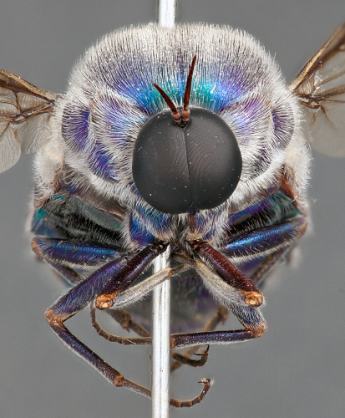
Using Skill Sets
opportunities to use individual skills
typing
imaging
language
writing
software / hardware
student / staff reads Russian → Russian labels
student is meticulous → updating taxonomy on specimens to latest names
students / staff share what works with each other
effects
efficient use of talent (resources)
engaging someone’s sense of purpose and usefulness allowing them to utilize mastery
Notes:
Some examples of changes we saw in various collections
as they adapt to improve their digitization.
Openness to change (2-way barcode validation strategy – Paul Morris at Harvard ENT)

Slide 20
Openness to Change
Our Welcome.
Upon arriving, Gil and I were greeted warmly and invited to a group luncheon – all hands staff. There, the director encouraged us to share any observations about processes they could change or improve.
Later, seeing the image processing workflow, we mentioned the 2-way barcode capture and automated barcode validation* mentioned earlier and the staff implemented this change on-the-spot.
Effects:
increased data integrity
reduced human quality control steps
reinforced importance of observation, sharing, and openness to change.
Notes:
Some examples of changes we saw in various collections
as they adapt to improve their digitization.
Openness to change (2-way barcode validation strategy – Paul Morris at Harvard ENT)

Slide 21
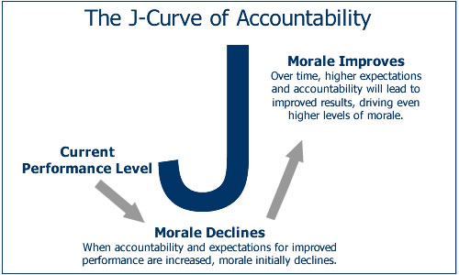
More about change
J-curve theory & will power
can’ts are steps not walls
“or, it’s all too hard and I don’t want to do it anyway.”
data quality concerns
data sensitivity concerns
lack of resources
what the research says about $
Notes:
More about change.
What happens (to morale) when change is instituted and accountability and expectations are set higher.
http://www.peterstark.com/triumph-unwanted-change/
http://www.peterstark.com/why-employees-resist-change/
http://www.peterstark.com/employees-handle-change/
Bryan Kalms bits on can’ts

Slide 22
5 important principles of effective workflows…
The Bioinformatics Manager is a key
People do the digitization
Processes and workflows vary
Workflows and protocols are business processes
Communication within and among projects is crucial
Notes:
There are likely more than 5 principles, but these seem to stand out the most.

Slide 23
Overview
observing digitization workflows
social issues
business processes
change, management & motivation
some changes seen
opportunities for redesign
evaluating & redesigning workflows
digitization & cultural maturity
interesting bits seen here already

Slide 24
Evaluate a Workflow
Pre Digitization Curation Tasks | must be done before digitization | could be done at or after digitization | Non expert | Crowd Source? | a step that could be automated | a task needing QC / QA | Can do with existing machine (Kirtas) | Authority file exists or would be useful | a physical tool exists | easy to compute time / costs for this task | formula exists
interview staff | ✓
hire staff | ✓
train staff | ✓ |  | ✓
decide what to digitize | ✓ |  |  |  |  |  |  |  |  |  | ✓
pull specimens | ✓ |  | ✓
sort specimens (e.g., by taxon, sex, geographic region, collecting event, collector) | ✓ | ✓ | ✓
add taxon names to database |  |  | ✓ |  |  |  |  | ✓
update taxonomic identification on specimens (e.g., vet type specimens) |  | ✓ | ✓ | ✓
Workflow (WF)
Documentation of WFs
Improving WFs
Talking with others / comparing
Evaluating WFs
See WF Mockups – for DROID workshop
Notes:
Work Flow Mock up for Upcoming DROID workshop.
The left column is meant to become a list of all tasks at the pre-digitization step.
The top row is a list of criteria to on which to evaluate each step for a possible place to make improvements in some way.
It is not comprehensive – it needs community input.
The results of these will be posted to help the community compare tasks
and create a road map for using the data gathered to speed things up!
A common language may be useful? Can we accomplish this? If we call the major tasks and sub-tasks the same thing, we can more easily compare our workflows
always on the look out for
others accomplishing the same task in fewer steps
doing the same task for less
doing the same task faster
achieving the same task with less errors
Keep in Mind: People skills opportunities, Protocol writing opportunities, Protocol feedback opportunities, Task order, Task method, What’s the slowest step?, how to figure that out, what to do about it, Do we have common workflow steps (common core processes)?, Software review opportunities, Hardware review,
Community expertise, Community resources, Openness to change (avoid bias , N-i-H), Is faster better? Check if the faster person is as accurate as the slower and if multi-keying – it doesn’t matter.

Slide 25
Why Slow Steps Occur
Lack of
sound process design
resources (use what we have wisely)
process knowledge automation
automation
Poor scheduling and allocation of resources
How to find the slowest step/s?
“ask the people who work within the process”
http://workflow.wordpress.com/2006/10/11/workflow-strategies-for-getting-around-chokepoints/

Slide 26
Tweak the Slowest Step/s
if possible: divide task into sub-tasks
see if those tasks can be parallel
if not, can resources be allocated to the new tasks?
can the slow task be placed in parallel with other tasks?
can more resources be allocated to the slow step?
can any part of the slow step be automated?
if it’s taking too long, can you reassign it? can you send an alert?
will scheduling it differently help?
http://workflow.wordpress.com/category/efficiency/
Notes:
From Craig Cameron’s Workflow Blog

Slide 27
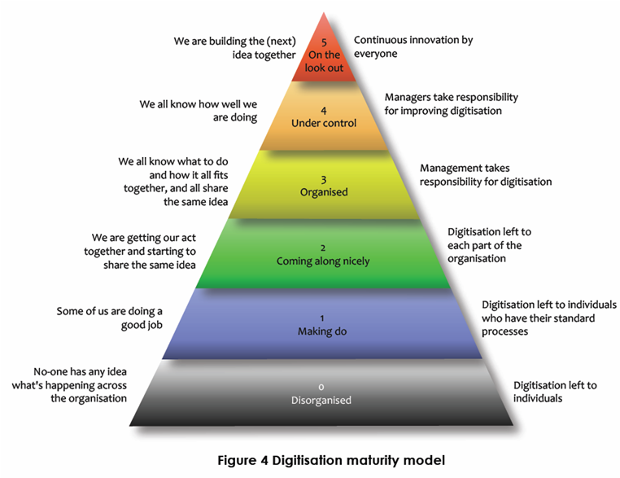
Organization Maturity
Six maturity levels for core digitization activities [Kalms 2012]
Notes:
Bryan Kalm’s digitization maturity scale. useful for organizations looking to benchmark their overall maturity within and between collections.

Slide 28
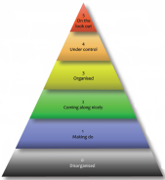
What’s your Digitization Maturity? Find out here …on page 67+
Digitisation: A strategic approach for natural history collections. Canberra, Australia, CSIRO, 2012.
Author: Bryan Kalms
Available at http://www.ala.org.au/wp-content/uploads/2011/10/Digitisation-guide-120223.pdf.

Slide 29
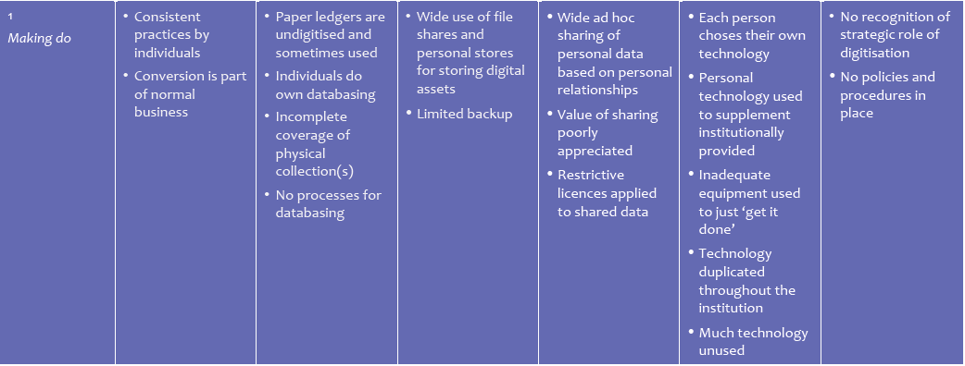
What’s your Digitization Maturity?
http://www.ala.org.au/wp-content/uploads/2011/10/Digitisation-guide-120223.pdf
Notes:
A sample of the digitization maturity scale criteria…shown here for level 1 and level 5 for comparison.

Slide 30
Increasing Cultural Maturity little science to big science
converging on ideas of how to collect data in the field
converging on ideas of what data to collect in the field
emerging trends and issues in data-sharing and intellectual properties
the boundaries (ours and the objects) are changing
"…to promote an organizational structure that encourages communication between scholars who are both creating and consuming information." (Barton 2005, quoted in Chern Li Liew 2009).

Slide 31
Your Workflows
Some highlights noted before the workshop
Software review: Photoshop batch limitations
Andrew Bentley: space (field, lab)
Paul Morris: workflow steps
skill levels (using color)
human or software mediated steps (using color)
timing (overlay)
data quality / data integrity tracking
Louis Zachos:
specimen handling (where it starts / stops)
legacy database
georeferencing (Dorothy, Ed, Paul H. Andy)
Linda Ford: the organizational process model
collaborative connections for output
collaborative database development
Melissa Tulig, Michael Bevans, Louis Zachos: throughput
Ed Gilbert: automated OCR/NLP/Georeferencing & parsed fields
Dorothy Allard: explicit qc / qa and implicit qc

Slide 32
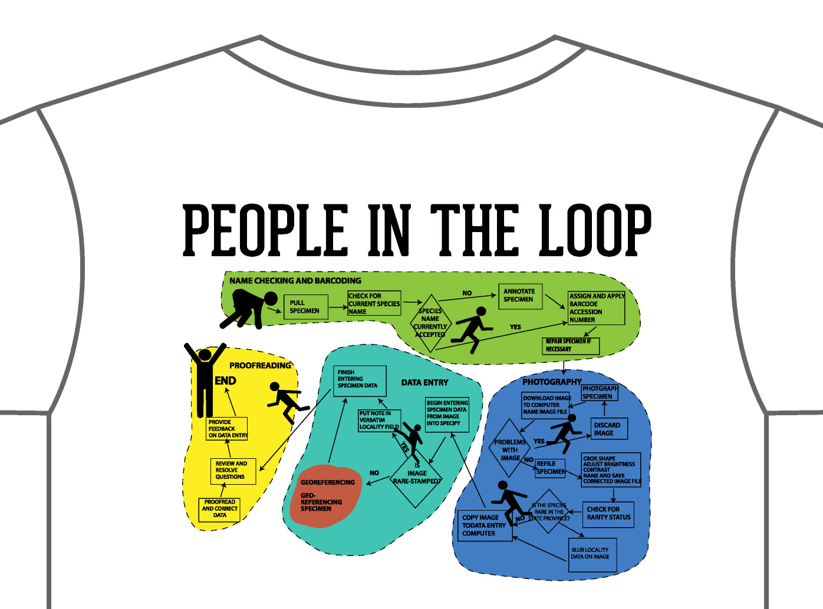
our T-shirt!
Thanks Dorothy, Jim, …

Slide 33
Keep in Mind
Communication, Culture & Community Awareness
Visit to see what others are doing
Contribute to the process, (example): learning how to document and evaluate workflows to find our common core processes and move forward.
Comfort
Work outside your comfort zone (Judy Skog)
Ask for feedback
Work collaboratively ~ Share
social events
workshops and training events (here!)
contribute to FAQ or Q and A
wikis
Influence others, be
open
clear
transparent
Keep Enterprise 2.0 in mind…
“Let people do the work – they’ll create amazing stuff.”

Slide 34
Life in Perpetual Beta http://www.jarche.com
“You have to have an idea of what you are going to do, but it should be a vague idea.”
Pablo Picasso
Ignorance more frequently begets confidence than does knowledge.
Darwin (The Descent of Man, Volume 1 page 3)
Notes:
When we remove artificial boundaries, we enable innovation.
http://www.jarche.com/category/wirearchy/
http://www.jarche.com/2012/03/making-collaborative-work-work/
14 May 2012

Slide 35
Social Issues in Collaborative Digitization…
Barton, J. 2005. “Digital libraries, virtual museums: same difference?”, Library Review, Vol. 54 No. 3, pp. 149-54
Reed Beaman, James Macklin, Michael Donoghue, James Hanken. 2007. Overcoming the Digitization Bottleneck in Natural History Collections: A summary report on a workshop held 7 – 9 September 2006 at Harvard University. [Accessed January 2012]
ĺñigo Granzow-de la Cerda and James H. Beach. December 2010. Semi-automated workflows for acquiring specimen data from label images in herbarium collections. Taxon 59 (6): 1830-1842
Bryan Kalms. 2012. Digitisation: A strategic approach for natural history collections. Canberra, Australia, CSIRO
Liew, Chern Li. 2009. Digital library research1997-2007:Organisational and people issues. Journal of Documentation 65(2): 245 – 266 http://dx.doi.org/10.1108/00220410910937606
Eric T. Meyer. 2009. Moving from small science to big science: Social and organizational impediments to large scale data sharing. In: E-Research: Transformation in Scholarly Practice. Jankowski, Nicholas W. (Ed), Routledge. 350 pp.
Susan Leigh Star and James R. Griesemer. 1989. Institutional Ecology, ‘Translations’ and Boundary Objects: Amateurs and Professionals in Berkeley’s Museum of Vertebrate Zoology, 1907 – 1939. Social Studies of Science 19: 387 – 420
John Tann & Paul Flemons. 2008. Report: Data capture of specimen labels using volunteers. Australian Museum
Ana Vollmar, James Alexander Macklin, Linda Ford. 2010. Natural History Specimen Digitization: Challenges and Concerns. Biodiversity Informatics 7 (1): 93 – 112
iDigBio Workshop: Developing Robust Object to Image to Data Workflows May 30 – 31, 2012
Notes:
papers contributing content to this presentation to add context and hopefully value to the continuing conversation…

Slide 36
Acknowledgment & Thanks
American Museum of Natural History (AMNH)
Botanical Research Institute of Texas (BRIT)
Florida Museum of Natural History (FLMNH)
Florida State University (FSU)
Harvard Herbarium (HUH)
Museum of Comparative Zoology (Harvard)
New York Botanical Garden (NYBG)
Southeast Regional Network of Expertise and Collections (SERNEC)
Specify Software Project (University of Kansas)
Symbiota Software Project (Arizona State University)
Tall Timbers Research Station and Land Conservancy (TTRS)
Tulane University Museum of Natural History
University of Kansas Biodiversity Institute Entomology Department
Valdosta State University (VSU)
Yale Peabody Museum (YPM)
and all participants at the iDigBio DROID Workflows Workshop
May 30 – 31, 2012 University of Florida
Notes:
Thanks! from all at iDigBio

Slide 37
Removing Artificial Boundaries: enabling innovation
When we remove artificial boundaries we enable innovation
from Harold Jarche’s blog: Life in perpetual beta
“The central change with Enterprise 2.0 and ideas of managing knowledge [is] not managing knowledge anymore — get out of the way, let people do what they want to do, and harvest the stuff that emerges from it because good stuff will emerge. So, it’s been a fairly deep shift in thinking about how to capture and organize and manage knowledge in an organization.” ~ Andy McAfee
Something new might be discovered because not everything is being dictated in advance (we won't learn as much this way).
For example, being somewhat open-ended with how to do the workflow documentation task -- so we can learn from each others point-of-view and approach to the material.
Notes:
Put this before discussion of what’s been seen here already.
When we remove artificial boundaries, we enable innovation.
http://www.jarche.com/2012/05/when-we-remove-artificial-boundaries/
http://www.jarche.com/category/wirearchy/
14 May 2012
http://www.techdirt.com/blog/?company=xerox
http://www.scoop.it/t/prionomy
http://www.google.com/imgres?start=831&um=1&hl=en&tbm=isch&tbnid=h9yySWG90U-EZM:&imgrefurl=http://www.forbes.com/sites/tedgreenwald/2012/01/31/business-model-canvas-a-simple-tool-for-designing-innovative-business-models/&docid=2a718O1OCAHIEM&imgurl=http://blogs-images.forbes.com/tedgreenwald/files/2012/01/business_model_canvas_poster-02.jpg&w=1000&h=667&ei=LWuxT577D46C8QSfypjkCA&zoom=1&iact=hc&vpx=906&vpy=199&dur=4149&hovh=183&hovw=275&tx=152&ty=88&sig=103108423568694251652&page=32&tbnh=137&tbnw=205&ndsp=26&ved=1t:429,r:20,s:831,i:168&biw=1222&bih=857
http://www.google.com/imgres?start=340&um=1&hl=en&tbm=isch&tbnid=BHxustec00BvEM:&imgrefurl=http://www.techdirt.com/blog/%3Fcompany%3Dxerox&docid=jn-24bMr4ZprLM&imgurl=http://i.imgur.com/YjEPD.png&w=846&h=468&ei=kWqxT-XwMYiw8ASk9v3vCA&zoom=1&iact=hc&vpx=791&vpy=560&dur=2642&hovh=167&hovw=302&tx=118&ty=125&sig=103108423568694251652&page=14&tbnh=125&tbnw=226&ndsp=29&ved=1t:429,r:27,s:340,i:185&biw=1222&bih=857
http://www.techdirt.com/blog/?company=xerox (everything is a remix)
The basic elements of creativity: copy transform combine
image YjEPD.png

Slide 38
to keep in mind…
People skills opportunities
Protocol writing opportunities
Protocol feedback opportunities
Task order
Task method
What’s the slowest step?
how to figure that out
what to do about it
Do we have common workflow steps (common core processes)?
Software review opportunities
Hardware review
Community expertise
Community resources
Openness to change (avoid bias , N-i-H)
Is faster better?

