Slide 1
Paleocollections Meeting
Judith E. Skog
Biological Sciences Directorate
Emerging Frontiers Division
H. Richard Lane
Geological Sciences Directorate
Earth Systems Science

Slide 2
Collections Digitization at NSF
Development of the ADBC program
Needs defined
Community strategic plan
NSF program based on policies and gaps
GEO joined in effort this year
Meets some of EarthCube goals
Need rationale for paleo integration

Slide 3
Defining the Need
Reports from the Federal Interagency Working Group on Scientific Collections and a survey by NSF of nonfederal collections cited need for ‘dark data’ in collections to be accessible for research broadly. Online accessibility critical.
needed for biodiversity-based studies as baseline
understand gaps in knowledge
proper validation of species
ancillary data such as SEM photos, DNA samples and environment/habitat information

Slide 4
Result from the Focus Group
Strategic plan for digitizing, imaging, mobilizing collections data for the non-federal collections in the USA completed June 2010
Need a central organization for integration
Need for thematic networks based on research area
Need for regional groups or clade based groups
Assess need for new tools and technologies
At the core are the collections

Slide 5
NSF Program
Community plan outlined program goals
NSF assessed programs to see what was available
Individual collections and regional or clade based activities supported through Collections Improvements program
Tools supported through informatics and instrumentation programs
Two items in plan had no place for funding
The Central coordinating resource for digitization projects
Digitization based on research challenges

Slide 6
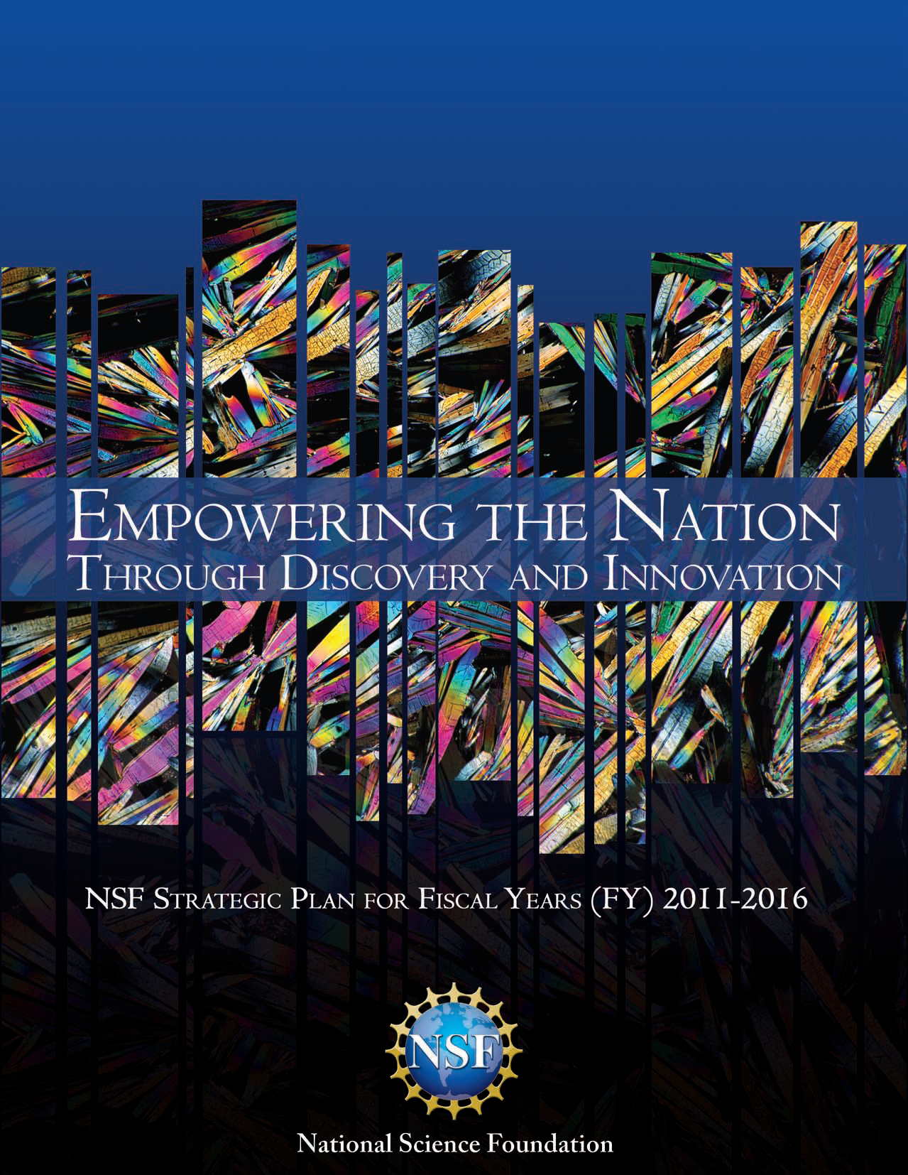
New NSF Strategic Plan
Transform the frontiers emphasizes the seamless integration of research and education as well as the close coupling of research infrastructure and discovery.

Slide 7
Division of Emerging Frontiers
Division devoted to innovative , multidisciplinary projects
Virtual division – works across boundaries and incubates activities
Encourages synergy between disciplines
Promotes networking activities for 21st Century Biology

Slide 8
ADBC program
Set up an integrative national resource
Focus on digitizing existing specimens into a network
Emphasize innovative ways to increase efficiency and cut costs
Rationale to inform grand challenge research questions through projects

Slide 9
Next Steps - Workshop
Innovate – think outside the standard approaches and think strategically and broadly
Integrate – look to big data issues, metadata, international activities – and think about other sources of funding beyond GEO and beyond NSF
Inquire – what are the grand challenges facing science, how does paleo play a role in the answers, and why are collections critical for these studies

