Slide 1


iDigBio Research Coordination and Scientific Community Outreach
Pam Soltis
iDigBio External Advisory Board Meeting
2012 (Project Year 1)
Supported by NSF Award EF-1115210

Slide 2
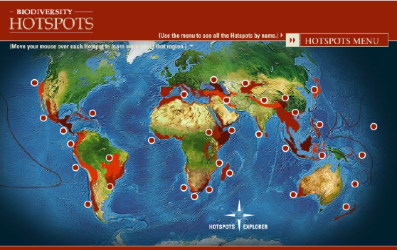
Research Questions
How are species distributed in geographical and ecological space?
What is the history of life on Earth?
What factors lead to speciation, dispersal, and extinction?
What are the impacts of climate change likely to be?
What information is needed for effective conservation strategies?

Slide 3
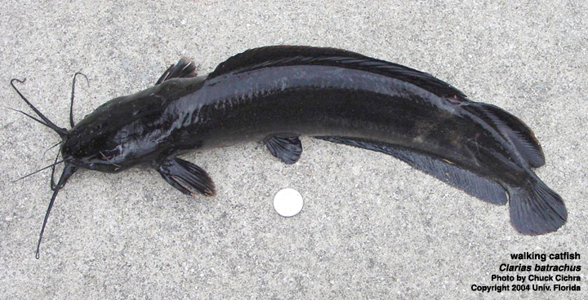
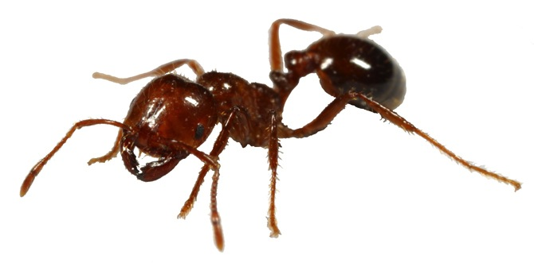
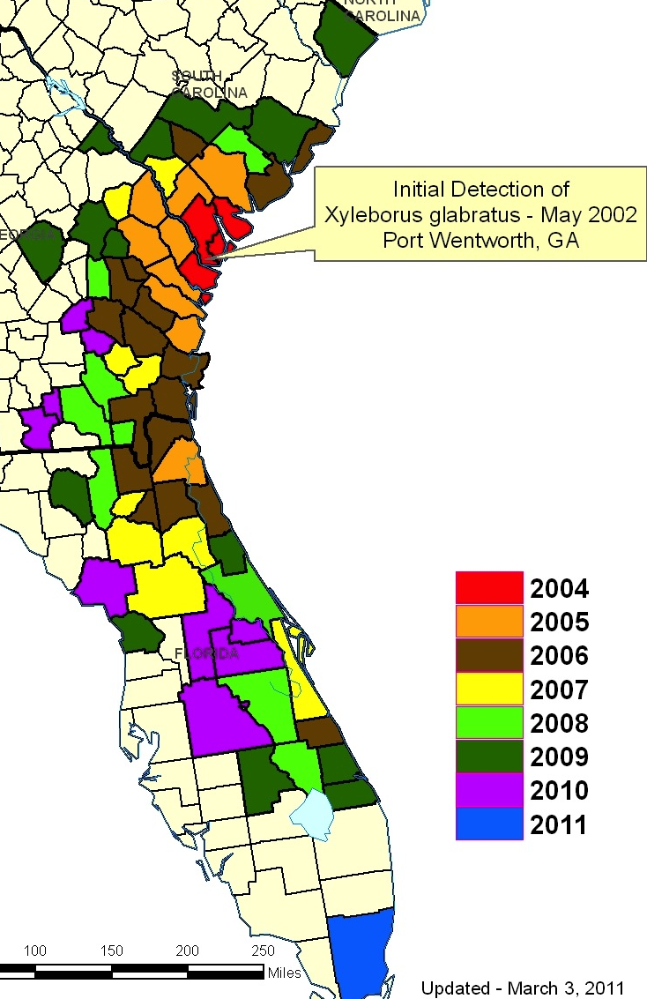
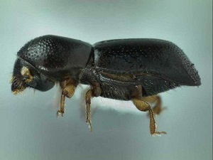
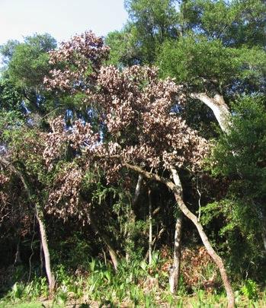
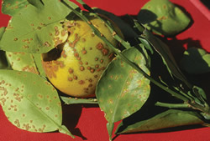
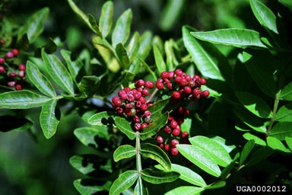
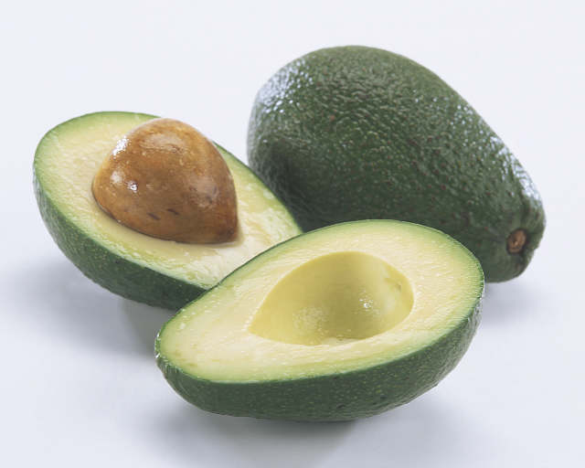
Invasive Species
Where have they been introduced, and how quickly are they spreading?
What is the pattern of spread, and do they covary with other taxa?
What is the effect of climate change on the spread of invasives?

Slide 4
Research & Scientific Outreach
Foster, encourage, enhance, enable research using collections data
  Foster research in IT
Integrate with various research communities
Work with research communities to develop collections and research-related workshops and symposia at meetings
Work with research communities to develop interfaces with data repositories, etc. to promote integrated research
Coordinate these efforts with TCNs and PENs

Slide 5
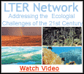

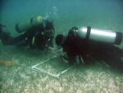
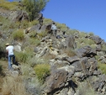
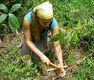
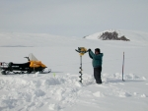

Linking Collections to Ecology
Through collections from LTERs

Slide 6
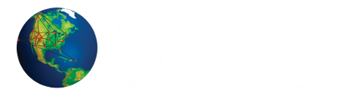
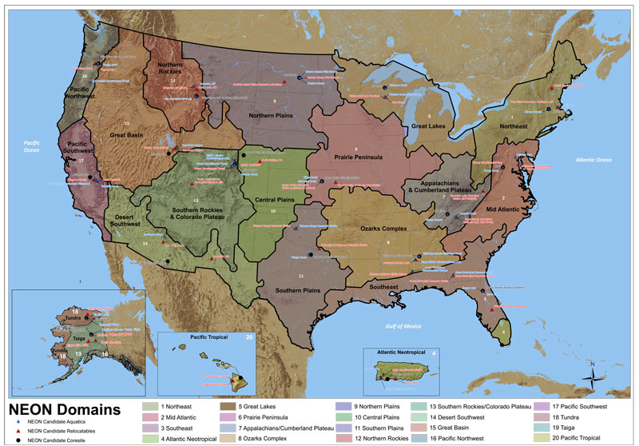
Linking Collections to Ecology
  Through NEON
  Biological monitoring at sites across USA; collections
  Baseline for changes in
  species distribution and
  abundance over time
National Ecological Observatory Network

Slide 7
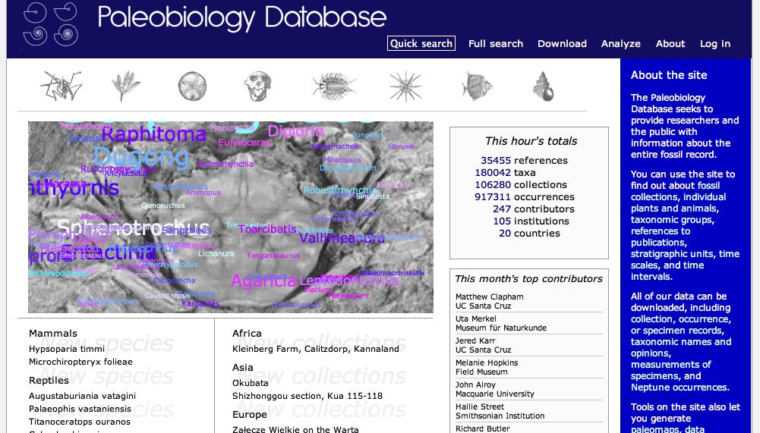
Linking Collections to Paleobiology
Paleobiology Database
  (http://paleodb.org/cgi-bin/bridge.pl)

Slide 8
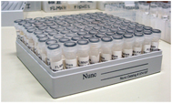
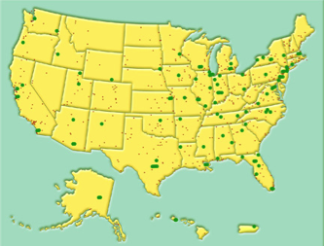
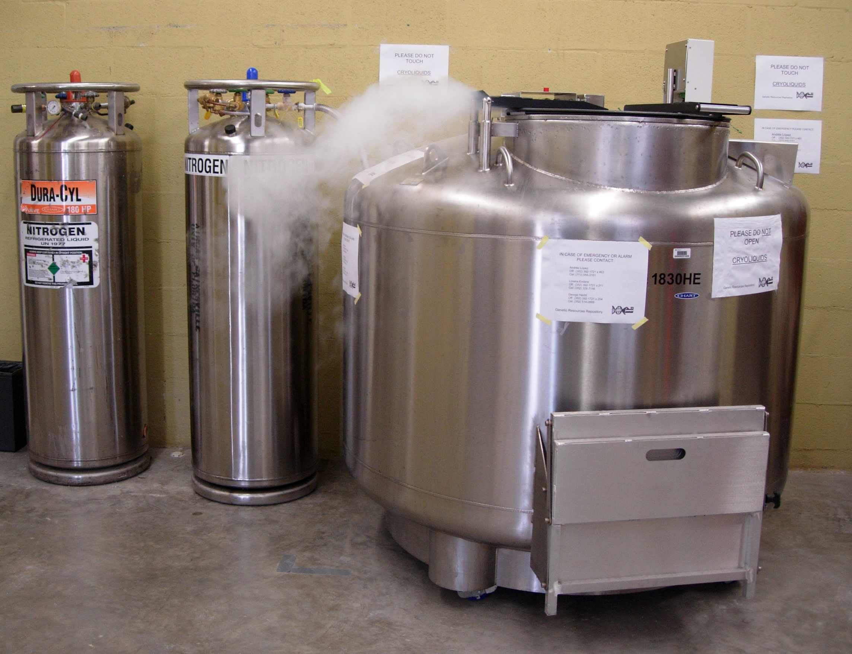
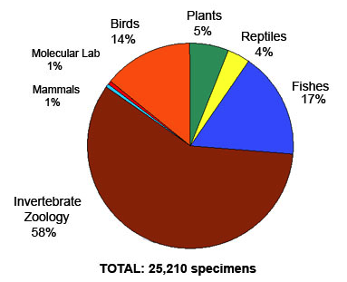
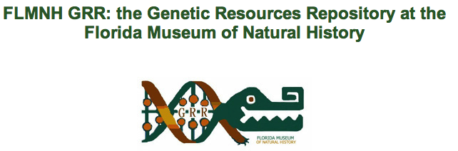
Linking Collections to Genomics
National network of tissue and genetic
resources

Slide 9
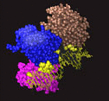
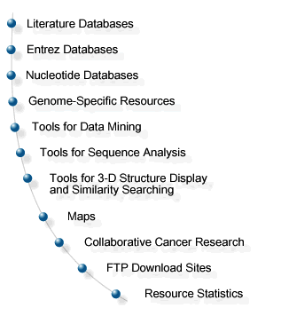
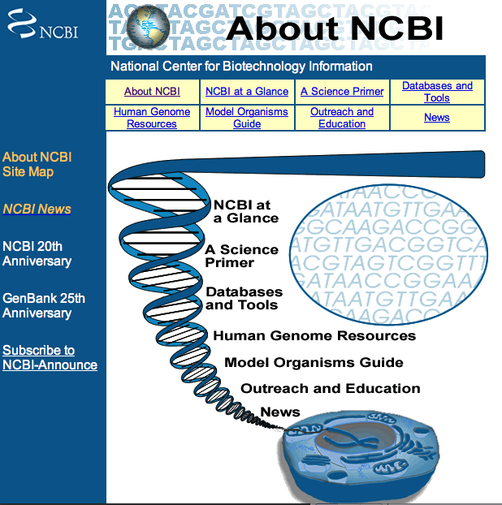
Linking Collections to Genomics
Extend HUB connections to genomics databases

Slide 10






Linking to Living Collections
Botanical gardens, zoos, culture collections

Slide 11
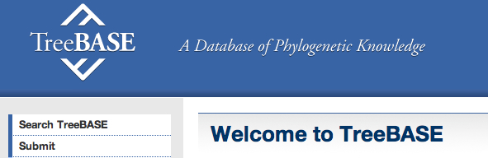


Interactions with Systematics Community and Beyond
Facilitate digitization efforts
Coordinate with other databasing efforts in systematics
Connect to databases outside systematics:
    ecology to genomics (NEON to GenBank)

Slide 12
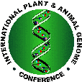




Interactions Fostered Through…
Discussions at national meetings of professional societies (systematics, ecology, evolution, genomics)
Workshops to engage members of systematics community
Workshops to engage members of different communities

Slide 13
Activities to Date
Meetings/symposia with collections community
  Botany 2011
  BISON
  TDWG
  Society of Vertebrate Paleontology
  Entomological Collections Network
  iDigBio Summit
  Paleocollections Workshop (B. MacFadden lead)
  Botany 2012: Symposium and Workshop (A. Mast)
  Participation at SPNHC 2012
Plans underway for additional workshops

Slide 14
Activities to Date
Discussions with various data repositories:
  TreeBASE
  Dryad
  NEON
  GenBank
  iPlant
Workshop on Linked Data (with NESCent)

Slide 15
Plans for Year 2
Linked Data workshop (with NESCent)
Foster additional workshops with research communities
Symposia and training at national/regional meetings
  Botany 2012 (Soltis and Mast)
  American Society of Ichthyologists and Herpetologists (Page)
Develop network of genetic and tissue collections
Develop evaluation strategy (Ellis)
Engage post-docs and students in research

Slide 16
Florida Plant Phylogeny:
Phylogenetic Diversity Under Climate Change
Vascular Plant Diversity in Florida
2609 species (of 4200)
all included in phylogeny
203 species
endemic to Florida
Ratio of endemics
to all species
~200,000 location points; data from UF, FSU, USF, GBIF, FNAI

Slide 17
Florida Plant Phylogeny:
Phylogenetic Diversity Under Climate Change
Vascular Plant Diversity in Florida
+
2609 species (of ~4200)
all included in phylogeny
Phylogenetic tree, 2609 species
GenBank, new (1000 spp)

Slide 18
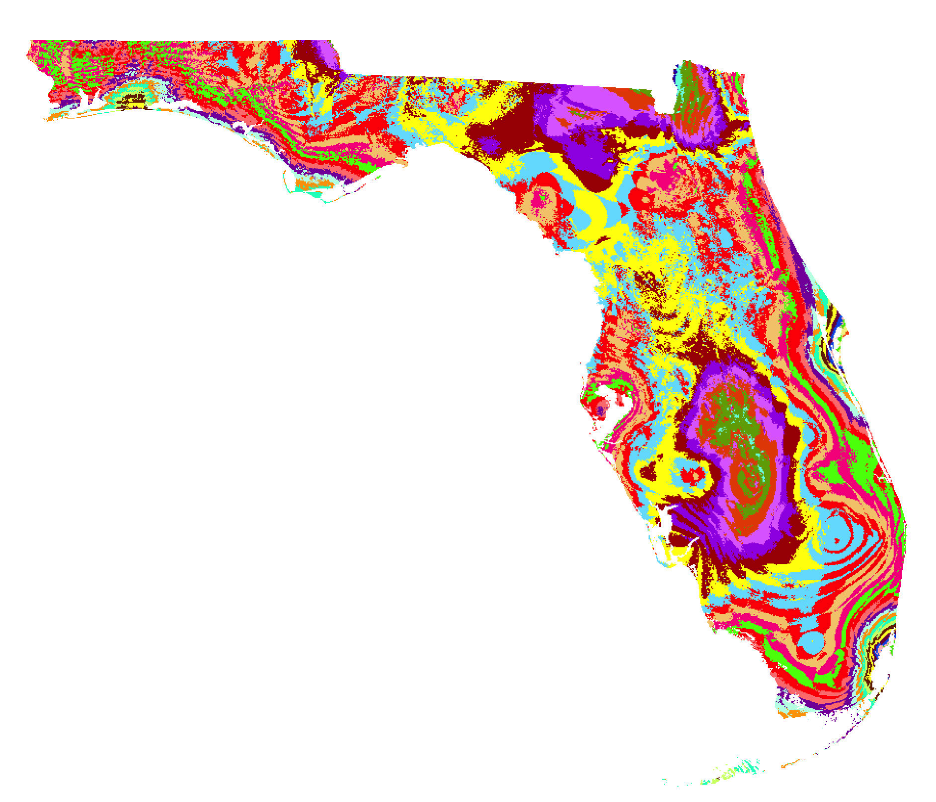
Florida Plant Phylogeny:
Phylogenetic Diversity Under Climate Change
Integrate distribution data, ecological data, climate models, phylogeny
  How does species diversity compare to
  phylogenetic diversity?
  How do species diversity and phylogenetic
  diversity change?
  How do invasive species respond?
  Integrate across clades
  Develop workflows to facilitate such studies
  D. Soltis, G. Burleigh, C. Germain-Aubrey, J. Allen, L. Majure

