Slide 1
Overview of iDigBio, the HUB for Advancing Digitization of Biological Collections
Larry Page
iDigBio Paleocollections Workshop
2012 (Project Year 1)
Supported by NSF Award EF-1115210

Slide 2
University of Florida & Florida State University
University of Florida
Pamela Soltis, Bruce McFadden, Jose Fortes, Larry Page
Florida State University
Greg Riccardi

Slide 3
University of Florida
Larry Page, Jose Fortes, Pamela Soltis, Bruce McFadden, Renato Figueiredo, Reed Beaman, Andrea Matsunaga, Alex Thompson, Matthew Collins, Jason Grabon, Shari Ellis, Kevin Love,
Betty Dunkel, Cathleen Bester
Florida State University
Greg Riccardi, Austin Mast, Marcia Mardis, Gil Nelson, Casey McLaughlin, Deb Paul, Guillaume Jimenez

Slide 4
ADBC
The enormous amount of information in biological
collections is inaccessible to most potential users.
The goal of ADBC is to remove this inaccessibility by putting
information online so that researchers, educators, students,
environmentalists, and policymakers will have access.

Slide 6
Mission of iDigBio:
To make ADBC a success.

Slide 7
Vision of iDigBio: Two Primary Outcomes
iDigBio is the primary source for information from
biological collections in the U.S.
information from biological collections reaches
users as seamlessly and as usefully as possible

Slide 8
Vision of iDigBio: Two Primary Outcomes
2. iDigBio a primary source for information on standards
and methods for digitization of biological collections
and digitization becomes routine in all
institutions with biological collections

Slide 9
‘Grand Challenges’
in science and in society

Slide 10
Grand Challenges in Science and Society
“… grand challenge efforts seek to drastically
alter the boundaries of existing knowledge,
established disciplines and available capabilities.”
Susan J Winter, National Science Foundation
Brian S Butler, University of Pittsburgh
Journal of Information Technology (2011) 26, 99–108

Slide 11
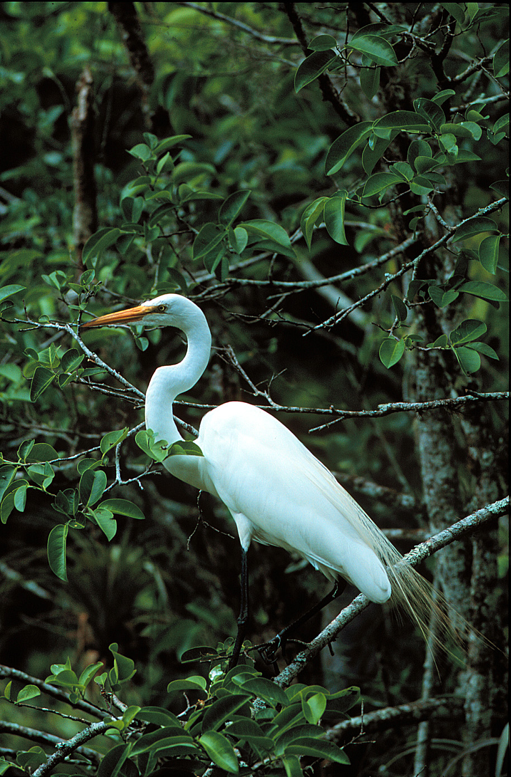
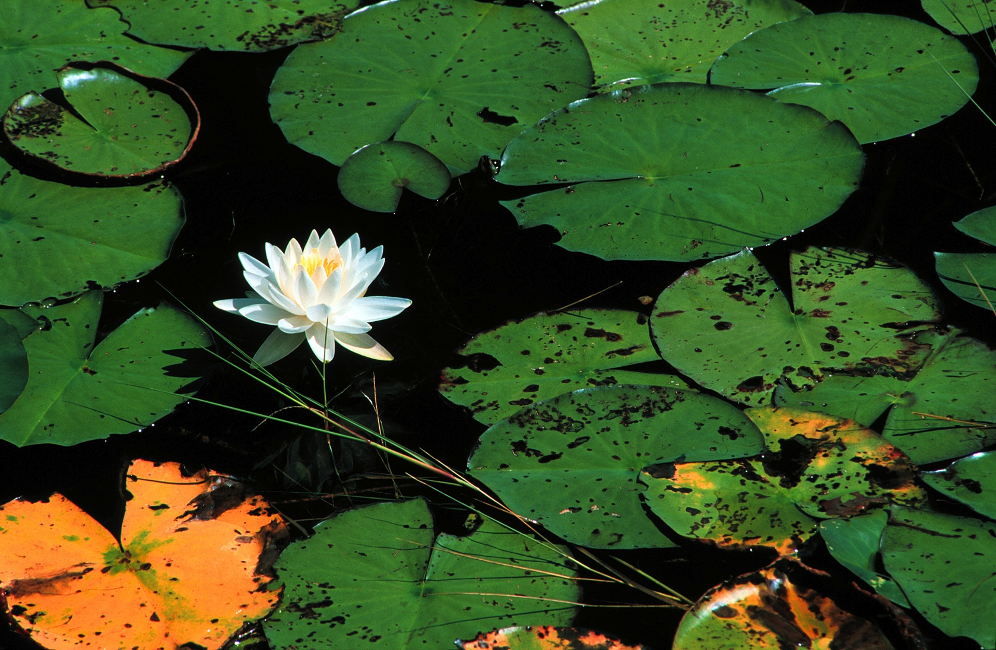
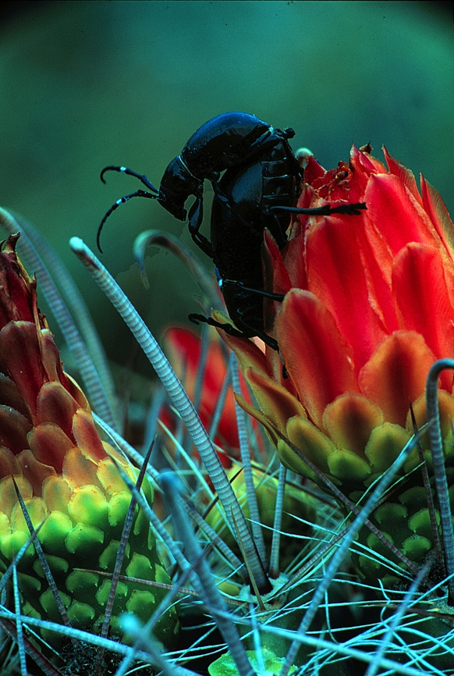
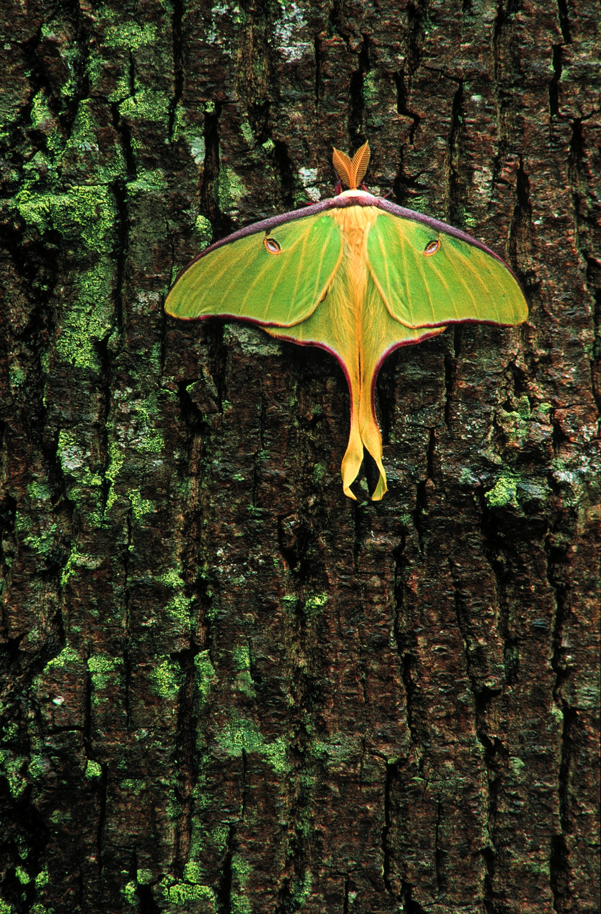
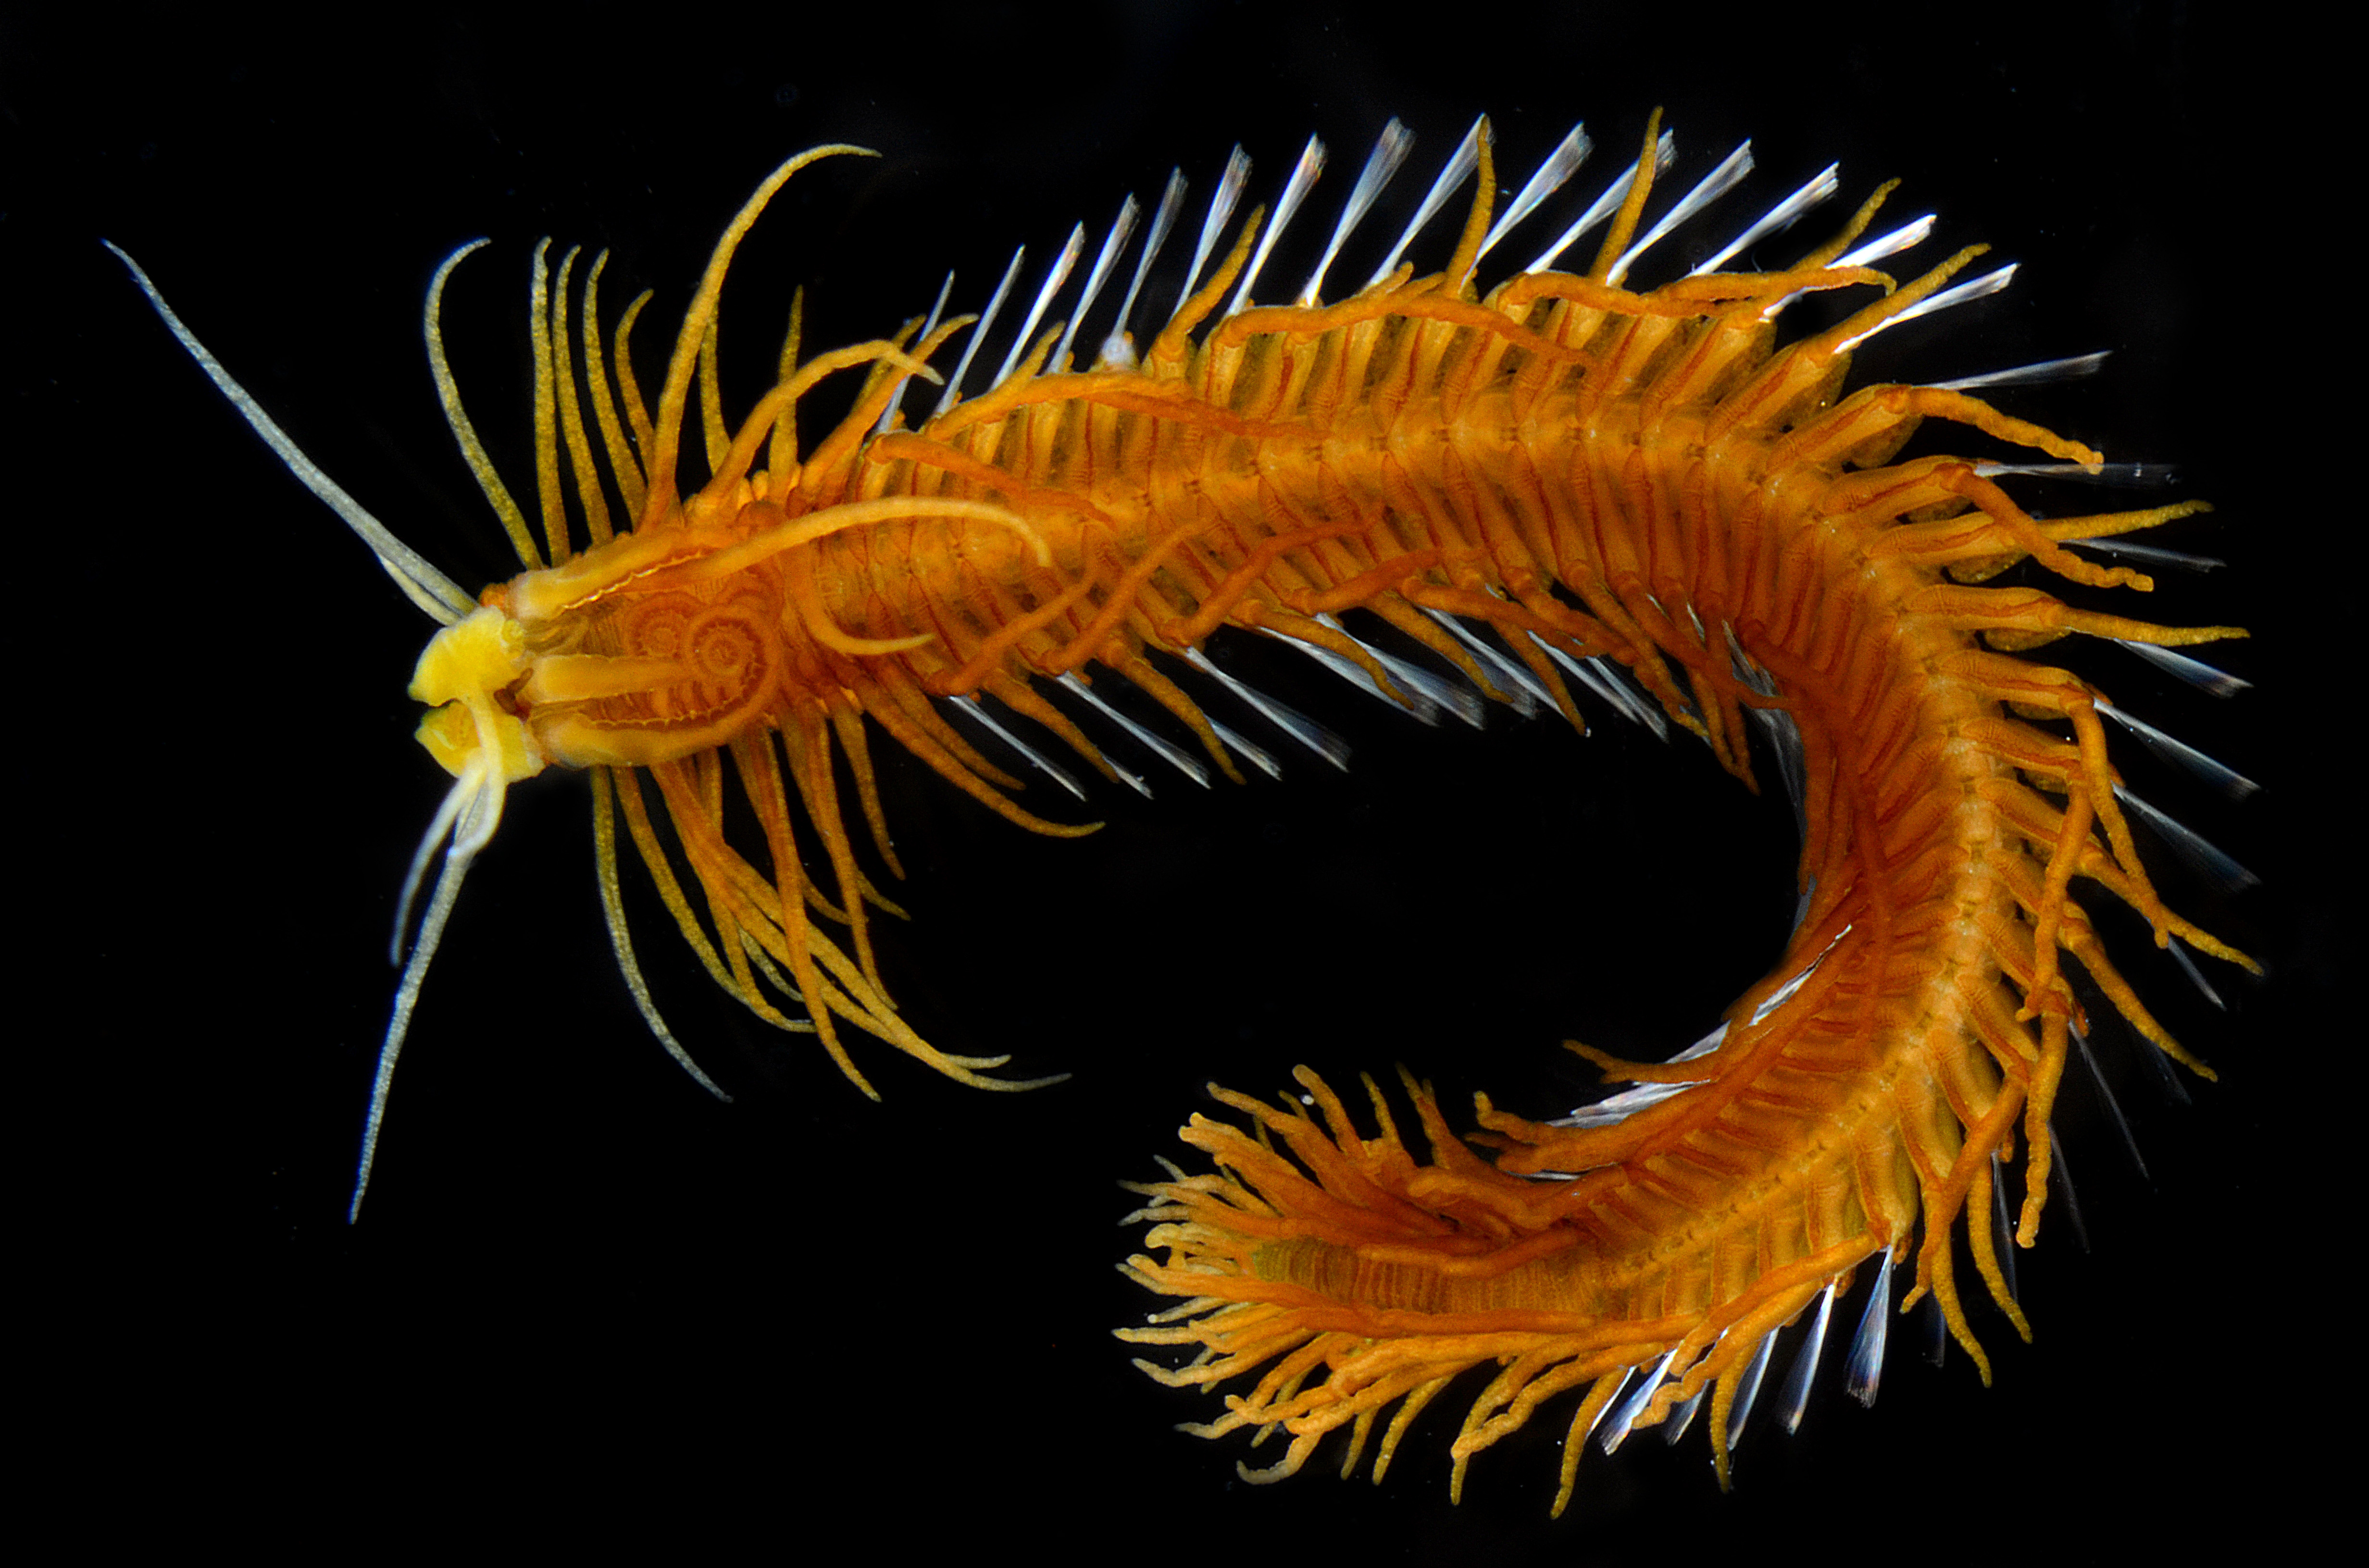
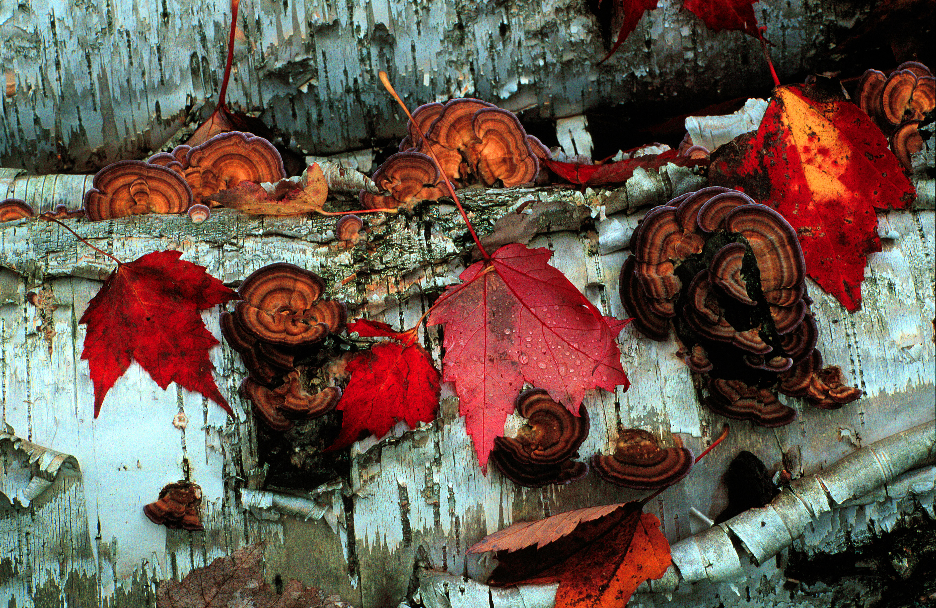
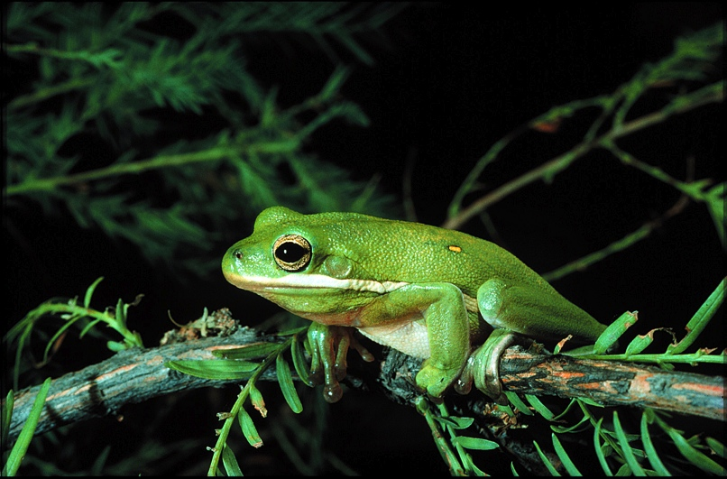
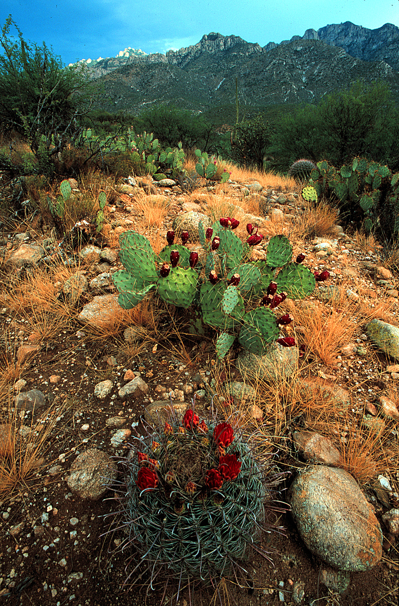
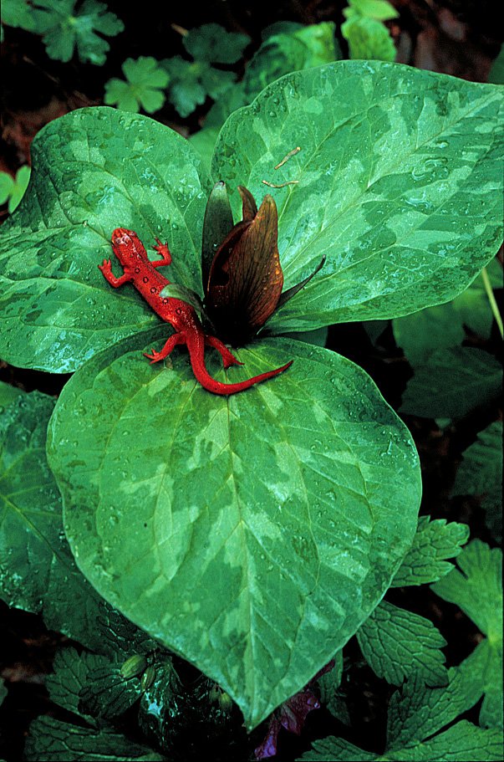
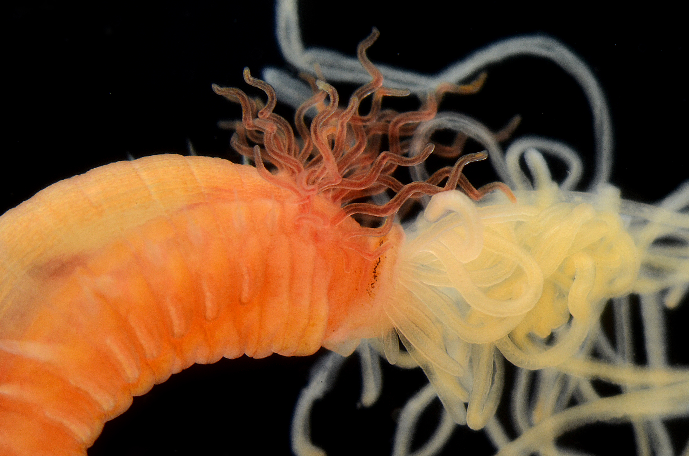
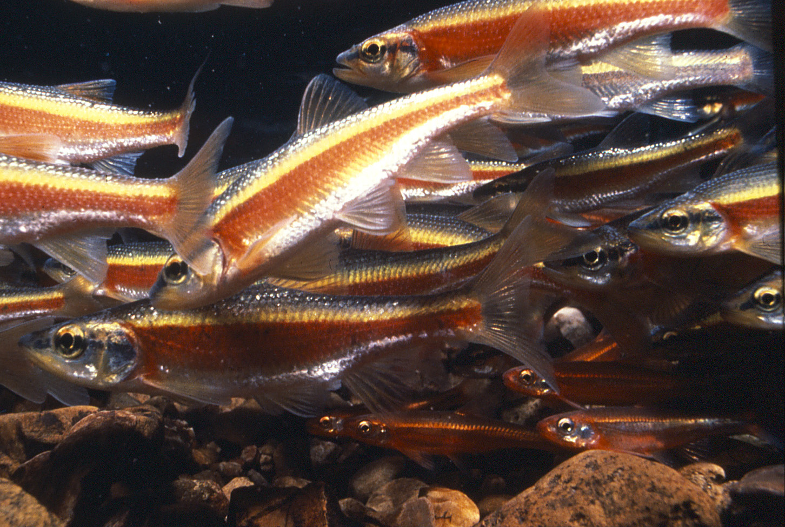
BIODIVERSITY

Slide 12
Biodiversity
Inadequate → Biodiversity Crisis
Environmental Policy
Management, Use,
Protection

Slide 13
ADBC
Address the Biodiversity Crisis in substantial ways

Slide 14
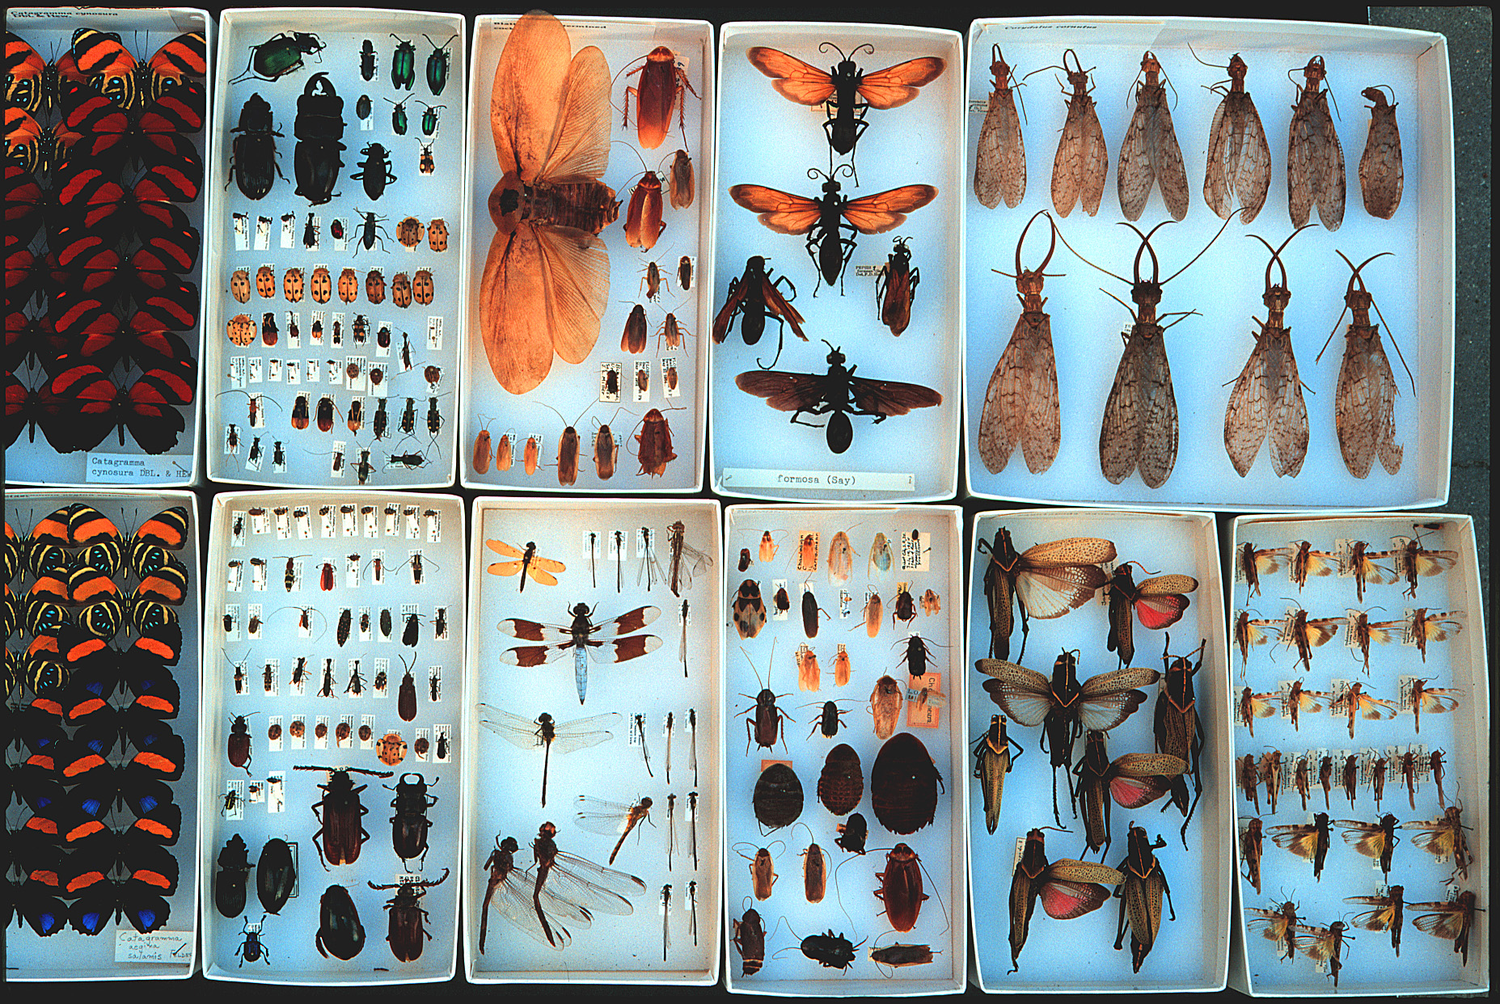
Biodiversity
Collections: Specimens, Observations, DNA
1 billion
specimens
in U.S.
Environmental Policy
Management, Use,
Appreciation, Protection
Understanding
Appreciation

Slide 15
Biodiversity
Collections: Specimens, Observations, DNA
1 billion
specimens
in U.S.
Environmental Policy
Management, Use,
Appreciation, Protection
New Discoveries
Research
Education
Outreach
Understanding
Appreciation

Slide 16
Biodiversity
Collections: Specimens, Observations, DNA
Digitization
Environmental Policy
Management, Use,
Appreciation, Protection
New Discoveries
Research
Education
Outreach
Understanding
Appreciation

Slide 17
Biodiversity
Collections: Specimens, Observations, DNA
Digitization
GBIF, BISON, VertNET, InvertNet
Environmental Policy
Management, Use,
Appreciation, Protection
New Discoveries
Research
Education
Outreach
Understanding
Appreciation

Slide 18
Biodiversity
Human Benefits
1
Environmental Policy
Management, Use,
Appreciation, Protection
Understanding
Appreciation

Slide 19
Biodiversity
Collections: Specimens, Observations, DNA
Human Benefits
2
Environmental Policy
Management, Use,
Appreciation, Protection
Understanding
Appreciation

Slide 20
‘Grand Challenges’
in science and in society
“To justify this level of investment and effort, grand
challenges must be perceived as having the potential
to significantly impact not only multiple academic
fields, but also community, national, or international
concerns such as competitiveness, security, economic
development or well-being. ”
Susan J Winter & Brian S Butler (2011) 26, 99–108

Slide 21
Human heath and safety Homeland security International trade Conservation planning Prevention of wildlife trafficking Sustaining ecosystems Land use planning Invasive species predictive models Discovery and exploration Climate change Emerging infection diseases Management of agricultural pests Biological control Identification of disease vectors Forensic science Bioprospecting for new medicines, foods, and fibers

Slide 22
Collections: Specimens, Observations, DNA
Human heath and safety Homeland security International trade Conservation planning Prevention of wildlife trafficking Sustaining ecosystems Land use planning Invasive species predictive models Discovery and exploration Climate change Emerging infection diseases Management of agricultural pests Biological control Identification of disease vectors Forensic science Bioprospecting
What are the barriers?
New Discoveries
Research
Education
Outreach
Understanding
Appreciation

Slide 23
Collections: Specimens, Observations, DNA
Human heath and safety Homeland security International trade Conservation planning Prevention of wildlife trafficking Sustaining ecosystems Land use planning Invasive species predictive models Discovery and exploration Climate change Emerging infection diseases Management of agricultural pests Biological control Identification of disease vectors Forensic science Bioprospecting
Digitization
What are the barriers?
Data have been inaccessible
New Discoveries
Research
Education
Outreach
Understanding
Appreciation

Slide 24
Collections: Specimens, Observations, DNA
Human heath and safety Homeland security International trade Conservation planning Prevention of wildlife trafficking Sustaining ecosystems Land use planning Invasive species predictive models Discovery and exploration Climate change Emerging infection diseases Management of agricultural pests Biological control Identification of disease vectors Forensic science Bioprospecting
Digitization
What are the barriers?
New Discoveries
Research
Education
Outreach
Understanding
Biodiversity scientists
lack an effective voice
Appreciation

Slide 25
American Arachnological Society American Bryological & Lichenological Society American Fern Society American Malacological Society American Ornithologists' Union American Society for Microbiology American Society of Ichthyologists and Herpetologists American Society of Mammalogists American Society of Parasitologists American Society of Plant Taxonomists American Society of Primatologists Botanical Society of America
California Botanical Society Cooper Ornithological Society Crustacean Society Entomological Society of America Helminthological Society of Washington International Society of Protistologists Lepidopterists' Society Mycological Society of America Paleontological Society Phycological Society of America Society for Integrative & Comparative Biology Society for Study of Amphibians & Reptiles Society of Nematologists Society of Systematic Biologists Society of Vertebrate Paleontology

Slide 26
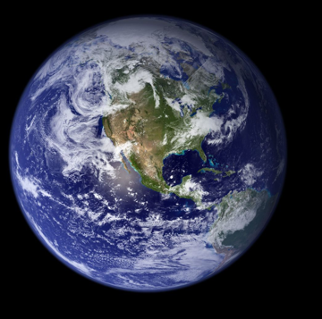
Ad Hoc AIBS Committee
• As a result of several meetings associated with CollectionsWeb and NSF’s “Future Directions for Systematics and Biodiversity”, a common theme emerged: the systematics community lacks a united voice.
• The Ad Hoc AIBS Committee was developed at the request of systematists to propose a long-term mechanism to develop and promote a shared agenda of systematic biologists.
Mary Liz Jameson

Slide 27
NSCA: The Natural Science Collections Alliance is a Washington, D.C.-based nonprofit association that supports natural science collections, their human resources, the institutions that house them, and their research activities for the benefit of science and society.
- headquartered in AIBS

Slide 28
Biodiversity
Collections
ADBC
NSCA
Collection Support
AIBS
One Voice
USGS
BISON

Slide 29
ADBC
Long-term Sustainability
-- a discussion to begin in earnest in Year 2
Given: New, improved, innovative research on biodiversity,
education and outreaches programs that reach downstream users
Also, focus on value of biodiversity collections data for human benefit
(improves human health, addresses energy needs, drives economic
growth, and enables sustainable management of our natural resources}

Slide 30
ADBC
Long-term Sustainability
-- a discussion to begin in Year 2
Needed from Collections Community:
How will we be most successful at using/explaining biodiversity data?
What uses?
Which data?
What questions?
What search capabilities?

Slide 31
BIODIVERSITY
Thank you
Photos: M. Jeffords
& G. Paulay

