Slide 1
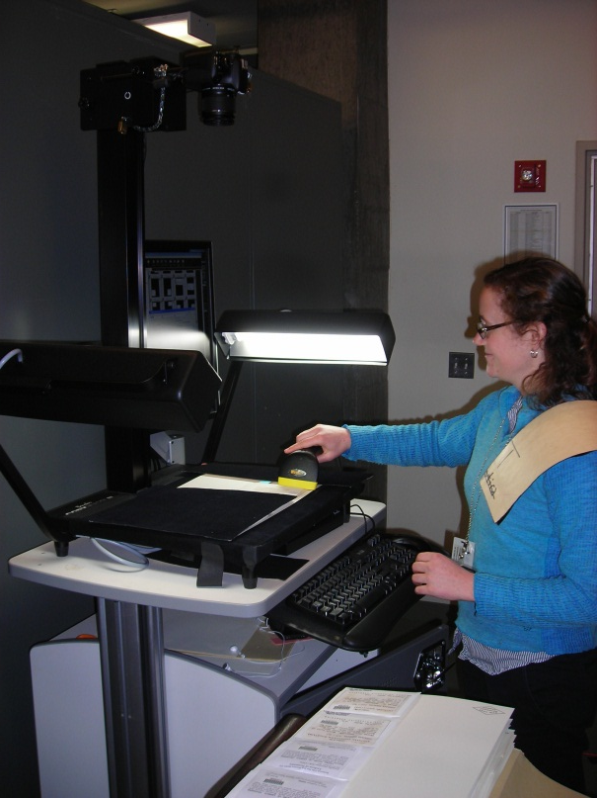
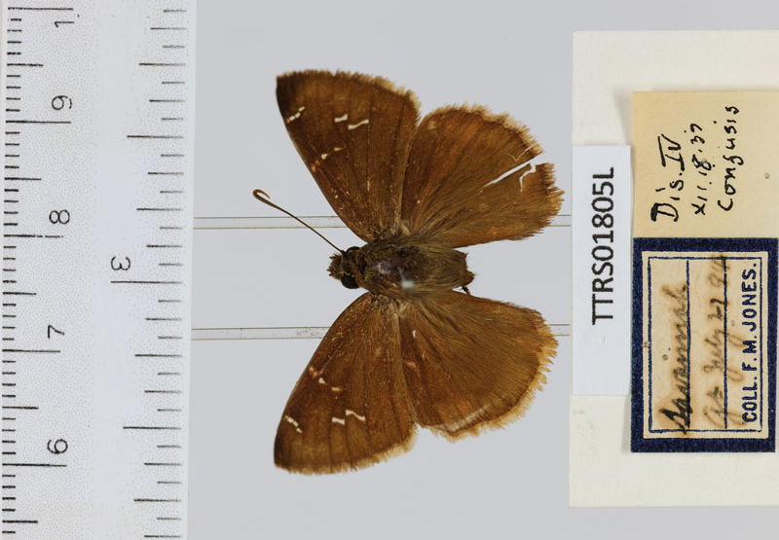
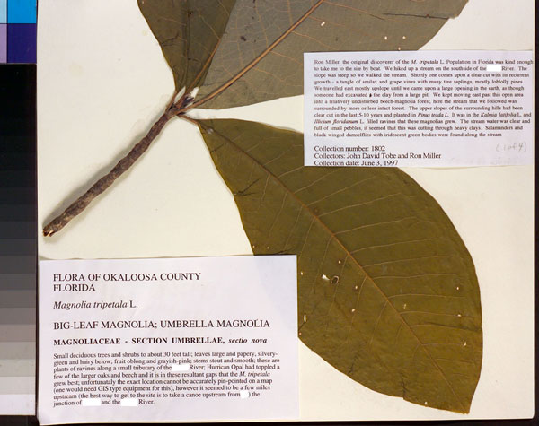
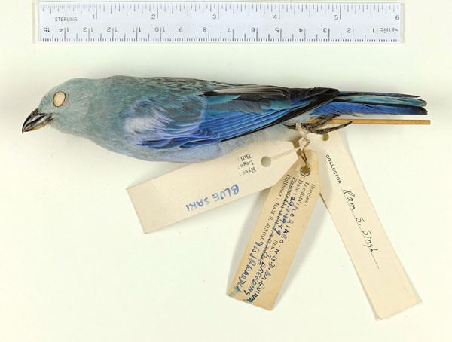
Digitizing Biological Collections
Workflow Elements and Concepts:
Common Practices
Gil Nelson
Digitization Workshop
May 30, 2012
Institute for Digital Information & Scientific Communication – Florida State University

Slide 2
Digitizing Biological Collections
Biodiversity Digitization:
Ultimate Goals of Effective Workflows
Output level: An abundance of scientifically useful and accessible data.
Constituency level: High quality exposure of the content and value of scientific collections.
Improvement level: Collaboration and workflow sharing across the collections community.
Institute for Digital Information & Scientific Communication – Florida State University
Notes:
useful:=fitness, robustness, usability, discoverability, elucidation, new knowledge

Slide 3
Digitizing Biological Collections
Global continua
guiding digitization
Local decisions and policies
Emphasis in
Specific
workflows
Implementation in
Institute for Digital Information & Scientific Communication – Florida State University
Notes:
Deductive approach: general issues to specific applications. In a perfect world, all of use would like to digitize (including data records, specimen images, ancillary filed books and catalogs, etc. and make it all available.

Slide 4
Digitizing Biological Collections
Long view
Short view
Taking the long view means developing doable, effective, and sustainable strategies for balancing long term goals with short term constraints, including a commitment to implementing future enhancements.
Pressures mitigating the long view
So much data, so little time.
Our collections are not getting smaller.
The funding agencies have high output expectations.
We only have 3 years to get this done.
All of our data and all of our specimens are important.
Let’s just use the images!
We’ll do the minimum now and enhance it later.
(while avoiding the Scarlet O’Hara syndrome).
Institute for Digital Information & Scientific Communication – Florida State University
Notes:
See the long view as our goal; see the short view only as a set of constraints, not as an end

Slide 5
Digitizing Biological Collections
Tracks to Digitization
• Taking the inside track is often based on stretching the institution’s resources. Decisions are made to maximize resources available for user-initiated digitization by using solid baseline practices. The primary focus on the inside track is to get the job done quickly and to fill the user’s request.
• Taking the middle track has the widest range of options, standards, and results. This is the most flexible of the tracks, where decisions often fall in gray areas.
• Taking the outside track focuses on the collections themselves. While users may initiate digitization, it is undertaken to deliver materials to a greater public. These decisions may lead to comprehensive digitization, such as an entire book, series, or collection. The goal is to create maximum access to special collections, using preservation and archival standards. This track usually involves a level of thought and planning that is more in-depth than the fulfillment of day-to-day digitization requests.
Scan and Deliver: Managing User-initiated Digitization in Special Collections and Archives, 2011
J. Schaffner, F. Snyder. S. Supple
Institute for Digital Information & Scientific Communication – Florida State University
Notes:
Taking the long view does not preclude also taking the inside track, as long as

Slide 6
Digitizing Biological Collections
Global Digitization Continua
Current Tools Potential Future Tools
Fitness Quantity
High cost/specimen Low cost/specimen
Efficiency Speed
Digital protocols Traditional practices
Image exemplars
Image everything Image nothing
Ancillary materials Specimens only
Evolving workflows Static workflows
Institute for Digital Information & Scientific Communication – Florida State University
Notes:
Here is a non-exhaustive list of global continua. Left column represents the outside track, right column, the inside track. This is not a set of continua of good and evil. Our challenge is to find balances in our workflows that ensure an appropriate level of affordable quality now that anticipates future tool enhancements.

Slide 7
Digitizing Biological Collections
Future Tools Favoring the Inside/Middle Tracks
OCR, NLP, and ICR (handwriting analysis) improvements
Automated image analysis for data extraction
Data mining of labels
Robotic technologies, conveyor belts, etc.
Improvements in discovery/capture/use of duplicates
Improvements in voice recognition and other data entry technologies
Post-digitization tools for curation and quality control
Field data capture
Institute for Digital Information & Scientific Communication – Florida State University
Notes:
Again, a non-exhaustive list. Taking the perspective that future tools will be developed to enhance our digitization practices is reasonable and might well be considered as an outside track solution. Are we reasonably confident that OCR, NLP, and ICR will improve quickly enough in the foreseable future? I am sometimes a skeptic….compulsive nature leads me to doubt things will be ready in time for me to accomplish what I want to accomplish.

Slide 8
Fitness Quantity
Digitizing Biological Collections
(Quality?)
Facilitators
Facilitators
Emphasize fitness for use
Robust datasets
Data validation/cleaning
Integrated quality control
Integrated georeferencing
Intensive curation
Record historical annotations
Staff specialization
Small collection
Emphasize images
High quality images
Emphasize output
Spartan datasets
Defer validation/cleaning
Deferred quality control
Deferred georeferencing
Deferred or cursory curation
Record current determination
Staff generalization
Large collection
Emphasize data
Low quality images
Institute for Digital Information & Scientific Communication – Florida State University
Notes:
Again, left column largely represents the outside track, right, inside track.

Slide 9
Efficiency vs. Speed
Digitizing Biological Collections
False dichotomy?
Is increased speed the inevitable outcome of improved efficiency?
Is increased speed always and necessarily the desired outcome of improved efficiency?
Institute for Digital Information & Scientific Communication – Florida State University
Notes:
Is this false? Would seem that if you’re more efficient, you’d be more speedy

Slide 10
Efficiency vs. Speed
Digitizing Biological Collections
Improving Efficiency
Reduce or eliminate redundancy (e.g., label data entry)
Reduce or eliminate unnecessary steps in a workflow
Maintain an evidently logical, easy-to-follow workflow
Mitigate monotony for technicians
Reduce or eliminate travel time
Reduce technician fatigue
Ensure sustained output
Increase output over the long term
Institute for Digital Information & Scientific Communication – Florida State University
Notes:
Some ento collectons are dbing then printing labels [more efficient]

Slide 11
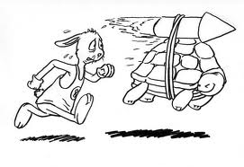
Efficiency vs. Speed
Digitizing Biological Collections
A rested, happy, satisfied tortoise is usually better than a harried hare!
Institute for Digital Information & Scientific Communication – Florida State University
Notes:
Is this false? Would seem that if you’re more efficient, you’d be more speedy

Slide 12
Productivity vs. Cost
Digitizing Biological Collections
Issues to Resolve in Assessing Productivity
Comparability: Just what is being measured?
What is included in the output?
Are all steps in the process accounted for?
Are all expenditures of time accounted for?
How do we arrive at a true per specimen cost?
Measuring productivity (comparability across collections):
Unit (output per unit time vs. expenditure/project totals)
Data fitness (should data robustness be factored in the calculus?)
Measuring cost:
Is this a competitive event?
Output per hour at given fitness?
$$ per specimen at given fitness?
Accounting for variances in prep type, regional pay rates, data robustness, etc.?
Institute for Digital Information & Scientific Communication – Florida State University
Notes:
Cost per specimen must be a determiner in our workflow decisions

Slide 13
Digitizing Biological Collections
Continuous Workflow Improvement
Develop written workflows
Continuous evaluation of written and production workflows by:
Technicians
Workflow managers
Collections mangers
With particular attention to:
Bottlenecks
Redundancy
Handling time
Varying rates of productivity
Institute for Digital Information & Scientific Communication – Florida State University

Slide 14
Digitizing Biological Collections
Written Protocols
Institute for Digital Information & Scientific Communication – Florida State University

Slide 15
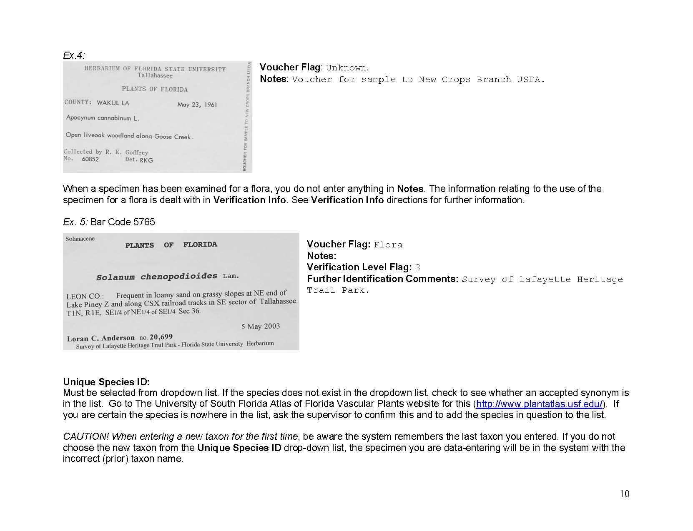
Digitizing Biological Collections
Written Protocols
Institute for Digital Information & Scientific Communication – Florida State University

Slide 16
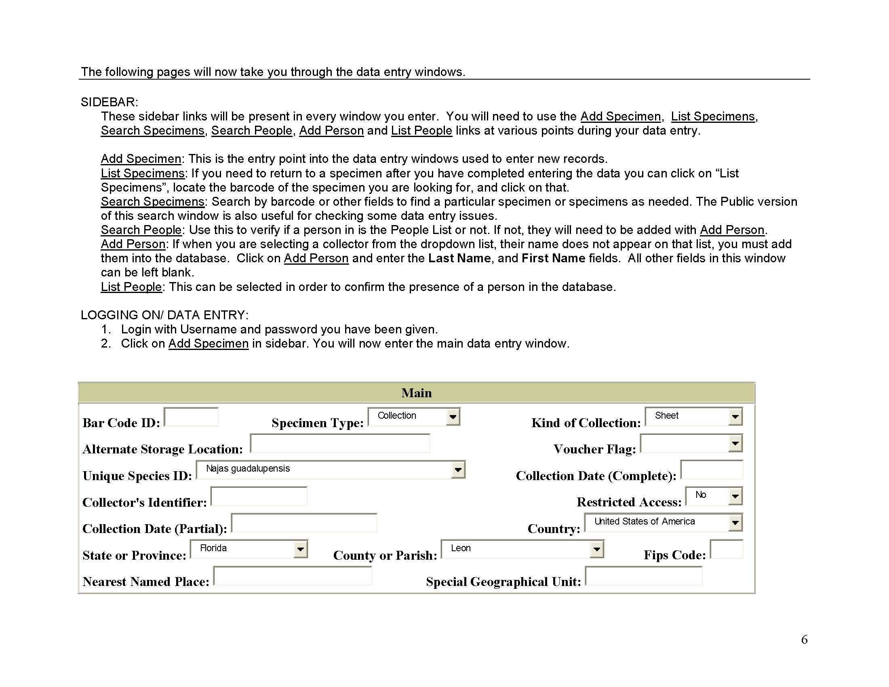
Digitizing Biological Collections
Written Protocols
Institute for Digital Information & Scientific Communication – Florida State University

Slide 17
Digitizing Biological Collections
Continuous Workflow Improvement
Develop written workflows that reflect actual practice
Continuous evaluation of written and actual workflows by:
Technicians
Workflow managers
Collections managers
With particular attention to:
Bottlenecks
Redundancy
Handling time
Varying rates of productivity
Institute for Digital Information & Scientific Communication – Florida State University

Slide 18
Digitizing Biological Collections
Observing Digitization Practices in Biological and Paleontological Collections
28 Collections
10 Museums
Spanning biological and paleontological collections
Insects and other invertebrates, plants, birds, mammals
Wet, dry
Institute for Digital Information & Scientific Communication – Florida State University

Slide 19
Digitizing Biological Collections
Acknowledgments
American Museum of Natural History
Botanical Research Institute of Texas
Florida Museum of Natural History
Florida State University
Harvard Herbarium
Museum of Comparative Zoology (Harvard)
New York Botanical Garden
SERNEC
Specify Software Project (University of Kansas)
Symbiota Software Project (Arizona State University)
Tall Timbers Research Station and Land Conservancy
Tulane University Museum of Natural History
University of Kansas Insect Museum
Valdosta State University
Yale Peabody Museum
Institute for Digital Information & Scientific Communication – Florida State University

Slide 20
Digitizing Biological Collections
Personnel
Task Clusters
Geo-referencing
Image Capture
Image Processing
Pre-digitization Curation
or “Staging”
Data Capture
Image/Data
Storage
Written
Protocols
Biodiversity informatics Manager
Institute for Digital Information & Scientific Communication – Florida State University

Slide 21
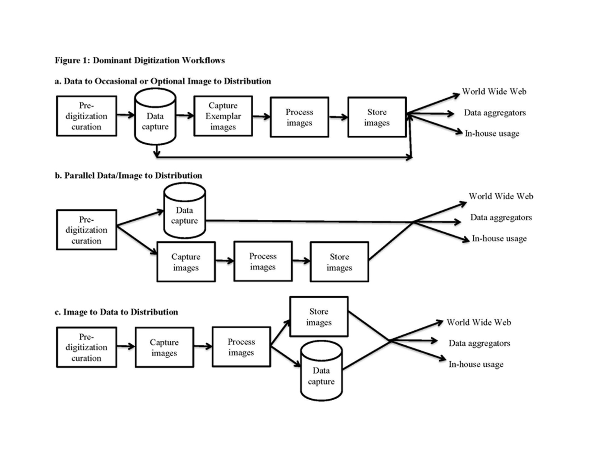
Digitizing Biological Collections
Dominant Digitization Patterns Observed
Institute for Digital Information & Scientific Communication – Florida State University

Slide 22
Digitizing Biological Collections
Linear vs. Looping
A
B
A
Barcode
Image
Data
B
A
B
Personnel specialization & availability | Reduces bottlenecks | Technician preference
Institute for Digital Information & Scientific Communication – Florida State University

Slide 23
Digitizing Biological Collections
Institute for Digital Information & Scientific Communication – Florida State University

Slide 24
Digitizing Biological Collections
Institute for Digital Information & Scientific Communication – Florida State University

Slide 25
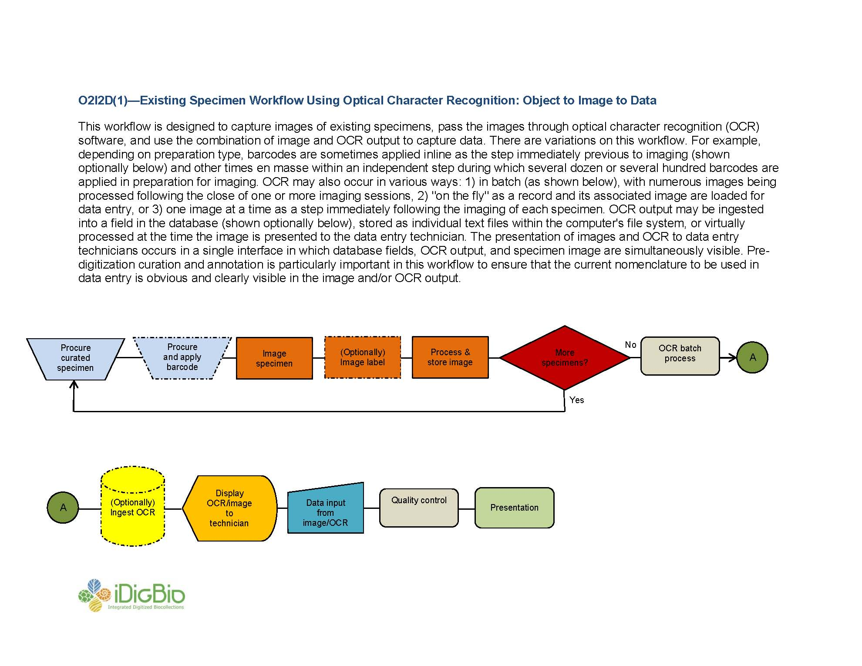
Digitizing Biological Collections
Institute for Digital Information & Scientific Communication – Florida State University

Slide 26
Digitizing Biological Collections
Institute for Digital Information & Scientific Communication – Florida State University

Slide 27
Digitizing Biological Collections
Institute for Digital Information & Scientific Communication – Florida State University

Slide 28
Digitizing Biological Collections
Institute for Digital Information & Scientific Communication – Florida State University

Slide 29
Digitizing Biological Collections
Institute for Digital Information & Scientific Communication – Florida State University

Slide 30
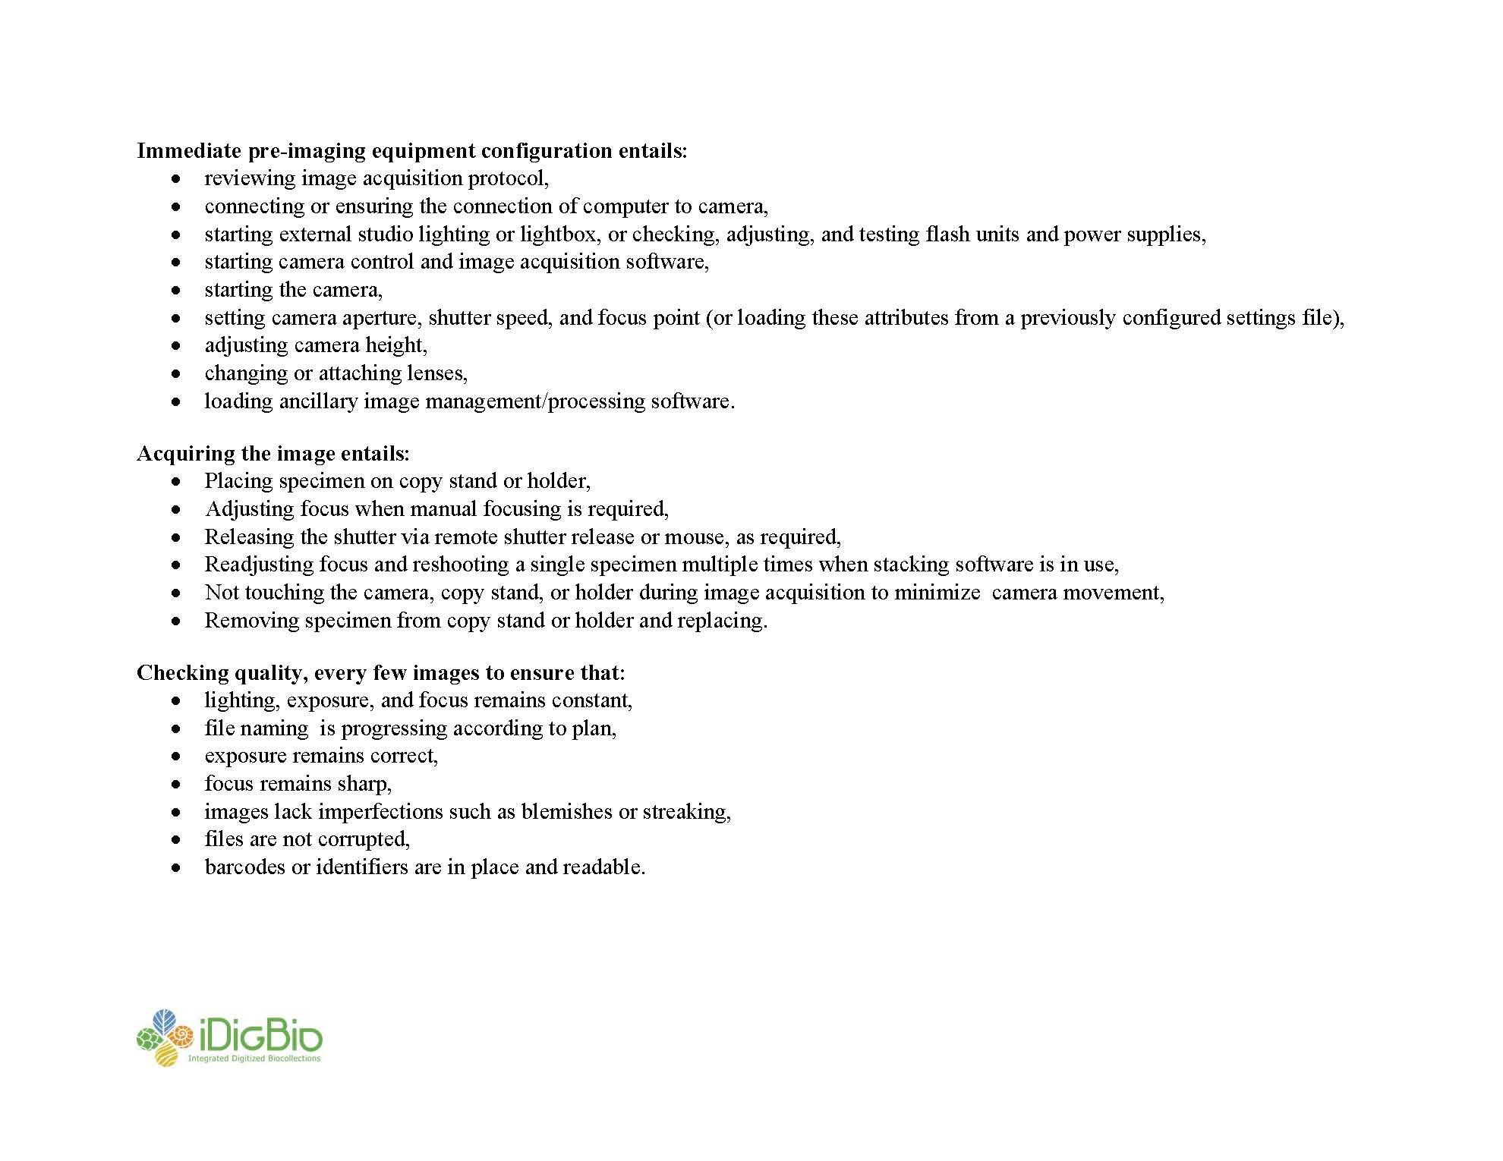
Digitizing Biological Collections
Institute for Digital Information & Scientific Communication – Florida State University

Slide 31
Digitizing Biological Collections
Institute for Digital Information & Scientific Communication – Florida State University

Slide 32
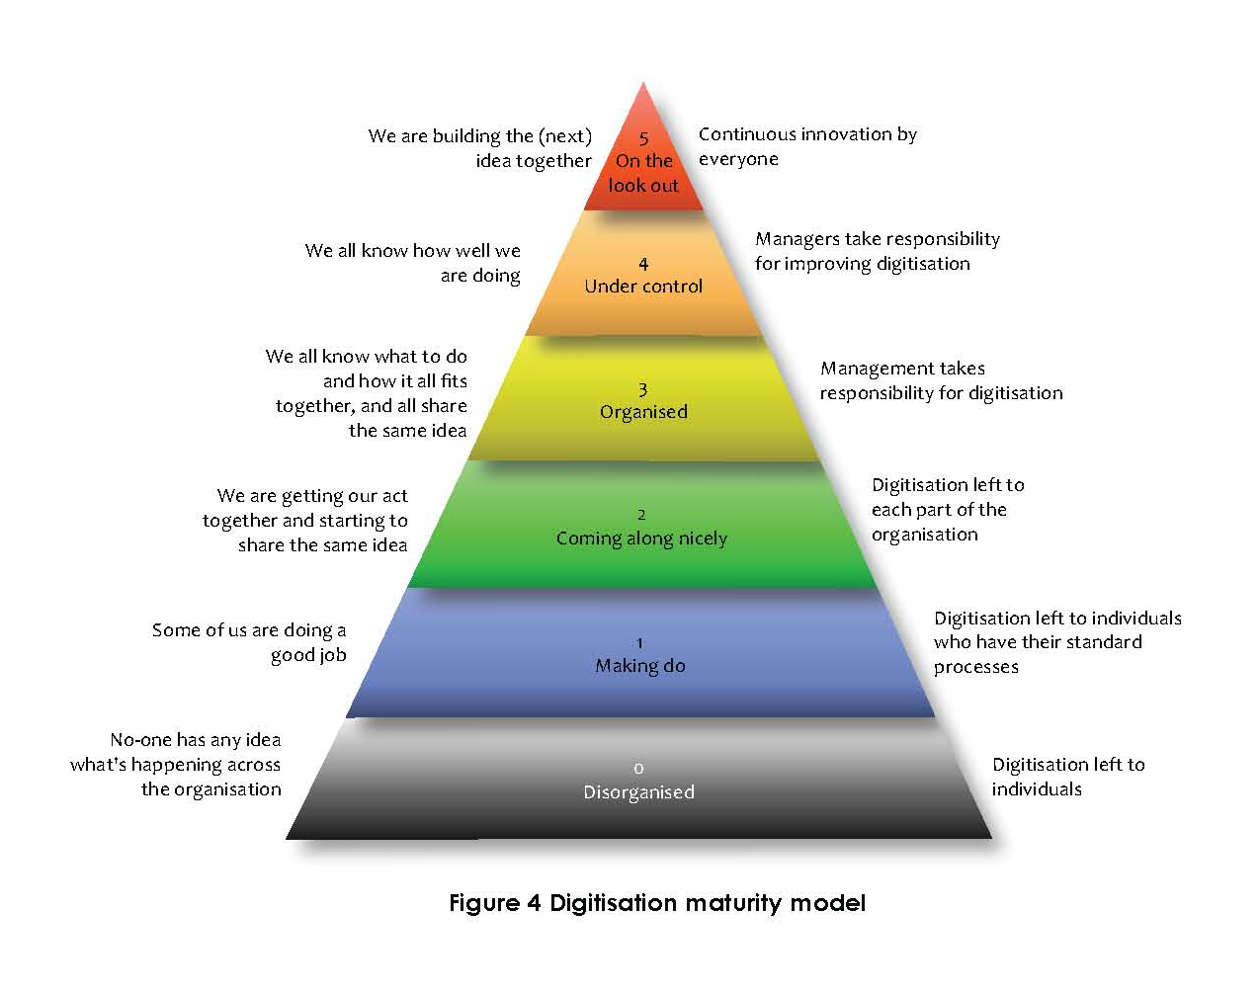
Digitizing Biological Collections
Guidance--Digitisation: A strategic approach for natural history collections, 2012
B. Kalms
Institute for Digital Information & Scientific Communication – Florida State University

Slide 33
Digitizing Biological Collections
Thank You!
Institute for Digital Information & Scientific Communication – Florida State University

