Slide 1

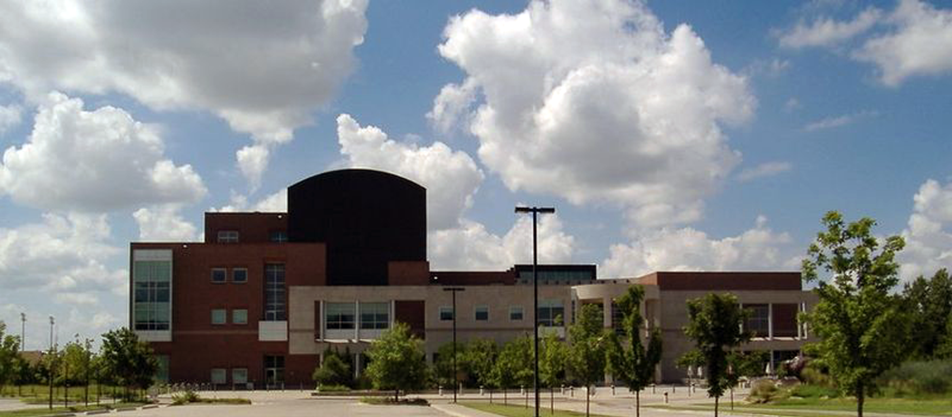
Reality check: Our experience integrating invertebrate paleontology and paleobotany collection databases
“The Talk”
Margaret Landis
Rick Lupia
Roger Burkhalter
Sam Noble Oklahoma Museum of Natural History

Slide 2
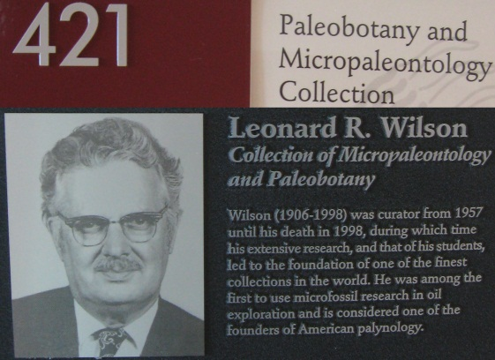
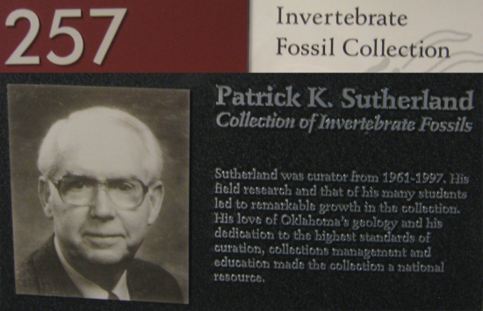
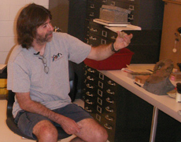
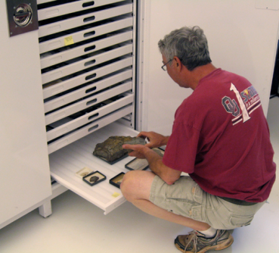
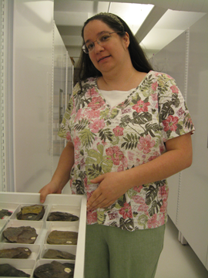
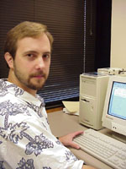
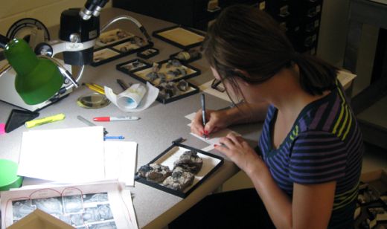
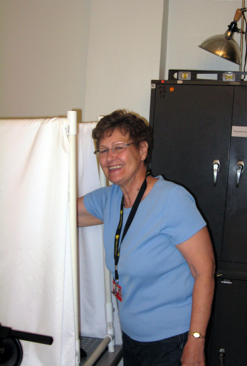
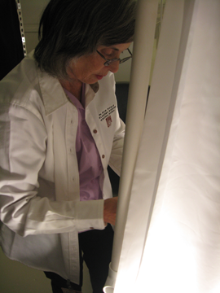
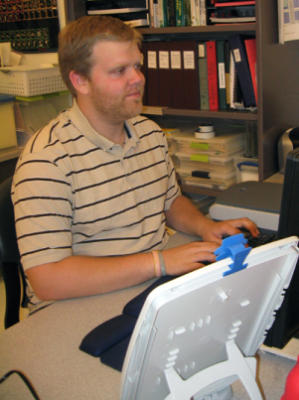
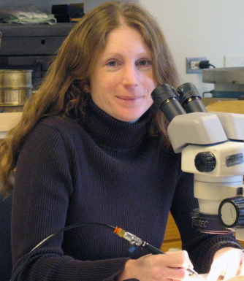
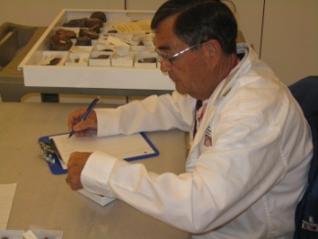
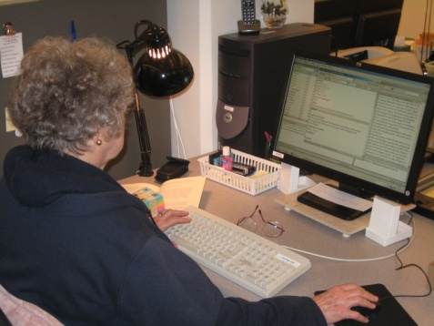
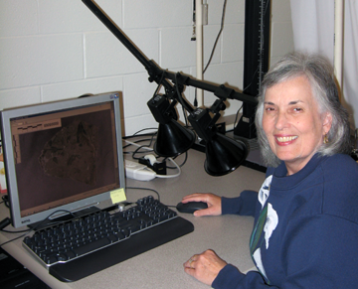
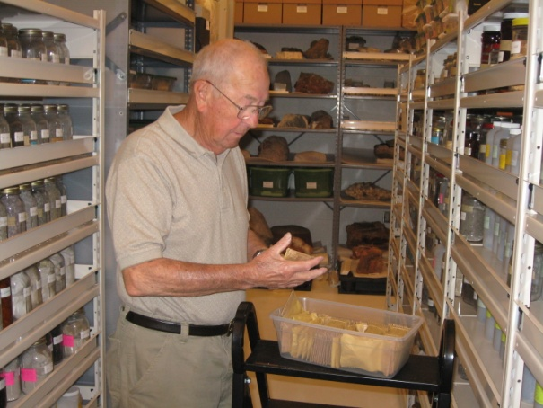
Who are “We”?
Collection
Staff
Students
Volunteers
IT Staff

Slide 3

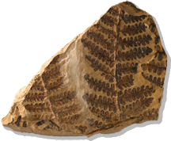
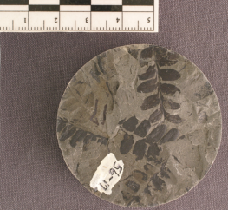
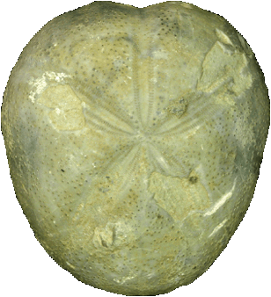
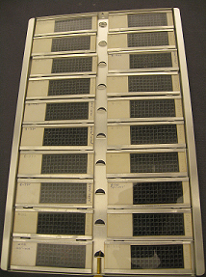
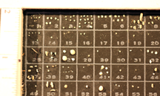
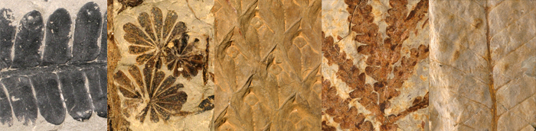
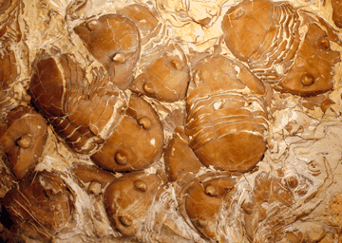

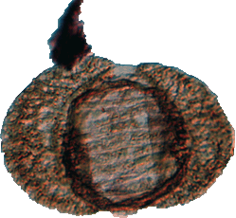
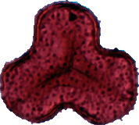
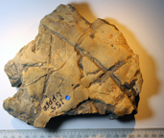
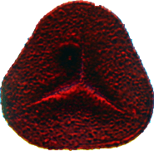
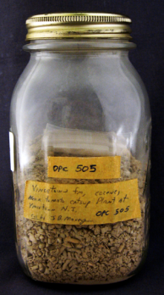
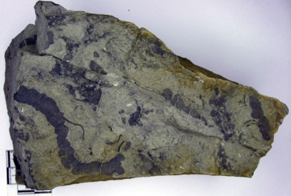
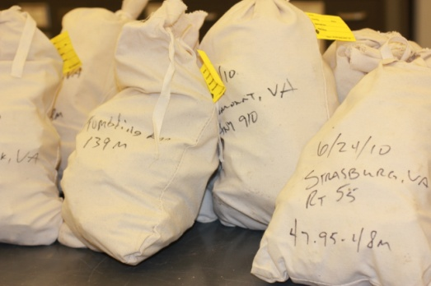
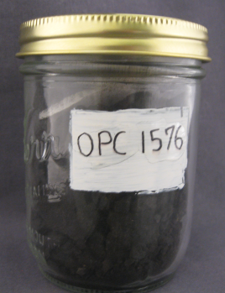
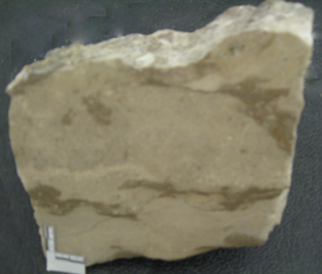
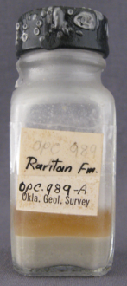
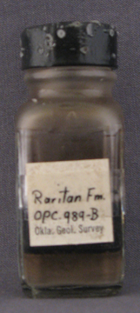
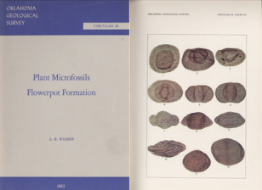
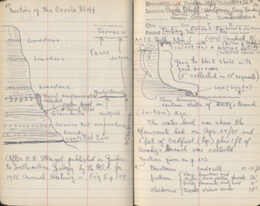
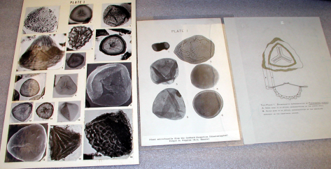
What do these collections encompass?
Macrofossils
Microfossils
Reserves/Bulk
Pollen
Spores
Trace Fossils
Lithology Samples
Residues
Supporting Documentation

Slide 4
Why are we databasing?
Improve collection management
View collection better
Increase users & uses
Make remote access of collection accessible
& user-friendly via web
Give researchers an idea of what we have
so that they can request loans &/or visit

Slide 5
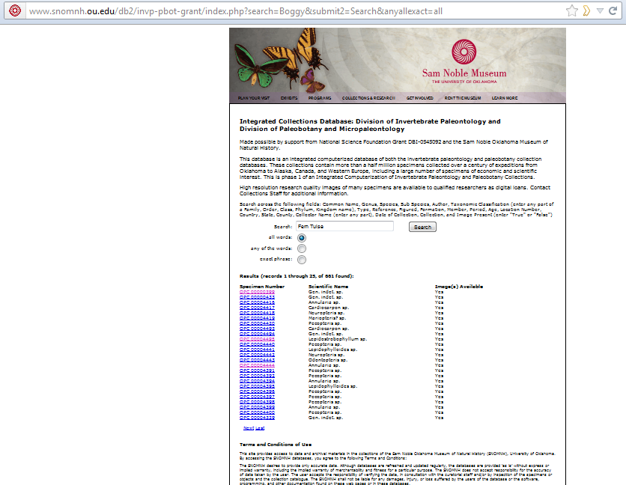
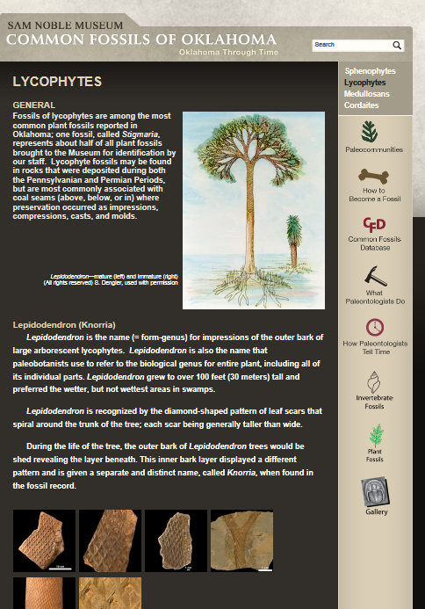
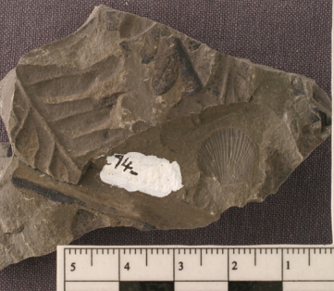
Why are we integrating our collections?
Single Access Point
  To serve the public
  To show relevance
Shared taxonomic holdings
  Plants & invertebrates on same specimen
  Microfossils include animals (e.g., ostracods)
Shared localities
Shared timescale/stratigraphy & ancillary data types

Slide 6
Why a “reality check”?
Challenges in databasing a collection
  Collection Specific Challenges
    Unique numbering systems
    Past record keeping techniques
  Museum Specific Challenges
    Past museum fires effect on data
    Technology support/programs allowed
  Challenges arising from bridging disciplines
    Legacy Geology & Paleontology specimens have had less standardization
    Changes in data recorded/needed
    Field Formatting/Dbase schema often not adequate
Today’s
Focus

Slide 7
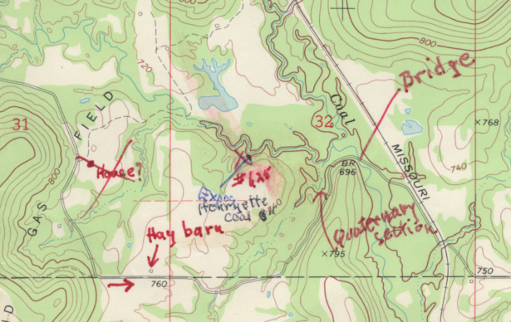
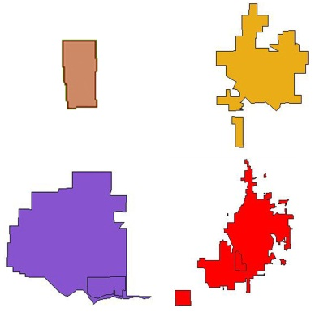
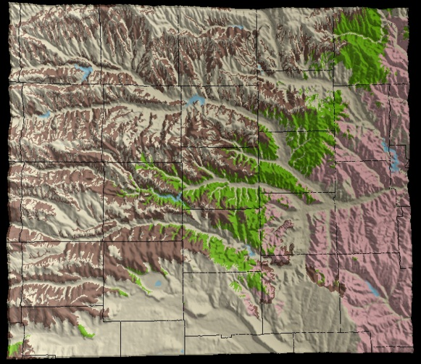
Paleontological “localities”
Usage & Definition of Locality Important
  How data are “seen”/”used”
  How data are managed
  How data are entered
  How data are accessed
    ex. Additional data needs & formats so GIS software can be used to create data portrayals data (especially 3D or relief)
Illustration of Geology with Relief
“Modern” City Outlines
Where is the “true” city center?
Where was it when specimen was collected?
© Landis, 2005

Slide 8
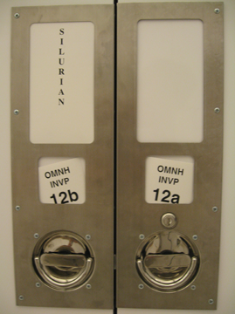
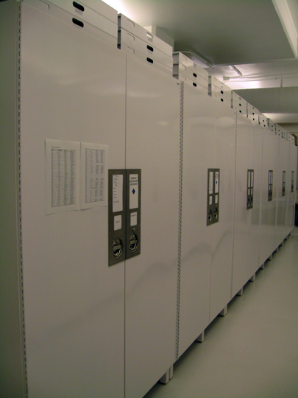
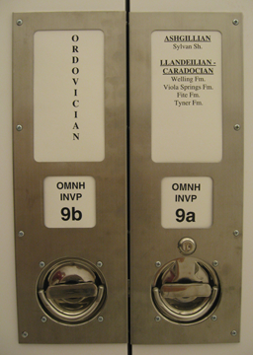
Paleontological “localities”
Historically age & stratigraphy associated with locality (paleontological context)
Many Paleo Collections stored by some paleontological context
  Age & Geography
  Age & Stratigraphy & Geography

Slide 9
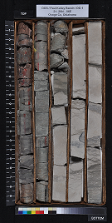
Defining Paleontological localities
Is it a point on a map?
  Treating as 2-D with associated info
  1400A, 1400B, 1400C
OR
Is it a point on a map with depth (point in space)?
  Treating as 3-D that still could have associated info
  1400 (1400A), 1900 (1400B), 1901 (1400C)

Slide 10
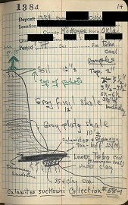
Other “locality” concerns
Geological Formations
Surface vs. Subsurface names
  Which to use
    Where collection came from
    What collector specified or What agreed on today?
  How to indicate which surface & subsurface names are related
Unofficial names (especially for coals)
Measurements
  Feet vs. Meters
  Original vs. Converted/Standardized
    Recording Errors & Error source?
  Direction of Measurement
    Outcrops measured bottom up
    Cores/Wells measure top down

Slide 11

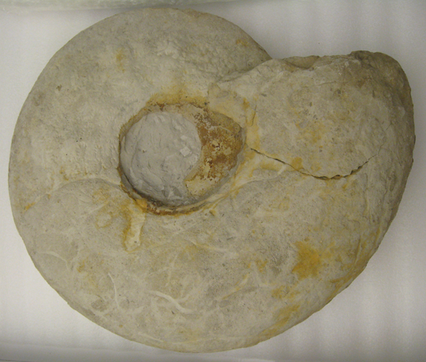
“Locality” differences – Why debated?
Some specimens are more sensitive to slight changes than others for varying reasons:
Size of specimen vs. thickness of strata
  Pollen
  Cephalopod
Condensed & expanded intervals

Slide 12
What is a Paleontological specimen?
What is a Specimen & How is it numbered?
  Has implications to dbase design & functionality
Better ?: Is a specimen a loanable object or an identifiable object?

Slide 13

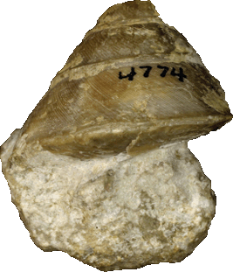







Loanable Object vs. Identifiable Specimen

Slide 14



Recording/Assigning IDs
How an object is handled depends on:
  How specimen is defined & numbered
  Database schema & capabilities
    Number of fields
    How searched &/or if Search possible

Slide 15
What about those IDs?
Do Plants & Animals agree?
  Separate Codes & standards of usage
  Differing hierarchical ranks
  Recording & formatting species authors

Slide 16

More - What about those IDs?
  How do the fossils affect these Codes & standards of usage?
  Unplaced taxa (many if not most fossil palynomorphs)
  Form taxa/ Ichnotaxa
  Portions of plants
  Trace Fossils
  Lithological samples
What about uncertainties?
  Genus? sp., Genus species?, cf., aff.
  Palynomorphs
Notes:
These may or may not “fit” into existing database schema
Palynomorphs can be part of multiple hierarchical ranks

Slide 17

What Mentioned
What Could Have Discussed
We Are Willing to
Discuss Our Experiences
&
Answer Questions
Be Sure to check out our
Common Fossils of Oklahoma webpage at:
http://commonfossilsofoklahoma.snomnh.ou.edu/
(Construction Ongoing)
Margaret Landis, Roger Burkhalter, Rick Lupia, Steve Westrop
Sam Noble Oklahoma Museum of Natural History

