Slide 1
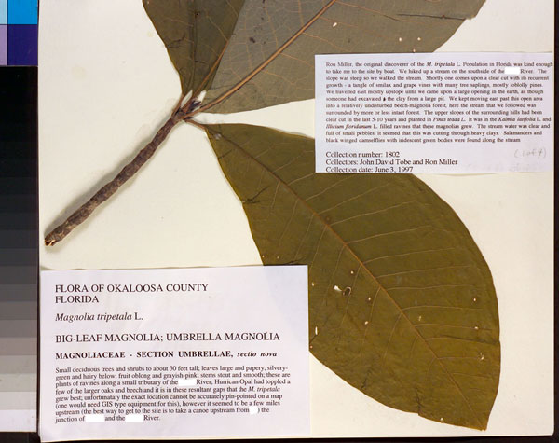
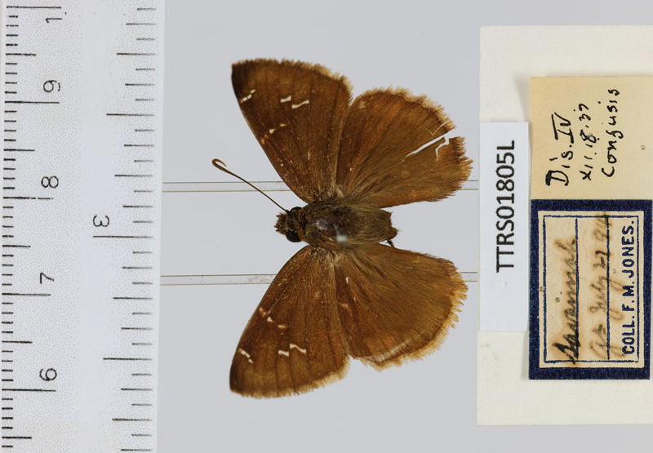
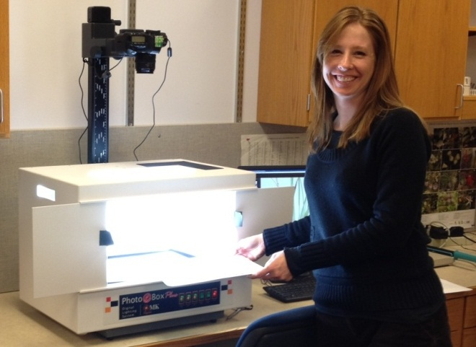
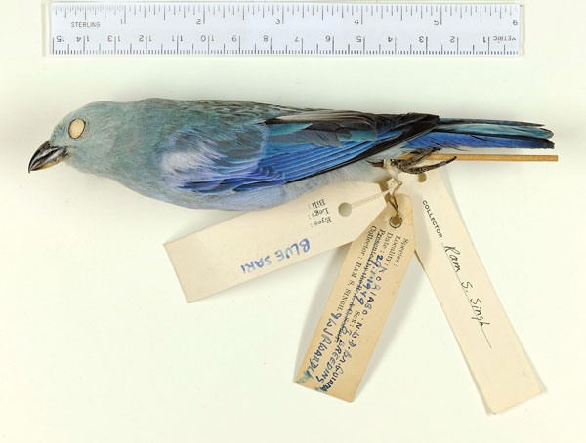
University of Florida
Florida State University
www.iDigBio.org

Slide 2
Advancing Digitization of Biodiversity Collections
Facilitate use of biodiversity data to address environmental and economic
challenges
Researchers
Educators
General public
Policy-makers
Enable digitization of biodiversity collections data
Develop efficient and effective digitization standards and workflows
Respond to cyberinfrastructure needs
Provide portal access to biodiversity data in a cloud-computing environment
Plan for long-term sustainability of the national digitization effort
Expand participation: partners and data sources

Slide 3
Seven Thematic Collections Networks (TCNs)
InvertNet: An Integrative Platform for Research on Environmental Change, Species Discovery and
Identification (Illinois Natural History Survey, University of Illinois) http://invertnet.org
Plants, Herbivores, and Parasitoids: A Model System for the Study of Tri-Trophic Associations (American Museum of Natural History) http://tcn.amnh.org
North American Lichens and Bryophytes: Sensitive Indicators of Environmental Quality and Change (University of Wisconsin – Madison) http://symbiota.org/nalichens/index.php http://symbiota.org/bryophytes/index.php
Digitizing Fossils to Enable New Syntheses in Biogeography-Creating a PALEONICHES-TCN (University of Kansas)
The Macrofungi Collection Consortium: Unlocking a Biodiversity Resource for Understanding Biotic Interactions, Nutrient Cycling and Human Affairs (New York Botanical Garden)
Mobilizing New England Vascular Plant Specimen Data to Track Environmental Change (Yale University)
Southwest Collections of Arthropods Network (SCAN): A Model for Collections Digitization to Promote Taxonomic and Ecological Research (Northern Arizona University)
http://hasbrouck.asu.edu/symbiota/portal/index.php

Slide 4
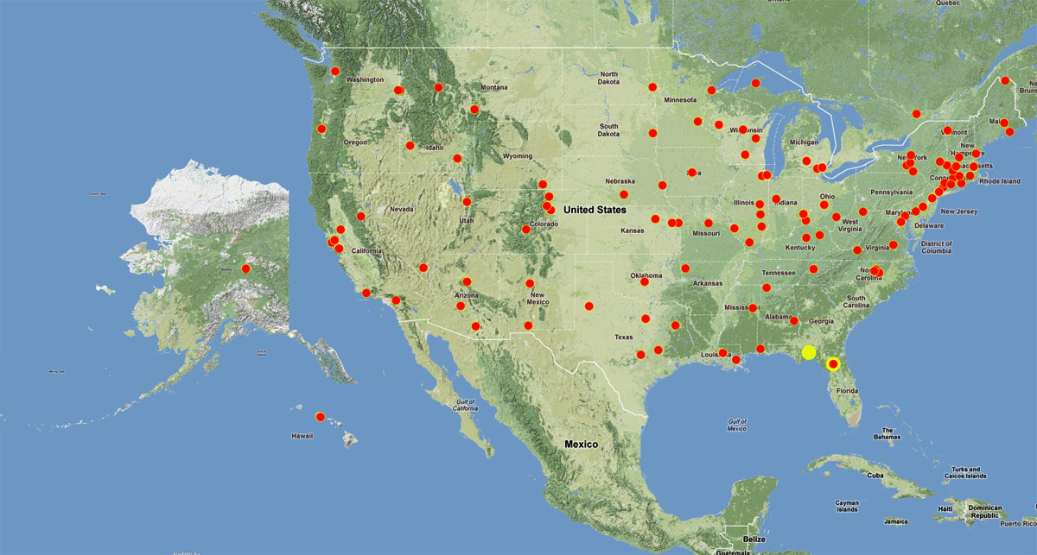
National Resource (iDigBio), Thematic Collection Networks (TCNs), and Collaborators
7 TCNs with 130 participating institutions

Slide 5
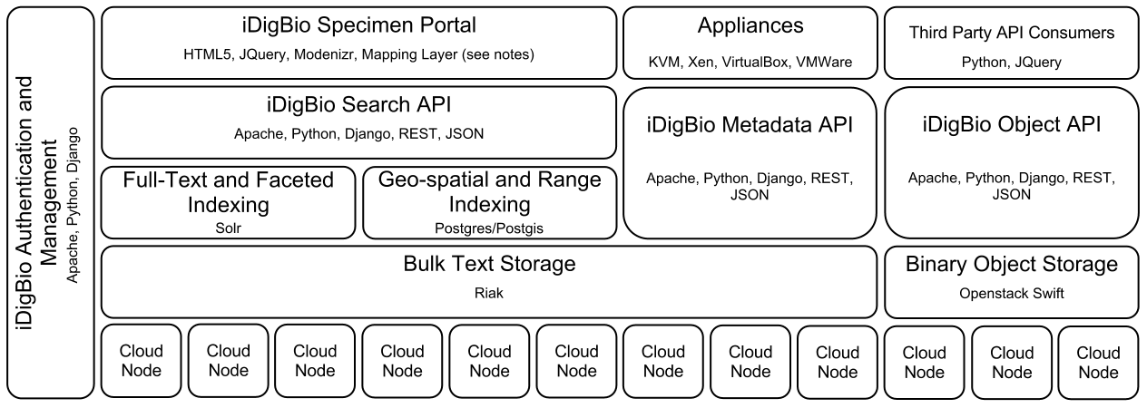
Building the iDigBio Cloud
Cloud-based strategy
Providing useful services/APIs (programmatic and web-based Application
Programming Interface)
Federated scalable object storage and information processing
Digitization-oriented virtual appliances
Reliance on standards, proven solutions and sustainable software
Continuous consultation with stakeholders
Surveys, working groups, workshops, person-to-person
Notes:
iDigBio uses a cloud-based strategy for building its cyberinfrastructure.
The strategy is to build a federated scalable object storage and information processing that can be accessed through programmatic and web-based interfaces; always relying on standards, proven solutions and sustainable software that can be packaged in virtual appliances that facilitate the digitization workflow.
This process is transparent and with continuous consultation with stakeholders through surveys, working groups, etc.
The picture abstracts main components that are being built into the iDigBio cyberinfrastructure, and suffices to say that it is being built having in mind the strategy just described.
----------------------
If the presenter is asked about the details of the figure, it shows:
a) The physical hardware at the bottom layer (“Cloud Nodes”);
b) The storage of both text and binary objects (“Bulk Text Storage” and “Binary Object Storage”) on top of physical nodes;
c) Various types of customized indexing that accelerates searches of data (“Full-text and Faceted Indexing”, “Geo-spatial and Range Indexing)”;
d) The different types of Application Programming Interfaces (APIs) that will be exposed to the public (“Search API”, “Metadata API”, “Object API”). The APIs allow other applications, especially from other stakeholders, to ingest and retrieve the data in iDigBio in a programmatic fashion.
e) The “iDigBio Specimen Portal” provides a web-based user interface that also makes use of the exposed APIs.
f) Different types of “Appliances” and “Third Party Consumers” also interact with the exposed APIs with the purpose of facilitating the digitization process by packaging well existing biodiversity tools.
g) All components will need to be integrated and managed securely (authentication, authorization, access control, auditing).
The names in smaller fonts inside each box (e.g., Apache, Solr) are particular software packages considered for delivering the expected capability.

Slide 6
What Makes iDigBio Unique?
Ingest all contributed data with emphasis on GUIDs, not only a restricted set of selected data elements
Maintain persistent datasets and versioning, allowing new and edited records to be uploaded as needed
Ingest textual specimen records, associated still images, video, audio, and other media
Ingest linked documents and associated literature, including field notes, ledgers, monographs, related specimen collections, etc.
Provide virtual annotation capabilities and track annotations back to the originating collection
Facilitate sharing and integration of data relevant to biodiversity research
Provide computational services for biodiversity research

Slide 7
Recent and Ongoing Activities
Assessment of common and effective practices (paper in ZooKeys)
Minimum information for scientific collections working group
Collaborative georeferencing pilot project at Godfrey Herbarium
Digitization workflows working groups
Public Participation in Digitization of Biodiversity Specimens workshop
Georeferencing working group & train-the-trainers workshop
OCR/natural language processing working group
Linked data workshop
Series of digitization training workshops
Call for appliances
Call for working groups
Cyberinfrastructure working group
Specimen data portal v0 implementation
Server hosting
This material is based upon work supported by the National Science Foundation under Cooperative Agreement EF-1115210. Any opinions, findings,
and conclusions or recommendations expressed in this material are those of the author(s) and do not necessarily reflect the views of the NSF.

