Slide 1


iDigBio
Technology,
Cloud and
Appliances
Jose Fortes
(on behalf of the
iDigBio IT team)
Paleocollections Workshop
Gainesville, Florida
April 27, 2012
Supported by NSF Award EF-1115210

Slide 2
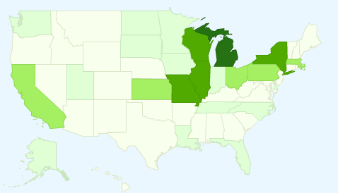
iDigBio (idigbio.org)
Goal: making data and images for millions of biological specimens available in electronic format for the biological research community, agencies, students, educators, and public
Mission: leadership, coordination, and outreach in digitization of collections by implementing resources for communication, use of technology, access to data, research and education.
  The “Hub” part of the NSF ADBC program aggregating TCNs and PENs
A resource: permanent cloud computing infrastructure
  to link biological data from collections across the USA
  to use search and analytics tools to mine and reference data
Notes:
ADBC – Advancing Digitization of Biological Collections; PEN – partners to existing networks
Search and analytics tools will enable anyone to mine and reference diverse data, such as taxonomy, geographic location, 2- and 3-dimensional images, vocalizations, and molecular resources, which are tied to specific specimens. These data promote integrative biological research on living and fossil species, and provide an immense resource for agricultural sciences, land use management, assessing the impacts of climate change, invasive species, and other natural resource management issues.

Slide 3
iDigBio IT Vision
Cyberinfrastructure to enable
  the collaborative creation, integration and management of digitized biocollections,
  their use in scientific research, education and outreach
Visible as a collection of persistent Internet-accessible services, data and resources
  For biocollection “producers”
  For biocollection “consumers”
  For biocollection service providers
  For cyberinfrastructure providers
  For national/global data aggregators

Slide 4
CI Stakeholders
TCNs
Domain Data Producers
Infrastructure Providers
Domain Service Providers
Domain Data Consumers
National/Global Data Aggregators
Museums
Collectors
Amazon Turk
GBIF
iPlant
Amazon WS
ALA
Google
DataONE
EOL
iDigBio
TCNs
BISON
Microsoft Azure
Data Conservancy
Georeferencing
Researchers
Teachers
Imaging services
Citizens
Data quality
NESCent
TCNs
Translation
Mapping
TCNs
OCR
Government
iPlant
Notes:
This diagram presents the stakeholders listed in the previous slide that will form the iDigBio cloud and that are distinct from a CI point of view.
Representative projects, industry and organizations of each group are shown around each rounded-box, and one can have multiple “hats”.
For example, a TCN will certainly be a biocollections data producer, would also likely be a consumer of this data, and could potentially offer biocollections-specific services or provide cyberinfrastructure for the iDigBio cloud.

Slide 5
Stakeholders APIs
TCNs
Domain Data Producers
Infrastructure Providers
Domain Service Providers
Domain Data Consumers
National/Global Data Aggregators
Museums
Collectors
Amazon Turk
GBIF
Updates
Notification
Usage track
Amazon WS
Domain-level data
ALA
Google
DataONE
EOL
iDigBio
TCNs
Domain data
BLOBs
Appliances
BISON
Microsoft Azure
Data Conservancy
Updates
Notification
Query results
Processed data
Customer Requests
Georeferencing
Researchers
Teachers
Imaging services
Citizens
Data quality
NESCent
TCNs
Translation
Mapping
TCNs
OCR
Government
iPlant
Notes:
To distinguish more each stakeholder, the animation show the “API” bewtween iDigBio and each stakeholder will differ with respect to the types of interactions and the level of interactions. (here types=unidirectional, bi-directional; level=software/data stack level, more generic at lower levels, more domain-specific at higher-levels).
With infrastructure providers, “APIs” will be generic BLOBs and appliances. It could be bi-directional or unidirectional. iDigBio will provide appliances specific for certain clouds, appliances from certain clouds could be used by iDigBio. iDigBio may have mutual agreements with storage providers to geographically replicate data. IaaS-like APIs (i.e., APIs to request resources on demand) will certainly be part of this “API”.
Interactions with biocollection data producers will certainly be bi-directional. Biocollection data producers will share their domain-specific data (mainly specimen occurrence, including media) with iDigBio for integration with other sources. Biocollection producers are the “owners” of the data, the ones responsible for administering/managing the data and getting credit for it (here administering does not necessarily include administering the CI, it means mainly organizing and defining the data that can be shared, potentially defining different access rights; and managing means being responsive to updates, ensuring correctness of the data, assignment of persistent globally unique ids, availability of the data, etc.). iDigBio will facilitate producers’ data to be found and used, recommend tools/standards/protocols for data producers, updates/annotations/notifications to be fed back to producers, and for usage to be tracked. Note: it is still not clear if iDigBio will have a push or pull model (or a mixture).
iDigBio will simply share/republish data received from data producers with other national and global biocollection data aggregators, since currently no aggregator presents a feedback mechanism. This could change in the future, depending on agreements established with these organizations/projects.
Biocollection data consumers will be able to query/access data integrated from multiple producers through programmatic APIs (and likely through a diverse set of user interfaces). iDigBio will receive back updates/annotations/notifications and forward those to producers, adding accounting value to this interaction.
Finally, biocollections SaaS providers will offer specific services that facilitate the data workflow of iDigBio, e.g. offering OCR services to transform label digital pictures into digital formatted text, imaging transformation services that automatically crop, rotate, and correct color/contrast. In turn, these services will get customers from this community.

Slide 6
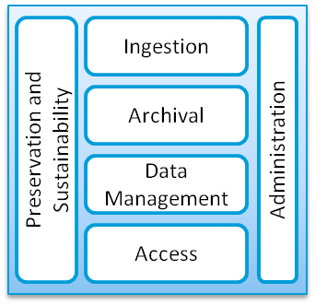
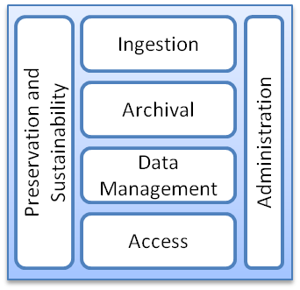
Interface Model for iDigBio and TCNs
TCNs
SQL
UTF-8
. . .
REST WS
SAML
WS-I
TAPIR
. . .
TDWG
XML
Archiving
Data Collections
Wiki
Workshop Resources
Workflow Engines
Taxonomic Validation
Learning Modules
Structured Data Services
Storage
Non-structured Data Services
Geographical Mapping
Data Conversion
Virtual Appliances
Machines
Networking
Collaboration Tools
iDigBio + Resources
TCP
OCCIWG
HTTP
RDF
JPEG2000
X.509
OpenID
XMPP
ODBC
National History Museums
BISON/Federal Collections
Applied Innovations
Microsoft Azure
Amazon EC2/S3
Google Apps
Microsoft Live
Google App Engine
iPlant
NCBI
EOL
LifeMapper
ALA
XSEDE
TCNs
DataONE
Academic Clouds
NESCent
Infrastructure Providers, National/Global Data Aggregators, Domain Service Providers, Domain Data Consumers
Notes:
iDigBio (darker blue area) will be driven by the biocollections community (especially TCNs) and partner with commercial and academic providers/consumers/aggregators (green box); work with existing standards to leverage previous investments (the dark blue contour); and offer resources (machines, storage, network), information (data collections, appliances, learning modules, workshop, wiki), services (data services, mapping, validation, conversion, collaboration).
In particular, the diagram shows that digitization efforts of different TCNs may be in different stages and that support from iDigBio will come in different shapes and forms to accommodate the need to implement an OAIS model (composed of data ingestion, data archival, data management, data access, data preservation and sustainability, and data administration components).
Note: Eventually all TCNs will be responsible for maintaining their OAIS model workflow (for a particular collection) and iDigBio will concentrate on the “integrated/aggregated OAIS model workflow”.
HTTP: Hypertext Transfer Protocol
OCCIWG: Open Cloud Computing Interface Working Group
ODBC: Open Database Connectivity
PNG: Portable Network Graphics (like JPEG, GIF, …)
RDF: Resource Description Framework
REST: Representational State Transfer
SAML: Security Assertion Markup Language
SQL: Structured Query Language
TAPIR: TDWG Access Protocol for Information Retrieval
TCP: Transmission Control Protocol
TDWG: Taxonomic Database Working Group
UTF-8: UCS Transformation Format-8-bit (most generic way of representing characters)
WS-I: Web Services Interoperability
XML: Extensible Markup Language
XMPP: Extensible Messaging and Presence Protocol
IPT “=“ http + Darwin-core archive (DwC-A which refers to a zip file of Darwin core records + xml metadata file) + registry (I am such institution and will provide such data – like uddi)
IPT stands for Integrated Publishing Toolkit

Slide 7
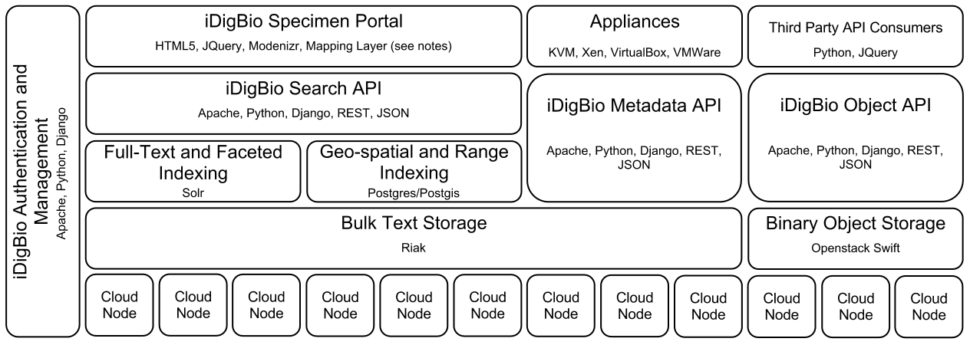
Building the iDigBio Cloud
Cloud-based strategy
  Providing useful services/APIs (programmatic and web-based)
  Federated scalable object storage and information processing
  Digitization-oriented virtual appliances
  Reliance on standards, proven solutions and sustainable software
Continuous consultation with stakeholders
  Surveys, workgroups, summit/workshops, person-to-person …

Slide 8

Keeping our eyes on the ball
  Common/frequent needs: archival storage, server hosting, feedback on the data, data intensive transformations …
  10-year tsunami of requirements: from being on Facebook to multilingual search-and-compute across multiple data sets…

Slide 9
Evolution of iDigBio capabilities
Data ingestion
Data access, provision and visualization
Provide and enable data feedback
Data linking and federation
Process and visualize integrated data
Time
Q3/2012
Q3/2013
Q3/2014
Q3/2015
Increasing storage and server hosting in support of the above
Increasing number of appliances in support of the above
Web site for interaction with public, community, education and above

Slide 10
Near-term goals: ingest data
  Textual data
    JSON document database
    Data ingestion via DwC-a files
    Get / Set API
  Image Data
    Internet-accessible object storage
    Upload appliance
    Limited access to low-level APIs
Internet access
API Gateway
Textual
Data
(RIAK)
Image
Data
(SWIFT)
Notes:
Exmaple iDigBio API:
Upload:
curl -X PUT http://storage.idigbio.org/uwisc-tcn/bryopytes/object --data-binary '<binary image data>'
JSON{"created": true, "url": "/uwisc-tcn/bryopytes/object/550e8400-e29b-41d4-a716-446655440001"}
Download (URL works in a web browser too):
curl http://storage.idigbio.org/uwisc-tcn/bryopytes/object/550e8400-e29b-41d4-a716-446655440001

Slide 11
Medium-term goals
Internet access
iDigBio Portal
  Textual Data
    JSON document database
    Data Ingestion via DwC-a files
    Rich RESTful API
  Image Data
    Web-accessible object storage
    Upload appliance
    Fully abstracted storage
  Indexing and Search
    Extract EXIF data from images
    Limited but useful set of indexes
    Intuitive search UI
    Search available via API
  Portal
    Consumes and interfaces text, image and search APIs (minimal server side code)
    Web-based mapping - client side javascript limits useable record count to about 50k records at a time.
API Gateway
Textual
Data
(RIAK)
Image
Data
(SWIFT)
Filter Set Query interface
EXIF extraction
Notes:
EXIF – image metadata embedding standard
Mapping – visualization on a map

Slide 12
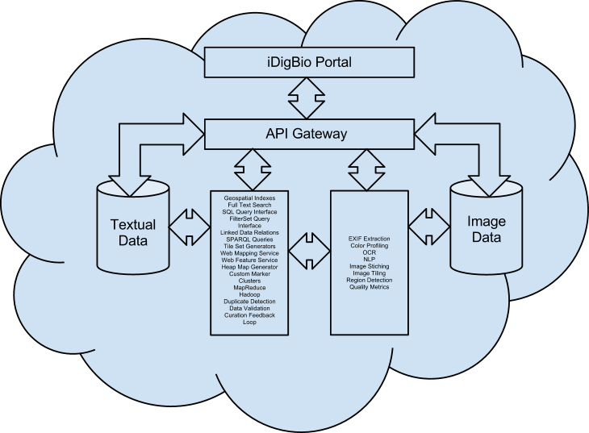
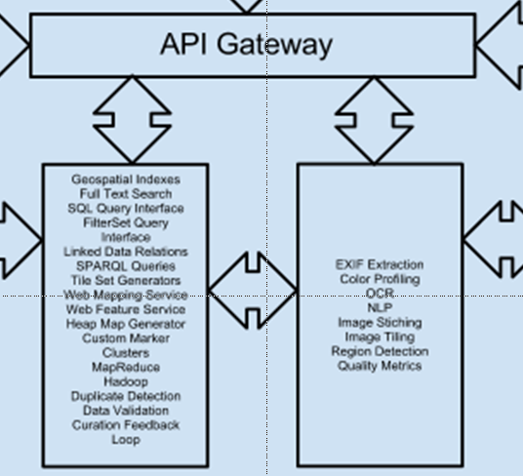
(Very) Long-term Goals

Slide 13


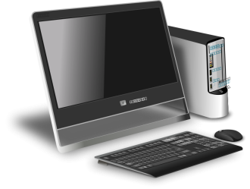

Virtual appliance cycle
Requirements,
standards
Domain expert
iDigBio
Collections
Community
download
instantiate
Users at
TCNs

Slide 14



Toolbox Workflow Example
Linux,
MySQL,
Specify,
GEOlocate
iDigBio Cloud
Cloud providers
(Amazon, Azure…)
(3) Data ingested into iDigBio
(4b) Replication Services
(1) Download iDigBio
appliance
(2) Data entry, improvement
TCN server
(5) Download analysis appliance
(6) Search
(4a) Data publishing
(7) Visualization
Global
Aggregators
Domain Data Consumer
Notes:
iDigBio will offer downloadable appliances specific for TCNs to permanently organize their collections (eventually including all tools/components present in the OAIS model).
Once the appliance is instantiated, data can be entered and validated by experts, and ingested into iDigBio.
Concurrently with data integration into iDigBio, data will be automatically replicated and published/shared with other national and global aggregators.
Researchers then can access the integrated data through search APIs and analyse/visualize results in another appliance provided by iDigBio.

Slide 15
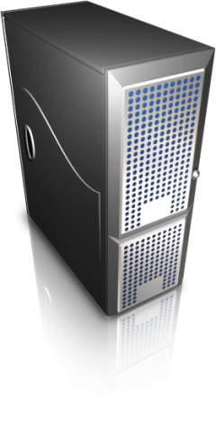

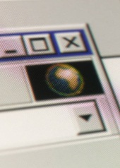
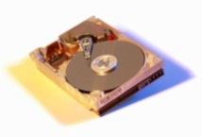
Short term
Facilitate data ingestion, interface with iDigBio
Tools identified by community in workshops/groups
Ingestion
appliance
Web-based UI
Web
server
Cloud
client
Batch upload,
Cloud APIs
File interface
/1/100.tif GUID1
/1/101.tif GUID2
iDigBio object
Storage cloud
(Swift)
Images captured
(e.g. HD/flash media)
/images/1/100.tif
/1/101.tif
/2/200.tif
…
Notes:
This overviews where we are in the data ingestion appliance
This is an example of an appliance that addresses a need identified internally – ingesting image files into the iDigBio cloud in a simple, reliable manner
A goal here is to streamline the process of consolidating images into a repository that is Web accessible. For instance, a TCN with multiple institutions can use this mechanism to ingest images in a distributed fashion, then later post-process the image to extract metadata, OCR, etc – rather than expecting TCNs to coordinate the exchange of these images, they get stored in iDigBio cloud
The approach here is akin to synchronizing media to storage; media here would be typically images captured using a camera/scanner.
The user interface is Web-based, so it’s accessible from a browser
An embedded web server is in the appliance and take user requests to specify a folder that are to be uploaded
The appliance takes this request and becomes responsible for locating and uploading images, interacting with the iDigBio API, dealing with failures, and providing unique URL identifiers that can be used to reference the uploaded image(s) (and can be used as GUIDs)

Slide 16





Medium-term – “Marketplace”
End
users
Users/
Developers
Community
appliances
iDigBio
appliances
Proposals
iDigBio Portal
iDigBio
Personnel
Notes:
Here, in the medium term, more appliances will be proposed and developed either in collaboration with iDigBio personnel, or by users in the community.
The portal will serve as an aggregator of the appliance images (and best practices for their development) and users will be able to download and use tools from this repository

Slide 17

Long-term – information processing
End
users
Users/
Developers
Workflows
Map/Reduce
Download
Community
appliances
Deploy
iDigBio Portal
iDigBio
Personnel
Specimen
Database
Notes:
Here, in the long term, appliances serve not only as user interfaces to interact with iDigBio for tasks such as ingestion, but they also can be packaged to run on iDigBio cloud resources (eventually also on a user’s private cloud, or on a commercial cloud). The goal here is to encapsulate in appliances workflows that are useful for research processes and that can programmatically retrieve from the specimen database and iDigBio storage.
The process continues to take proposals and working with the community, as well as enabling contributions from users, but here the appliances have a different purpose – e.g. scalable queries and data-intensive processing using for instance appliances that run Hadoop map/reduce jobs.

Slide 18
Summary
iDigBio cloud
  Service-oriented standards-based cyberinfrastructure focused on the ADBC community needs
  Scalable data management and information processing using standard interfaces, data formats, protocols, tools
Toolboxes as appliances
  Evolving collection of community-selected tools
  Built-in interfaces for effortless iDigBio integration
  Embedded best practices and standards in biocollections work
Software re-use when open-source, well maintained, manageable, sustainable and efficient to re-purpose
Feedback and suggestions welcome
  fortes@ufl.edu and “Contacts” at idigbio.org

Slide 19
Acknowledgments
National Science Foundation
  Judith Skog and Anne Maglia
IDigBio team at University of Florida and Florida State University

Slide 20
Extras

Slide 21
Examples
Image ingestion appliances (short term)
  Batch upload of several images from a local storage device/file system to cloud storage
  Generate GUID/URLs for later processing
  Reliable transfers using cloud APIs (e.g. Swift/iDigBio)
Post-processing appliances
  OCR tools; end-user or for batch processing
Geo-referencing appliances
  Training/verification
Research workflow appliances
  Data-intensive/batch processing workflows; e.g. data mining, image processing
Notes:
These are examples of appliances that can run ranging from end-user to iDigBio cloud environment
Image ingestion: end user (images are on their local resources)
Post-processing: might be at the end-user side (if post-processing is in workflow before committing to iDigBio), or on iDigBio cloud environment (if workflow has post-processing decoupled from image capture)
Geo-referencing (appliances with pre-set data/examples/benchmarks for training; hosting of geo-referencing services as virtual appliances in the iDigBio cloud)
Research workflow: run in iDigBio back-end infrastructure; e.g. provide APIs for scalable Map/Reduce information processing with queries to iDigBio specimen/image databased

Slide 22
Now: appliance proposal process
By users/developers through the iDigBio Web portal
  Requirements – demonstrates usage/buy-in, software license, documentation, etc
Queue of appliances for integration
  iDigBio will prioritize and work with developers
Leverage expertise in appliance development
  Focus on images that users can download and run on VMware, Virtualbox
  Application, in addition to appliance, if applicable/desirable
Notes:
The point to make here is that the process of identifying appliances comes from the community and our own anticipation of needs of iDigBio users (e.g. tools to interact with the cloud/APIs), and that in the long term a goal is to foster the development of appliances by the community.

Slide 23
Virtual Appliances in iDigBio
Packaging of software and dependences in virtual machines
  End user/desktop (e.g. VMware, Virtualbox)
  Infrastructure-as-a-Service clouds (e.g. OpenStack)
  Enhance user experience, facilitate integration with cloud
Image ingestion appliances (short term)
  Batch upload of images from a local storage to cloud
  Generate GUID/URLs for later processing
  Reliable transfers using cloud APIs (e.g. Swift/iDigBio)
Post-processing appliances (OCR tools; end-user or batch)
Geo-referencing appliances (Training/verification)
Research appliances (Data-intensive/batch workflows)
Notes:
The main points for this slide are:
iDigBio is not funded to develop tools, but there are many tools produced by the community that can be of general use
There are also tools that support interaction with cloud infrastructures (e.g. cloud storage put/get, provisioning of VMs)
Our goal is to integrate existing and future tools and package in a way that makes them accessible to end users
Our general framework to accomplish this is to use virtualization to encapsulate pre-configured tool(sets)

Slide 24
iDigBio Cloud Internal Architecture
Domain Data Producers
Specimen-record objects
Specimen-image objects
National/Global Data Aggregators
Publish
API/XML Consumer
GBIF
Morphbank
…
Comment
Updates
Notifications
iDigBio Collections Management
Initial deployment
on UF ACIS resources;
partially replicated at FSU for
reliability and performance
Object store
Database
Compute
(NOVA)
(SWIFT)
(RIAK)
Data Intensive Processing
Media
Data/Metadata
Notes:
Potential object store: Swift
Potential database: MySQL/Triple store
The Darwin Core community is very anal about distinguishing between an occurrence (in nature) and the specimen object documenting that occurrence…

Slide 25
Archer cyber-infrastructure
www.archer-project.org
Notes:
Here is one slide where we can claim that we have deployed an appliance-based cyber-infrastructure for the computer architecture community. In this system, there is a cloud of “seed” resources, appliances are designed and customized based on computer architecture needs (e.g. we have Condor, Simics, and NFS file systems), and a Web 2.0 CMS/Wiki site where users can register their own groups, post tutorials, etc.

Slide 26
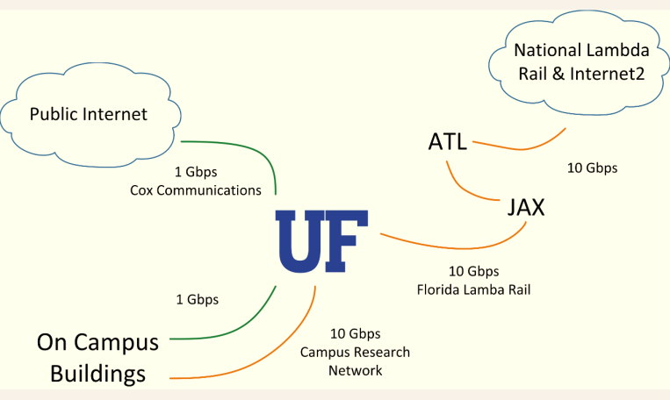
Unique UF+FSU IT resources
Excellent resources
  Computational
    ACIS lab: 14 clusters, 700+ cores, 500 Terabytes
    3 HP centers: ~6000 cores, 300 Terabytes
  Networking to/from UF and FSU
    10 Gbit connectivity to UF Campus Research Network
    10 Gbit connections to Florida Lambda Rail, National Lambda Rail, and Internet2

Slide 27
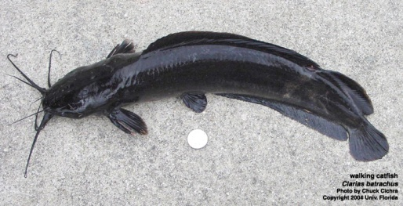
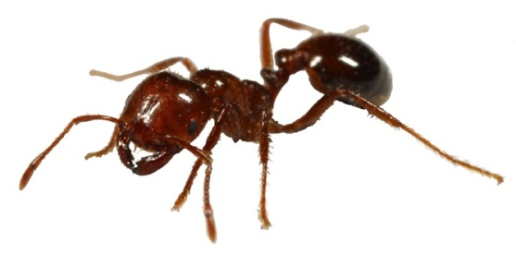
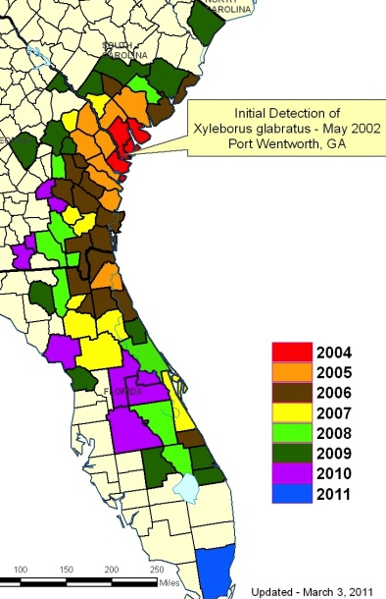
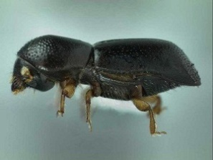
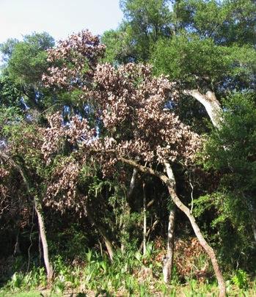
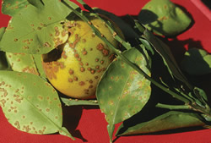
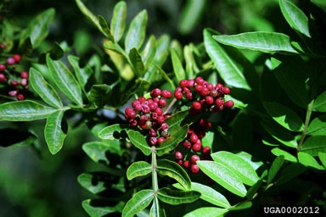
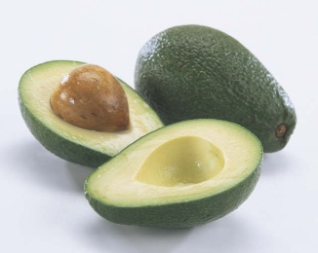
Invasive Species
Where have they been introduced, and how quickly are they spreading?
What is the pattern of spread, and do they covary with other taxa?
What is the effect of climate change on the spread of invasives?

Slide 28
Florida Plant Phylogeny:
Phylogenetic Diversity Under Climate Change
Vascular Plant Diversity in Florida
2609 species (of 4200)
all included in phylogeny
203 species
endemic to Florida
Ratio of endemics
to all species
~200,000 location points; data from UF, FSU, USF, GBIF, FNAI
Notes:
Density and distribution maps

Slide 29
Florida Plant Phylogeny:
Phylogenetic Diversity Under Climate Change
Vascular Plant Diversity in Florida
+
2609 species (of ~4200)
all included in phylogeny
Phylogenetic tree, 2609 species
GenBank, new (1000 spp)
Notes:
Integrated with phylogeny, tree, found new species which added to genbank data
Integrate distributional data, ecological data, climate models and phylogeny to address questions that compare biodiversity distributions with
Biogenetic diversity how surface patterns

Slide 30
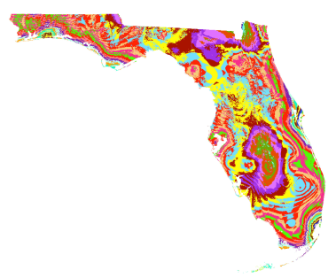
Florida Plant Phylogeny:
Phylogenetic Diversity Under Climate Change
Integrate distribution data, ecological data, climate models, phylogeny
  How does species diversity compare to
  phylogenetic diversity?
  How do species diversity and phylogenetic
  diversity change?
  How do invasive species respond?
  Integrate across clades
  Develop workflows to facilitate such studies
D. Soltis, G. Burleigh, C. Germain-Aubrey, J. Allen, L. Majure

Slide 31
Research & Scientific Outreach
Foster, encourage, enhance, enable research using collections data
  Foster research in IT
Integrate with various research communities
Work with research communities to develop collections and research-related workshops and symposia at meetings
Work with research communities to develop interfaces with data repositories, etc. to promote integrated research
Coordinate these efforts with TCNs and PENs

Slide 32
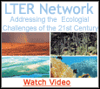

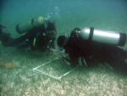
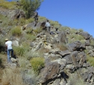
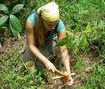
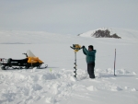

Linking Collections to Ecology
Through collections from LTERs

Slide 33
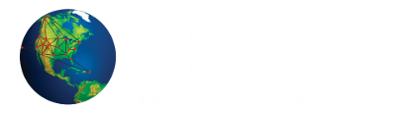
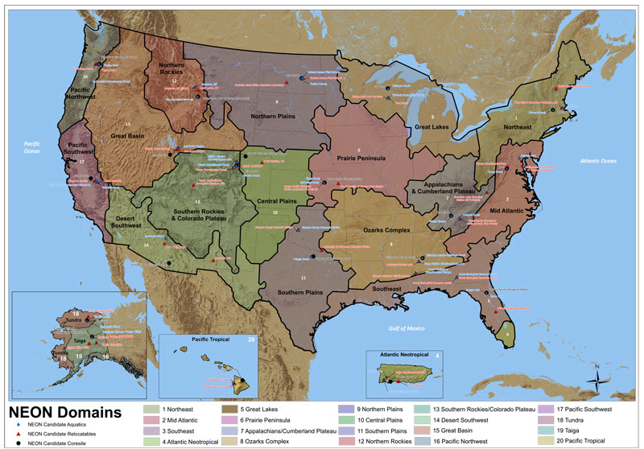
Linking Collections to Ecology
  Through NEON
  Biological monitoring at sites across USA; collections
  Baseline for changes in
  species distribution and
  abundance over time
National Ecological Observatory Network

Slide 34
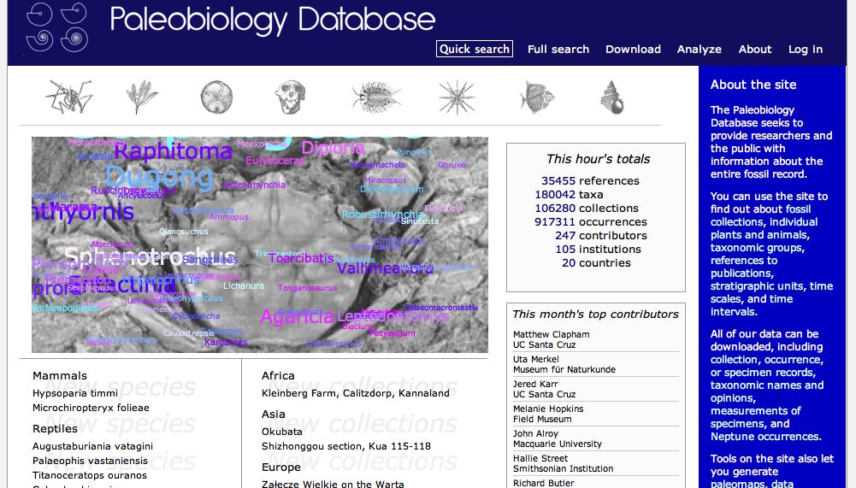
Linking Collections to Paleobiology
Paleobiology Database
  (http://paleodb.org/cgi-bin/bridge.pl)

Slide 35
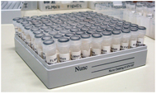
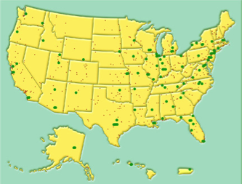
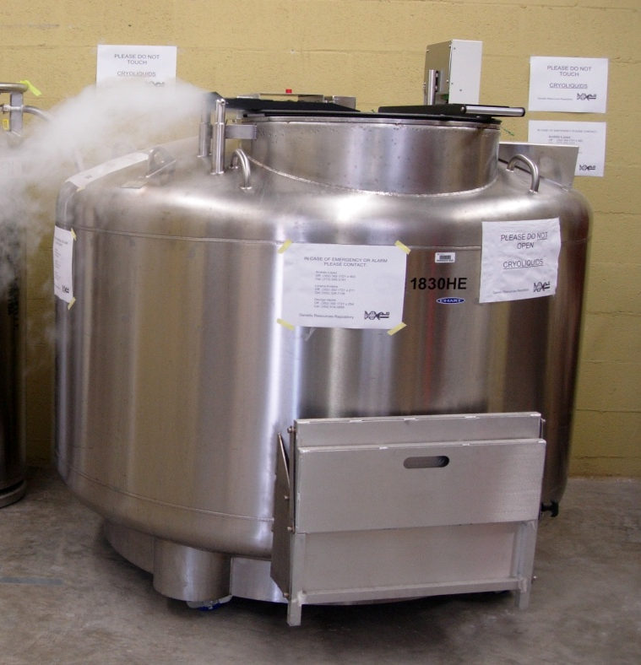
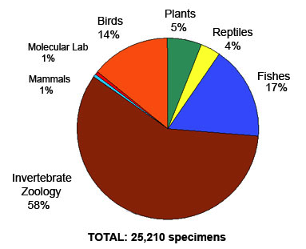
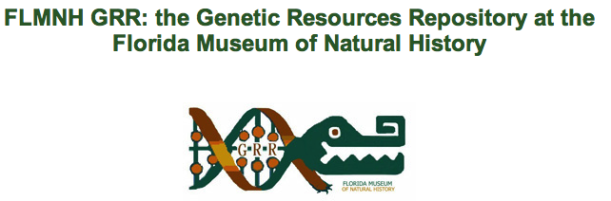
Linking Collections to Genomics
National network of tissue and genetic
resources

Slide 36
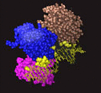
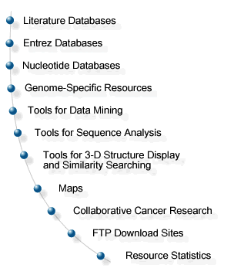
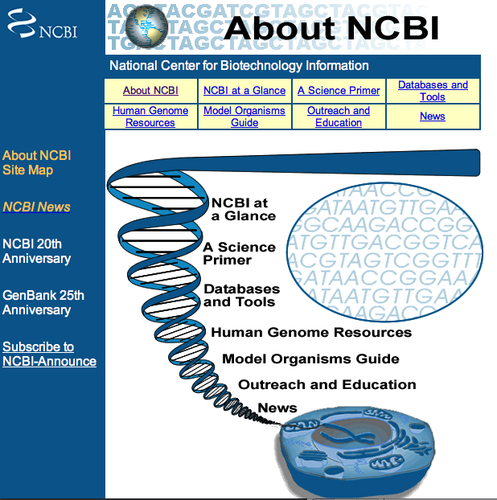
Linking Collections to Genomics
Extend HUB connections to genomics databases

Slide 37






Linking to Living Collections
Botanical gardens, zoos, culture collections

Slide 38
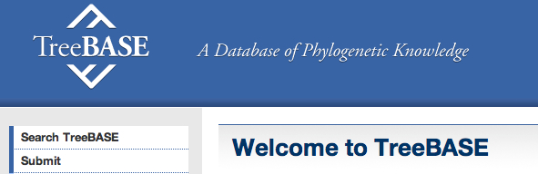


Interactions with Systematics Community and Beyond
Facilitate digitization efforts
Coordinate with other databasing efforts in systematics
Connect to databases outside systematics:
    ecology to genomics (NEON to GenBank)

Slide 39
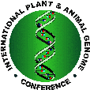




Interactions Fostered Through…
Discussions at national meetings of professional societies (systematics, ecology, evolution, genomics)
Workshops to engage members of systematics community
Workshops to engage members of different communities

Slide 40
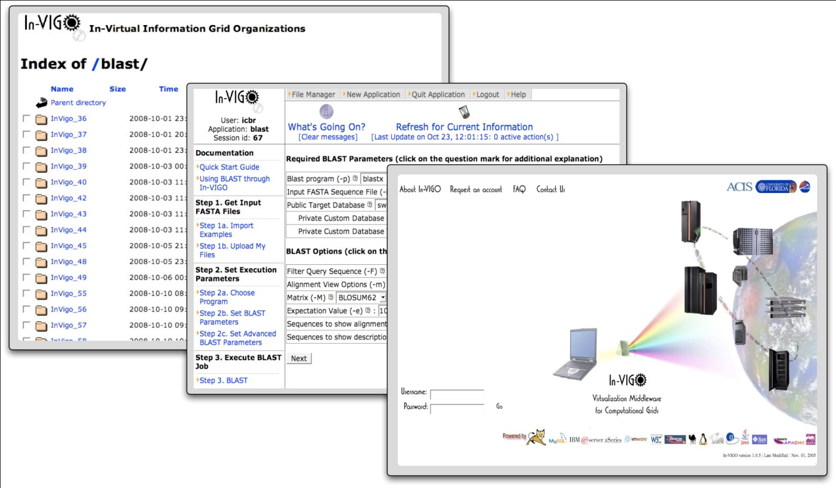
Unique UF+FSU record
Track record of building cyberinfrastructure
  PUNCH and In-VIGO
    Nanohub, Netcare, In-VIGOBlast …
  Morphbank
  AFRESH
  Telecenter
  Archer

Slide 41
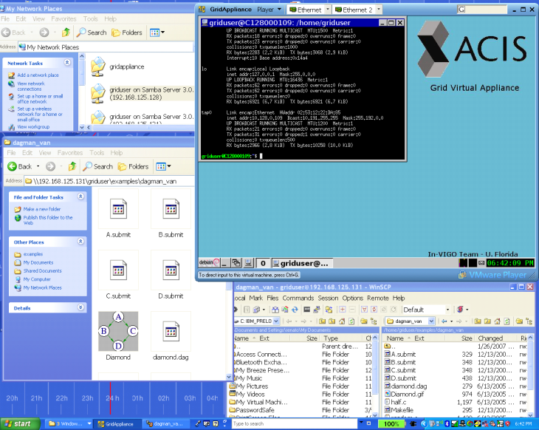
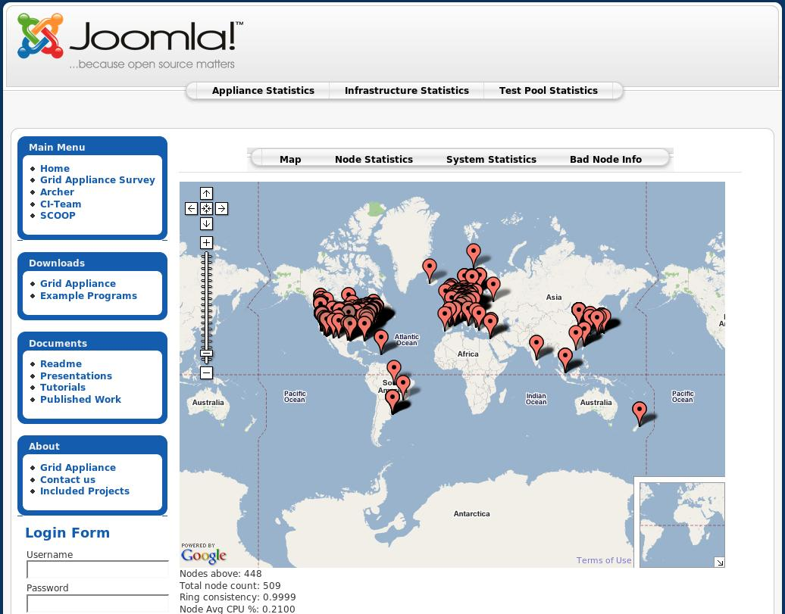
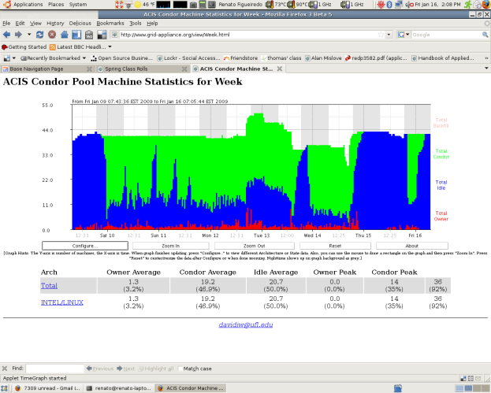
Archer cyber-infrastructure
Custom appliance image
for computer architecture
community
Hundreds of distributed
compute/routers nodes
24/7 operation, 650+ cores
Job scheduling across
participating institutions
Notes:
Here’s a slide where you can provide a glimpse of the magnitude and complexity of the system. We have a virtual network with overlay routers than run 24/7 in ~500 resources in the PlanetLab infrastructure, and about 650 cores distributed across clusters at participating Archer institutions, and individual user workstations – Linux, Windows or MacOS. They all run the same appliance developed/maintained at UF, and are used in this case for Grid/job scheduling. In the case of the HUB, the purpose will be of data management; the tools will be different, but with a basis of appliances connected by a virtual network, we can reuse a wealth of existing tools.

Slide 42
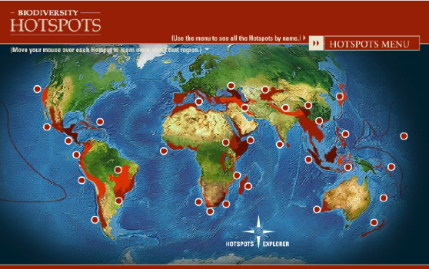
Research Questions
How are species distributed in geographical and ecological space?
What is the history of life on Earth?
What factors lead to speciation, dispersal, and extinction?
What are the impacts of climate change likely to be?
What information is needed for effective conservation strategies?
Slide provided by Pam Soltis

