Slide 1
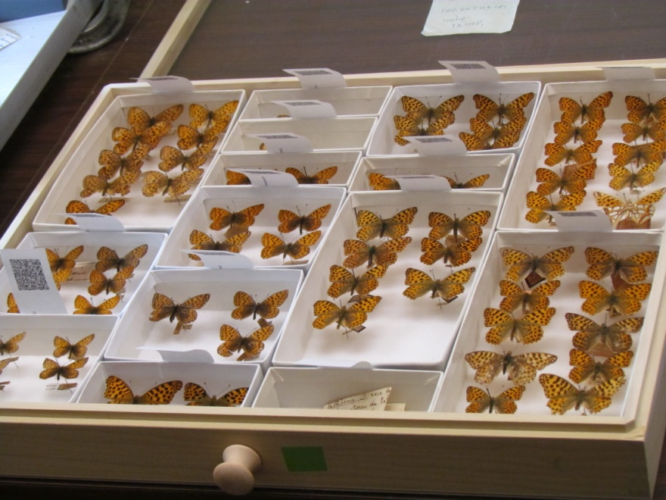
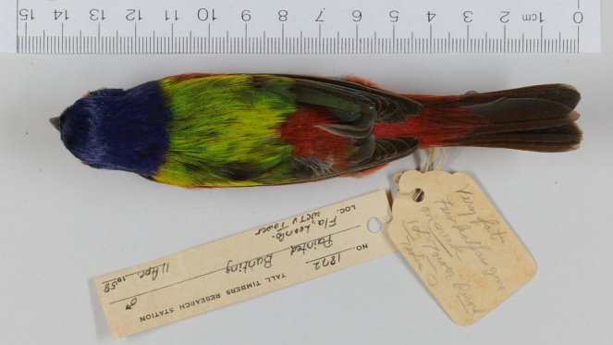
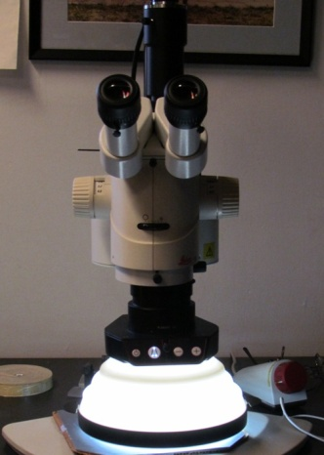
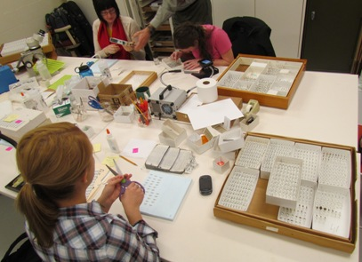
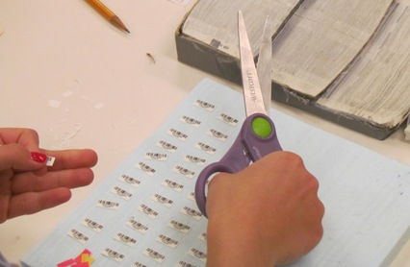
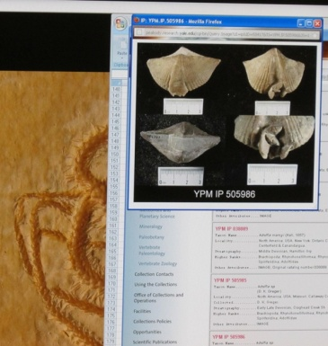
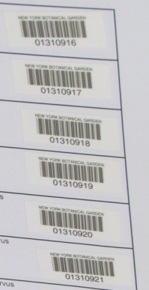
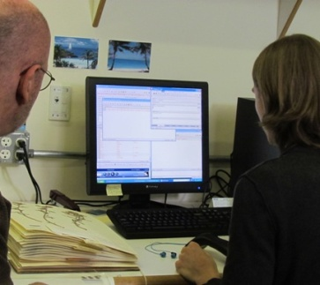
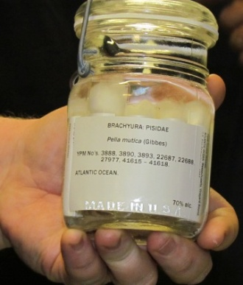
Discovering Effective Workflows How can iDigBio help the biological and paleontological community with workflow development?
Deborah Paul, Gil Nelson
Paleocollections Workshop April 26 – 28, 2012
support from NSF grant: Advancing Digitization of Biological Collections Program (#EF1115210)
Notes:
One of iDigBio’s goals is to assist the biodiversity collections community in finding ways to streamline digitization.
That might be taking photos, data entry, specimen preparation, label handling, file naming, image processing, etc….
Scenes on this slide are from L >R, top row first: University of Kansas Biodiversity Institute Entomology Department, Harvard Entomology (Formicidae), University of Kansas Biodiversity Institute Entomology Department, Tall Timbers Research Station (TTRS) Florida, Yale Peabody Museum (YPM) Invertebrate Zoology Collection, YPM Entomology Collection, New York Botanical Garden (NYBG) and the YPM Invertebrate Paleontology Department.

Slide 2
Overview
Digitization survey
Observing Collections
Finding groups of common activities
Workflow patterns
Some important principles of effective workflows
Examples of real workflows
Digitization maturity
Notes:
We begin our efforts in late 2011 putting a survey of questions together for visiting a variety of collections.
Our collections to visit are chosen by input from the iDigBio staff to cover small and large collections of many types.
We are effectively carrying out benchmarking – step 1. We are looking at what everyone is doing to see where the
common overlap is in order to further the discussion and put together a conceptual model for the community
to utilize as a method to systematically hunt for places to make our processes more efficient.
After our surveys and visits, we submitted a paper and are now planning our first digitization workshop to
try and utilize this model for finding places to digitize faster, more efficiently and with less error.
In our research, we discovered Bryan Kalms, Business Analyst on the Atlas of Living Australia project.
His Digitization Guide, published in February 2012 addresses Digitization Maturity – a chart for looking at digitization from an organizational perspective.
It seems to be a useful model to add to our toolkit when evaluating organizational and overall workflow patterns in these digitization efforts.

Slide 3
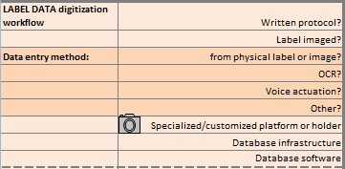
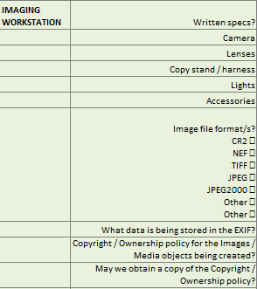
Informal Digitization Survey
iDigBio staff compiled a survey
collection type information
protocols
specimen handling logistics
imaging
specimen data entry
Community feedback: Survey helped
finding gaps in documentation
helping with writing of workflows & protocols
organizing workflows for sharing & archiving
Notes:
Our survey and feedback.
Note it will be available online.
We value your feedback to improve upon it.

Slide 4
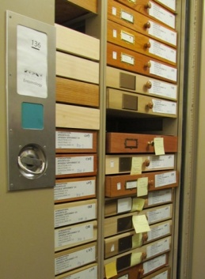
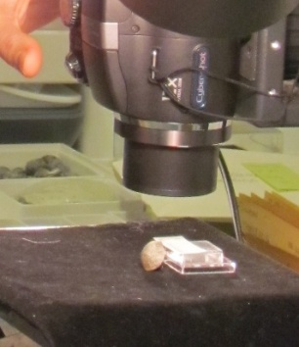
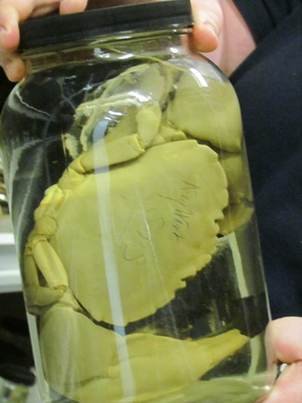
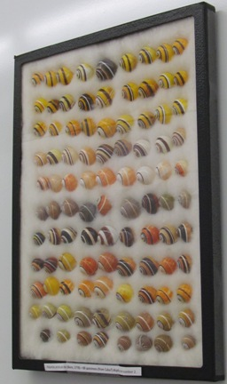
Observing Collections
iDigBio staff visited
28 Collections in 10 different museums
Collections varied in size, kind, staffing
entomology
invertebrate paleontology
invertebrate zoology
ornithology
botany
vertebrate paleontology
zoology
Notes:
Kinds of collections we visited

Slide 5
Characterizing Workflows
We can divide activities into coherent groups Task Clusters
pre-digitization curation
data capture & processing
imaging capture
image processing
image storage
All groups share concern for
Data Quality
Data Integrity
Notes:
influenced by Tann and Flemons paper.
http://australianmuseum.net.au/Uploads/Documents/23183/Data%20Capture%20of%20specimen%20labels%20using%20volunteers%20-%20Tann%20and%20Flemons%202008.pdf
Our overall groups (Task Clusters) seen across collection types.

Slide 6
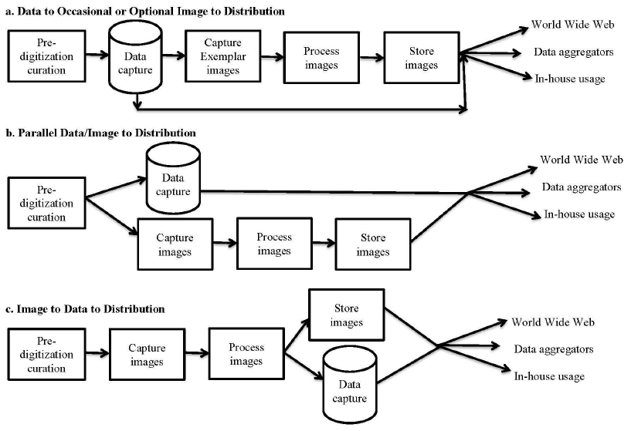
5 task clusters, + 1 3 workflow patterns
blue shading indicates specimen handling steps
Notes:
Susan Butts published a formula for figuring out how to decide what to digitize (move from the stratigraphic to the systematic collection).
Yale’s Entomology Department is an example of the first path.
We have seen herbariums utilizing the second path.
Necessitates keeping track of what is databased, but not imaged
and
what is imaged, but not yet in the database.
The last path minimizes specimen handling and is best suited to those collection types
where imaging the specimen (and the label) at the same time is feasible.
Herbarium specimens, and other specimen types (like bird skins) where the label can be placed
in the image field are well-suited to this flow.
The first 2 paths will at times mean the specimen has to be located and handled again to check data in the database.
The last path is to be studied more thoroughly in the upcoming iDigBio DROID workshop May 30-31, 2012.

Slide 7
5 Task Clusters and Key Elements
Personnel
Geo-referencing
Image Capture
Image Processing
Pre-digitization Curation
or “Staging”
Data Capture
Image/Data
Storage
Written
Protocols
Biodiversity Informatics Manager
Notes:
Another way to view the various paths.
The importance of Personnel and Written Protocols.
Where Geo-referencing fits in (some are doing this record-by-record).
Others are waiting until all their data is databased and plan to then use
automated georeferencing for the bulk of their records, followed by crowd-sourcing record-by-record for the more difficult data sets.

Slide 8
5 important principles of effective workflows…
The Bioinformatics Manager is key
protocols, workflows, data entry, imaging, storage, hardware, staffing …
People do the digitization
Staff
Processes and workflows vary according to
Type of collections: the physical specimens
Space
Labels and label formats
Workflow (WF) and protocols
Must be carefully documented
Can be improved iteratively
Must be evaluated
Communication among projects is crucial
Notes:
There are likely more than 5 principles, but these seem to stand out the most.

Slide 9
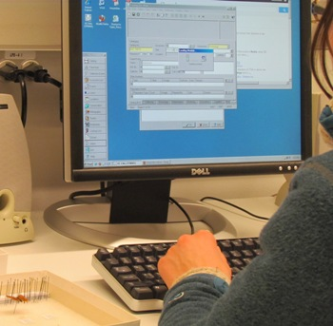
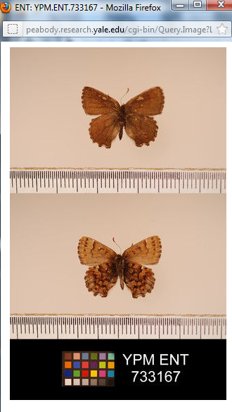
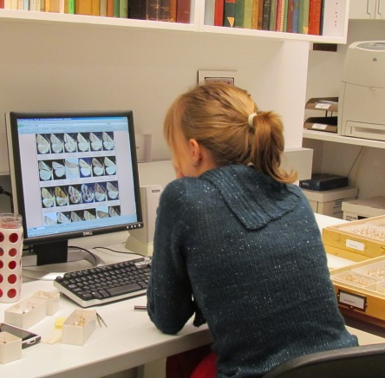
workflow example
pre-curation
database entry into KE EMu
publish to web immediately
hire students
image exemplars
re-box
collecting event sort
check taxon names
enter taxon names
rank sort
finding students
interview
jobs: sorting by taxon, taxonomy verification, grouping by collecting event, data entry, imaging
training
Notes:
The Bioinfomatics Manager is key
able to customize the process for each collection in the museum
People doing the digitization – students / volunteers can do a lot.
varies by the people available, the collection type, keep an open mind
Nature of the collection
this particular collection – a student is able to successfully update the taxon names (with supervision)
Physical space characteristics
The label / specimen data format
labels here are printed on thermal paper – each workstation has its own printer
Workflow (WF) – great documentation, students can often train the next students
documentation of WFs
improving WFs
evaluating WFs
Talk with others
story heard at YPM – a new field needed in the database – collection managers conferred with each other (collaboration)
Example in the slide is from YPM ENT.

Slide 10
workflow evolution: Things people changed
tweezers
autonomy to alleviate boredom
keystroke short cuts
ocr to validate scanned barcode entry
capturing feedback from staff
tracking flow
what happens when there’s a problem?
where do problems go?
losing information
Institutional level
Coordinated effort
Ready and willing to try a new strategy
Avoiding the NIH syndrome
Notes:
Some examples of changes we saw in various collections
as they adapt to improve their digitization.

Slide 11
Documentation of Workflows
Workflow (WF)
Documentation of WFs
the informal survey is a start
Improving WFs
Talking with others / comparing
Evaluating WFs
WF mockup Example
for upcoming DROID workshop
Notes:
The Workflow Creation and improvement process.
See the next slide for a Mock up example of how one might evaluate a particular Task Cluster in this workflow pattern.

Slide 12
Evaluating a Workflow
Pre Digitization Curation Tasks | must be done before digitzation | could be done at or after digitization | Non expert | Crowd Source? | a step that could be automated | a task needing QA / QC | Can do with existing machine (Kirtas) | Authority file exists or would be useful | a physical tool exists | easy to compute time / costs for this task | formula exists
interview staff | ✓
hire staff | ✓
train staff | ✓ |  | ✓
decide what to digitize | ✓ |  |  |  |  |  |  |  |  |  | ✓
pull specimens | ✓ |  | ✓
sort specimens (e.g., by taxon, sex, geographic region, collecting event, collector) | ✓ | ✓ | ✓
add taxon names to database |  |  |  |  |  |  |  | ✓
update taxonomic identification on specimens (e.g., vet type specimens) |  | ✓ | ✓ | ✓
Workflow (WF)
Documentation of WFs
Improving WFs
Talking with others / comparing
Evaluating WFs
See WF Mockups – for DROID workshop
Notes:
Work Flow Mock up for Upcoming DROID workshop.
The left column is a list of all tasks at the pre-digitization step.
The top row is a list of criteria to on which to evaluate each step for a possible place to make improvements in some way.
The results of these will be posted to help the community compare tasks
and create a road map for using the data gathered to speed things up!

Slide 13
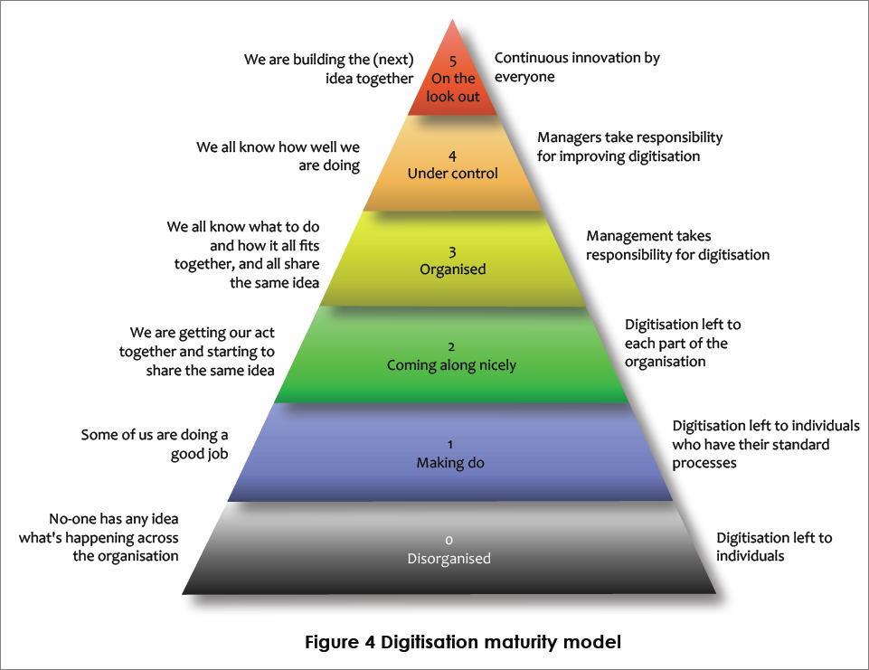
Digitization Maturity? Six maturity levels for core digitization activities
http://www.ala.org.au/wp-content/uploads/2011/10/Digitisation-guide-120223.pdf
Notes:
Bryan Kalm’s digitization maturity scale. useful for organizations looking to benchmark their overall maturity within and between collections.

Slide 14
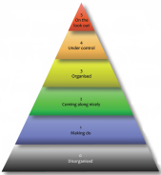
What’s your Digitization Maturity? Find out here …on page 67+
Digitisation: A strategic approach for natural history collections. Canberra, Australia, CSIRO, 2012.
Author: Bryan Kalms
Available at http://www.ala.org.au/wp-content/uploads/2011/10/Digitisation-guide-120223.pdf.

Slide 15
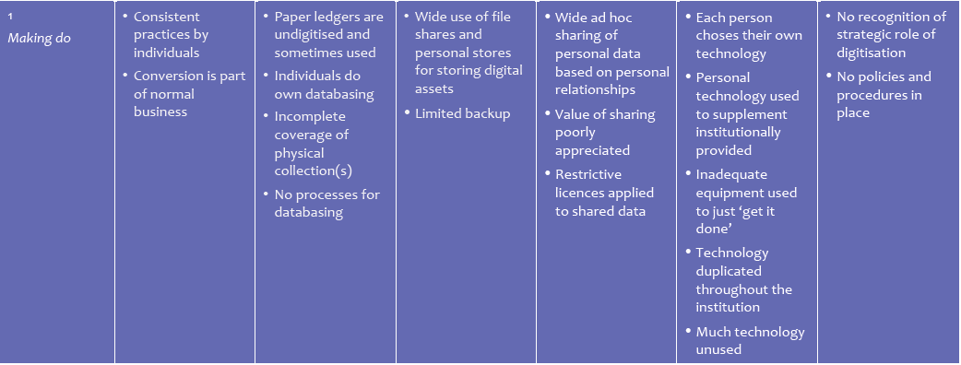
What’s your Digitization Maturity? Level 1, 5
http://www.ala.org.au/wp-content/uploads/2011/10/Digitisation-guide-120223.pdf
Notes:
A sample of the digitization maturity scale criteria…shown here for level 1 and level 5 for comparison.

Slide 16
Assessing Digitization Workflows…
Reed Beaman, James Macklin, Michael Donoghue, James Hanken. 2007. Overcoming the Digitization Bottleneck in Natural History Collections: A summary report on a workshop held 7 – 9 September 2006 at Harvard University. [Accessed January 2012].
ĺñigo Granzow-de la Cerda and James H. Beach. December 2010. Semi-automated workflows for acquiring specimen data from label images in herbarium collections. Taxon 59 (6): 1830-1842
Bryan Kalms. Digitisation: A strategic approach for natural history collections. Canberra, Australia, CSIRO, 2012.
John Tann & Paul Flemons. 2008. Report: Data capture of specimen labels using volunteers. Australian Museum
Ana Vollmar, James Alexander Macklin, Linda Ford. 2010. Natural History Specimen Digitization: Challenges and Concerns. Biodiversity Informatics 7 (1): 93 – 112
iDigBio Developing Robust Object to Image to Data (iDigBio DROID) Workshop – May 30 – 31, 2012
Notes:
papers influencing our take on data we gathered and what we observed.

Slide 17
Acknowledgments & Thank You from
American Museum of Natural History (AMNH)
Botanical Research Institute of Texas (BRIT)
Florida Museum of Natural History (FLMNH)
Florida State University (FSU)
Harvard Herbarium (HUH)
Museum of Comparative Zoology (Harvard)
New York Botanical Garden (NYBG)
Yale Peabody Museum (YPM)
Southeast Regional Network of Expertise and Collections (SERNEC)
Specify Software Project (University of Kansas)
Symbiota Software Project (Arizona State University)
Tall Timbers Research Station and Land Conservancy (TTRS)
Tulane University Museum of Natural History
University of Kansas Biodiversity Institute Entomology Department
Valdosta State University (VSU)
and all participants at the iDigBio Paleocollections Workshop
Notes:
Thanks! from all at iDigBio

