Slide 1
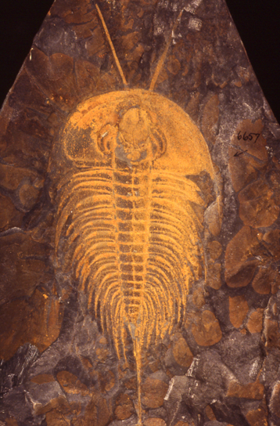
Applying Biodiversity Science to Paleontology
Bruce S. Lieberman
Department of Geology and Natural History Museum
The University of Kansas, Lawrence, Kansas U.S.A.

Slide 2
Rode and Lieberman. 2004. Palaeo ³
Stigall and Lieberman. 2006. Journal of Biogeography

Slide 3
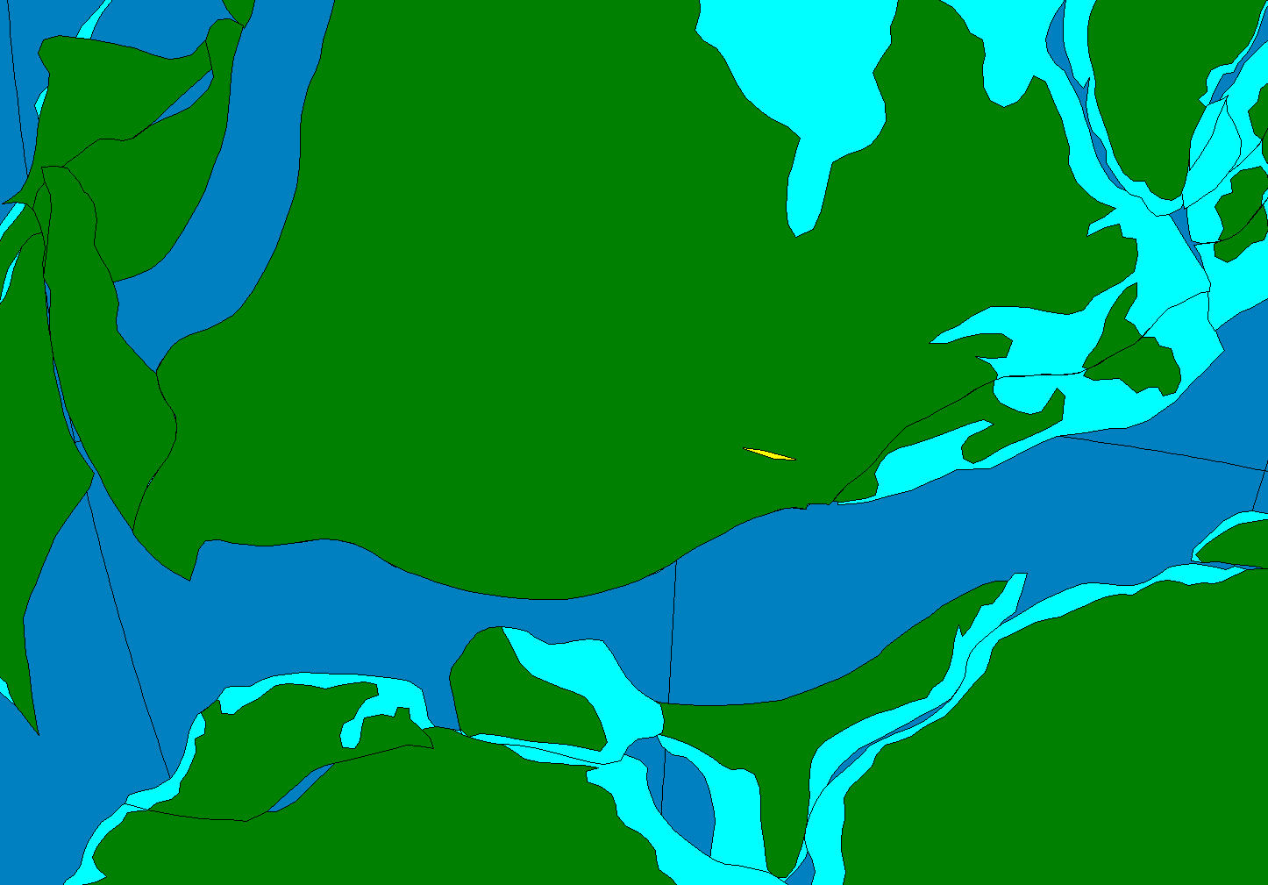
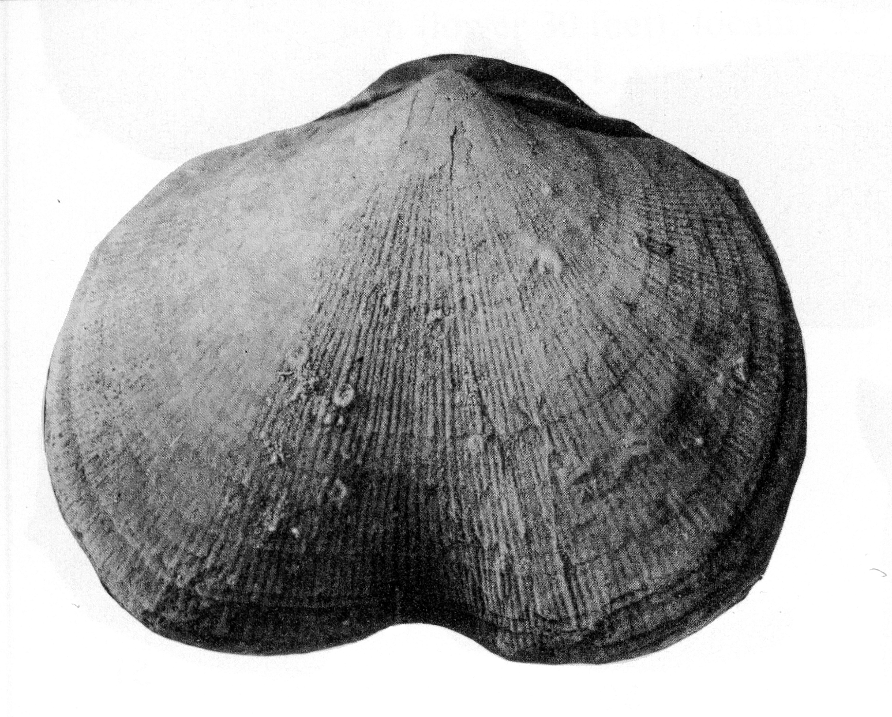
Schizophoria impressa range
Fam.
crepida
triangularis
linguiformis
rhenana
jamieae
Frasnian
hassi
punctata
transitans
falsiovalis
disparilis
Givetian
hermanni-cristatus
varcus

Slide 4
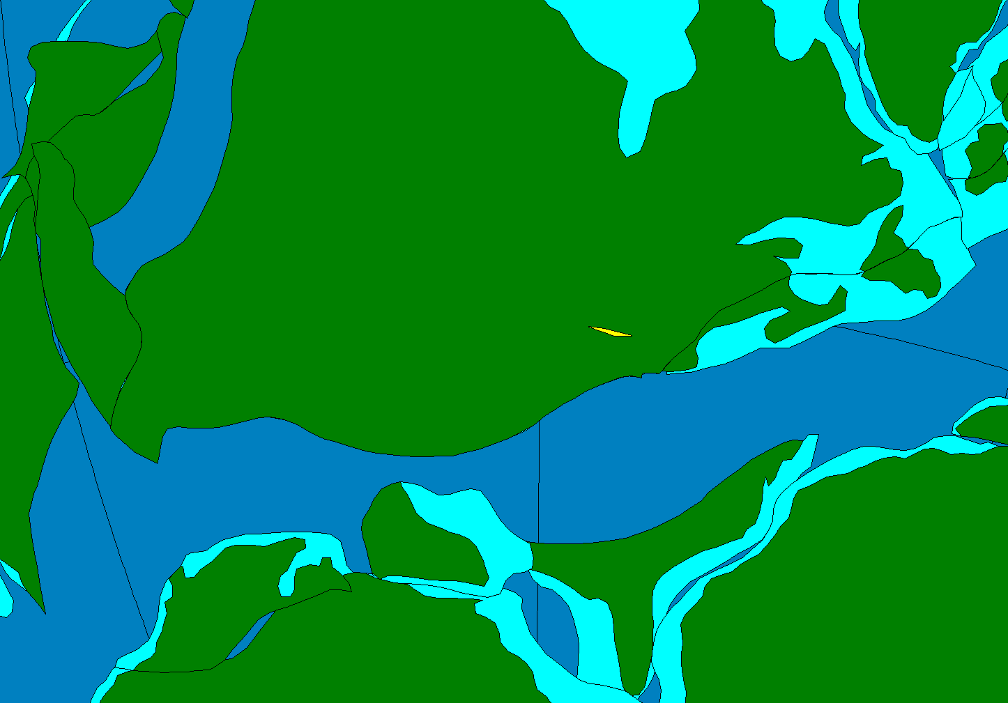
Fam.
crepida
triangularis
linguiformis
rhenana
jamieae
Frasnian
hassi
punctata
transitans
falsiovalis
disparilis
Givetian
hermanni-cristatus
varcus

Slide 5
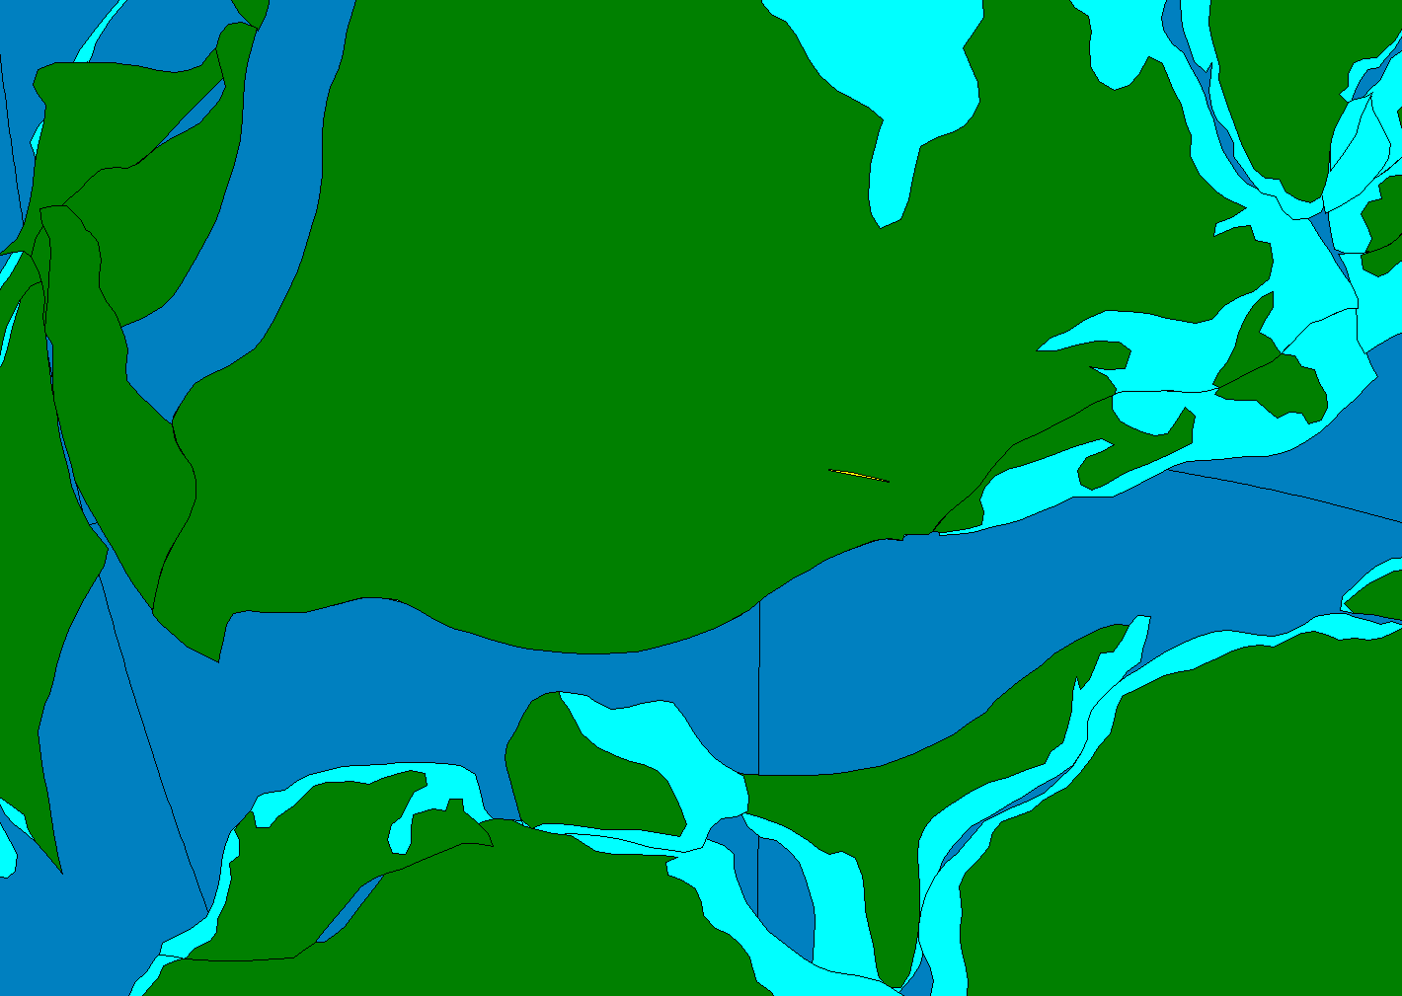
Fam.
crepida
triangularis
linguiformis
rhenana
jamieae
Frasnian
hassi
punctata
transitans
falsiovalis
disparilis
Givetian
hermanni-cristatus
varcus

Slide 6
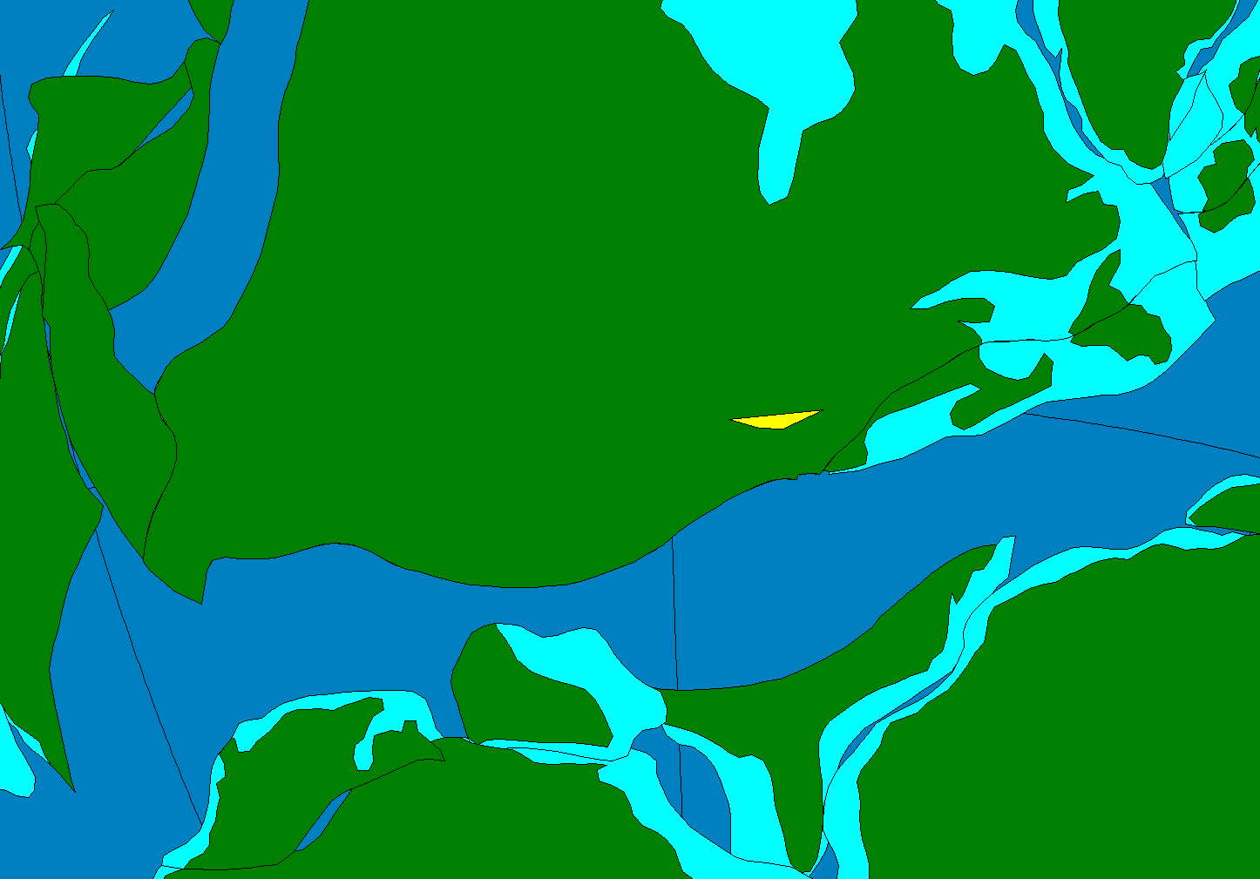
Fam.
crepida
triangularis
linguiformis
rhenana
jamieae
Frasnian
hassi
punctata
transitans
falsiovalis
disparilis
Givetian
hermanni-cristatus
varcus

Slide 7
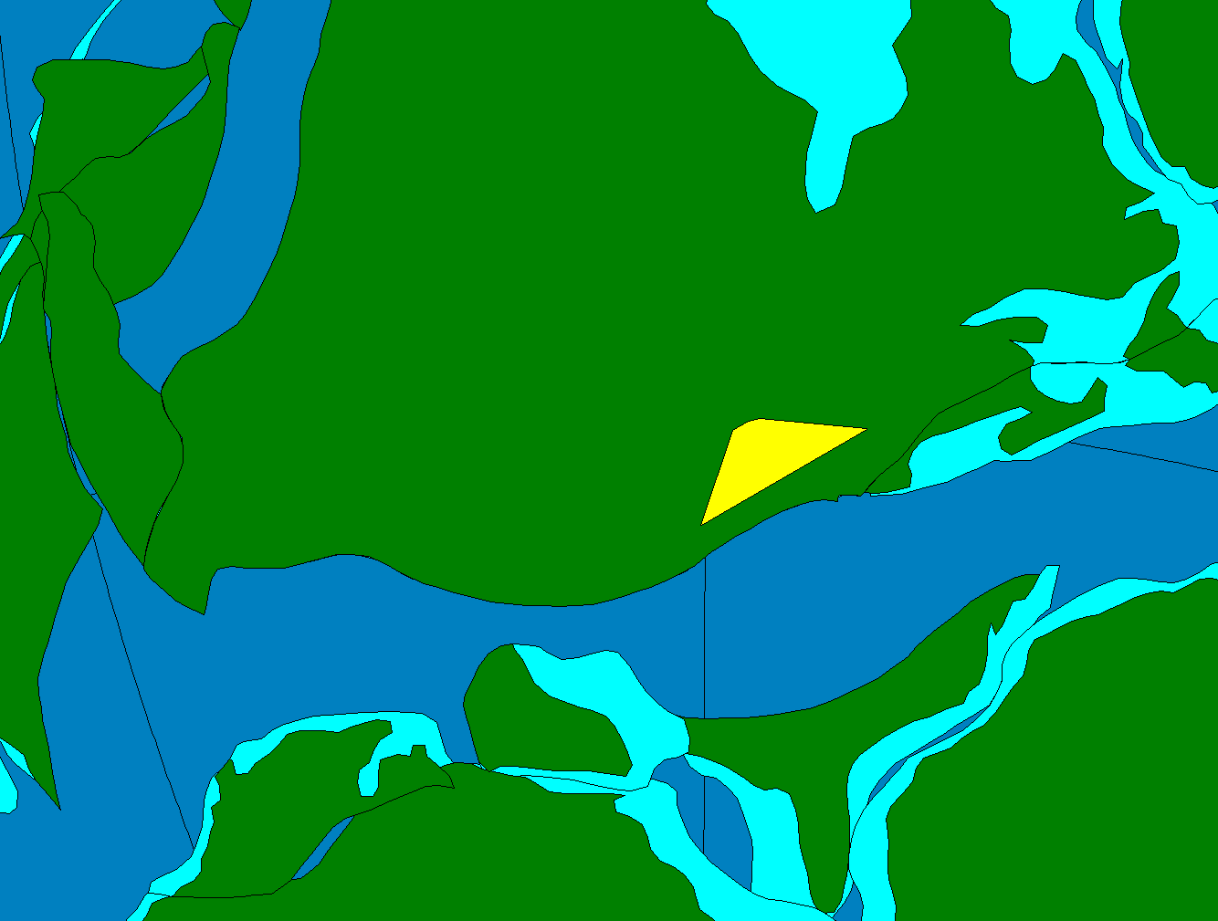
Fam.
crepida
triangularis
linguiformis
rhenana
jamieae
Frasnian
hassi
punctata
transitans
falsiovalis
disparilis
Givetian
hermanni-cristatus
varcus

Slide 8
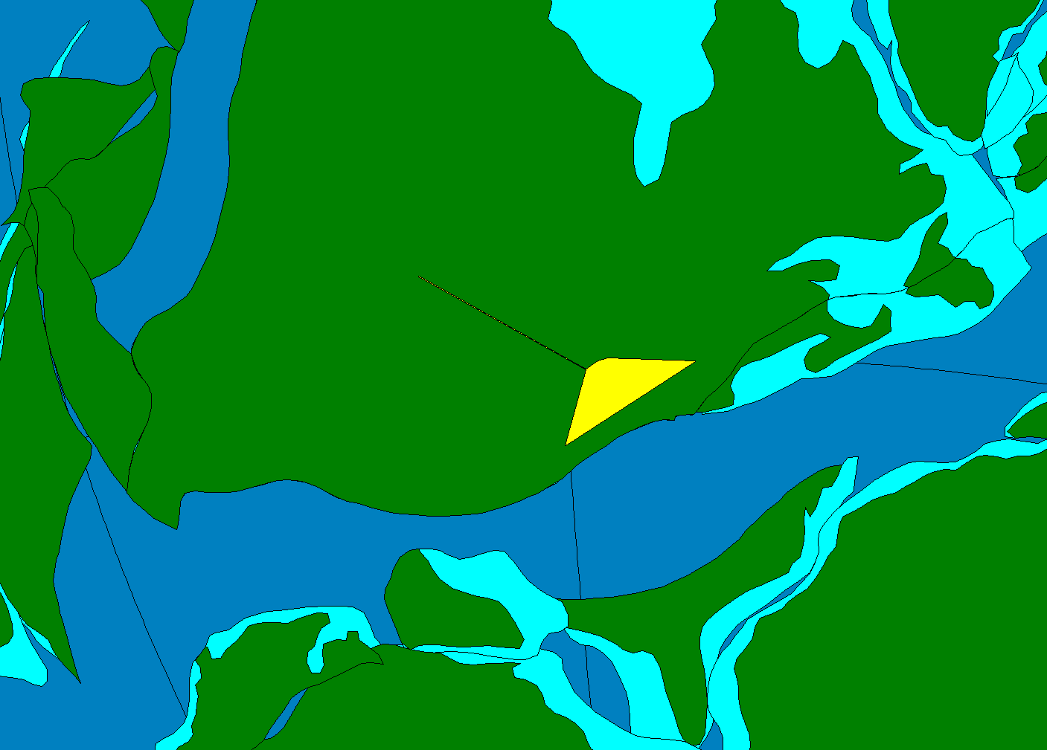
Fam.
crepida
triangularis
linguiformis
rhenana
jamieae
Frasnian
hassi
punctata
transitans
falsiovalis
disparilis
Givetian
hermanni-cristatus
varcus

Slide 9
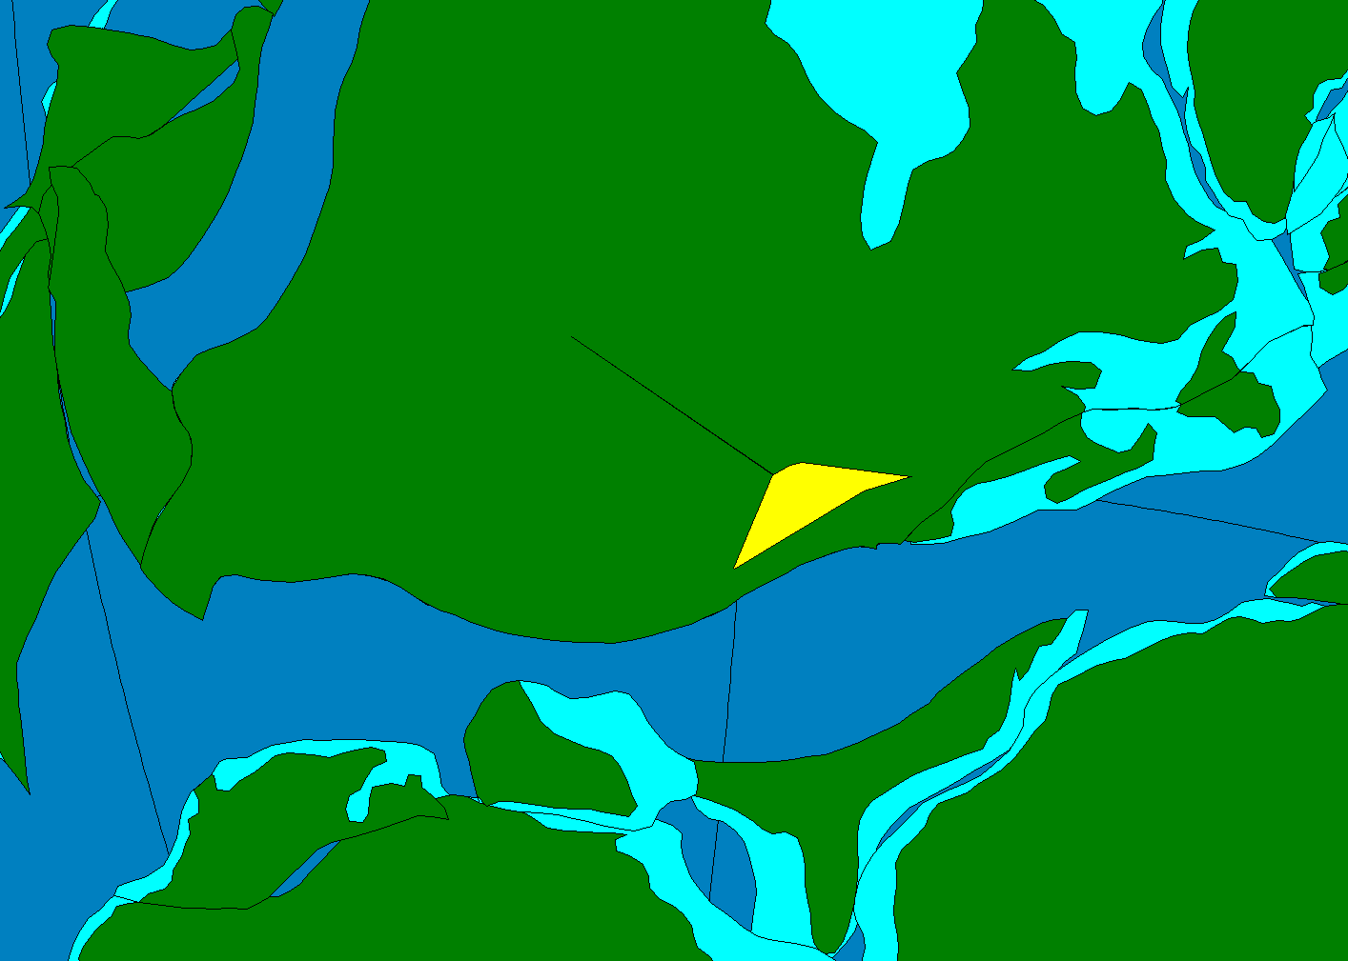
Fam.
crepida
triangularis
linguiformis
rhenana
jamieae
Frasnian
hassi
punctata
transitans
falsiovalis
disparilis
Givetian
hermanni-cristatus
varcus

Slide 10
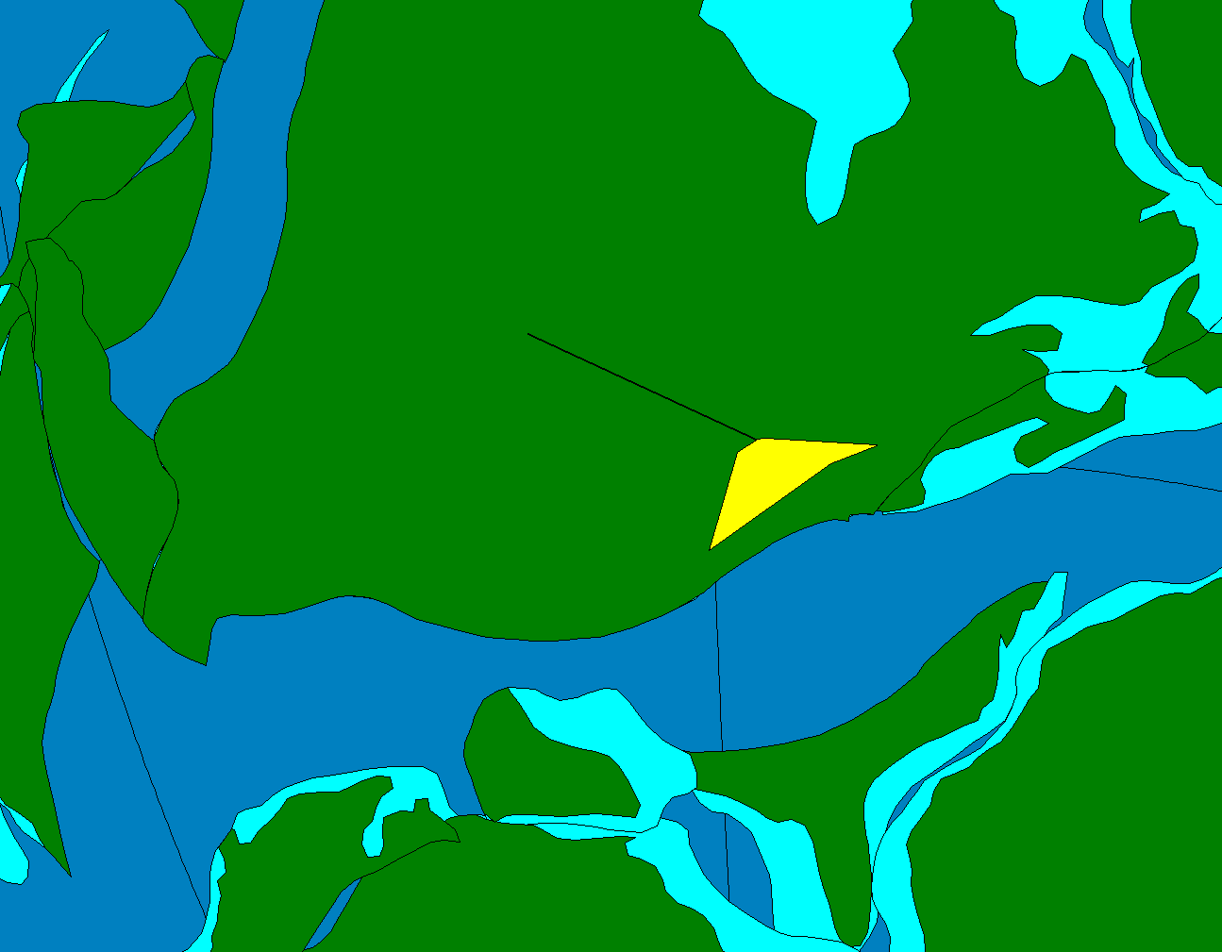
Fam.
crepida
triangularis
linguiformis
rhenana
jamieae
Frasnian
hassi
punctata
transitans
falsiovalis
disparilis
Givetian
hermanni-cristatus
varcus

Slide 11
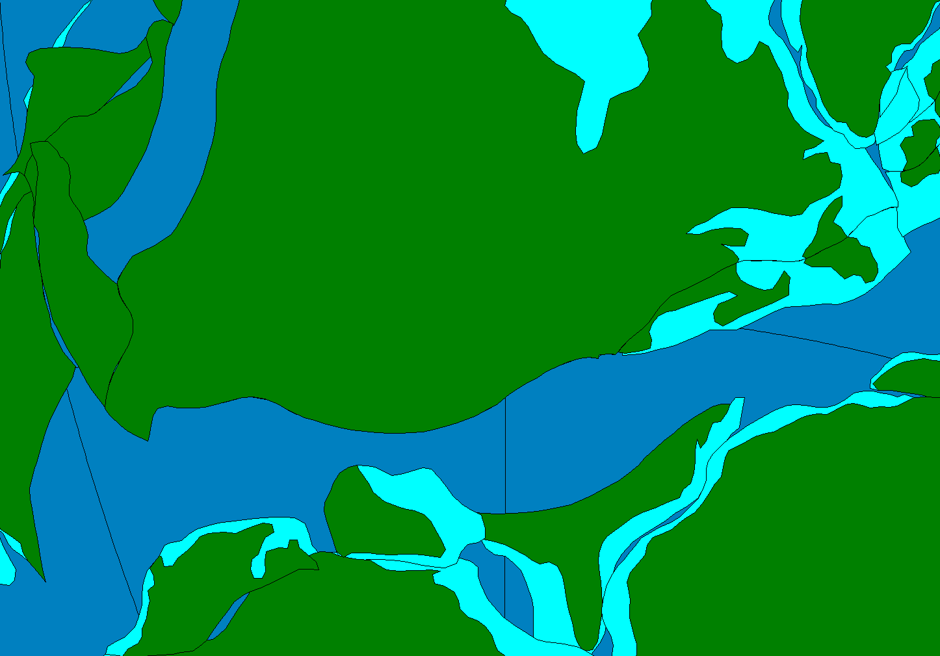
Fam.
crepida
triangularis
linguiformis
rhenana
jamieae
Frasnian
hassi
punctata
transitans
falsiovalis
disparilis
Givetian
hermanni-cristatus
varcus

Slide 12
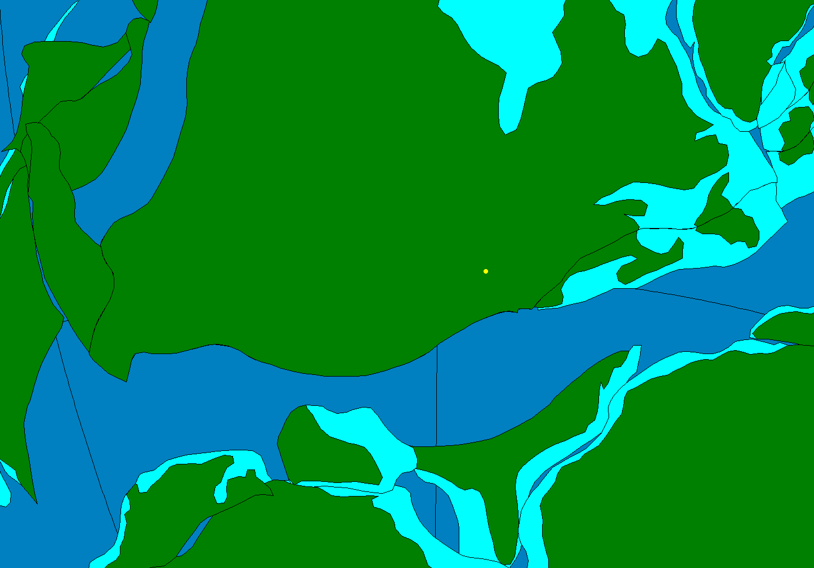
Fam.
crepida
triangularis
linguiformis
rhenana
jamieae
Frasnian
hassi
punctata
transitans
falsiovalis
disparilis
Givetian
hermanni-cristatus
varcus

Slide 13
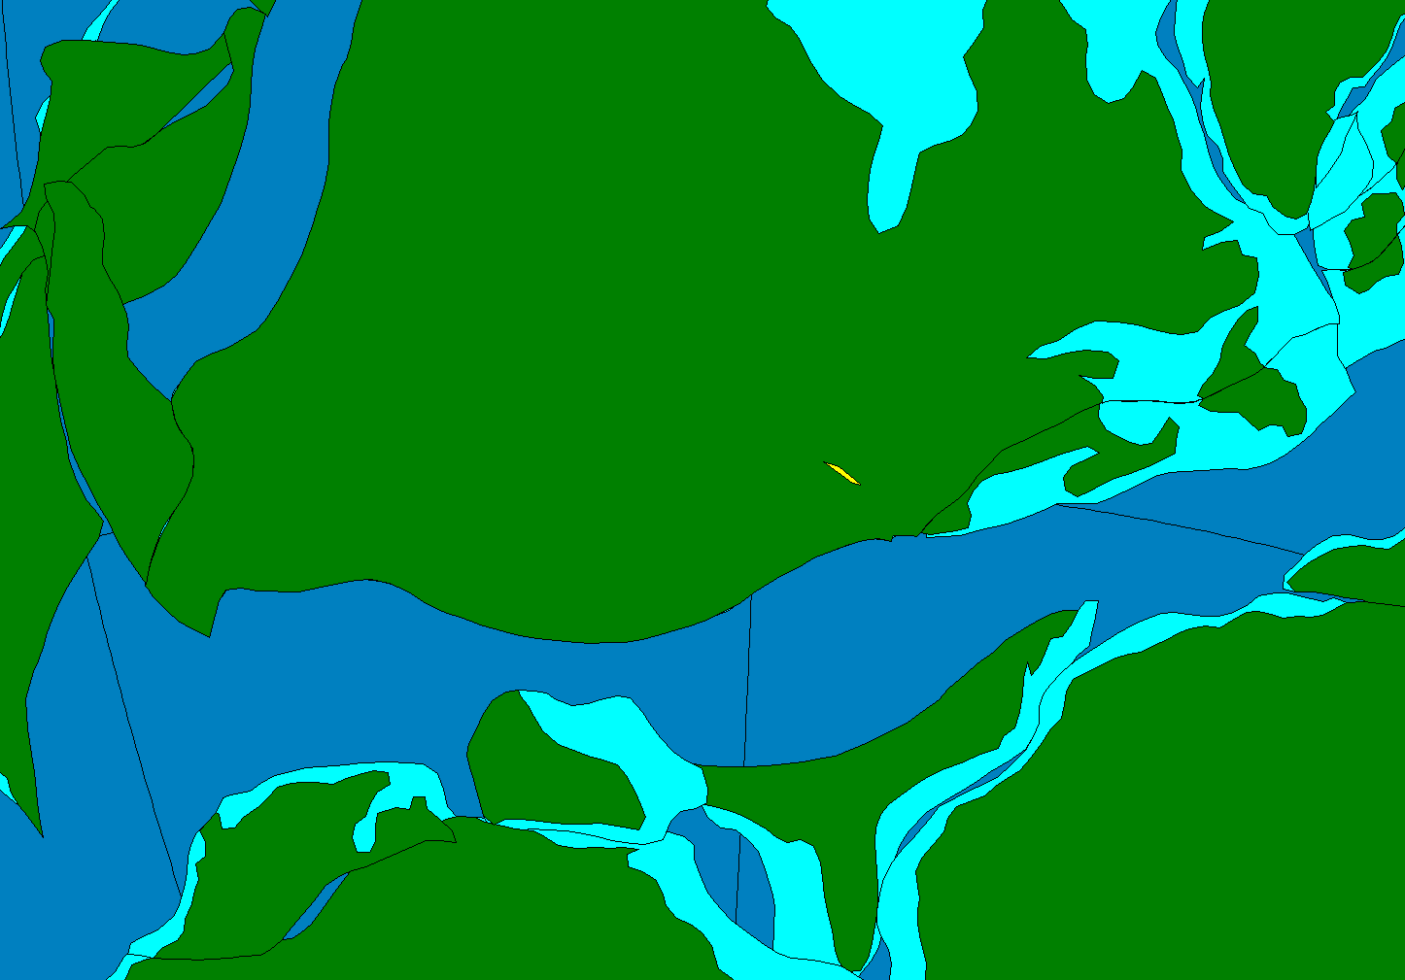
Fam.
crepida
triangularis
linguiformis
rhenana
jamieae
Frasnian
hassi
punctata
transitans
falsiovalis
disparilis
Givetian
hermanni-cristatus
varcus

Slide 14
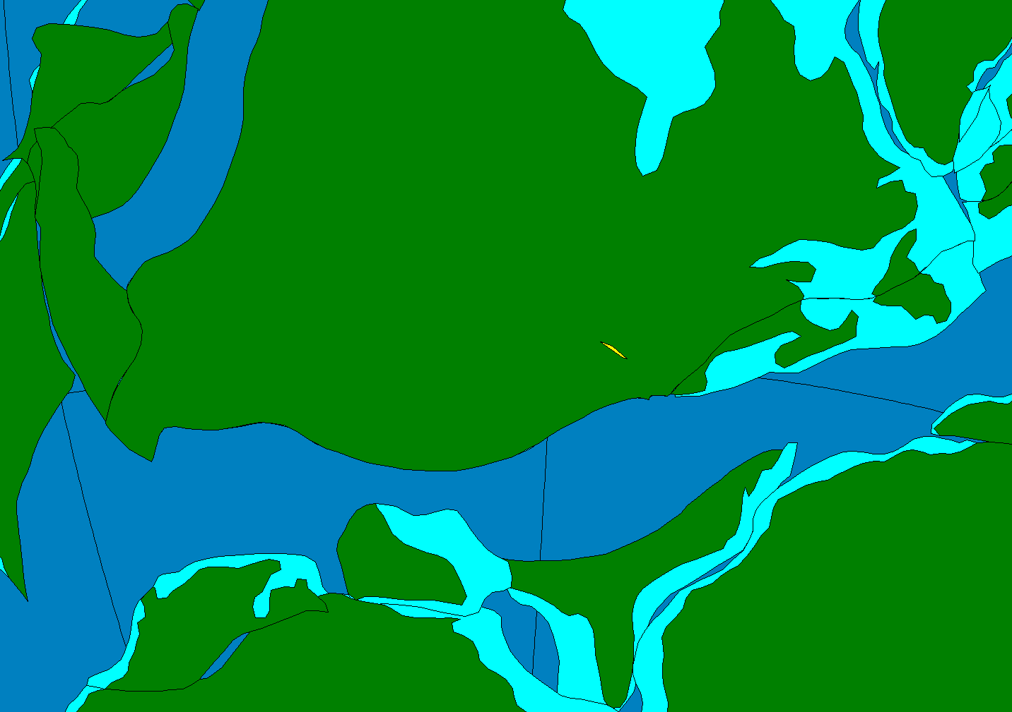
Fam.
crepida
triangularis
linguiformis
rhenana
jamieae
Frasnian
hassi
punctata
transitans
falsiovalis
disparilis
Givetian
hermanni-cristatus
varcus

Slide 15
Paleontological data enabling new syntheses in ecology and evolution
Fossils as data derived from museum collections and fieldwork
Georeference fossil localities
Rotate onto paleogeography of appropriate time period using PaleoGIS
Notes:
15

Slide 16
Paleontological data enabling new syntheses in ecology and evolution
Geographic information systems
Ecological niche modeling
Consider correlations between distributional, ecological, and evolutionary parameters
Assess statistical significance of pattern

Slide 17
Applying Biodiversity Science to Paleontology
Cambrian Radiation
Competition and macroevolution in the Cretaceous
Biotic impacts of climate change
Notes:
17

Slide 18
Applying Biodiversity Science to Paleontology
Cambrian Radiation
Competition and macroevolution in the Cretaceous
Biotic impacts of climate change
Notes:
18

Slide 19
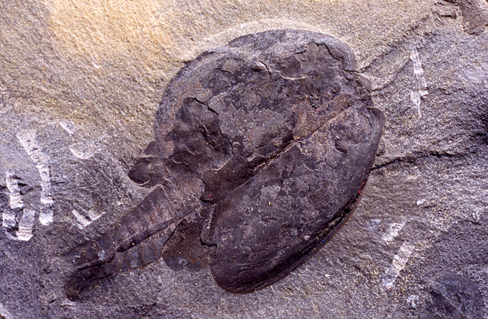

Slide 21
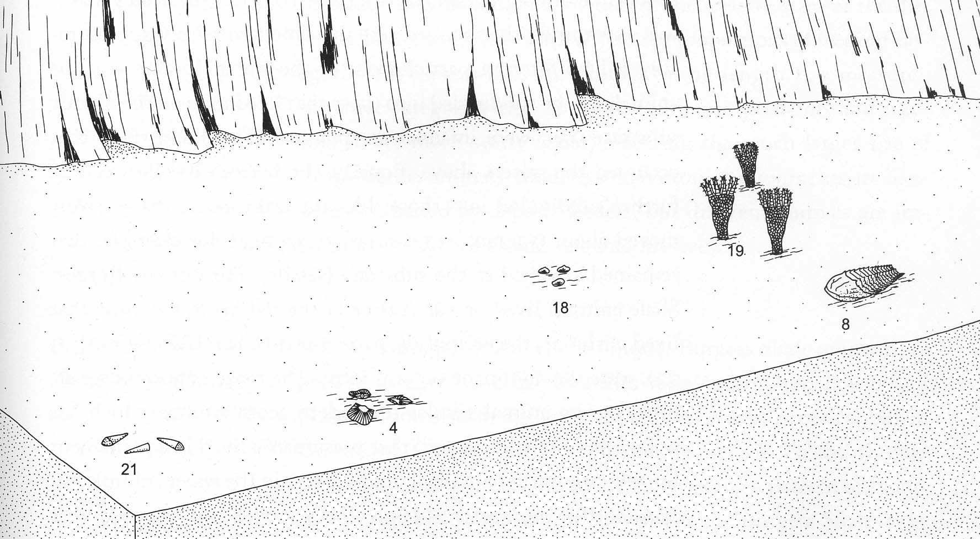
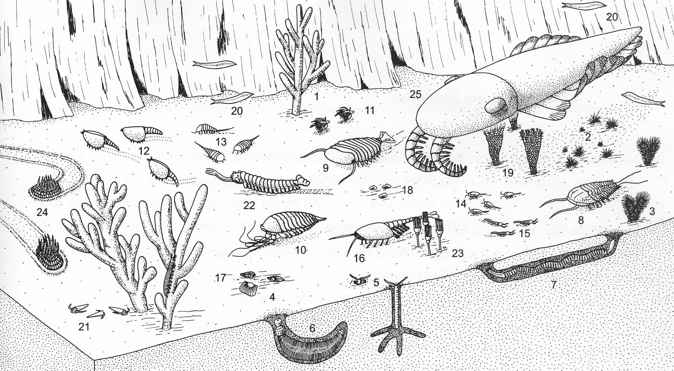
Typical Cambrian Fossils:
Shells, Exoskeletons
Skeletonized and Soft-Bodied Faunas
Briggs et al. (1994, fig. 2.7)
Notes:
21
Typical Cambrian fossils following the Cambrian radiation looked like these: trilobites, brachiopods, hyolithids, primitive crinoids
Very rarely, fossil record grants extraordinary glimpses on ancient life: Lagerstatten

Slide 22
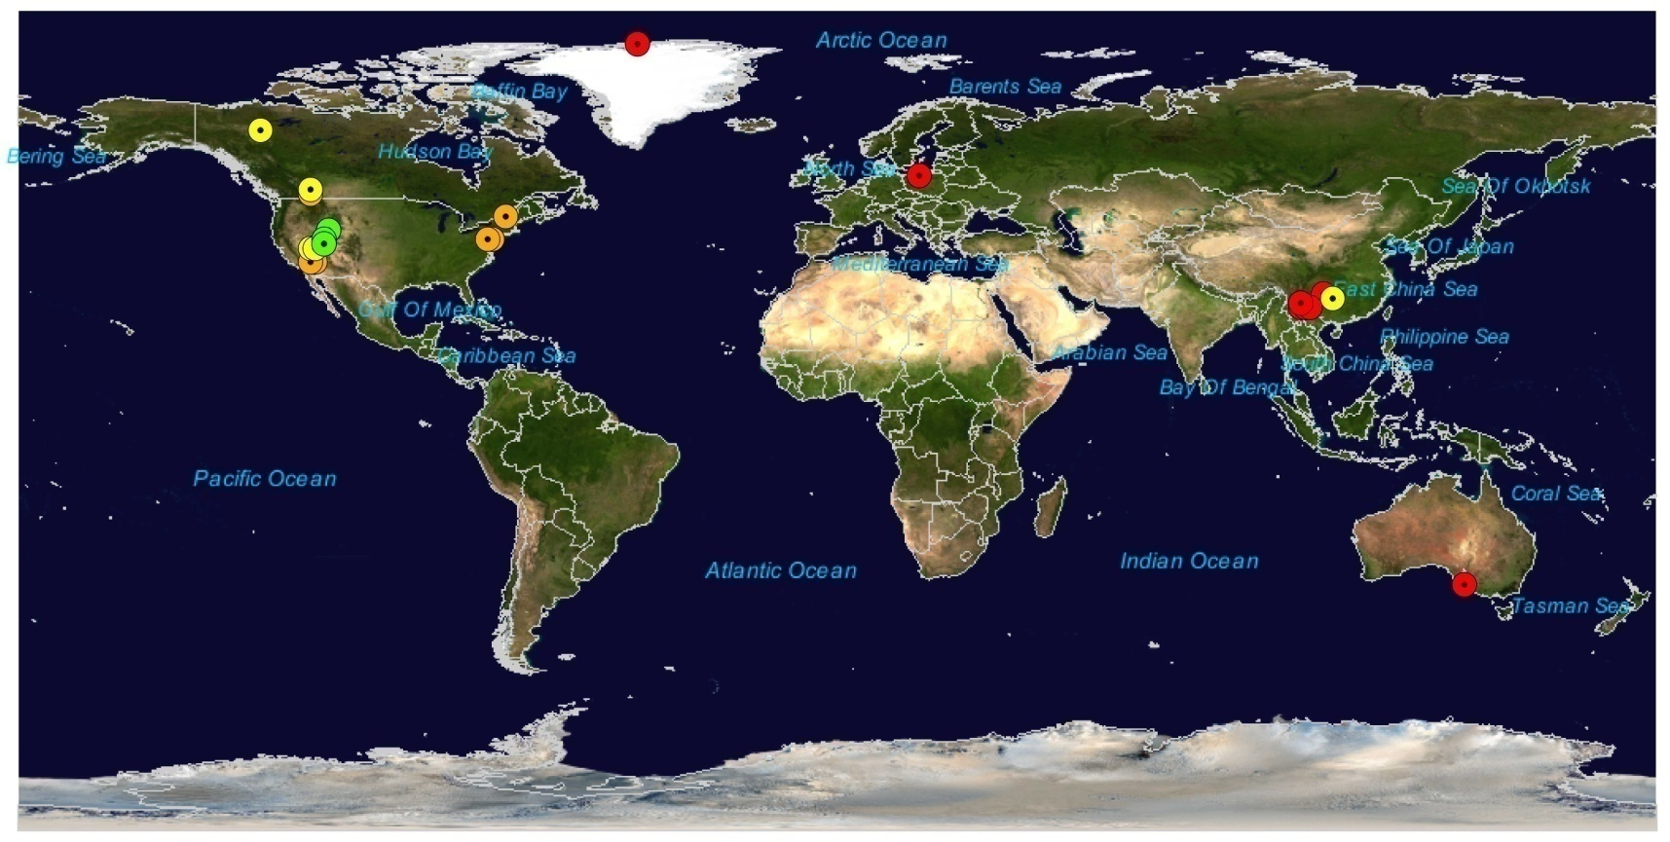
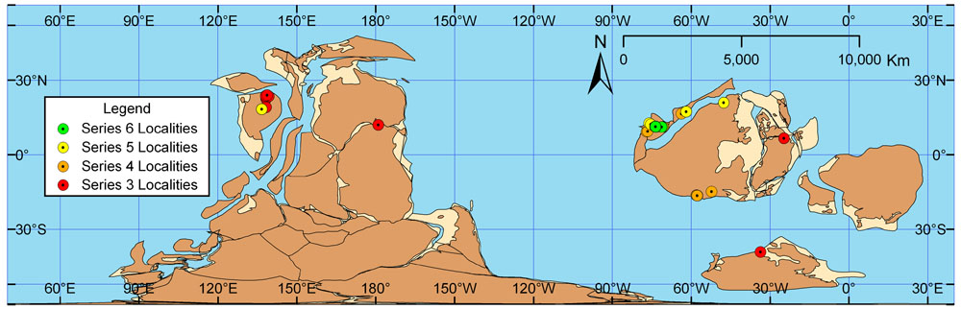
Hendricks, Lieberman, and Stigall. 2008. Palaeo ³

Slide 23
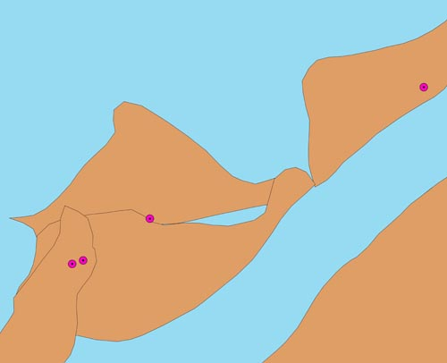
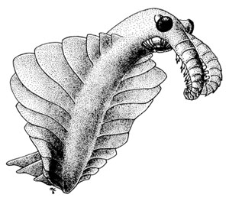
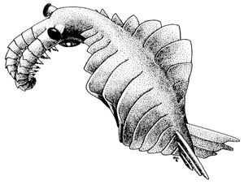
Georeferencing Data
Example: Anomalocaris canadensis
Burgess Shale
Antelope Mt., Utah
Providence Mts., CA
Marble Mts., CA
Hendricks, Lieberman, and Stigall. 2008. Palaeo ³

Slide 24
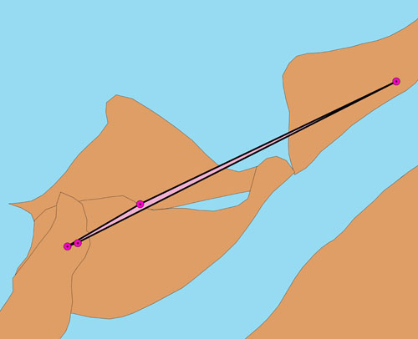
Calculating Geographic Range
33,481 km²
Hendricks, Lieberman, and Stigall. 2008. Palaeo ³

Slide 25
Top 5% (n=14) most widely ranging species
Species | Range (km²)
Naraoia compacta | 5,823,727
Tuzoia polleni | 3,527,839
Anomalocaris saron | 935,458
Perspicaris dilatus | 221,186
Canadaspis perfecta | 220,925
Branchiocaris pretiosa | 102,264
Laggania nathorsti | 100,400
Hurdia sp. | 98,133
Mollisonia symmetrica | 97,171
Tuzoia nitida | 56,669
Anomalocaris canadensis | 33,481
Amplectobelua trispinata | 25,704
Leanchoilia illecebrosa | 19,684
Isoxys paradoxus | 15,608

Slide 26
On average soft-bodied arthropod species have wider geographic ranges than co-occurring trilobite species
Trilobites | Non-Trilobites | Difference Significant? | # Trilobites among top 10% most widely ranging species (n=28)
115 km² (σ = 694 km²) | 73,857 km² (σ = 551,529 km²) | Yes (Mann Whitney U-test, p=0.004) | 2
Hendricks, Lieberman, and Stigall. 2008. Palaeo ³

Slide 27
Applying Biodiversity Science to Paleontology
Cambrian Radiation
Competition and macroevolution in the Cretaceous
Biotic impacts of climate change
Notes:
27

Slide 28
Competition and Macroevolution
Is there geographic evidence for competitive replacement?
Statistical tests for negative range area correlations
What is the relative influence of physical vs. biological factors on species’ distribution and macroevolution?
Notes:
Effects of ecology and environment observed in fossil record as changes in species distribution and range size over time
2) In this talk, I will be focusing on my analysis looking for evidence of competition in the fossil record
-look for negative correlations between range size between pairs of spp (suggests possible CCR)

Slide 29
Competitive Replacement
B
time
A

Slide 30
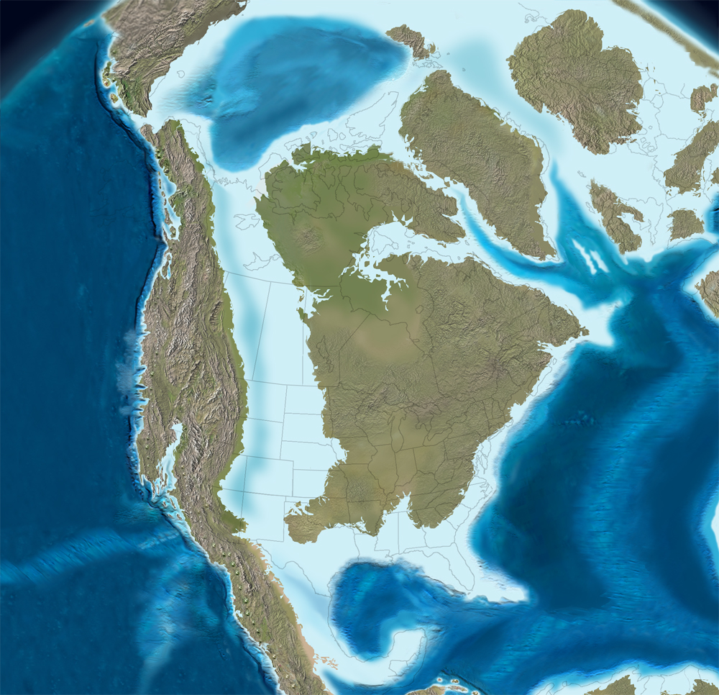
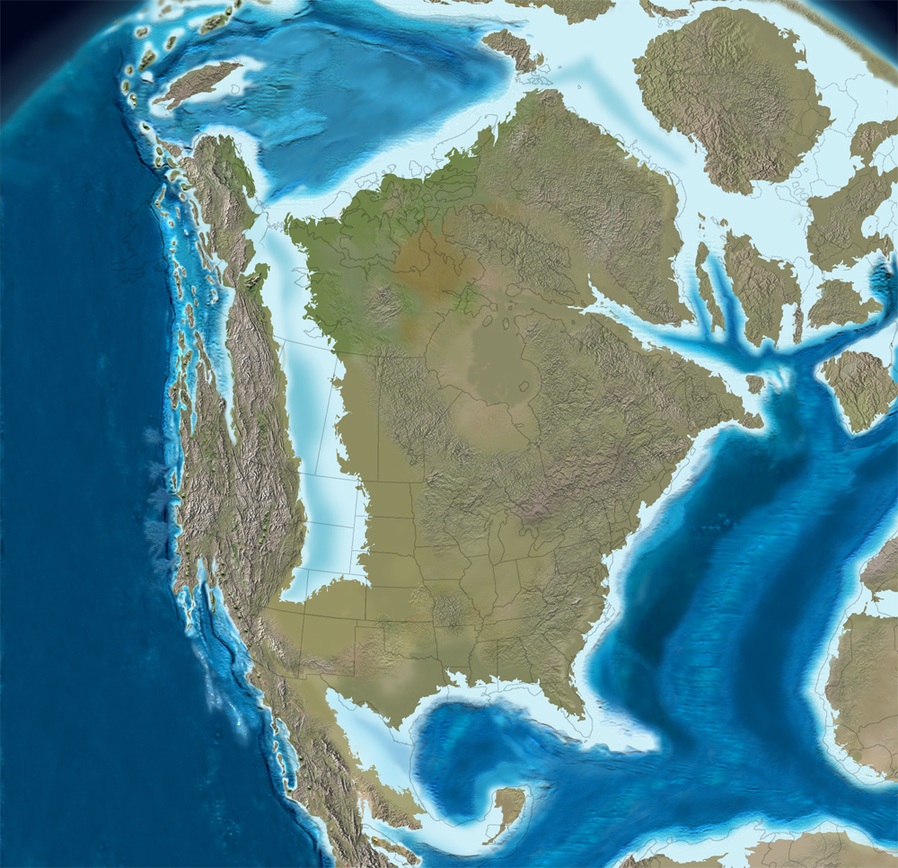
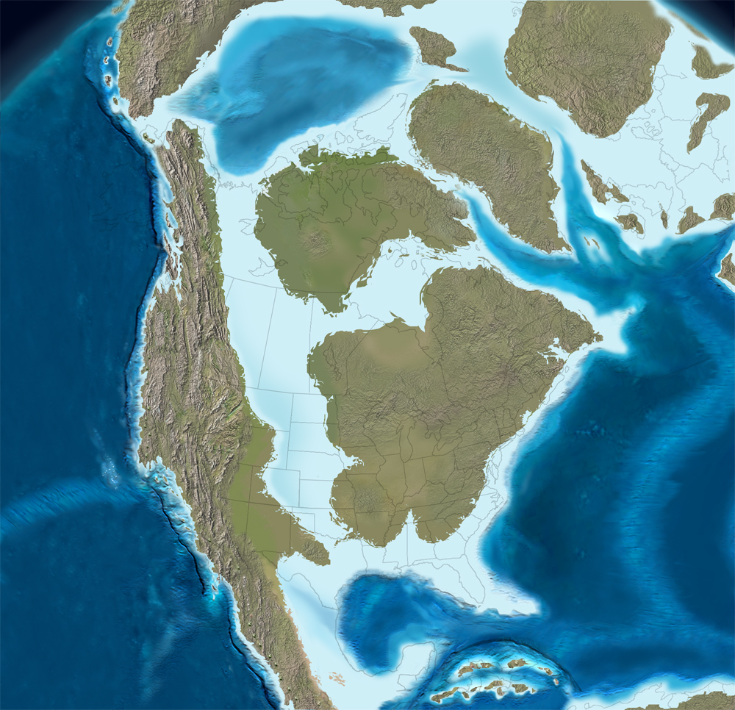
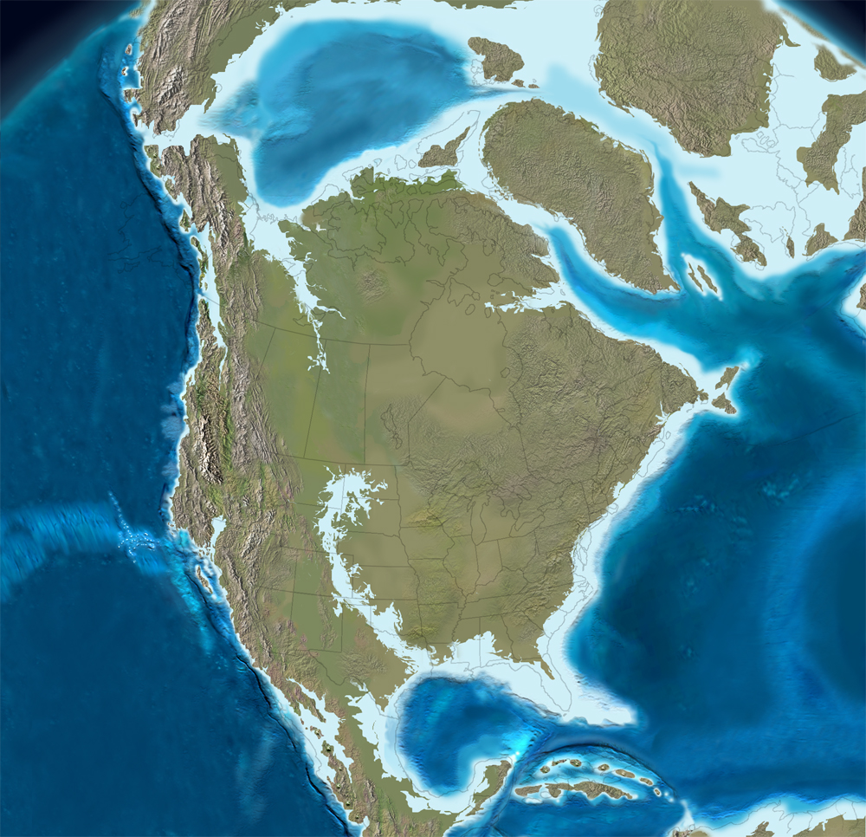
Cretaceous Western Interior Seaway
100Ma
85Ma
Coniacian (~ 85Ma)
75Ma
65Ma
(Ron Blakey
reconstructions)
Notes:
~100-65Ma great epicontintental sea stretched over a good portion of N Am; partly this resulted from higher eustatic sea level and partly the WIS = foreland basin! result of tectonic loading/lithospheric flexure and subsidence in the W by the formation of the Rocky Mtns (slamming N Am plate into Pac Plate)
WIS began as extension of boreal Arctic waters; northern waters were met by spread of tropical waters north from the proto-Gulf of Mexico--important cause resulted in mixing of different waters (to various degrees) as well as migration of various faunas from N and S
-shallow → at most 600m deep; but plagued with dysoxic to anoxic bottom waters as a result of the mixing of cold, brackish northern waters with warmer tropical waters
30

Slide 31
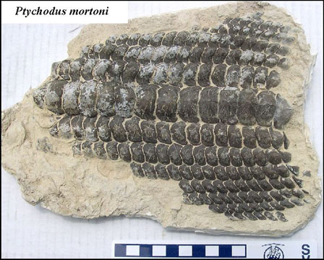
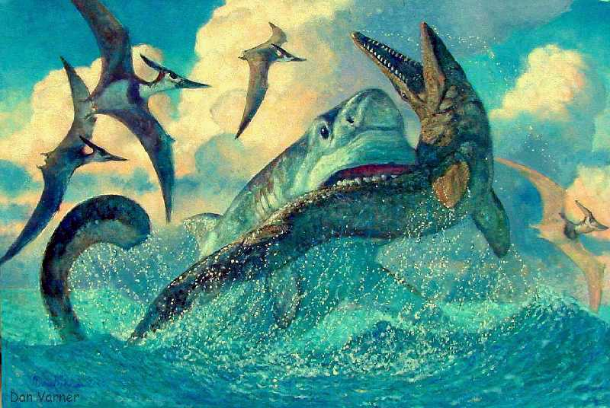
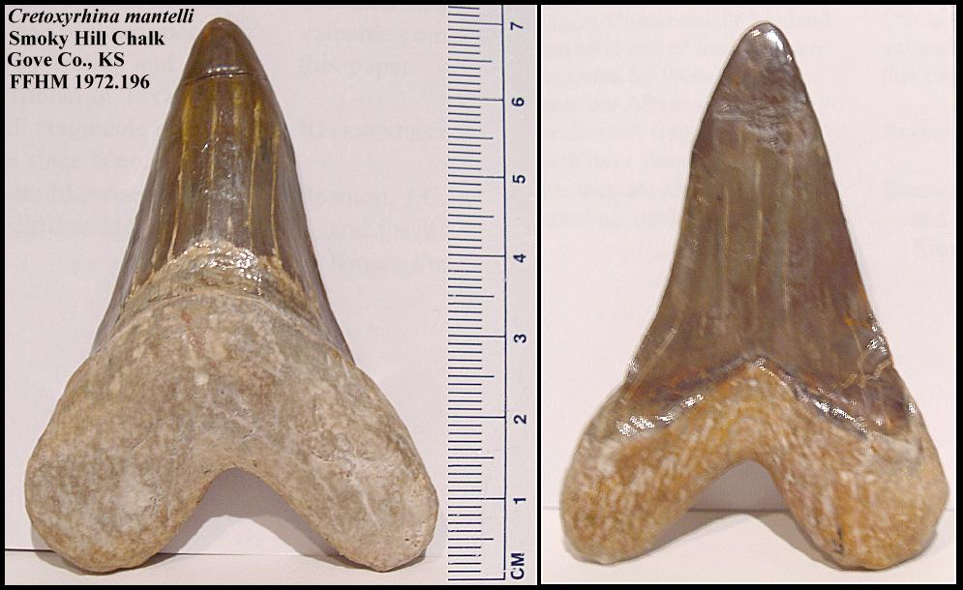
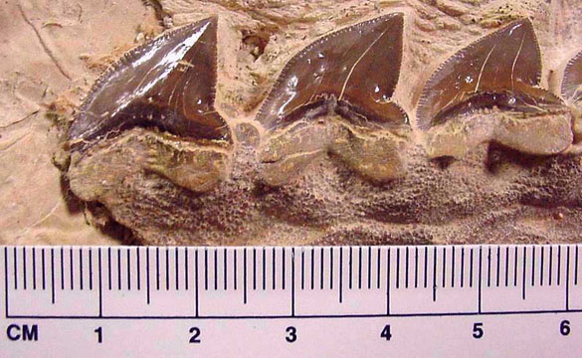
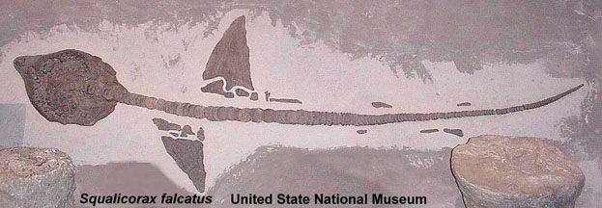
Sharks
Notes:
-looked for signal of competitive interaction in 10 vert taxa from the Cretaceous WIS
*could write names on them so I don’t’ have to talk about them – mostly just say have 7 chondrichtyhans, 2 mosasaurs, 1 teleost
31

Slide 32
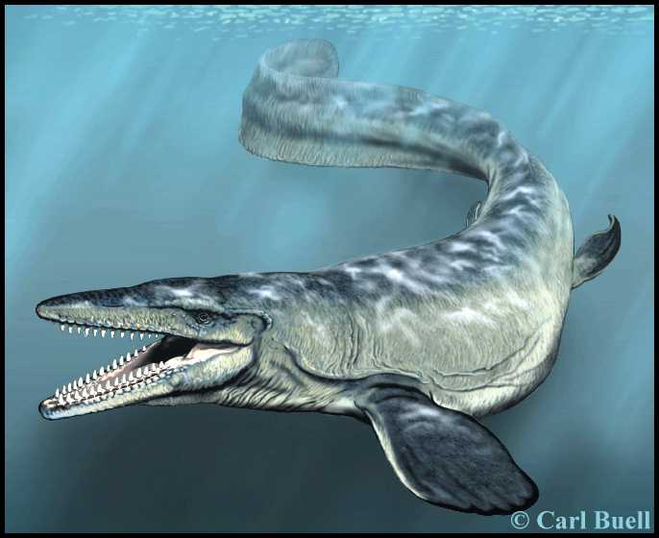
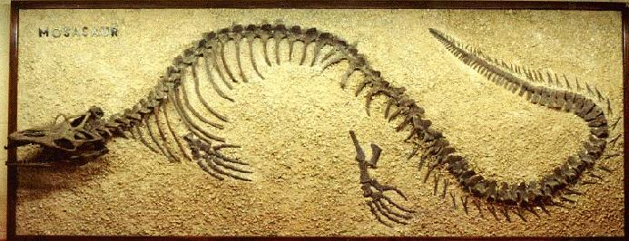
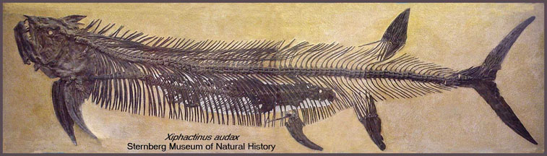
Mosasaurs
Xiphactinus
Notes:
32

Slide 33
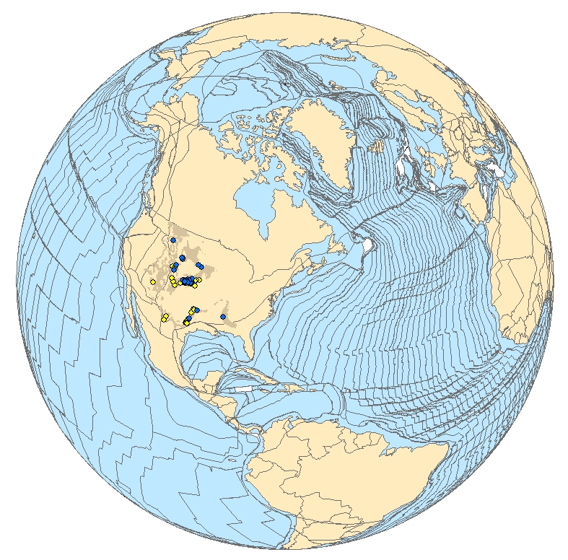
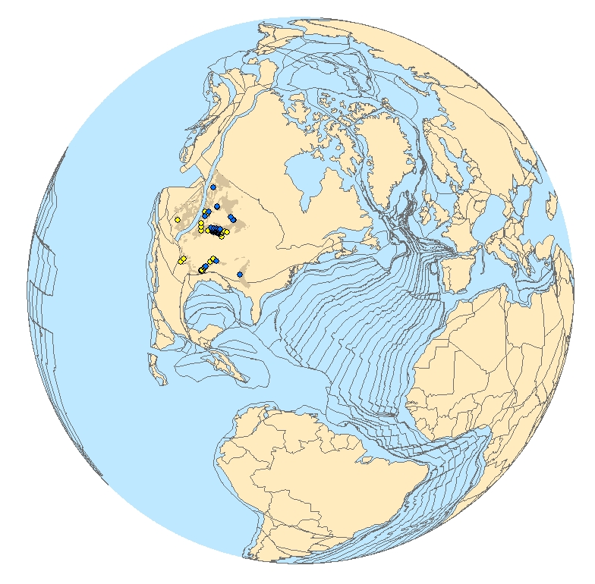
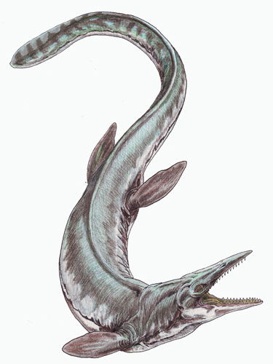
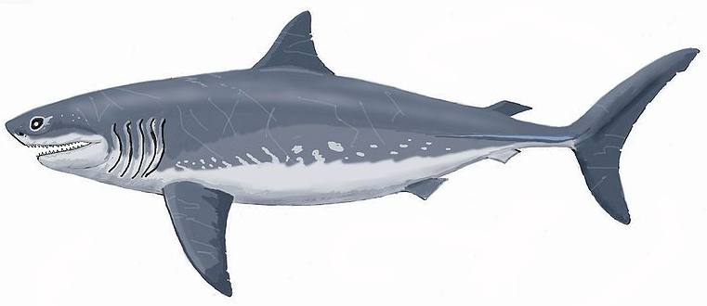
Present Day
Coniacian (~87Ma)
Cretoxyrhina mantelli
Tylosaurus sp.
Myers & Lieberman. 2011. Proceedings of the Royal Society Ser. B

Slide 34
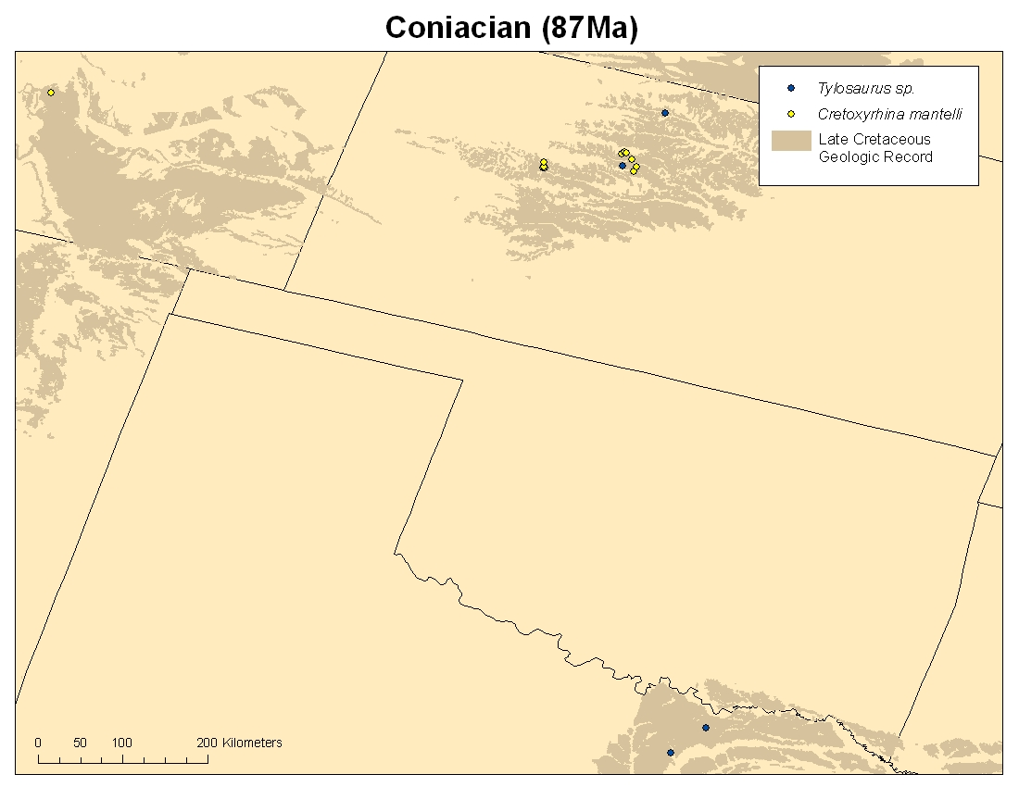
Myers & Lieberman. 2011. Proceedings of the Royal Society Ser. B
Notes:
-buffer points for error estimation in locality data
-construct least-fit polygons; measure area in ArcMap
34

Slide 35
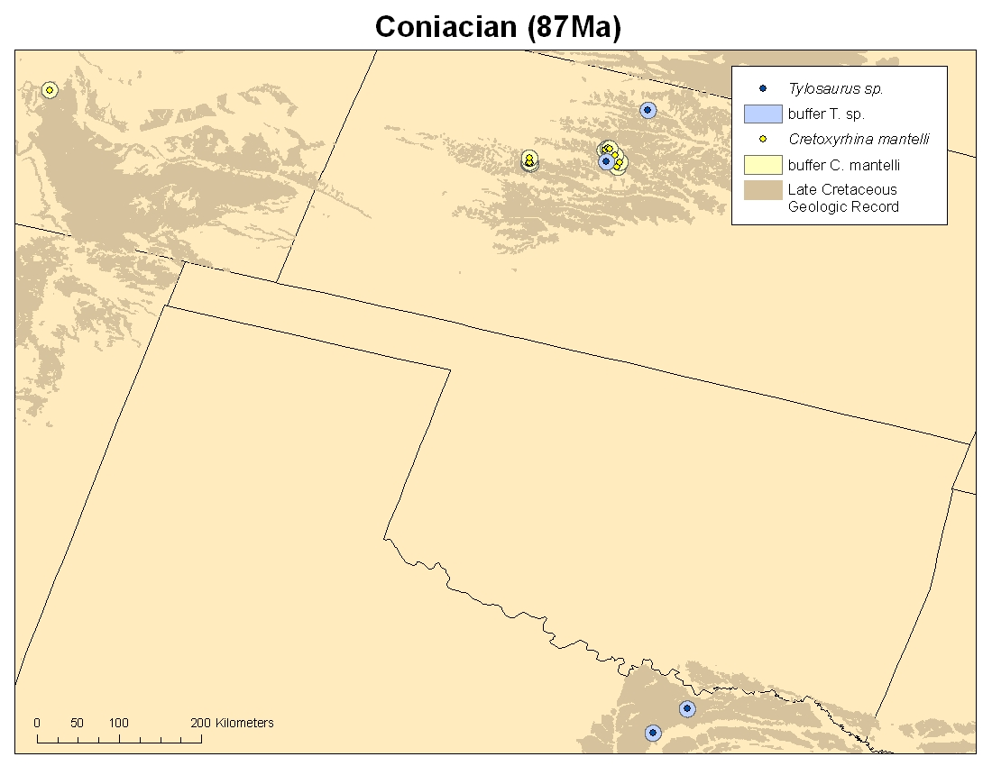
Myers & Lieberman. 2011. Proceedings of the Royal Society Ser. B
Notes:
-buffer points for error estimation in locality data
-construct least-fit polygons; measure area in ArcMap
35

Slide 36
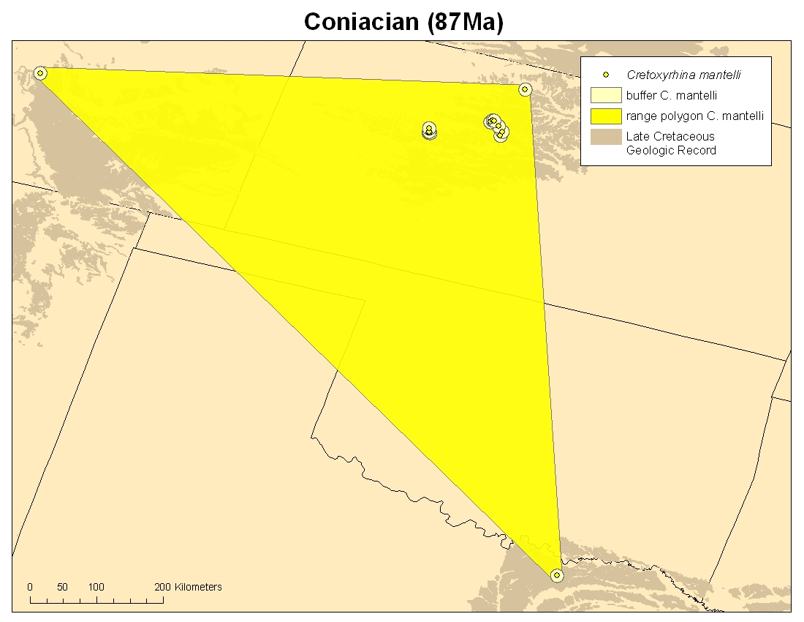
Myers & Lieberman. 2011. Proceedings of the Royal Society Ser. B
Notes:
36

Slide 37
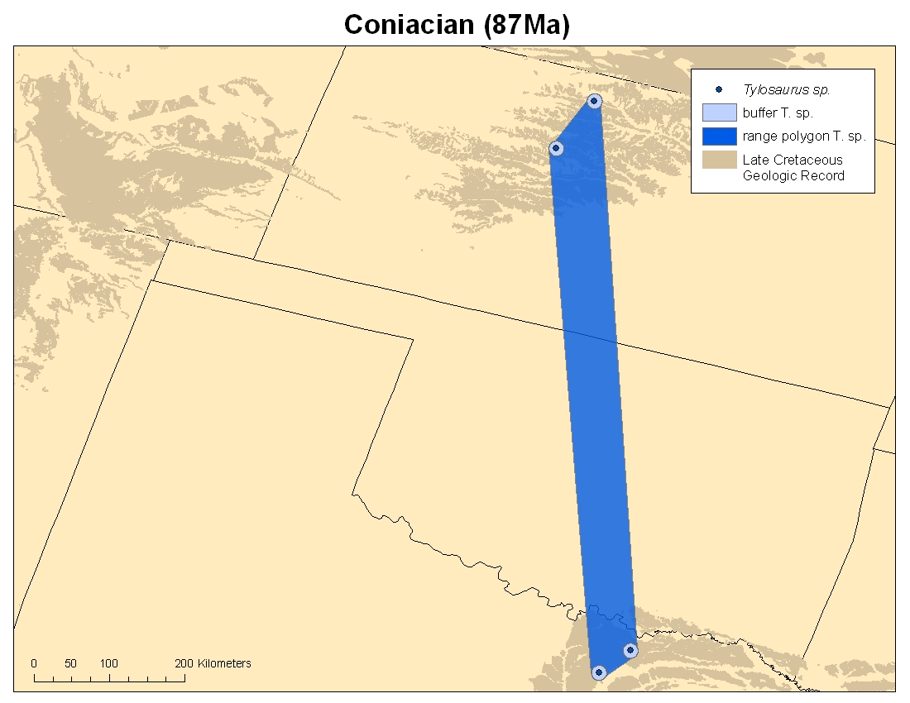
Myers & Lieberman. 2011. Proceedings of the Royal Society Ser. B
Notes:
37

Slide 38
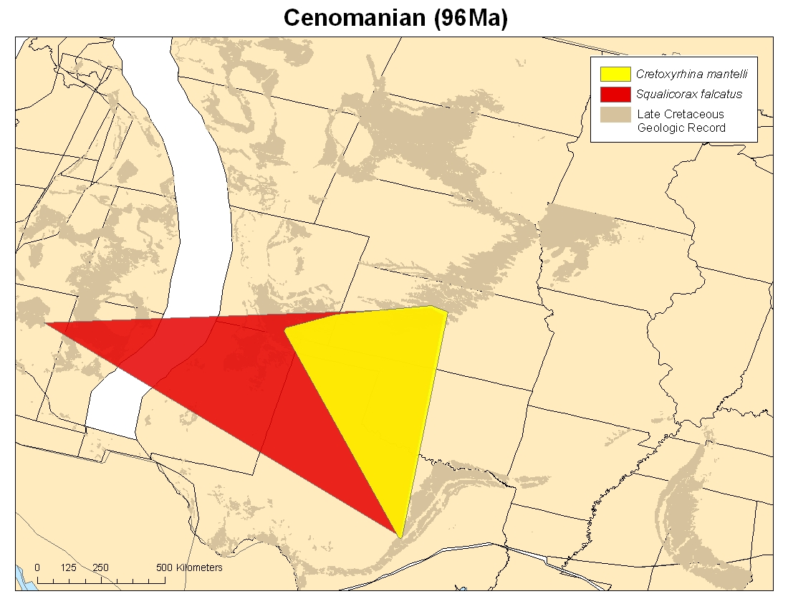
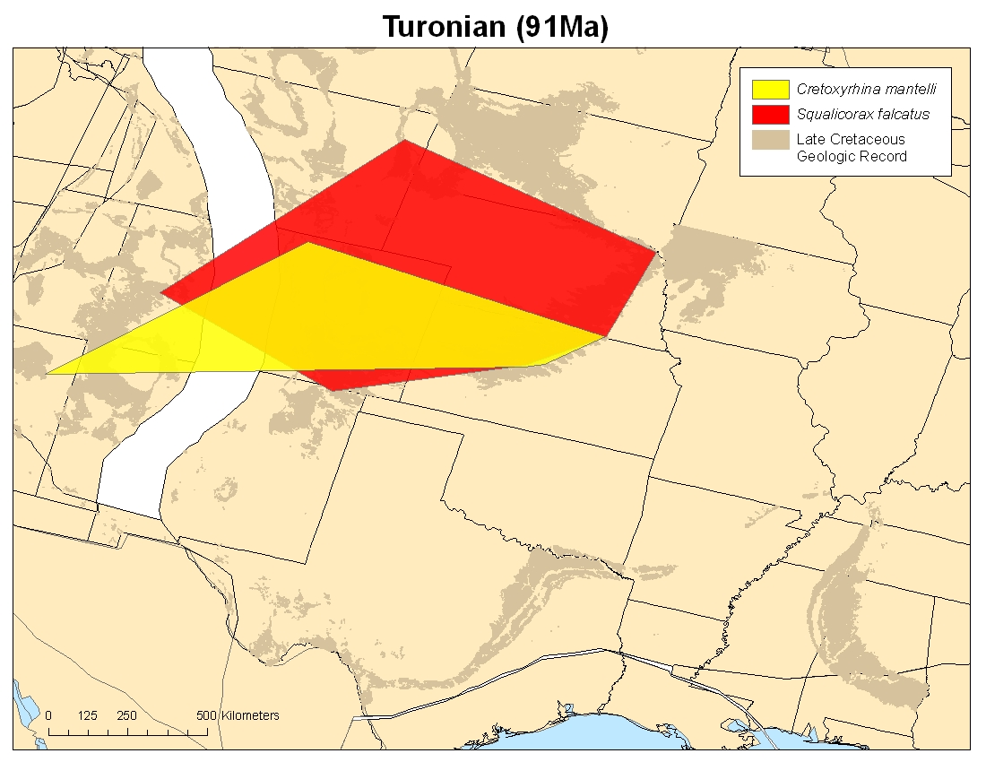
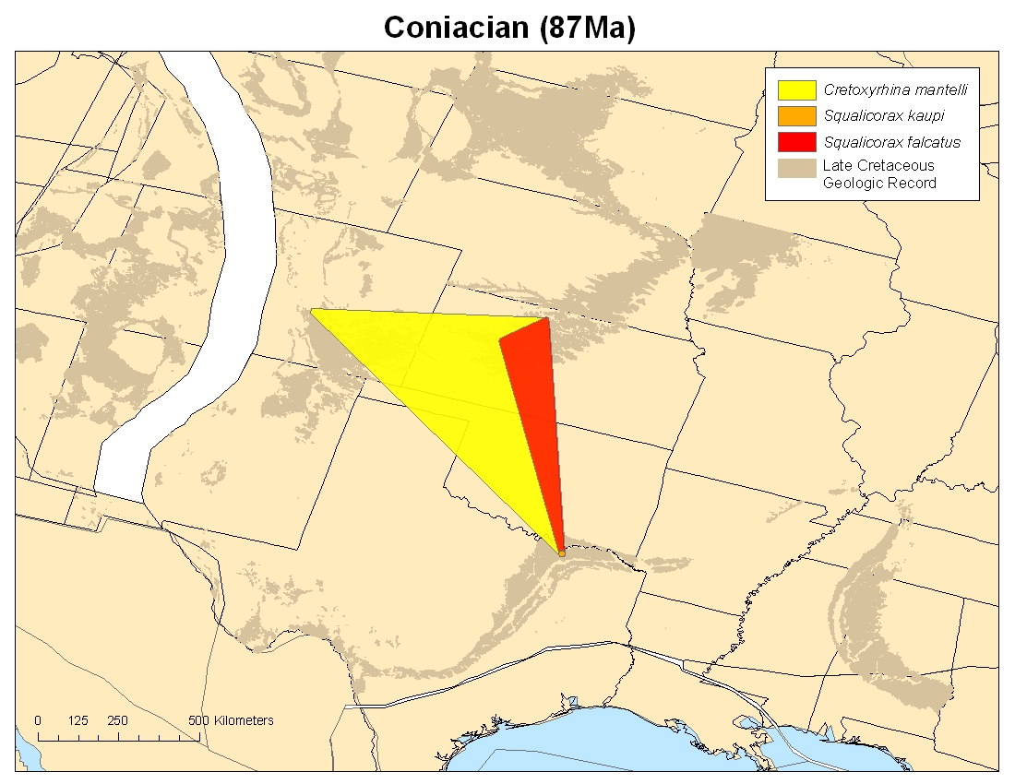
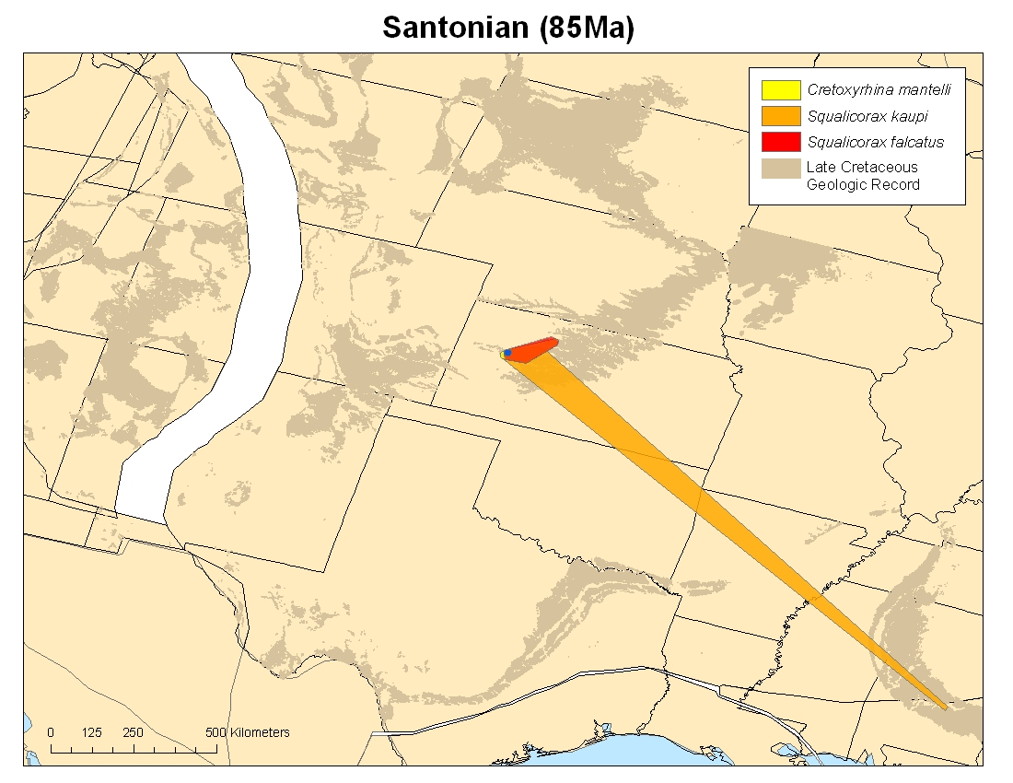
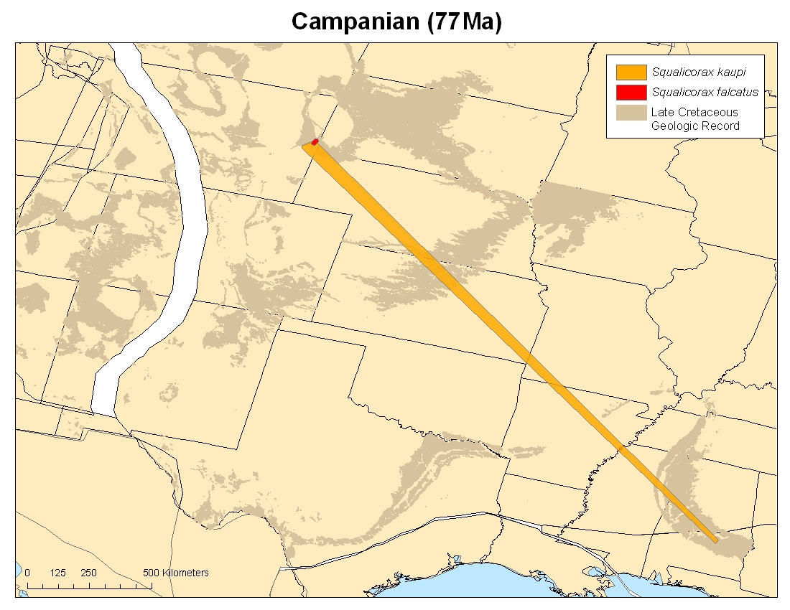
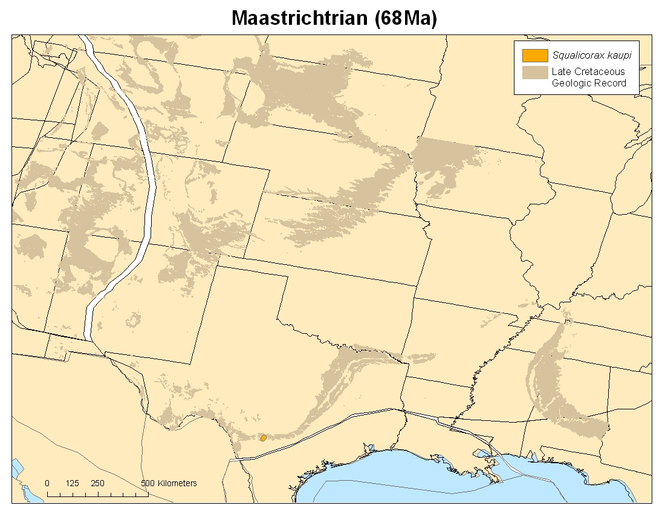
Is there statistical evidence for competitive replacement?
Myers & Lieberman. 2011. Proceedings of the Royal Society Ser. B
Notes:
38

Slide 39
Results
CCRs identified by statistically significant negative range area correlations using Pearson rank correlation
Type of Comparison | Number of Comparisons | Bonferroni corrected critical p-value | Percent Statistically Significant CCRs
All Taxa | 45 | 0.001 | 0%
Intrageneric | 4 | 0.012 | 0%
By inferred eco-type | 18 | 0.003 | 0%
Myers & Lieberman. 2011. Proceedings of the Royal Society Ser. B
Notes:
39

Slide 40
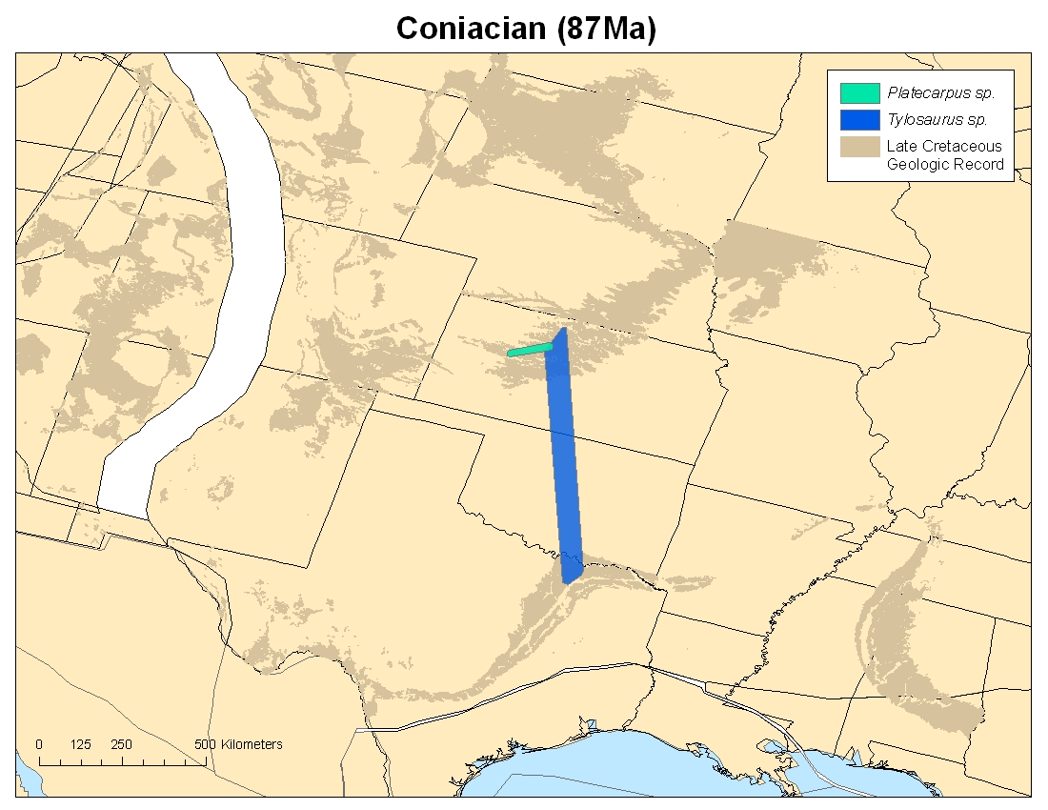



Myers & Lieberman. 2011. Proceedings of the Royal Society Ser. B
Notes:
40

Slide 41
Applying Biodiversity Science to Paleontology
Cambrian Radiation
Competition and macroevolution in the Cretaceous
Biotic impacts of climate change
Notes:
41

Slide 42

CLIMATE IS CHANGING…

Slide 43










Future Projections
?

Slide 44
OUTLINE
ENM
Study system
Model validation
Results
Conclusions

Slide 45
Ecological Niche Modeling
Relates species occurrence points and predictor variables in an iterative fashion
Makes inferences about the ecological requirements of a species, which are then projected onto geography
Notes:
45

Slide 46
Ecological Niche Modeling
Collect occurrence points from museums and fieldwork
Environmental data from WorldClim database
Modeling algorithm – GARP or Maxent
  Test using statistical methods
Project into future using global climate models from IPCC
Notes:
46

Slide 47





SSS
Nitrogen
Saupe, Hendricks, and Lieberman. In review.
Diatom Phytoplankton

Slide 48
Niche estimate
Nitrogen
Not suitable
Temperature
Suitable
Saupe, Hendricks, and Lieberman. In review.

Slide 49

p(x) = e^{(λ1x1+…+λnxn)}
SSS
Nitrogen
Diatom Phytoplankton

Slide 50

56
-110
-33
STUDY AREA
-28
Saupe, Hendricks, and Lieberman. In review.

Slide 51





Saupe, Hendricks, and Lieberman. In review.

Slide 52

ALL OCCURRENCE POINTS

Slide 53






SSS
Bathymetry
Zooplankton
Environmental Data
Nitrogen
SST
Total Alkalinity
Diatom Phytoplankton
Non-diatom Phytoplankton
DIC

Slide 54

Partial Roc

Slide 55
Model Statistics
Saupe, Hendricks, and Lieberman. In review.

Slide 56

Present
2021-2040
2041-2060
2081-2100
Saupe, Hendricks, and Lieberman. In review.

Slide 57
% change from Present
<Ma
Maxent
GARP
Saupe, Hendricks, and Lieberman. In review.

Slide 58

INVASIONS & EXTINCTIONS
Saupe, Hendricks, and Lieberman. In review.

Slide 59

OVERLAP
Purple = Present
Green = Overlap
Orange = Future
Saupe, Hendricks, and Lieberman. In review.

Slide 60
CONCLUSIONS
Severe reductions in suitable habitat for marine mollusks
  - Population extirpation
  - Similarity to terrestrial realm
Species are not predicted to respond in unison
No northward expansion
  - Differs from terrestrial realm
Community reorganization potential

Slide 61
Museums and Universities Participating in PaleoNICHES-TCN ADBC Grant
University of Kansas – Lieberman, Beach, Farrell
Ohio University – Stigall
  Cincinnati Museum Center – Hunda
  Miami University – Hauer
San José State University – Hendricks
  Florida Museum of Natural History – Portell
Notes:
61

Slide 62

Databasing Specimens

Slide 63

Georeferencing Localities

Slide 64

Specimens and Localities for ADBC Grant

Slide 65

Digital Atlases

Slide 66

Conclusions
Biodiversity studies using GIS and ENM techniques provide significant insight into macroevolution and the history of life

Slide 67

Conclusions
Rich repositories built up by generations of paleontologists preserve critically relevant data bearing on evolution, the history of life, and ecology

Slide 68




Slide 69


Thanks to:
B. MacFadden and P. Soltis (FLMNH)
A. Stigall (Ohio U.)
J. Hendricks (San Jose State U.)
C. Myers, E. Saupe (KU)
R. Portell (FLMNH)
P. Halloran (Hadley Climate Centre)
U. Farrell, J. Beach (KU)
Funding
NSF ADBC & Emerging Frontiers
NSF Systematic Biology
NSF Sedimentary Geology & Paleobiology

